Slide 1
Welsh second language in the National Curriculum for Wales
Key Stages 2 – 4
Blwyddyn 3

Slide 2

Welsh second language in the National Curriculum for Wales
Notes:
This is the curriculum document used – Welsh second language in the National Curriculum for Wales.
At Key Stage 2, learners build on the skills, knowledge and understanding acquired during the Foundation Phase
This progress is achieved through an integrated programme of oracy, reading and writing
Learners are presented with experiences and opportunities that interrelate the requirements of the Skills and Range sections of the programmes of study

Slide 3
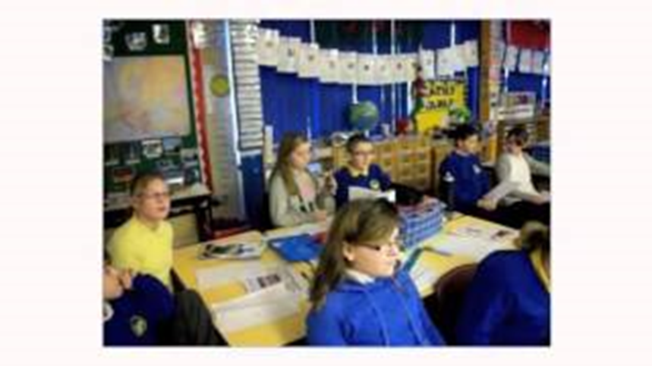
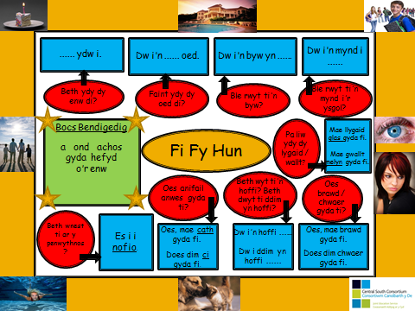
Oracy
Notes:
Learners speak with confidence, working as individuals and as members of a group and using a range of vocabulary, phrases, sentences and questions
The experiences presented to them include opportunities to take part in drama and role-play activities
Learners should be given opportunities to:
e.g. –
3. communicate for a variety of purposes including:
• asking questions and offering simple comments
• giving and following sets of simple instructions
• presenting personal and imaginative experiences and straightforward factual information
Example of a language mat included on this slide – discuss how it can be used

Slide 4
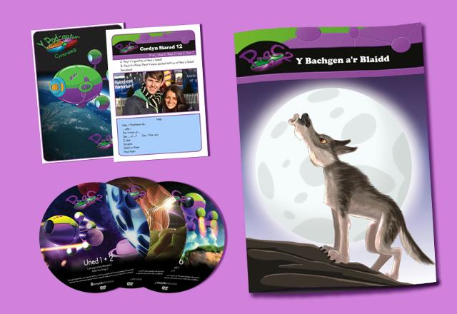

Reading
Notes:
They develop as active and responsive listeners, and experience a wide range of texts, including authentic materials, as they develop as independent and effective readers
Make reference to Y Pod-antur Cymraeg – shown on next slide if you wish to show a clip of it for them?
Y Pod-antur Cymraeg’ is a comprehensive Welsh language series aimed at Key Stage 2 pupils and teachers. Packed with over 7 hours of video, books, worksheets, discussion cards and an interactive game, it naturally builds on language patterns learnt during the Foundation Phase and introduces new and useful language skills. All packs feature two characters who embark on fun adventures and take the Welsh language into real situations.
Learners should be given opportunities to:
e.g.-
develop as enthusiastic, independent and reflective readers
3. experience a variety of texts and forms including:
• traditional and contemporary poetry and prose including some material written specifically for learners
• material which is challenging
• material that broadens horizons and expands the mind
• material that presents information and reference material including media texts and computer material

Slide 5

Y Pod-antur Cymraeg
Y Pod Antur Cymraeg
Notes:
Y Pod-antur Cymraeg - P-aC1
This pack has been designed to teach Welsh Second Language at Key Stage 2. The aim is to build upon language patterns and vocabulary already introduced during the Foundation Phase, to develop them further and to transfer them to different contexts, thus enabling pupils to understand written and spoken Welsh, to speak and write in different situations and for different purposes.

Slide 6
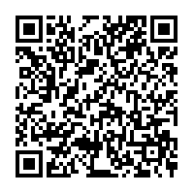
QR codes for reading books
CSCJES - Central South Consortium Joint Education Service
Notes:
Reminder about the QR codes available on the Central South Consortium website and the link to books that are available as power points is on slide 9

Slide 7


Writing
Notes:
They write in response to a range of stimuli with a growing understanding of the need to speak and write in a way that is appropriate to the purpose and audience
Learners should be given opportunities to:
e.g.
1. write for a variety of purposes including:
• to entertain
• to present information
• to express opinions
• to convey feelings and ideas
Write in a variety of forms e.g. posters, diaries, scripts, notes, reviews, electronic texts such as using ‘book creator’
Check spelling using various methods including ICT Draft and improve work using ICT as required

Slide 8
Moving learners from level 3 to level 4
Resource WJEC Educational Resources Website
Part 1 contains seven exemplary teaching units:
■ Role play
■ Describing a friend
■ Personal news
■ Personal profile
■ Responding to a poem
■ Discussing a book
■ Leisure time
Notes:
Moving learners from level 3 to level 4
Welsh Support Team
KS2 >
The aim of this training pack is to provide guidance for teachers on how to move learners on from level 3 to level 4.
The pack contains 7 example teaching units and a series of video clips showing the journey from level 3 to level 4 of learners in two schools.
The clips exemplify a number of activities mentioned in the teaching units as well as providing other ideas practitioners can use in the classroom.
Part 1 contains seven exemplary teaching units:
In addition to this, the resource includes video clips of the journey from level 3 to level 4 of learners in two schools.
The clips exemplify a number of activities mentioned above as well as providing other
ideas practitioners can use in the classroom.

Slide 9
Discussing a book
Aim: Read a story and respond to it.
CSCJES - Central South Consortium Joint Education Service
Notes:
Read a story
TPR: (Total physical response)
When learners are introduced to a new word, they are given a specific action or learners choose their own actions.
Step 1: Teacher says the word / phrase and performs an action
Step 2: A few learners join teacher. Teacher says and performs actions and learners perform actions only, in front of class
Step 3: A different group of learners join teacher. Teacher says the words and learners perform the actions on hearing the
words
Step 4: Teacher says words / phrases and whole class perform the actions
Variation
Step 4: Learners say the words / phrases as teacher performs the actions

Slide 10


Self Assessment Sheet - Reading aloud
Notes:
Shared reading paying attention to expression and intonation.
4. Possible reading aloud assessment opportunity. See the selfassessment sheet in Appendix 2. – distribute sheets
9. Pair work - play Flipper game using questions in Appendix 6.
Flipper resources are to be found in Appendix 7.
Learners can be encouraged to create their own flipper by following the instructions in Appendix 7.

Slide 11
Gwnewch sgwâr
Plygwch fel hyn
Torrwch fel hyn
Pa liw?
Pa siâp?
Sawl sgwâr?
Sawl triongl?
Ysgrifennwch coch / glas ... yma
Lliwiwch
Pa rif?
Ysgrifennwch un, dau ... yma
Ysgrifennwch gwestiynau
Ffeindiwch bartner
Bant â chi
Notes:
Good opportunity here to use Welsh, e.g see vocabulary included in this slide
Distribute Appendix 7 (double sided sheet) with instructions of how to make a flipper – make and use

Slide 12
Gwnewch sgwâr Make a square
Plygwch fel hyn Fold like this
Torrwch fel hyn Cut like this
Pa liw? Which colour?
Pa siâp? Which shape?
Sawl sgwâr? How many squares?
Sawl triongl? How many triangles?
Ysgrifennwch coch / glas ... yma Write red / blue ... here
Lliwiwch Colour in
Pa rif? Which number?
Ysgrifennwch un, dau ... yma Write one, two ... here
Ysgrifennwch gwestiynau Write questions
Ffeindiwch bartner Find a partner
Bant â chi / Ffwrdd â chi Off you go
Notes:
Good opportunity here to use Welsh, e.g see vocabulary included in this slide
Distribute Appendix 7 (double sided sheet) with instructions of how to make a flipper – make and use

Slide 13
Moving learners from level 4 to level 5
Training Packs - Welsh Second Language - KS3/KS4
Seven exemplary teaching units are provided:
Disgrifio ffrind / Describing a friend
Newyddion personol / Personal news
Proffil personol / Personal profile
Ymateb i gerdd / Responding to a poem
Chwarae rôl / Role play
Trafod llyfr / Discussing a book
Trafod amser hamdden / Discussing leisure time.
Notes:
The aim of this training pack is to provide guidance for year 6 and 7 teachers on how to move learners on from level 4 to level 5.
An important element of the pack is the DVD, which includes:
four teaching sessions filmed at St Patrick’s School, Newport and St Peter’s School, Rossett, Wrexham
Follow the link here to training pack and show
number 4 film - Codi Safonau Llythrennedd / Raising Standards of Literacy (4)
Just show a little part of the film showing the use of language mats (bear in mind this was filmed in North Wales, hence the use of certain vocabulary)
There are other ideas students may find useful to watch in their own time to show how they can promote Welsh in their lessons at KS2.
Useful ideas and activities in both documents – advise looking at these in their own time!

