Slide 1
Physiology 1
Care Plan for a Fictional Patient with Chronic Obstructive Pulmonary Disease (COPD)
Sunny Nosa Umweni BMHP5023 15/06/2026

Slide 2
Introduction – What is COPD?
COPD is a chronic breathing disorder characterised by chronic airflow obstacles due to airway and/or alveolar abnormalities.
Main conditions include:
Chronic bronchitis
Emphysema
Key symptoms:
Breathlessness
Chronic cough
Excess mucus production
Wheezing
Fatigue

Slide 3
Fictional patient profile
Patient information:
Name: Mr K
Age: 68 years old
Gender: Male
Ethnicity: White British
Living Situation: Lives alone in a council flat
Occupation: Retired factory worker
Medical History:
COPD was diagnosed 8 years ago
Hypertension
Previous chest infections
Current medication:
Salbutamol inhaler
Tiotropium inhaler
Blood pressure medication

Slide 4
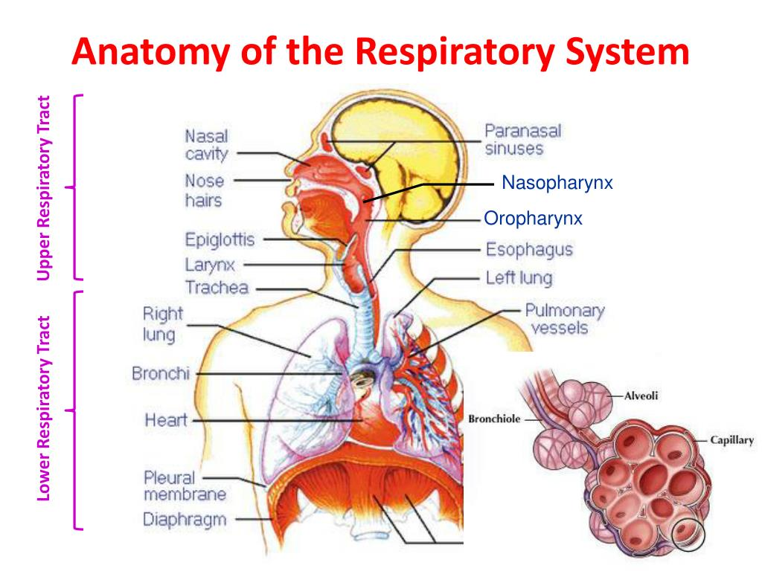
Respiratory system anatomy
Main structures:
Nose and mouth
Trachea
Bronchi
Bronchioles
Alveoli
Lungs
Diaphragm
Functions:
Oxygen intake
Carbon dioxide removal
Gas exchange
Maintenance of blood oxygen levels

Slide 5
Physiology of the respiratory system
Normal Function
Gas exchange occurs in the alveoli.
Oxygen:
Inhaled into lungs
Passes via the alveolar membrane
Enters bloodstream
Carbon dioxide:
Travels from the blood to the alveoli
Exhaled from the lungs
The diaphragm contracts at some point of inhalation and relaxes during exhalation.

Slide 6
HOW COPD AFFECTS THE RESPIRATORY SYSTEM
Changes include:
Airway inflammation
Excess mucus production
Narrowed airways
Destruction of alveolar walls
Reduced lung elasticity
Effects:
Reduced airflow
Impaired gas exchange
Breathlessness
Lower oxygen levels
Increased risk of respiratory infections

Slide 7
RISK FACTORS
Lifestyle and Disease Risk Factors
Non-modifiable
Older age
Family history
Modifiable
Long-term smoking (40-year history)
Physical inactivity
Occupational dust exposure
Poor diet
Air pollution exposure
Patient-specific risks:
Smokes 10 cigarettes daily
Limited exercise
Previous industrial exposure

Slide 8
Assessment and monitoring
According TO NHS AND NICE RECOMMENDATIONS:
Regular assessment of:
Respiratory symptoms
Oxygen saturation
Inhaler technique
Weight and nutrition
Exercise tolerance
Frequency of exacerbations
Mental wellbeing
Tools:
Spirometry
Pulse oximetry
COPD Assessment Test (CAT)

Slide 9
Care plan goals
Short term goals
LONG TERM GOALS
Improve breathing control
Reduce symptoms
Correct inhaler use
Increase physical activity
Prevent exacerbations
Reduce hospital admissions
Improve quality of life
Maintain independence

Slide 10
Care routine recommendations
Medication management
Take inhalers as prescribed
Review inhaler technique regularly
Physical activity
Daily walking programme
Pulmonary rehabilitation
Nutrition
Balanced diet
Adequate hydration
Monitor weight
Smoking cessation
Referral to NHS stop smoking services

Slide 11
Evidence based interventions
NHS and NICE Recommendations
Pulmonary rehabilitation
Annual influenza vaccination
Pneumococcal vaccination
Smoking cessation support
Self-management education
Personalized action plan for flare-ups
Benefits:
Improved exercise tolerance
Reduced exacerbations
Better quality of life

Slide 12
Communication in care
Person-Centred Communication
Healthcare professionals should:
Use clear and simple language
Encourage shared decision-making
Check patient information
Provide written data
Involve circle of relatives or carers (with consent)
Importance:
Improves adherence
Builds trust
Promotes self-management

Slide 13
Ethical considerations
Ethical Principles
Autonomy
Respect the patient's choices and preferences.
Beneficence
Act in the patient's best interests.
Non-Maleficence
Avoid causing harm.
Justice
Provide fair access to healthcare resources.
Other considerations:
Confidentiality
Informed consent
Equality and diversity

Slide 14
Multidisciplinary team
Professionals Involved
GP
Respiratory consultant
Respiratory nurse specialist
Physiotherapist
Pharmacist
Dietitian
Smoking cessation advisor
Purpose:
Coordinate care
Improve outcomes
Support self-management

Slide 15
EXPECTED OUTCOMES
Following the care plan:
Reduced breathlessness
Better symptom control
Improved oxygenation
Fewer hospital admissions
Increased independence
Enhanced quality of life

Slide 16
CONCLUSION
SUMMARY:
COPD is a chronic respiratory disease affecting the respiratory system.
Damage to airways and alveoli reduces effective gas exchange.
Risk factors include smoking, age, and environmental exposure.
Evidence-based care following NHS and NICE guidance includes:
  Smoking cessation
  Pulmonary rehabilitation
  Medication management
  Regular monitoring
  Person-centred communication
A multidisciplinary approach improves health outcomes and quality of life.

Slide 17
REFERENCES
National Institute for Health and Care Excellence (2023) Chronic Obstructive Pulmonary Disease in Over 16s: Diagnosis and Management (NG115).[accessed 15/06/2026] https://ppahs.org/for-patients/respiratory/?gad_source=1&gad_campaignid=20240419353&gbraid=0AAAAAo5iSn3_btbdP1dFm-0S3Z5nStlz6&gclid=CjwKCAjwxb7RBhA5EiwAQ-AAdDU02NfCku4qgbDw_2FHRLxIf5txPBXD6XCZDAd_QymV01O2e5UHFBoC3YYQAvD_BwE
NHS England (2024) Chronic Obstructive Pulmonary Disease (COPD). [accessed 15/06/2026] https://www.england.nhs.uk/long-read/copd-commissioning-strategies-resources/
Tortora and Derrickson's Principles of Anatomy and Physiology. [accessed 19/06/2026]
Ross and Wilson Anatomy and Physiology in Health and Illness. [accessed 23/06/2026]
Kumar and Clark's Clinical Medicine. (2023) Kumar and Clark's Clinical Medicine. 11th edn. Edinburgh: Elsevier. [accessed 29/06/2026]
Global Initiative for Chronic Obstructive Lung Disease. (2025) *Global Strategy for the Diagnosis, Management, and Prevention of Chronic Obstructive Pulmonary Disease. Available from the GOLD report. [accessed 30/06/2026]

