Slide 1



Q4: Discuss what UNISON’S perceived barriers to communication are and give examples where possible.
By Khalid Alaale - 1817420

Slide 2
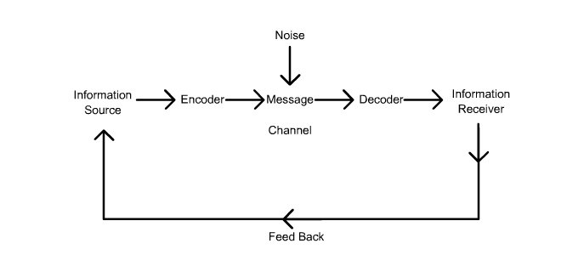
The Shannon-Weaver Model of Communication (1949)
This relates to the process of ‘noise’, and it is a significant barrier to contact and weakens messages that are being processed to be sent from the sender to the receiver that is recognised as a one way process.
Notes:
The image used allows us to visually see the process of ‘noise’ or barriers involving communication.
The sender will create the message by putting data into a form which the receiver will understand. This is called Encoding. If this is interrupted there is no certification that the receiver will understand or get the message. This will be due to communication difficulties, which we understand to be called ‘noise’ or a barrier. Eg. If a message consisted of bad chosen language.
Image taken from : https://www.researchgate.net/figure/The-Shannon-Weaver-Model-of-communication-1949-with-the-inclusion-of-feedback-to-suit_fig3_237479142 date accessed 31/05/2019

Slide 3

Purposes of communication
To show that you're a friendly person
To give information
To get them to do something
To persuade
For them to understand your point of view/purpose
To question
Notes:
There are many reasons for communication and it is important that it is understood and received by the receiver.
With the purposes mentioned it is important that the communication is precise and clear so that it is not possible not to be received.

Slide 4

Types of ‘Noise’
No interest
Language
Time
Distractions
Disability
Other people / influences
No access to a computer
Lone workers
Notes:
Here are a list of some of the types of ‘Noise’ that arise within communication.
Firstly, people may not hold any interest and disregard the message,
Language may be another issue, unable to understand English, only another language so an alternative would need to be made available,
Time is also a major issue as some do not have any spare time to be reading through communications, so short, precise, informative communications is preferred.
Disability – for example, blind, dyslexic, the reciever may not be able to read/ digest the information.
Others around them may distract from reading/listening to communications
No access to a computer/radio etc to view/listen to communication.
UNISON target lone workers e.g Lock-keepers by applying individual messages rather than group to be sent to them.

Slide 5



Groups and Lone Workers
Unison has adapted communication methods by flexibility of varied groups of employees and individuals.
This offers great understanding and acknowledgement of services by being diverse in communication methods.
Notes:
As the services that are offered on a day to day basis are forever expanding the communication methods are also developing further to meet the types of employees communication methods and are being carefully targeted. Day to day communication is also progressing and types of noise need to be overcome to accommodate the employees and audience. This has been a recognised barrier and has been accommodated by UNISON and it the case study explains that ‘it has not been easy’.

Slide 6

Thank you for listening
If you have any questions please feel free to ask.

