Slide 1

National Waterfront Museum

Slide 2
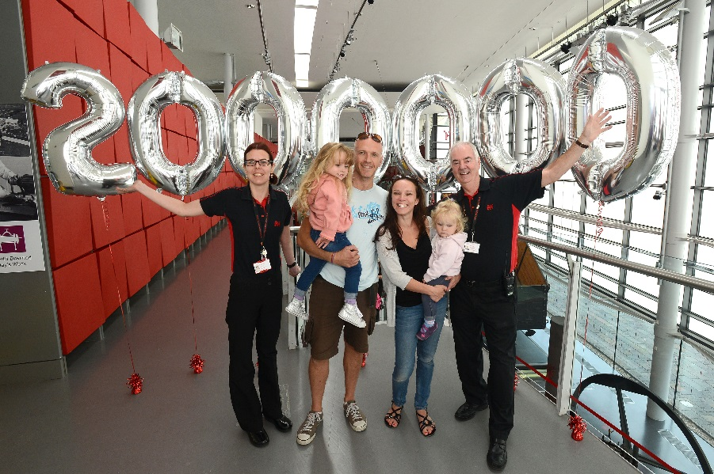
National Museum Wales
7 sights across Wales – which are all FREE to go to
Attract over 1.6 million visitors annually across all sites
National Waterfront Museum
Story of Industry and innovation in Wales
Celebrated our 11th birthday this October
Average 250,000 visitors per annum
Over two million visitors welcomed since opening in 2005
My role in the Museum is in the events team
Programme over 250 public events per year

Slide 3
Current Issues
Faced with cuts from the Welsh Assembly
Led to change programme, people had to reapply for their jobs on a lower paygrades
Voluntary redundancies
Industrial dispute over weekend pay and contracts
Longest industrial dispute since the mid 80’s
Establish Historic Wales
Merge some of the commercial functions of Cadw with those of National Museum Wales
Undermining Museums independence

Slide 4

Event Programming
NWM events are programmed in three 4 monthly blocks
Bilingual - Web & Printed What’s On guide
One off initiatives, Dylan Thomas centenary events, Solar eclipse breakfast, British Science Festival
Yearly National Initiatives - British Science Week, The Big Draw & Museums at Night
Welsh Calendar - Mari Lwyd, Santes Dwynwen, St David’s Day, Calan Mai
Seasonal Events, Summer holidays, Easter, Christmas

Slide 5
Cultural diverse important dates in the year, Chinese new year, Diwali
Partnership programming – Oxfam, Swansea Museum, Historical Association, Swansea University, Trinity St David’s
NWMs In-house exhibitions / themes displays projects
Plus regular monthly events that the public enjoy

Slide 6

STRATEGIC AIMS FOR PUBLIC EVENTS
AT THE WATERFRONT
Enrich & enhance the experience of a visit
Provide Learning outcomes to be accessible & enjoyable
Encourage repeat visits through offering year round variety
Broaden partnership work
Assist interpretation of display collections for different audiences
Increase visits from under represented groups
Raise the profile of the Museum & further it’s strategic aims

Slide 7
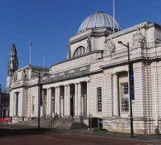
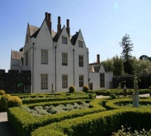
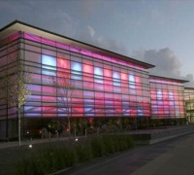
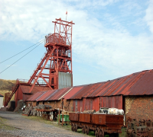
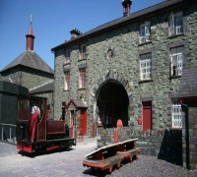
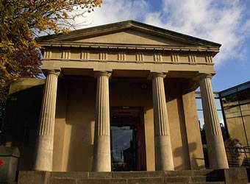
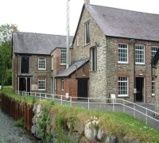

National Waterfront Museum continues to attract a high proportion of repeat visits in last 12 months. Significantly more revisit than other museums.
Visit patterns in focus: Site comparison (2012-13)
National
Museum
Cardiff
National
Waterfront
Museum
National
Slate
Museum
National
Roman
Legion
National
Wool
Museum
St Fagans
NHM
Big Pit
NCM
% Repeat visit | 61 | 65 | 64 | 32 | 38 | 33 | 33
% Visited in last 12 months (all visitors) | 40 | 33 | 52 | 10 | 18 | 15 | 19
Mean repeat visits in last year (repeat visitors) | 4.46 | 5.13 | 5.89 | 1.90 | 2.14 | 3.13 | 4.71
% Day trippers from home | 71 | 70 | 78 | 47 | 24 | 60 | 46
NWM
Bdrc 2012-13 Research Findings

Slide 8



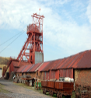
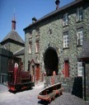


NWM repeat visits are generated by ‘special focus’ audiences – motivated to visit by ‘ever-changing’ programme.
Site comparison (2012-2013)
NMC
ST F
WAT
BP
NSM
NRLM
NWM
Topic Interest
Children
Tick Box
NWM
Bdrc 2012-13 Research Findings
Social
Special Focus
Broaden Horizons

Slide 9
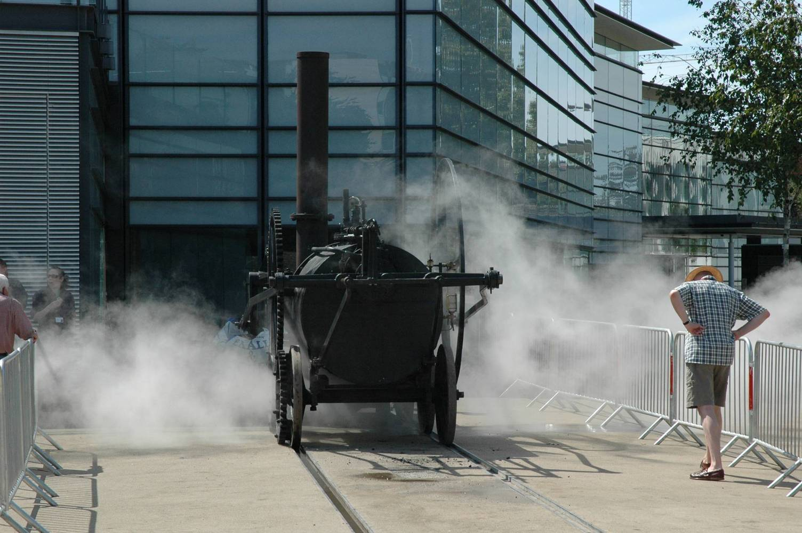

Slide 10
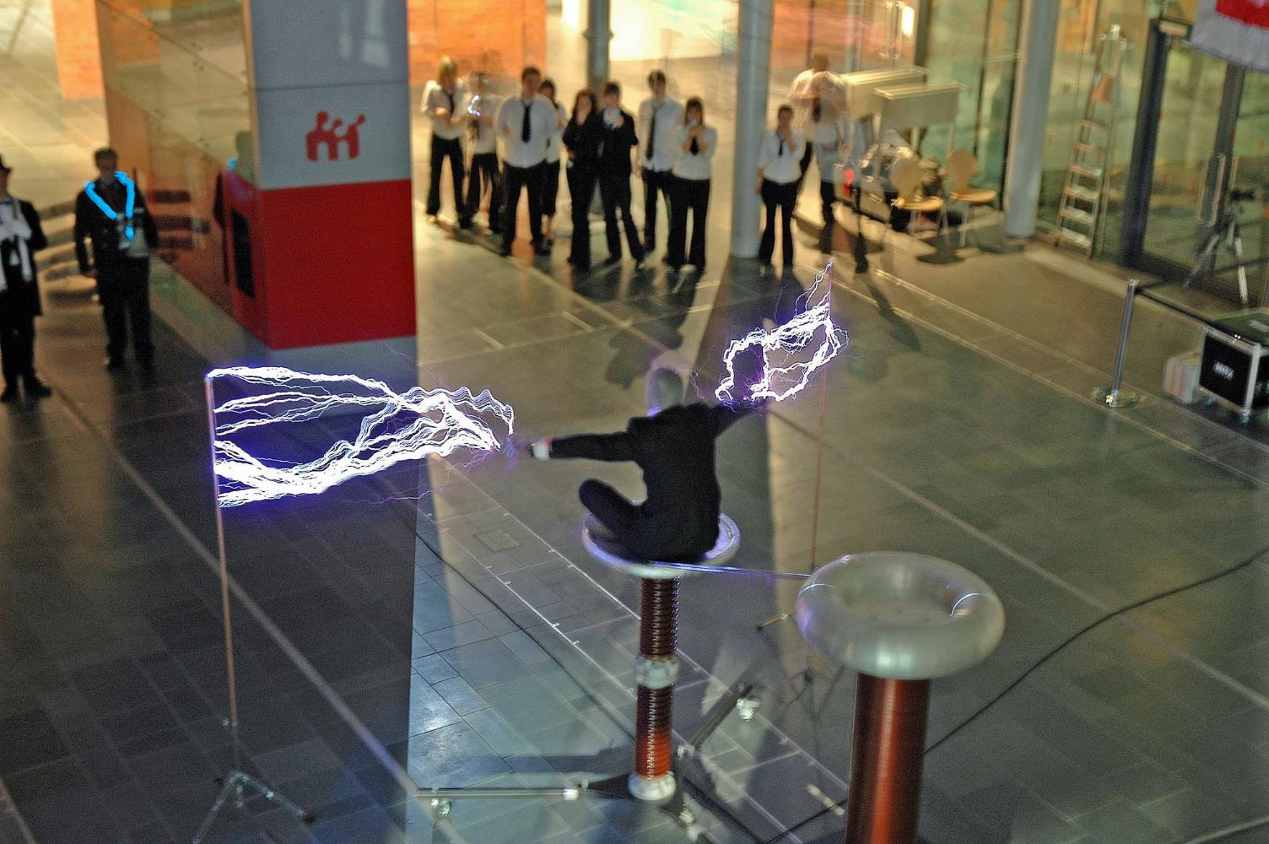

Slide 11
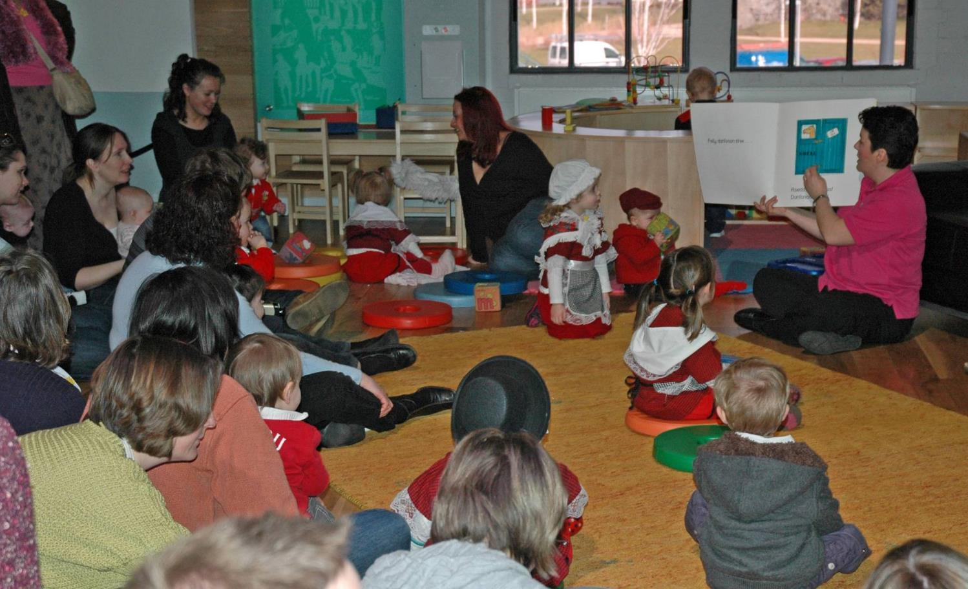

Slide 12
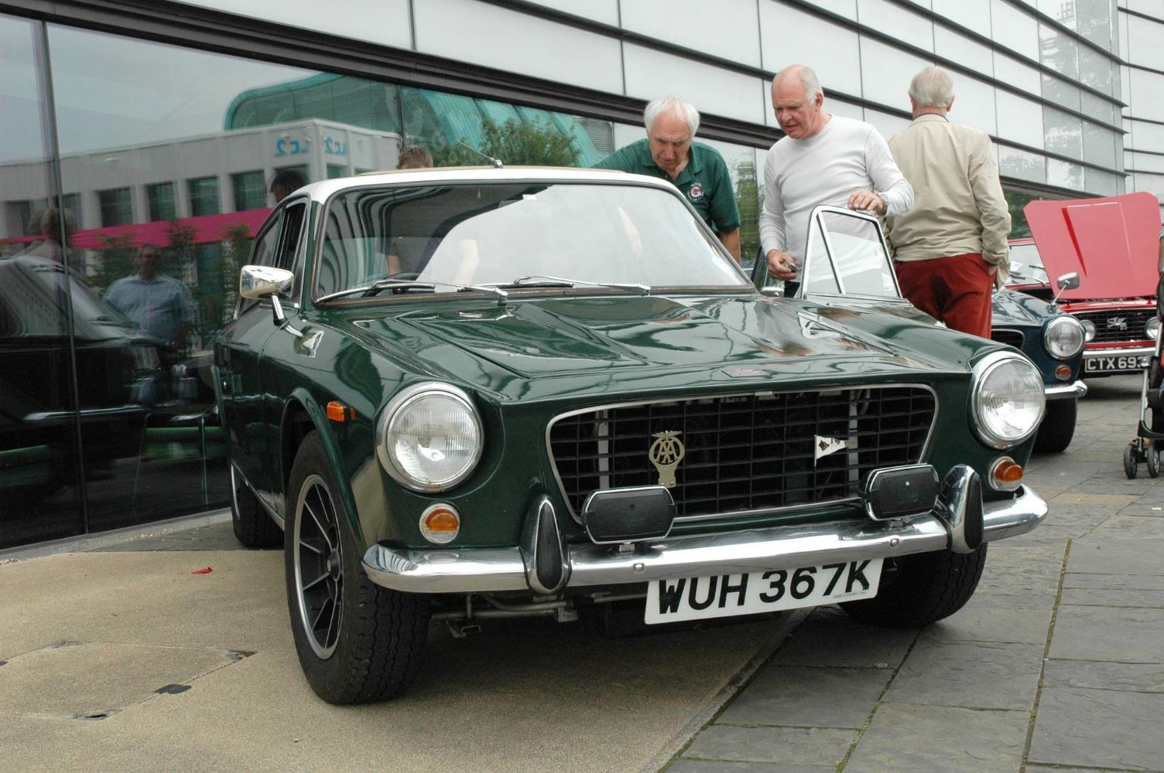

Slide 13
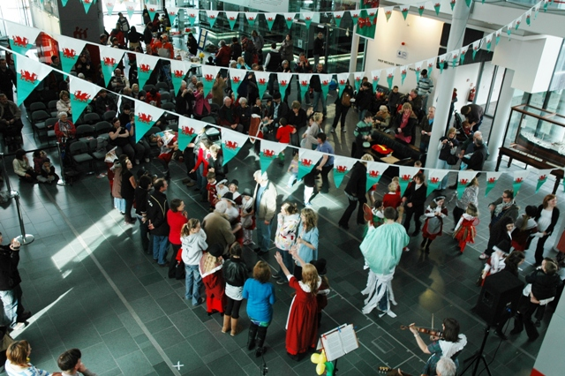

Slide 14
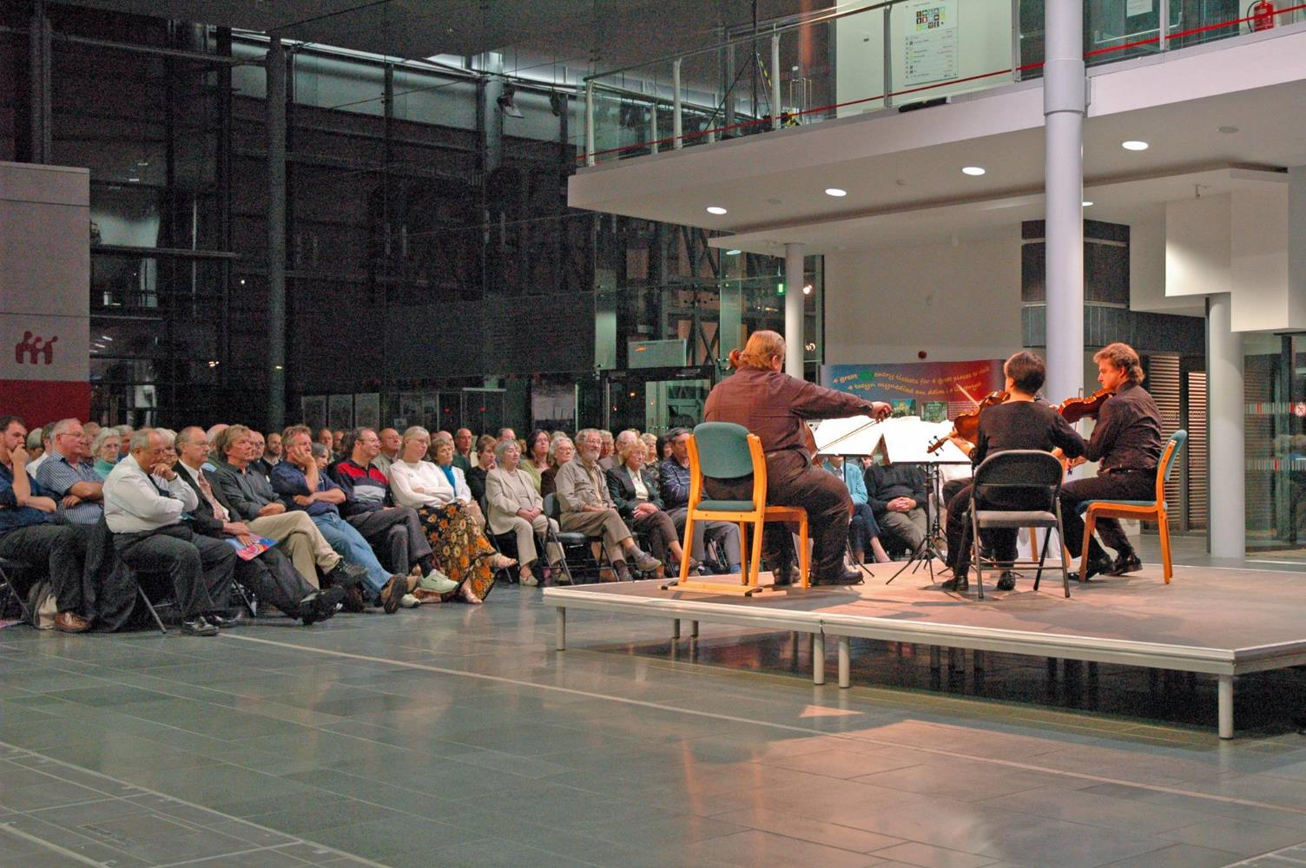

Slide 15
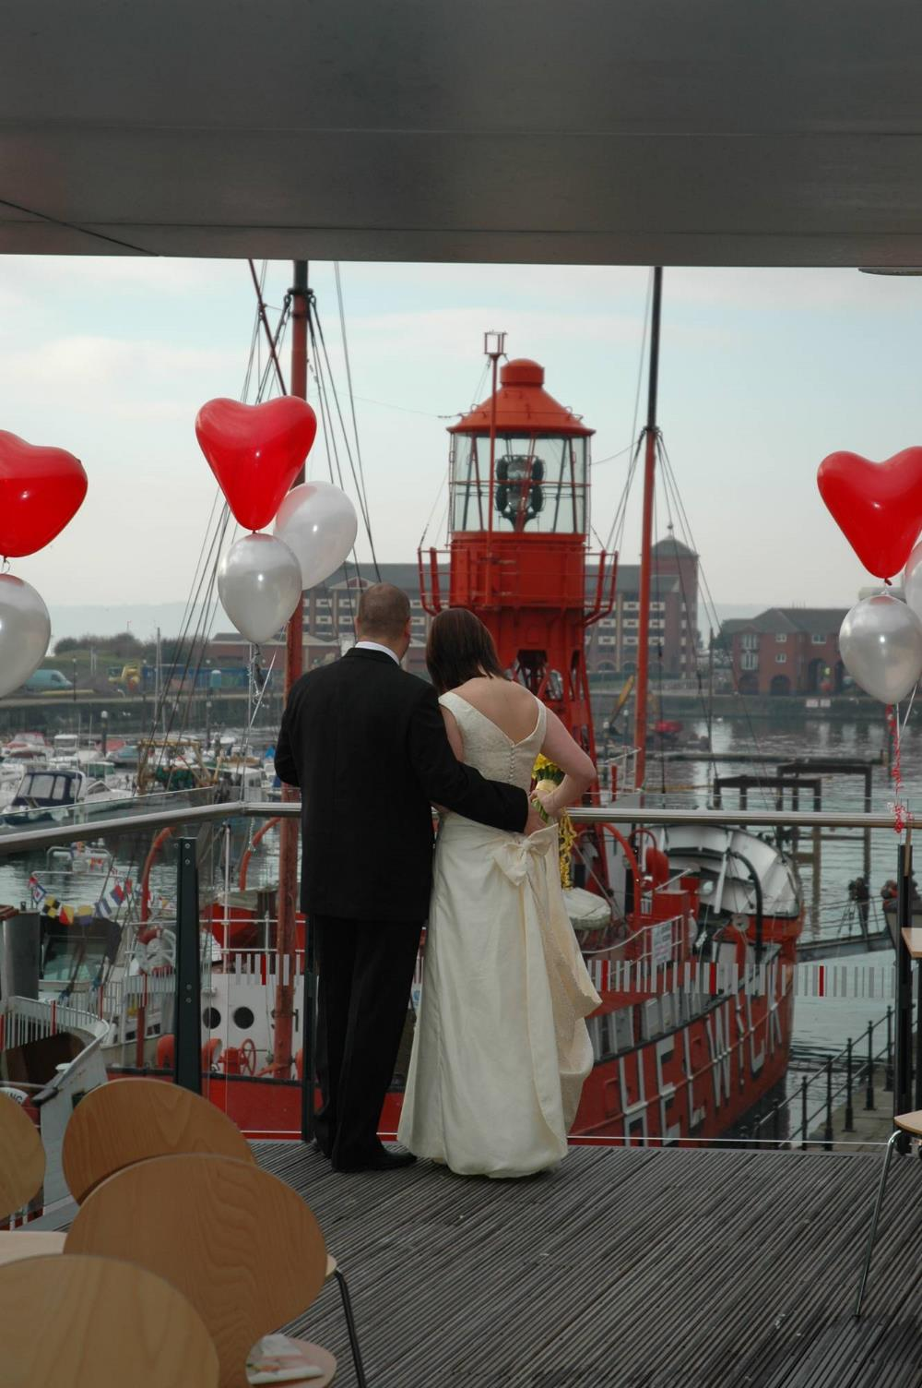

Slide 16
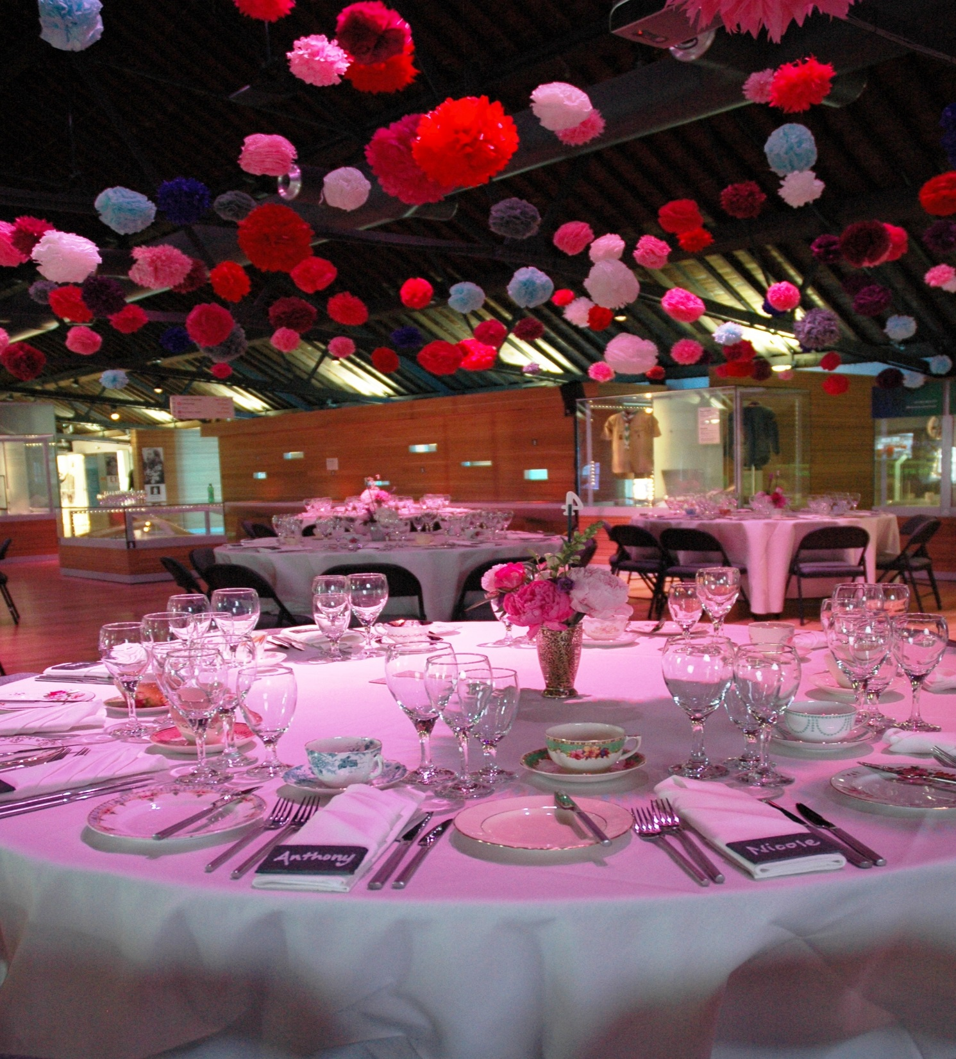

Slide 17
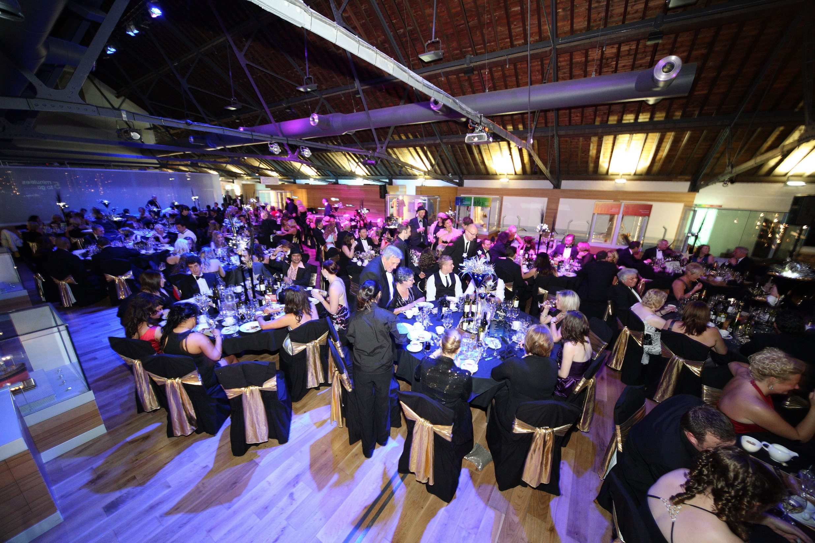

Slide 18
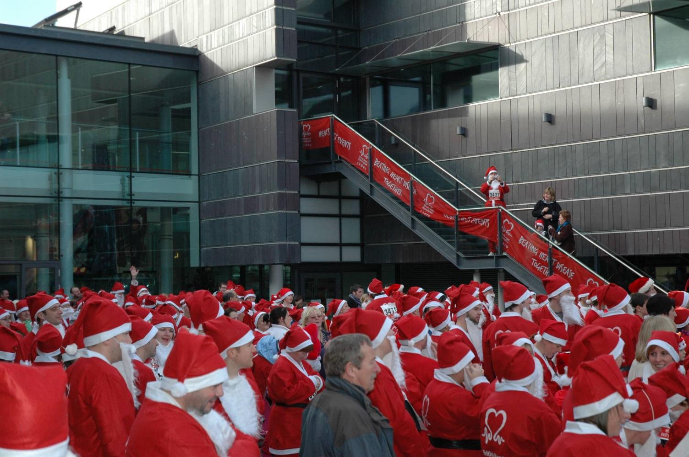

Slide 19
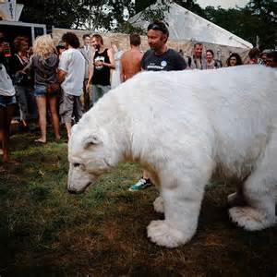

Slide 20
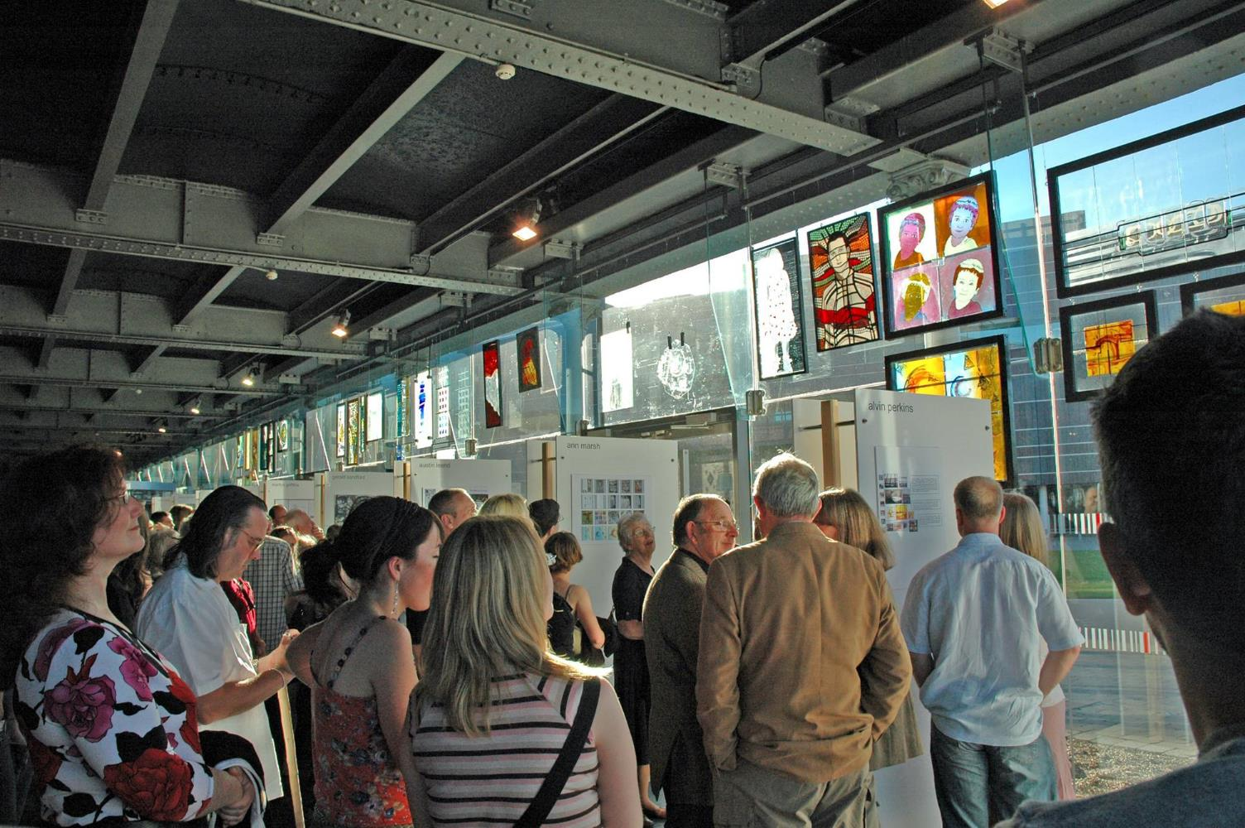

Slide 21
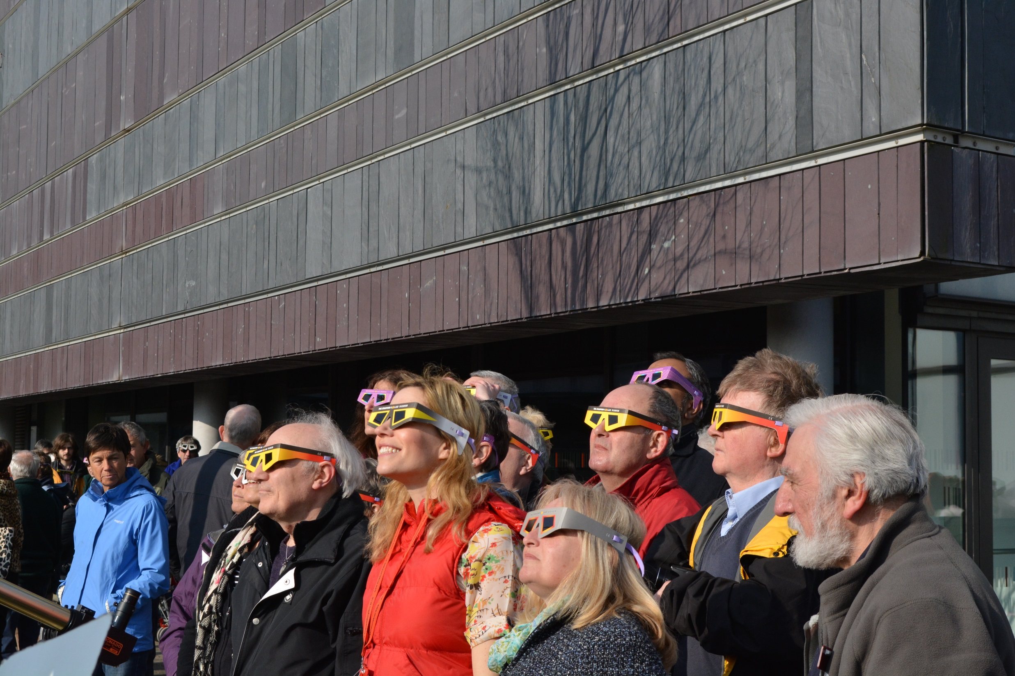

Slide 22
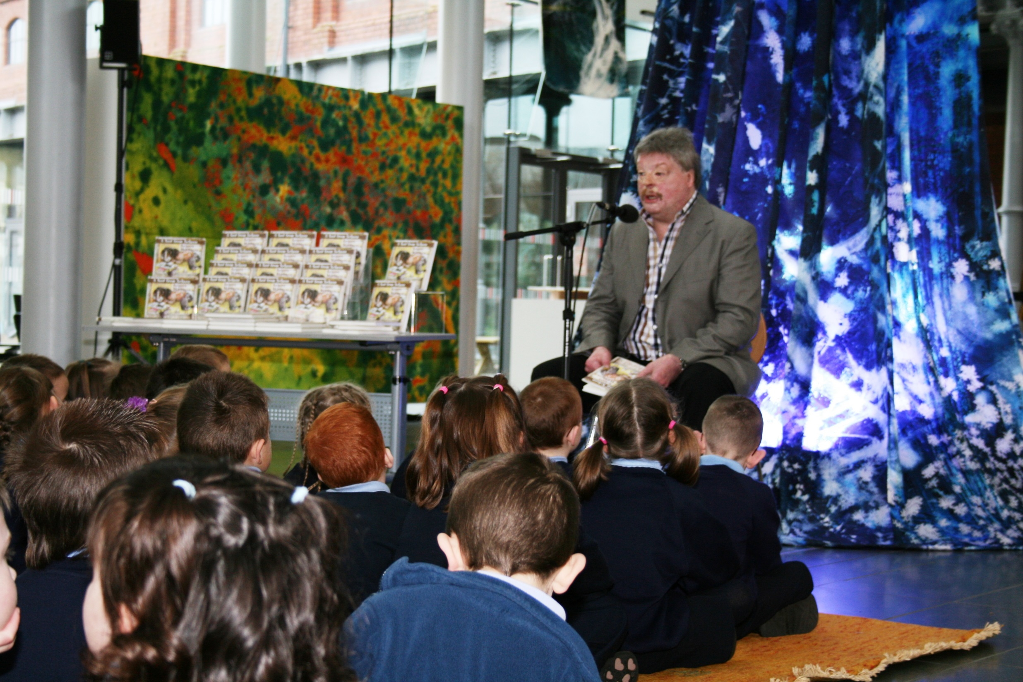

Slide 23
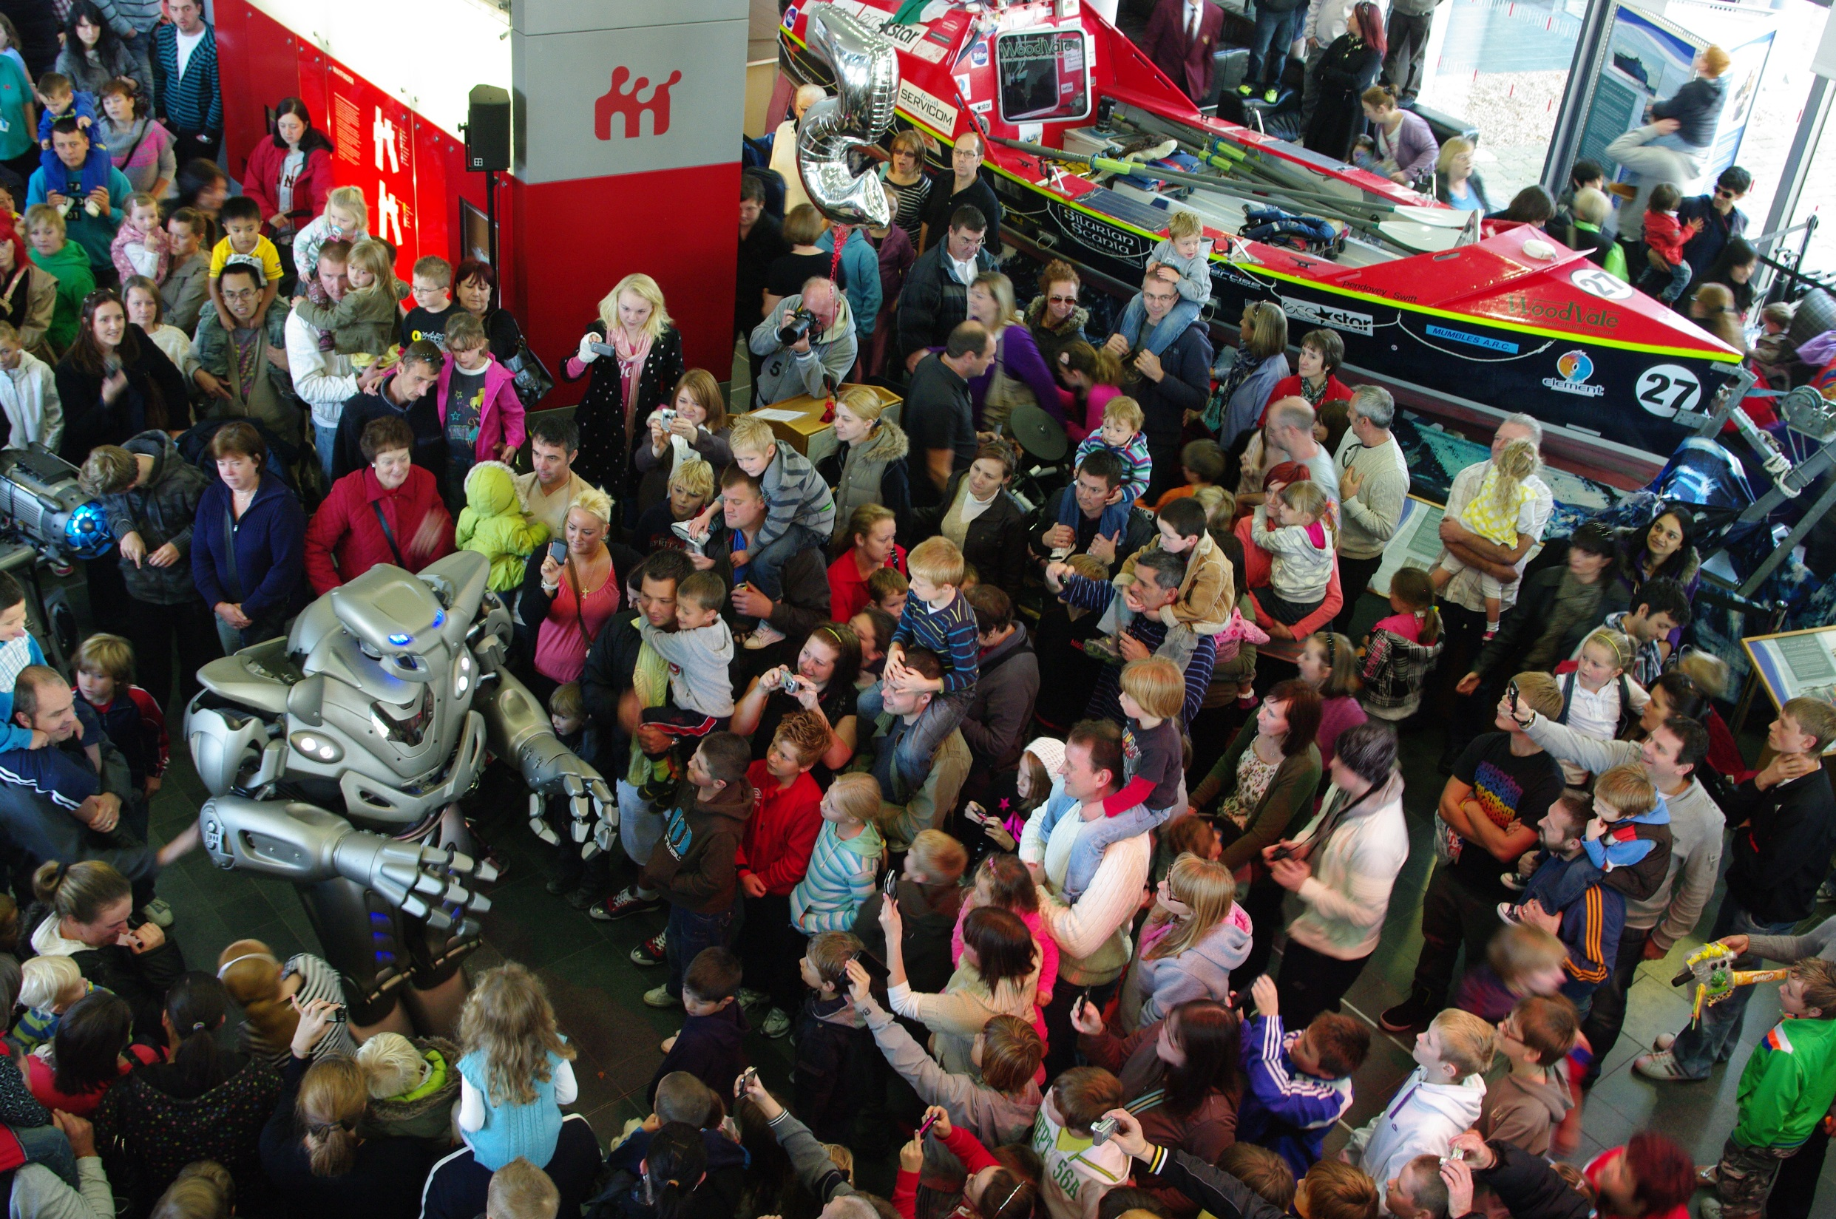

Slide 24


Slide 25


Slide 26
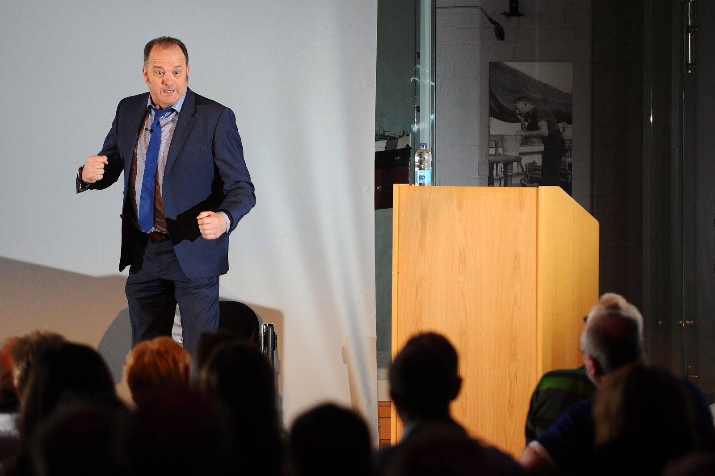

Slide 27
Budget of £30k
Put on over 250 events a year
Conception to delivery
Team of two
Thank you any questions??

