Slide 1
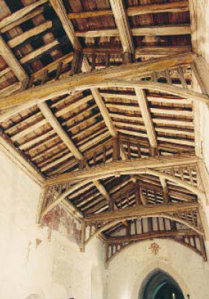
Construction technology I
Roof Construction
Notes:
An old arched tie-beam roof.

Slide 2
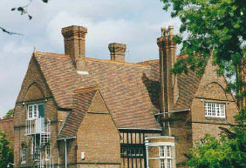
Functions of roofs
Strength and stability
Dimensional stability
Exclusion and disposal of rain and snow
Energy conservation and ventilation
Control of solar heat, air temperature etc

Slide 3
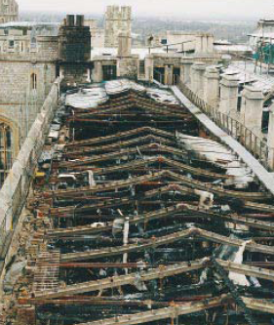
Functions of roofs
Fire precautions and lightning protection
Daylighting, control of glare etc
Sound insulation
Durability and ease of maintenance
Notes:
Class
What are the basic causes of deterioration in buildings?
Weathering
Biological infestation
Stress
Chemical interactions
Normal use

Slide 4
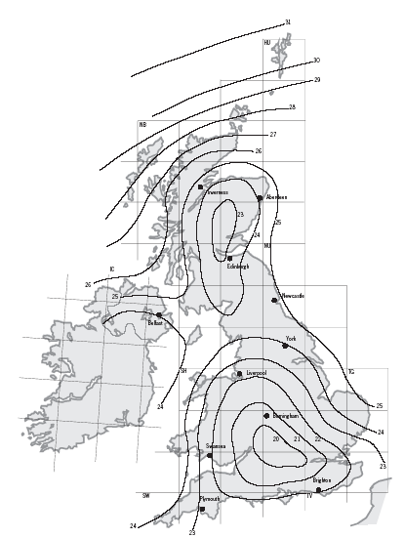
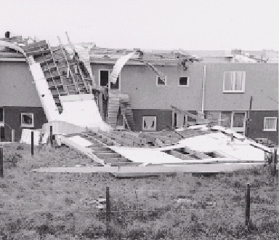
Notes:
A map of the UK showing the reference basic hourly mean wind speed in metres per second Swansea approx. 22m/sec (contour lines (isopleths) give max wind speeds which have 2% probability of being exceeded in any year.
Picture shows wind damage to aluminium sheeted pitched roofs (1950s)
Wind speed varies depending on the geographical location of the site, the altitude of the site above sea level, the direction of the wind and the season of the year. More locally, height above ground level, topography and terrain also affect speed and direction of the wind.

Slide 5
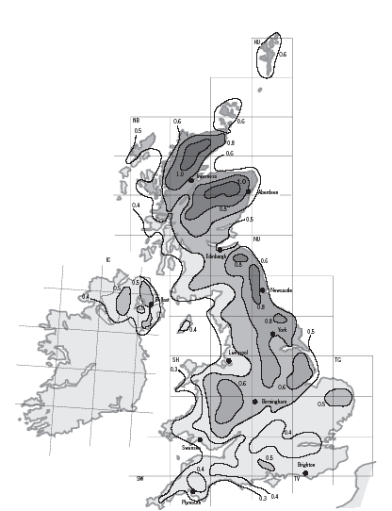
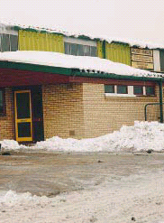
Notes:
A map of the UK showing the basic snow load on the ground (not on the roof) 100m above mean sea level in kN/m2. These values must be corrected for altitude, and they do not allow for drifting; they have a probability of exceedance of 0.02
Picture shows snow distribution by wind.

Slide 6
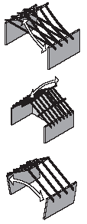
Dimensional stability
Expansion and contraction
  Moisture movement
  Thermal movement
Notes:
Sagging – humping – spreading
Expansion and contraction of any part of the building fabric subjected to variations of moisture content and temperature will have the potential to cause problems if not accommodated in the design.
Where elements are totally restrained, the stress developed is the product of the strain and Young’s modulus, and will lead to compressive forces for expansion and tension forces for contraction. It is the larger components which need most consideration. Moisture movement is mainly a property of porous materials; thus metal, glass and well fired ceramics have zero movement, while concrete, calcium silicate, porous clay and stone have reversible movements in the range 0.02–0.2%. Concrete and calcium silicate products also have an irreversible drying and carbonation shrinkage in the range 0.02–0.1%, and fired clay has an irreversible initial expansion in the range 0.02–0.1%.

Slide 7
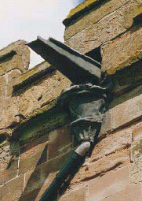
Exclusion and disposal of rain and snow
Vertical rain
Driving rain
Rain splashing
Hailstones and snow
Disposal of rainwater and snow meltwater
Notes:
Within the terms of the Bld. Regs., control of moisture penetration is a functional requirement, and the building needs to be designed accordingly.
Vertical rain – for non-porous materials, which includes many roofing materials, short spells of high intensity rain may be more significant than slight rainfall over longer periods.
Driving rain – rain falling while the wind is blowing affects pitched roofs more than flat (and walls even more).
Rain splashing – rain, whether wind driven or vertical, is conventionally expected not to splash up more than 150mm from horizontal surfaces (dpc / lead flashing levels!) has been known to splash as much as 300mm!
Disposal of rainwater and snow meltwater – normal practice to drain roofs by means of eaves gutters. As with most aspects of construction technology, there is a predictable risk that the capacity of a drainage system will be exceeded. Picture shows how previous generations dealt with such overload (gargoyles)
Design needs to consider: category of protection, calculating rainfall rate and run-off, sizing gutter/channel/outlet/pipework.
Hailstones and snow – 10mm dia little or no damage. 75mm have fallen (100g) and can smash roof lights, dent metal roof coverings. Dry, wind blown snow can penetrate tiny gaps in roof coverings and accumulate, sometimes in drifts, within the roof void. Good detailing!

Slide 8
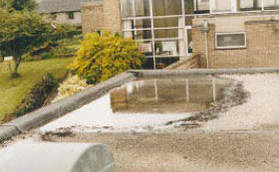
Rainwater disposal
Ponding occurred because the outlet has been set too high.

Slide 9
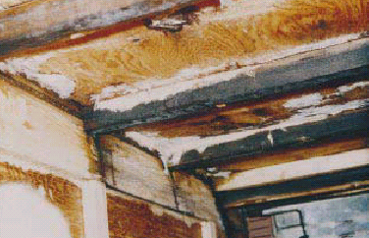
Energy conservation and ventilation
Prevention of heat loss
Condensation
Pressure differentials
Water in materials
Notes:
Evidence of severe condensation and fungal growth on the underside of a plywood decked flat roof.
All the materials of the roof and even the spaces between layers of the materials (cavities) contribute to the thermal performance of the roof. The thermal layer of the roof system will need to’ resist loads Positive and negative), cater for movement, chemically compatible with adjoining materials and have the appropriate fire resistance.
Condensation – must be minimised. Occurs on a surface when the temperature falls below the dew point of the air for a sustained period. In such conditions the RH of the air in direct contact with the cold surface rises to 100% and the moisture in the air condenses on the surface. Reduce risk by; installing thermal insulation to reduce heat loss, install vapour control on warm side of thermal insulation to restrict moisture which diffuses through the insulation from condensing on any colder outer surface, ensure cross-ventilation.
External wind pressures and suctions forcing air to and from the inside of the roof void, and/or temperature changes affecting the inside air can cause some liquid water/water vapour to pass from the outside to the inside. Moisture stored in materials during construction either, hydroscopic absorption from the atmosphere or rainfall

Slide 10
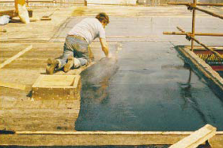
Thermal insulation
Asphalting a warm deck roof. The thermal insulation (urethane with a perlite topping) was selected so as not to be affected by the heat of the asphalt while laying; it protects the metal deck from excessive thermal movements.
Notes:
(no protective measures! – old photo!
Perlite – volcanic glass. When expanded by heat it forms a lightweight aggregate used in concrete and plaster, or as a soil conditioner to aid drainage.

Slide 11
Control of solar heat, air temperature etc
Solar energy
Temperature prediction
Frost
Notes:
In summer a roof will gain heat through solar radiation. This can affect surface materials by: UV radiation disrupting specific chemical bonds between materials, solar energy on the surfaces causing their temperature to rise.
Temperature predictions – material selection is key here. Also cities / towns as heat islands. (section A2 CIBSE Vol A).
Frost – deterioration of building components frequently happens when several meteorological parameters act together. One example of this is frost damage to porous materials. This occurs when freezing conditions coincide with high moisture content, near saturation. The air temperature at which frost damages roof materials usually needs to be substantially below freezing since the roof often receives heat energy from inside the building. It will also have some thermal capacity.

Slide 12
Fire precautions and lightning protection
Reduce outbreaks
Escape of occupants
Minimise the spread
Control fire growth
Avoid conflagration
Notes:
Windsor castle. The designer of the roof of a building will need to know a great deal about the conditions that will be imposed on that structure in service. Factors such as loading, environmental and durability all have to be understood and assimilated into the design process, and considered in relation to behaviour in fire. Objectives include those shown above.
Cavity barriers / fire stops have an important influence on the growth and development of a fire within an enclosed space.
Fire can attack a roof from both outside and inside. Consider weak spots – roof lights! Both Bld. Regs and BS476.
Adjacent buildings – unprotected zones! Roof as an escape route
Lightning protection – the roof carries the main provision for terminals for any lightning protection system. As a general rule, if lightning protection is to be effective, no part of the roof should be more than 10m from a conductor; 5m for high risk buildings. BS6651
Conflagration – large, destructive fire!

Slide 13
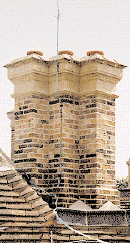
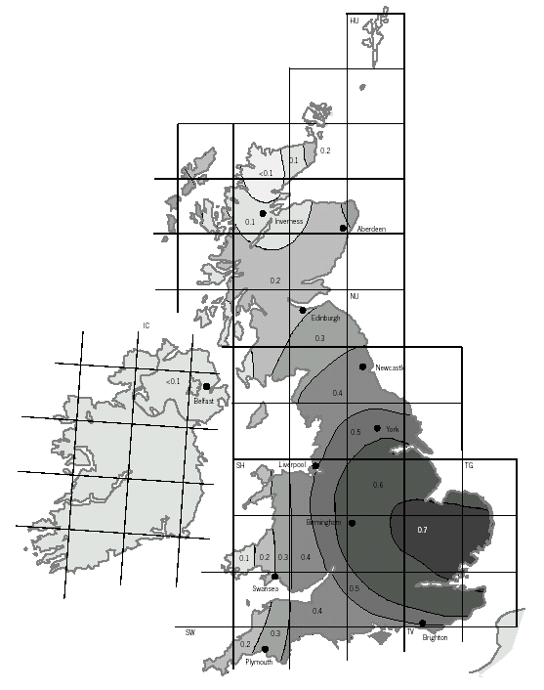
Notes:
The risk of a building being struck by lightning should be calculated.
The above map gives the number of lightning strikes to the ground per square kilometre per year. This should be multiplied by the effective collection area of a structure to give the probable number of strikes per year.
Swansea – 0.25/square kilometre.

Slide 14
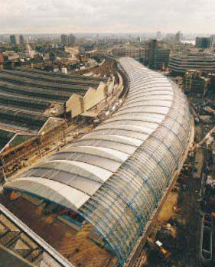
Daylighting, control of glare etc
Daylight factor
Reflection
Roof lighting
Notes:
Roof lighting at Waterloo International Railway Station.
Larger span roofs are unable to capture sufficient light through windows. Area for area, quantities of light received at the working plane from above can be considerably greater than from the side. It is especially important to consider the effects of glare when considering the design of roof lights.
Daylight factor is the usual way of indicating the amount of daylight received under any roof lighting.(proportion of the available light outside the building which can reach the working plane.(5% min).
Reflection – glare or dazzle can occur when sunlight is reflected from a glazed roof light or from roof surfaces. The reflectance value of the surface of the roofing of a low building may affect the amount of daylight reaching adjoining higher buildings.
Roof lighting – corrugated sheets (PVC, GRP), flat sheets(PVC, reinforced, polycarbonate), moulded roof lights.

Slide 15
Sound insulation
Air-borne
  Internally generated
  Externally generated
Structure-borne
  Machinery
  Weather generated
Notes:
The roof of a building must be given as much consideration as walls when designing for sound insulation.where a building has to contain noise – in other words, unwanted sound – it is common practice to set a maximum noise level at the boundary of the plot. Where the building has to protect its occupants from external noise, often a requirement is put on the insulation of the building envelope.
Noise from the roof itself,caused by wind sun rain or hail, may need to be considered. For example, drumming on thin sheets from rain and hail, or vibration from wind causing whistling.

Slide 16
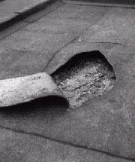
Durability and ease of maintenance
Pollutants
Insects
Rodents, bats and birds
Mould, fungus etc
Plants
Notes:
One of the most important influences on durability is the quality with which the original work was carried out.
Opening up this blister reveals a complete lack of adhesion between layers. Other factors for the durability of roofs are the types and amounts of pollution and organisms that attack roofing materials.
Pollutants – industrial, natural, CO2, chlorides, ozone.
Insects – degradation wood-boring beetles. Infestation – voids that allow wasps, cockroaches.
Rodents, bats and birds – health and hygiene issues
Mould, fungus etc – those that cause wood rot and those that don’t.
Plants -

Slide 17
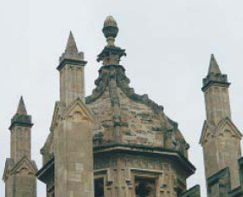
Durability
This ribbed stone vault does not have a separate weatherproof covering. Durability of the roof depends on many factors including correct selection of the stone and its bedding planes, suitable mortar mixes and air pollution levels
Notes:
Deterioration will be accelerated by:
Poor design/detailing
Inappropriate selection of material or component for intended use
Quality of material / component
Adverse on-site storage and handling
Poor workmanship
Inadequate maintenance
Inappropriate use
The design and construction process attempts to minimise these factors and experience suggests that it is usually a combination of factors that leads to failure. For example, a poor design that is poorly built and poorly maintained may fail, when getting any one of these processes right might allow it to perform adequately.

Slide 18
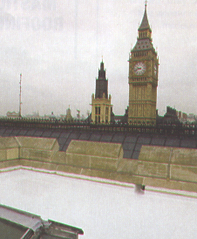
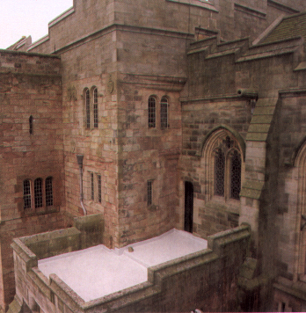
Protecting our heritage
Mastic asphalt
Notes:
Mastic asphalt is considered more of a traditional material – do we know more about its properties?
The buildings shown here are heavily reliant on waterproof and wear-resistant qualities to protect their ancient building envelopes.
Bamburgh Castle, Northhumberland
Houses of Parliament – often quoted as the prime example of the longevity of mastic asphalt roofing. Both HoP have relied on Mastic asphalt for well over 100 years.
Permaphalt, the polymer modiefied mastic asphalt roofing system has gained approval from The Loss Prevention Certification Board (LPCB). The first of its kind to achieve such an endorsement in the UK. Backing from the LPCB, the UK’s primary insurance accreditation body, demonstrates the product’s fire performance credentials and suitability for all types of flat roof waterproofing applications.

Slide 19
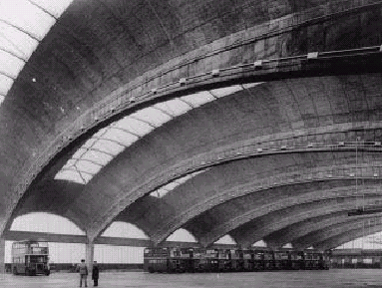
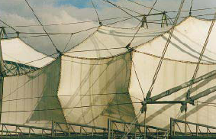
Long span roofs
From this…
…to this
Notes:
A long span shell roof in RC constructed in the 1950s
A plastics fabric roof

Slide 20
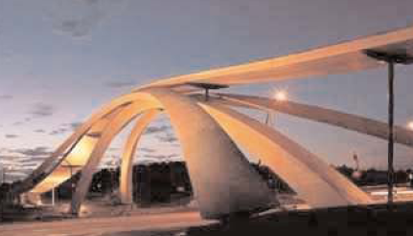
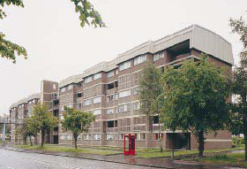
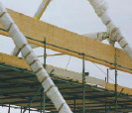
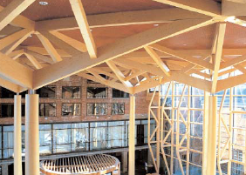
Notes:
Over-roofing completed on a six storey block of flats.
Top - glulam in Norway

Slide 21
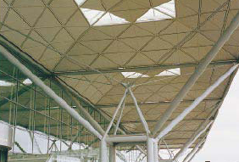
Factors affecting choice of roof structure
Building type
Foundation condition
Spans

Slide 22
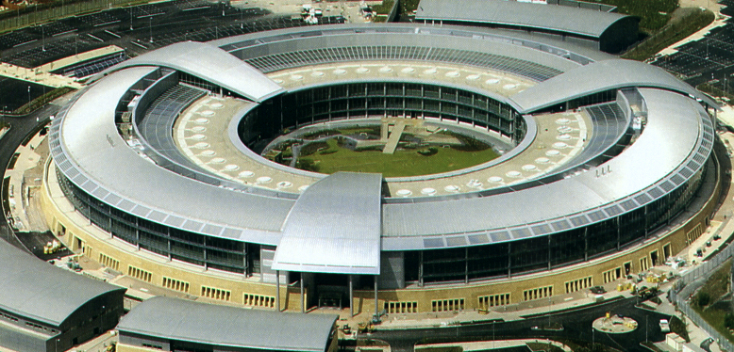
Tapered roofing
Corus 2005
Notes:
GCHQ building in Cheltenham
Tapered sheet lengths of 1.5m to whatever limitations are imposed by transportation or on-site lifting. A range of finishes available.

Slide 23
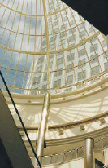
Factors affecting choice of roof structure
Loading
Lighting requirements
Notes:
A framed glazed dome illustrating a good understanding of the principles of natural lighting and the control of glare.

Slide 24
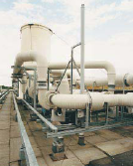
Factors affecting choice of roof structure
Service accommodation
Possible future alterations
Speed of erection

Slide 25
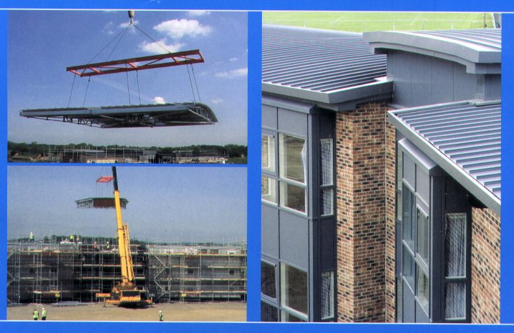
Notes:
Corus Hi-point roofing.
Manufactured and assembled into volumetric modules under factory controlled conditions.
Off-site or on-site methods available – depends on space availability. Kit forms available for erection on-site.
This slide – MOD contract. Ten accommodation units, main structure lifted into position and weathering process of joints, gutters and fascias added.

Slide 26
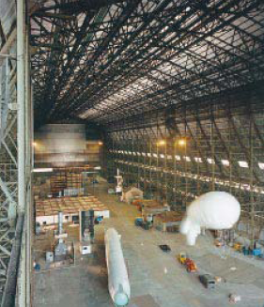
Factors affecting choice of roof structure
Aesthetic considerations
Internal height

Slide 27
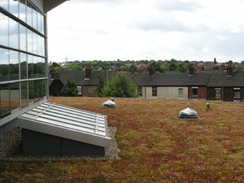
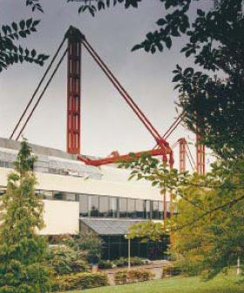
Notes:
An example of a unique design of roofing at Waterloo International Railway Station
An external skeleton suspended roof at the NEC Birmingham

Slide 28
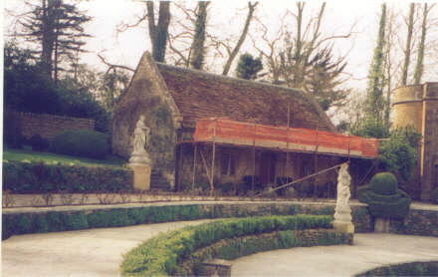
Obsolescence
Physical
Economic
Functional
Technological
Social
Legal
What determines the
Life expectancy of a roofing
System?

Slide 29
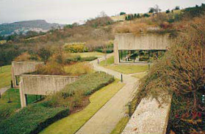
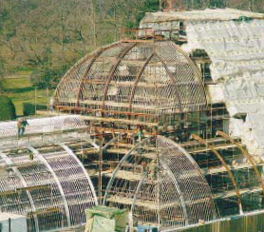
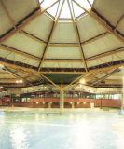
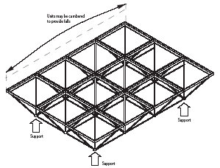
Notes:
A roof garden on two levels on an office building
Major restoration on the palm House at the Royal Botanic Gardens, Kew
. A potentially aggressive internal atmosphere in buildings housing swimming pools can cause corrosion of structural members and deterioration in other parts of building fabric
.

Slide 30
Sustainable roofs!
Orientation
Overhangs
Rooflights
Inverted flat roofs
Ballasted membranes
Green roofs
Stones / ballast heat sinks
Good detailing
Over-design
Adequate specification
Notes:
Cantonal hospital Basel
Orientation of the building to provide shade
Influence of rooflights on solar shade
Inverted flat roofs to protect the membrane
Ballasted membranes to protect from UV light
Green roofs to reduce rainfall run-off and to protect the membrane
Stones or ballast heat sinks (low sloping roofs) to reduce surface temperature
Systems to be designed according to good practice and to achieve high levels of workmanship
To compensate for predicted higher wind loads and rainfall over-designing and over-specifying foofs by increasing:
density of fixing patterns for slates and tiles
the strength of the roof structure with braces, lateral restraint straps etc.
gutter capacity
Also by specifying:
flexibility in roof systems to cope with higher thermal movements
Solar reflective materials for exposed surfaces (roofs with dark surfaces increase heat build-up in buildings
Materials offering the best durability for the expected climatic conditions

Slide 31
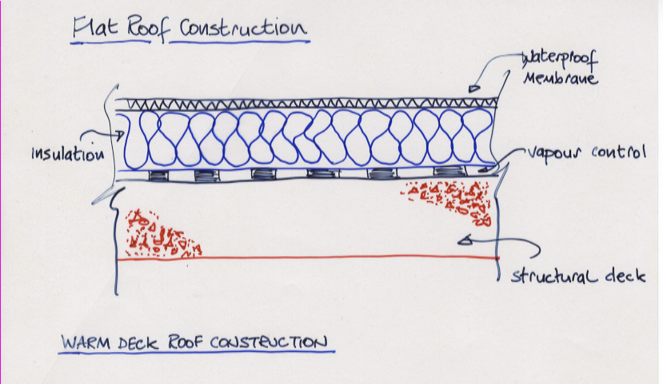
Roof Construction
Warm deck
  Insulation warms the deck
  Waterproof membrane externally
  Vapour control needed under insulation to prevent condensation

Slide 32
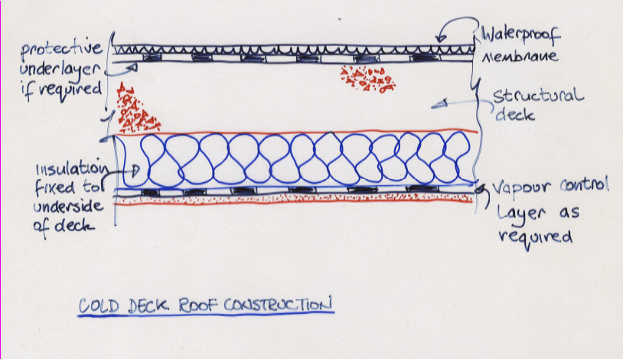
Roof Construction
Cold deck system
  Vapour control under insulation to reduce condensation risk
  Difficult to ensure integrity of VC
  Deck not warmed by building
  Poor option in UK – temperate, humid climate, sheltered conditions (lack of ventilation)

Slide 33
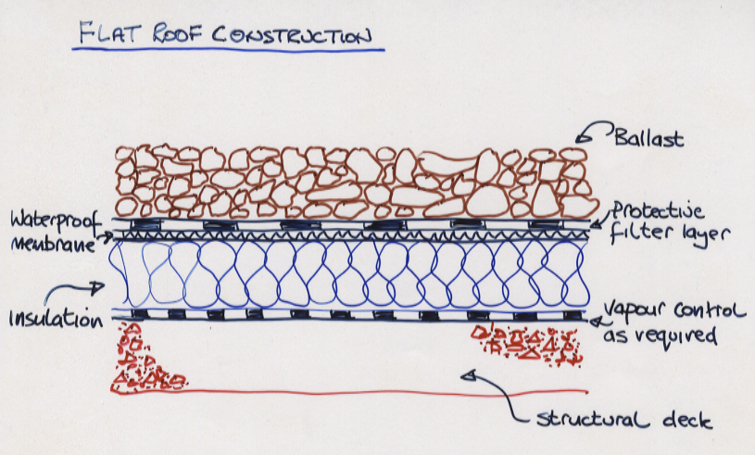
Roof Construction
Conventional ballasted warm roof construction
  Insulation keeps the deck warm
  Waterproof membrane is above insulation
  Vapour barrier needed below insulation to reduce risk of condensation

Slide 34
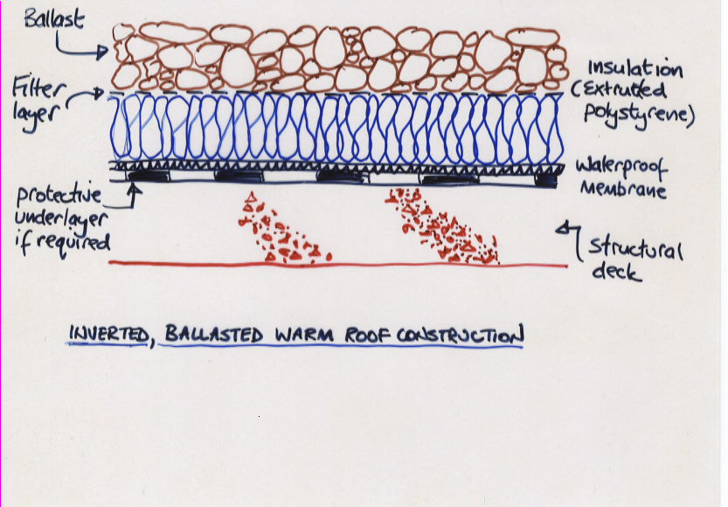
Roof Construction
Insulation above the deck provides protection to the membrane and deck from extremes in temperature.
Some challenges:
  Grit
  Degradation
  Condensation

Slide 35
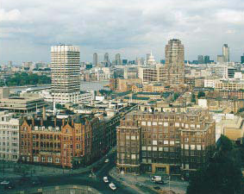
The odd shapes of
Roofs!
Notes:
A variety of roofs is evident in this area of London.

Slide 36
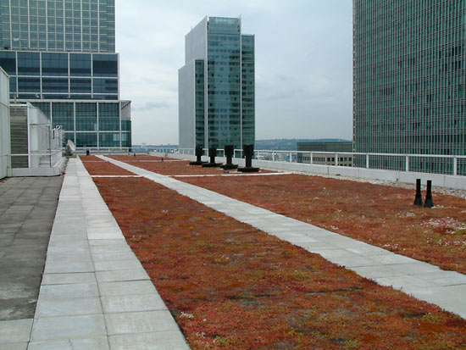
Case Study: Green Roofs

Slide 37
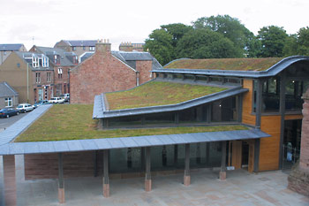
Why have a green roof?
Water retention
Climate control
Life expectancy
Pollution control
Thermal insulation
Space use
Encourages natural habitats

Slide 38
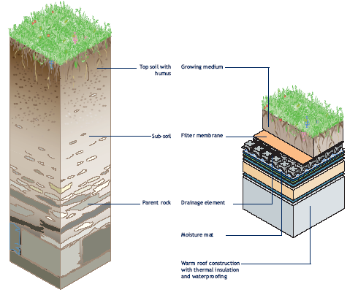
Replicating nature
Nutrients
Water retention
Aeration
Drainage

Slide 39
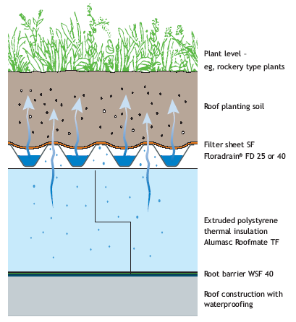
Inverted Green Roof
Some key points:
Root barrier
Wind uplift
Water storage
Irrigation
Notes:
Inverted Green Roof
The characteristic of an inverted roof is that the insulation is above the waterproofing. Extruded polystyrene insulation is used for inverted roofs because it is impervious to water.
However, the insulation is not impervious to water vapour. It is therefore essential to avoid forming a vapour barrier directly above it when installing a green roof.
The following must be taken into account when designing an inverted green roof:
■ If a root barrier is required, it must be placed below the insulation
■ The weight of the soil must be adequate to prevent wind uplift
and flotation
■ It is not possible to use the roof dam irrigation system
■ Water can be stored in the Floradrain® layer without affecting
aeration or vapour pressure

Slide 40
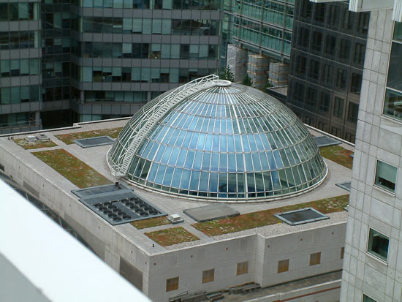
Some Barriers!
Structural issues
Maintenance
Guidance and
support
Guarantees
Aesthetics

Slide 41
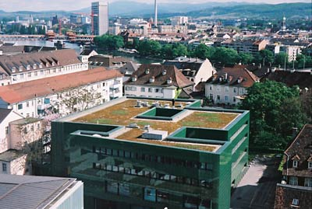
Research: the Swiss experience
Local substrates
Depth variation
Planting
Biodiversity

Slide 42
Discussion
Explain what is meant by a warm roof. How does this differ from an inverted and cold roof systems?
Examine each of the performance requirements of roofs as applied to both medium and long span systems.
Examine the key factors that are likely to cause instability or deformation in a long span roof.
Compare and contrast the use of a fabric as a roofing material with that of a more rigid sheet system.
What is meant by a sustainable roof system?
Notes:
Performance requirements
Key factors – thermal movements – reversible and irreversible movements due to drying shrinkage, moisture movement or creep in concrete members – elastic deflection due to the self weight of the roof and applied loading – ageing which may lead to brittleness in certain types of material.
Fabrics – durability 20 years for fabrics, less/more for traditional materials. Unaffected by UV light. PVC coated fabrics less durable. Fabrics vulnerable to mechanical damage / vandalism. Needs factory manufacture controlled environment, maintenance on site not easy. Fabrics stretch more than normal expansion / contraction of traditional materials. Fabrics are relatively self-cleansing under the action of rain – concentrates at seams (dirt / detritus). Bird spoiling.

