Slide 1
Module Code: LCHS7003
Module Title: Community Care and Management of Longer-term Conditions
Title: Chronic Obstructive Pulmonary Disease (COPD) for Primary Care Nurses
Student Name: Mst. Sima Begum
Student ID: 2433426
Lecturer: Muhammed khan

Slide 2
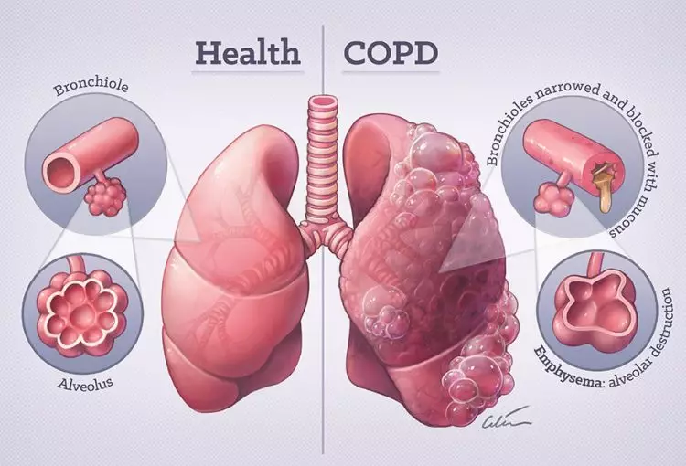
Overview of COPD
  Chronic obstructive pulmonary disease (COPD) is an ongoing lung condition caused by damage to the lungs (Lopez-Campos et al., 2016).
  The damage results in swelling and irritation, also called inflammation, inside the airways that limit airflow into and out of the lungs (GOLD, 2024).
  Pathophysiology: chronic bronchitis and emphysematous destruction (Ford & Mannino, 2019)
  Core symptoms: chronic productive cough, dyspnoea, wheezing, recurrent exacerbations
  Primary aetiology: tobacco exposure; other factors include occupational dust, air pollution, and α1-antitrypsin deficiency (Lopez-Campos et al., 2016)
  Strong association with frailty and declining functional capacity (Brighton et al., 2020)
Source: Lopez-Campos et al., 2016)

Slide 3
Epidemiology (UK & Global)
UK & Global Burden of COPD
Indicator | United Kingdom | Global
Diagnosed prevalence | 1.2 million people (BLF, 2020) | 392 million people (GOLD, 2024)
Annual deaths | ~30,000 (BLF, 2020) | 3.2 million deaths/year (Lopez-Campos et al., 2016)
Ranking | 5th leading cause of death | 3rd leading cause worldwide
Higher prevalence in low-income and high-deprivation UK regions (King’s Fund, 2022)
Increased hospital utilisation, particularly winter admissions
Rising global prevalence linked to aging populations and persistent tobacco exposure

Slide 4
Economic & Social Burden (UK)
Economic Impact:
Direct & Indirect Costs of COPD (UK)
Cost Component | Estimated Burden
Annual NHS COPD expenditure | £1.9 billion (de Nigris et al., 2022)
Exacerbation-related hospital admissions | ~140,000/year (BLF, 2020)
Average cost per acute exacerbation | £1,500–£2,500 (de Nigris et al., 2022)
Social Impact:
Substantial productivity loss and workforce limitations due to breathlessness and disability (de Nigris et al., 2022).
Heights social burden: carer dependency, reduced quality of life, and multi-morbidity (Angelis et al., 2015).
Higher economic impact in socioeconomically deprived areas (King’s Fund, 2022).

Slide 5
Diagnosis of COPD (NICE NG115; GOLD 2024)
Diagnostic confirmation: post-bronchodilator FEV1/FVC < 0.7 (GOLD, 2024)
Clinical assessment: persistent respiratory symptoms and exacerbation history
Symptom scoring tools: COPD Assessment Test (CAT) (Jones et al., 2009)
Radiology: chest X-ray to exclude alternative pathology
Laboratory testing: full blood count, eosinophils, α1-antitrypsin deficiency (Ford & Mannino, 2019)
Consideration of overlapping chronic illnesses (King’s Fund, 2022)

Slide 6
Initial Assessment
Comprehensive symptom review: CAT, MRC dyspnoea scale
Frailty assessment (Brighton et al., 2020)
Assessment of smoking and environmental exposures
Review of exacerbation frequency
Multi-morbidity screening (King’s Fund, 2022)
Assessment of social needs: housing, heating, income

Slide 7

Management of COPD in the UK (NICE NG115; GOLD 2024)
Smoking cessation as primary intervention; behavioural and pharmacological support
Pharmacological treatment aligned with symptom level and exacerbation risk:
SABA/SAMA
LABA/LAMA combinations
ICS use for frequent exacerbators (GOLD, 2024)
Pulmonary rehabilitation enhancing physical capacity and reducing frailty-related limitations (Brighton et al., 2020)
Self-management plans to reduce hospital admissions (Han et al., 2016)
Vaccinations: influenza and pneumococcal
Close monitoring in primary care for early deterioration detection
Source: (Jin and Mosweu, 2017)

Slide 8

Treatment Options in the UK
Inhaled therapy optimisation: device choice, adherence checks, technique assessment (Han et al., 2016).
Acute exacerbation care: oral corticosteroids + antibiotics (as indicated)
Long-term oxygen therapy for persistent hypoxaemia (GOLD, 2024)
Pulmonary rehabilitation programmes improving exercise capacity and quality of life (Brighton et al., 2020)
Integration of psychological support for anxiety/depression linked to COPD burden
Cost-effectiveness considerations in treatment choice (de Nigris et al., 2022)

Slide 9

House of Care Model (NHS England)
Framework developed to support long-term conditions through co-productive, personalised care (Year of Care Partnerships, 2020)
Emphasises shared decision-making between patients and MDT professionals
Aligns with UK priorities in the NHS Long Term Plan for chronic disease management (NHS England, 2019)
Core components: engaged individuals, trained professionals, supportive organisational systems, and responsive commissioning
Addresses gaps in COPD care experience identified in UK surveys (Philip et al., 2019)
Reinforces structured assessments and care planning consistent with NICE NG115 (NICE, 2019)
Source: (Foster et al., 2015)

Slide 10
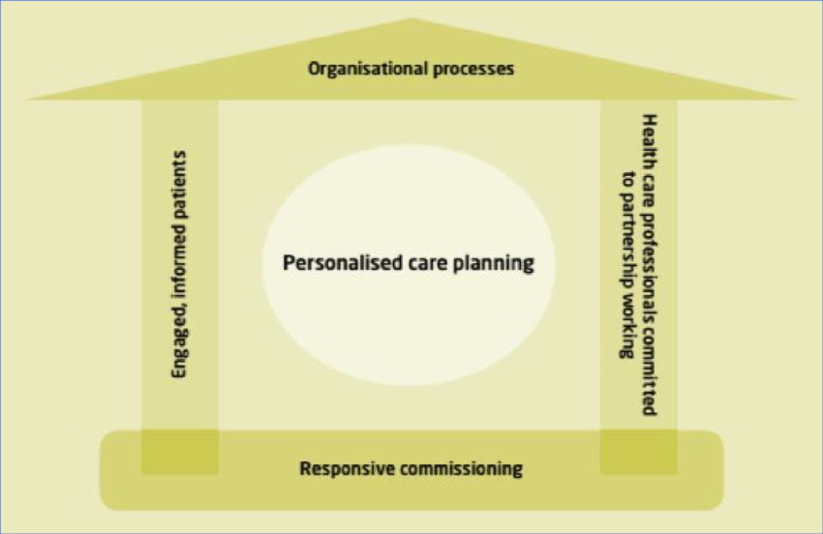
Application of House of Care Model to COPD
Facilitates co-produced COPD care plans enabling improved symptom control and reduced admissions (Grindell et al., 2022)
Supports systematic use of assessment tools (CAT, MRC) within personalised care pathways (Jones et al., 2009)
Enhances inhaler adherence and technique review through shared decision processes (Han et al., 2016)
Integrates self-management and pulmonary rehabilitation into routine care (Richardson et al., 2019)
Addresses multi-morbidity burdens common in COPD, reducing fragmentation of services (King’s Fund, 2022)
Challenges include inconsistent access to PR programmes and resource variation across UK regions (Morton et al., 2019)
Source: (Sav et al., 2015)

Slide 11
Comorbidities Associated with COPD
Comorbidity Burden in COPD (UK & Global Evidence)
Comorbidity | Key Evidence | Notes
Cardiovascular disease | Han et al. (2016) | Leading cause of death in COPD
Anxiety & depression | Sav et al. (2015) | High psychological burden impacts self-management
Sleep-disordered breathing | Lyons et al. (2020) | Increases nocturnal hypoxaemia and exacerbation risk
Osteoporosis | Ford & Mannino (2019) | Linked to corticosteroid exposure
Metabolic syndrome | Lopez-Campos et al. (2016) | Common in chronic inflammation
Non-smoker COPD–environmental exposure | Yang et al. (2022) | Highlights importance of air pollution prevention
Comorbidities significantly increase healthcare utilisation and treatment burden (Spencer-Bonilla et al., 2017)

Slide 12
Prevention Strategies (UK Public Health)
Primary prevention:
National tobacco control policies, smoke-free legislation, and prevention campaigns (NHS England, 2019)
Regulation of workplace exposures and air quality control (Yang et al., 2022)
Secondary prevention:
Early identification through spirometry in at-risk groups (GOLD, 2024)
Screening of individuals with environmental/occupational risk factors (Ford & Mannino, 2019)
Tertiary prevention:
Pulmonary rehabilitation improving functional capacity and reducing hospitalisations (Richardson et al., 2019)
Structured care bundles reducing readmissions (Morton et al., 2019)
Community-based activity programmes reducing exacerbation frequency and cost burden (Ramos et al., 2019)
Consideration of holistic well-being, including nature-based interventions improving mental health (Seymour, 2016)

Slide 13
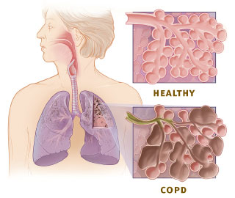
Skills, Values, and Behaviours for Co-Productive COPD Care
Competence in delivering shared decision-making within LTC frameworks (NHS England, 2021)
Use of motivational interviewing to support behavioural change (Sav et al., 2015)
Cultural competence to address health inequalities in COPD burden (King’s Fund, 2022)
Effective MDT communication to support continuity of care (Han et al., 2016)
Empathy, active listening, and patient-centred goal negotiation (Philip et al., 2019)
Skills in reducing treatment burden and supporting minimally disruptive care (Spencer-Bonilla et al., 2017)
Source: (Han et al., 2016 )

Slide 14
Personalised Care & Self‑Management (Six Components)
Based on “Universal Personalised Care” (NHS England, 2021)
Shared Decision-Making
  Supports inhaler optimisation and treatment choices; improves engagement (Han et al., 2016)
Personalised Care & Support Planning
  COPD action plans reduce exacerbation-related admissions (Morton et al., 2019)
Supported Self-Management
  Education on breathlessness management, inhaler technique, and pacing (Richardson et al., 2019)
Social Prescribing
  Links to exercise groups, smoking cessation, community support, and nature-based activities (Seymour, 2016)
Patient Choice
  Options for pulmonary rehabilitation locations and remote-monitoring tools
Personal Health Budgets
  Facilitates resource allocation for complex, multi-morbid COPD cases requiring enhanced home support (NHS England, 2021).

Slide 15

Personalised Care & Self‑Management
Expand equitable access to pulmonary rehabilitation across UK regions (Brighton et al., 2020).
Strengthen use of House of Care personalised planning for COPD to reduce fragmented care (Year of Care Partnerships, 2020).
Enhance support for individuals experiencing high treatment burden through MDT-coordinated approaches (Spencer-Bonilla et al., 2017).
Increase adoption of care bundles during acute exacerbation admissions to reduce readmission rates (Morton et al., 2019).
Integrate social prescribing pathways to address physical and psychosocial needs (NHS England, 2021).
Implement advanced prevention strategies for non-smoker COPD, focusing on air pollution and occupational exposure reduction (Yang et al., 2022).
Strengthen public health initiatives targeting high-risk and deprived communities (King’s Fund, 2022).

Slide 16
References
Angelis, A., Tordrup, D., and Kanavos, P. (2015). Socio-economic burden of rare diseases: a systematic review of cost of illness evidence. Health Policy, 119(7), 964-979.
Brighton, L. J., Evans, C. J., Man, W. D., and Maddocks, M. (2020). Improving exercise-based interventions for people living with both COPD and frailty: a realist review. International journal of chronic obstructive pulmonary disease, 841-855. https://doi.org/10.2147/COPD.S238680
British Lung Foundation (2020) COPD statistics for the UK. London: BLF. Available at: https://statistics.blf.org.uk
de Nigris, E., McEwan, P., Marshall, J., Holmgren, U., and Foos, V. (2022). POSB65 economic burden of COPD in the United Kingdom (2021–2040) estimated with the COPD health outcome policy and intervention (CHOPIN) model. Value in Health, 25(1), S72-S73. DOI: 10.1016/j.jval.2021.11.338
Ford, E.S. and Mannino, D.M. (2019) Update in epidemiology, pathophysiology, and diagnosis of COPD. Journal of the American Medical Association, 321(8), pp. 786–797. doi: 10.1001/jama.2019.0564
Foster, N., Vassall, A., Cleary, S., Cunnama, L., Churchyard, G., and Sinanovic, E. (2015). The economic burden of TB diagnosis and treatment in South Africa. Social science and medicine, 130, 42-50.
Global Initiative for Chronic Obstructive Lung Disease (GOLD) (2024) Global Strategy for the Diagnosis, Management, and Prevention of COPD. Available at: https://goldcopd.org
Grindell, C., Coates, E., Croot, L., and O’Cathain, A. (2022). The use of co-production, co-design and co-creation to mobilise knowledge in the management of health conditions: a systematic review. BMC Health Services Research, 22(1), 877. https://doi.org/10.1186/s12913-022-08079-y
Han, M. K., Martinez, C. H., Au, D. H., Bourbeau, J., Boyd, C. M., Branson, R., ... and Dransfield, M. T. (2016). Meeting the challenge of COPD care delivery in the USA: a multiprovider perspective. The Lancet Respiratory Medicine, 4(6), 473-526. DOI: 10.1016/S2213-2600(16)00094-1
Hsieh, P. H., Wu, O., Geue, C., McIntosh, E., McInnes, I. B., and Siebert, S. (2020). Economic burden of rheumatoid arthritis: a systematic review of literature in biologic era. Annals of the rheumatic diseases, 79(6), 771-777.
Jin, H., and Mosweu, I. (2017). The societal cost of schizophrenia: a systematic review. Pharmacoeconomics, 35(1), 25-42.
Jin, L. J., Lamster, I. B., Greenspan, J. S., Pitts, N. B., Scully, C., and Warnakulasuriya, S. (2016). Global burden of oral diseases: emerging concepts, management and interplay with systemic health. Oral diseases, 22(7), 609-619.
Jones, P.W., Harding, G., Berry, P., Wiklund, I., Chen, W.H. and Kline Leidy, N. (2009) Development and first validation of the COPD Assessment Test (CAT). European Respiratory Journal, 34(3), pp. 648–654. doi: 10.1183/09031936.00102509
King’s Fund (2022) Long-term conditions and multi-morbidity in the UK. London: The King’s Fund. Available at: https://www.kingsfund.org.uk
Lopez-Campos, J.L., Tan, W. and Soriano, J.B. (2016) Global burden of COPD. European Respiratory Review, 25(140), pp. 117–138. doi: 10.1183/16000617.0076-2016

Slide 17
References
Lyons, M. M., Bhatt, N. Y., Pack, A. I., and Magalang, U. J. (2020). Global burden of sleep‐disordered breathing and its implications. Respirology, 25(7), 690-702.
Morton, K., MacNeill, S., Sanderson, E., Dixon, P., King, A., Jenkins, S., ... and Purdy, S. (2019). Evaluation of ‘care bundles’ for patients with chronic obstructive pulmonary disease (COPD): a multisite study in the UK. BMJ open respiratory research, 6(1). https://doi.org/10.1136/bmjresp-2019-000425
NHS England (2019) The NHS Long Term Plan. London: NHS England. Available at: https://www.longtermplan.nhs.uk
NHS England (2021) Universal Personalised Care: Implementing the Comprehensive Model. London: NHS England. Available at: https://www.england.nhs.uk/personalisedcare
NICE (2019) Chronic obstructive pulmonary disease in over 16s: diagnosis and management (NG115). London: National Institute for Health and Care Excellence. Available at: https://www.nice.org.uk/guidance/ng115
Philip, K., Gaduzo, S., Rogers, J., Laffan, M., and Hopkinson, N. S. (2019). Patient experience of COPD care: outcomes from the British Lung Foundation Patient Passport. BMJ open respiratory research, 6(1). https://doi.org/10.1136/bmjresp-2019-000478
Ramos, M., Lamotte, M., Gerlier, L., Svangren, P., Miquel-Cases, A., and Haughney, J. (2019). Cost-effectiveness of physical activity in the management of COPD patients in the UK. International journal of chronic obstructive pulmonary disease, 227-239. https://doi.org/10.2147/COPD.S181194
Richardson, C. R., Franklin, B., Moy, M. L., and Jackson, E. A. (2019). Advances in rehabilitation for chronic diseases: improving health outcomes and function. Bmj, 365.
Sav, A., King, M. A., Whitty, J. A., Kendall, E., McMillan, S. S., Kelly, F., ... and Wheeler, A. J. (2015). Burden of treatment for chronic illness: a concept analysis and review of the literature. Health Expectations, 18(3), 312-324.
Schattenberg, J. M., Lazarus, J. V., Newsome, P. N., Serfaty, L., Aghemo, A., Augustin, S., ... and Ratziu, V. (2021). Disease burden and economic impact of diagnosed non‐alcoholic steatohepatitis in five European countries in 2018: a cost‐of‐illness analysis. Liver International, 41(6), 1227-1242.
Seymour, V. (2016). The human–nature relationship and its impact on health: A critical review. Frontiers in public health, 4, 260. https://doi.org/10.3389/fpubh.2016.00260
Spencer-Bonilla, G., Quiñones, A. R., Montori, V. M., and International Minimally Disruptive Medicine Workgroup. (2017). Assessing the burden of treatment. Journal of general internal medicine, 32(10), 1141-1145.
Taylor, S. (2017). Caring at the edge: a synthesis of new paradigm insights and a case study of care for older people (Doctoral dissertation, University of Glasgow).
Year of Care Partnerships (2020) The House of Care Model: Improving care for people with long-term conditions. Newcastle: Year of Care Partnerships. Available at: https://www.yearofcare.co.uk
Yang, I. A., Jenkins, C. R., & Salvi, S. S. (2022). Chronic obstructive pulmonary disease in never-smokers: risk factors, pathogenesis, and implications for prevention and treatment. The Lancet Respiratory Medicine, 10(5), 497-511.

Slide 18


