Slide 1
Data Analysis and Visualisation
Lecture 9
Data representation II

Slide 2
Colour
Colour is a useful encoding tool
It must, however, be used with great care for cultural and physiological reasons
The minimum size of a point or the thickness of a line that can easily be discriminated differs with differing colours
Colour is often used to show scales, e.g. spectral, shaded or bi-colour

Slide 3
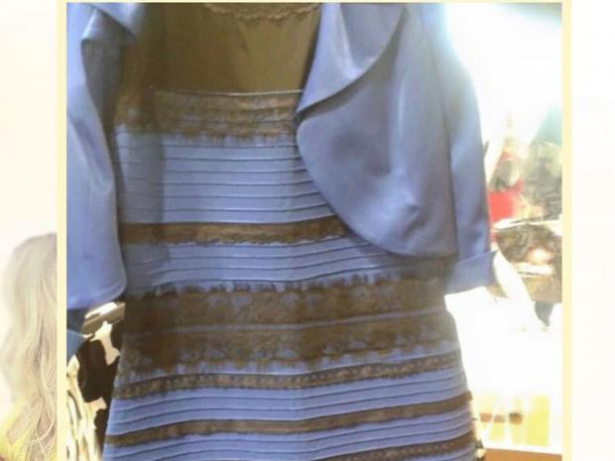
The Dress
Black and blue or gold and white?

Slide 4
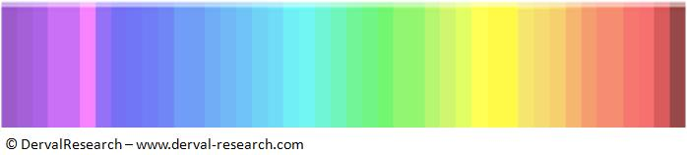
Colours Test

Slide 5
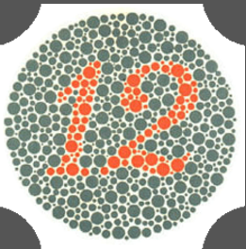
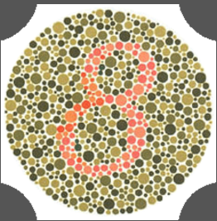
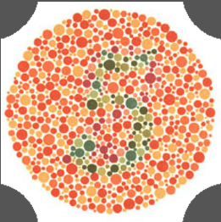
Ishihara Test
This is used for the diagnosis of colour vision deficiency

Slide 6
Colour
Colour is a useful encoding tool
It must, however, be used with great care for cultural and physiological reasons
The minimum size of a point or the thickness of a line that can easily be discriminated differs with differing colours
Colour is often used to show scales, e.g. spectral, shaded or bi-colour

Slide 7
Colours
The human eye can distinguish over 10 million different colours under suitable viewing conditions
13 colours
  Chromatics: red, orange, yellow, green, turquiose, blue, lilac, purple, pink, brown
  Achromatics: black, white, grey

Slide 8
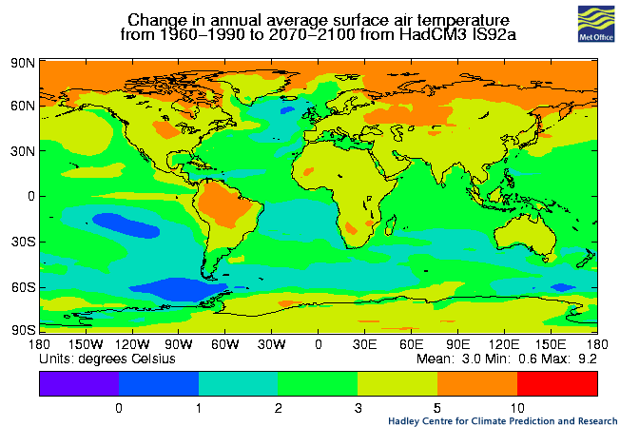
Spectral Coding

Slide 9
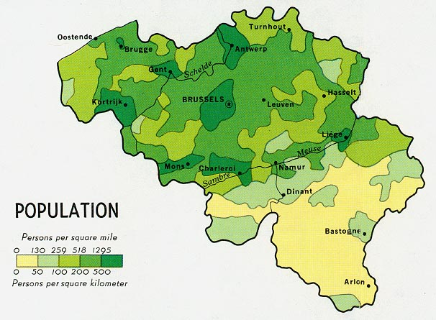
Shaded Coding

Slide 10
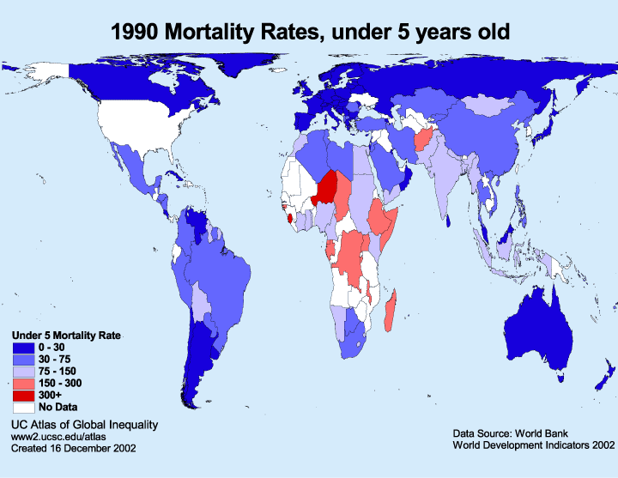
Bi-colour Coding

Slide 11
Different types of visual stimuli
Method | Max # | Max # for speed | Comments
Numerals and letters | Unlimited | Unlimited | Highly versatile but little aid to memory; long search times
Geometric shapes | ~ 15 | ~10 | Effective, high mnemonic value
Marks / icons | ~10 | 5 | Smaller number useful aid to recognition
Angle of line | 16 | 8 | Good in some cases
Length of line | 4 | 3 | Fair, but can clutter up display
Width of line | 3 | 2 | Good

Slide 12
Different types of stimuli
Method | Max # | Max # for speed | Comments
Solid and broken lines | 9 | 5 | Good
Size of object | 5 | 3 | Fair, but space considerations; longer to locate than colour or shape
Brightness | 4 | 2 | Poor, depends on screen contrast
Flashing element | 4 | 2 | Poor; confusing for encoding; good for attracting attention
Colour | 11 | 6 | Good, low location time; some users may be colour-blind

Slide 13
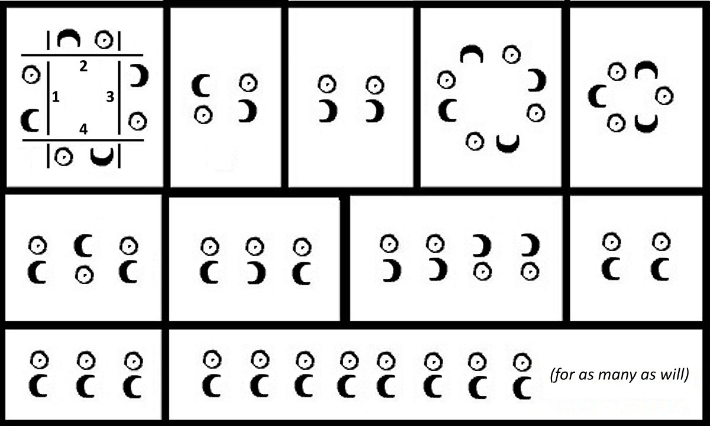
What is this?
A diagram to show starting positions for dances (Playford, 1651)

Slide 14
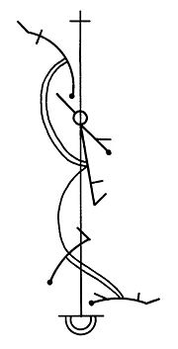
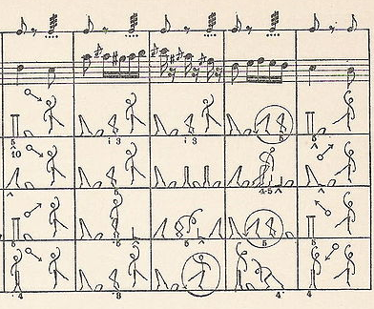
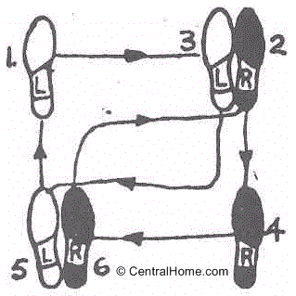
Choreography
Waltz in square, man’s steps
La Cachucha, by Friedrich Albert Zorn.
Beauchamp-Feuiller notation
for a French courante

Slide 15
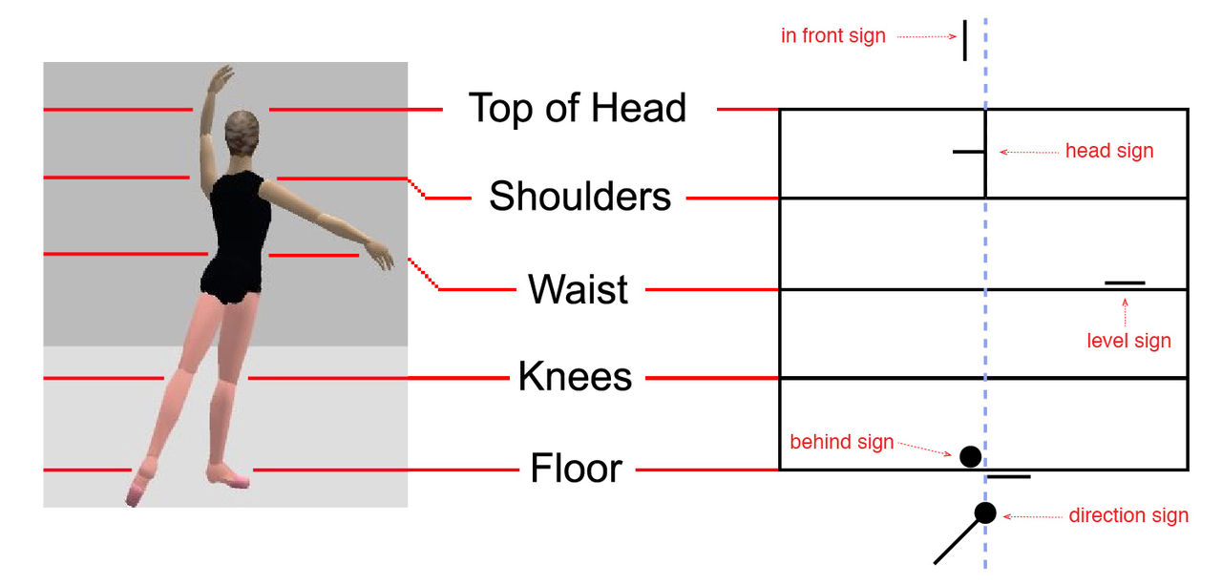
Choreography
Benesh notation describes the position of the dancer with respect to five levels
  Always views dancer from behind

Slide 16
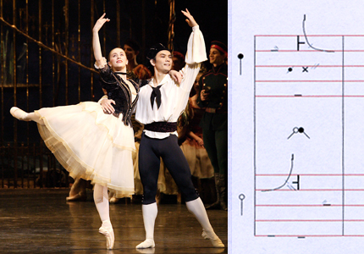
Choreography
Marianela Nuñez and Yohei Sasaki in a position from the 'Swan Lake' Act I
pas de trois and the Benesh notation for the same position

Slide 17
Labanotation
It is possible to use a different form of choreography notation, Labanotation, to define almost any human movement
  E.g. sign language
This can also be used to define the movement of any humanoid object
  Robotic arms
  Humanoid robots
  Animated characters
Introduction to Labanotation
  http://user.uni-frankfurt.de/~griesbec/LABANE.HTML

Slide 18
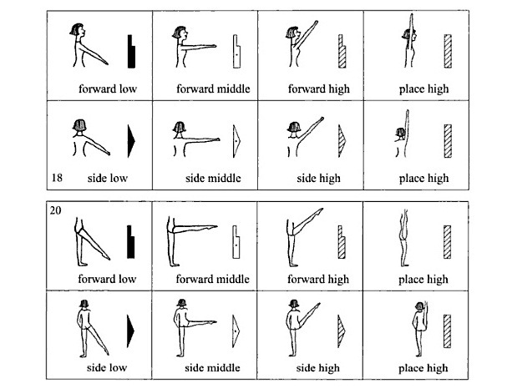
http://arpc167.epfl.ch/alice/WP_2011_S4/studiokoessler/files/2011/03/Labanotation02.jpg

Slide 19
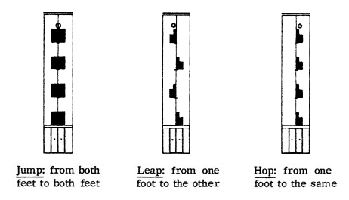
http://www.is-movementarts.com/wp-content/uploads/2013/12/jumpLeapHop.jpg

Slide 20
Sound
Visualisation does not need to be visual
Aural presentation can be used on its own or in conjunction with visual forms
There are many different features of sound that may be used to encode information
  Instrument, pitch, tempo, rhythm, chords
The presentation can range from a beep to a large-scale soundscape

Slide 21
Musical Visualisation
Many fields use symbolic notations that are unfamiliar to non-experts
  Choreography
  Music
  Mathematics…
Musical notation makes it relatively simple to read a piece of music but more difficult to compose music
Often music is composed on an instrument then transcribed into musical notation
It is now possible to play an instrument and have a computer automatically convert it into a paper-based notation that other people can read
Even so, there are a number of different musical notations in use today…

Slide 22
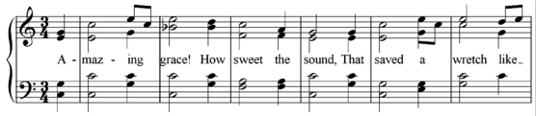
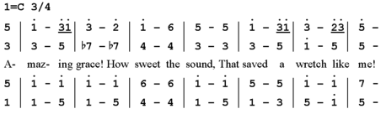
Music Notations
Amazing Grace in ‘standard’ SATB double stave notation
(G-clef and F-clef)
The same phrase in numerical notation

Slide 23
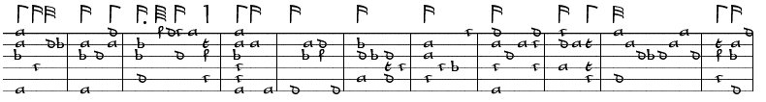
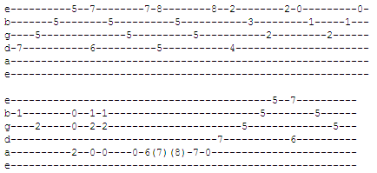
Tablature for stringed instruments
Lachrymae by John Dowland in lute tab
Stairway to Heaven by Led Zeppelin in guitar tab

Slide 24
Music Visualisations
Reading any musical notation is a skill that has to be learned – otherwise you can see if the music goes up or down, but that’s about it
Another alternative is to show as an animation not only the ‘up and down’ of the notes but also the ‘length’
  Eg, http://www.youtube.com/watch?v=ipzR9bhei_o
Loudness of the note might be shown by size
  https://www.youtube.com/watch?v=MvF8XWr17nw

Slide 25
Mathematics
Mathematics has a wide vocabulary of ‘specialised squiggles’ that mean nothing to non-mathematicians
Common symbols
Less common symbols
Weird and wonderful symbols

Slide 26
Which Is Best?
It depends…
We don’t know…
There are no hard and fast rules on when to use which technique
Multiple techniques are often used together
  So long as the viewer understands the methods chosen then complex combinations are acceptable
  Hints may be given using a key to the diagram
A visualisation tool that allowed the designer to choose from all of these would be exceedingly complex
  Often there are special tools to write specialised notations

Slide 27
Summary
Data may be ‘visualised’ using things other than graphics
In order to be visualised and explored the data has to be represented in some symbolic method; some fields have very specialised symbolic notations

Slide 28
Coming soon
Next session: Connectivity
Homework: Read chapter 4 of Information Visualisation.

