Slide 1

LCMB7023 Component 2
Training & Development at Unilever PLC
Human Capital Management
Student Ioan Eusebiu
Student ID: 2232121

Slide 2
Table Of Content
Content | Slide no
Introduction | 3
Current Policies and Practices at Unileve | 4
Overview of Training & Development | 5
Digital Learning & Online Platforms | 6
Leadership Development at Unilever PLC | 7
AI & Digital Skills Training at Unilever PLC | 8
Sustainability & Employee Wellbeing at Unilever PLC | 9
Opportunities in Training & Development at Unilever PLC | 10
Challenges in Training & Development at Unilever PLC | 11
Root Cause Analysis of T&D Challenges at Unilever PLC | 12
Recommendations for Unilever PLC | 13
Future of Work & AI Implications at Unilever PLC | 14
Conclusion | 15
Reference List

Slide 3
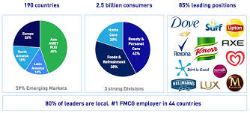

Introduction
Global FMCG Organisation Operating In 190+ Countries
Approximately 96,000 Employees Worldwide (Unilever.Com;2026)
Human Capital Management Supports Innovation, Productivity, And Competitiveness
Training & Development (T&D) Enhances Workforce Capability And Leadership Growth
AI And Digital Transformation Are Reshaping Employee Skill Requirements
Continuous Learning Is Essential For Adapting To Global Business Change
Notes:
Unilever PLC is one of the fast-moving consumer goods companies that operates in more than 190 countries with about 96,000 workers around the world (unilever.com;2026). Human Capital Management is a critical tool for enhancing organisational performance, innovation and sustainability in highly competitive multinational environments. In the context of an ever-changing technological and organisational landscape, training and development, or T&D, is a crucial part of filling employees with the ability to meet the demands of the changing world.
Moreover, the requirements of the workforce are undergoing drastic changes across industries due to the influence of AI and automation as well as the adoption of digital transformation. The World Economic Forum predicts that almost 44% of employees' skills will be impacted by technology over the next five years (weforum.org;2023). So, lifelong learning and workforce upskilling is now more crucial for the company to remain competitive in the global market and for the workforce to be adaptable.

Slide 4
Current Policies and Practices at Unilever
Uses the Degreed digital learning platform for continuous learning
Operates the Unilever Future Leaders Programme (UFLP)
Provides mandatory compliance and ESG training
Delivers AI and digital capability programmes
Supports mentoring, coaching and career development
Encourages self-directed and lifelong learning through global learning frameworks
Notes:
Presently, the company uses the integrated approach to the process of training and development. This includes the following types of training: digital learning, leadership development, and continuous professional learning. Employees have access to personalized learning by using the Degreed system, which provides for flexibility in online training at all locations around the world. The capabilities of leadership are formed by means of participation in the programme "Unilever Future Leaders Programme" (UFLP), mentoring, and coaching. Employees take part in mandatory compliance, ethics, sustainability, and ESG training programs. Being faced with digital transformation, the company has enhanced its programs on AI, automation, and digital skills, as well as promoted self-directed learning.

Slide 5
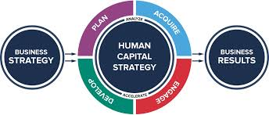
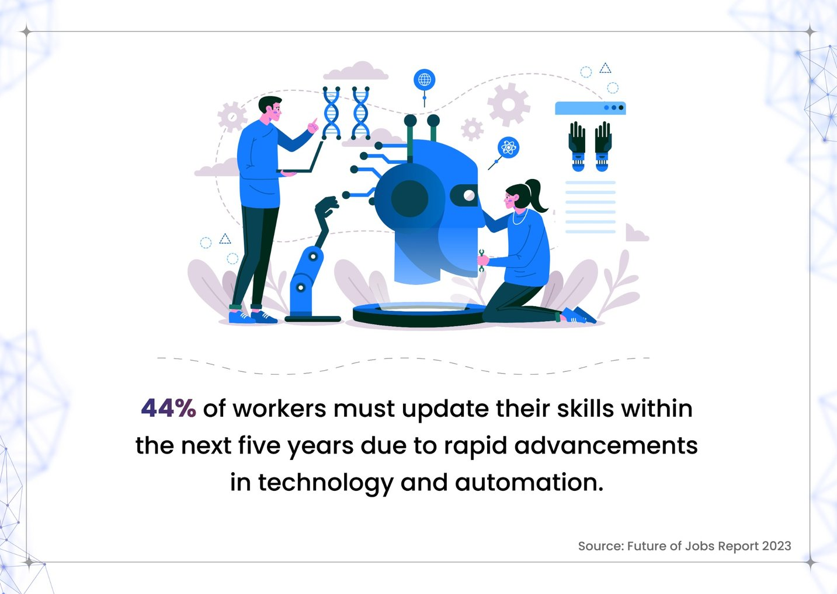
Overview of Training & Development
Training: Short-term process focused on improving job-specific skills and performance
Development: Long-term employee growth, leadership capability, and career advancement
Human Capital Theory views employees as strategic organisational assets
SHRM Perspective aligns training with organisational objectives and competitiveness
AMO Framework emphasises employee Ability, Motivation, and Opportunity
Approximately 44% of employee skills are expected to change due to technological transformation by 2030 (weforum.org;2023)
Continuous digital learning is increasingly important in multinational organisations
Notes:
In the context of a Multinational Company like Unilever PLC, Training and Development forms part of Human Resource Management. Training: It is a short-term learning activity that enhances the technical knowledge, job specific competencies and job performance of employees. Whereas development is about long-term, career promoting, leadership development and professional growth (Yertas, 2024).
There are some academic theories that explain the significance of T&D for organisational success. Human Capital Theory posits that the competitive advantage of organisations can be achieved through investing in knowledge and skills of employees, and viewing employees as a valuable strategic asset (Khemraj, 2023). Likewise, the Strategic Human Resource Management (SHRM) perspective emphasizes that the training of employees should be related to the organisation's strategy and business goals and should enhance the performance and competitiveness of the organisation. Additionally, the AMO Framework holds that employees' performance is influenced by their ability to perform, motivation, and opportunity to perform (Bos‐Nehles, et al., 2023).
The digital business world is a forever-learning place – with ever-changing demands on the skills of the workforce. According to the World Economic Forum, 44% of the skills required by workers will shift by 2030 because of AI and automation (weforum.org;2023).

Slide 6
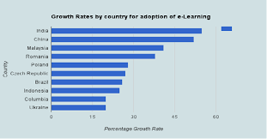
Digital Learning & Online Platforms
Uses the Degreed learning platform for personalised employee development
Provides online courses, self-paced learning, and mobile learning access
Supports flexible and continuous learning for global workforce
Digital learning improves scalability and accessibility across 190+ countries
AI-supported platforms help identify employee skill gaps and learning needs
Benefits: flexibility, cost efficiency, and global knowledge sharing
Limitations: digital fatigue, reduced interaction, and employee engagement challenges
Notes:
Unilever PLC invests heavily in the digital learning infrastructure to enhance employee development and adaptability. The company's key efforts include the implementation of the Degreed learning platform, which allows employees to have personal online learning experiences, learning at their own pace and mobile learning accessibility. This allows employees worldwide across Unilever's brands to have access to training programs, irrespective of their geographical location or working hours.
Multinational organisations can reap a number of strategic advantages from digital learning systems. One of the first advantages is that they foster flexibility for employees to learn at their own speed and in line with their own development needs. Secondly, these platforms are extremely scalable and allow Unilever to offer consistent training programmes effectively in over 190 countries (unilever.com;2026). AI-driven learning platforms can also leverage employee performance data to pinpoint areas of need, which can inform more focused training efforts. Organisations are more and more leveraging AI-driven learning systems to enhance workforce agility and digital capability building (Rastogi and Pandita, 2025)
Digital learning comes with its challenges, though. With the increased time on screens for employees, especially in hybrid working environments, digital fatigue can become a problem. In addition, in certain training courses, the face-to-face environment plays a significant role in engagement, collaboration and experiential learning and so can negatively impact learning outcomes.

Slide 7
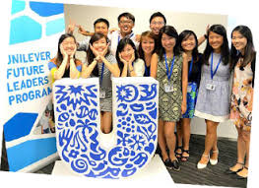
Leadership Development Programmes
Unilever Future Leaders Programme (UFLP) develops future managerial talent
Graduate schemes provide cross-functional and international experience
Leadership mentoring supports knowledge sharing and career development
Focus on innovation, adaptability, and strategic leadership capability
Experiential learning aligns with Kolb’s Learning Theory
Leadership development strengthens succession planning and employee retention
Continuous leadership training supports organisational growth in dynamic global markets
Notes:
Unilever PLC has leadership development as an integral part of its strength and sustainability strategy to ensure that the organisation continues to have a competitive edge (unilever.com;2026). One of its flagship programs is the Unilever Future Leaders Programme (UFLP), a structured training program for graduates, cross-curricular work experience and international exposure to help develop future business leaders. The programme allows students to gain strategic, analytical and leadership abilities, and gain practical experience in different business roles.
Furthermore, Unilever employs mentoring and coaching initiatives as tools to build up employee development and knowledge sharing in the company (Habeeb and Babatunde, 2023). Leadership mentoring is designed to improve employees' decision-making skills, communication and problem-solving skills and increase employee engagement and retention. Graduate development schemes also help with succession planning, as they can help to groom employees for managerial positions.
These practices are similar in many ways to the Kolb's (1984) theory of Experiential Learning that suggests that learning is experienced in four phases: Concrete experiences, Reflections, Conceptualisation and Active experimentation (Wijnen-Meijer et al., 2022). The experience gained in the workplace along with ongoing feedback and development helps increase the effectiveness of learning and the preparedness of employees as leaders. Leaders in today's rapidly changing business landscape must be flexible and innovative to adapt to digital transformation and manage staff changes, making this type of leadership program crucial.

Slide 8
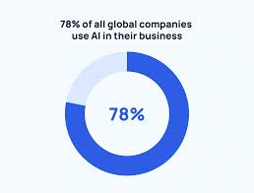
AI & Digital Skills Training
Focus on AI literacy and digital capability building
Employees receive training in data analytics and automation adaptation
Supports workforce readiness for AI-driven business transformation
AI-powered learning platforms identify skill gaps and personalise learning
Approximately 78% of organisations globally now use AI in operations
Around 44% of employee skills are expected to change due to automation and digital transformation (World Economic Forum, 2023)
Continuous reskilling is essential for maintaining organisational competitiveness
Notes:
Unilever PLC continues to put efforts into developing its employees' AI and digital skills to equip them for the quick technological switch (unilever.com;2026). The organisation has a particular emphasis on building AI literacy, digital capability, data analytics skills, and skills for automation adaptation, to bolster workforce readiness. Staff are encouraged to develop their digital skills to contribute to innovation, improved working practice and decision making in increasingly digital workplaces.
AI-driven learning systems are also changing the typical ways in which employees develop their capabilities. Additionally, AI-driven learning systems are revolutionizing employee growth procedures (Khan and Sheraz, 2025). These platforms can assess employee performance, determine skill gaps and offer tailored learning suggestions according to the individual's development needs. These systems have the potential to enhance the efficiency of learning and assist organisations in adapting to evolving skill needs of the workforce. To stay competitive in markets dominated by artificial intelligence, organisations around the world are focusing on enhancing their digital skills and capabilities.
In addition, workforce transformation is the current trend, and it is happening at quick pace globally. The World Economic Forum finds that on average, 44% of workers' skills are projected to transform as a result of automation and digitalization by 2030 (weforum.org;2026). Moreover, approximately 78% of all companies globally now utilize AI in their business operations (Davenport, and Mittal, 2023). Hence, reskilling and lifelong learning have become a key organisational priority. But, with the rapid adoption of AI, it is possible that some group of employees might face learning pressure, anxiety and resistance to technological change

Slide 9
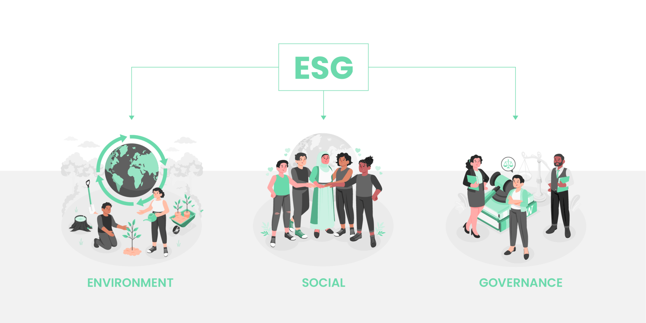
Sustainability & Employee Wellbeing
Provides ESG and sustainability-focused employee training programmes
Promotes ethical business education and climate awareness initiatives
Supports employee wellbeing through hybrid learning and flexible development opportunities
Encourages employee empowerment, inclusion, and continuous learning culture
Sustainability training aligns workforce behaviour with corporate ESG objectives
Hybrid learning improves accessibility and work-life balance across global operations
Employee wellbeing initiatives strengthen engagement, productivity, and organisational commitment
Notes:
The approach of Unilever PLC to training and development incorporate sustainability and employee wellbeing themes to contribute to its long-term organisational performance and responsible business practice. The organisation offers ESG training courses, covering ethical business practices, environmental awareness, sustainability, and climate education. The purpose of these initiatives is to provide staff with greater clarity regarding how their conduct aligns with the Company's Sustainability goals.
Moreover, the company has introduced hybrid learning techniques as well as flexible development programs for the employees. Learning on the professional front for the employees is made possible through personal learning, digital learning and flexible work environment. The wellbeing and sustainability programmes of employees are not just about the health and safety of the workforce; they are also critical for increasing employee engagement, commitment to the organisation and enhancing productivity. Unilever's 2025 Annual Report states that it keeps prioritizing employee wellbeing and sustainability as part of its organizational transformation strategy. These activities also help to improve the employer brand and attract and retain talent in competitive global labour markets

Slide 10

Opportunities in Training & Development
AI-personalised learning supports adaptive training and customised employee development pathways
Global workforce upskilling focuses on digital reskilling and future skills development
HR analytics improves training effectiveness, ROI measurement, and performance tracking
VR and gamified learning enhance immersive learning experiences and employee engagement
Workforce innovation strengthens organisational agility, productivity, and continuous learning culture
Approximately 60% of employees globally will require reskilling before 2030 (weforum.org;2026)
Notes:
Unilever PLC has a number of potential avenues for enhancing its training and development approach with workforce innovation and digital transformation. AI-personalised learning is one opportunity that offers substantial potential. With the help of adaptive learning technologies, one can develop personalised learning courses, tailored to employees' skills, experience, and professional aspirations. This type of systems increases the effectiveness of imparting knowledge and enhance more focused training for the workforce.
Another chance for upskilling workforce around the world. The need for future skills like AI literacy, digital collaboration, analytical thinking, and problem-solving is growing, especially due to the rapid technological advances and automation. The World Economic Forum estimates that around 60% of all workers around the world will need to be reskilled by 2030 as a result of technological change (weforum.org;2026). Hence, it is essential that Unilever continues to reskill its employees using digital channels to reinforce the adaptability and innovation of its workforce.
In addition, HR analytics allows organizations to measure training effectiveness, employee engagement, and ROI more accurately using workforce data integration. Unilever can also see the advantages of Virtual Reality and gamified learning systems that offer a more immersive learning experience and the opportunity for more interaction that boosts employee involvement and motivation. All these opportunities provide a sustainable competitive advantage in terms of organizational agility, the ability of the workforce and long-term business performance.

Slide 11
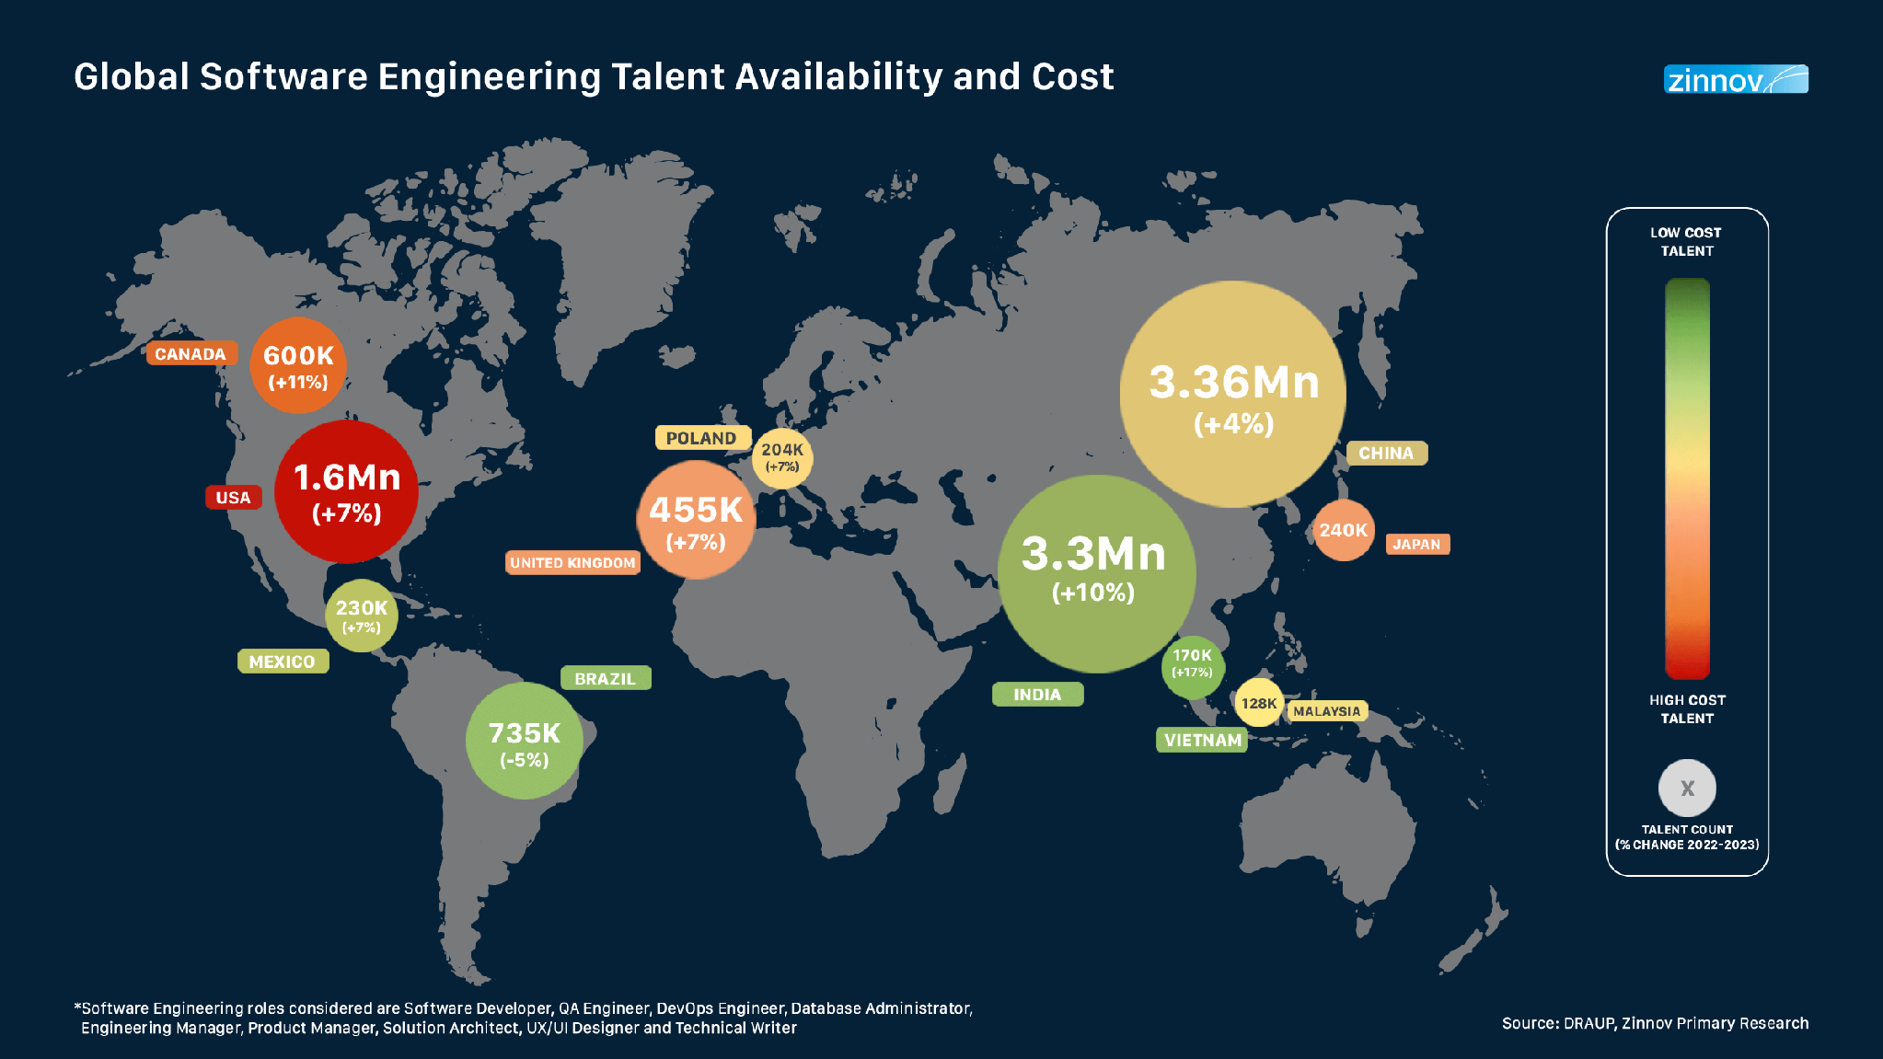
Challenges in Training & Development at Unilever PLC
Digital skill gaps and employee resistance to AI-driven learning remain significant challenges
Maintaining consistent training across 190+ countries is operationally complex
Rising investment costs for technology and workforce development create financial pressure
Measuring training ROI and long-term effectiveness remains difficult
Approximately 60% of employees globally will require reskilling before 2030 (weforum.org;2026)
Rapid technological change increases organisational complexity and impacts productivity, adaptability, and long-term competitiveness
Notes:
Despite all the investments that are being made in the workforce development, Unilever PLC is still having its share of problems with training and development in its working. Unilever PLC had faced some problems with training and development in their working despite the fact that they have invested a lot in the area. The first problem is that there are digital skill gaps in the workforce, especially with AI, automation, and digital technologies driving the changes in business operations. Digital readiness may vary by region, age, etc., resulting in inconsistencies in capabilities of the workforce.
Another challenge is employee resistance to the AI-based learning system and technological change. Certain staff members might be concerned about losing their employment, being subjected to greater surveillance, or struggling to keep up with the faster-paced digital platforms. This can affect the uptake of training opportunities and hinder organisational change.
It is also difficult to ensure training consistency around the world in over 190 countries. International operations, such as overseas delivery of learning programmes, may be impacted by cultural differences, language barriers and differences in technological infrastructure. Moreover, there is a significant need for financial resources for training and digital infrastructure, which puts strain on organizational budgets and resource distribution.
ROI on training programs is hard to quantify as often the tangible gains of improved leadership ability, innovation and employee engagement are intangible and have longer-term impact. The World Economic Forum estimates that around 60% of workers around the world will need to be reskilled by 2030, as a result of the technological transformation that is unfolding in our society (weforum.org;2026). Therefore, companies need to be flexible and constantly adjust their strategies on workforce development in order to be competitive in an ever-changing business world

Slide 12

Root Cause Analysis of T&D Challenges at Unilever PLC
Digital skill gaps caused by rapid technological advancement and unequal digital readiness
Organisational resistance linked to fear of automation and job insecurity
Continuous AI and technology changes increase learning complexity
Leadership challenges affect communication, workforce engagement, and change management
Global workforce diversity creates inconsistency in training implementation
Fishbone Diagram and 5 Whys Analysis help identify underlying organisational and operational causes
Notes:
The problems that Unilever PLC have in their training and development are affected by a number of underlying factors in the organisation and technology. The speed of technological change is another issue that can lead to digital skill gaps, as employees may not always keep pace with the quick changes. Variations in digital literacy, occupational expertise and access to technology add to the inconsistencies when it comes to global operations.
Organisational resistance is also a key issue. Fear of automation, the loss of jobs and/or the lack of human interaction in the workplace can cause employees to be hesitant to adopt AI learning systems. This can have a negative impact on employee engagement, and participation in learning programs.
Training problems are also caused by leadership problems. Poor communication, poor change management and low management support can create a decrease in motivation to attend continuous learning programmes. Additionally, there is a challenge of operating multi-country workforce development as a single entity, due to differences in culture, language and expectations of learning.
It can be helpful to use analytical tools like the Fishbone Diagram and 5 Whys Analysis to get to the root of workforce development issues and to inform more effective strategic decision making

Slide 13
Evidence-Based Recommendations for Unilever PLC
Implement AI-powered personalised learning using HR analytics to identify skill gaps and deliver customised training (Human Capital Theory).
Evaluate training effectiveness using the Kirkpatrick Four-Level Evaluation Model to measure learning outcomes and return on investment (ROI).
Strengthen digital leadership through coaching, mentoring and cross-functional projects based on the AMO Framework.
Standardise global training using centralised digital learning platforms and shared learning standards.
Expected outcomes: improved digital capability, employee engagement, leadership readiness, workforce agility and organisational competitiveness.
World Economic Forum (2023): 44% of employee skills will change by 2030 (weforum.org;2023).
Deloitte (2024): Strong learning cultures improve productivity and retention.
Notes:
It would be reasonable for Unilever to develop AI-enhanced personalised learning ecosystem with the help of workforce analytics to detect competence gaps and suggest individual learning paths. The reason why this recommendation can be made from the perspective of Human Capital Theory is that investment in the employee skills and knowledge provides sustainable competitive advantage (Becker, 1993; Khemraj, 2023). Second, the company should estimate the results of all its learning programmes using Kirkpatrick's Four-Level Evaluation Model. Through reaction, learning, behavior and organisational level assessment, HR managers will be able to measure return on investment (ROI) and optimise training process (Kirkpatrick and Kirkpatrick, 2016; Azmy and Setiarini, 2023). Last but not least, Unilever should focus on increasing its digital leadership capacity through mentoring, coaching and cross functional assignments. The theoretical basis for this recommendation can be found in Ability-Motivation-Opportunity (AMO) framework, according to which employee performance improves when people have the required abilities, motivation and opportunities to use them (Bos‐Nehles et al., 2023). Recommendations proposed above are feasible for Unilever due to the fact that the company already has digital learning environment (unilever.com;2026). Also, the industry proves that AI-enabled learning, reskilling, and evidence-based training evaluation increase workforce adaptability and organisational performance (weforum.org;2023).

Slide 14
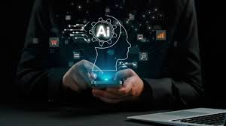
Future of Work & AI Implications at Unilever PLC
AI-driven learning systems will personalise employee development
Predictive analytics can identify future workforce skill gaps
Demand for future skills such as AI literacy, adaptability, and digital collaboration will increase
Human-AI collaboration will reshape organisational roles and decision-making
Automation may replace repetitive tasks while increasing demand for strategic and analytical skills
Lifelong learning is essential for workforce adaptability and long-term organisational competitiveness
Notes:
AI, automation and digital transformation have become some of the key factors in the future of work and it's affecting Unilever PLC and their work strategy. The AI-supported learning systems will evolve into sophisticated systems that will integrate workforce data to provide personalised learning solutions and predictions. This technology will help organizations forecast future skill shortages and make their workforce planning more strategic.
According to The World Economic Forum, continuous reskilling and learning will be essential in maintaining a competent workforce in the evolving market environment. Organizations are now focusing on developing their workforce to be prepared for the future (weforum.org;2026).
In addition, the skills that will be sought in the future will be digital literacy, analytical thinking, adaptability, creativity, and working with AI technologies collaboratively. Demand for strategic, problem solving and leadership skills may rise, but repetitive operational tasks may be taken over by automation. According to the World Economic Forum, reskilling and learning continually throughout life will be among the critical elements in ensuring that individuals stay employable in the evolving market environment (weforum.org;2026). Consequently, organizations continue to invest their resources in developing their employees

Slide 15

Conclusion
Training and Development (T&D) are essential for maintaining organisational competitiveness and workforce capability at Unilever PLC
Digital transformation and AI create both opportunities and challenges for workforce development
AI-personalised learning, continuous reskilling, and digital leadership development can strengthen organisational performance
Strategic investment in employee learning supports innovation, adaptability, and long-term business sustainability
Notes:
The contribution and involvement of Employee Development and Learning in Unilever PLC, through Employee Training Programs and various initiatives, is another critical factor impacted by performance, innovation and competitiveness. The presentation outlined how the impact of digital transformation, connections with Artificial Intelligence (AI)/machine learning and a wide range of changes in the globalized business climate will influence the Learning and Development (L&D) needs of staff in the future. Although Unilever provides extensive advanced digital learning platforms and training resources aimed primarily towards its leaders, Unilever is still experiencing problems with trying to meet the needs of its staff for digital skill development and acceptance of AI.
Initiatives such as using (AI) based personal learning systems, creating a culture of continuous learning, developing leadership through digital channels and globally standardizing training methods will have positive effects on increasing employee adaptation and increasing operating efficiency levels of Unilever PLC. To summarize, continual training of employees is essential to ensure business sustainability within the evolving technical environment of the global business sector.

Slide 16
Reference List
Azmy, A. and Setiarini, N.Y. (2023) 'Kirkpatrick Model as Evaluation Training Program for Assessor: Case Study of Government Employee', International Journal of Management, Accounting & Economics, 10(9).
Becker, G.S. (1993) Human Capital: A Theoretical and Empirical Analysis, with Special Reference to Education. 3rd edn. Chicago: University of Chicago Press.
Bos‐Nehles, A., Townsend, K., Cafferkey, K. and Trullen, J. (2023) 'Examining the Ability, Motivation and Opportunity (AMO) framework in HRM research: Conceptualization, measurement and interactions', International Journal of Management Reviews, 25(4), pp. 725–739.
Davenport, T.H. and Mittal, N., 2023. How companies can prepare for the coming “AI-first” world. Strategy & leadership, 51(1), pp.26-30.
Habeeb, H. and Babatunde, A.T., 2023. Impact of Training and Development on the Performance of Employees in the Workplace, the Case of Unilever Plc [online]
Khan, D. and Sheraz, F., 2025. The Future of Learning and Development: Redefining Employee Growth in the Age of AI and Automation. The Critical Review of Social Sciences Studies, 3(4), pp.754-770.
Khemraj, S. (2023) 'Enhancing Competitive Advantage through Learning Capabilities and Innovative Human Resource Management', Intersecta Minds Journal, 2(1), pp. 26–41.
Kirkpatrick, J.D. and Kirkpatrick, W.K. (2016) Kirkpatrick's Four Levels of Training Evaluation. Alexandria, VA: ATD Press.
Rastogi, S. and Pandita, D., 2025. Rethinking learning agility in the age of AI: a self-determination framework for the digital workforce. Development and Learning in Organizations: An International Journal, pp.1-4.
unilever.com;2026. A new era of corporate sustainability: building resilience through action [Online] Available At: https://www.unilever.com/sustainability/ [Accessed On; 16/05/2026]
unilever.com;2026. Desire at Scale [Online] Available At: https://www.unilever.com/files/unilever-annual-report-and-accounts-2025.pdf [Accessed On: 27/06/2026]
unilever.com;2026. We are Unilever [Online] Available At: https://www.unilever.com/our-company/ [Accessed On; 16/05/2026]
weforum.org;2023. The Future of Jobs Report 2023 [Online] Available At: https://www.weforum.org/publications/the-future-of-jobs-report-2023/ [Accessed On; 16/05/2026]
weforum.org;2026. Reskilling Revolution: Preparing 1 billion people for tomorrow’s economy [Online] Available At: https://www.weforum.org/impact/reskilling-revolution-preparing-1-billion-people-for-tomorrows-economy/ [Accessed On; 16/05/2026]
Wijnen-Meijer, M., Brandhuber, T., Schneider, A. and Berberat, P.O., 2022. Implementing Kolb s experiential learning cycle by linking real experience, case-based discussion and simulation. Journal of medical education and curricular development, 9, p.23821205221091511.
Yertas, M., 2024. The role of training and continuous development in improving employee productivity and its impact on company financial performance. Atestasi: Jurnal Ilmiah Akuntansi, 7(2), pp.1362-1379.

