Slide 1
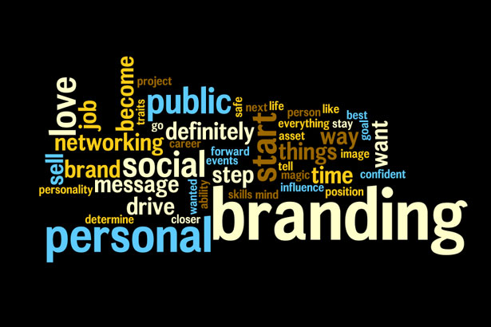



  Personal Brand Management & Effective Communication
  January 2015
Notes:
Introductions and Welcome.

Slide 2

We are the CEO’s of our own companies. ME inc. To be in business today, our most important job is to be head marketer for the brand called YOU.
Tom Peters
We are all BRANDS. We have our own intellectual balance sheets and brand name, we need to invest in ourselves and market ourselves.
Notes:
Tom Peters – The Brand called You – anyone know about it/read it?
Overview discussion

Slide 3
AIMS AND OBJECTIVES
Aim
An understanding of the importance of Personal Brand Management and Effective Communication and how they will influence your future career development.
Objectives
Understand what is meant by personal brand.
Awareness of the elements of building a successful brand for yourself.
Appreciate how to communicate effectively in support of your brand
Identify where you are now and how you can bridge the gap to where you want to be.

Slide 4




WHY IS BRAND IMPORTANT?
Notes:
4
Why is brand important to these companies? What does it provide them with? Open discussion question. Write some ideas down in the box provided in your workbook.
DIFFERENTIATOR
UNIQUE SELLING POINT
Workbook ref: Why is brand important? Page 1

Slide 5
WHAT IS A BRAND?
Logo
Name
Association
…….or is it more than this?
Notes:
5
Reflect on your thoughts about the brands you have seen and others which you admire or otherwise. Use your workbook to record your thoughts.
Brands are born of experience and reflect reputation.
Workbook ref: Brands that I admire and why. Page 1

Slide 6
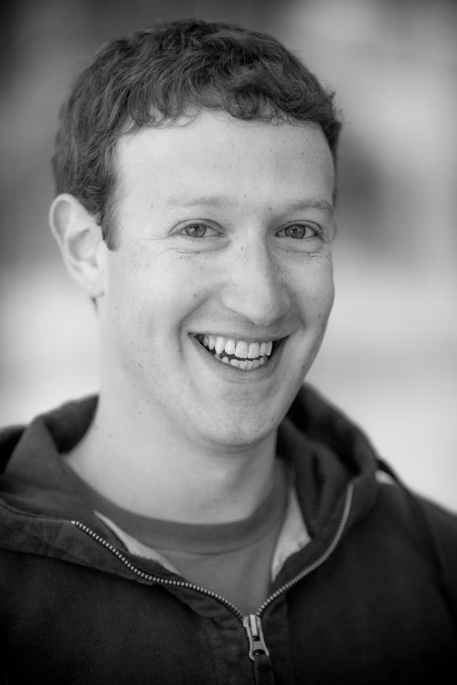
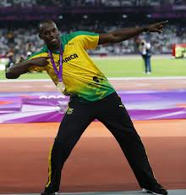
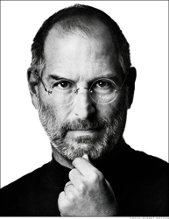

AN INDIVIDUAL AS A BRAND
Notes:
6
Individuals can be brands too. What is you perception of the people you see here? Are there any individuals that you think have a strong brand and what does it mean to you. Record in your workbook. What do people say when they see a picture of you?
Open discussion.

Slide 7
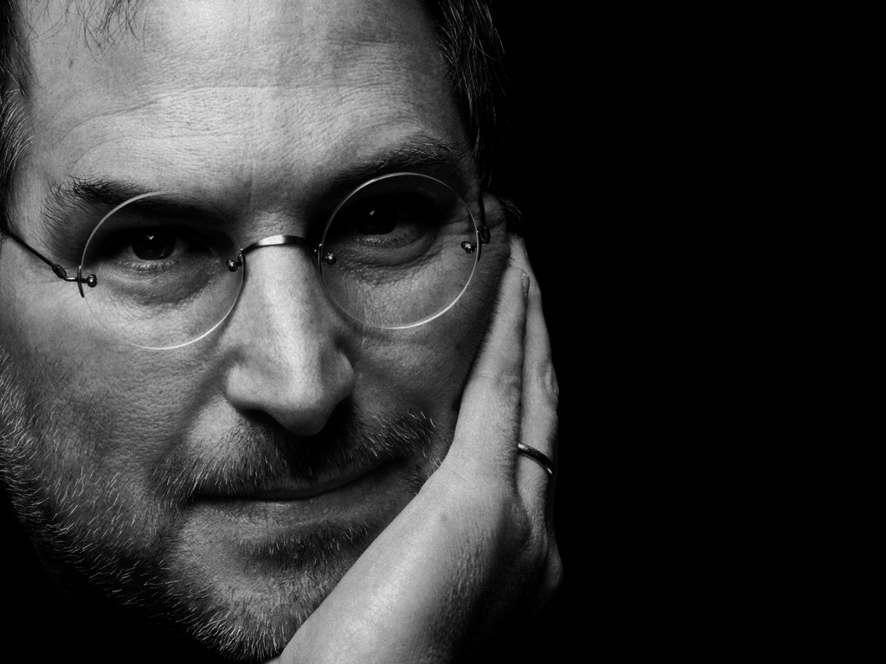

AN INDIVIDUAL AS A BRAND
Personal Brand allows individuals to differentiate themselves by consistently articulating and leveraging their unique value proposition.
Think
Different
Notes:
7
Your brand should not be treated as an after thought but as a key differentiator. A consensus about who you are. Your reputation, public image, character. The collective opinion about you. Your unique value proposition.
Workbook ref: Individual brands that I admire and why. Page 2

Slide 8

AN INDIVIDUAL AS A BRAND
How do you want to be perceived by others?
  What is your UVP?
  What does your brand reflect?
  What is the collective opinion about you?
  What can you be doing to enhance your brand?
Notes:
8
Refer to learning materials. Jot down some answers to the questions you see here. How do you want to be perceived by others?
If you are not branding yourself you can be sure that others are doing it for you. What is your USP? What does you brand reflect? What do you want it to reflect? What are you/could you be doing to enhance your brand?
Workbook ref: how do you want to be perceived by others. Page 2

Slide 9
BUILDING YOUR PERSONAL BRAND
Things to consider when building your brand:
Questions to ask yourself
Some rules to follow
5 Steps
Purpose, proposition, packaging, people, perseverance
Notes:
9
The next part of the session is the How

Slide 10

BUILDING YOUR PERSONAL BRAND
Some questions to ask yourself:
What are your goals?
What do you value?
What are you passionate about?
What motivates you?
What makes you stand out?
Notes:
10
Think about these questions and jot down some ideas, you will need them in the activity later in the workshop.
Consider personal achievements and bigger picture and how this effects your brand.
Workbook ref: Some questions to ask yourself. Page 3

Slide 11
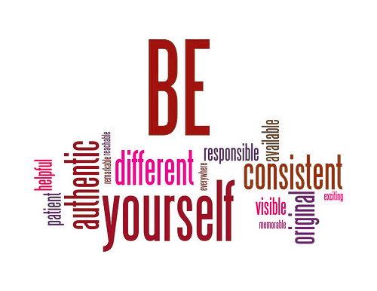
BUILDING YOUR PERSONAL BRAND
Some rules to follow:
Notes:
11
Why do you need to be each of these things. Open discussion. Pick one and tell us why it is important.
Consider personal achievements and bigger picture and how this effects your brand.

Slide 12

BUILDING YOUR PERSONAL BRAND
5 Steps to Brand Success
Purpose
Proposition
Packaging
People
Perseverance
Notes:
12
The 5 steps to building a successful brand are…. We are going to look at each one of these in more detail.
Use page 4 to make notes.

Slide 13

BUILDING YOUR PERSONAL BRAND
Step1: Purpose
Notes:
13
When someone hears your name what do they think?
Go to person? Really good at? A pain in the bum? Negative? Personal branding lets you control how other people perceive you.

Slide 14

BUILDING YOUR PERSONAL BRAND
Step 2: Proposition
Notes:
14
What is your core competency/unique value proposition? Are you the creative one in a group? Are you the one that gets things done, keeps things on track? Have you got an eye for detail or are you more of a big picture person.
Decide what it is that you can do better then others and make it your UVP.
Provide an example.

Slide 15

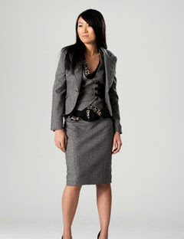

BUILDING YOUR PERSONAL BRAND
Step 3: Packaging - Visual
Notes:
15
Do you dress for the job you want? Create an impression. Dress appropriately for the job you do.

Slide 16

Last weekend I was driving along a country road on my way to visit a friend. As I approached a sharp bend a car careered round the corner on the wrong side of the road. The driver just about managed to corrected his position narrowly missing me and as he approached shouted at me out of his window…..”PIG!!!”
“ROAD HOG!!!!” I shouted back angrily and looked in my mirror as he disappeared at speed. What a damn cheek I thought as I entered the bend, probably going a little too fast……
……It was then that I hit the pig standing in the middle of the road!

Slide 17
BUILDING YOUR PERSONAL BRAND
Step 3: Packaging - Communication
It’s not just what you say…………….
Source: Albert Mehrabian
Notes:
17
Ask the room what they think the value of each of the elements of VC are? Talk about the importance of the way things are said and how telling body language can be.
Use/ask for examples.

Slide 18
BUILDING YOUR PERSONAL BRAND
Step 3: Packaging - Communication
Context
Sender
Channel
Receiver
Msg
Encoding
Msg
Msg
Decoding
Msg
Feedback
Shannon & Weaver 1949
Notes:
What goes wrong?

Slide 19
BUILDING YOUR PERSONAL BRAND
Step 3: Packaging - Communication
Barriers to Effective Communication
So, why does the message so often get distorted?
The use of jargon.
Emotional barriers and taboos.
Lack of attention, interest, distractions, or irrelevance to the receiver.
Differences in perception and viewpoint.
Physical disabilities such as hearing problems or speech difficulties.
Physical barriers to non-verbal communication.
Language differences and the difficulty in understanding unfamiliar accents.
Expectations and prejudices which may lead to false assumptions or stereotyping. .
Cultural differences.
Notes:
The use of jargon. Over-complicated, unfamiliar and/or technical terms.
Emotional barriers and taboos. Some people may find it difficult to express their emotions and some topics may be completely 'off-limits' or taboo.
Lack of attention, interest, distractions, or irrelevance to the receiver. (See our page Barriers to Effective Listening for more information).
Differences in perception and viewpoint.
Physical disabilities such as hearing problems or speech difficulties.
Physical barriers to non-verbal communication. Not being able to see the non-verbal cues, gestures, posture and general body language can make communication less effective.
Language differences and the difficulty in understanding unfamiliar accents.
Expectations and prejudices which may lead to false assumptions or stereotyping. People often hear what they expect to hear rather than what is actually said and jump to incorrect conclusions.
Cultural differences. The norms of social interaction vary greatly in different cultures, as do the way in which emotions are expressed. For example, the concept of personal space varies between cultures and between different social settings.

Slide 20
BUILDING YOUR PERSONAL BRAND
Step 3: Packaging - Communication
It’s not just about delivering the message……..
People speak at a rate of words per minute.
People can listen at a rate of words per minute.
of misunderstandings can be traced to poor listening and only
to written communication.
Studies have shown that immediately after listening to a 10-minute oral presentation, the average listener has heard, understood, properly evaluated, and retained approximately of what was said.
Within 48 hours, that percentage drops off to a final level of retention.
    How well do you listen? Respond to the questions in your workbook.
    What can you improve on to make you a better listener?
125 - 150
500 - 600
60%
1%
50%
25%

Slide 21

BUILDING YOUR PERSONAL BRAND
Step 3: Packaging - Communication
Pay Attention
Show that you’re listening
Provide feedback
Defer judgement
Respond appropriately
Become a Better Listener

Slide 22

BUILDING YOUR PERSONAL BRAND
Step 3: Packaging – On-line Networking
Notes:
22
Your on-line presence is a way of promoting your brand.
Group discussion: Ask for examples in the media of where people have enhanced or tarnished their brand through social media.
What do your networks look like: Are you visible enough or too visible?
Workbook ref: What do your networks look like? Page 5

Slide 23

BUILDING YOUR PERSONAL BRAND
Step 3: Packaging – Face-to-face Networking
Elevator Speech:
What’s yours?
Notes:
23
Events and meetings, even just bumping into someone in the corridor these are all opportunities for you to enhance your brand.
Ask for a volunteer to deliver an elevator speech.
Write down some ideas for inclusion in your speech.
Workbook ref: Elevator speech. Page 5

Slide 24

BUILDING YOUR PERSONAL BRAND
People
Step 4:People
Nothing the slightest bit amazing has ever been done in isolation:
What you know + Who you know
Notes:
Team-working, sharing ideas, supporting colleagues.
Think about the people who have been influential in helping you to succeed. Write their names in the box provided in your booklet.
Workbook ref: People who helped you succeed. Page 5

Slide 25
BUILDING YOUR PERSONAL BRAND
Tutor
Step 4: People
?
?
Community
Self
Peers
?
Friends
Family
Other Academics
?
Notes:
25
Activity 1 – split into 2 groups
This is an example of a role map.
Hand out - A3 of map to each group.
Create a group map with agreed headings
Put yourself in the centre
Continue the process to include all the people who expect something of you
10 minutes to fill in the map
Workbook ref: Page 6 & 7

Slide 26

BUILDING YOUR PERSONAL BRAND
Step 5: Perseverance
Notes:
26
Focus, focus focus. Hurdles along the way etc.

Slide 27
BUILDING YOUR PERSONAL BRAND
5 Steps to Brand Success
Purpose
Proposition
Packaging
People
Perseverance
Notes:
27
The 5 steps to building a successful brand are…. We are going to look at each one of these in more detail.
Use page 4 to make notes.

Slide 28

BUILDING YOUR PERSONAL BRAND
Build Your Brand Activity
Think about your current brand and how you would like to develop it to meet your future career aspirations.
Think about:
Your aspiration
Competencies and Skills
Values
Personality traits
Your role models
Notes:
28

Slide 29
RECAP AIMS AND OBJECTIVES
Aim
An understanding of the importance of Personal Brand Management and Effective Communication and how they will influence your future career development within Tata Steel Europe.
Objectives
Understand what is meant by personal brand.
Know the elements of building a successful brand for yourself.
Understand how to communicate effectively in support of your brand
Identify where you are now and how you can bridge the gap to where you want to be.
Notes:
Aims and Objectives
Interactive workshop: Plenty of opportunity to get involved with discussion
Questions: As we go
Duration: 2 hours 30 minutes
Hand out learning materials and explain how they will be used.

Slide 30

REMEMBER……..
You are a brand . You are in charge of your brand. There is no single path to success and there is no right way to create the brand called You. Except this – start today!
Tom Peters
What one thing will you do this week as a result of what you have learned from today’s activities?
Notes:
30
155 minute

Slide 31

Thank you for your participation in the workshop. Please complete the feedback sheet.
Notes:
31
Your feedback is important as it gives us the opportunity to continually improve the quality of the programme.

