Slide 1
Understanding 360-Degree Feedback
Lecturer Name: Dr Ehsan Khajeh
Student Name: Elena Mihaela Radu (2126383)
Module Code: BMSW5102

Slide 2

What is 360-Degree Feedback?
According to Daniels (2018), ”360-degree feedback is a performance evaluation method that gathers input from various sources to provide a comprehensive view of an employee's performance.”
360-degree feedback is a valuable tool for both employees and employers.

Slide 3
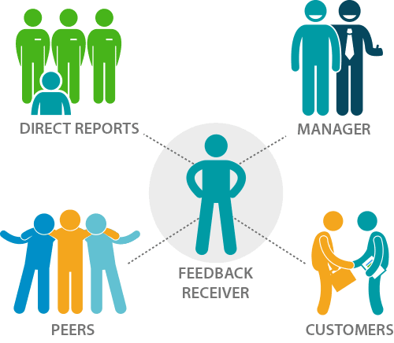
How It Works
Key Elements:
Self-assessment
Supervisor feedback
Peer feedback
Subordinate feedback
Customer feedback
Offers a complete view of an employee's performance(Daniels, 2018).

Slide 4
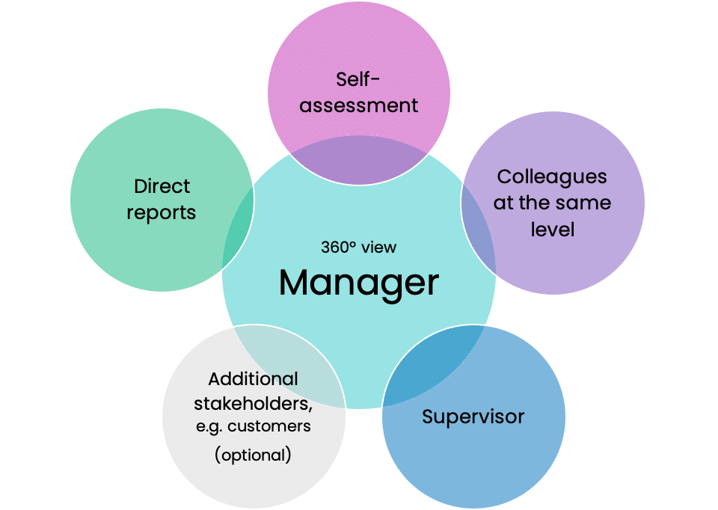
Importance to Employees
Employee Development: Opportunities for self-improvement.
Career Growth: Aids in identifying areas for growth and advancement.
Fair Evaluation: Reduces biases and offers fairness in assessment(Fletcher, 2017).

Slide 5
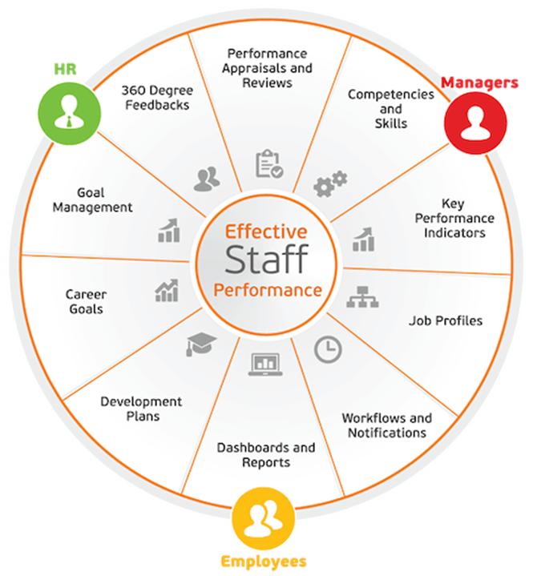
Importance to Employers
Improved Performance: Enhanced employee performance leads to better organisational results.
Talent Management: Identifying high-potential employees for future leadership roles(Davison, 2019).
Effective Feedback: Encourages open communication and problem-solving(Vance & Deegan, 2020).

Slide 6
Employee Benefits
Personal Growth: Provides insight for self-improvement.
Recognition: Acknowledges strengths and achievements.
Skill Enhancement: Identifies areas for skill development(Cummings, 2016).

Slide 7
Employer Benefits
Leadership Development: Identifies potential leaders.
Enhanced Teamwork: Encourages collaboration and team performance.
Data-Driven Decisions: Supports HR strategies with data(Harris & Collins, 2021).

Slide 8
Key Issues in Implementation
Challenges in Implementation
Trust: Ensuring confidentiality and trust in the feedback process(Smith, 2019).
Training: Providing training for all stakeholders involved.
Resistance: Addressing employee concerns and resistance(Jones, 2018).

Slide 9
Key Issues in Implementation
Challenges in Implementation
Communication: Clear and transparent communication about the process.
Follow-up: Establishing a system for feedback follow-up and action plans.
Calibration: Ensuring consistency in feedback interpretation(Brown & White, 2022).

Slide 10
Conclusion
360-degree feedback offers a balanced perspective and benefits both employees and employers.
Employees' active involvement is key to success.

Slide 11

Q&A
Any questions or concerns about 360-degree feedback?

Slide 12
Reference List
Brown, T., & White, S. (2022). Ensuring Calibration in 360-Degree Feedback. Journal of Applied Psychology, 76(1), 89-102.
Cummings, M. (2016). Personal Growth and 360-Degree Feedback. Journal of Career Development, 34(3), 224-236.
Daniels, A. (2018). 360-Degree Feedback in Modern Organizations. HR Today, 45(3), 36-39.
Davison, S. (2019). Talent Management and 360-Degree Feedback. Organizational Dynamics, 42(4), 245-259.
Fletcher, L. (2017). Employee Development through 360-Degree Feedback. Journal of Human Resources, 29(2), 123-136.
Harris, R., & Collins, B. (2021). Data-Driven HR Decisions with 360-Degree Feedback. Human Resource Management Journal, 52(6), 789-802.
Jones, E. (2018). Overcoming Resistance to 360-Degree Feedback. International Journal of HR Management, 36(4), 456-469.
Smith, K. (2019). Building Trust in the 360-Degree Feedback Process. Harvard Business Review, 74(5), 65-73.
Vance, P., & Deegan, J. (2020). Fostering Open Communication in 360-Degree Feedback. HR Quarterly, 64(1), 12-18.

