Slide 1
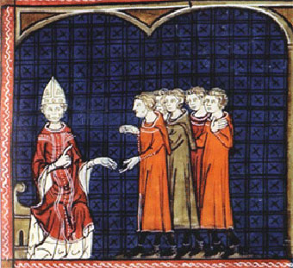
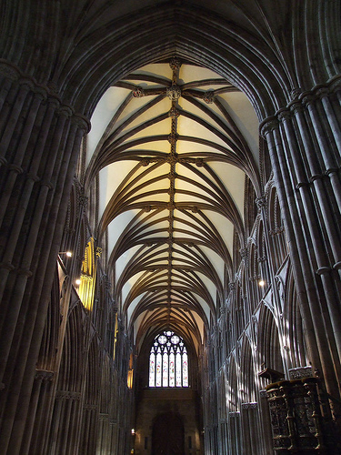
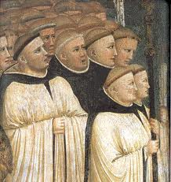
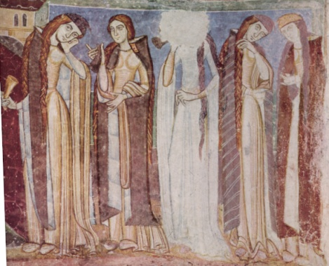
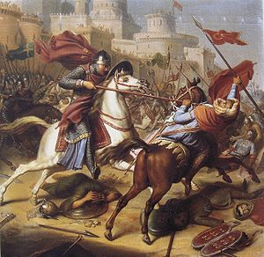

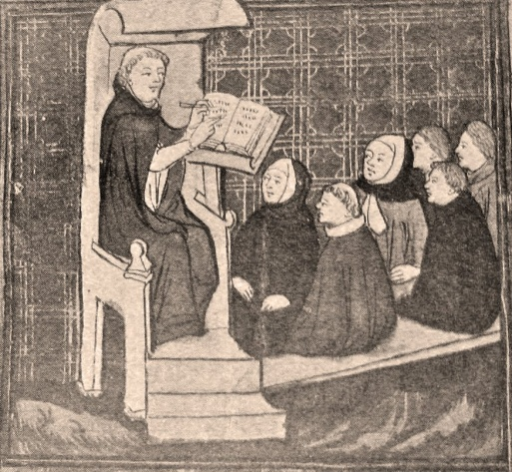
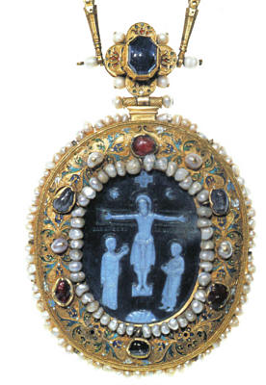
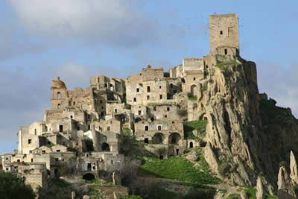
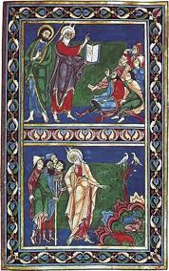
The Twelfth Century
1073 x 1095? – 1215?
Heresy
Architectural innovation
Textiles, trade & manufacturing
New monasticism
Crusading zeal
Church reform
New learning
Material wealth &
culture
Urban expansion
A Renaissance?

Slide 2
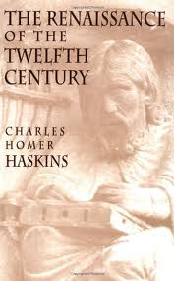
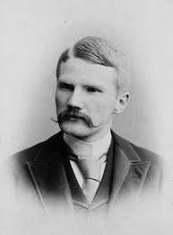
Charles Homer Haskins, 1870- 1937
‘America’s first medieval historian’
His path-breaking work
1927

Slide 3
The Concept of the Twelfth-Century Renaissance
Introduced by an eminent American historian Charles Homer Haskins (1870-1937), in his book The Renaissance of the Twelfth Century (1927)
Challenged the assumption of a more or less complete cultural decline between the fall of Rome and the Italian Renaissance
Since then historians and art historians have suggested that there were other ‘renaissances’ in medieval period (e.g. in the Carolingian and Ottonian periods)
Is therefore this idea over-used?

Slide 4
Characteristics
1. Expansion and systematisation of learning:
ultimately led to foundation of universities from late 12C. But also development of more basic education.
2. Growth of concern for the ‘Individual’:
reflected in theology, religious devotion, history writing, & autobiographies
3. Quest for definition: of both ideas and law (especially theology and canon law), but also in secular government.
4. Growth of a literate mentality: probably the major impact upon society as a whole. Very important in the development of law and government; also led to the emergence of vernacular literature.
5. Took place within the context of an expanding society: growing population, developing economy, & increasing contact with Byzantium & the Muslim world.

Slide 5
Fields in which the 12th Century Renaissance was important
Theology
Canon Law
Revival of Latin Classics
History Writing
Education
Vernacular literature
‘Gothic’ Architecture

Slide 6
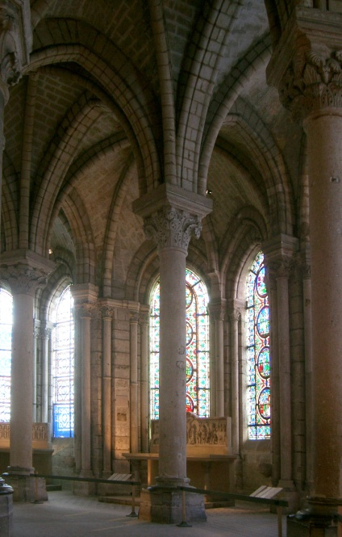
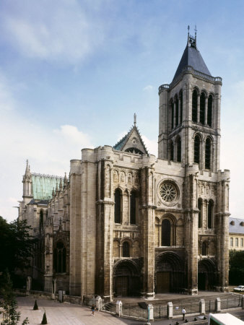
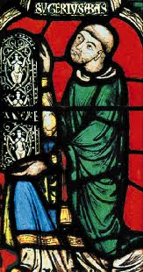
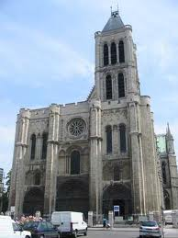
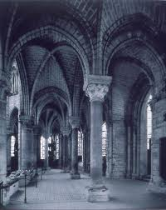
Abbot Suger and St Denis

Slide 7
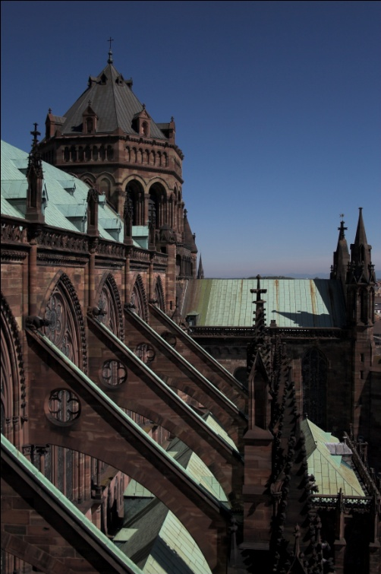
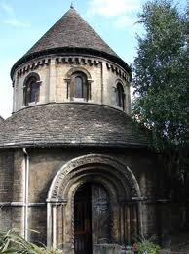
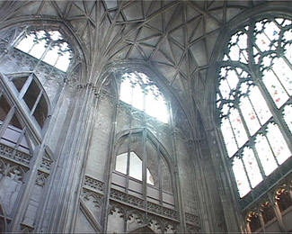
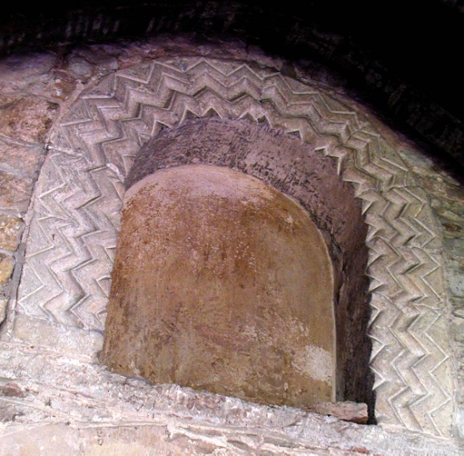
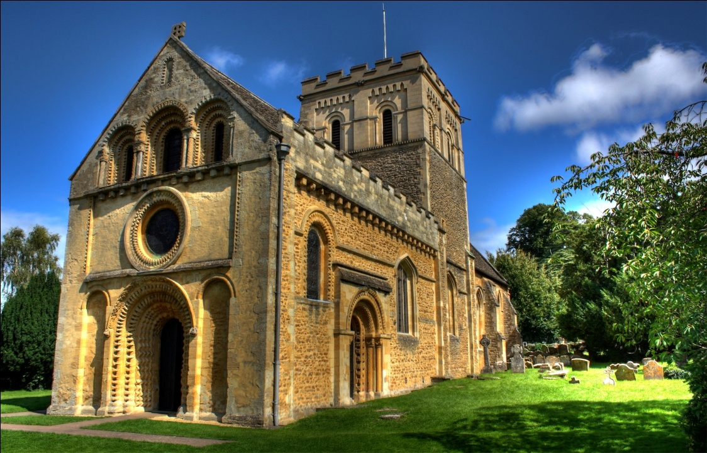
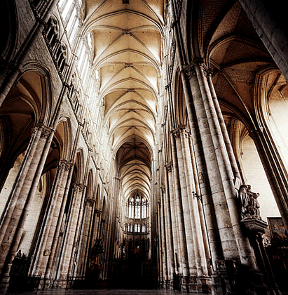
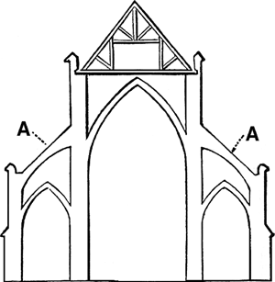

Slide 8
Gothic Architecture
Developed in northern France, spread to other regions later
St. Denis (1140-4), the first significant ‘Gothic’ Church
Sens (1140s →), Laon (1165-1205), Paris, Notre Dame (1163→), Canterbury (designed by a Frenchman, William of Sens, 1175→), Chartres (1194 →), Bourges (c.1195→)
Followed by (early 13th Century)
Rheims (1210s →), Amiens (1218→), Cologne (1248→)

Slide 9
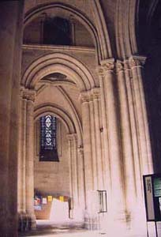
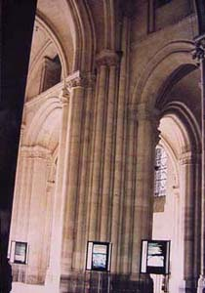
Architectural innovations in St Denis
the use of multiple shafts and mouldings: the technology of the rib vault and that of the pointed arch come together.
The huge piers have been subdivided into a multitude of shafts
‘a circular string of chapels, by virtue of which the whole church would shine with the wonderful and uninterrupted light of most luminous windows’

Slide 10
The Twelfth Century
1073 x 1095? – 1215?
Heresy
Architectural innovation
Textiles, trade & manufacturing
New monasticism
Crusading zeal
Church reform
New learning
Material wealth &
culture
Urban expansion
A Renaissance?

Slide 11
Theology and Canon Law
Theology: n.b. disputes about the Eucharist (1050’s – 1070’s), and about the Trinity, involving Peter Abelard (Council of Soissons 1118 and Council of Sens 1140). Application of Logic to theology, e.g. Abelard’s Sic et Non
Canon Law: n. b. especially the Decretum of Gratian of Bologna (c. 1140). Also used techniques of Formal Logic. Linked with Growth of Papal Authority.

Slide 12
Revival of Latin Classics: used in a much less imitative manner than hitherto, e.g. John of Salisbury, the History of ‘Hugo Falcandus’. Some translations from Greek and Arabic, via Spain and Sicily.
History Writing: more concerned with individuals and their motivation as an explanation for events: e.g. The Murder of Charles the Good by Galbert of Bruges (1127-8), The History of the Papal Court by John of Salisbury (c. 1165); cf. contemporary concerns in spirituality. Recognisable pen-pictures of individuals.

Slide 13
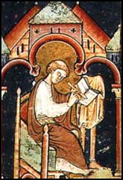
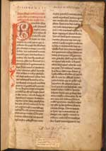
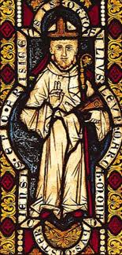
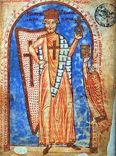
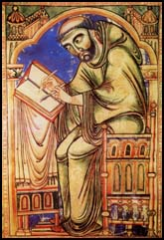
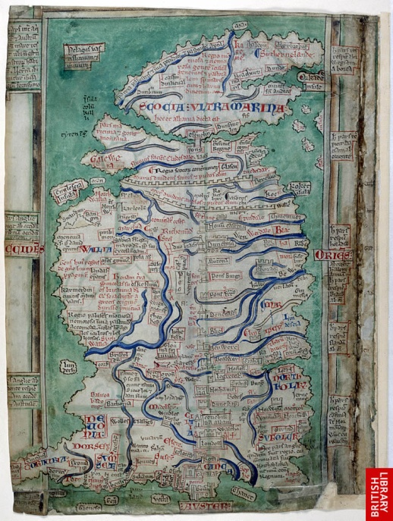
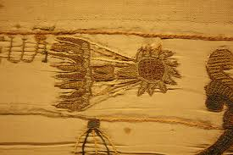
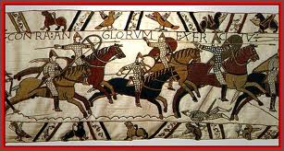
William of Malmesbury: Gesta Pontificum
Otto of Freising: Gesta Friderici Imperatoris
The Norman Conquest of England
Matthew Paris: map of Great Britain
Apocalyptic preoccupations

Slide 14
5. Education: development of cathedral schools, especially in N. France, and then universities (Paris & Bologna, 1160s), (Oxford & Montpellier 1190s), (Cambridge c. 1210). By 1300 19 universities in Christendom.
6. Vernacular Literature: e.g. work of Chretien of Troyes (1170s), Wolfram von Eschenbach (Parzifal, Willehalm), the Nibelungenleid; and vernacular history, e.g. ‘The Conquest of Constantinople’ by Geoffrey of Villehardouin (c. 1216).

