Slide 1
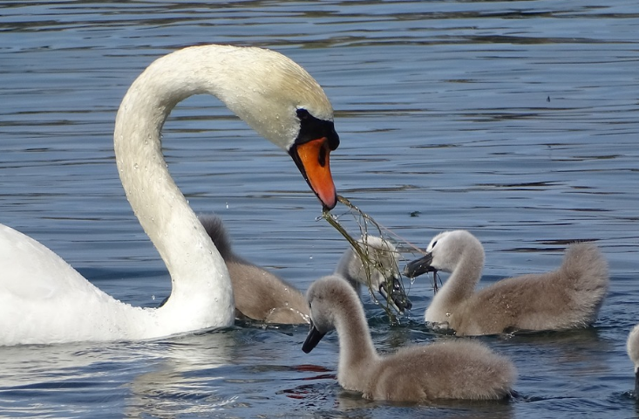
Family School
Lynda Westhead P151589

Slide 2

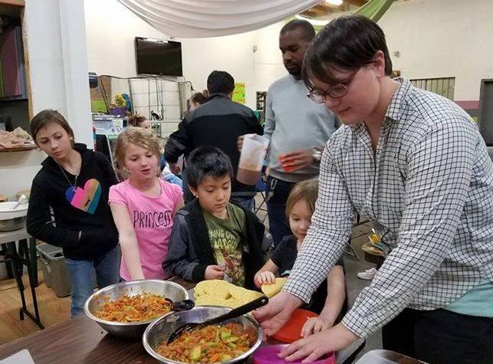
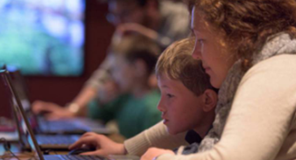
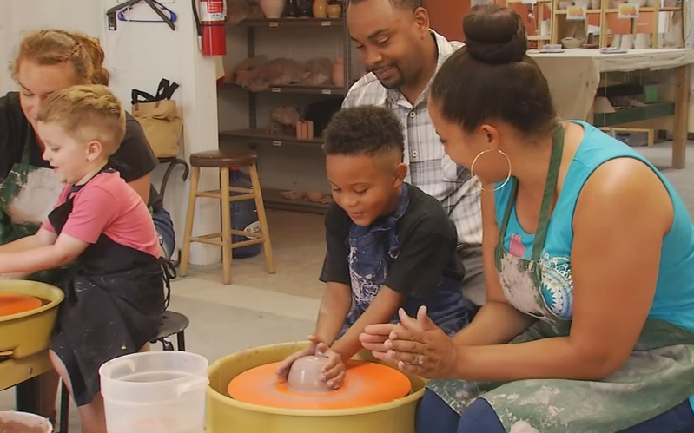
Introducing Family School:
The inspiration behind the concept

Slide 3
Who is Family School for?

Slide 4
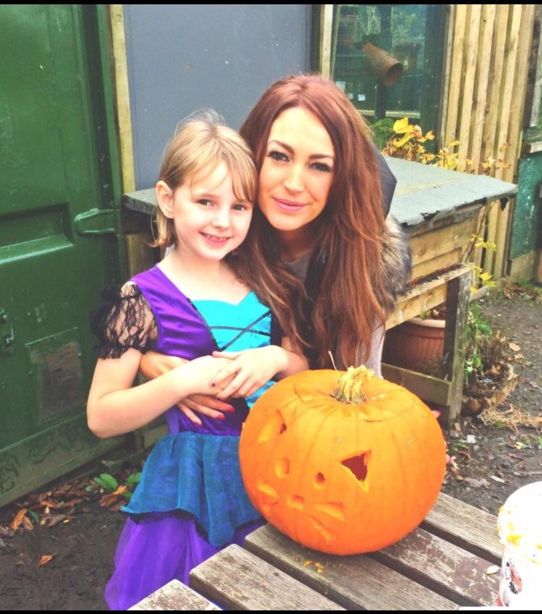
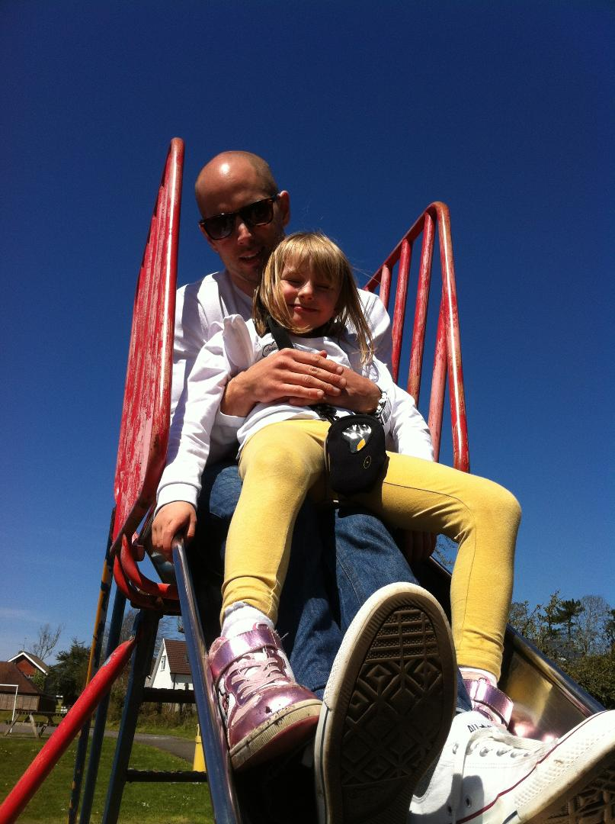
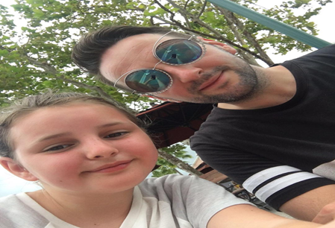
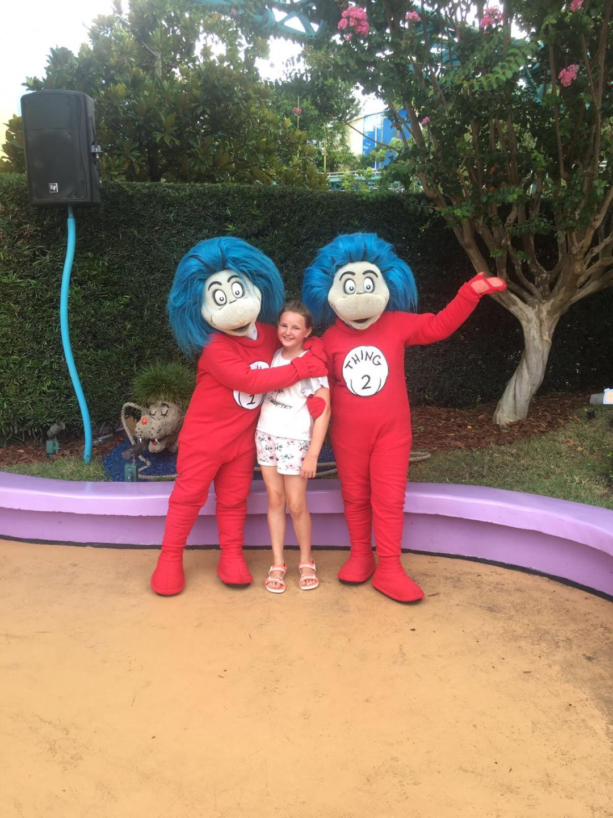
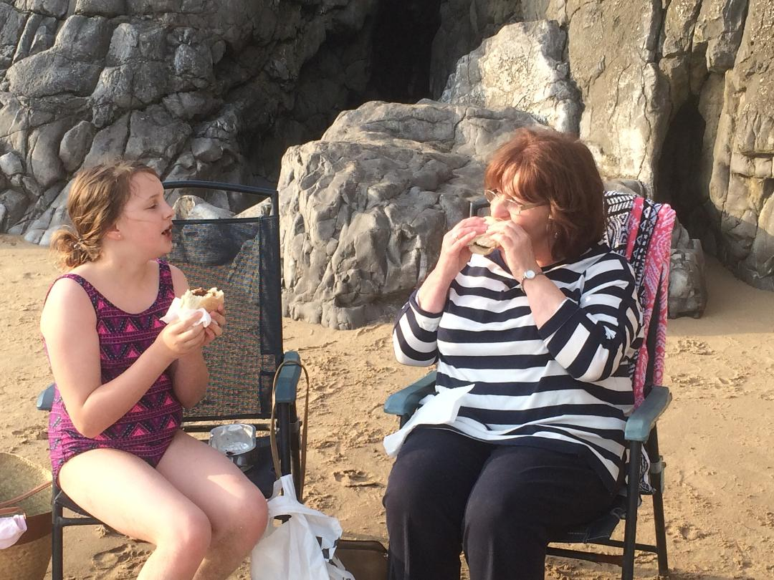

Slide 5
Why do we need Family School?

Slide 6
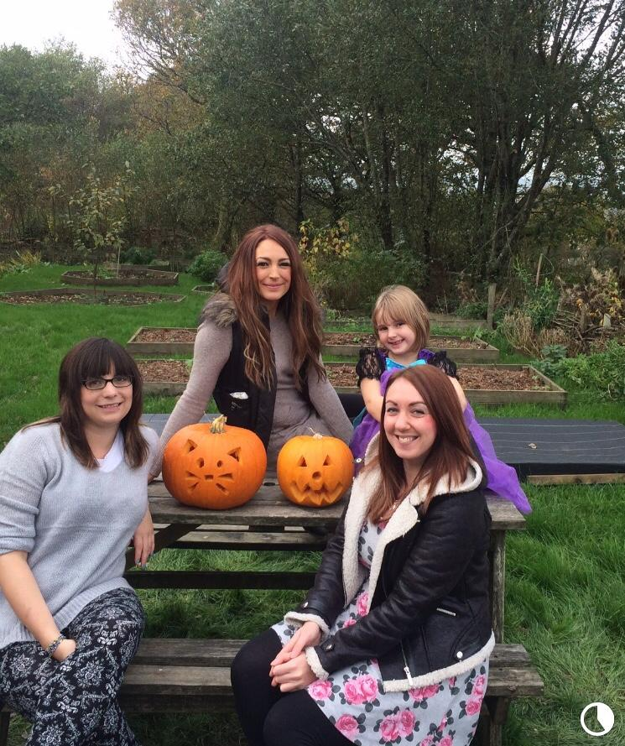

Slide 7
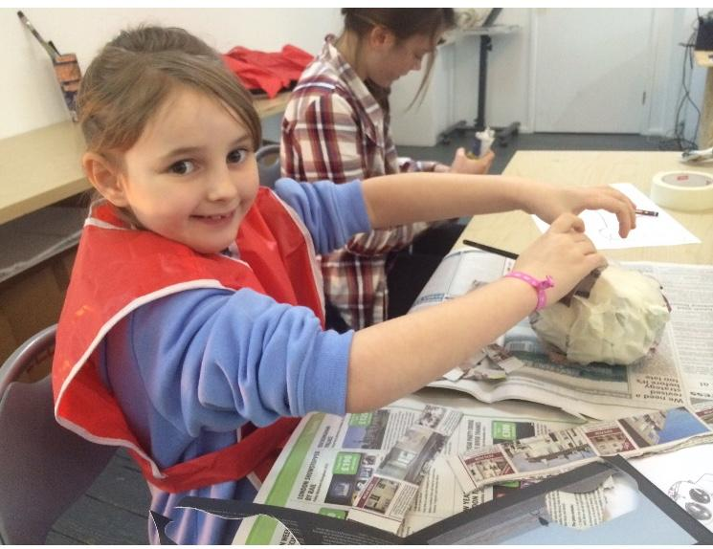
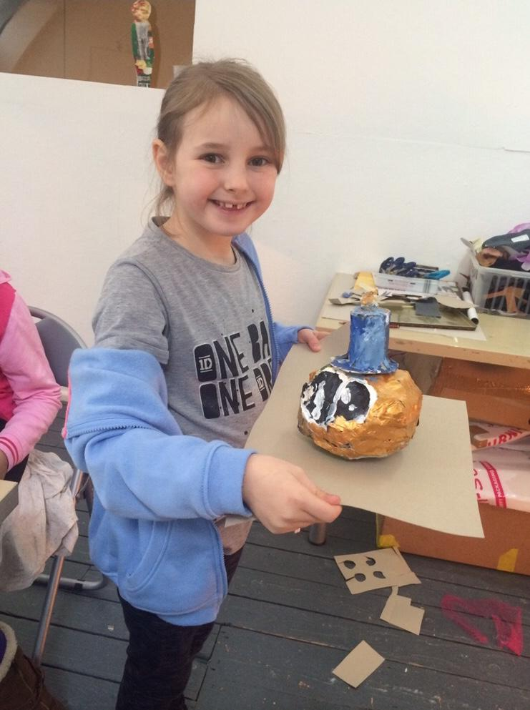
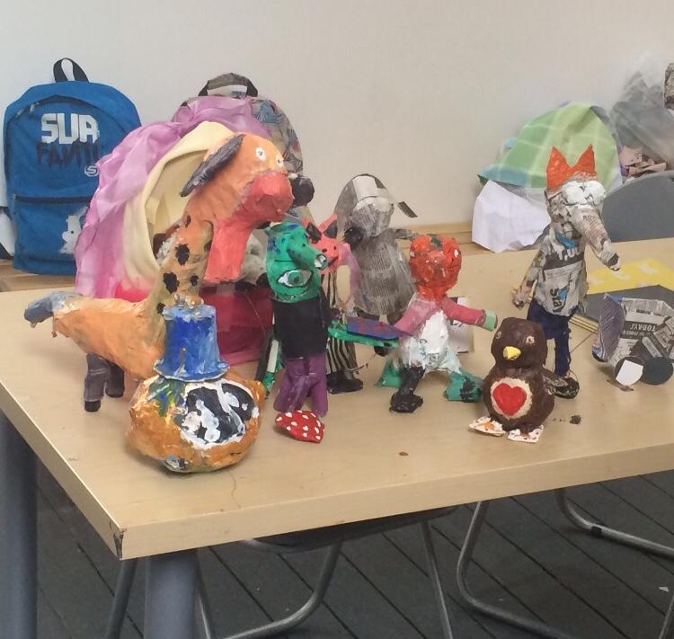

Slide 8
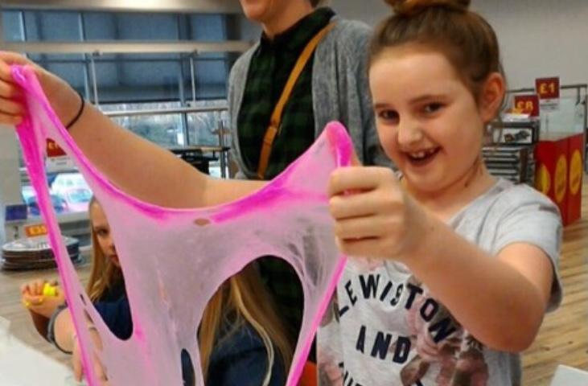
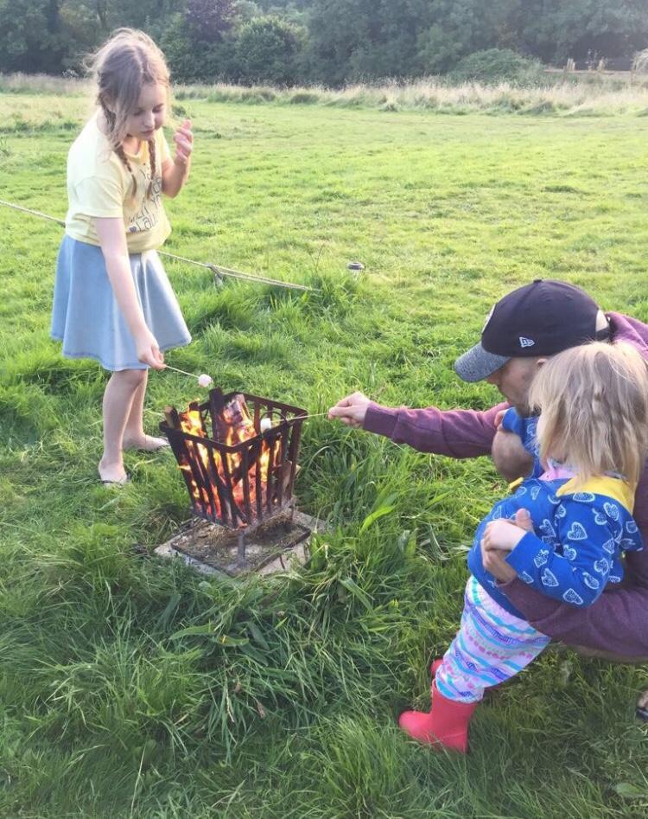
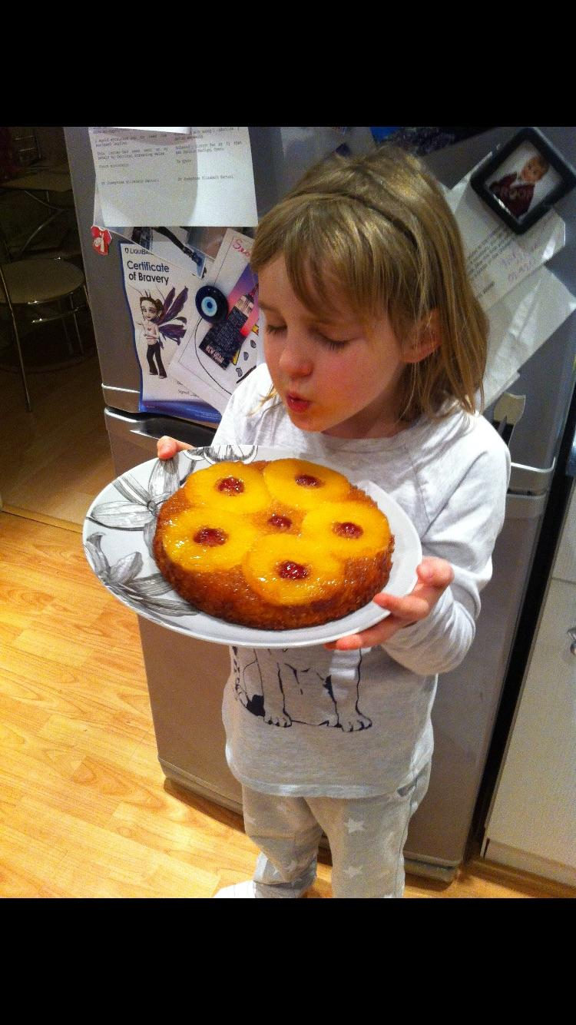

Slide 9

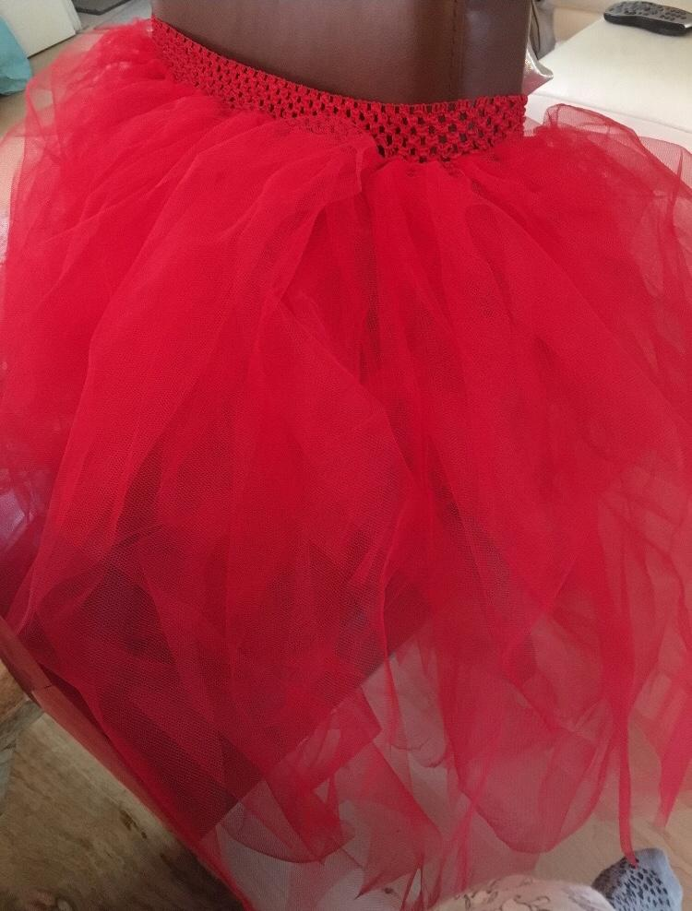
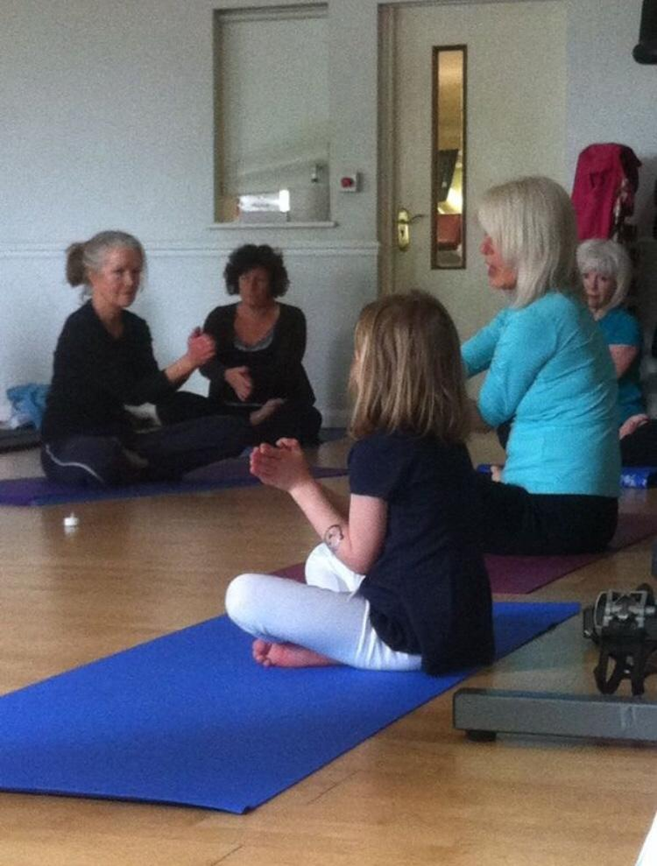

Slide 10
How will it work?

Slide 11
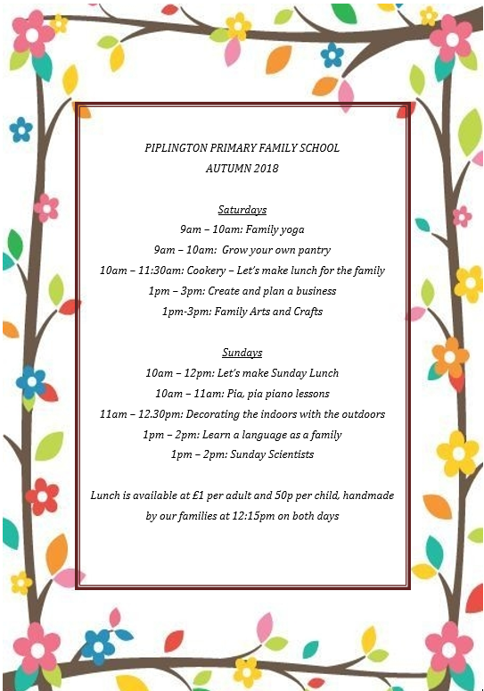
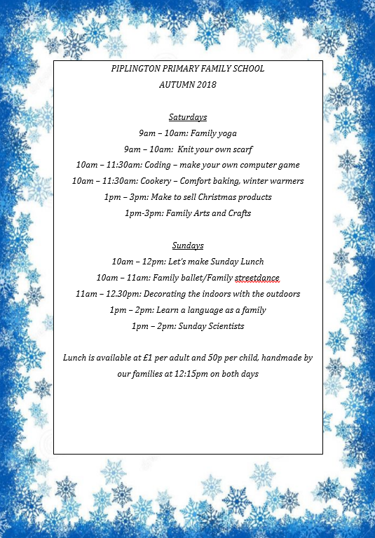

Slide 12
Family school setting

Slide 13
Influences

Slide 14
What Family School hopes to achieve

Slide 15
Engaging children and parents with education as a collaborative fun experience
Improving the relationships between the parents and children with the school environment
Taking away the regimented and compulsory concept of standard education in school
Providing valuable life skills which are not taught in the school curriculum
Classes and workshops which enhance the pillars of the curriculum, ensuring that every child and family has the opportunity to be rich in their desired interest areas, without fear of social class immobility and financial restraints (allowing culture for all).
Education for parents not just children, this could then compliment skills for future careers or life aspirations.
Building bonds and creating memories for children and their families, which may not have been a possibility.
Positively stimulating families’ general well-being, both physically and mentally.

Slide 16
References
Estyn, (2018) Involving parents . Cardiff: Welsh Assembly Government [Online]. Available at: https://www.estyn.gov.wales/sites/default/files/documents/Involving%20parents%20-%20en.pdf (Accessed: 15 October 2018).
Uddin, L. (2017) Family ties: how to get parents involved with children’s learning
https://www.theguardian.com/teacher-network/2017/feb/24/parents-involved-school-teaching-engagement (Accessed: 16 October 2018)
Department for Children, Education, Lifelong Learning and Skills, (2015) Foundation Phase Framework. Cardiff: Welsh Assembly Government. [Online]. Available at: http://learning.gov.wales/docs/learningwales/publications/150803-fp-framework-en.pdf (Accessed: 14 October 2018).
Department for Children, Education, Lifelong Learning and Skills, (2015) Successful Futures. Cardiff: Welsh Assembly Government. [Online]. Available at: https://gov.wales/docs/dcells/publications/150225-successful-futures-en.pdf (Accessed: 16 October 2018).
Curtis, W. (2011) ‘The Philosophy of Education’, in Curtis, W. and Dufour, B. (eds.) Studying Education. Maidenhead: Open University Press, pp. 59 – 84
Oksenberg Rorty, A. (ed.) (1998) Philosophers on Education. Oxon: Routledge.
Swansea Council (2018) Flying Start. I https://www.swansea.gov.uk/flyingstart (Accessed: 19 October 2018).

