Slide 1
Athrofa Cymru ar gyfer Arfer Proffesiynol ac Ymchwil Cymhwysol
Wales Academy for Professional Practice and Applied Research

Slide 2
Module BMPF7021
Authenticity and the Role of the
Leader
Day 1

Slide 3

Our Vision
Our intention for this presentation:
welcome you to the university
introduce everyone
overview of first module
Hwb support
academic writing and plagiarism
start BMPF7021 module

Slide 4

Introductions
Your name
Area you work in
Previous experience

Slide 5
Our Vision
Meet the team...
Dr Louise Emanuel– Cyfarwyddwr Academaidd/ Academic Director l.emanuel@uwtsd.ac.uk
Ann Beaumont – Swyddog Gweinyddol/ Administrative Officer a.beaumont@ydds.ac.uk
Steve Darnell - Darlithydd/Lecturer
s.darnell@uwtsd.ac.uk
Julie Crossman – Uwch Darlithydd/Senior Lecturer julie.crossman@uwtsd.ac.uk

Slide 6
Our Vision
Guidance and support...

Slide 7


Our Vision

Slide 8

Module Requirements and Support
30 Credit Module
Consists of:
  Induction including 7 half day
  sessions
  -- Regular workshops
  Module Material
  Access to our Virtual
  Learning Environment (VLE)
  Support from your Tutors and UWTSD
Notes:
Steve

Slide 9
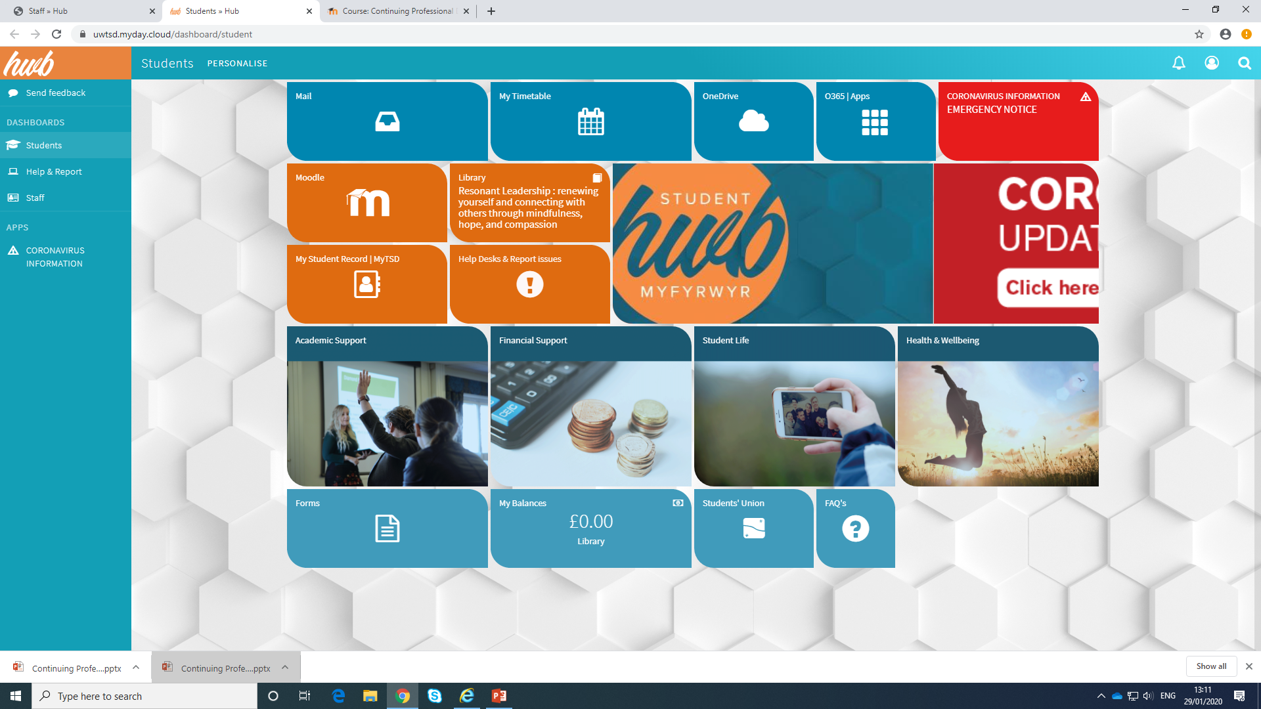
Students » Hub (myday.cloud)
Notes:
Julie

Slide 10

Notes:
Julie

Slide 11

Academic writing
Critical thinking, reading and writing booklet:
  Adapted from Stella Cottrell’s book
Notes:
Julie

Slide 12
Our Vision
Llên-ladrad a Chyfeirnodi
Plagiarism and referencing...

Slide 13
Our Vision
Plagiarism defined...
“…uses words, ideas or work products, attributable to an identifiable person or source, without attributing the work to the source from which it was obtained, in a situation in which there was a legitimate expectation of original authorship, in order to obtain benefit, credit or gain".
Fishman, 2010

Slide 14
Sbectrwm Llên-ladrad
A spectrum of plagiarism
Twyll bwriadol – bwriad i dwyllo / Deliberate cheating – intent to deceive
Gwybod y rheolau a gwenud camgymeriad. / Knows the rules and makes a mistake
Camymddygiad / Misconduct
Ddim yn gwybod y rheolau a’u torri. / Doesn’t know the rules and breaks them
Camddefnydd / Misuse
Camddealltwlriaeth / Misunderstanding
Notes:
Julie

Slide 15
Our Vision
Rhai enghreifftiau Some examples…
- Copying without showing it is a copy
- Paying someone to do it for you
- Not showing your sources (words and work) transparently enough
- Working closely with others and not acknowledging the shared work
- Copïo heb ddangos mai copi yw e.
- Talu rhywun arall i wneud drosoch.
- Dim danogs eich ffynonellau (gair neu weithred) yn ddigon clir.
- Gweithio gydag eraill a dim cydnabod rhannu’r gwaith

Slide 16
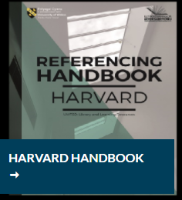

Referencing Handbook

Slide 17
Harvard Referencing Examples
I don’t like referencing,
not et al
Notes:
Julie

Slide 18


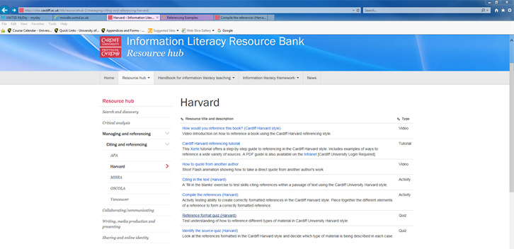
http://sites.cardiff.ac.uk/ilrb/resourcehub-2/managing/citing-and-referencing/harvard/
Activities: Compile the references (Harvard)
Notes:
Julie

Slide 19
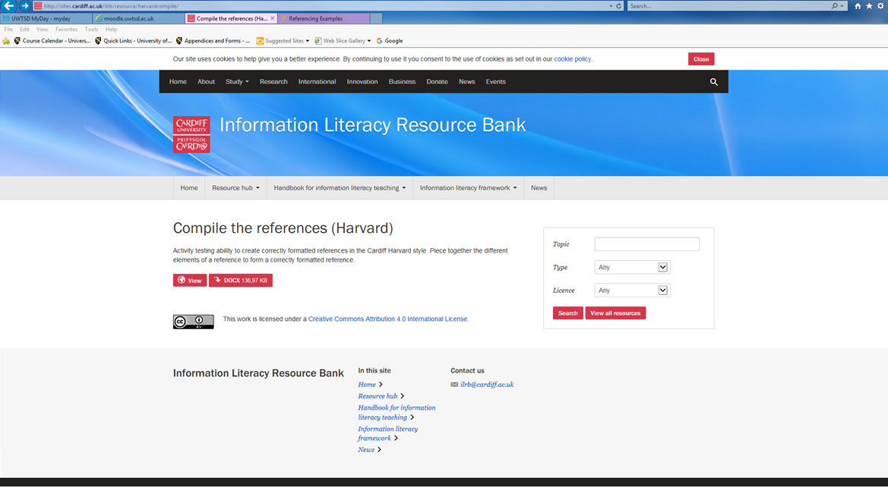
Activity – Harvard Referencing
http://sites.cardiff.ac.uk/ilrb/resource/harvardcompile/
Click “View”
Notes:
Julie

Slide 20
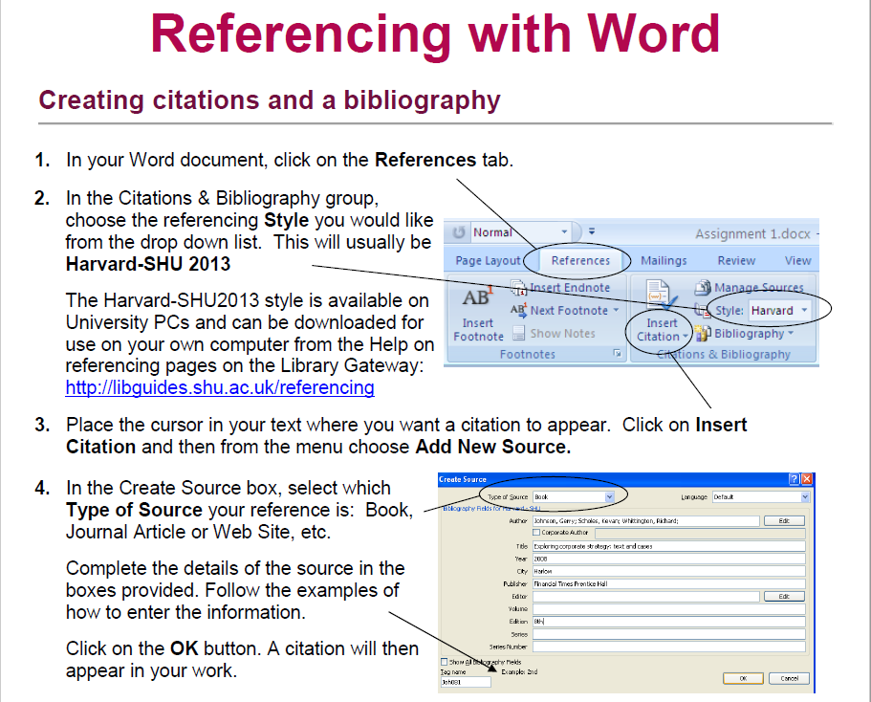

Slide 21
The Module
Notes:
File

Slide 22

Learning Outcomes
(1) Critically evaluate at least five leadership theories and their relevance to the workplace
Notes:
Steve

Slide 23
Learning Outcomes
(2) Explore and critically reflect on personal leadership styles and behaviours, and interpersonal skills, and their impact on workplace relationships
Create a personal development plan with a specific focus on leadership skills
Notes:
Steve

Slide 24


Leadership and management differentiation activity – two groups
Activity:
Characteristics; qualities; skills; attributes; approach:
1. Leaders
2. Managers
B
A
Notes:
Julie

Slide 25
Leadership Defined
Leadership is the process of influencing people to enable the achievement of relevant goals (Ivancevich et al, 2008)
Leadership is essentially a relationship through which one person influences the behaviour or actions of other people (Mullins, 2018)
Leadership is the ability to motivate, influence and enable individuals to contribute to the objectives of the organisations of which they are members (House et al, 2004)
Notes:
Julie

Slide 26
Leadership Defined
Leadership is a process whereby an individual influences a group of individuals to achieve a common goal (Northouse, 1994)
Leadership involves mobilising people to tackle tough problems (Heifetz, 1994)
Great leaders are resonant leaders. These leaders are moving people - powerfully, passionately and purposefully (Boyatzis and McKee, 2005)
Notes:
Julie

Slide 27
Leadership Defined
Leadership is not about making clever decisions and doing bigger deals, least of all for personal gain. It is about energising other people to make good decisions and do other things. In other words, it is about helping release the positive energy that exists naturally within people. Effective leadership inspires more than empowers; it connects more than controls; it demonstrates more than it decides. It does all of this by engaging, itself above all, and consequently others (Mintzberg, 2004).
Notes:
Julie

Slide 28
Leadership Defined
According to Crainer (1995), there are over 400 definitions of leadership and “it is a veritable minefield of misunderstanding and difference through which theorists and practitioners must tread warily.”
Notes:
Julie

Slide 29
Close relationship between management and leadership
“Increasingly, management and leadership are being seen as inextricably linked. It is one thing for a leader to propound a grand vision, but this is redundant unless the vision is managed so it becomes real achievement.”
Sir John Harvey-Jones
Notes:
Julie

Slide 30
Leadership / management
Subject | Leader | Manager
Persuasion | Sell | Tell
Style | Transformational | Transactional
Exchange | Excitement for work | Money for work
Likes | Striving | Action
Wants | Achievement | Results
Risk | Takes | Minimises
Rules | Breaks | Makes
Conflict | Uses | Avoids
Direction | New roads | Existing Roads
Truth | Seeks | Establishes
Concern | What is right | Being right
Credit | Gives | Takes
Notes:
Julie

Slide 31
Leadership / management
Subject | Leader | Manager
Essence | Change | Stability
Focus | Leading people | Managing work
Have | Followers | Subordinates
Horizon | Long-term | Short-term
Seeks | Vision | Objectives
Approach | Sets direction | Plans detail
Decision | Facilitates | Makes
Power | Personal charisma | Formal authority
Appeal to… | Heart | Head
Energy | Passion | Control
Dynamic | Proactive | Reactive
Blame | Takes | Gives
Notes:
Julie

Slide 32
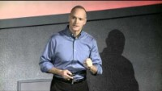
The Essence of Authentic Leadership | Sean Georges | TEDxEvansville - Bing video

