Slide 1
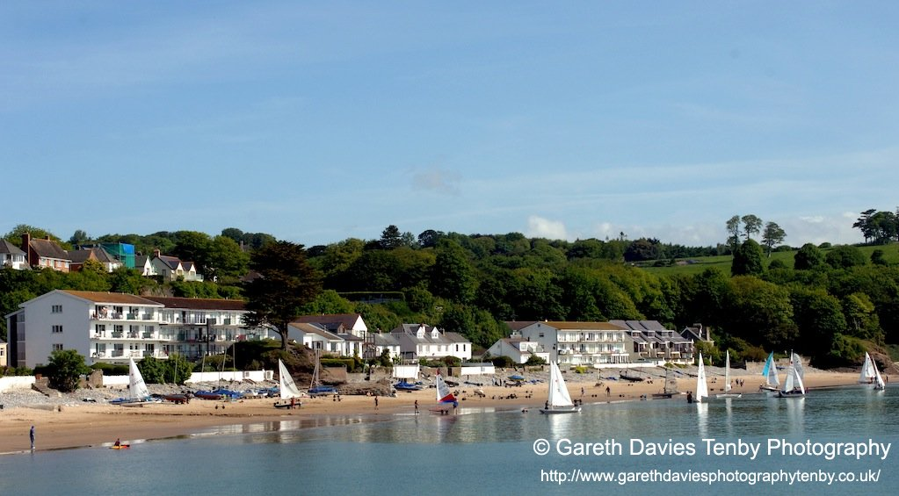
Leisure Attraction Management
Case study Lecture
Saundersfoot

Slide 2
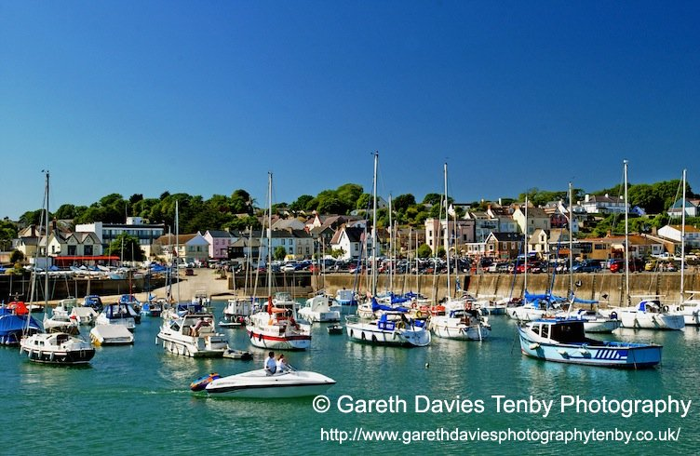
Saundersfoot

Slide 3
History
The name is thought to have derived from a combination of ‘Saunders’ – the name of a locally important family and ‘foot’ a topographical feature
13th century St Issells Church
1324 1st record of coal mining
18th century Industrial Revolution

Slide 4
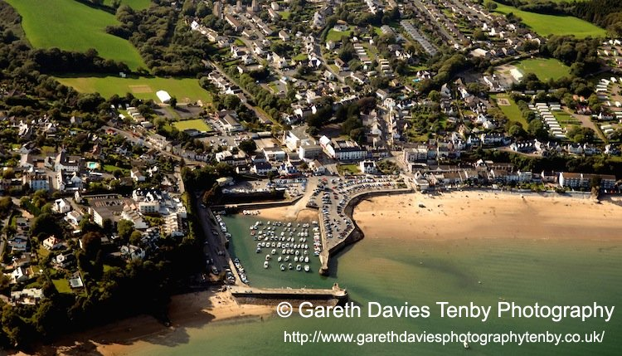
Saundersfoot

Slide 5
Village
By 1840 30 homes – Industrial links created growth
Village life – Shops and community
Schools, churches, Regency Hall and King George 5th Memorial Fields
Sailing and watersports –Harbour and beaches
Regattas and Harbour Sports
Great Western Railway
Growth of small scale tourism - Hotels
Neighbouring Tenby was a Victorian Tourist Resort and Spa

Slide 6
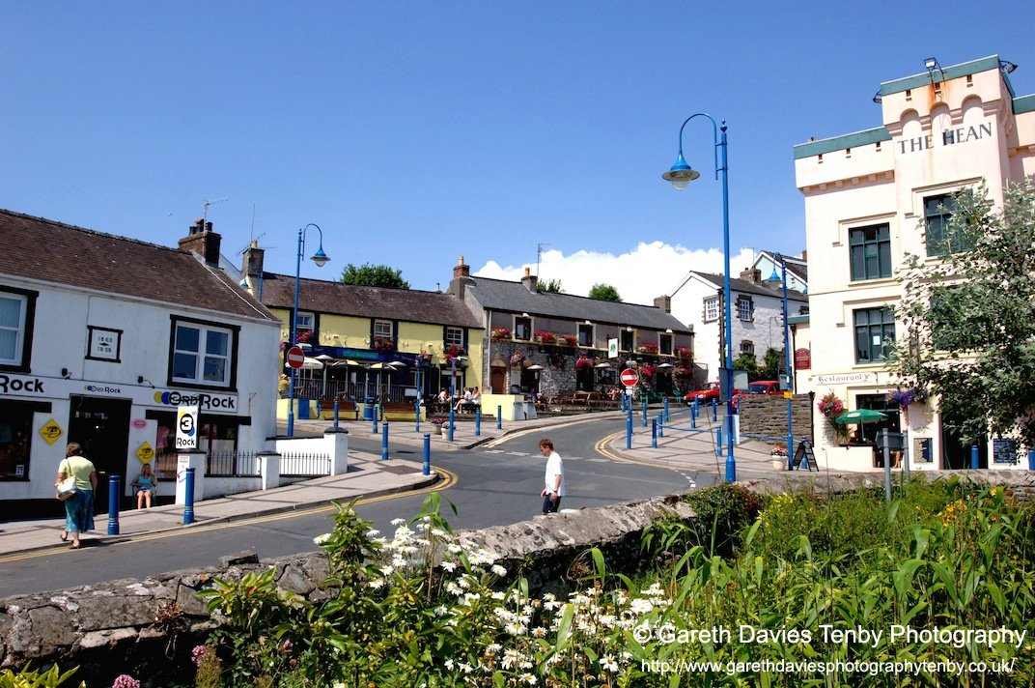
Saundersfoot

Slide 7
Industrial Heritage
Small scale ship building
1829 the Saundersfoot Railway and Harbour
Company was authorised by Parliament
Anthracite Coal – Queen Victoria and the Royal Yacht
Tram road was built to connect a number of local collieries.
Incline
By 1837 five jetties were in full use loading coal and iron ore.
Harbour
Coastal Tunnels
Rosalind link from Saundersfoot to Wiseman’s Bridge
The Stepaside Ironworks provided further employment for local men as did a fire brick works at Wisemans Bridge.

Slide 8
Hean Castle
Historical fortified site
1896 reconstructed by Charles Vickerman
Industrial links
Lewis Merthyr Family
Estate
Coppitt Hall – Coal Pit Haul
National Park and Coastal Path links

Slide 9
Impact of War
Evacuees
Tourism limited
Royal Marines – St Brides Hotel
Operation Jantzen
Practice for D day landings
Use of barbed wire fences
Security
Winston Churchill and President Eisenhower

Slide 10
Post War Tourism
Village development and growth
Servicemen returned with families
Growth of seaside tourism
Since 1950’s caravan site development
self catering properties
Pubs, cafes, restaurants and other tourism-related businesses

Slide 11
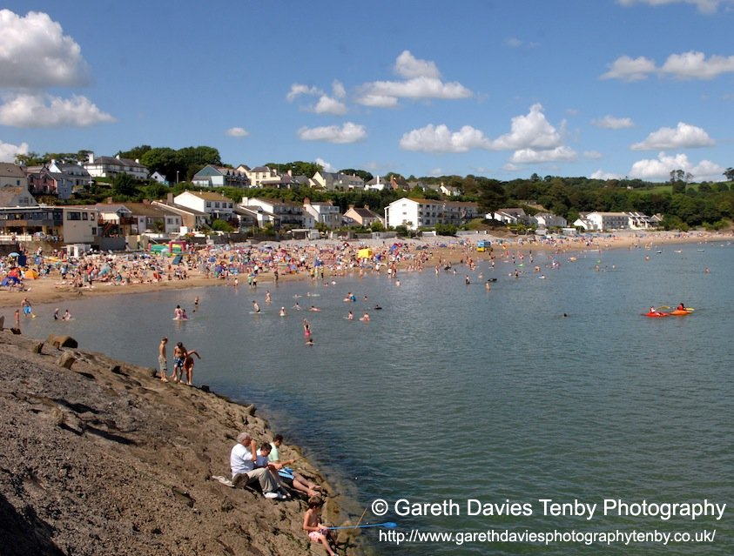
Saundersfoot

Slide 12
Projects
1992 Action Plan
Saundersfoot 2000 Completed projects include:
• Village History Leaflet
• Interpretation Panels and plaques marking historic sites
• Enhancement, including lighting and planting
• Traffic calming and road signing
• Playground improvements near the Regency Hall
• Harbour Study

Slide 13
2000 Action Plan
Future search weekend – 50 stakeholders
The Sensory Garden
• A Feasibility Study of the old Coal Office (Barbecue Building)
• Village centre enhancement
• Highways improvements
• Regency Hall Study.

Slide 14
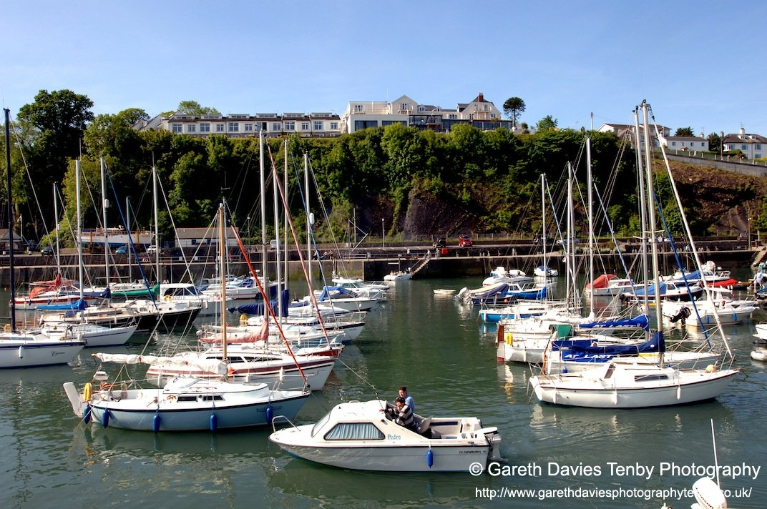
Saundersfoot

Slide 15
2007
Community vision exercises
PLANED, National Parks, Tourism Association and Local Authority
Something Special – special qualities of the Saundersfoot community.
A Community Audit – listing the main features and facilities
The Community in the Bigger Picture – considering global and local issues
ΣΩΟΤ
The Vision for 2020– Saundersfoot in the future.

Slide 16
A Vision for the Future – the Saundersfoot Experience
It is a unique combination of an unspoilt natural environment, top grade accommodation, quality shopping and leisure opportunities, with a year round calendar of events.
It is felt essential to retain the integrity of a traditional working seaside village, offering opportunities for all ages, including the chance for young people to live and work in their community.

Slide 17
Enhancement, Environment & Recycling
Maintaining the quality of the natural environment and of the village centre
ISSUES
cleanliness, litter, dog mess
‘shabby’ appearance of some shops and buildings
Ownership of beach rights
POLICIES
Planting schemes
Enhancement scheme
Heritage Trail

Slide 18
Proposals
o Saundersfoot Forum will continue to support the Chamber for Tourism to promote the village and its special qualities - ‘The Saundersfoot Experience.’
o Continue to support work of the Tourism Growth Area group and keep the local community informed of possible developments.
o Commission a study of potential Wet Weather Facilities.
o Support a Harbour Study and a Village Enhancement Study.

Slide 19
Heritage Opportunities
Industrial heritage
Railway
Use of the old Mining office (Barbeque building) on the harbour – TIC
Trails
Willie Frost – flights
War impacts

Slide 20
Macro Issues
The Wales Spatial Plan
‘Wales a Better Country’; the ‘Sustainable Development Scheme’
‘Wales: A Vibrant Economy.’
Coastal Tourism Strategy
Green Seas
Cadw Projects

Slide 21
Pembrokeshire Tourism
Destination partnerships – Private, Public and voluntary
Beaches – Water Quality, Blue Flag and Seaside Awards
Facilities
Experience

Slide 22
Tourism in Pembrokeshire
Staycation?
2010 4.2m visitors
2010 £5.44m injection
16,300 full time jobs
2011 37% of tourism businesses saw an increase

Slide 23
Coastal Tourism Strategy
‘An integrated year round coastal tourism industry, based on an outstanding natural environment and a quality tourism product that exceeds visitorbexpectations, whilst bringing economic, social, cultural and environmental benefits to coastal communities’.

Slide 24
Aims
Wales Coastal Path
Strengthen resorts/resort regeneration
Encourage improvements in accommodation stock
Strengthen community involvement (encourage engagement in the management of the rural coast)

Slide 25
Centres
Minister for Heritage Alun Ffred Jones
"The centres will provide top class facilities to improve the visitor experience of Wales' outstanding coast and help showcase what Wales has to offer to visitors."

Slide 26
Cadw Pan Wales Interpretation
Opportunity for interpretation consultant to create an interpretation plan for maritime Wales. This will include wider consultation with organisations with an interest / holding on the coast
Framework for future heritage interpretation work along the coast.

Slide 27
Coppett Hall
Wales wide Coastal Tourism Project - £17.5m
£2m ERDF
Pembs CC and Partners
Aim improve the visitor experience
Improved facilities
Access Issues
Links between attractions
“ To help Pembrokeshire meet and exceed the expectations of our many visitors.“ Rob Lewis PCC

Slide 28
Coppet Hall visitor centre and car park (The Hean Castle Estate).
Demolish the existing toilets and to upgrade
Upgrade and re-surface the car park incorporating some light landscaping and seafront disabled parking.
A new multi-functional two storey building with public conveniences will be constructed to provide exhibition space.
Restaurant and tourist related retail outlets.

Slide 29
Saundersfoot Harbour Redevelopment
£4m Project
£463,500 European Regional Development Funding (ERDF) towards a £927,000 total project cost
£200,000 via Tourism Infrastructure Support Scheme fund
Colliery Offices - TIC

Slide 30
Aims
International Marine Tourism Destination
Improve Access
“ensure long term viability”
Saundersfoot Harbour Commisioners to a Trust Port
Iconic Tourism Destination

Slide 31
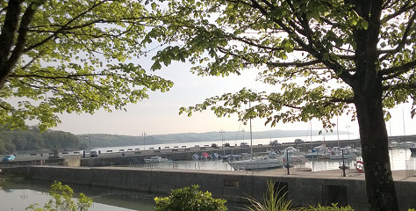
New Attractions

Slide 32
Project
New commercial slipway
An inner harbour landing pontoon and access bridge
Installation of decking over the existing sluice to enable open-air events to be held
“Saundersfoot is a vibrant tourist destination and the harbour is a key feature which has an important role to play in attracting visitors.”
Phil Odley Chair of the Chamber of Tourism

Slide 33
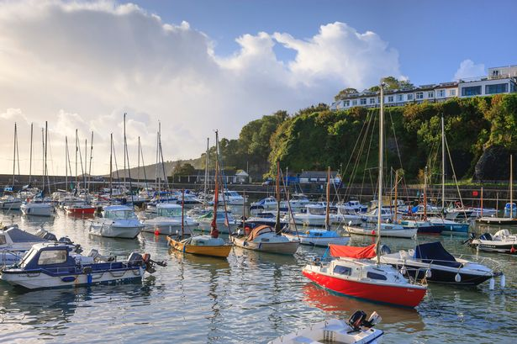
Harbour Redevelopment

