Slide 1
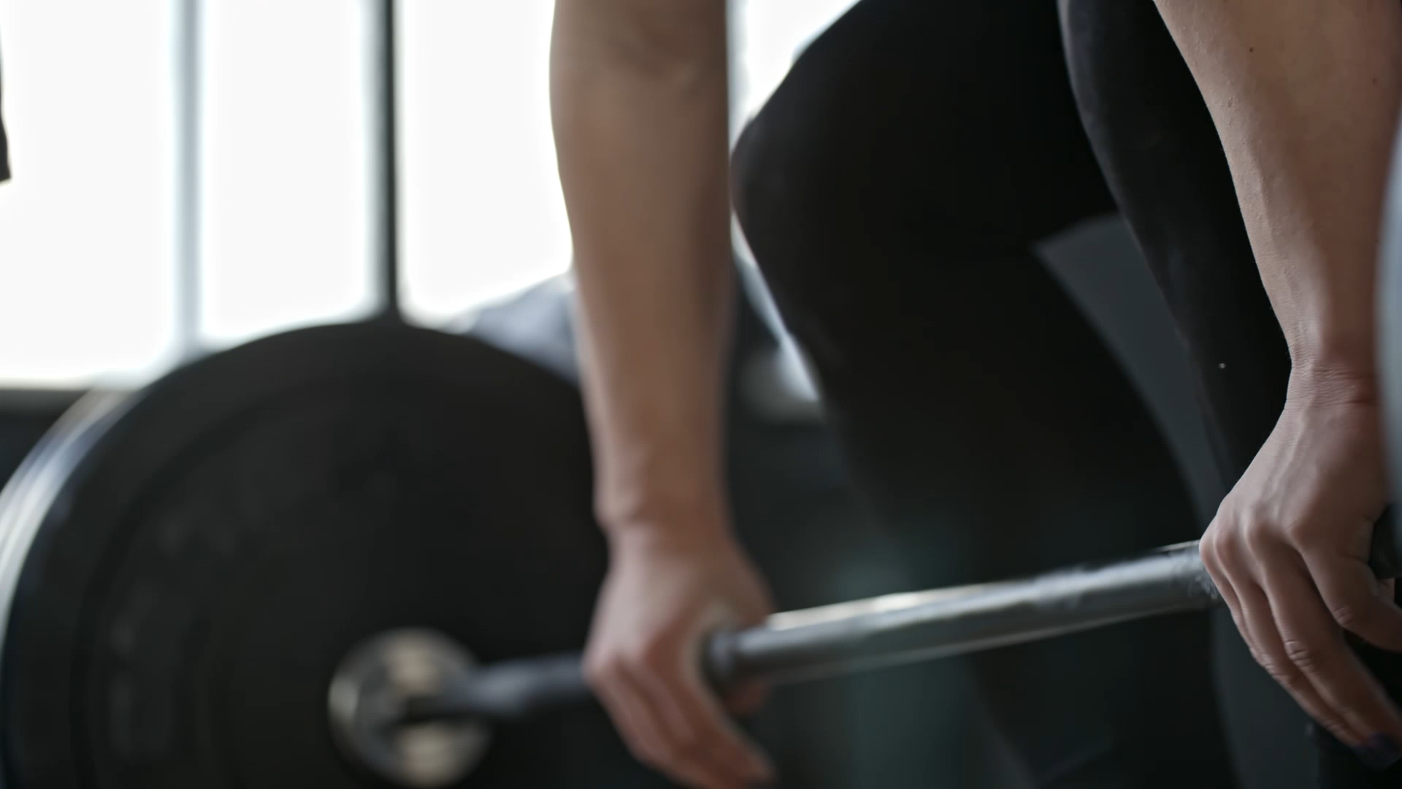
Designing training sessions
Geraint Forster

Slide 2
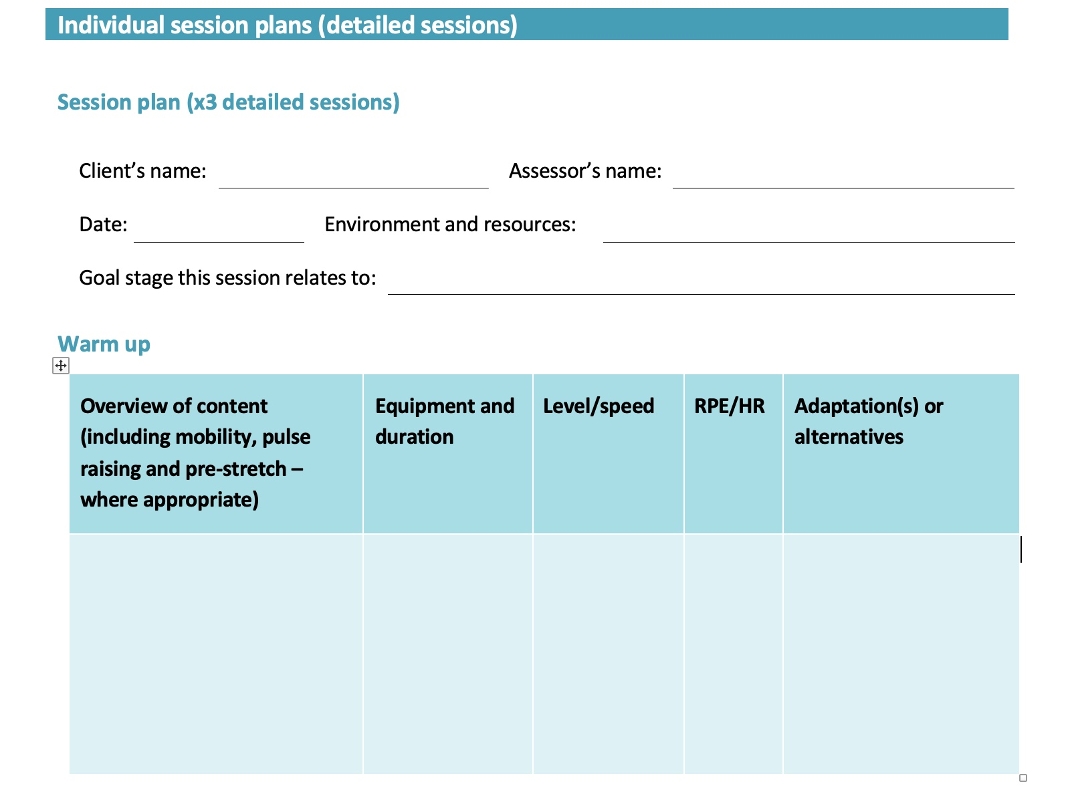
Warm Up

Slide 3
Warm Up
- Must start with pulse raiser – 3-5 minutes on a cardio machine if you are in a busy gym
- give clear timings and intensity
- using RPE10 , it should start easy (3/10) and build to moderate (5/10)

Slide 4
Warm Up
- after pulse raiser, should move on to dynamic exercises that ACTIVATE muscles and MOBILISE joints
- NO STATIC STRETCHING – these should be movements e.g. arm circles, high knees, floor sweeps, torso twists, lunges, yoga flows, etc.
- Ensure you involve all muscle groups and all joints (but focus on the ones involved in that session)
- Keep them moving throughout (don’t let them cool down again)

Slide 5
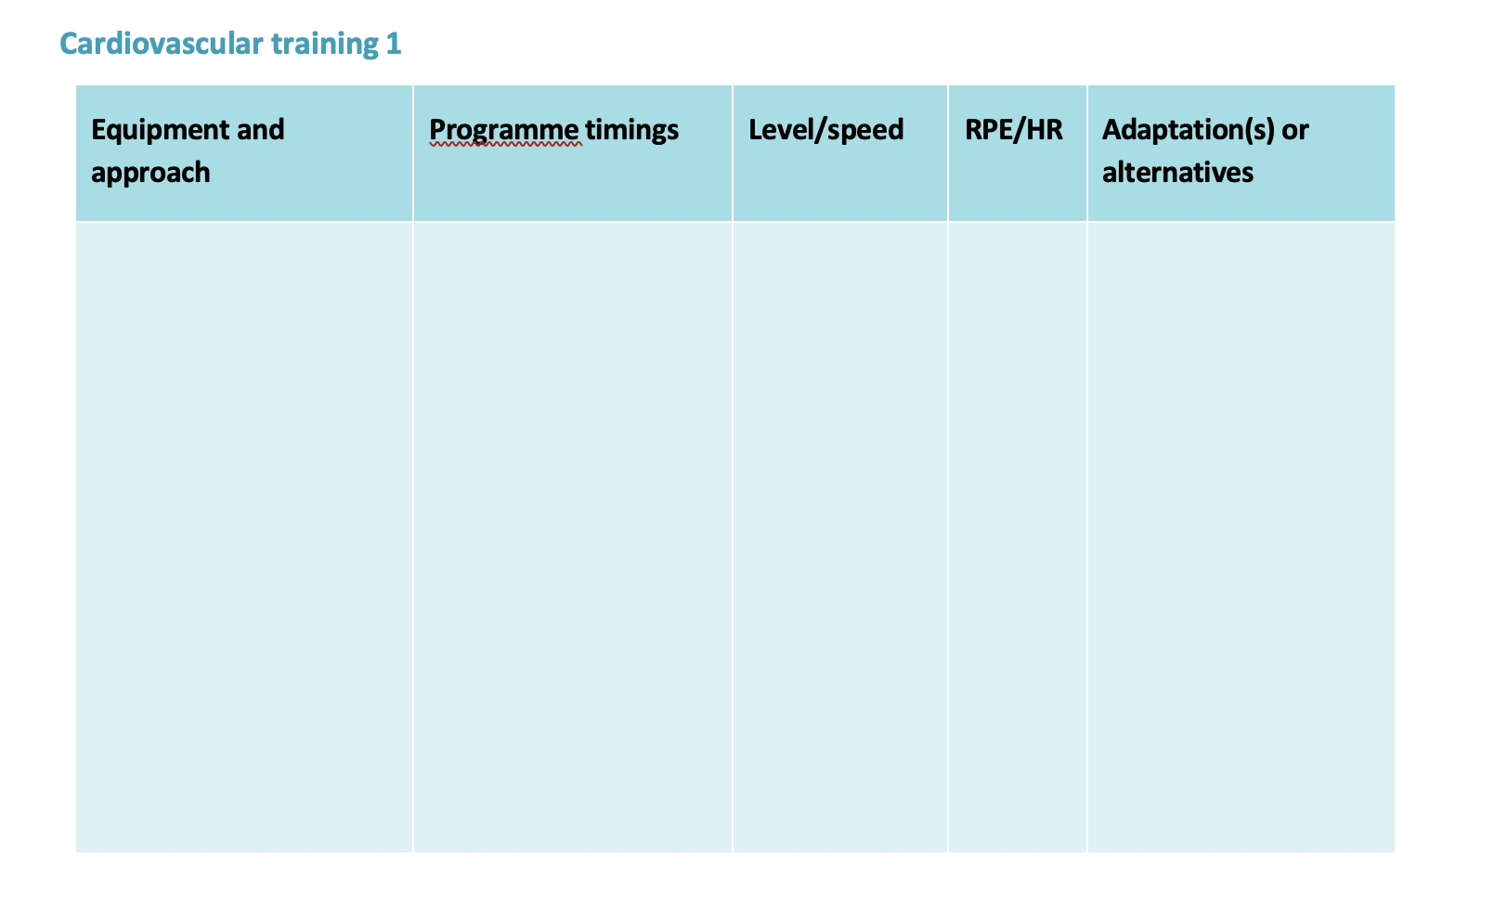
Cardiovascular (CV)
- unless they have a specific goal (e.g. running 10k) then find out what they LIKE – as long as they are doing some CV, it doesn’t matter what.
- give them an alternative to do if the equipment they need is not available

Slide 6
Cardiovascular (CV)
- the ‘approach’ refers to the type of session:
- continuous
- interval
- fartlek
- e.g Treadmill – Intervals, or
Cross-trainer – Continuous

Slide 7
Cardiovascular (CV)
- give specific timings (particularly if it is an interval session)
- You will likely not know the level/speed, but you can set the desired RPE and then work out the speed/intensity that corresponds to that RPE on the first session
- see couple of examples opposite
Treadmill 20 min 8kph. 6/10. Bike
(continuous)
OR
Bike 1 min 250W 8/10 Cross-Trainer
(intervals) 1 min 100W 4/10
Repeat x 10

Slide 8
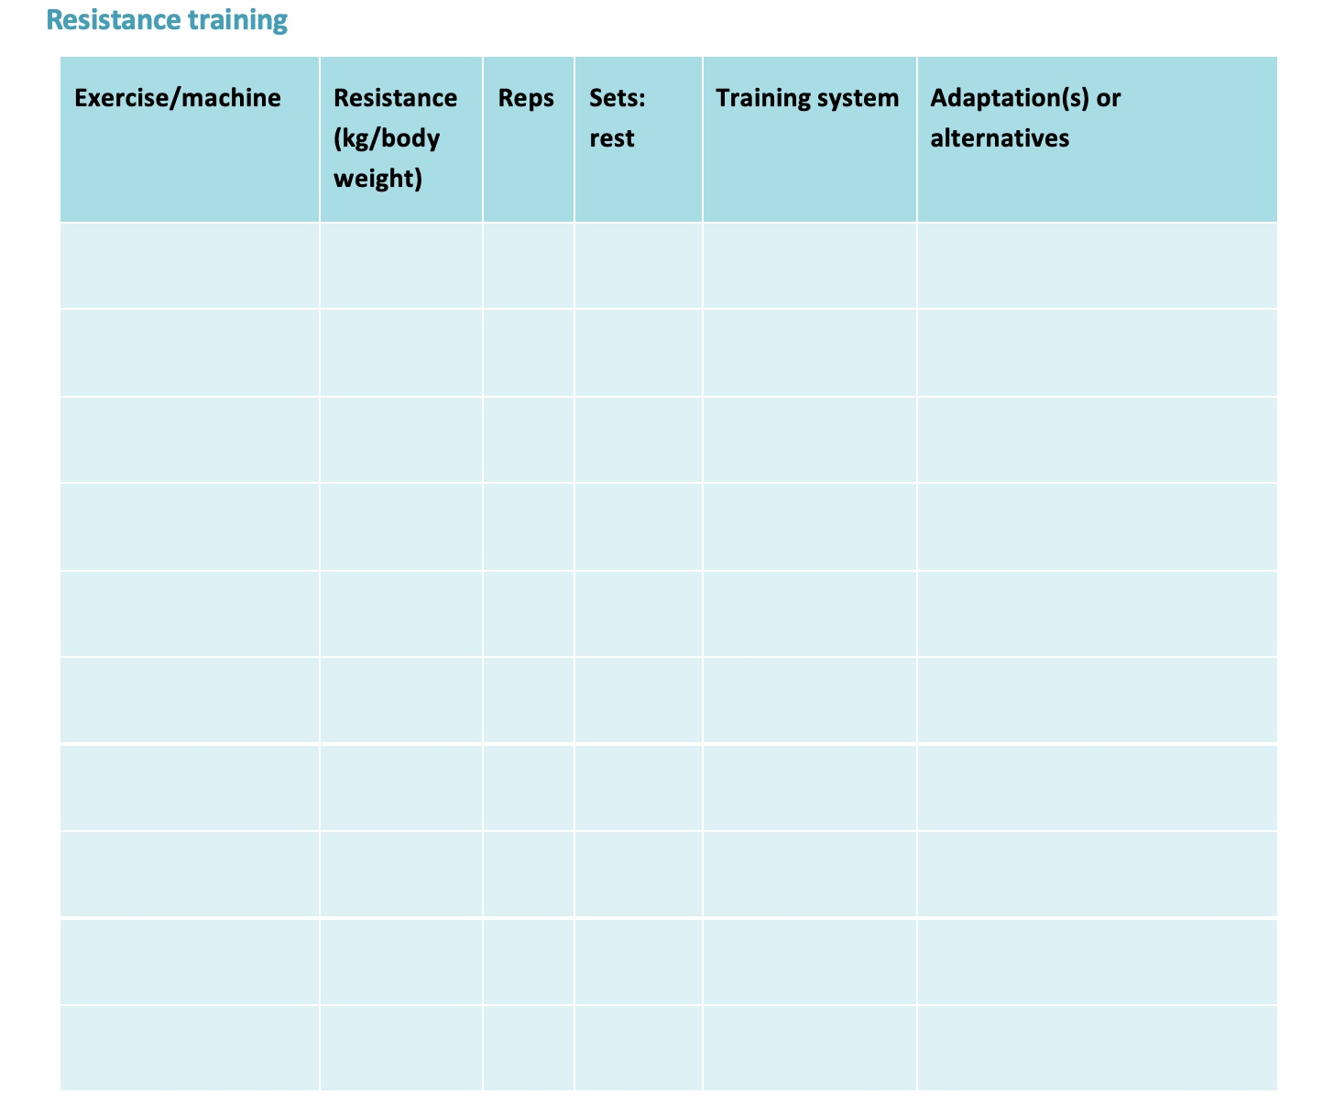
Resistance Training
General Principles
- ensure a balanced programme – all muscle groups worked.
- have you included all of the foundation movements?
- push
- pull
-brace
- rotate
- squat
- lunge
- hinge

Slide 9
Resistance Training
General Principles
- unless they are doing more than 3 session per week, a split routine is not needed – plan a full-body resistance session each session.
- Select appropriate exercise for their experience:
- novice – body weight & machines
- intermediate/advanced – include free weights also

Slide 10
Resistance Training
General Principles
- multi-joint movements are preferable to single-joint movements as they replicate real life more accurately.
- if you are going to include single-joint isolation exercises (e.g. bicep curl, leg extension) make sure to place them AFTER any multi-joint exercises that use those muscle groups e.g. pull ups come before bicep curl.

Slide 11
Resistance Training
Resistance
- you will need to calculate this on the first session
- for novices, stopping 5 reps from failure is sufficient for the first few weeks – reduce muscle soreness
- for optimal muscle growth, aiming for getting to within 2 reps of failure is ideal.

Slide 12
Resistance Training
Reps
Depends on their goals, and there is mixed research on this, but some general rules:
- for muscular endurance at least 12-15 reps
- for hypertrophy around 10 reps (close to failure)
- for maximal strength – 2-6 reps heavy
- for novice – at least 10 reps to keep the load lower and reduce injury risk/soreness

Slide 13
Resistance Training
Sets
- for novice, 2 sets is sufficient for the first 4-6 weeks, then maybe look to progress to 3 sets
- for more experienced, 3 sets or more depending on goals.
- for hypertrophy, volume is the main driver – 10-20 sets per week per muscle group gives optimal muscle growth

Slide 14
Resistance Training
Rest
- for strength, when lifting heavy, at least 2-3 minutes rest is needed to ensue recovery
- novices might also need 2-3 minutes to begin with if they lack cv fitness
- for general health, shorter rest (1 min) keeps HR up and gives a cv benefit also
- hypertrophy – shorter rest 1-2 mins gives more ‘pump’

Slide 15
Resistance Training
Training system
Choose one of the following:
- Traditional – this is where the client completes each exercise then moves on to next e.g. they do 2 x 10 on chest press, before moving on to next exercise
- Super-set – this is pairing two opposing exercises (e.g. a push and a pull) and working one whilst resting from the other and vice versa. Good for saving time and increasing session intensity.

Slide 16
Resistance Training
Training system
Choose one of the following:
- Circuit – do one set of each exercise until you complete them all, then start again. Important to sequence the exercises so that they work different muscle groups e.g. push – pull – squat – brace – push – pull……
This is good for getting a cardio benefit from your resistance session.

Slide 17
Resistance Training
Training system
Choose one of the following:
- Drop set – only for advanced clients, used at end of session to fully fatigue muscle, mainly for hypertrophy goals. Involves putting a weight on that can be lifted 10-12 times, lifting to failure, then immediately reducing the load, and going to failure again, then keep repeating until liftin the lowest weight possible (e.g. just the bar)

Slide 18
Resistance Training
Training system
Choose one of the following:
- Pyramid Set – Involves using a range of reps within one session to hit multiple targets (e.g. strength and endurance), can be ascending or descending or full e.g.
12-10-8-6-4
4-6-8-10-12
6-8-10-8-6
The load is also changed each time, and rest between sets as with standard sets.

Slide 19
Resistance Training
Training system
Choose one of the following:
- Tri Set – only for advanced clients – this involves doing three consecutive exercises on on muscle group back to back with no rest. Generally done for hypertrophy. E.g. Bench Press –DB Incline Bench – DB Fly – then rest and repeat.

Slide 20
Resistance Training
Training system
Choose one of the following:
- Pre-exhaust – again for advanced clients – mainly for hypertrophy. This involves pre-fatiguing a muscle by using a single joint exercise prior to immediately doing a multi-joint exercise for that muscle group e.g. doing leg extensions immediately followed by leg press to target the quads.

Slide 21
Resistance Training
Training system
Choose one of the following:
- Negatives/eccentric training – only for advanced clients – tends to result in a LOT of muscle soreness. Involves doing an exercise to failure, then the PT helps with the concentric portion (e.g. lifting the bar back up in Bench Press) and the client controls the lower back down for a few more reps.

Slide 22
Resistance Training
Adaptations/Alternative
Here you should list similar exercises that would work the same muscle groups.
These are in case the client is unable to do an exercise due to the equipment being unavailable, or if they find an exercise difficult or painful and they want to swap it for something else.
Please ensure you put something here for every exercise.

Slide 23
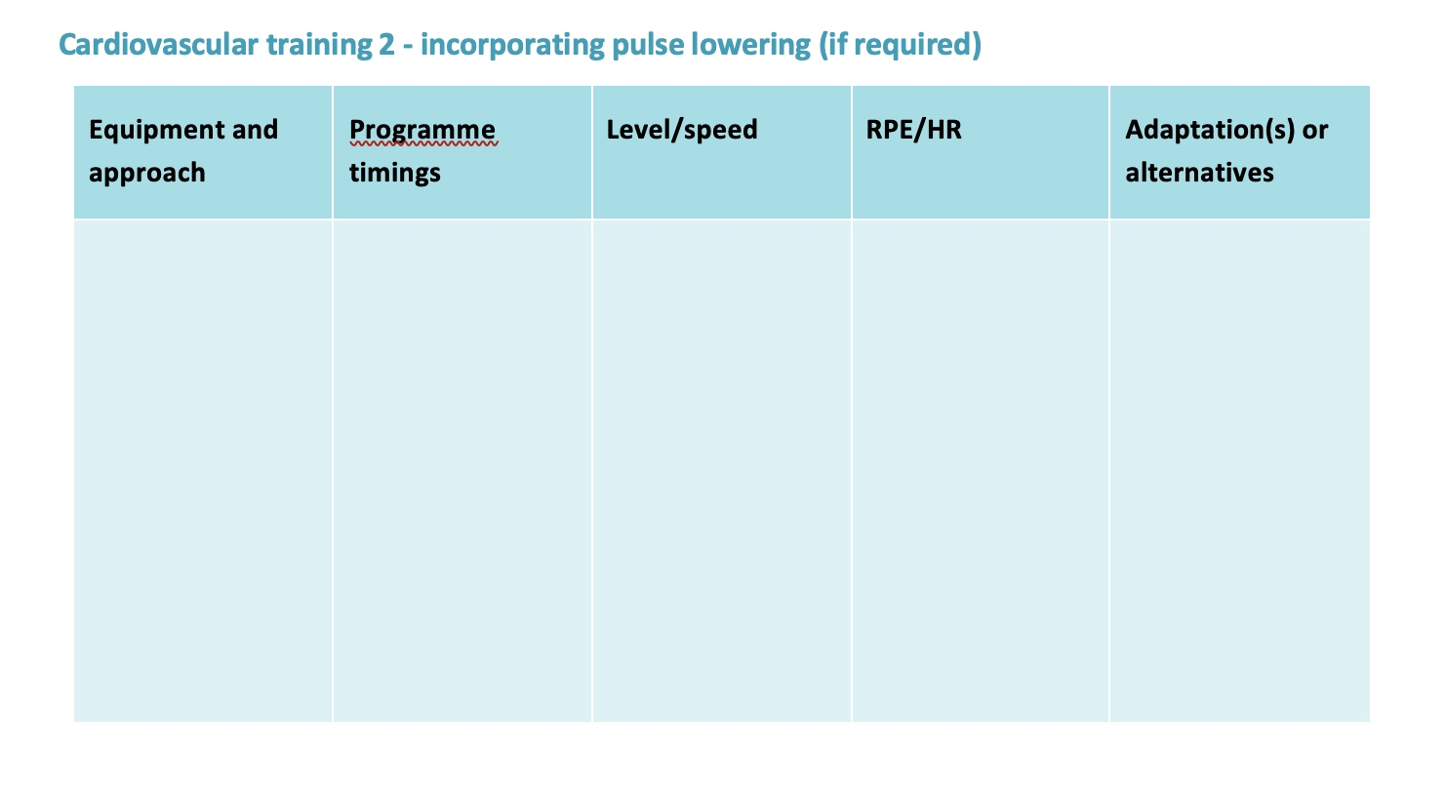
CV 2 / Warm Down
You can either use this for a second cardio section if that is what is needed, in which case follow the instructions given earlier for cardio.
Or you can use this for the pulse-lowering element of the warm down – see next slide for details.

Slide 24
CV 2 / Warm Down
As part of the warm down you should have the client do 5 minutes or so of easy cardio in order to keep the blood moving through the muscles that have been working, and gradually bring them back to a resting level.
See the notes on CV section, but the main difference is the RPE/intensity should gradually reduce e.g. RPE 5/10 reducing to 3/10.

Slide 25
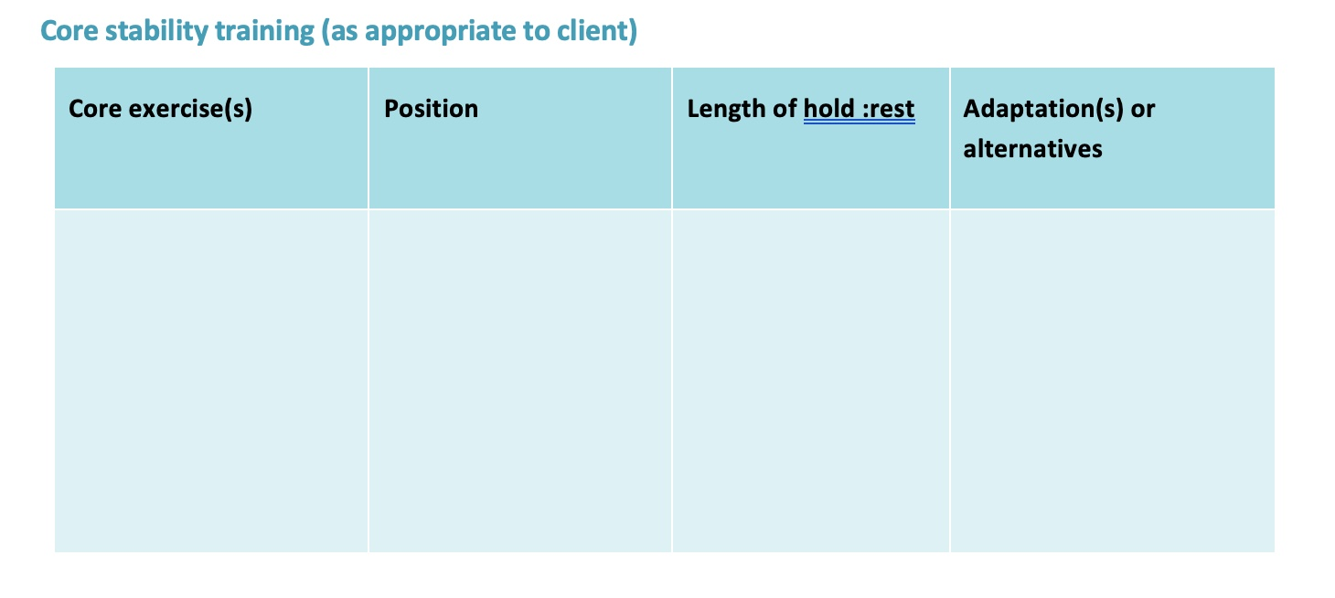
Core stability
This is where you would generally put the brace and rotate exercises from your foundation movements.
Flexion of trunk (e.g. sit ups) is not really beneficial – trunk muscles mainly brace and rotate, so think about plank variations, shoulder taps, russian twists, paloff press, etc

Slide 26
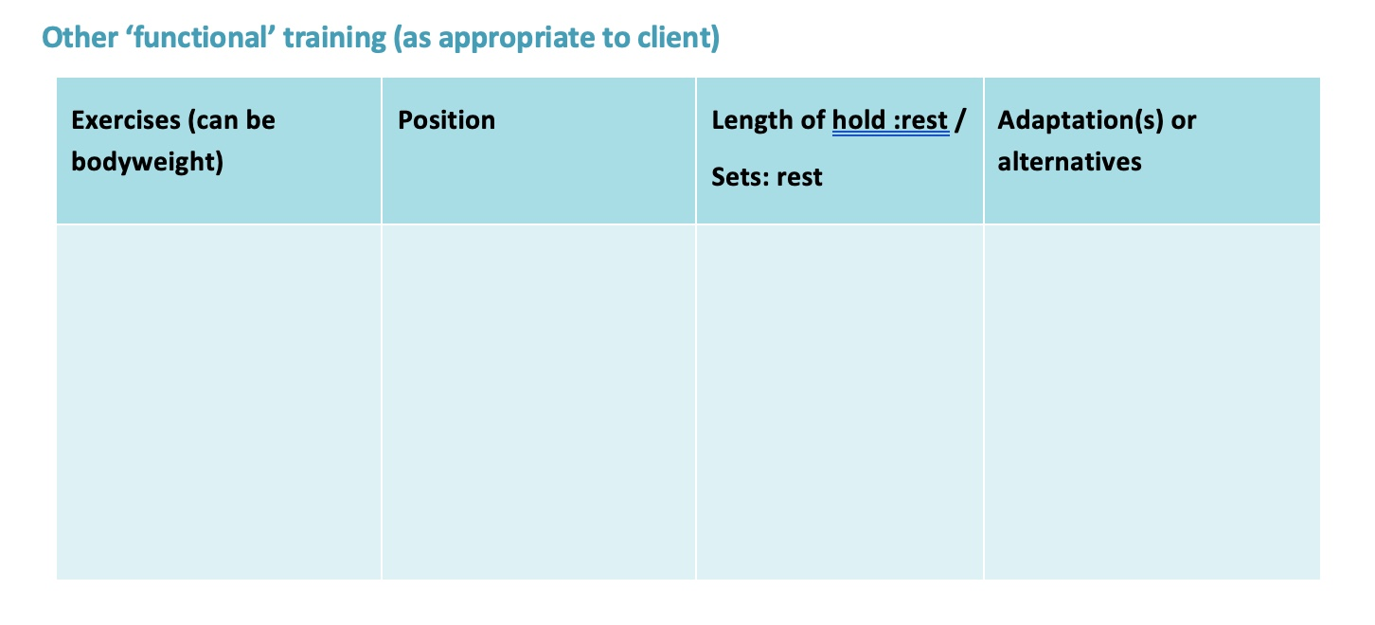
Functional Training
- if you are going to add any ‘functional training’ these is where you would list it e.g. body weight exercises, battle ropes, trx suspension trainer, BOSU ball stability work, swiss ball, etc.
Ensure you provide an alternative/adaptation, and that you give detail regarding reps/duration etc.

Slide 27
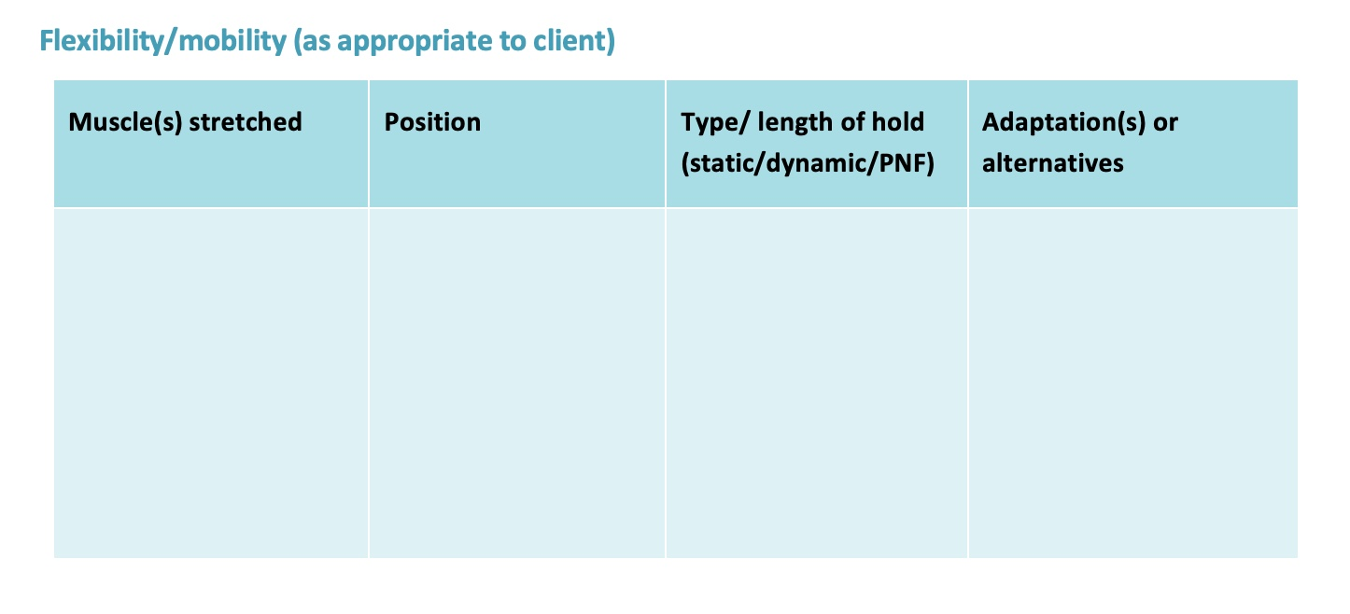
Flexibility/mobility
If any mobility/flexibility work needs doing (i.e. static stretching) then it should be done at the end of the session.
For maintenance, stretches should be held for 10s – consider the main areas where people are likely to be tight if they spend a lot of time sitting – hip flexors, chest, etc
If you identify they need to improve range of motion, then you need to perform a developmental stretch – either static hold 30s, or something like PNF

Slide 28
Final Points
You do not have to use every section – only use what is relevant for your client
If giving a programme for a client to follow on their own, make sure not to use complicated language and jargon so they can understand it.
Does your plan fit into the required time – e.g. if you put 3 x 10 reps of 8 exercises with 3 minutes rest, that will take 1 ½ hours, without warm up, cool down or CV!
If you have a novice who has general health goals, a basic programme of 2 x 10 reps on one exercise for each main muscle group (e.g. chest press, lat pulldown, leg press, bodyweight lunge), along with a cv, core, warm up and cool down is plenty.
For novices, just getting them coming in regularly is the most important thing – don't make it too hard.

