Slide 1

Digital Strategy
Chris Thomas
christopher.thomas2@uwtsd.ac.uk

Slide 2
Introductions

Slide 3
Lectures: Wednesdays and Saturdays
Date | Time
20.09.17 | 5:00pm - 8:00pm (W)
04.10.17 | 5:00pm - 8:00pm (W)
21.10.17 | 10:00am - 4:00pm (S)
01.11.17 | 5:00pm – 8:00pm (W)
08.11.17 | 5:00pm - 8:00pm (W)
18.11.17 | 10:00am - 4:00pm (S)
22.11.17 | 5:00pm - 8:00pm (W)

Slide 4
Deadlines
Registration for Digital Strategy Assignment
  3 November 2017
Assignment submission deadline
  1 December 2017

Slide 5

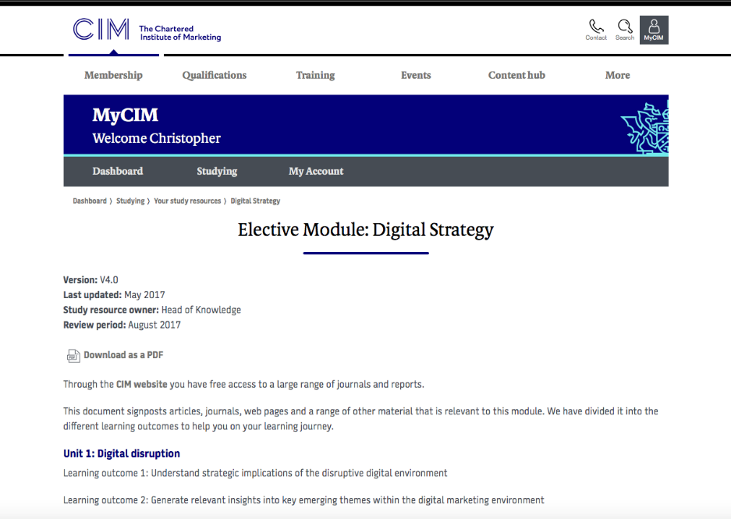
Reading Lists
Good general background reading
More specific reading (for higher marks)

Slide 6



Use social media!
Follow:
thought leaders
Competitors
Search key word “digital marketing”
Link with:
Digital Marketing groups
Industry groups
Etc.
Set up own group
Join other groups and pages

Slide 7
Module has 3 parts
Unit 1: Digital disruption
  Learning outcome 1: Understand strategic implications of the disruptive digital environment
  Learning outcome 2: Generate relevant insights into key emerging themes within the digital marketing environment
Unit 2: Digital planning
  Learning outcome 3: Develop strategic recommendation in response to the need to acquire, convert and retain customers
  Learning outcome 4: Deliver agile response to changing customer behaviours
Unit 3: Delivering success
  Learning outcome 5: Know how to manage and optimise key channels and content within a digitally enhanced strategic plan
  Learning outcome 6: Apply key digital measures to analyse social, sentiment, search and site behaviour

Slide 8
Lectures: Wednesdays and Saturdays
Date | Time
20.09.17 | 5:00pm - 8:00pm (W)
04.10.17 | 5:00pm - 8:00pm (W)
21.10.17 | 10:00am - 4:00pm (S)
01.11.17 | 5:00pm – 8:00pm (W)
08.11.17 | 5:00pm - 8:00pm (W)
18.11.17 | 10:00am - 4:00pm (S)
22.11.17 | 5:00pm - 8:00pm (W)

Slide 9
Assessment
Assessment: Portfolio
A work-based portfolio which is broken down into three tasks:
  Research
  Plan
  Report

Slide 10
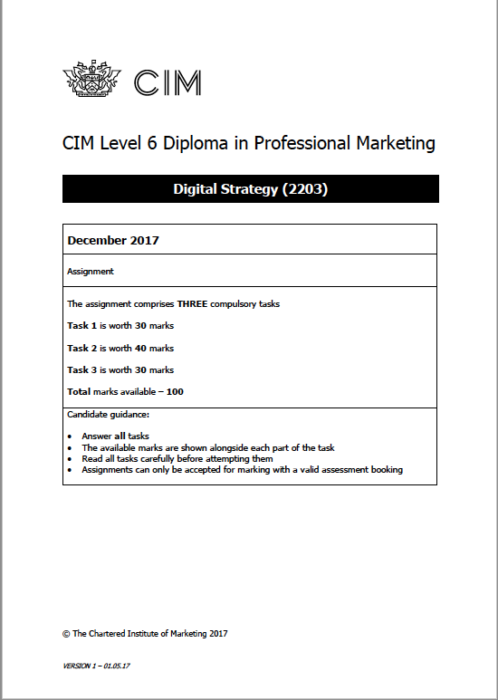
Assessment
Read the CIM Brief
Listen to the podcast on MyCIM from senior examiner assignment briefing
Look at previous examiner’s reports
Look at study resources on MyCIM especially assessment guidance

Slide 11
Lecture content and draft deadlines
Date | Time | Lecture | Drafts Deadline
20.09.17 | 5:00pm - 8:00pm (W) | Introduction/Assignment Digital Disruption
04.10.17 | 5:00pm - 8:00pm (W) | Digital Disruption
21.10.17 | 10:00am - 4:00pm (S) | Digital Planning | Task 1 23.10.17 (M)
01.11.17 | 5:00pm – 8:00pm (W) | Digital Planning
08.11.17 | 5:00pm - 8:00pm (W) | Delivering Success | Task 2 13.11.17 (M)
18.11.17 | 10:00am - 4:00pm (S) | Delivering Success
22.11.17 | 5:00pm - 8:00pm (W) | Re-cap. Queries answered. | Task 3 24.11.17(F)

Slide 12
Social Media Revolution
https://www.youtube.com/watch?v=odoYOuvwjDE

Slide 13
Quick quiz
What percentage of the world’s population are Internet users?
50%
What percentage of the UK’s population are Internet users?
92%
What percentage of the UK’s population are social media users?
64%

Slide 14
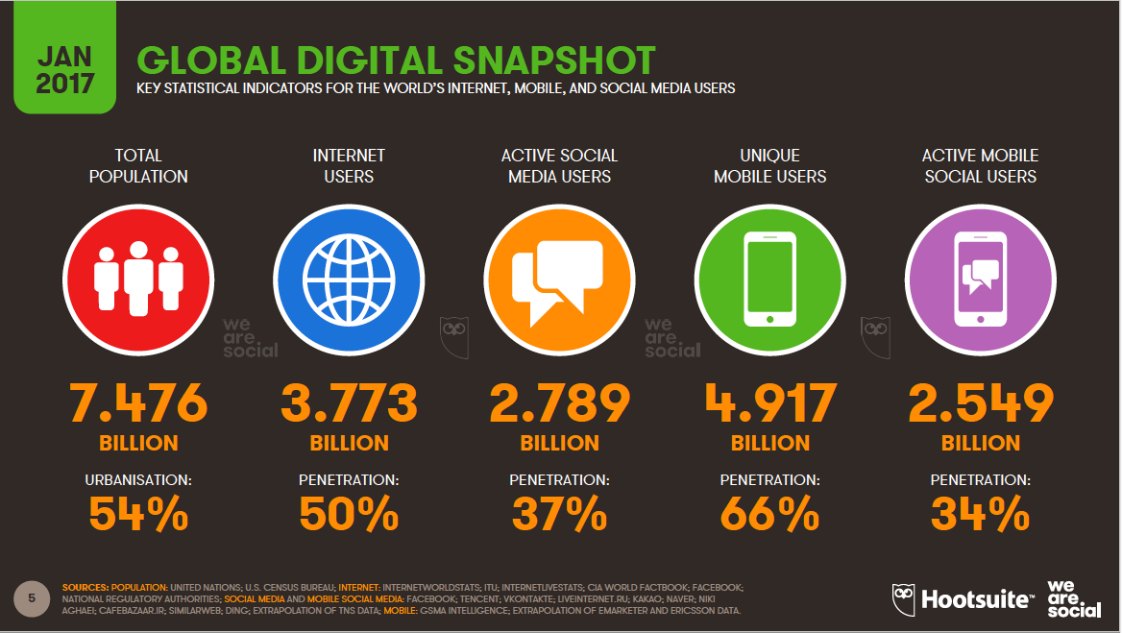

Slide 15
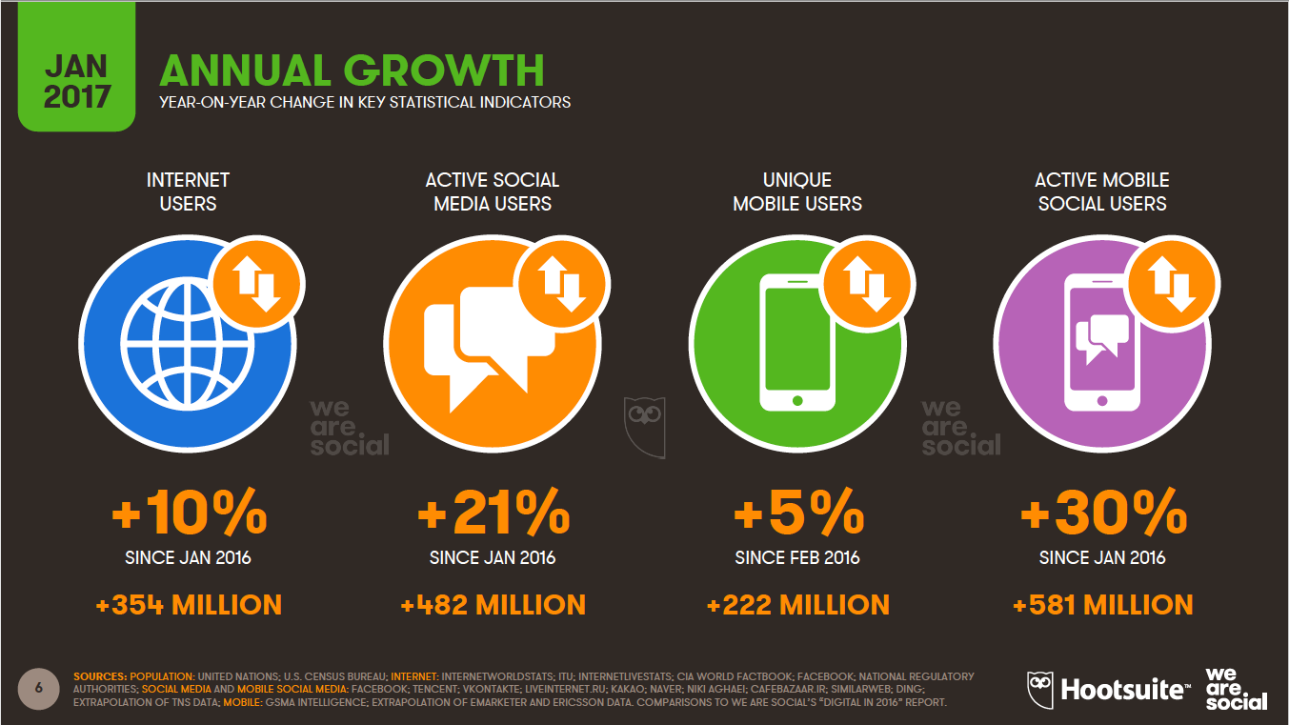

Slide 16
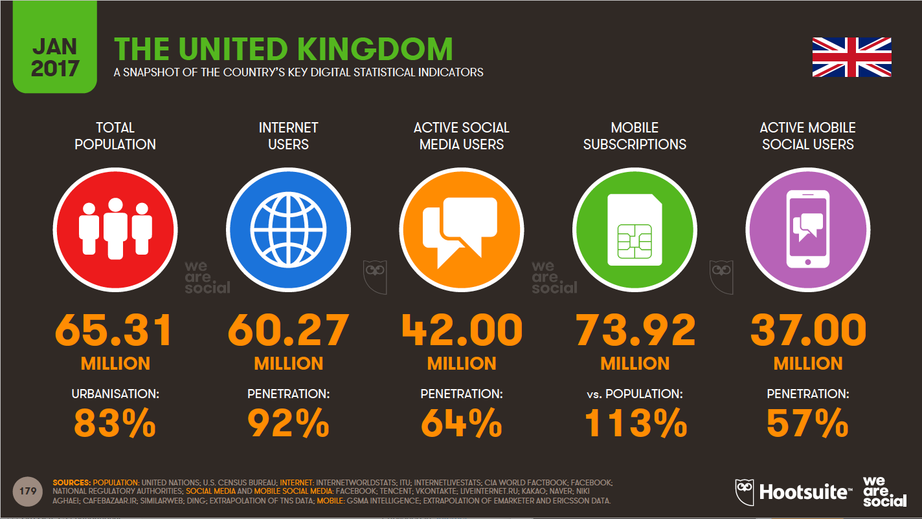

Slide 17
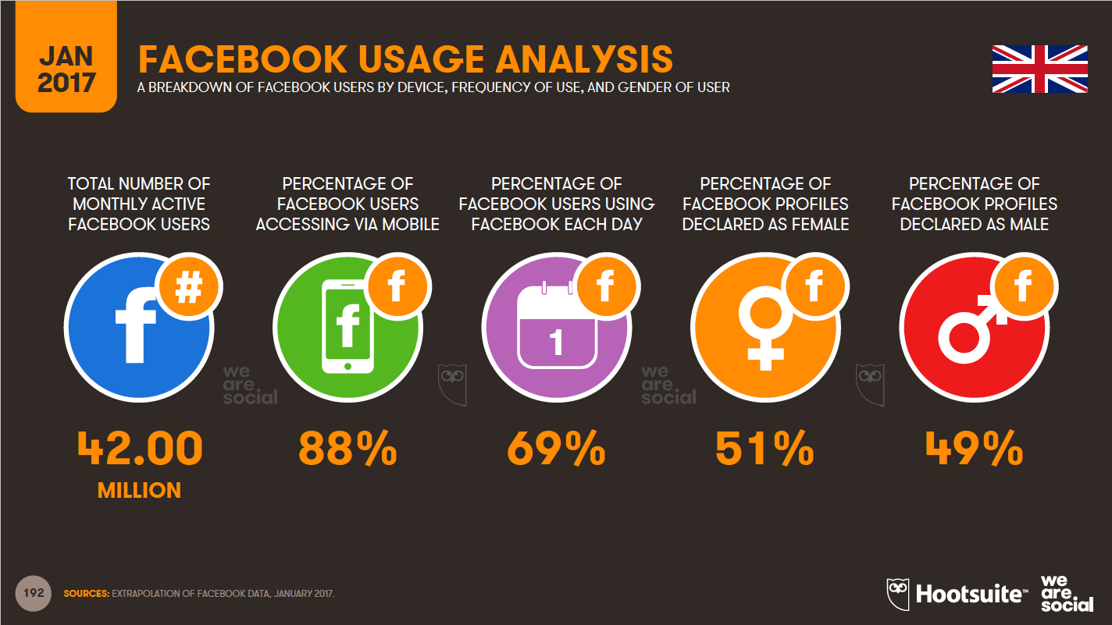

Slide 18
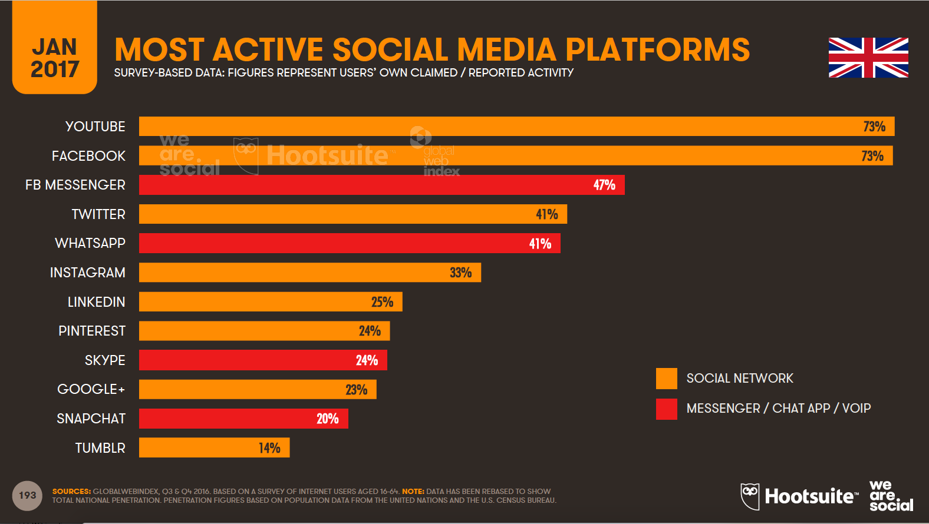

Slide 19
What is digital marketing?
Achieving marketing objectives through applying digital technologies
              Chaffey 2012
Managing a company’s online presence:
  Company websites
  Social media
  Search Engine Marketing
  Social Media Marketing
  Online advertising
  E-mail marketing
  Partnerships/affiliate marketing
  Digital Posters

Slide 20
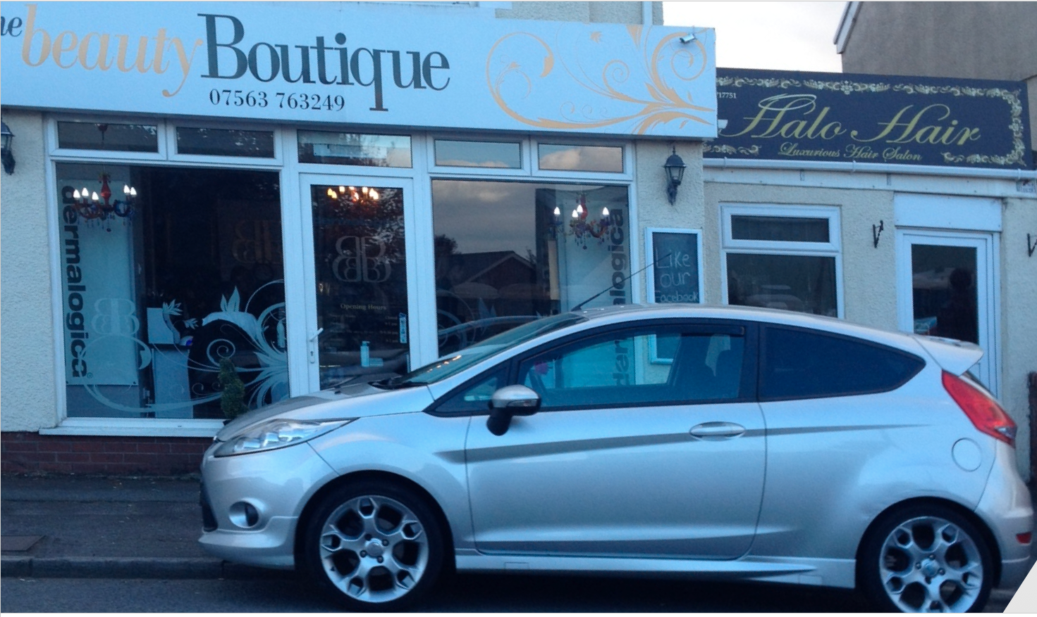
Everybody’s doing it!

Slide 21
Traditional Marketing
Traditional marketing is interruptive e.g. email while working; cold calling on phone, an ad whilst watching your favourite tv show.
Focus is on finding customers who you can sell to.
People’s tolerance for these sorts of advertising has fallen and they are able to block it.

Slide 22
Inbound Marketing
Approach focused on attracting customers through creating content and interactions that are relevant and helpful: blog, video or e-book.
Potential customers find you through channels like blogs, search engines, and social media.
Focus is on customers finding you through content designed to address their problems and needs
Inbound marketing attracts qualified prospects and builds trust and credibility for your business

Slide 23
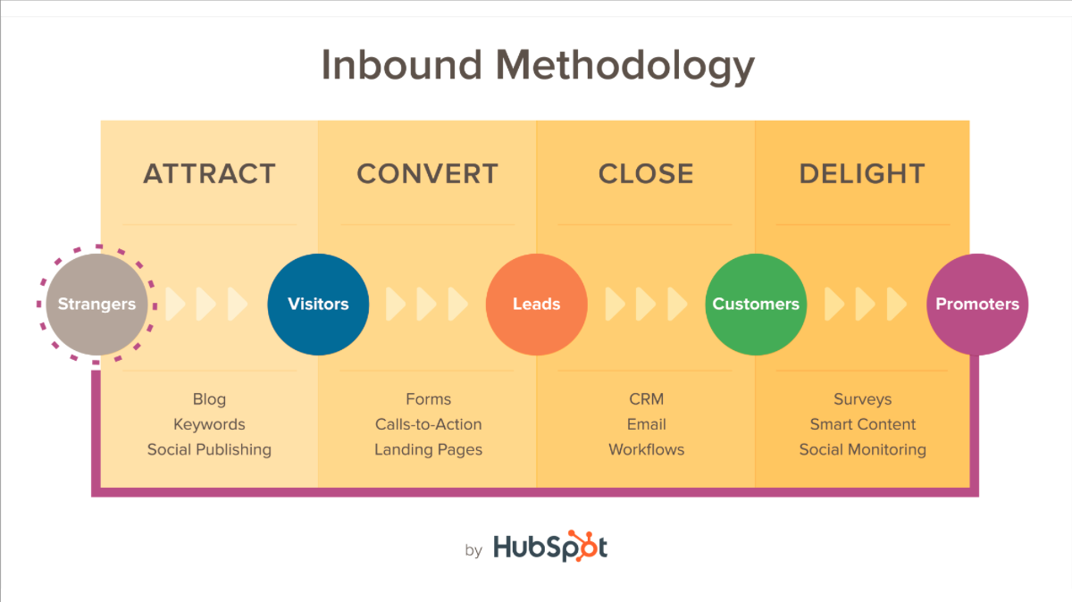

Slide 24
5 S’s of Digital Marketing (Chaffey and Smith 2012)
http://www.smartinsights.com/goal-setting-evaluation/goals-kpis/goals-for-your-digital-marketing/

Slide 25
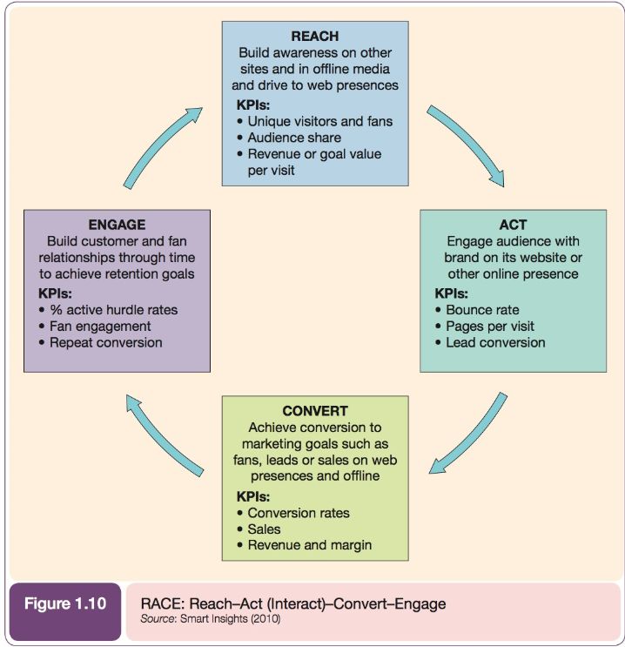
How to manage and improve the commercial value organisations gain from digital marketing

Slide 26
What is a strategy?
Plan
Long term
Planning Frameworks such as SOSTAC
First S of SOSTAC = Situational Analysis
  Where are we now? Analysing macro and micro-environments
  PESTEL and SWOT analysis

Slide 27
What is a digital marketing strategy?
Focussing on the digital side
Aligned with the business and marketing strategy
Clear digital objectives (SMART)
Define and communicate differential in value proposition
Specify the mix of online and offline communications tools
Support the online customer lifecycle from attraction to conversion to return and growth

Slide 28
Discussion
Think of the innovations you have witnessed during the time you have used the internet.

Slide 29
What is Digital Disruption?
Digital disruption is a transformation that is caused by emerging digital technologies and business models.
These innovative new technologies and models can impact the value of existing products and services offered in the industry.
This is why the term ‘disruption’ is used, as the emergence of these new digital products/services/businesses disrupts the current market and causes the need for re-evaluation.
Examples?

Slide 30
Examples
Digital Cameras
Downloadable music/film
Uber taxi services
Online news and magazines

Slide 31
Keeping an eye on the ball and knowing the signs of digital disruption emerging in your industry means you can get ahead of the game and work with the flow rather than against it.
Not only does this prevent the wave of digital disruption from washing away your success, it can also lead to further growth and new opportunities for the business.

Slide 32
Digital Disruption
https://www.youtube.com/watch?v=neShgTczCM0

Slide 33
Strategic Agility
In the digital world changes in social culture are particularly rapid. As are changes in technology.
Government and legal changes tend to happen over longer time scales.
Digital marketers need to be alert to the forces that are important in the context of their own trading environment.
The should also develop the capacity to respond to environmental changes and the emerging opportunities and threats by developing strategic agility: a sound process for reviewing marketplace opportunities and threats and then selecting the appropriate strategy options.

Slide 34
Strategic Agility
Digital marketers should consider
  Collection and dissemination of information
  Processes for generating and reviewing
  Research into potential customer value of innovations
  Implementation of prototypes and review results
  Measurement and review of results from prototypes to revise further

Slide 35
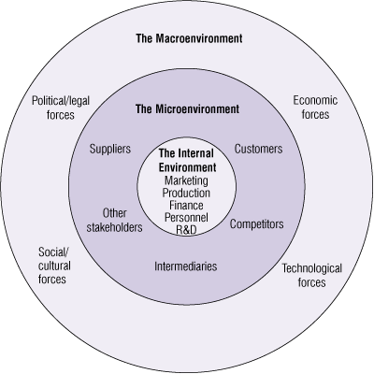
THREE LEVELS OF THE BUSINESS ENVIRONMENT
Macro- Environment
Micro- Environment
Internal environment
(Palmer and Hartley (2009); The Business Environment 6e. McGraw-Hill)

Slide 36
The Macro Environment
PESTEL
Beyond an organisation’s control
Organisations should monitor, understand and respond to the changes in the environment to utilise opportunities and overcome threat that are created by the environment,
Monitor trends trends, where people are going. You are responding not leading if you don’t.
Since these factors are uncontrollable , it is important that organisations adjust their decision as per the changes in the environment

Slide 37
Political factors
These are all about how and to what degree a government intervenes in the economy. This can include – government policy, political stability or instability in overseas markets, foreign trade policy, tax policy, labour law, environmental law, trade restrictions and so on.
It is clear from the list above that political factors often have an impact on organisations and how they do business. Organisations need to be able to respond to the current and anticipated future legislation, and adjust their marketing policy accordingly.

Slide 38
Governments can ban or block activities For example, Facebook has been blocked in Iran, Vietnam and North Korea. Twitter is currently banned in several other countries.
This means if you're a business using Facebook in these areas, you cannot use these advertising options and it is less likely that your target audience can see your updates. It also means you need to consider local alternatives, for example, Sina Weibo in China and Facenama in Iran and Afghanistan.

Slide 39
Economic Factors
Economic factors have a significant impact on how an organisation does business and also how profitable they are.
Factors include – economic growth, interest rates, exchange rates, inflation, disposable income of consumers and businesses and so on.
These factors can be further broken down into macro-economical and micro-economical factors.
Macro-economical factors deal with the management of demand in any given economy. Governments use interest rate control, taxation policy and government expenditure as their main mechanisms they use for this.
Micro-economic factors are all about the way people spend their incomes. This has a large impact on B2C organisations in particular.

Slide 40
Economic Factors
The arrival of the Internet created many pricing options that would have previously been impossible to imagine. For example:
First visitor and return visitor pricing is available through the use of cookies
24 hour sales are easier to accommodate with a code to enter at checkout, "only available until midnight"
Dynamic pricing based on availability and quantity is now used by most airlines and by many hotel groups and hotel chains
Auction pricing focused on highest and lowest offers (reverse auctions) is used by eBay, Priceline and many others
Software being sold as a service, with monthly payments rather than an upfront fee for a box of disks!
Free, freemium and premium services have evolved with some services such as games, being free, but showing ads and premium options available for ad-free services

Slide 41
A major challenge to many businesses are price comparison websites, where the prices are compared in a situation that isn't always accurate as delivery charge may be excluded.
In the future, most delivery charges will be removed as free delivery becomes the norm. The difference may be the speed of delivery with options for premium charges for super-fast delivery.

Slide 42
Social/Cultural Factors
The areas that involve the shared belief and attitudes of the population.
These factors include – population growth, age distribution, health consciousness, career attitudes etc.
These factors are of particular interest as they have a direct effect on how marketers understand customers and what drives them.

Slide 43
A good example is Moonpig. There may have been a time where they offered cards for birthdays, weddings and events like Christmas. Today they offer a wide range of cards for all occasions and religions.
Christmas, Chinese New Year, Diwali, Easter, Eid etc etc

Slide 44
Other issues on a socio cultural level include
Access to internet – surprising as it may seem, not everyone has access to the internet. This is especially true of the 80+ demographic, as well as those on lower incomes.
Acceptance of the technology – as the age profile in Facebook grows with more parents and grandparents adopting the platform, younger users are finding it less socially acceptable and are moving towards other social platforms.

Slide 45
Technological Factors
We all know how fast the technological landscape changes and how this impacts the way we market our products. Technological factors affect marketing and the management thereof in three distinct ways:
New ways of producing goods and services
New ways of distributing goods and services
New ways of communicating with target markets
It's all about the technology being used, whether that's desktop or mobile, tablets or wearables.
Issues for your business include:
Screen size and where the internet is accessed
How you can make your user journeys easier
Whether new technology makes elements of your marketing mix redundant

Slide 46
Environment factors
These have become important due to the increasing scarcity of raw materials, pollution targets, doing business as an ethical and sustainable company, carbon footprint targets set by governments.
More and more consumers are demanding that the products they buy are sourced ethically, and if possible from a sustainable source.

Slide 47
Legal factors
Legal factors include - health and safety, equal opportunities, advertising standards, consumer rights and laws, product labelling and product safety. It is clear that companies need to know what is and what is not legal in order to trade successfully. If an organisation trades globally this becomes a very tricky area to get right as each country has its own set of rules and regulations.

Slide 48
Legal issues online are a major consideration. Here are some issues that you may need to consider within your local laws:
Bloggers being paid, but not disclosing that they are promoting a business (misleading practices)
Product placement including verbal mentions during ‘editorial content’
Stealing images from other websites (copyright infringement)
Using well-known brand names on your own website (passing off – common tort)
Paying commissions direct to staff (Bribery Act)
Selling customer data (Data Protection)

Slide 49
Plus, when setting up social media pages, you may need to adapt to meet different laws in different places.
For example, if you’re setting up a Facebook page to promote alcoholic drinks, it’s essential to age-gate and country-gate; ensuring your page is only available to those aged over 18 and those in the UK. If you ignore this, you could be breaking laws in other jurisdictions and this could have a negative impact on your business.

Slide 50
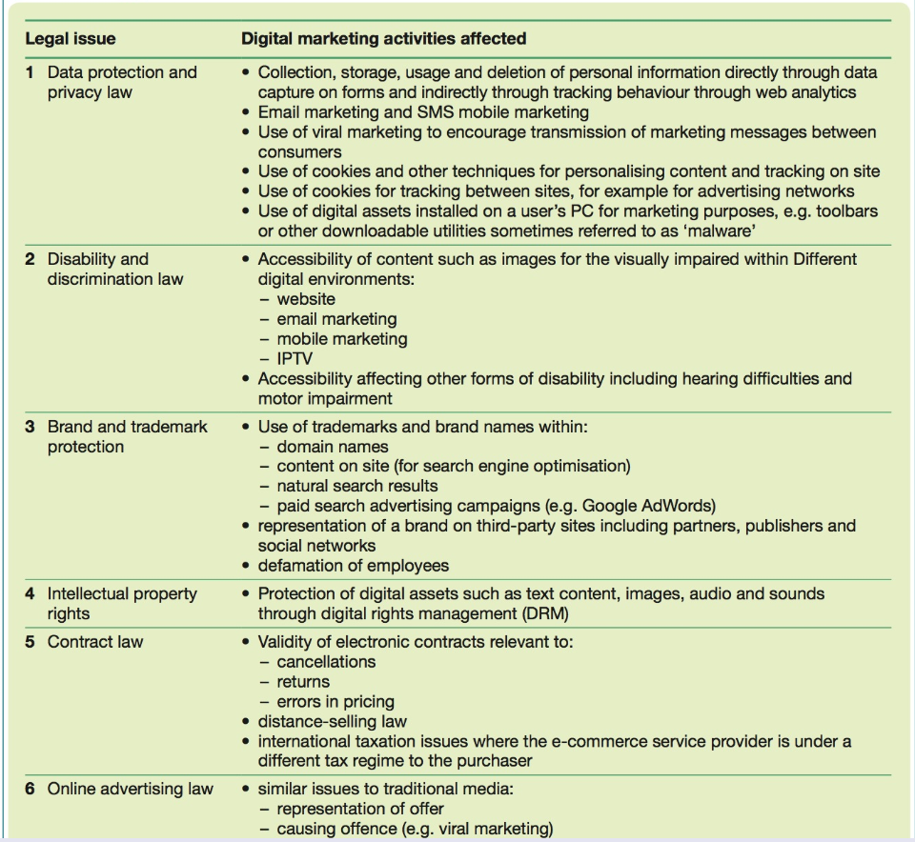

Slide 51
THREE LEVELS OF THE BUSINESS ENVIRONMENT
Macro- Environment
Micro- Environment
Internal environment
(Palmer and Hartley (2009); The Business Environment 6e. McGraw-Hill)

Slide 52
Micro Environment/ Operating Environment
Organisations can have some influence over stakeholder groups

Slide 53
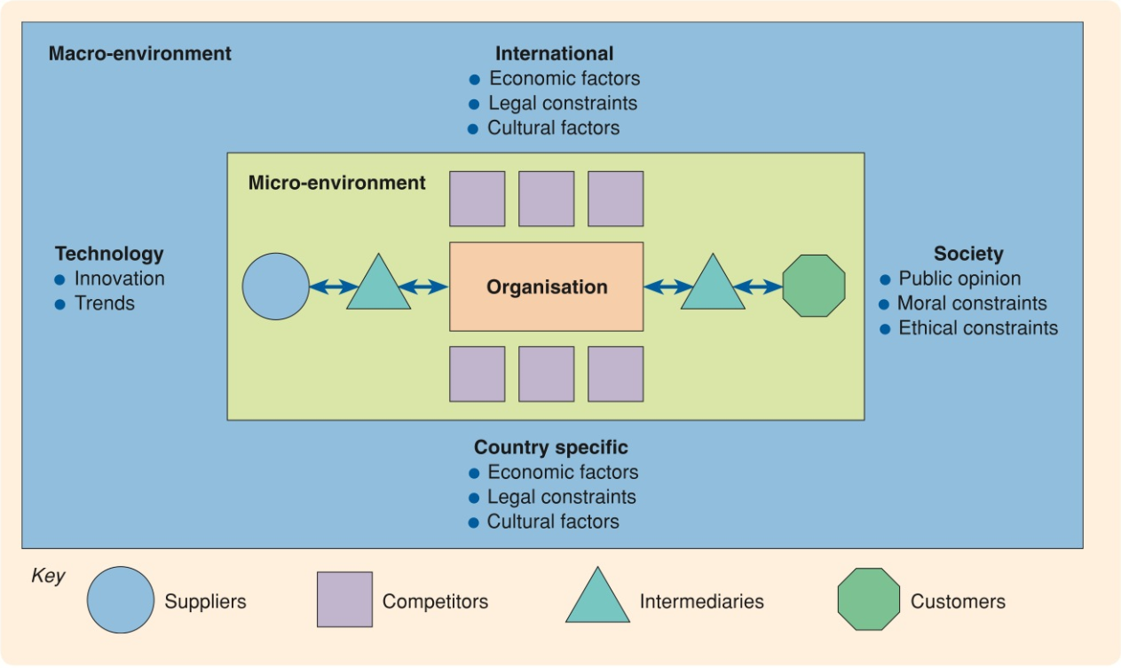
Chaffey & Ellis 2016

Slide 54
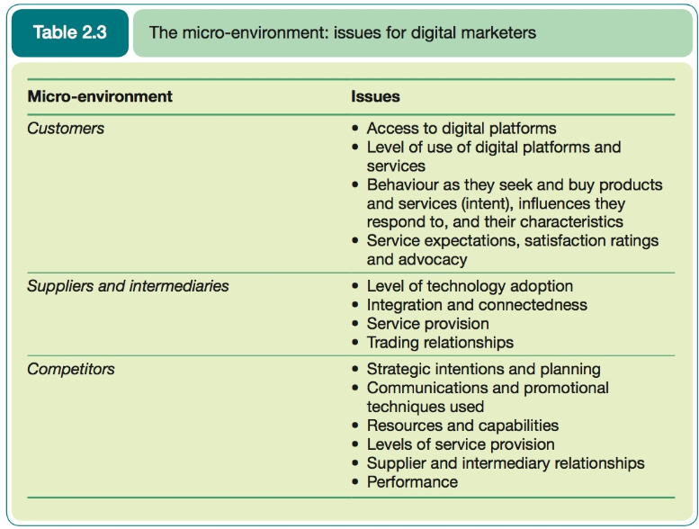

Slide 55
Customers
Consumer behaviour analysis
  Demand analysis: the potential and actual volume of visitors to a site and the extent to which this achieves strategic objectives.
  Digital consumer behaviour: the characteristic and digital experiences of target consumers. Customers segments can be created from this.

Slide 56
Using tools outlined below along with primary research a digital marketer should be able to develop a sound understanding of the characteristics, needs and wants of their target market and their propensity to engage with digital channels.

Slide 57
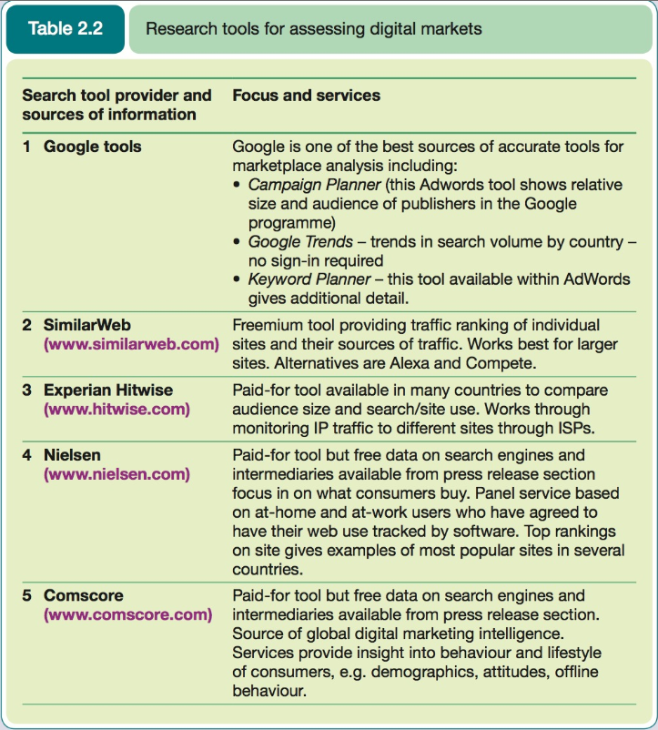

Slide 58
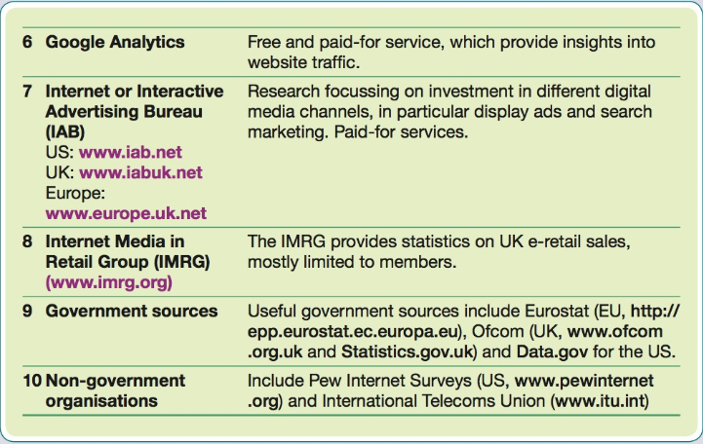

Slide 59
Online Keyword Research Tools
Google Autocomplete
Google AdWords Keyword Planner
Google Trends
SEMRush – for competitor information

Slide 60
Discussion
What influences you, to buy from a website or not?

Slide 61
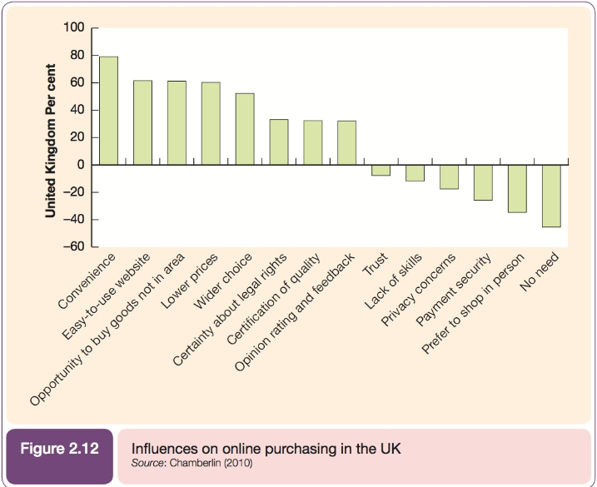

Slide 62
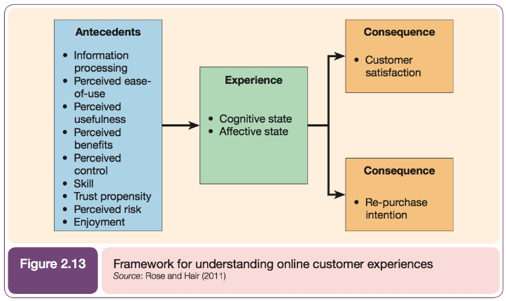

Slide 63
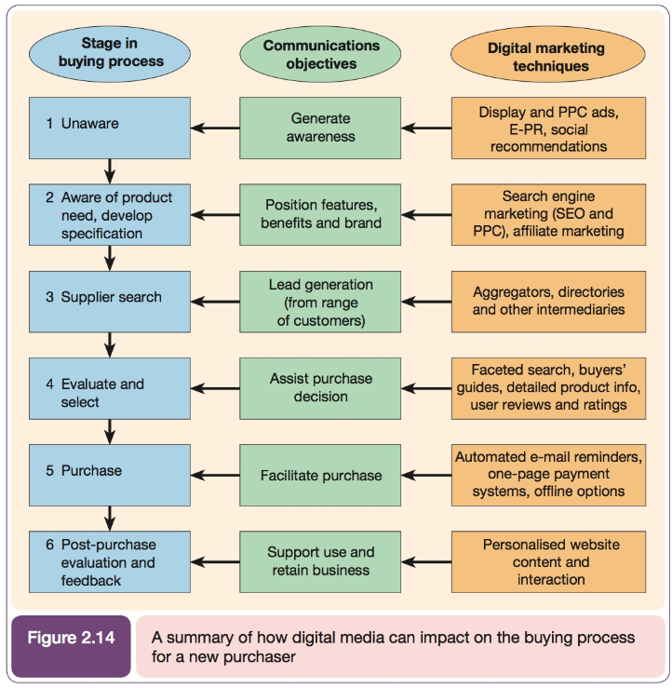

Slide 64
Customer Personas
https://blog.hubspot.com/blog/tabid/6307/bid/33491/everything-marketers-need-to-research-create-detailed-buyer-personas-template.aspx

Slide 65
The Buying Process
Awareness
Interest
Evaluation
Trial
Adoption
    Kotler et al (2001)

Slide 66
The Digital Buying Process
Problem Recognition
Information Search
Evaluation
Decision
Action
Post-purchase
      Chaffey and Smith (2012)

Slide 67
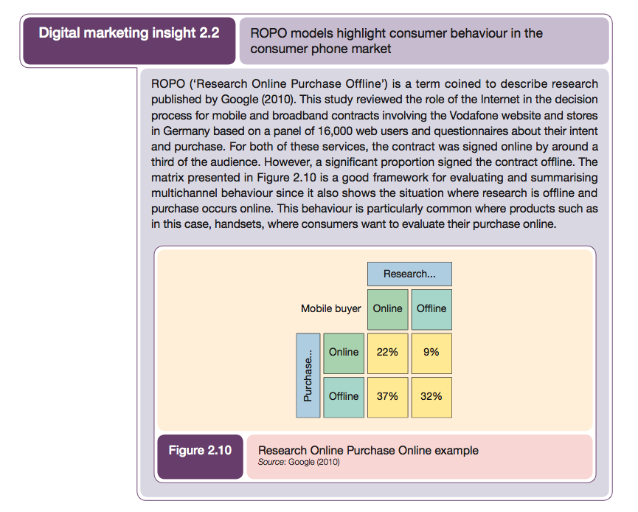
Multichannel Purchase

Slide 68
Multichannel conversion models
Conversion modelling can be quite complex because it needs to take into account online and offline behaviour.
Some shopper may buy online while others use phone or buy in-store.
Useful to put in place some sort of monitoring of cross-channel conversion at different stages of the buying process.

Slide 69
How?
Phone numbers unique to the website can be used as an indication of the volume of callers to a contact centre influenced by the website (figure 2.9).

Slide 70
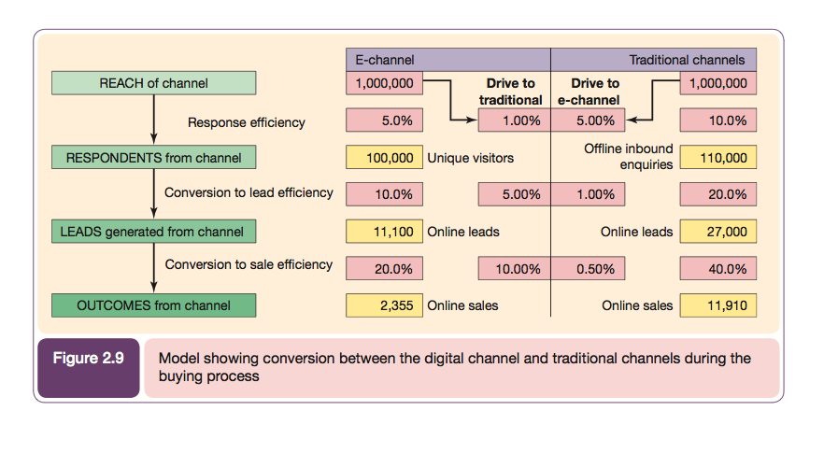

Slide 71
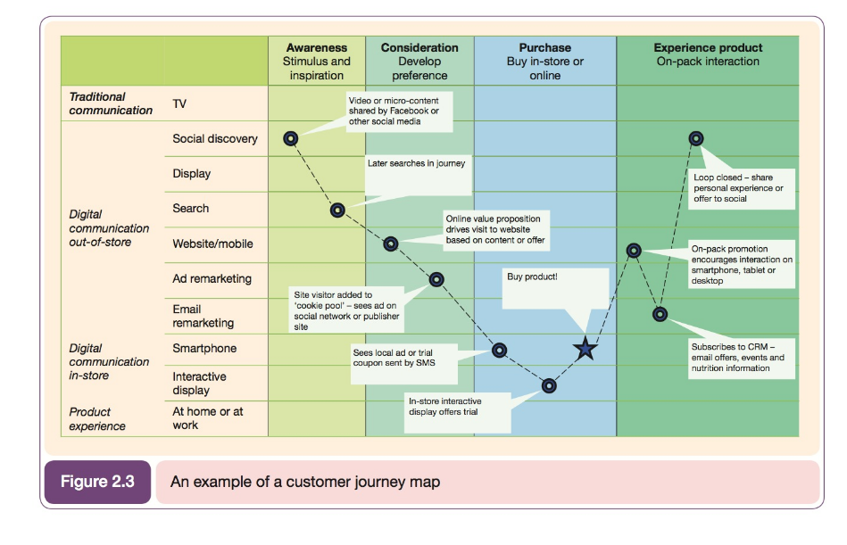

Slide 72
ZMOT Google’s retail-specific model for understanding customer journey

Slide 73
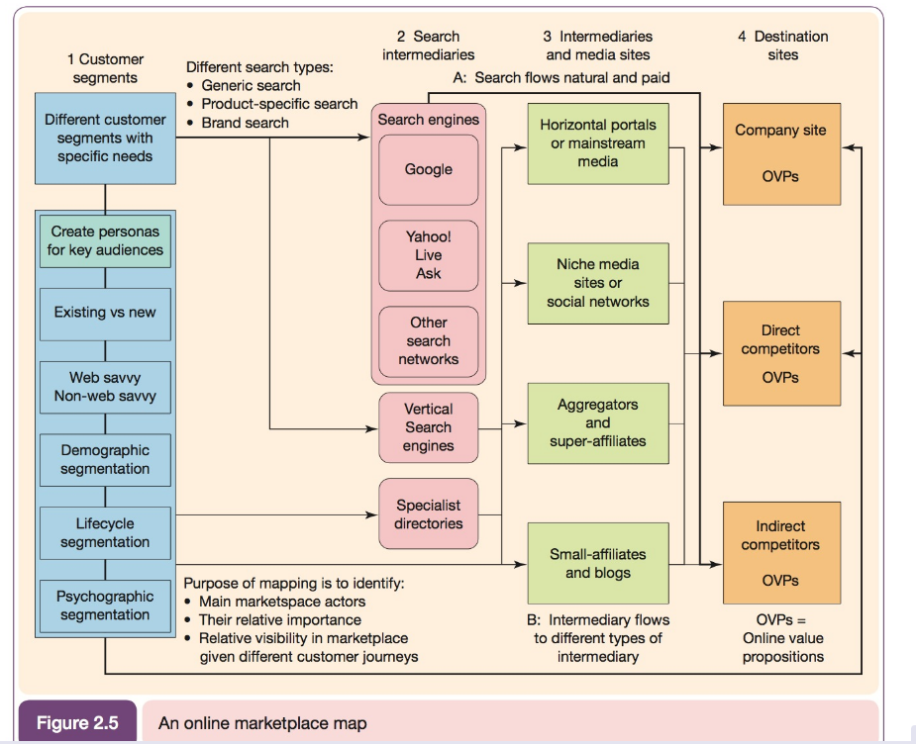
Customer Journey

Slide 75
Social Network
Members of a social network or community will differ in the extent to which they are connected with others.
The most influential will be highly connected and will discuss issues of interest with a wide range of contacts.
(Social listening tools can find these people)

Slide 76
How do you qualify what is a competitor?
Swansea City Football Club
What business are they in?
  Football?
  Sporting Event?
  Leisure?

Slide 77
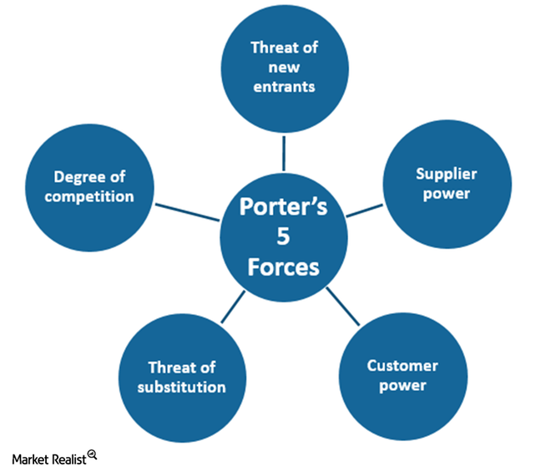
Competitors: Porter’s 5 Forces

Slide 78
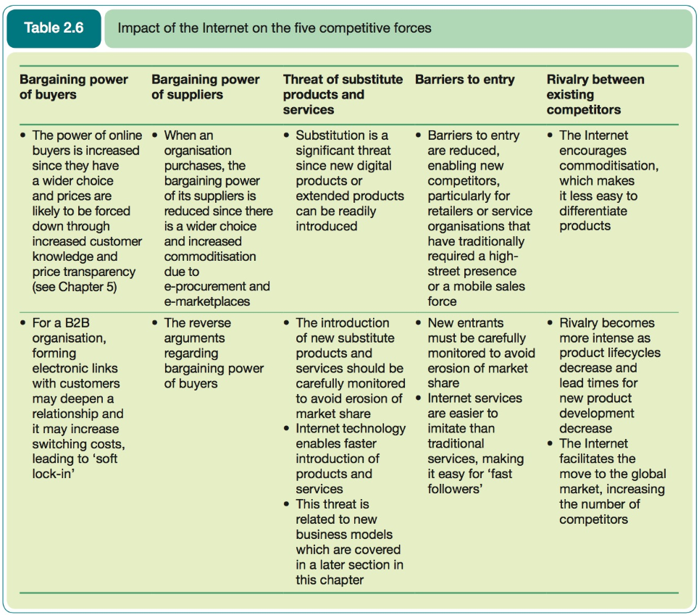

Slide 79
Competitor Benchmarking
A structured analysis of the online services, capabilities and performance of an organisation within the areas of customer acquisition, conversion and growth.

Slide 80
Competitor monitoring tools
https://blog.kissmetrics.com/25-sneaky-online-tools/

Slide 81
Suppliers
Key issues
  How suppliers affect the price of final product
  Availability
  Features
Internet has created new structures and channels in the supply chain

Slide 82
Online marketing intermediaries
Companies that help to promote, sell and distribute its products and services
  Portals
  Directories
  Price comparison sites
  Affiliate sites
  Auction sites

Slide 83
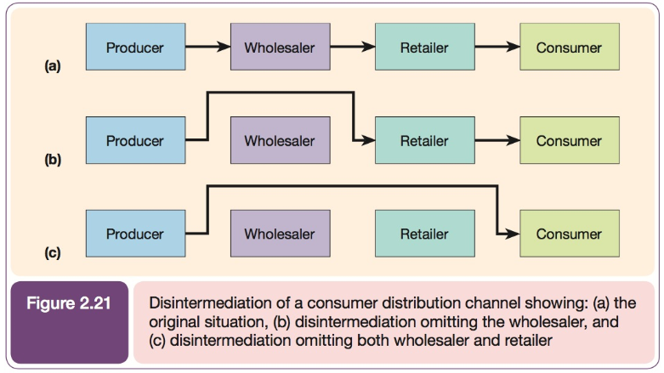
New Channel structures

Slide 84
Monitoring Existing Trends and their impact
The changes to the environment shold be monitored on an ongoing basis,
Market research can be used to gather primary and secondary data in order to analyse and monitor emerging trends in the market.
Digital marketing research is carrying out market research through digital technologies. It allows for studies which may not have been possible to conduct offline.

Slide 85
Google Trends
https://www.koozai.com/tv/search-marketing/seo-resources/google-trends/

Slide 86
Primary Data
Primary data is data gathered for the first time to answer a specific problem. It is original and collected for a specific purpose. This is expensive and time consuming but it is more focused than secondary research.
Online primary research methods include:
  Surveys (online, SMS, email)
  Online focus groups

Slide 87
Secondary Data
Information that has previously been gathered for another purpose.
Secondary data can be gathered though:
  The opinions of writers/consumers
  Facts published by experts and professionals.

Slide 88
Data gathering and analysis using industry applications
Google Analytics
  The most commonly used tool for onsite web analytics
  Track visitor behaviour
  Record and analyse a wealth of information including how visitors come to your site, which key word they search for, where they go when they leave…

Slide 89
Practice with Google Analytics demo account:
  https://support.google.com/analytics/answer/6367342?hl=en
Learn through Analytics Training and Support
  https://support.google.com/analytics/answer/4553001?hl=en

Slide 90
Radian 6
(Now part of Social Studio)
A marketing cloud to listen, engage, gain insight publish content, optimise social media advertising, measure social media marketing programmes and integrate social data with CRM information.
Many brands use this tool to find out what people are saying on Facebook, Twitter and the rest of the social web
https://www.youtube.com/watch?v=295brS23_4I

Slide 91
Sentiment Analysis
https://www.iprospect.com/en/ca/blog/10-sentiment-analysis-tools-track-social-marketing-success/
https://www.quora.com/What-are-the-best-alternatives-to-radian6
Hootsuite

Slide 92
News
Older news
Newer news

Slide 93
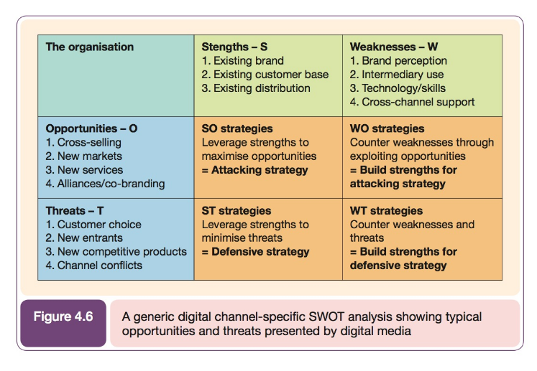
SWOT and TOWS

Slide 94
By analyzing the external environment (threats and opportunities), and your internal environment (weaknesses and strengths) you can use these techniques to think about the strategy of your whole organization, a department or a team.
You can also use them to think about a process, a marketing campaign, or even your own skills and experience.

Slide 95
The only difference between TOWS and SWOT is that TOWS emphasizes the external environment whilst SWOT emphasizes the internal environment.

Slide 96
For each combination of internal and external environmental factors, consider how you can use them to create good strategic options:
Strengths and Opportunities (SO) – How can you use your strengths to take advantage of these opportunities?
Strengths and Threats (ST) – How can you take advantage of your strengths to avoid real and potential threats?
Weaknesses and Opportunities (WO) – How can you use your opportunities to overcome the weaknesses you are experiencing?
Weaknesses and Threats (WT) – How can you minimize your weaknesses and avoid threats?

Slide 97
Two more micro models…

Slide 98
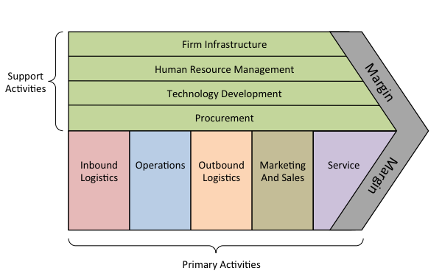
Porter’s Value Chain

Slide 99
Porter Value Chain
https://www.youtube.com/watch?v=9-iaL2KxtsA

Slide 100
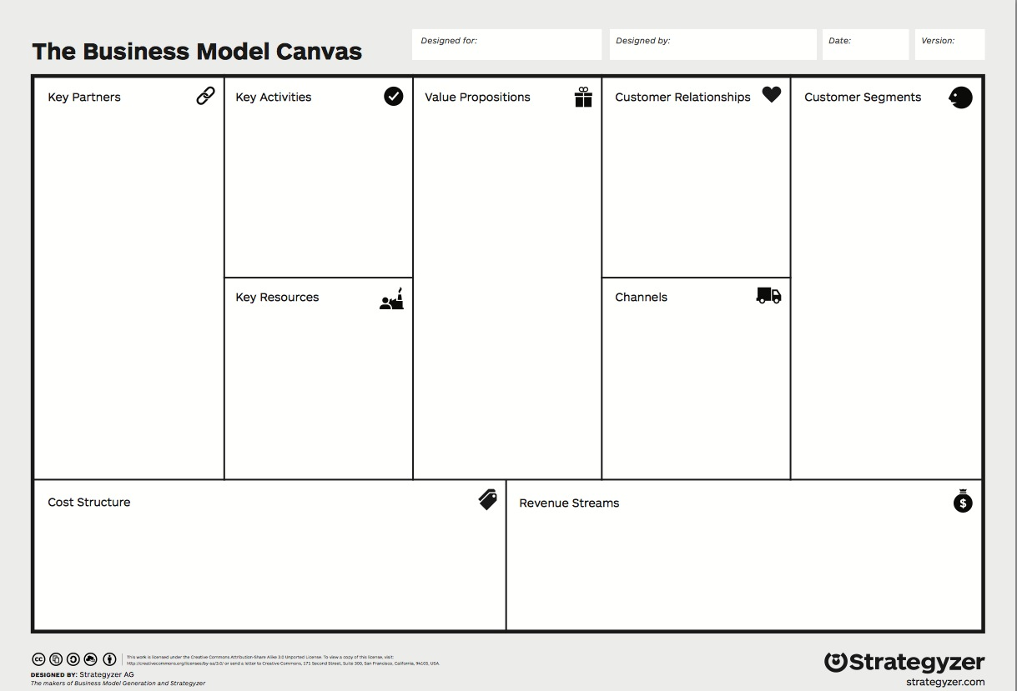
Business Models

Slide 101
Business Model Canvas Explained

