Slide 1
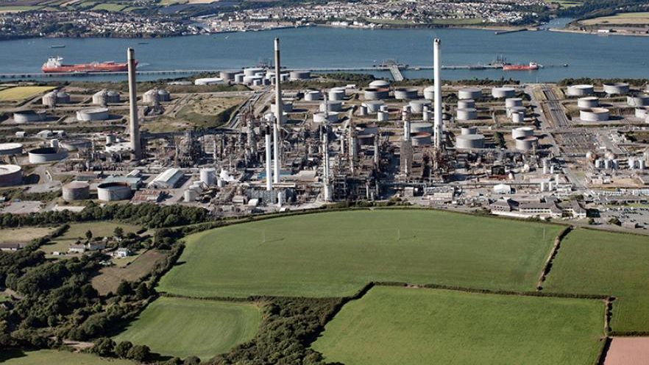

Technical Report
By Thomas Griffiths-Reynolds

Slide 2
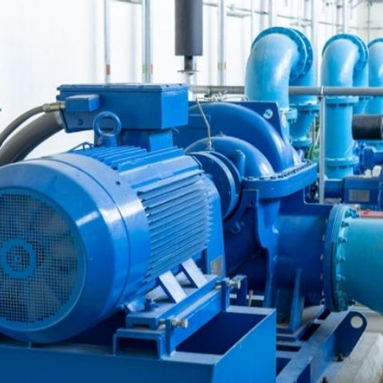

What was researched?
For my technical I decided to research DC motors since they are a big factor in my job as I am currently in the electrical department at the refinery and would like to improve my knowledge and understanding.

Slide 3

Aims & Objectives
To research the topic of DC motors using a variety of sources to get a better understanding of how they operate to assist me in my apprenticeship.
Successfully carry out tests on two variations of the DC motor to see how they compare to one another

Slide 4
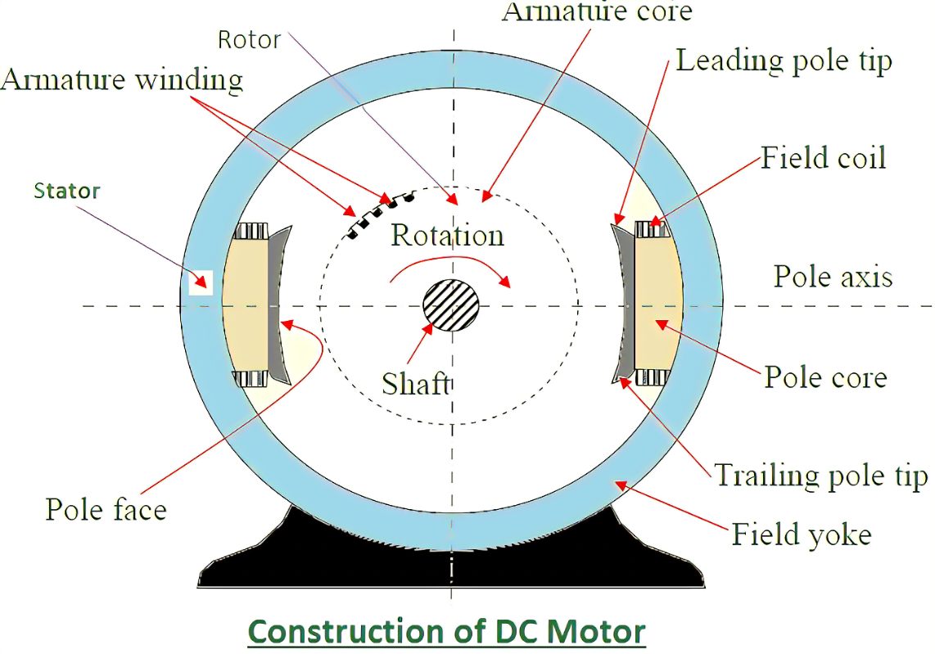

What is a DC motor?
DC motors are electrical machines that transform electrical energy into mechanical movement through the interaction of magnetic fields and current-carrying conductors.

Slide 5
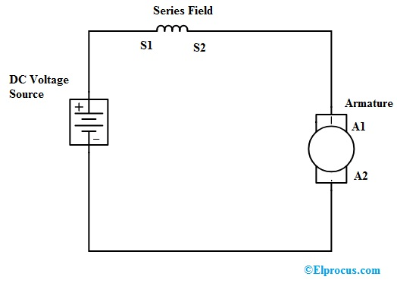
Series DC Motor

Slide 6
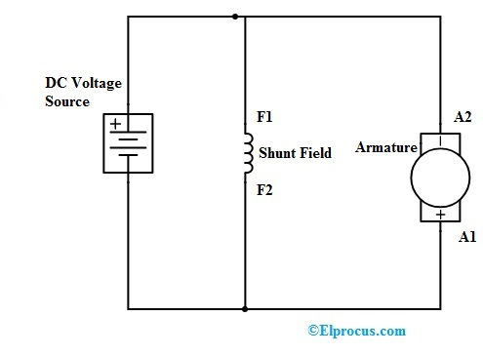
DC Shunt Motor

Slide 7
Testing
Run motor 10 minutes prior to testing to ensure the temperature of the motor is properly stabilized.
Activate variable DC power supply and mains distribution panel.
Raise voltage to 24 volts
Activate the 3 Amp Eddy Current Power Supply
Gradually lower the speed of the motor as much as possible whilst increasing the voltage.

Slide 8
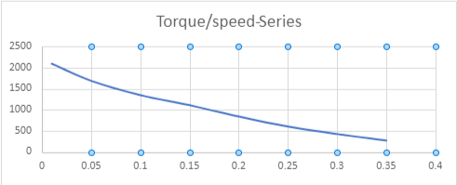
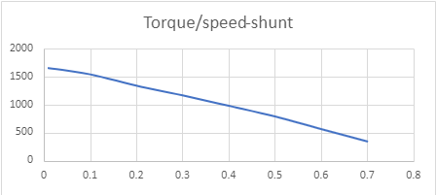
Discussion of Results: Torque/Speed

Slide 9
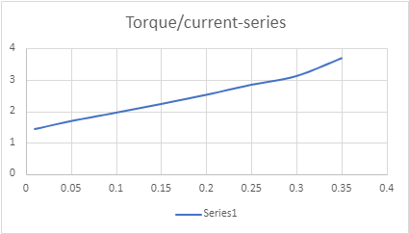
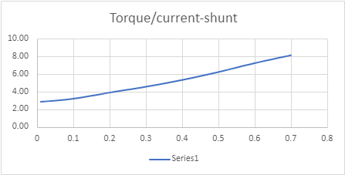
Discussion of Results: Torque/Current

Slide 10
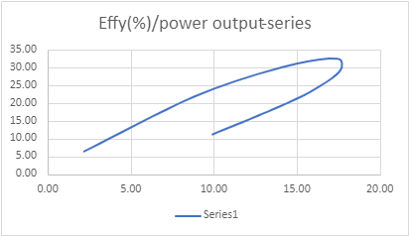
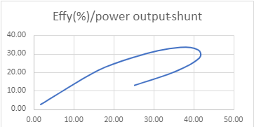
Discussion of Results: Efficiency (%)/Power Output

Slide 11
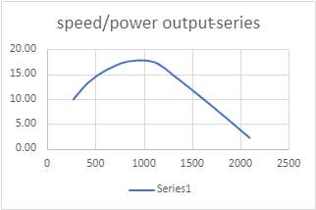
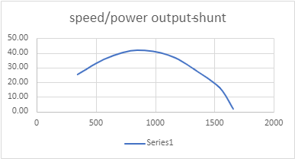
Discussion of Results: Speed/Power Output

Slide 12
Conclusion

Slide 13

Any Questions?

Slide 14
Thank You For Listening

