Slide 1

Coaching and Mentoring
BMPF7303D Day 3

Slide 2


Slide 3

Action Learning Sets
Apply action learning principles within a peer coaching context
Explore complex professional issues
Demonstrate reflective practice, ethical awareness, and collaborative inquiry

Slide 4

Action Learning Sets
What it involves
Small peer learning groups that meet regularly
Real, current work challenges brought by participants
Questioning and listening, not advice or teaching
How it works
Action taken between meetings, owned by the individual
Reflection on learning, not just problem resolution
Clear ground rules for confidentiality, respect, and challenge

Slide 5
Powerful questions
Sharing and learning
Reflection
Action (Do)
Development: Group & individual
Active listening
Action
Learning

Slide 6
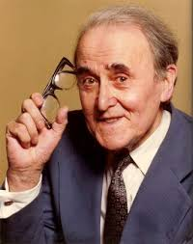
Reg Revans (1907–2003)
Background as a physicist
Director of Education for the NCB (1945–1950), where he first formally developed action learning in practice
Worked extensively in South Wales coal mines, bringing managers and miners together to learn from shared challenges at the coalface
Demonstrated significant improvements in safety and productivity through action learning in Welsh and UK coalfields
Believed learning equals programmed knowledge plus questioning insight (L = P + Q)

Slide 7

Action Learning Conventions
Ground rules
‘Wicked problem’
‘Set’ of 5-8 individuals
Open (no leading) questions
Action
Learning
Facilitator

Slide 8


Slide 9




Time management
Confidentiality
Use of “I”
Everyone is equal

Slide 10

Active listening
Being able to hear what is said as well as what is not being said
Requires astute observation to be in touch and in tune with who is saying what, how, when and to whom
Careful listening enables you to acquire a “helicopter-level” perspective and holistic view
Able to focus on any concerns as well as on the development of the individual

Slide 11
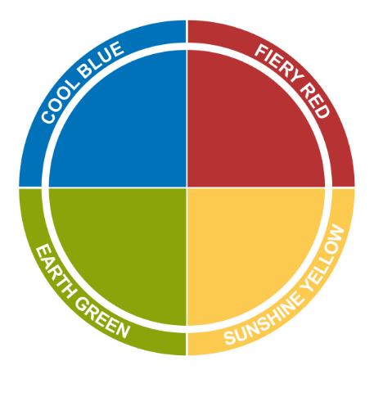

Insights Colour Energy Recap
Recognise and describe Insights colour energies in behaviour and communication
Apply Insights awareness to listening, questioning, and interaction in groups
Reflect on personal preferences and their impact in Action Learning Sets
Notes:
Brief as above. Ask for output to be produced on a sheet of flipchart paper, do not elaborate on what is required.
At the end of the 2 minutes, ask each group to feedback in turn.
Do not comment on the content of each presentation until all four groups have completed their presentations.
Ask the group to identify from each of the presentations evidence of the selected colour energy.
Add any observations of your own and highlight the differences between the colour approaches, pointing out any opposites if appropriate.
Debrief questions:
Within your group, what did you notice about your interaction?
What were your key concerns in planning the celebration?
How did you make decisions?
What did you notice about other groups’ presentations?
Did any of the other groups consider things that your group didn’t think about?
What other colour energies did you see at play in the groups other than their dominant?

Slide 12


Slide 13
Individuals with a preference for Fiery Red energy …
Are active and move in a positive and firm direction
Have a strong determination that influences those they interact with
Are single-minded and determined in their focus on results
Approach others in a direct and straightforward manner
Seek an outcome that is specific and tangible

Slide 14
Individuals with a preference for Sunshine Yellow energy …
Radiate enthusiasm and encourage participation
Approach others in a persuasive, engaging and inviting manner
Enjoy and seek the company of others
^{Have a desire to be involved}
Like to be noticed and appreciated for their contributions

Slide 15
Individuals with a preference for Earth Green energy …
View the world through what they value and what is important to them
Defend what they value with quiet determination and persistence
Seek harmony and depth in relationships
Ensure all individual perspectives are heard and considered in making choices or decisions
Prefer democratic approaches that respect the individual

Slide 16
Individuals with a preference for Cool Blue energy …
Desire to know and understand the world around them
Value independence and intellect
Maintain a detached and objective standpoint
Think things through before committing to action
Like information to be accurate and complete before proceeding

Slide 17
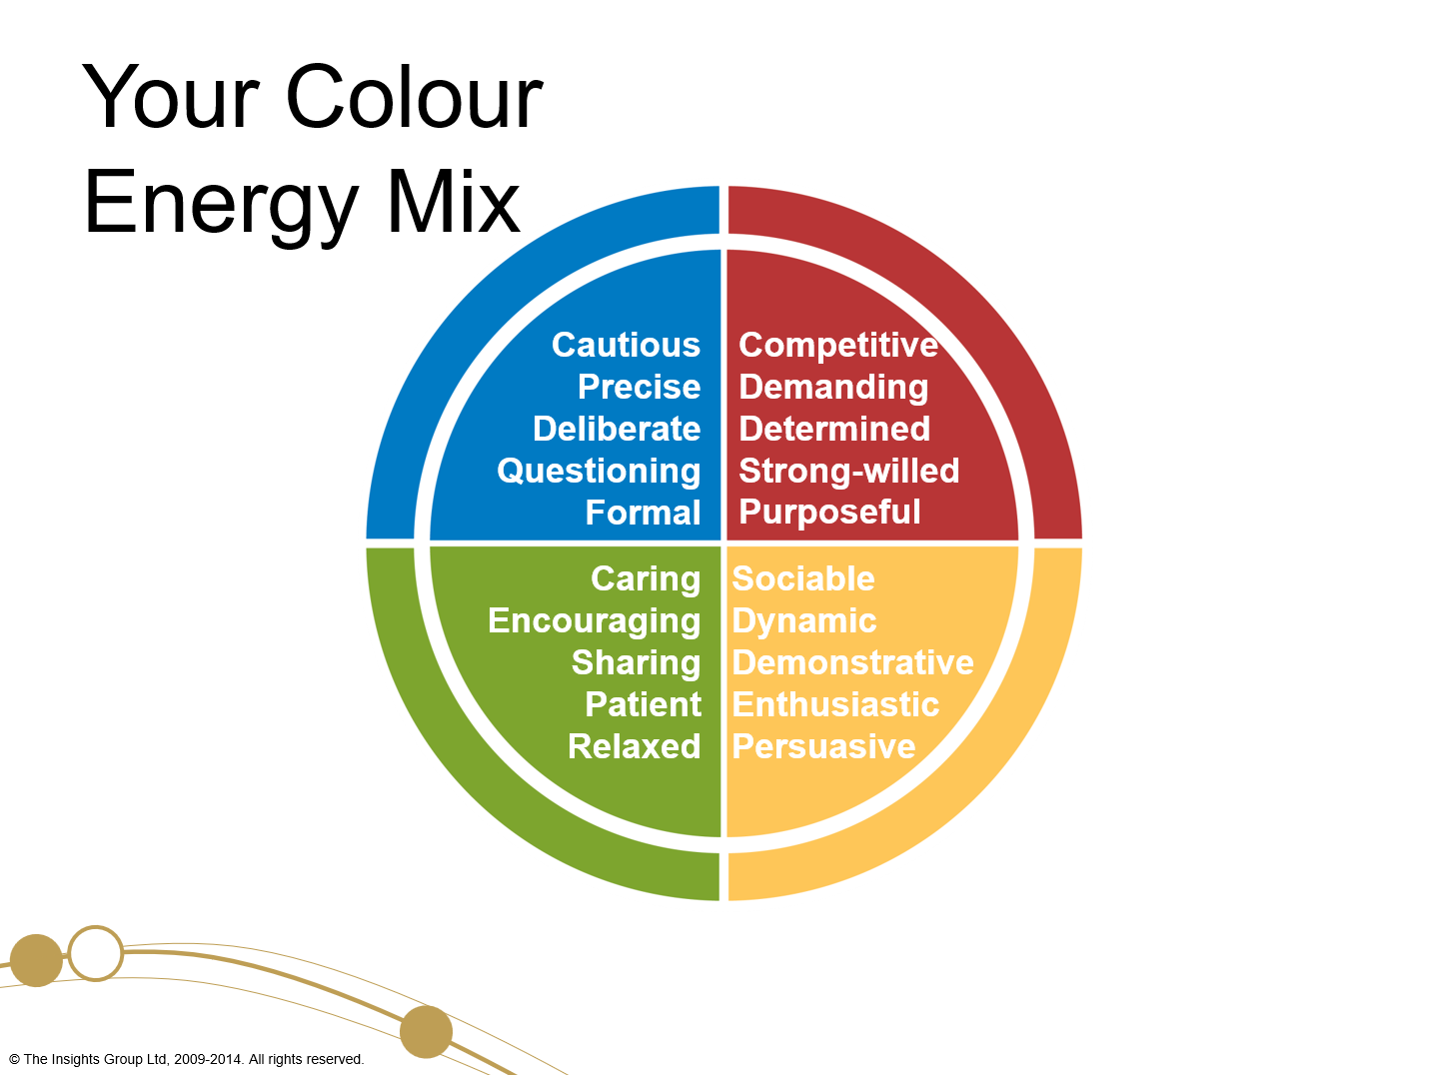

Slide 18

Your Colour Energy Mix
Cautious
Precise
Deliberate
Questioning
Formal
Competitive
Demanding
Determined
Strong-willed
Purposeful
Stuffy
Indecisive
Suspicious
Cold
Reserved
Aggressive
Controlling
Driving
Overbearing
Intolerant
Caring
Encouraging
Sharing
Patient
Relaxed
Sociable
Dynamic
Demonstrative
Enthusiastic
Persuasive
Docile
Bland
Plodding
Reliant
Stubborn
Excitable
Frantic
Indiscreet
Flamboyant
Hasty

Slide 19
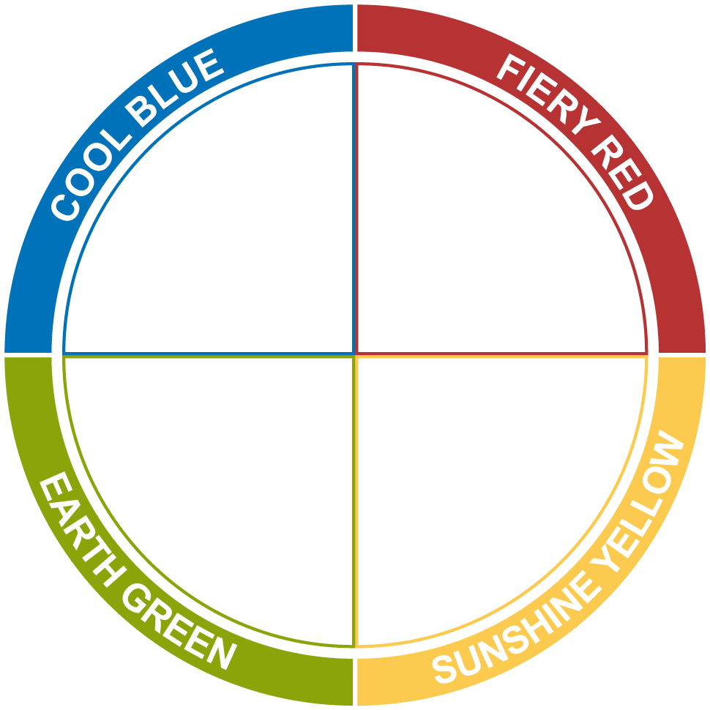
Your Colour Energy Mix
We each have all four colour energies within us; it is the combination of the four energies that creates the unique YOU.

Slide 20
Action Learning Set

