Slide 1
ECEY4010C
Arfer amlieithog yn y blynyddoedd cynnar
Hanes yr iaith Gymraeg
ECEY4010
Multilingual practice in the early years
History of the Welsh language

Slide 2
Cynnwys
Contents
Hanes yr iaith;
Yr wyddor;
Ymadroddion cyffredin;
Cerddoriaeth Cymraeg;
Cyfryngau Cymraeg.
History of the language;
The alphabet;
Common phrases;
Welsh music;
Welsh media.

Slide 3
Sgiliau Cyflogadwyedd/Trosglwyddadwy
Employability/Transferable Skills
Trefn;
Cynllunio;
Ymchwilio;
Cymryd nodiadau;
Sgiliau trafod;
Rhannu syniadau.
Organisation;
Planning;
Researching;
Note taking;
Discussion skills;
Idea sharing.

Slide 4
Adnoddau
Resources
PP;
Ymchwil;
Erthyglau;
Gwefannau;
Cyfryngau.
PP;
Research;
Articles;
Websites;
Media.

Slide 5
Yr iaith Gymraeg
The Welsh language
Esblygodd o’r Indo-Ewropeaidd;
Wedi'i siarad o leiaf 6,000 o flynyddoedd yn ôl;
Ymfudo - esblygodd tafodieithoedd i ieithoedd gwahanol;
Evolved from Indo-European;
Spoken at least 6,000 years ago;
Migration – dialects evolved into separate languages;
(Davies, 2014)

Slide 6
Yr iaith Gymraeg
The Welsh language
Ieithoedd Celtaidd Brythonig - un ohonynt yn Gymraeg;
Cymraeg yw'r iaith hynaf ym Mhrydain.
Brythonic Celtic languages – one of which is Welsh;
Welsh is the oldest language in Britain.
(Davies, 2014)

Slide 7
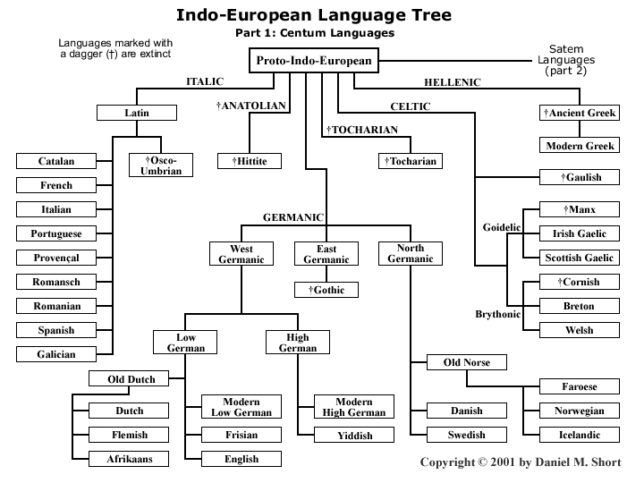

Slide 8
Yr iaith Gymraeg
The Welsh language
Yr iaith Gymraeg wedi rhagflaenu’r iaith Saesneg;
Mae’r Gymraeg wedi wynebu yr un heriau ac ieithoedd lleiafrifol/treftadaeth eraill;
Welsh preceded the arrival of the English language;
Welsh has faced the same issues as other minority/heritage language;

Slide 9
Yr iaith Gymraeg
The Welsh language
Nawr, mae’r Gymraeg ochr yn ochr gyda Saesneg fel iaith swyddogol Cymru;
Fodd bynnag, nid oedd hyn yn wir rhai blynyddoedd yn ôl...
Alongside English, it is now the official language of Wales;
However, this status was not always the case…

Slide 10
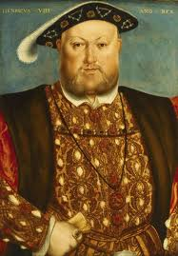
1536 – 1542: Deddfau Undeb
Cyfraith Lloegr i fod yr unig gyfraith yng Nghymru;
Saesneg byddai’r unig iaith swyddogol yng Nghymru;
Ni fyddai unrhyw un â ddefnyddiodd y Gymraeg yn dal swydd gyhoeddus yn nhiroedd y Brenin;
Yr iaith Gymraeg yn colli statws swyddogol;
Yr iaith Gymraeg yn gyfyngedig i ddosbarthiadau gweithiol a chanol is.
(Source: henry-viii.jpg)
Notes:
10

Slide 11
1536 – 1542: The Acts of Union
Law of England to be only law of Wales;
English would be the only official language to be used in Wales;
Anyone who used the Welsh language would not hold public office in the lands of the King;
Deprived Welsh of its official status;
Welsh became confined to working and lower middle classes.
(Source: henry-viii.jpg)
Notes:
11

Slide 12
Effaith y Ddeddf?
Impact of the Act?
“A monoglot Welsh speaker could only feel underprivileged under such a system and over the centuries this awareness of the privilege of English speakers would nurture attitudes towards the Welsh language which would endanger the existence of the language.”
(Davies, 1994: 9)
Notes:
12

Slide 13
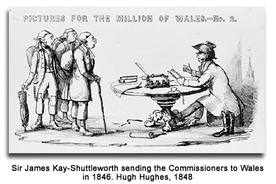
Brad y Llyfrau Gleision
Ymchwiliad mewn i system addysg Cymru;
Canfyddiadau ~ Plant Cymreig:
- Wedi’u addysgu a’u dysgu’n wael;
Ychydig neu dim dealltwriaeth o’r iaith Saesneg;
Anwybodus, yn frwnt a chymhelliant gwael;
Canlyniad ~ Unig ffordd i wella’u hunain oedd i gyfathrebu a chael eu haddysgu yn Saesneg.
(Carradice, 2011; National Library of Wales, no date)

Slide 14
The Treason of the Blue Books
Inquiry into Welsh education system;
Findings ~ Welsh children were:
Poorly educated and taught;
Little or no understanding of English language;
Ignorant, dirty, badly motivated;
Result ~ Only way to improve themselves was to communicate, and be educated in English.
(Carradice, 2011; National Library of Wales, no date)

Slide 15
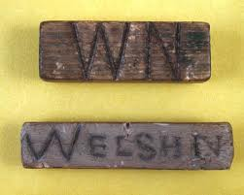

Slide 16
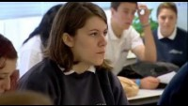
The Welsh Knot (2010)

Slide 17
Beth oedd yr effaith?
What was the impact?
Cyfrifiad 1911 – 43% siaradwyr Cymraeg;
Cyfrifiad 2011 – 19% siaradwyr Cymraeg;
Cyfrifiad 2021 – 17.8% siaradwyr Cymraeg.
Pam y gostyngiad?
Ystyriwch teimladau tuag at yr iaith a allai fod wedi tyfu dros canrifoedd.
Beth am eich cymuned chi?
Census 1911 – 43% Welsh speakers;
Census 2011 – 19% Welsh speakers;
Census 2021 – 17.8% Welsh speakers.
Why the decline?
Consider feelings towards the language which may have grown over centuries.
What about your own communities?
Notes:
17

Slide 18
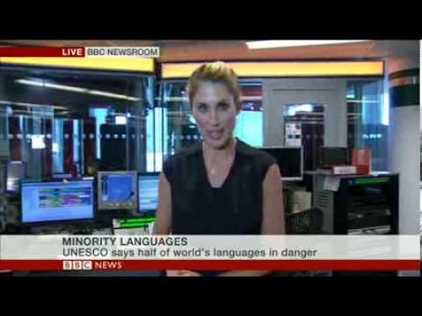
Clip BBC
BBC Clip
Tomchak, A. (2013) Minority Languages, https://www.youtube.com/watch?app=desktop&v=T-5HDuhEaDM [Accessed: February 17 2021].
Notes:
18

Slide 19
Meddwl cyfredol?
Current thinking?
Nation Cymru (2018) Carmarthen business denies ‘anti-Welsh language’ comments after bad reviews, https://nation.cymru/news/carmarthen-business-denies-anti-welsh-language-comments-after-bad-reviews/ [Accessed: February 17 2021].
ITV News (2021) Iceland apologises after supermarket director calls Welsh language 'gibberish‘, https://www.itv.com/news/wales/2021-02-17/iceland-apologises-after-supermarket-director-calls-welsh-language-gibberish [Accessed: February 17 2021].
Wales Online (2023) Artists refuse to perform at Eisteddfod amid Welsh-language policy row’, Artists refuse to perform at Eisteddfod amid Welsh-language policy row - Wales Online [Accessed: October 17 2023].
Sky News (2023) University lecturer ‘sacked’ after saying bilingual road signs are ‘dangerous’, University lecturer 'sacked' after saying bilingual road signs are 'dangerous' (msn.com) [Accessed: October 17 2023].

Slide 20
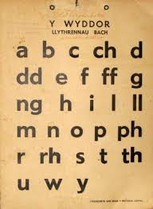
Yr Wyddor
The Alphabet
29 lythyren;
Newydd ychwanegu ‘j’;
8 lythyren dwbl;
Bob lythyren yn ffonetig.
Ynganiad/Pronunciation
(Source: Pinterest, no date)
Notes:
20

Slide 21
Yr Wyddor
The Alphabet
29 letters;
‘j’ recently added;
8 double letters;
Every letter is phonetic.
Ynganiad/Pronunciation
(Source: Pinterest, no date)
Notes:
21

Slide 22
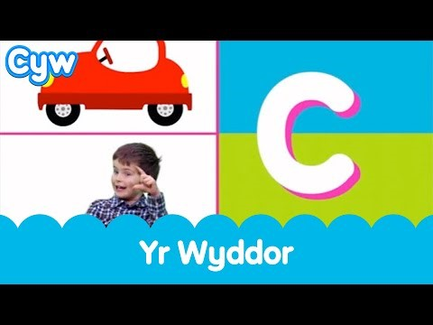
Clip Cyw
Clip from Cyw (Chick in Welsh)
Cyw (2017) Cân Yr Wyddor 🍎 | The Cyw Alphabet Song, https://www.youtube.com/watch?v=h-zu72YpXKY [Accessed: February 17 2021].
Notes:
22

Slide 23

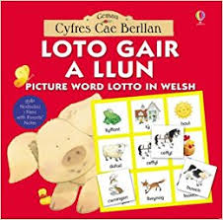
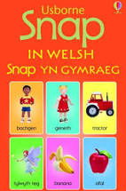
Syniadau…
Ideas…
Notes:
23

Slide 24
Lliwiau
Colours
coch | red
oren | orange
melyn | yellow
gwyrdd | green
glas | blue
porffor/piws | purple
pinc | pink
gwyn | white
llwyd | grey
du | black
brown | brown

Slide 25
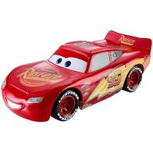
Y gystrawen Gymraeg
Welsh syntax
Yn yr iaith Gymraeg, rhoddir geiriau mewn trefn wahanol i eiriau Saesneg.
Saesneg – Ansoddair-Enw;
Cymraeg – Enw-Ansoddair.
In Welsh, words are placed in a different order to English words.
English – Adjective-Noun;
Welsh – Noun-Adjective.
Example:
red car
car coch

Slide 26
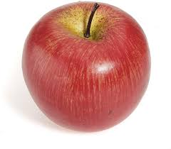



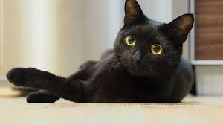
Ewch amdani!
Have a go!
yellow sun
haul melyn
red apple
afal coch
blue book
llyfr glas
black cat
cath ddu
green grass
porfa/glaswellt gwyrdd

Slide 27
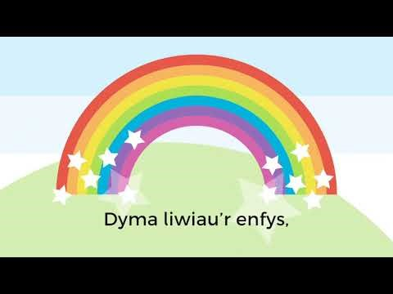
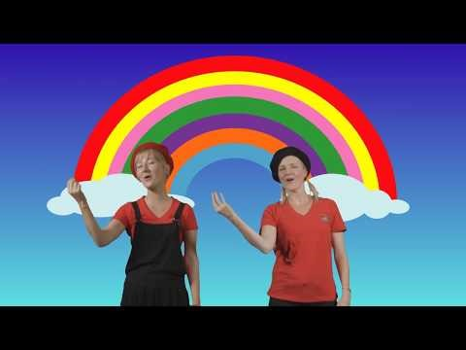
Amser i ganu…
Time to sing…
(Source: Cymraeg i Blant, 2018)
(Source: Hey dee ho educational services, 2018)

Slide 28
Rhifau
Numbers
1 - Un
2 - Dau
3 - Tri
4 - Pedwar
5 - Pump
6 - Chwech
7 - Saith
8 - Wyth
9 - Naw
10 - Deg
1 - One
2 - Two
3 - Three
4 - Four
5 - Five
6 - Six
7 - Seven
8 - Eight
9 - Nine
10 - Ten

Slide 29
Rhifau
Numbers
20 - Dau ddeg/Ugain
30 - Trideg
40 - Pedwardeg
50 - Pumdeg
60 - Chwedeg
70 - Saithdeg
80 - Wythdeg
90 - Nawdeg
100 - Cant
1,000 - Mil
1,000,000 - Miliwn
20 - Twenty
30 - Thirty
40 - Forty
50 - Fifty
60 - Sixty
70 - Seventy
80 - Eighty
90 - Ninety
100 - Hundred
1,000 - Thousand
1,000,000 - Million

Slide 30
Rhifau trefnol
Ordinal numbers
1af - Cyntaf/yn gyntaf
2il - Ail
3ydd - Trydydd
4ydd - Pedwerydd
5ed - Pumed
6ed - Chweched
7fed - Seithfed
8fed - Wythfed
9fed - Nawfed
10fed - Degfed
100fed - Canfed
1,000fed - Milfed
1,000,000fed - Miliynfed
1st - First
2nd - Second
3rd - Third
4th - Fourth
5th - Fifth
6th - Sixth
7th - Seventh
8th - Eighth
9th - Ninth
10th - Tenth
100th - Hundredth
1,000th - Thousandth
1,000,000th - Millionth

Slide 31
Y tywydd
The weather
“Beth yw’r tywydd heddiw?”
Mae’n heulog
Mae’n bwrw glaw
Mae’n bwrw eira
Mae’n wyntog
Mae’n gymylog
Mae’n niwlog
Mae’n stormus
“What’s the weather today?”
It’s sunny
It’s raining
It’s snowing
It’s windy
It’s cloudy
It’s foggy
It’s stormy

Slide 32
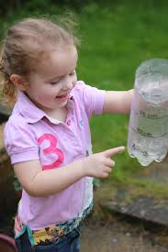
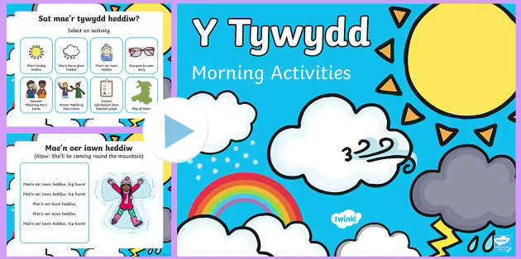
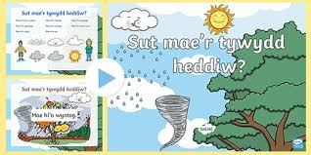
Syniadau…
Ideas…
Notes:
32

Slide 33
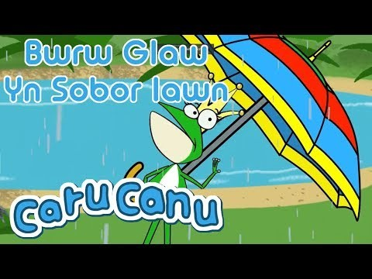
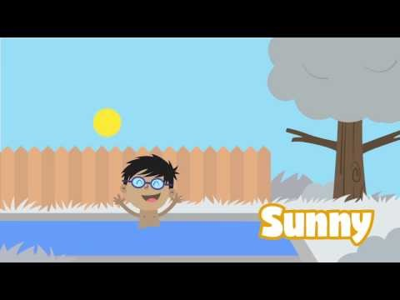
Amser i ganu…
Time to sing…
(Source: Cyw, 2019)
(Source: The Kiboomers, 2016)

Slide 34
Dyddiau’r wythnos
Days of the week
Dydd Sul
Dydd Llun
Dydd Mawrth
Dydd Mercher
Dydd Iau
Dydd Gwener
Dydd Sadwrn
Penwythnos
Sunday
Monday
Tuesday
Wednesday
Thursday
Friday
Saturday
Weekend

Slide 35
Misoedd
Months
Ionawr
Chwefror
Mawrth
Ebrill
Mai
Mehefin
Gorffennaf
Awst
Medi
Hydref
Tachwedd
Rhagfyr
January
February
March
April
May
June
July
August
September
October
November
December

Slide 36
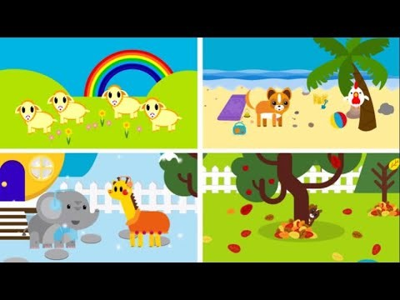
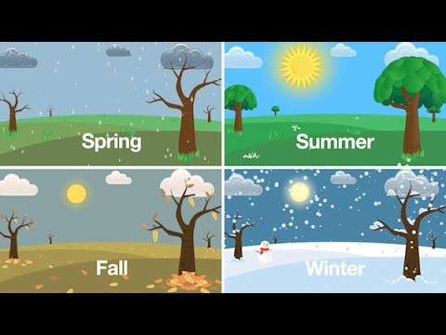
Tymhorau
Seasons
(Source: Cyw, 2017)
Gwanwyn - Spring
Haf - Summer
Hydref - Autumn
Gaeaf - Winter
(Source: Have fun teaching, 2015)

Slide 37
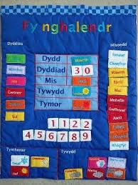
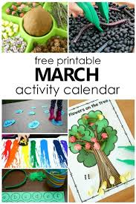

Syniadau…
Ideas…
Notes:
37

Slide 38
Teimladau – “Sut wyt ti’n teimlo?”
Feelings – “How are you feeling?”
Rwy’n/Rydw i’n hapus.
Rwy’n teimlo’n hapus.
Rwy’n/Rydw i’n drist.
Rwy’n teimlo’n drist.
Rwy’n flin/Mae’n ddrwg gen i.
Rwy’n teimlo’n flin.
I am happy.
I feel happy.
I am sad.
I feel sad.
I am sorry.
I feel sorry.

Slide 39
Teimladau
Feelings
Rwy’n/Rydw i’n gyffrous.
Rwy’n teimlo’n gyffrous.
Rwy’n flinedig/Rwyf wedi blino.
Rwy’n teimlo’n flinedig.
Rwy’n/Rydw i’n ofnus.
Rwy’n teimlo’n ofnus.
I am excited.
I feel excited.
I am tired.
I feel tired.
I am frightened.
I feel frightened.

Slide 40
Teimladau
Feelings
Rwyf wedi synnu.
Rwy’n teimlo’n syn.
Rwy’n/Rydw i’n grac/ddig.
Rwy’n teimlo’n grac/ddig.
Rwy’n/Rydw i’n swil.
Rwy’n teimlo’n swil.
I am surprised.
I feel surprised.
I am angry.
I feel angry.
I am shy.
I feel shy.

Slide 41
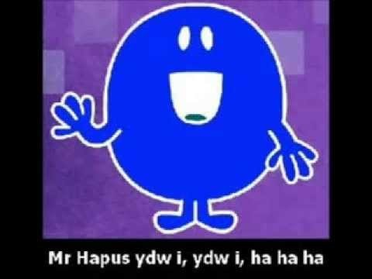
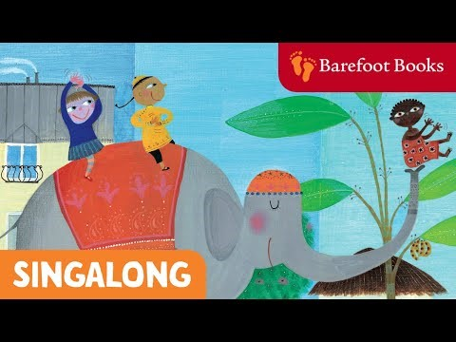
Amser i ganu…
Time to sing…
(Source: stiwdiojg cymru, 2014)
(Source: Barefoot Books, 2010)

Slide 42
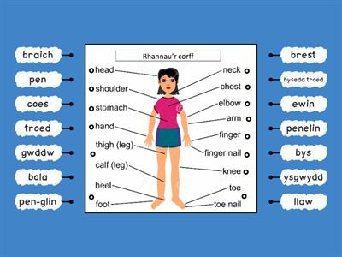
Rhannau o’r corff
Parts of the body

Slide 43
Syniadau eraill?
Further ideas?
Anifeiliaid;
Trafnidiaeth;
Siapiau;
Adrodd stori;
Gweithgareddau awyr agored;
Dillad;
Diddordebau.
Animals;
Transport;
Shapes;
Storytelling;
Outdoor activities;
Clothing;
Interests.

Slide 44
Cerddoriaeth Gymraeg – Gwlad y Gân
Welsh music – Land of Song
Canu yn rhan o hunaniaeth a thraddodiadau Cymreig;
Corau/cerddoriaeth gorawl;
Eglwys/Capel/Ysgol Sul;
Eisteddfodau;
Singing is part of Welsh identity and traditions;
Choirs/choral music;
Church/Chapel/Sunday school;
Eisteddfod;

Slide 45
Cerddoriaeth Gymraeg – Gwlad y Gân
Welsh music – Land of Song
Pyllau glo/haearn;
Clybiau a chymdeithasau;
Gwyliau a chyngherddau;
Chwaraeon.
Mines (coal, iron);
Clubs and societies;
Festivals and concerts;
Sports.

Slide 46
Cerddoriaeth
Music
Anthemau;
Emynau;
Hwiangerddi;
Caneuon plant;
Anthems;
Hymns;
Nursery rhymes;
Children’s songs;

Slide 47
Cerddoriaeth
Music
Corau/cerddoriaeth gorawl;
Canu gwerin;
Cerddoriaeth gyfoes;
Eraill?
Choirs/choral music;
Folk music;
Contemporary music;
Others?

Slide 48
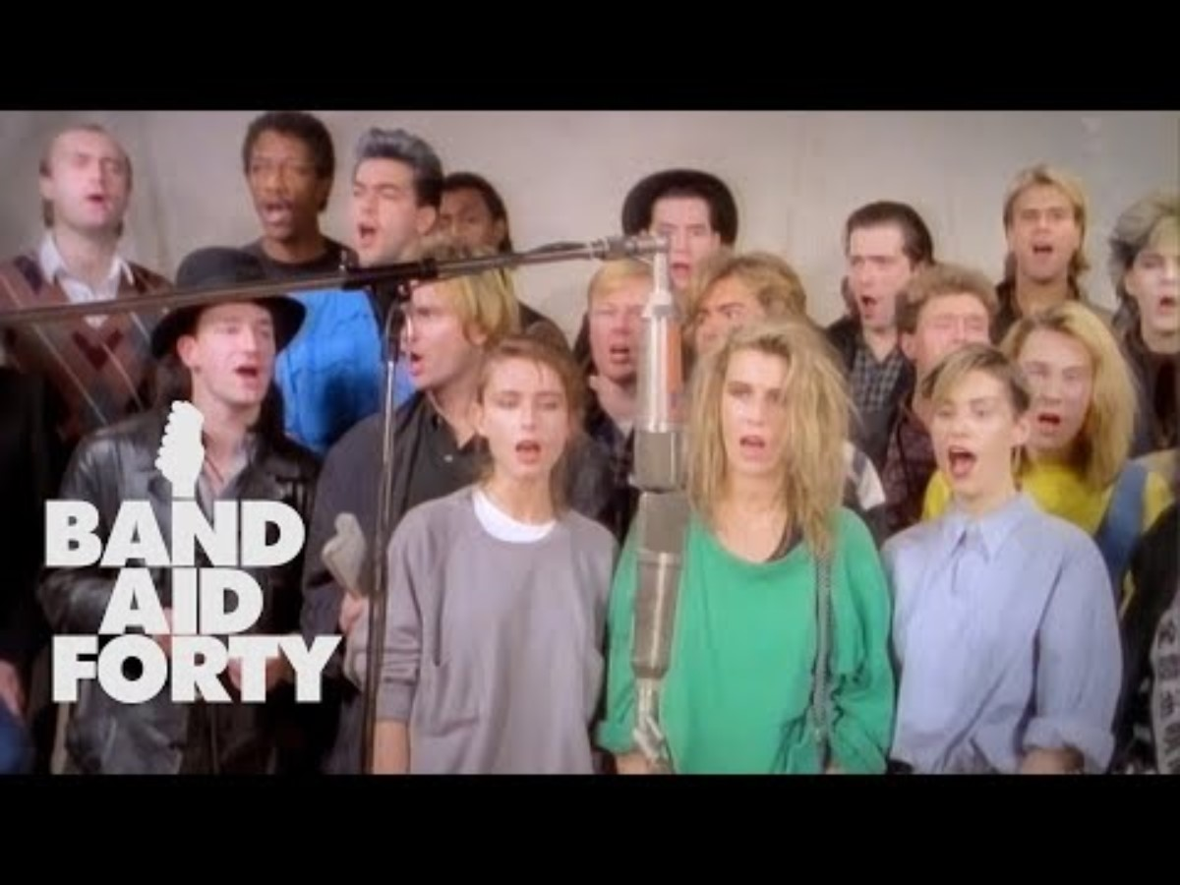
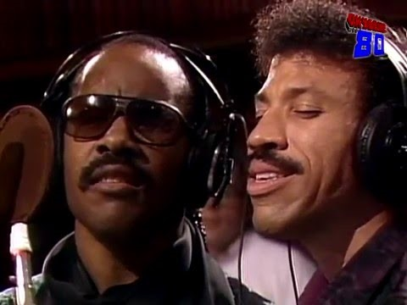
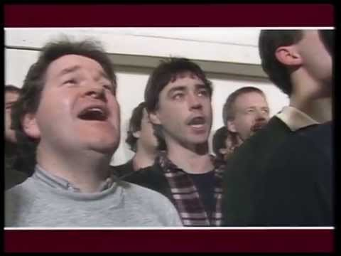
Caneuon elusennol
Charity songs

Slide 49
Cyfryngau Cymraeg
Welsh media
Rhaglenni teledu;
Ffilmiau;
CDau/Ffrydio;
DVDau;
Television programmes;
Films;
CDs/Streaming;
DVDs;

Slide 50
Cyfryngau Cymraeg
Welsh media
Gwefannau;
Llyfrau;
Cyfryngau cymdeithasol.
Websites;
Books;
Social media.

Slide 51
Gwefannau
Websites
Cyw - https://cyw.cymru/en/
https://cyw.cymru/
Cbeebies Cymru - https://www.bbc.co.uk/cbeebies/shows/cymraeg
BBC Bitesize – https://www.bbc.co.uk/bitesize/subjects/zdm3nrd
Llywodraeth Cymru/Welsh Government - https://learnwelsh.cymru/
Mudiad Meithrin - https://www.meithrin.cymru/cymraeg-for-kids/
Dinolingo - https://dinolingo.com/learn-welsh-for-kids/

Slide 52
Eich aseiniad…
Your assignment…
Wedi cael eich cyflwyno i sawl syniad ar gyfer gweithgaredd;
Ystyriwch gynnwys cân/caneuon;
Gallwch ddefnyddio CD/DVD i’ch cefnogi;
Ymarferwch eich ynganiad;
Cofiwch amseru.
Introduced to several ideas for an activity;
Consider including song/s;
- Can use CD/DVD for support;
Practice pronunciation;
Remember the timing.

Slide 53
Cyfeiriadau
References
Barefoot Books (2010) If you’re happy and you know it, https://www.youtube.com/watch?v=71hqRT9U0wg [Accessed: February 18 2021].
Baugh, A. & Cable, T. (2013) A History of the English language. London: Routledge.
BBC (2014) The 1536 Act of Union, https://www.bbc.co.uk/wales/history [Accessed: February 11 2021].
Britishdocs (2010) The Welsh Knot [video], https://www.youtube.com/watch?v=U0bgSbJUBG0 [Accessed: February 11 2021].
Carradice, C. (2011) The Treason of the Blue Books, https://www.bbc.co.uk/blogs/wales/entries/72d77f69-72a7-3626-9c19-469c91f45753 [Accessed: February 11 2021].
Notes:
,

Slide 54
Cyfeiriadau
References
Census 2021 (2022) Census 2021 Results, https://census.gov.uk/census-2021-results#:~:text=Census%202021%20results%20are%20the%20data%20and%20supporting,main%20results%20within%20two%20years%20of%20the%20census. [Accessed: February 23 2023].
Cymraeg i Blant (2018) Lliwiau’ Enfys, https://www.youtube.com/watch?v=A-fs5JB_b7E [Accessed: February 17 2021].
Cyw (2019) Caru Canu, https://www.youtube.com/watch?v=kvuur1Hm9HE [Accessed: February 17 2021].
Cyw (2017) Can y Tymhorau, https://www.youtube.com/watch?v=ULYLcymq968 [Accessed: February 17 2021].
Cyw (2017) Cân Yr Wyddor 🍎 | The Cyw Alphabet Song, https://www.youtube.com/watch?v=h-zu72YpXKY [Accessed: February 17 2021].
Notes:
,

Slide 55
Cyfeiriadau
References
Davies, J. (2014) The Welsh Language: A History. Cardiff: University of Wales Press
Davies, J. (1994) The History of Wales. London: Penguin.
Have Fun Teaching (2015) Seasons Song, https://www.youtube.com/watch?v=8ZjpI6fgYSY Accessed: February 17 2021].
Hey dee ho Educational Services (2018) Sing a Rainbow - with all your Auslan signs, https://www.youtube.com/watch?v=g5m3TLBmeuc [Accessed: February 17 2021].
Notes:
,

Slide 56
Cyfeiriadau
References
National Library of Wales (no date) The Blue Books of 1847, https://www.library.wales/discover/digital-gallery/printed-material/the-blue-books-of-1847 [Accessed: February 11 2021].
Stiwdiojg Cymru (2014) Mr Hapus, https://www.youtube.com/watch?v=-aw59C-89P8 [Accessed: February 18 2021].
The Kiboomers (2016) What's the Weather Like Today, https://www.youtube.com/watch?v=Jn7uAsLWXpk [Accessed: February 17 2021].
Tomchak, A. (2013) Minority Languages, https://www.youtube.com/watch?app=desktop&v=T-5HDuhEaDM [Accessed: February 17 2021].
Notes:
,

