Slide 1


Programme: BA(Hons) Leadership and Management skills for the workplace Module Name: Developing and Managing Individuals and Teams
Module code:LCLM5002
Lecturer name: Dr Mudassar Hassan
Name: Mehrunnisa Durrani
Student Number:2421022

Slide 2

Introduction to HSBC UK
HSBC UK is a major banking and financial organisation operating across the UK.
UK headquarters located in Birmingham.
Operates in a highly competitive and regulated environment.
Strong focus on employee learning and leadership development
(HSBC, 2024).

Slide 3

Organisational Context
Financial Services Sector Requires high compliance and risk management.
Digital transformation increases demand for skilled employees.
Continuous learning is essential for performance and competitiveness
Effective L&D supports organisational goals
(Armstrong,2020).

Slide 4

Workplace Planning
Job Analysis
Assessment centre
Introduction
Interview
Application
Recruitment and selection process at HSBC Uk
This recruitment circle ensures HSBC continuously attracts suitable candidates (Armstrong,2020)

Slide 5
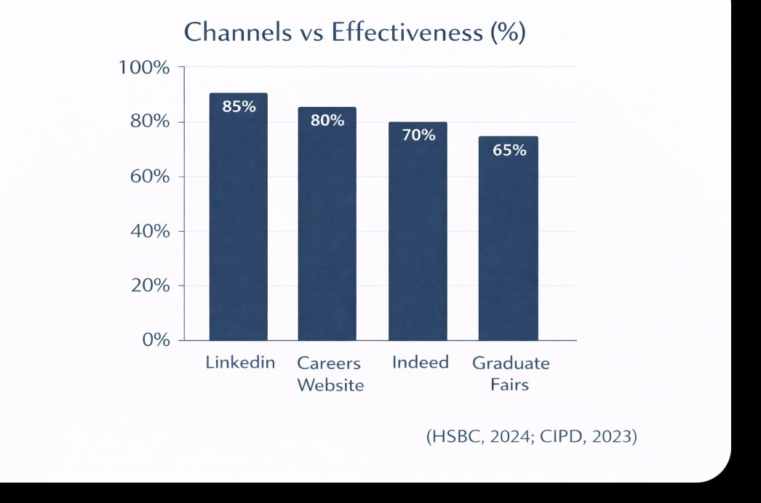
Recruitment Advertisement channel at HSBC
HSBC carrier website
Linkedln recruitment campaigns
Indeed and Glassdoor job platforms
University career portals
Graduate recruitment fairs
Internal vacancy postings

Slide 6
Job Analysis Customer Relationship Manager
Managing customer relationships and customer accounts.
Providing compliant financial products and services.
Meeting Organizational and regulatory standards.
Strong communication and problem- solving skills required.

Slide 7

Job description
Deliver High quality customer service
Achieve performance and sales targets.
Follow HSBC Polices and
financial regulators.
Work collaboratively with team members.

Slide 8
Person Specification
Relevant Qualification or banking experience.
Strong interpersonal and communication skills.
Ability to work under pressure
Commitment to continuous professional development.

Slide 9

Interview Techniques (HSBC UK)
HSBC uses competency based interviews to access skills, behaviours, and experience.
STAR method (Situation, Task, Action, Result) is use to evaluate candidate responses.
Panel Interviews are conducted for graduate and leadership roles.
Behavioural interviews help predict future job performance
Video interviews are used for early stage screening
(HSBC,2024,CIPD,2023|)

Slide 10
Interview Question Method (STAR Technique)
Situation
Describe the Context
Task
Action
What You did
|result
Outcome acheived
Explain your responsibility
HSBC uses STAR technique to access competencies, decision making, and problem solving skills
(CIPD,2023;Noe,2020)

Slide 11
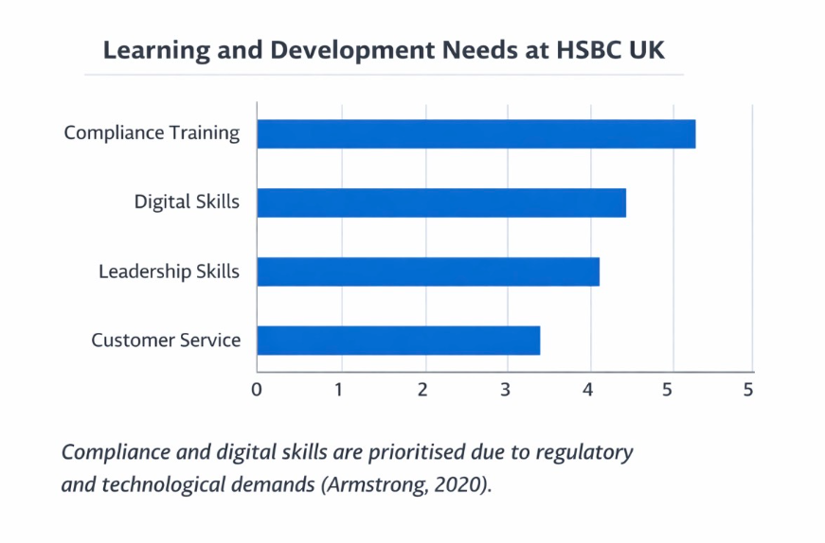
Learning
And
Development
Needs
at
HSBC Uk

Slide 12
Learning theories Framework
Behaviourist learning theory
Cognitivist learning theory
Humanist learning theory
Experiential learning theory
HSCC uses a blended learning approach to meet diverse employee needs

Slide 13
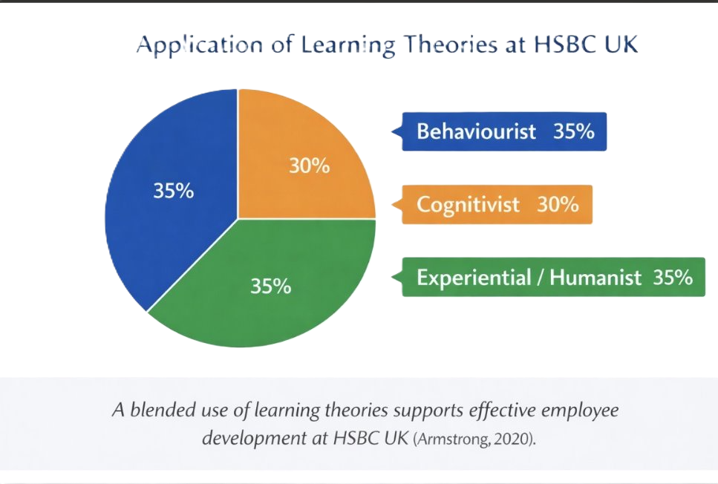
Application of Learning Theories

Slide 14
Cognitivist Learning Theory
Focuses on mental processes and understanding (Piaget, 1970)
Case studies and simulations support decision making
Useful for problem solving and judgement base4d roles.

Slide 15
Behaviourist Learning Theory
Learning occurs through reinforcement and feedback (Skinner,1953)
Effective for compliance and procedural training
Targets and monitoring reinforce correct behaviour
Suitable for regulated banking environments

Slide 16
Kolb's Experimental Learning Cycle
HSBS supports learning through real-worldce and reflection
(Kolb,1984)
Concrate Experience
Abstract Conceptulisation
Reflective Observation
Active experimentation

Slide 17
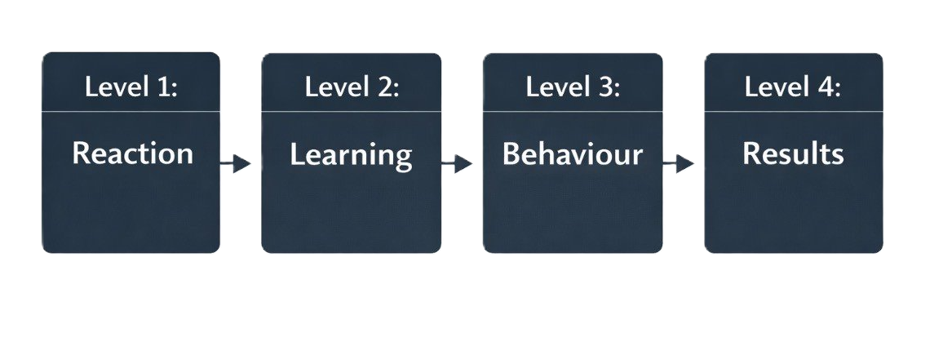
Kirkpatrick's Training Evaluation model
HSBC evaluates training effectiveness through feedback, performance changes and business outcomes (Kirkpatrick,1998)

Slide 18
Impact of Learning and Development
Improved employee confidence and competence
Higher customer satisfaction levels
Reduce compliance risks
Improved organisational performance

Slide 19
Conclusion
Effective recruitment ensures organisational fit
Learning theories enhance training design
Continuous development supports HSBC UK's success
Strategic L&D is essential in financial services

Slide 20
References
Armstrong, M. (2020) Armstrong’s Handbook of Human Resource Management Practice. 15th edn. London: Kogan Page.
HSBC (2024) Careers and learning at HSBC UK. Available at: https://www.hsbc.co.uk/careers/ (Accessed: 8 February 2026).
Kolb, D.A. (1984) Experiential Learning: Experience as the Source of Learning and Development. Englewood Cliffs, NJ: Prentice Hall.
Maslow, A.H. (1943) ‘A theory of human motivation’, Psychological Review, 50(4), pp. 370–396.
Piaget, J. (1970) Science of Education and the Psychology of the Child. New York: Orion Press.
Skinner, B.F. (1953) Science and Human Behavior. New York: Free Press.
Kirkpatrick, D. (1998) Evaluating Training Programs: The Four Levels. San Francisco: Berrett-Koehler.
CIPD (2023) Recruitment and selection factsheet. London: Chartered Institute of Personnel and Development. Available at: https://www.cipd.org/uk/knowledge/factsheets/recruitment

