Slide 1

New L5 Online Learning module. Enhancing Creativity & Innovation in the 21st Century.
L5: Changemakers: Creativity & Value Creation
Support Tutorial – U3 T1&2.
This Photo by Unknown Author is licensed under CC BY-SA-NC

Slide 2
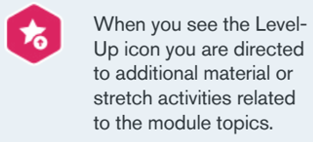
Reminders
Optional activity icon. If it is taking you longer than you would like to go through the Online content. Remember:
  The Level-Up content/activities are optional.
  Some Article/Video key findings are summed up in the introduction and conclusions.
  You do not have to view and digest all external content. Some is only recommended reading/watching.
You do not have to view/read all the online content. 90% of the marks for Assignment 1 is on what you submit through Turnitin. And 100% of Assignment 2 is what you submit through Turnitin.
When asked, post in the blog/forum/padlet for the participation marks and note some the key concepts and some activity answers to complete the Assignment tasks.
Hopefully, these tips will help those of you who are struggling with time due to e.g. family and/or work commitments.

Slide 3
UCM Feedback
To UCM: Meeting with Head of the Design Team last week to give feedback.
  He agreed that the Development Team and the content created for Unit 2 was and is too heavily biased towards 'Design' and needs to be updated.
  This was also seen reported to the UCM PM 2 weeks ago and a Development Team is being assembled to review and update it in January.
From UCM Man. Team: With regards to progress through the interactive activities in the sessions, don’t worry too much about interactive activity work being saved if there's a problem. Any text inputs or interactive tasks are there for you to reinforce and reflect on your learning. They are not intended to be saved and are not assessed. The most important thing is for you to view all the slides, and to complete the blog, forum and Padlet tasks as instructed in the sessions. This goes towards the 10 participation marks for Assignment 1.

Slide 4
Study Support
Additional study and time management support is available from the University.
“From foundation to postgraduate level. Support is offered with researching, referencing, avoiding plagiarism. academic writing, critical thinking, presentation skills, planning and organisation, and exam revision.”
All sessions are currently being delivered remotely, for additional help and support, please contact studyskillsdistance@uwtsd.ac.uk.
For more information: https://www.uwtsd.ac.uk/study-skills/.

Slide 5



Student Support
The University is mindful of student wellbeing, particularly during this time, and has put in place a range of support measures to help students, including:
Online study support.
Counselling and mental health support.
Extended bursary and financial hardship schemes.
An opportunity for residential students to opt into a weekly welfare check with operations staff.
A Teams meeting with any residential students that need to self-isolate to ensure that their practical needs are met. The range of services include:
  Assisting to manage food deliveries, collecting prescription medication, providing extra linen, towels and cleaning packs, and delivering post directly to student flats.
  Students living off campus can receive support should they need to self-isolate.
The University’s Catering Team and SU have organised food parcels for students who are self-isolating.
The SU has also arranged a chat service as part of their support.
Communication with students is co-ordinated via the Student Hwb who are issuing weekly Bulletins and are on hand to answer any queries and to signpost students to the support services available to them.
This Photo by Unknown Author is licensed under CC BY-SA
This Photo by Unknown Author is licensed under CC BY-NC
This Photo by Unknown Author is licensed under CC BY

Slide 6

Last week’s - Moodle Activities & Assignment task
Unit 2: Creative Solutions
Topic 3 - Identifying New Ideas
Topic 4 - Seeking Solutions.
Task 2 - Assignment 1.

Slide 7



This Photo by Unknown Author is licensed under CC BY-SA
This Photo by Unknown Author is licensed under CC BY-SA

Slide 8



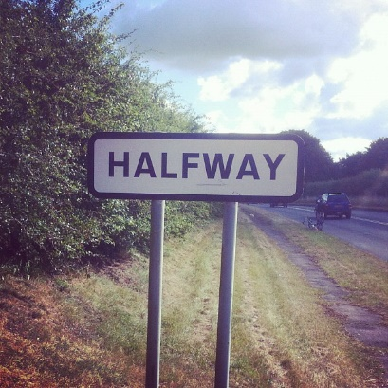
Halfway through the Online content
This Photo by Unknown Author is licensed under CC BY-SA
This Photo by Unknown Author is licensed under CC BY-NC-ND
This Photo by Unknown Author is licensed under CC BY-SA-NC

Slide 9



This Photo by Unknown Author is licensed under CC BY-NC

Slide 10

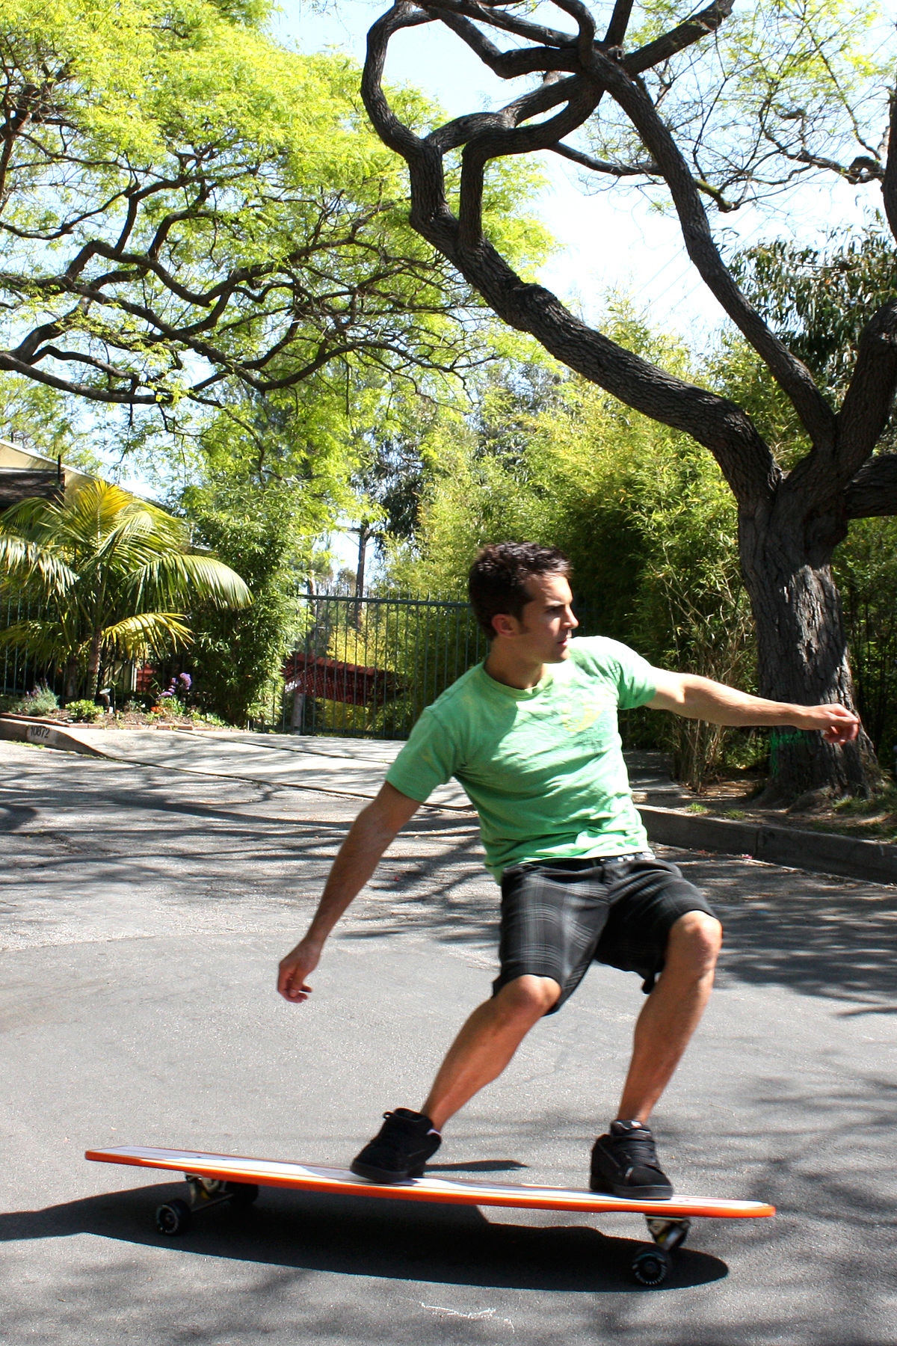
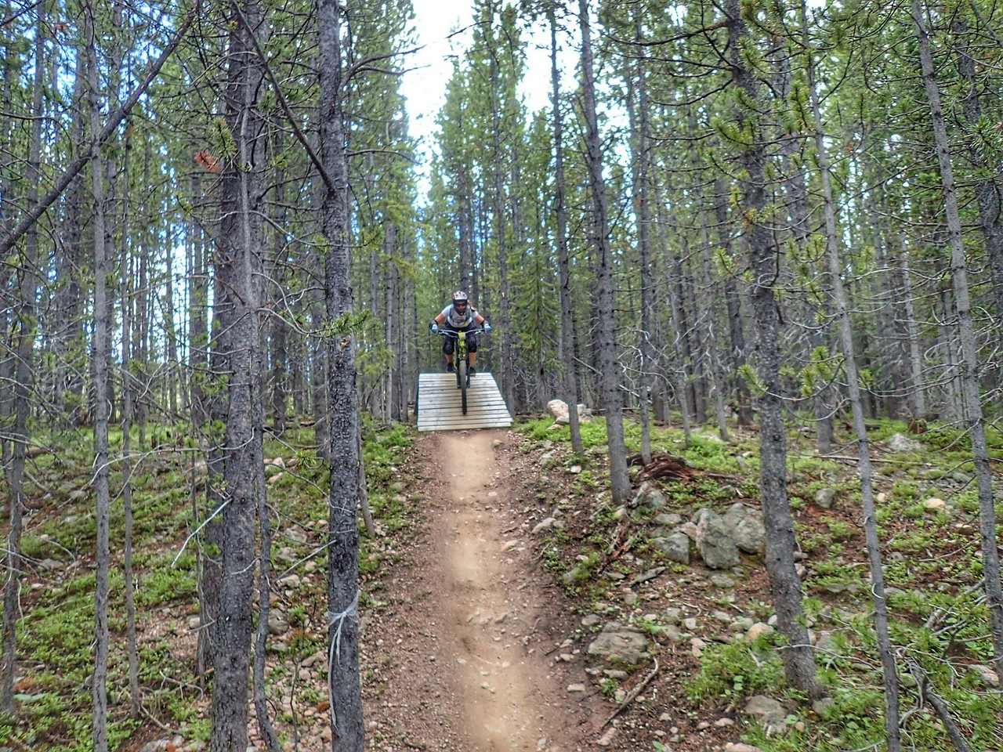
Downhill from here.
This Photo by Unknown Author is licensed under CC BY-SA
This Photo by Unknown Author is licensed under CC BY-ND
This Photo by Unknown Author is licensed under CC BY-SA

Slide 11
This week’s Moodle Activities & Assignment task
Unit 3: Mobilizing Support
Topic 1 - Collaboration not Competition
Topic 2 - Funding Your Idea.
Start Task 3 - Assignment 1.

Slide 12
Assignment 1: Task 3
3. Unit 3 – Video presentation: Create a 3 to 4-minute Video presentation that:
Refers to some of the concepts & some of your answers to activities in Unit 3; and
Refers to the progress on your project to date.
  Tip: include some initial design work. Task 1 & 2 = your idea. Task 3 move on to include some design work.

Slide 13
Tips for this week:
Create a new slide deck using presentation software of your choice e.g. PowerPoint. And Label it e.g. L5 Changemakers A1 T3.
As you go through Topics 1 & 2, save concept notes, images and activity answers to the slide deck.
See Assignment 1 on Moodle for the full task description, task requirements and Video presentation guidelines.
Start some initial design work for your project idea.

Slide 14
Next step: Moodle and
U3: Topics 1 & 2.
Start Assignment 1: Task 3.
Start Project: Designs.
Schedule in your diary /\.
Typically for a 20c semesterized module learners are asked to attend 4hrs of classes and 8-10hrs of private study.

Slide 15

Example Timeline for Computing Innovation Project:
October: Ideation & Start Design work.
November: Design & Start Dev. work.
December: Development work.
January wk. 1: Project Video presentation.

Slide 16
Bg. Tips for your Computing Innovation Project
Your project should help you to develop new up-to-date skills.
Your project should be of interest to you, relevant to your course and your future career.
In addition to learning new skills, your project will need to have a purpose e.g. to serve the community, to help a group of people, to solve a problem, for an Organisation, to offer a product or service that would add value and benefit society in some way.
Due to the time limitations, be careful to limit the scope of your project.

Slide 17
Initial Project Planning & Design tips
Consider and state your project’s scope e.g.
  Aim and Objectives.
    Aim (1): E.g. To research design and develop a … or … To research test and evaluate a ….
    Objectives (3/4): The 1st objective could be to simply research appropriate technology to use. The 2nd objective to design a potential solution. The 3rd to develop a basic prototype. The 4th to test, evaluate and provide recommendations.
  Deliverable / Prototype: What do you intend to create / build / test or simulate.
  Key milestones: State approx. dates for each project stage.
  Project constraints: State the project's limitations.
  Note: If time: start some initial design work.

Slide 18

Event:
Bubble Banter

Slide 19

Virtual events @ The Centre for Computing History
Thursday 29th October - Computing History Tour
Friday 30th October - Gaming History Tour
Saturday 31st October - Coding Workshop - Spooky Pong!
Saturday 31st October - Spooky Gaming Tour
Note: booking in advance is required. You will need Zoom installed and an internet connection.

Slide 20
Register.
Download Attendee list.

Slide 21

Questions.
Any questions?, particularly about the Assignment task or Project.

Slide 22

Student Social Support.
(Chat & Support each other.)

Slide 23
The End.

Slide 24
Industry projects:
BrdSports Lrd.: A Downhill boarding/carting sports company looking for someone interested in developing an Augmented Reality (AR) downhill boarding/carting solution. If you are really interested, please contact Ben Room on info@brdsports.co.uk.
DIMAX GYMNASTICS: The club is a not for profit organisation and it has a number of children with different disabilities amongst it’s members. They need a modern website to heighten & improve the profile of the club. Based in Cross Hands. If really interested, please contact Michelle Bury on m4services@me.com.
  Tip: Start in this module, continue to develop idea in Res. Methods module in Semester 2 and design/development over Summer and in L6 Independent Project or Emerging Trends module.

Slide 25
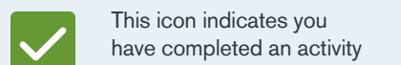
Progressing through the Module
COMPLETION OF ACTIVITIES will EARN YOU MARKS AND BADGES towards the participation assessment element of the module.

Slide 26

Weekly Progress
THE KEY TO SUCCESS FOR THIS MODULE IS TO MAKE WEEKLY PROGRESS.
You will not be able to leave it until the end.

