Slide 1

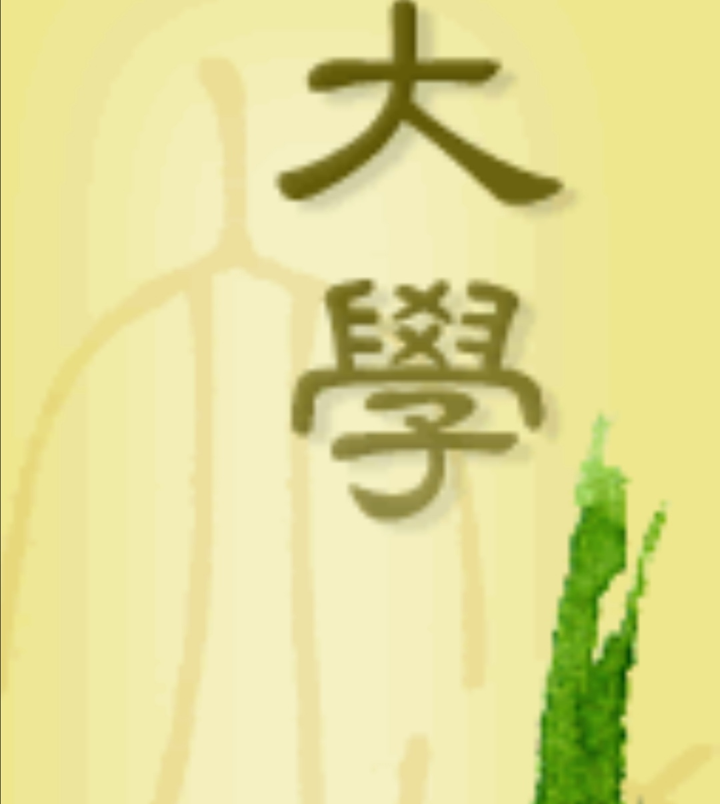

《大學》
The Great Learning

Slide 2
《大學》
1.知止而后有定，定而后能静，静而后能安，安而后能慮，慮而后能得
2.致知在格物

Slide 3
Introduction to The Great Learning
The Great Learning or Daxue was one of the Four Books in Confucianism.
A chapter in the Book of Rites (禮記).
Ten commentary chapters accredited to one of Confucius’ disciples, Zengzi (曾子).

Slide 4
知止而后有定 1.1
“When a man has a standard of excellence before him, and only then will he has a fixed and definite purpose”
Everyone’s life goals have to specialize.
It is contentment (知足).
The heart is set (心定).
The heart has a fixed direction.

Slide 5
定而后能静 1.2
“With a fixed and definite purpose, and only then will he be able to have peace and tranquillity of mind”
Must understand the teaching of the ancients.
To cultivate babies with these three hearts :
1 filial piety(孝順), 2 Sincere respect(誠敬), 3 Quiet (寧静)
Train him to be obedient.
Teach him to endorsement, to recite sages book.
Train him to be quiet, to concentrate.

Slide 6
静而后能安 ;安而后能慮 1.3
“With tranquillity of mind, and only then will he be able to have peace and tranquillity of soul; with peace and serenity of soul, and only then can he devote himself to deep, serious thinking and reflection”
When the heart is fixed, his heart calm down.
He can think and understood.
Peace of mind will be given birth of wisdom.
Wisdom does not come from outside, meditation creates wisdom.
Precept, concentration and wisdom.

Slide 7
慮而后能得 1.4
“It is only by deep, serious thinking and reflection that a man can attain true culture.”
The ancient Chinese had wisdom.
They had thousands years of vision.
Moral cultivation has reached the highest level.

Slide 8
致知在格物 2.1
“The acquirement of wisdom and understanding comes from the elimination of materials desire”
Don't be tempted by materials and environment.
Letting go of material desire, fight our desire.
Letting go of greed, anger and ignorant.
Self cultivation of virtue.
To recite a hundred ancient essays.

Slide 9
致知在格物 2.2
The heart will be righteous and sincere.
The meaning of a sage is true sincerity.
The importance of the foundation.
Be a success person and example of others.

Slide 10
Conclusion
Believe Chinese ancesters’ wisdom.
The benefit of this method.
Peace of mind.
A path to true happiness.

Slide 11
Reference :
1. 摘自：《辜鴻銘英譯經典：大學中庸》 — 辜鴻銘 英譯 王京濤 譯註在豆瓣閱讀書店查看：https://read.douban.com/ebook/35497216/本作品由中華書局授權豆瓣閱讀全球範圍內電子版製作與發行。© 版權所有，侵權必究。
2. 英文翻譯：理雅各（James Legge）https://ctext.org/liji/da-xue/zh?en=on
3. 淨空老法師：為什麼要背書？https://www.youtube.com/watch?v=VzvX7p6zhx0文摘恭錄—淨土大經科註（第四三九集）2012/7/20 檔名：02-037-0439
4. 淨土大經科注（第四三六集)

Slide 12
Reference :
5.北宋【司馬光】解 “致知在格物”，查看： https://baike.baidu.com/item/%E6%A0%BC%E7%89%A9%E8%87%B4%E7%9F%A5
6. Di Zi Gui (dizigui) or "STUDENTS' RULES"by Li Yuxiu, During the Reign of the Qing Dynasty Emperor Kangxi (1661-1722)English & Vernacular (Modern Spoken) Chinese Translationby Feng Xin-ming, 查看：http://tsoidug.org/dizigui_trans_simp.php

Slide 13
Presentation Speech
Introduction of The Great Learning
A very good evening to Teacher Lee and Yap. Today I am going to present a small paragraph of The Great Learning. Firstly let me give you an introduction of The Great Learning.
The Great Learning or Daxue was one of the “Four Books” in Confucianism. The Great Learning had come from a chapter in the Book of Rites (禮記) which formed one of the Five Classics(五經). It consists of the teachings of Confucius and then ten commentary chapters accredited to one of Confucius’ disciples, Zengzi. The ideals of the book were supposedly Confucius’, but the text was written after his death.

Slide 14
Presentation Speech 1.1
I would like to share with you the teaching in The Great Learning“知止而后有定”translated by辜鴻銘
“When a man has a standard of excellence before him, and only then will he has a fixed and definite purpose”
Everyone’s life goals are different, but here’s a principle: no matter what kind of company you‘re in, you have to specialise.
It is contentments (知足), knowing what can be done and what cannot be done, that knowledge is wisdom. The heart is set and will not be tempted by the environment and that’s “A standard of excellence before him.” When he has a fixed and definite purpose, the heart has a fixed direction, here is decided, how to be a fixed and definite purpose?

Slide 15
Presentation Speech 1.2
I think we must understand the teaching of the ancients, they know from young age to cultivate babies with these three hearts, 1 filial piety, 2 Sincere respect, 3 Quiet. Train him to be obedient. When parents call, don’t be slow to answer; when parents give an order, act, don’t be lazy; when parents teach, one must listen respectfully; when parents reprimand, one must accept. Then only can achieve“定而后能静” “With a fixed and definite purpose, and only then will he be able to have peace and tranquillity of mind”
I like quiet, I don't like to move. This is the education of children and babies. Teach him to endorsement, and not let him think about it and to reduce his wondering thought. The best way is to recite sages book, the most important meaning is to let the child without thinking, training him to be quiet, to concentrate.

Slide 16
Presentation Speech 1.3
After that,“静而后能安 ;安而后能慮” “With tranquillity of mind, and only then will he be able to have peace and tranquillity of soul; with peace and serenity of soul, and only then can he devote himself to deep, serious thinking and reflection”
When the heart is fixed, his heart calm down, after that, he can think and understand, slowly he understood. Peace of mind will be given birth of wisdom. If the heart cannot be quiet, he understood his meaning, but not the true meaning.
The wisdom does not come from outside, we all have it. But our mind is chaotic, with many delusions and distracting thoughts, only meditation can create the wisdom. The meditation is the pivot. The highest guiding the principle of Dharma practice is a precept, concentration and the wisdom. The precept is a rules, and by observing the rules, the heart is truly set and determines the wisdom.

Slide 17
Presentation Speech 1.4
Finally, will achieve“慮而后能得” “It is only by deep, serious thinking and reflection that a man can attain true culture.”
From these places we understand why the ancient Chinese had wisdom, they had 50 years vision to see, 100 years to see. Saints saw this society thousands of years ago, what's the reason? They saw it in silence, through meditation. So, it's clear. “It is only by deep, serious thinking and reflection that a man can attain true culture.”, it is proof that Confucius’ moral cultivation has reached the highest level.

Slide 18
Presentation Speech 2.1.1
Now I would like to share with you the second paragraph “致知在格物”, “The acquirement of wisdom and understanding comes from the elimination of materials desire”
The meaning get from Song Dynasty historian, 司馬光
Don't be tempted by materials and environment, letting go of material desire, control and fight our desire, letting go of greed, anger, and ignorant, purity of mind will be given birth of wisdom.

Slide 19
Presentation Speech 2.1.2
Where can I find a good teacher? Now a day we can only rely on ourselves to cultivate virtue. This virtue is to eliminate materials desire. I wanted to read and recite a hundred ancient essays as the golden key of wisdom. I needed to check the time and decided to complete it in two years. That is “The acquirement of wisdom and understanding.”

Slide 20
Presentation Speech 2.2
After this effort is achieved, the heart will be righteous and sincere. You can understand all the books left by the sages. There are no obstacles. Why? Because your mind and heart are the same as those of the saints.
The meaning of a sage is true sincerity, and the heart of a sage is upright. You are the same as him, so, you can understand it at a glance, and there will be no mistakes. You see how importance the basics are! Today, most people work very hard, work hard, and have no achievements at last. What is the reason? The basic things are gone, and they have not taken root on the foundation. If we succeed in doing it ourselves, others will realize it when they see it, and they will learn from you.

Slide 21
Conclusion
Today, people no longer believe chinese ancestor' wisdom. They thought, reciting sages book is an obsolete way in this modern society. Here I want to tell you, you are not wasting your time by reciting sages book. Maybe one day, when you feel exhausted and want to calm down your mind, it is time for you by using this method. Please don't too believe to your own thinking, because what you think may change from time to time. People called it impermanence. When you know the benefit of this method, you will apply in your daily life. Letting go of your wondering thought. Peace of mind is on the way, wisdom is waiting for you. I believe everyone can become the saint and reach the perfect wisdom. Trust me, this is a path to true happiness.

