Slide 1
INTERNATIONAL HOTEL MANAGEMENT
Marketing Essentials
BMIH4005

Slide 2
Before we start
As there are quite a few of us here, please ensure that your microphone is muted during all teaching until you are asked a question or there is a group discussion to prevent background noise.
Your camera must be always on during lectures please.
This and all sessions will be recorded so that you can watch it again

Slide 3
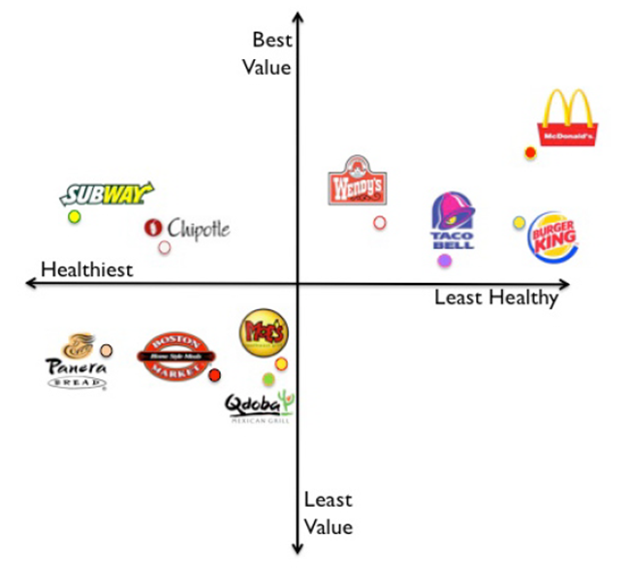
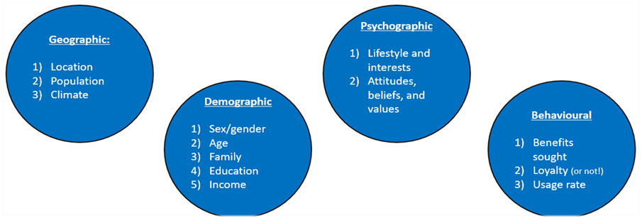
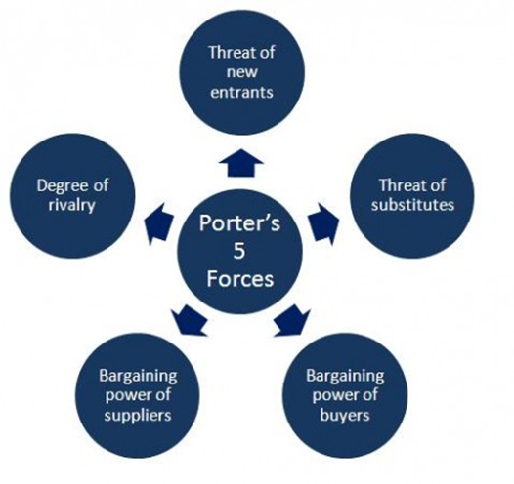
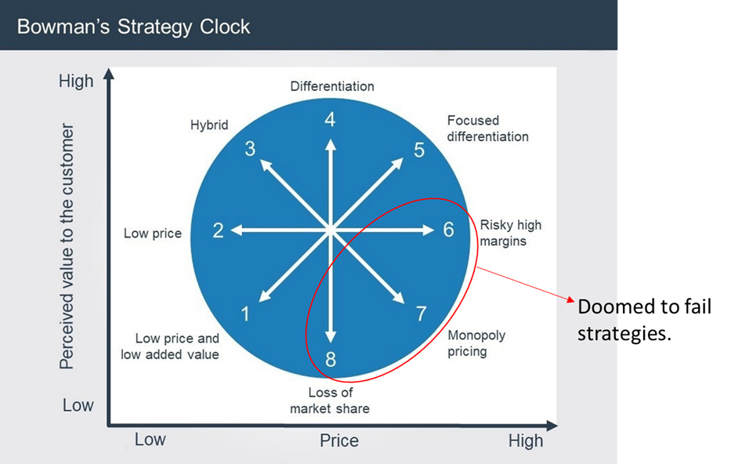
Recap
Three stages of marketing
Pre encounter
Encounter
Post encounter
STP stands for?
Segmentation/ targeting/positioning
Segmentation strategies
Undifferentiated
Differentiated
Concentrated
Customised

Slide 4
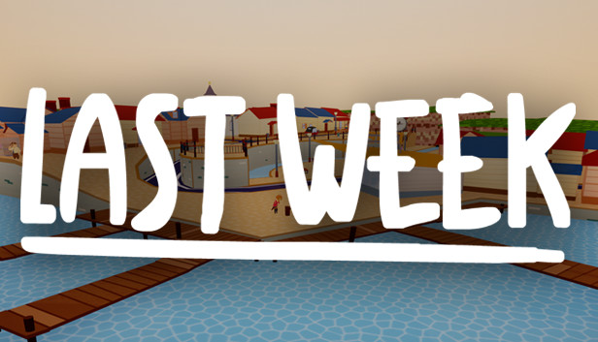
Notes:
So last week I asked you to make sure that you had picked out your two hotels
In the chat function you can write down the two hotels you have started to consider to write about for your assignment 1.

Slide 5

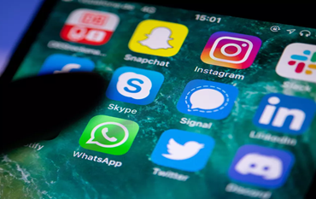
Aims For Today
What is Social Media/Digital Marketing
What affect does it have on Hotels and Hospitality Industry?
Communication & promotional Mix

Slide 6
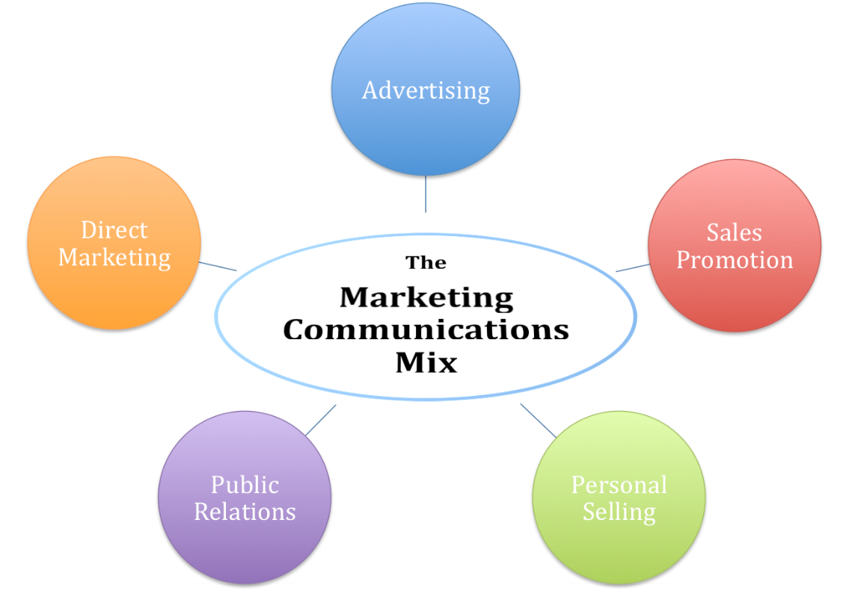
Communications Mix
A company’s overall marketing communication strategy is called the “Communications” or “Promotional” mix.
“The specific blend of advertising, public relations, personal selling, and direct-marketing tools that the company uses to persuasively communicate customer value and build customer relationships.” (Kotler & Armstrong, 2018)
In the era of mass communications and emerging mobile technologies, an organization must build an adequate mix of marketing communications (Todorova, 2015)
Notes:
the Communications Mix defines the ways you communicate with your customers,
i.e. the tools you use.
Advertising: This tool of IMC refers to any paid form of non personal promotions of products and services by a public figure and identified sponsor. The various forms of media used are print, broadcast, network, electronic and display. Advertising form of communication reached geographically dispersed consumers.
Sales Promotions: Sales promotions are a variety of short-term incentive to encourage trial or purchase of product or service. This usually includes consumer promotions- such as distribution of free samples, coupons on purchase of higher quantity, discounts and premiums or trade promotions, focusing on retailers, such as display and merchandising allowances, volume discounts, pay for performance incentives and incentives on salespersons.
Personal Selling: This tool of marketing is done through face-to-face interaction with consumers. The whole purpose of personal selling is making presentations, answering questions and taking orders. Personal selling helps in maintaining long term relations with the customer. The main advantage is that the message can be customized as per the needs of the customer.
Public Relations: PR is a two way communication process which is directed towards improving the relationship between the organization and the public. This method of communication monitors the feedback of the customers and adjusts its message for providing maximum benefits to them.
Direct Marketing: This method of communication includes the usage of mail, telephones, fax or internet to communicate with or respond back to the customers or prospects. Companies usually have a database of contact details of consumer through which they directly contact the customers to send catalogues and other marketing material making it easier for the consumer to purchase online.

Slide 7
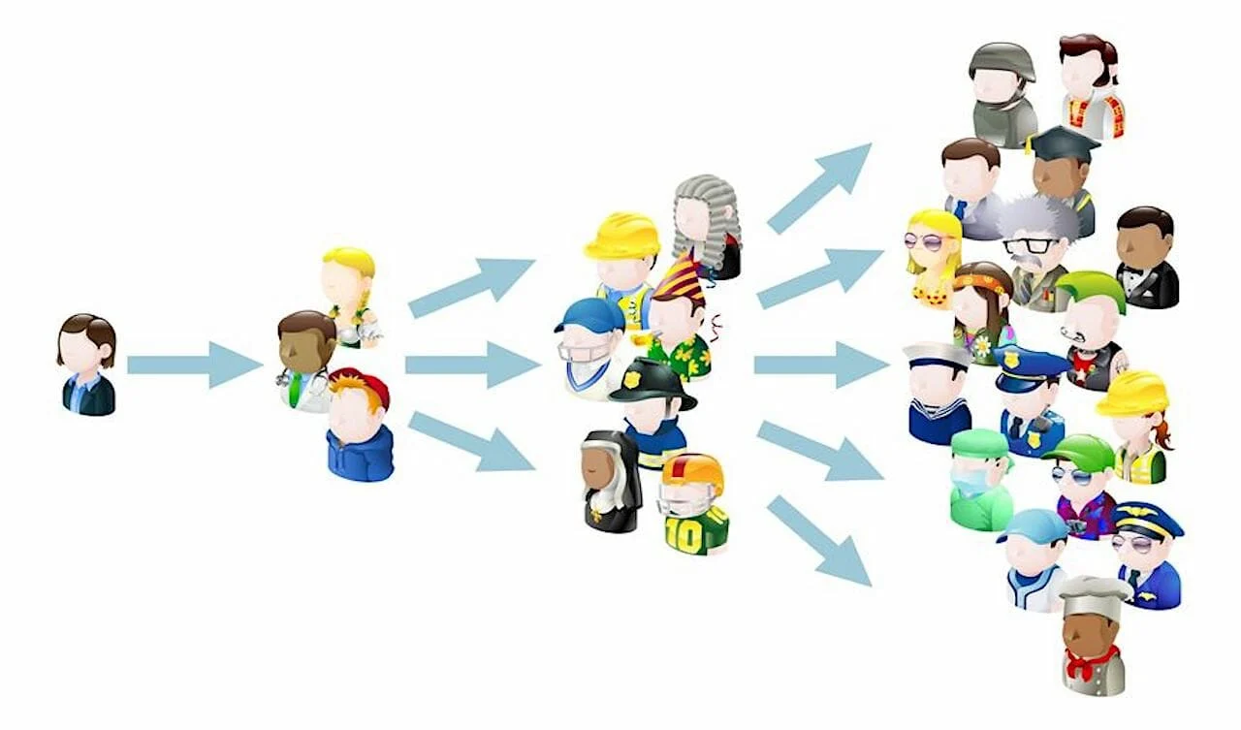
Channels & Vehicles
If you think of your marketing plan, and the message that you would want to communicate to current and future guests, how many different channels could we use to share that message?
Word of mouth
TV
Newspaper/Magazine
Radio
Signage
Internet
Direct mail
Telephone.
What vehicles could we use?
TV
Radio
Social Media
and like other media there are many combinations that could be used within one channel.

Slide 8
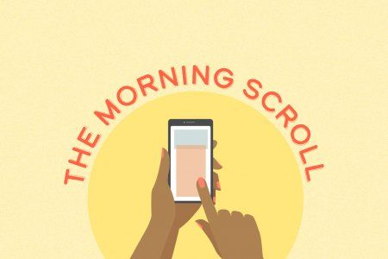
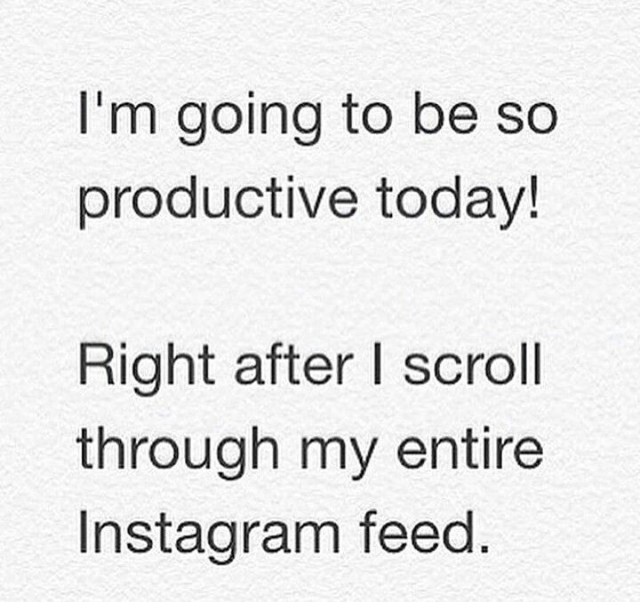
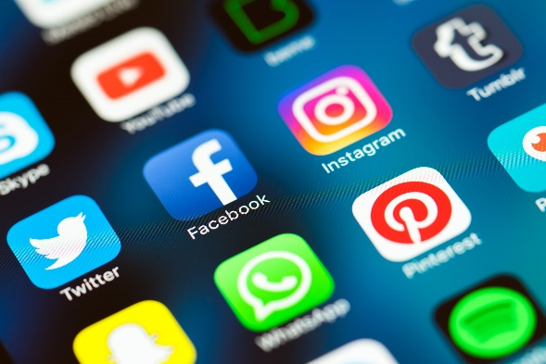

Its a social World
What was the first thing you did when you woke up this morning?
You wouldn't be alone one survey of people from 31 countries reported that 96% of them use their smartphone within an hour of waking up often before they get out of bed
(Lee & Calugar-Pop 2016)
Notes:
Checked your mobile?
Maybe set up a snapchat story?
Scrolled through a few Tweets
or checked out WhatsApp

Slide 9
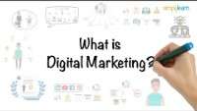

Slide 10
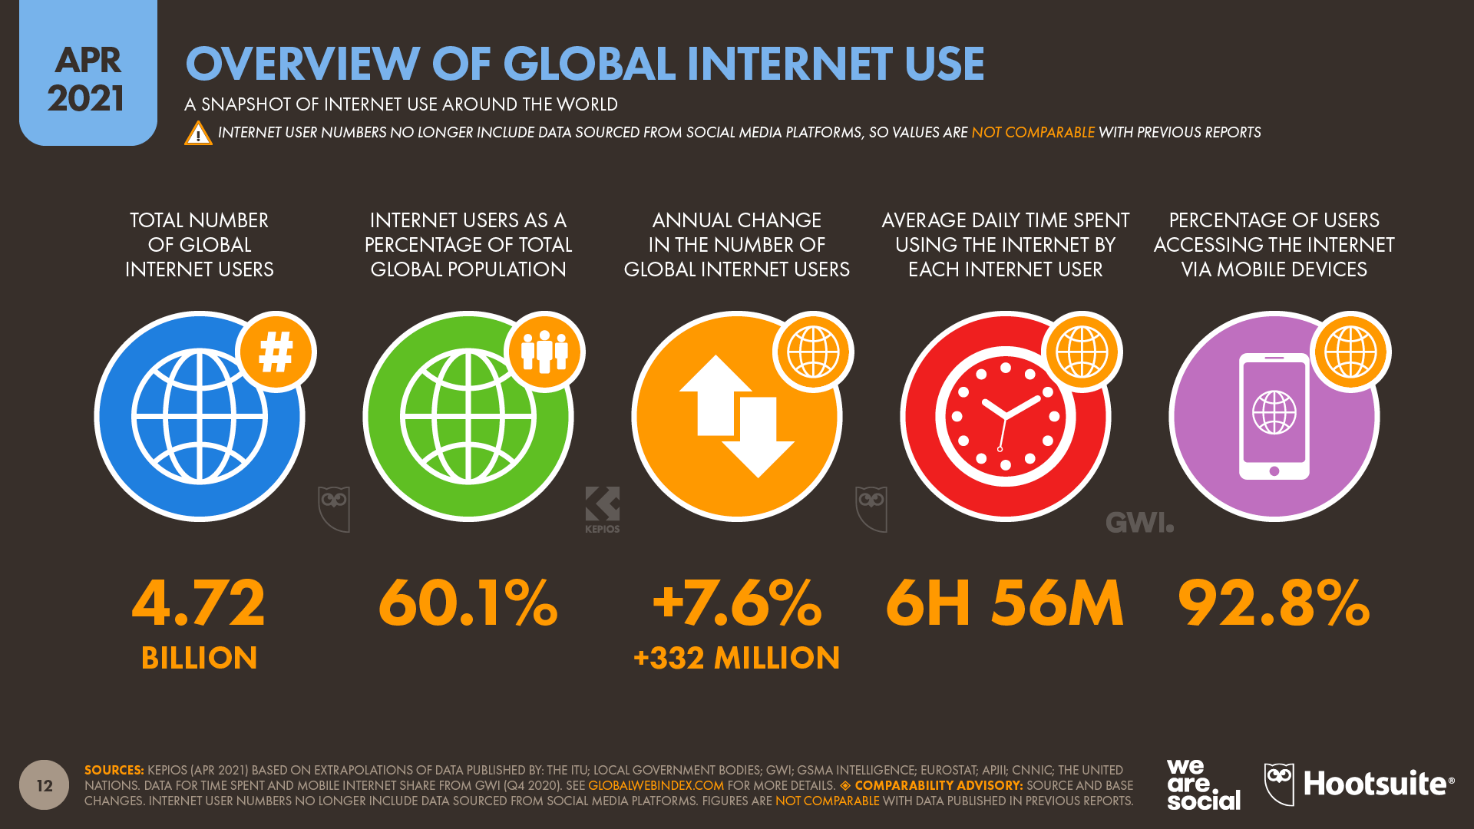
So how connected are our customers?
(Hootsuite, 2022)

Slide 11
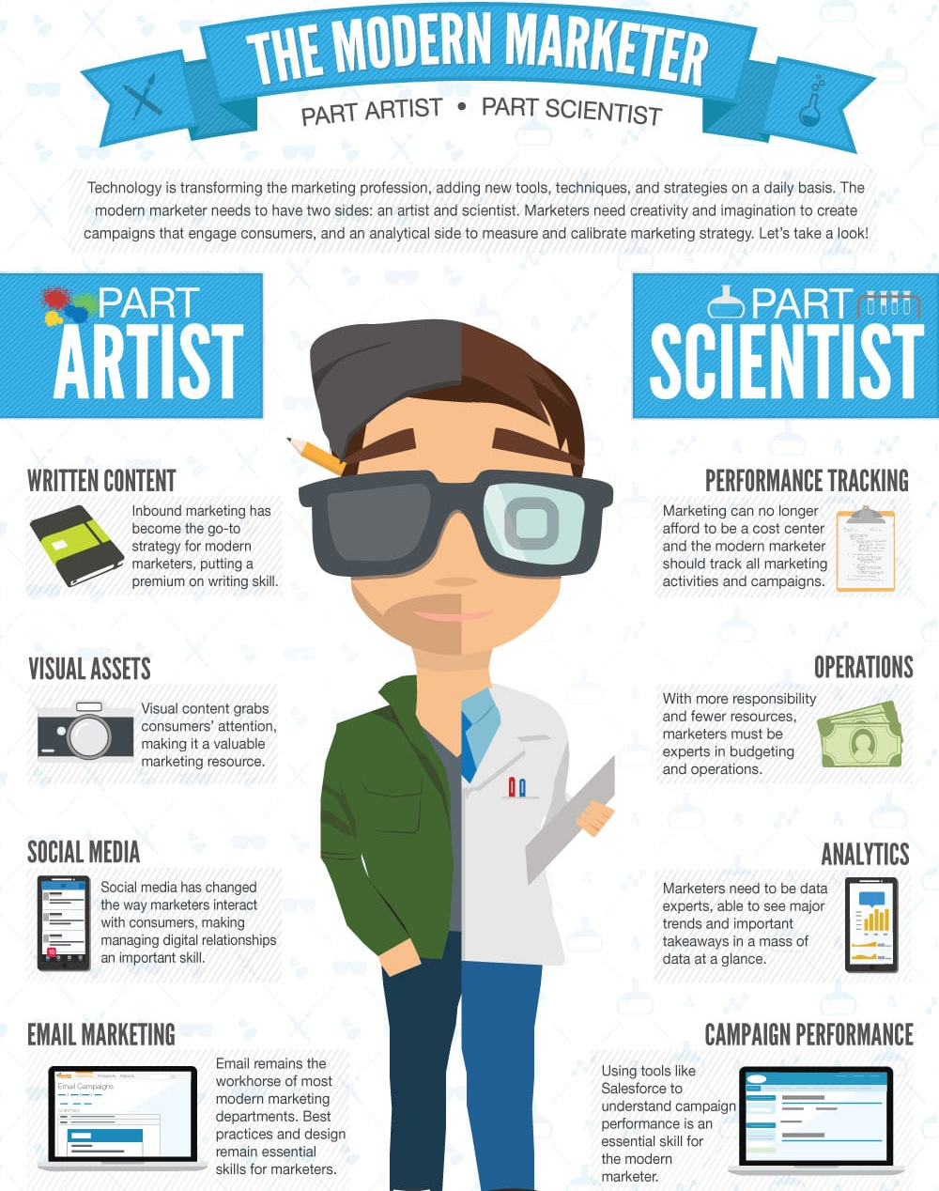
Digital Marketing Applications
An advertising medium
A direct-response medium
A platform for sales transactions
A lead-generation method
A distribution channel
A customer service mechanism
A relationship-building medium
Data capture opportunity

Slide 12
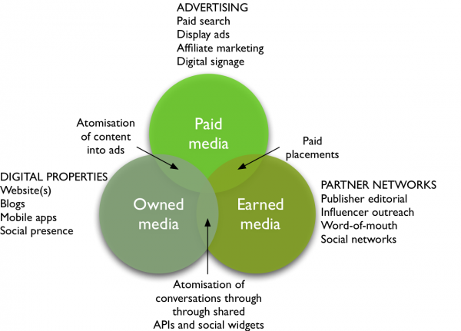
Types of Media
Notes:
PGC & UGC
Professionally Generated content / User Generated Content
1. What is paid media?
Defining paid media is the most simple. Paid or bought media are media where there is investment to pay for visitors, reach or conversions through search, display ad networks or affiliate marketing.
Offline traditional paid media like print and TV advertising and direct mail remain important accounting for a large share of paid media spend.
Digital diffusion means we are seeing more and more opportunities for targeted digital paid media such as online streaming and in-app ads.
What is earned media?
Traditionally, earned media has been the name given to publicity generated through PR invested in targeting influencers to increase awareness about a brand.
Of course, it’s still an investment - whether time or money, or both. But this type of investment, when done well, has the most potential to instill customer trust through recommendations/advocacy.
Earned media also includes word-of-mouth that can be stimulated through viral and social media marketing and includes conversations in social networks, blogs and other communities.
It’s useful to think of earned media as developed through different types of partners such as publishers, bloggers and other influencers including customer advocates. Think of earned media as different forms of conversations occurring both online and offline.
API’s = Application programming interfaces
Widget = media/social plugins for use on personal sites
3. What is owned media?
This is media owned by the brand. Online this includes a company’s own websites, blogs, mobile apps or their social presence on Facebook, Linked In or Twitter. Offline owned media may include brochures or retails stores.
It’s useful to think of a company’s own presence as media in the sense that they are an alternative investment to other media and they offer opportunities to promote products using similar ad or editorial formats to other media. It emphasizes the need for all organizations to become multi-channel publishers.

Slide 13
The Internet as a Communications Tool
Key digital media channels
Search engine marketing (SEM)
Online PR
Online partnerships
Interactive advertising
Opt-in email
Social media marketing

Slide 14
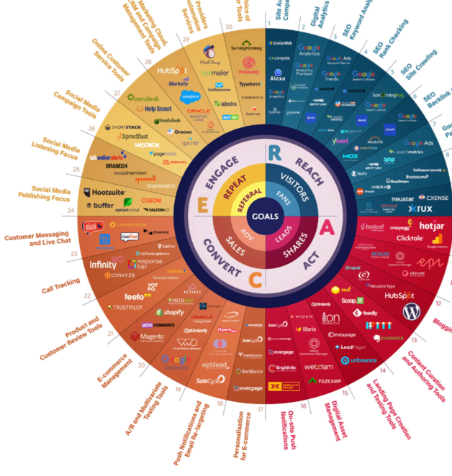
Communications Mix
(Online)
Similar to the traditional communications mix, the same activities are continued online in the RACE digital planning framework
The RACE mnemonic summarizes the key online and multichannel marketing activities that need to be managed as part of digital marketing communications. RACE covers the full digital touch points in the customer lifecycle or “Funnel”.
(Chaffey, 2022)

Slide 15

Reach
Reach involves building awareness of a brand, its products and services on other websites and in offline media in order to build traffic by driving visits to different web presences like your main site, microsites or social media pages. It involves maximising reach over time to create multiple interactions using different paid, owned and earned media touchpoints
SEO – Search engine optimisation
Notes:
.

Slide 16
Act
Act: Act is short for Interact. For most businesses the main aim of Act is to generate online leads. So, it’s about persuading site visitors or prospects take the next step, the next Action on their customer journey when they initially reach your site or social network presence. It may mean finding out more about a company or its products, searching to find a product or reading a blog post.
Notes:
.
You should define these actions as top-level goals of the funnel in analytics. Goals can include “Viewed product”, “Added to Basket”, “Registered as member” or “Signed up for an e-newsletter. Act is also about encouraging participation. This can be sharing of content via social media or customer reviews (Can also be an element of “Engage”).

Slide 17
Convert
Convert: This is simply conversion to sale, online or offline. It involves getting your audience to take that vital next step which turns them into paying customers whether the payment is taken through online e-commerce transactions or offline channels.

Slide 18
Engage
Engage: This is long-term customer engagement and communications that is, developing a long-term relationship with first-time buyers to build customer loyalty as repeat purchases using communications on your site, social presence, email, and direct interactions to boost customer lifetime value
Notes:
It can be measured by repeat actions such as repeat sale and sharing content through social media. We also need to measure percentage of active customers (subscribers), customer satisfaction etc..

Slide 19
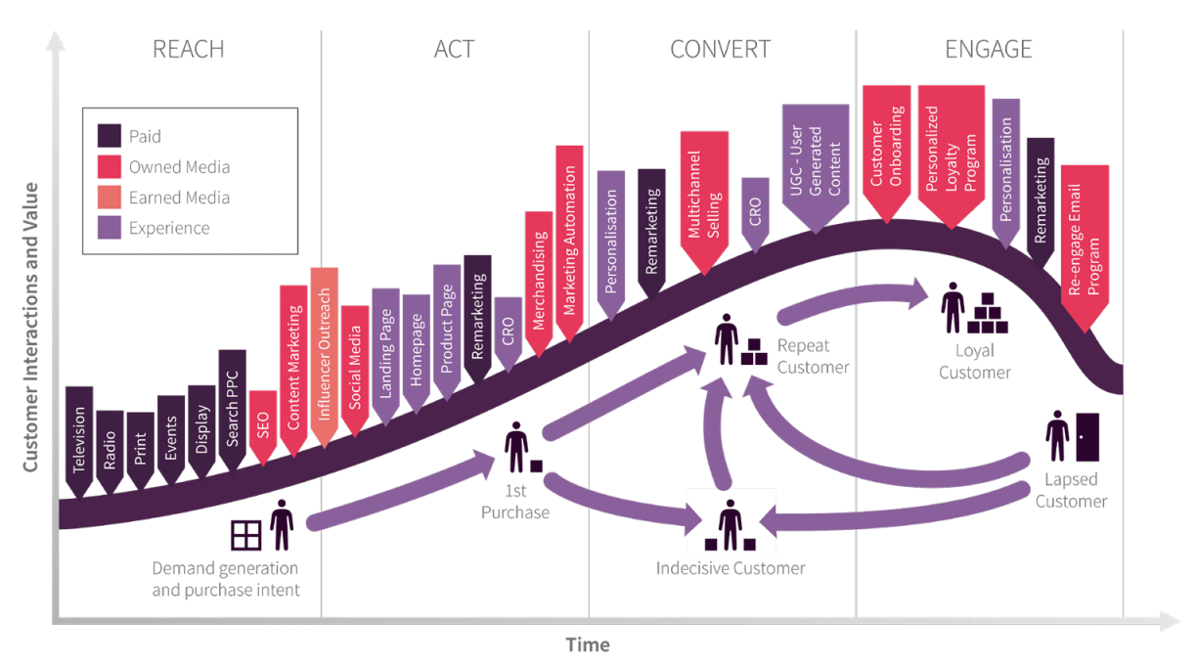
(Chaffey, 2022)
Notes:
Distribution of Media types across the customer lifecycle

Slide 20

Social media marketing
Social media marketing refers to the process of gaining website traffic or attention through social media sites. Social media marketing programs usually centre on efforts to create content that attracts attention and encourages readers to share it with their social networks
(Source - http://mashable.com/category/social-media-marketing/ )

Slide 21

Social media marketing
Creating content that encourages customers to share it with others within their social network.
Viral – trusted source
Reasons why social media marketing has become so important for businesses include:
  Accessibility
  Inexpensive
  Global
  Feedback/Conversations
Notes:
-How do you know if your social media marketing is very good? It goes viral (it spreads).
-This is the golden ticket of SM marketing – Different levels, bigger companies have the biggest reach etc.
-Trusted source: busy shop/empty shop analogy – more likely to go in the busy shop | Online, nothing is physical - trust is created by shares, likes, comments etc. the more the better
1) Accesibilty: what do we mean by this? Easy for both the public and businesses to access online channels. They’re ubiquitous: lots of them/phones/tablets etc.
2) Inexpensive: It’s free! Gwyn Thoms: #1 rule “if it’s free, use it!” Crucial for small businesses in the start up stages-lack of resources
3) Global: back in the day, people sold to the public on the street. Now, sell to people all over the World. small work shops in the home through social media, gained attention from people in Australia/France/South Africa – people sharing and liking thing, attracts attention from the unlikeliest of sources
4) Feedback/Conversations: Why is this important?
-> real time feedback: quickly change / improve something before it spreads
-> Conversations: helps establish as a trust worthy brand/thoughleader. Good customer experiences/services will encourage people to act as brand advocates etc.

Slide 22

Pick one of your hotels and for the next 20 minutes
spend time looking at your hotel choices and ...
Look at the communication activity : social media sites, review sites, website etc. What are the marketing messages?
Look at other advertising your hotel does.
Make a list of these marketing communications.
Let’s discuss your findings.

Slide 23
Social Media Optimisation
SMO is the method of maximizing unique visitors to Website content through the use of social media activity.
SMO similar to SEO, but differs in that the aim is to drive unique visitors to Website content from sources other than search engines.
Five Golden Rules:
  Create shareable content
  Make sharing easy
  Reward engagement
  Proactively share content
  Encourage the ‘mashup’
(Bhargava, 2022)
“First to introduce the term SMO”
Notes:
Essentially, the better, more engaging, the more relevant your content is, the more likely you will encourage people to drive
The two main SMO methodologies are: -Add social media features to the content itself (e.g. RSS feeds, Share buttons, User ratings, Photos, Video).
-Promote additional social media activities in addition to the content itself (e.g. Blogging, Discussion groups, Updates in social network sites).
5 Golden rules
1) The better your content is, the more people will want to share it with their entire social networks whether they link it, like it, dig it or share it.
2) We’ve all been there; what happens when you can’t share something instantaneously? You click off. People are busy/no time/short attention spans. You need to make it as painless as possible for the use. Ask how?
->Include social sharing buttons on each page of your site [main thing]
->Optimize your images for different social media networks (Pinterest has long/Facebook more square – dimensions)
3) This links to your behaviour as content creator in terms of conversation or engagement– rewarding engagement can be as easy as just saying thank you to someone for a nice comment, or a share. Competitions are an ultimate for of this; in turn for sharing, one lucky person will win something (c.valley wine comp)
4) Businesses should aim to share content across all their social media channels even other businesses s.media. E.g. Copper Valley blog posts (FB/TW/P), I cross promote things on Twitter and FB such as the most recent competition I did
5) The concept of the “mashup” where people take and remix your content by adding their own input and voice. It’s allowing people to take an ownership over the social content you publish. users edit and adapt your media to make it their own (absorption into cultural zeitgeist)

Slide 24
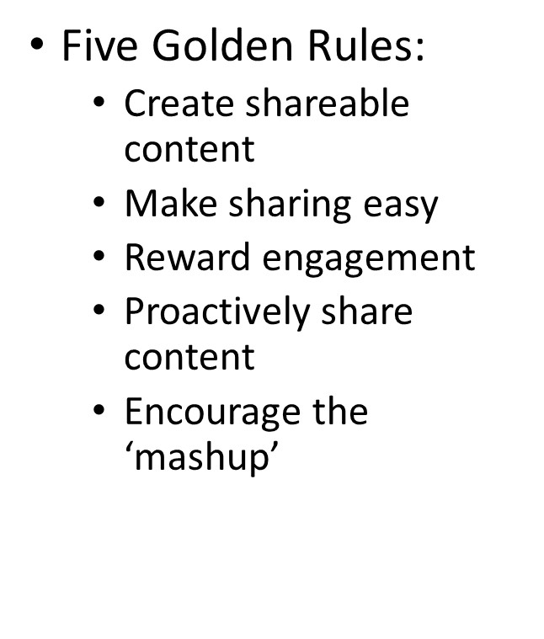
Activity
20 mins
For the same hotel make some content (A short video, social media post, photo post, Meme, etc) that you feel is in line with their current social media content (with the 5 golden rules in mind!.)
Use any tools you have available and send these to the chat box as screen shot or upload.
Canva is a good tool! Login to your Canva account

Slide 25
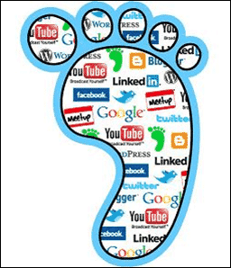
Big Data, Social footprints &
The Goldmine!
This is the impression or mark that we make when we visit sites.
When we visit websites and web communities, we leave a digital trail behind… your footprints become a source of Big data
Much research on what can be revealed about you by the footprints that you leave has been carried out, one notably by Dong (2015) who found that personal traits are clear including whether your parents were divorced could be established!
Notes:
Big Data – Where does it come from? Everywhere, everything you do online is recorded and logged.. In 2020 44 trillion gigabytes of big data had been collected by marketers of consumer habits, behaviours and purchases.
In 2018 Google spent 3 billion on Big data management and capture, Facebook 1 Billion (Jay Parikh - Vp of engineering at Facebook Said “everything we do is a Big data problem”
CIA paid Amazon web services 600 million Dollars to build private cloud infrastructure to manage Big Data. (Ira Hunt – CTO at the CIA said “Our mission is to collect everything and hang on to it forever!”
Big Issues – much of the data gathered is unstructured and fragmented lacking cohesion of databases. only 12% on average of this data is ever analysed, with so much data humans simply cant keep up, The advent of the AI marketeer, now a 40 billion a year industry and needed to make sense of vast quantities of data produced.

Slide 26
Benefits for Hotels?
Allows small businesses compete at the same level as large businesses.
Allows a business communicate directly with the target market in an informal setting.
Enables a business to build a relationship of trust and credibility with the target audience.
Ability to conduct detailed market research.
Global
Notes:
Craft Breweries example. In Wales, craft breweries are mostly small micro businesses. To give you some sense of scale, Brewdog (largest craft beer producer, but still quite a small biz) only has 0.01 of the total UK share of the beer market - £43Mn. The scope/money of the large breweries is huge. Craft breweries use free means such as s.media as they have no choice – they have no money for big advertising spend etc. What has happened in the U.K? super markets/pubs/even large breweries jumping on the band wagon as they feel threatened by it’s popularity
No need for a shop front premises.
Conversations/engagement
Last week we discussed Customer profiles S.media channels are a gold mine for finding out about your client base and gathering Big data. Can be as easy as running a poll and asking your audience for feedback or by assessing the type of words and language your audience is using for more targeted communications
Global – this goes back to what I mentioned earlier; essentially allows you to access markets the world over for free and in real-time.

Slide 27
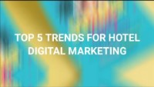

Slide 28
Assessment1
Due:04November2022
An essay of 1500 words –
A comparison of the marketing methods of two multinational hotel chains.
Students will be required to write an academic essay introducing the subject of marketing, specifically comparing the marketing methods and strategy of two multinational hotel brands.
They will choose two hotel brands (one from Group A and one from Group B) and will compare the brand marketing strategies, i.e. the ways in which these organisations market their products and services. This will include discussing the use of segmentation, targeting and positioning as well as marketing communications with their target audiences. Students will identify similarities and differences in the respective marketing strategies and make recommendations to develop and enhance marketing activities for their chosen brands that will aid potential future growth with consideration for any relevant contemporary concerns/influence to the hospitality market.
You will explore a number of different generational and strategic approaches to marketing and perhaps the use of social media and digital marketing versus traditional advertising and marketing techniques. What is the brand message? What changes have been made because of the pandemic and other industry factors, such as trends influencing marketing e.g ‘green’ message?
Notes:
Pass mark 40-60-70/Submission deadline 23.55/late submission protocol / return 20 working days/plagiarism /refs 15 min/etc..

Slide 29
WHERE DO I START?
Do further reading and try to get a basic understanding of main theory.
Read about your Hotel choices online web pages, social media, comparison sites, third party sites, Review sites etc.. .
When looking at their marketing activities try to link these to theoretical frameworks:
The Marketing mix 7 P’s, what is each brands Mix? Try to find examples
RACE planning framework, how are they managing online presence? Which methods, what seems to be the goal of the content they releasing?
Examine how are they managing communications How frequently? What seems to be the aim of their communications? Drive engagement, reputation management, build relationships, create value, share information etc.
which channels are being used?
Discuss with examples! For example, “The hotels use of social media management seems to focus on creating shareable content (Bhargava, 2010) which is clearly demonstrated by their focus on humour based content which links to Engage in the RACE framework (Smart Insights, 2022)……”

Slide 30

How do I write my essay?
Within an academic essay you must separate out the content of your writing using paragraphs only.
There must be NO contents list, The focus of your work should be text although you may use some screen shots to provide examples of marketing activities. You should discuss in paragraphs and avoid bullet points or numbers used to list content.
Remember you need to be displaying your understanding of the subject and so writing in your own words to be able to show this.
Drawing from a single source is plagiarism, drawing from 20 is research!

Slide 31


How should the work be presented?
Before you start writing make sure that you have chosen the correct font and size for your essay so either
Calibri
Arial
Times New Roman
size 10 or 12.
Also, as paragraphs will be used to separate out your content, these must not be indented but set to the left-hand side of the page and justified on the page so that your layout looks neat.
The obvious gain to customers is that they can find products that seem to fit more closely with what they want. These needs and wants are not only related to product function, but also psychological fulfilment.
Customers may feel that a particular supplier is more sympathetic towards them or is speaking more directly to them and therefore is more responsive and eventually more loyal to that supplier. The organisation that fails to segment deeply enough on significant criteria will lose customers to competitors that do

Slide 32
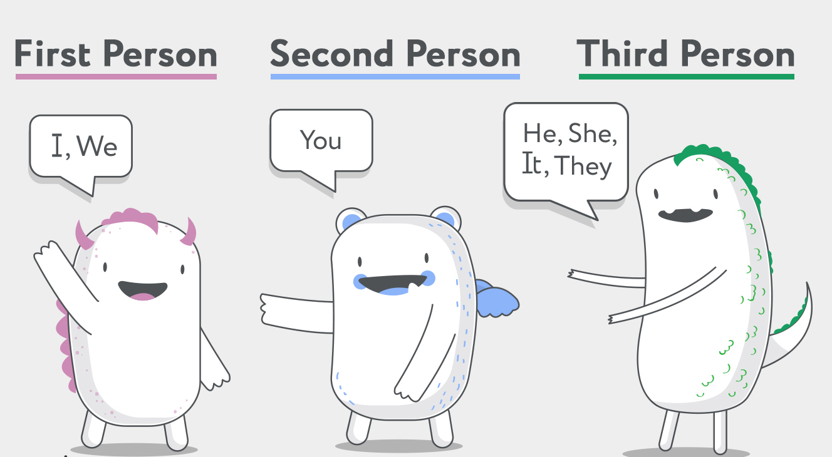
What is the third person?
You will be writing this essay ‘in the third person’ so you will not be writing this from a personal viewpoint, so you will be unable to say, “I have chosen to write this essay” rather you would write “This essay has been written to compare the marketing strategies of two Hotel brands”.
You do not ask questions in essays, this is not a discussion piece, so do not write something like “So, what is marketing strategy”? …
you would write something more like
“A Marketing strategy can be described as the planning and…… remember if you ask a question of the reader, they expect to be able to answer it, but they can’t from simply reading what you have written!

Slide 33

References …. How many?
Remember the word count for this essay has been set at 1500, plus or minus 10% so you could go as low as 1350 or as high as 1650, but nothing more or less either way. You will lose marks by being under or over the minimum and maximum guidance.
As this is a 1500-word count essay then you must use a minimum of 15 different reference sources to support your work, these will not only be listed in the reference list at the end but must also be inserted as in-text citations.

Slide 34
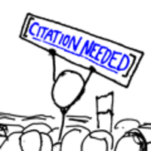
What is an in-text citation?
These are used when referring to a source of information within the text of your assignment to show where it came from.
They are abbreviated details of the source you are referring to and generally consist of the author’s / editor’s surname, year of publication and, if required, page numbers e.g.
(Pears and Shields, 2016, p. 6).
You do not need to include the author’s surname in the in-text citation if it is referred to within the body of your work e.g. According to Pears and Shields (2006). This would just be unnecessary repetition!

Slide 35
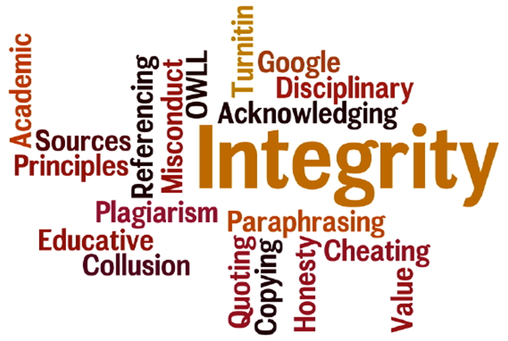
Reference List
(not included within the word count)
You will list your references in alphabetical order by the family name of the author.
Refer to the Harvard Referencing guide on the Moodle page, and make sure that you have used credible sources.
Sources such as Essays UK, Essay Online, are not considered credible, and can bring doubt on your work as they also offer essay writing service so be careful.
Other non credible sources: The Daily Mail, Sun, Wikipedia, Business Balls, Blogs etc
Credible sources are going to be the chosen hotel chains own website, some review sites, industry journals, textbooks, Media sources.

Slide 36
What is plagiarism?
SIMILARITY SCORE on reference lists is not a cause for concern, only in your main work.
Accurate referencing also means you avoid plagiarism, which is passing off someone else’s work as your own.
The University’s full definition of plagiarism can be found on the University website.
Plagiarism can be deliberate or accidental; without accurate referencing, it is possible to accidentally plagiarise someone else’s work.
Therefore, understanding when and how to reference will help you to easily avoid this.

Slide 37
Within your essay you must include:
An introduction to your chosen multinational hotel brands, including why you have chosen them.
The marketing choices they have made and the directions they have taken within marketing. (Some historical background and what changes they have made- within their marketing approach)
Their current market positions.
What marketing strategies they use now.
What considerations have they made within their marketing regarding sustainability and green messaging.
How they are positioned since the COVID-9 pandemic/relevant contemporary events, what marketing messages are being given to their customers now?

Slide 38
You must present your essay with a title page, this to include:-
The title of the essay:
A comparison of the marketing methods of two multinational hotel brands
[Brand & Other Brand]
Your full name
Your student ID number
The module title: Marketing Essentials: BMIH1005
Your lecturer’s name
Date

Slide 39
PLEASE NOTE:
As this is written as an essay, it must follow the approved academic essay format with:
Introduction (5-10% of word count) – Usually short and introduces the context and reason for writing the essay- ‘This is what this essay is about’.
Main body (80% of word count) – Develops key themes and topics around the writer’s position, which link together to produce logical and coherent progression ideas, with each paragraph linking to the title of the essay “The golden thread of essay writing”.
And conclusion (10-15% of word count). - Summarises the content of the essay and presents concluding arguments and implications for the future ‘Here’s what this essay has shown’.
It is completed by a reference list (Using the Harvard referencing system) this is an essential part of your essay but is not included within the word count.

Slide 40
DRAFT ESSAY
Must be emailed (not uploaded).
DEADLINE: 5pm Friday 28th October 2022.
Please ensure that these drafts are complete as possible. I will only provide feedback on ONE draft so this is your only chance.
I will aim to get these back to you, with feedback, within 7 days.
Please do not submit your draft onto TurnItIn/Moodle - I will not check there.
However, please do use the similarity check link to check your score before emailing me the draft to mark (this will make you aware of any copied work or bad referencing that needs looking at).

Slide 41
REFERENCES
Bhargava, R., 2022. The 5 NEW Rules Of Social Media Optimization (SMO) - Rohit Bhargava. [online] Rohit Bhargava. Available at: <https://rohitbhargava.com/the-5-new-rules-of-social-media-optimization-smo/> [Accessed 16 October 2022].
Chaffey, D., 2022. The RACE Framework: A practical digital marketing strategy framework. [online] Smart Insights. Available at: <https://www.smartinsights.com/digital-marketing-strategy/race-a-practical-framework-to-improve-your-digital-marketing/> [Accessed 1 September 2022].
HootSuite, 2022. The Global State of Digital 2022. [online] The Global State of Digital 2022. Available at: <https://www.hootsuite.com/resources/digital-trends> [Accessed 16 October 2022].
Kotler, P., Keller, K. and Chernev, A., 2021. Marketing management. 16th ed. Pearson.
Lee, P. and Calugar-Pop, C., 2021. The home-based worker. [online] Deloitte Insights. Available at: <https://www2.deloitte.com/us/en/insights/industry/telecommunications/global-mobile-consumer-survey.html> [Accessed 15 May 2022].
Solis, B., 2013. The Ultimate Moment of Truth and The Art of Digital Engagement - Brian Solis. [online] Brian Solis. Available at: <https://www.briansolis.com/2013/11/the-ultimate-moment-of-truth-and-the-art-of-engagement/> [Accessed 15 May 2022].
Todorova, G., 2015. Marketing communication mix. Trakia Journal of Science, 13(Suppl.1), pp.368-374.

