Slide 1
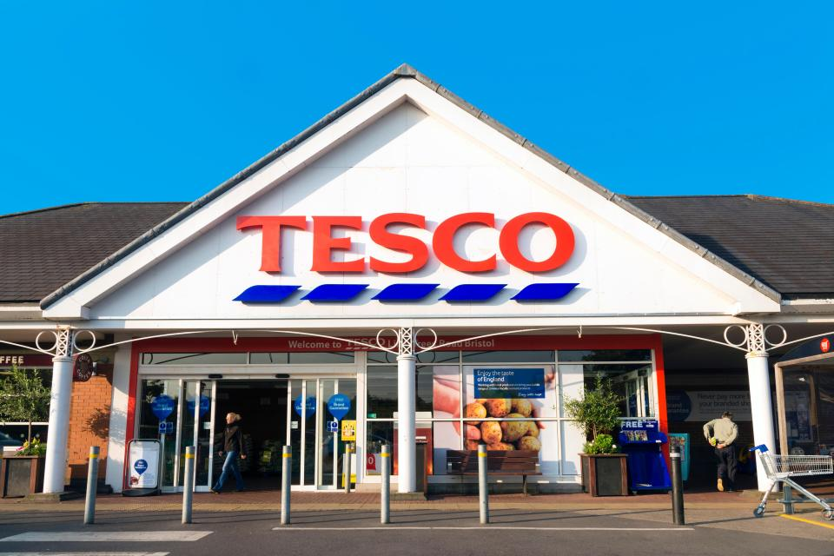
Name：Shuoyan Hai
Student number：1900931

Slide 2
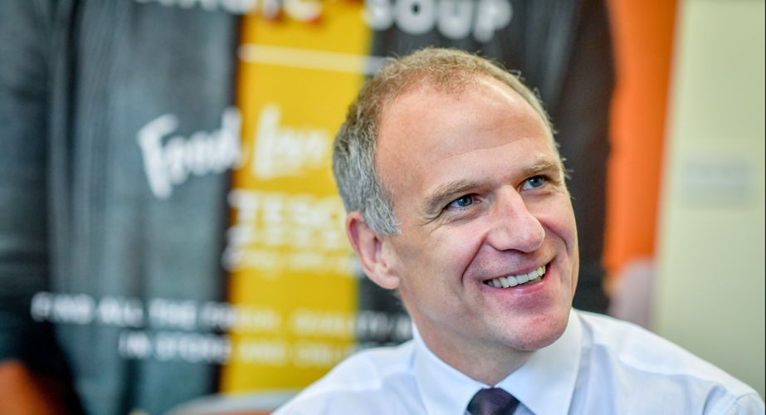
Business case
Marketingweek
‘Brutal objectivity’: Tesco’s CEO on how he reversed the brand’s fortunes（Marketing Week Reporters” on 4th Dec 2019）
As Tesco CEO Dave Lewis prepares to depart, he offers an inside look at the brand strategy behind the supermarket’s turnaround.

Slide 3
Project justification
Aim and objectives
1.To analyze the marketing strategy developed by CEO Dave Lewis for the Tesco company and its impact on the Tesco market position.
2.To identify the issues that prevailed in the marketing and branding strategies of the Tesco company.
3.To explore the issues related to the marketing faced by Tesco even after the implication of new marketing strategies by “CEO Dave Lewis”.
4.To establish a strong understanding of the existing literature of the marketing strategies that are significant for the Tesco company to implement in the UK and global markets.
5.To provide knowledge about the brand value of Tesco that is vital to sustaining in the highly “competitive business environment”.

Slide 4
Project justification
Research question
SWOT Analysis
To analyze the marketing strategy developed by CEO Dave Lewis for the Tesco company and its impact on the Tesco market position.
(1) Strength （2）Weakness （3）Opportunities （4） Threats

Slide 5
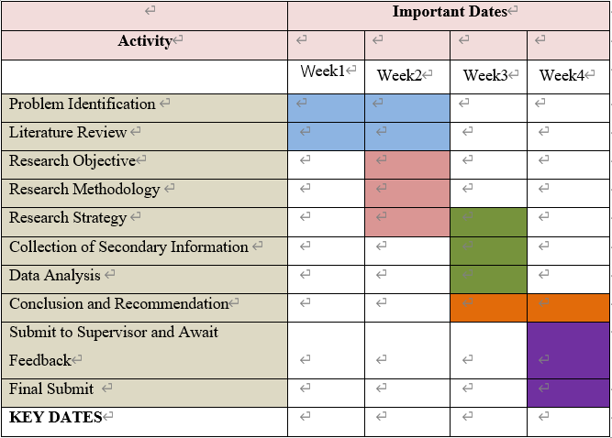
Project plan
(Gantt Chart)

Slide 6

Reference
（1）Curry, L. A., Nembhard, I. M. & Bradley, E. H., 2009. Qualitative and Mixed Methods Provide Unique Contributions to Outcomes Research. Circulation, , 119(10), pp. 1442-1452.
（2）Das, G. (2014) ‘Linkages of retailer awareness, retailer association, retailer perceived quality and retailer loyalty with purchase intention: A study of Indian food retail brands’, Journal of Retailing and Consumer Services. Elsevier, 21(3), pp. 284–292. doi: 10.1016/j.jretconser.2014.02.005.
（3）De Pelsmacker, P., van Tilburg, S. and Holthof, C. (2018) ‘Digital marketing strategies, online reviews and hotel performance’, International Journal of Hospitality Management. Elsevier, 72(July 2017), pp. 47–55. doi: 10.1016/j.ijhm.2018.01.003.
（4）Harrison, A., Mennecke, B. and Peters, A. (2014) ‘Marketing avatars revisited : A commentary on facial recognition and embodied representations in consumer profiling’, Business Horizons. ‘Kelley School of Business, Indiana University’, 57(1), pp. 21–26. doi: 10.1016/j.bushor.2013.08.006.
（5）Mattinson, A., 2019. Tesco CEO Dave Lewis' pay up 17.5% to £4.9m. [Online] Available at: https://www.thegrocer.co.uk/people/executive-compensation/tesco-ceo-dave-lewis-pay-up-175-to-49m/566876.article [Accessed 24 2 2020].

