Slide 1
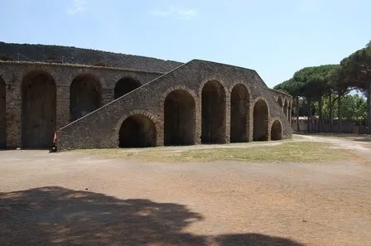
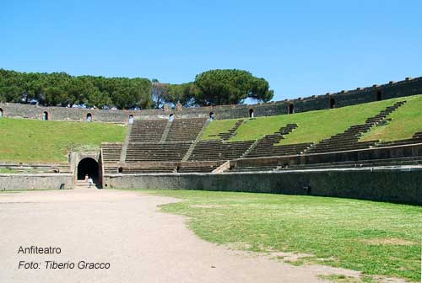
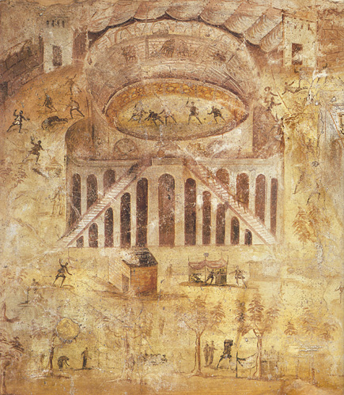
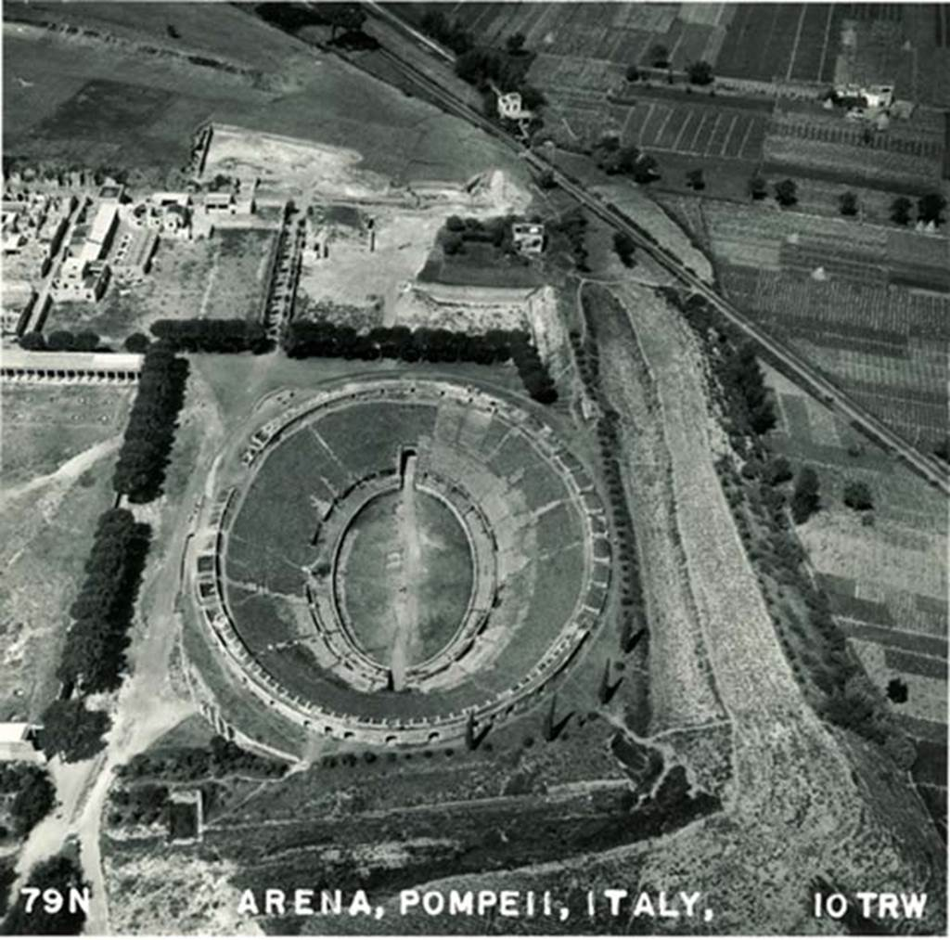
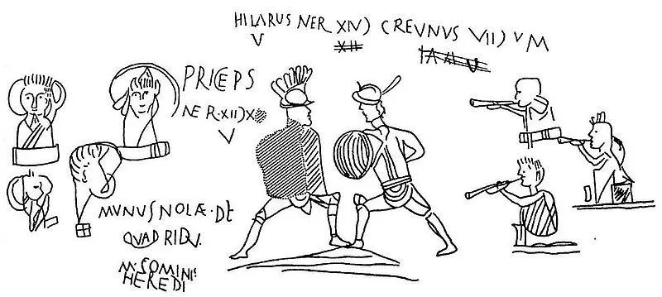
Pompeii Amphitheatre
Iwa Lewis
2406068
Games and graffiti
Pompeii’s amphitheatre drew in large crowds to watch a variety of events. These events ranged from gladiatorial combat between armed fighters, to venationes (wild animal hunts) and athletic contests such as boxing. Paintings and graffiti were often found depicting specific matches or hunts as well as advertising the amphitheatre. (HSC, 2026)
Pompeii amphitheatre exterior, Natasha Sheldon, 2018
Pompeii amphitheatre, Tiberio Gracco, 2025
Architecture and seating
The building has an elliptical plan, roughly 135 m by 104 m, with the arena sunk about 6 m below ground level. Scholars argue that understanding of mathematics and spacial planning was used to construct the Pompeii amphitheatre. Analysis has been done that combines data from ancient geometric tools as well as modern computer methods that shows the building followed an elliptic pattern rather than a simpler oval. (Springer, 2014)
Seating was divided into three sections (named ima, media, and summa cavea), each section was designated for elite citizens, ordinary men, and women + the lower classes respectively. (The origins and early development of the amphitheatre 2026)
The graffiti and wall inscriptions around the amphitheatre tell archaeologists and historians a lot about the performances and engagement with the events, they show the enthusiasm of attendees as well as showcasing familiar fighters. (Smithsonian, 2024)
Amphitheatre fresco, 2026
General info
Pompeii in pictures, 1950
The Amphitheatre of Pompeii is one of the earliest known stone amphitheatres in the Roman world, built in the late Republican period (around 80–70 BC) and capable of seating around 20,000 spectators for gladiatorial contests and public spectacles. Its preservation under volcanic ash provides a rare insight into Roman urban and social life before the eruption of Vesuvius in 79 AD.
The amphitheatre was funded by Gaius Quinctius Valgus and Marcus Porcius, commissioned shortly after Pompeii became a Roman colony.
Bibliography
2.1 Evidence | Amarantus [WWW Document], n.d. URL https://www.cambridgeamarantus.com/topics/topic-ii/21/21-evidence (accessed 1.22.26).Anderson, S., n.d. The Children of Pompeii Saw Gladiators Fight to the Death—and They Drew Graffiti About It [WWW Document]. Smithsonian Magazine. URL https://www.smithsonianmag.com/smart-news/the-children-of-pompeii-saw-gladiators-fight-to-the-death-and-they-drew-graffiti-about-it-180984432/ (accessed 1.22.26).Duvernoy, S., Rosin, P.L., 2015. The Compass, the Ruler and the Computer: An Analysis of the Design of the Amphitheatre of Pompeii, in: Williams, K., Ostwald, M.J. (Eds.), Architecture and Mathematics from Antiquity to the Future: Volume II: The 1500s to the Future. Springer International Publishing, Cham, pp. 525–540. https://doi.org/10.1007/978-3-319-00143-2_36HSC Pompeii and Herculaneum - Amphitheatre [WWW Document], n.d. URL https://sites.google.com/narrabeenhs.com/pompeiiandherculaneum/public-buildings/amphitheatre (accessed 1.22.26).Milnor, K., 2014a. Landscape and Literature in the Roman City, in: Milnor, K. (Ed.), Graffiti and the Literary Landscape in Roman Pompeii. Oxford University Press, p. 0. https://doi.org/10.1093/acprof:oso/9780199684618.003.0002Milnor, K., 2014b. Graffiti and the Literary Landscape in Roman Pompeii. Oxford University Press. https://doi.org/10.1093/acprof:oso/9780199684618.001.0001Milnor, K. (Ed.), 2014c. List of Illustrations, in: Graffiti and the Literary Landscape in Roman Pompeii. Oxford University Press, p. 0. https://doi.org/10.1093/acprof:oso/9780199684618.002.0007Pompeii amphitheater [WWW Document], n.d. URL https://penelope.uchicago.edu/encyclopaedia_romana/gladiators/pompeii.html (accessed 1.5.26).Pompeii Amphitheatre [WWW Document], 2025. . Pompeii Online. URL https://www.pompeionline.net/en/archaeological-park-of-pompeii/pompeii-amphitheatre (accessed 1.5.26).pompeiiinpictures.com/pompeiiinpictures/R2/2 06 00 p7.htm [WWW Document], n.d. URL https://pompeiiinpictures.com/pompeiiinpictures/R2/2%2006%2000%20p7.htm (accessed 1.5.26).Sheldon, N., 2018. The World’s Oldest Arena: The Amphitheatre of Pompeii. History and Archaeology Online. URL https://historyandarchaeologyonline.com/the-worlds-oldest-arena-the-amphitheatre-of-pompeii/ (accessed 1.5.26).Snacks from the Colosseum in Ancient Rome, n.d.The seating bank - The Story of the Roman Amphitheatre [WWW Document], n.d. . Ebrary. URL https://ebrary.net/147697/history/seating_bank (accessed 1.22.26).
Pompeii amphitheatre graffiti, Marcus Cyron, 2026

Slide 2
Bibliography (but visible)
2.1 Evidence | Amarantus [WWW Document], n.d. URL https://www.cambridgeamarantus.com/topics/topic-ii/21/21-evidence (accessed 1.22.26).
Anderson, S., n.d. The Children of Pompeii Saw Gladiators Fight to the Death—and They Drew Graffiti About It [WWW Document]. Smithsonian Magazine. URL https://www.smithsonianmag.com/smart-news/the-children-of-pompeii-saw-gladiators-fight-to-the-death-and-they-drew-graffiti-about-it-180984432/ (accessed 1.22.26)
.Duvernoy, S., Rosin, P.L., 2015. The Compass, the Ruler and the Computer: An Analysis of the Design of the Amphitheatre of Pompeii, in: Williams, K., Ostwald, M.J. (Eds.), Architecture and Mathematics from Antiquity to the Future: Volume II: The 1500s to the Future. Springer International Publishing, Cham, pp. 525–540. https://doi.org/10.1007/978-3-319-00143-2_36HSC Pompeii and Herculaneum - Amphitheatre [WWW Document], n.d. URL https://sites.google.com/narrabeenhs.com/pompeiiandherculaneum/public-buildings/amphitheatre (accessed 1.22.26).
Milnor, K., 2014a. Landscape and Literature in the Roman City, in: Milnor, K. (Ed.), Graffiti and the Literary Landscape in Roman Pompeii. Oxford University Press, p. 0. https://doi.org/10.1093/acprof:oso/9780199684618.003.0002Milnor, K., 2014b. Graffiti and the Literary Landscape in Roman Pompeii. Oxford University Press. https://doi.org/10.1093/acprof:oso/9780199684618.001.0001Milnor, K. (Ed.), 2014c. List of Illustrations, in: Graffiti and the Literary Landscape in Roman Pompeii. Oxford University Press, p. 0. https://doi.org/10.1093/acprof:oso/9780199684618.002.0007Pompeii amphitheater [WWW Document], n.d. URL https://penelope.uchicago.edu/encyclopaedia_romana/gladiators/pompeii.html (accessed 1.5.26).
Pompeii Amphitheatre [WWW Document], 2025. . Pompeii Online. URL https://www.pompeionline.net/en/archaeological-park-of-pompeii/pompeii-amphitheatre (accessed 1.5.26).
pompeiiinpictures.com/pompeiiinpictures/R2/2 06 00 p7.htm [WWW Document], n.d. URL https://pompeiiinpictures.com/pompeiiinpictures/R2/2%2006%2000%20p7.htm (accessed 1.5.26).
Sheldon, N., 2018. The World’s Oldest Arena: The Amphitheatre of Pompeii. History and Archaeology Online. URL https://historyandarchaeologyonline.com/the-worlds-oldest-arena-the-amphitheatre-of-pompeii/ (accessed 1.5.26).
Snacks from the Colosseum in Ancient Rome, n.d.The seating bank - The Story of the Roman Amphitheatre [WWW Document], n.d. . Ebrary. URL https://ebrary.net/147697/history/seating_bank (accessed 1.22.26).

