Slide 1
Module: Research Methods and Professional Development
Md Ahasanul Kobir Opy (2522648)
Lecturer: Suresh Shanmugasundaram

Slide 2
Topic
Machine Learning-Based Detection and Digital Forensic Reconstruction of MAVLink Command-and-Control Attacks on UAVs.

Slide 3
Research Context & Background
The Proliferation of UAVs
The MAVLink Protocol Flaw
The Paradigm Shift
The Core Issue

Slide 4

Research Problem
Current ML models successfully act as real-time binary classifiers to detect anomalies, but they fail to
preserve cryptographic and telemetry artifacts required for legal investigation

Slide 5
Research Aim & Objectives
Analyze Vulnerabilities
Automated Logging
Develop ML Detection
Simulate & Reconstruct
Design, implement, and critically evaluate a hybrid ML detection framework for MAVLink C2 attacks, proposing a novel methodology to securely extract and reconstruct the attack timeline.

Slide 6
Literature Review
K.A. et al. (2014) established the kinetic risk of unauthenticated packets.
Smith & Doe (2023) confirmed heavy IT encryption degrades edge flight stability

Slide 7
Identified Gap
While the cybersecurity community focuses on
blocking active threats, digital forensics requires
immutable evidence.
Conclusion: There is no cohesive, standardized
framework linking real-time ML detection directly
to secure, non-volatile forensic logging on the
edge device

Slide 8
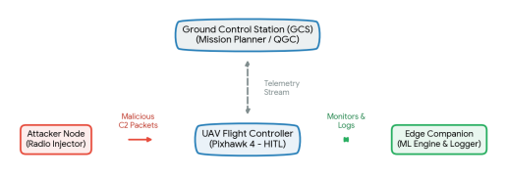
Research Methodology & Architecture
Design Science Research (DSR) & Quantitative Experimental Simulation

Slide 9
Data Collection & Evaluation
Entirely synthesized data (PCAP, telemetry) from the HITL testbed. Public datasets are insufficient as they lack the volatile memory constraints and raw MAVLink logic
overwrites required
Classification Accuracy
Computational Latency
Evidence Yield

Slide 10
Project Planning Timeline
The research is structured over a 12-week schedule to ensure completion prior to the submission
deadline.
Week 1-2: Literature Review
Week 3-4: Lab and Testbed Setup
Week 5-6: Simulate C2 Attacks
Week 7-8: ML Model and Logger Deb
Week 9-10: Data Analytics

Slide 11
Impact, and References
Transitions aviation cybersecurity from reactive analytics to proactive forensic readiness, providing incident responders with legally defensible evidence
[1] K. A. et al., "Vulnerability Analysis of MAVLink...", DTIC, 2014.
[2] S. Jeong et al., "MUVIDS: False MAVLink Injection Attack Detection...", AutoSec, 2021.

Slide 12
Any Questions

