Slide 1

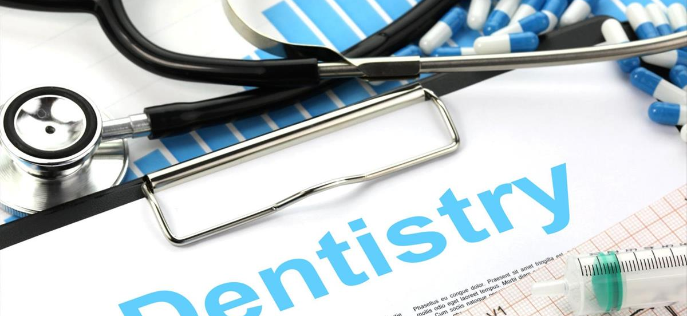
Name: Moveta Douglas
Module: Introduction to health and social Care
Module code: LCHS4003-London
Lecturer: Dr. Rachel Cohen
Student ID: 2329297
Topic: Dental Services
This Photo by Unknown Author is licensed under CC BY-SA

Slide 2
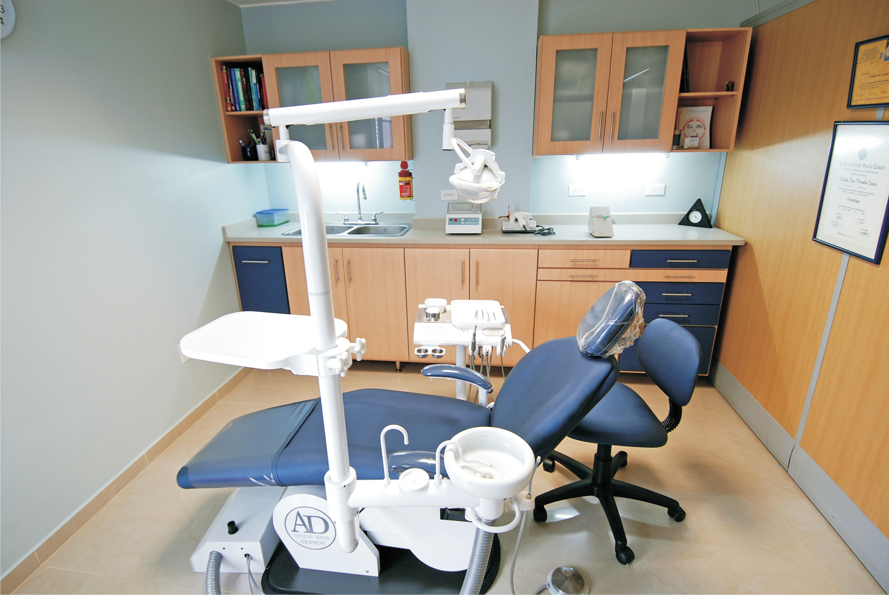
Introduction
Dental services is very important in our society, especially in our communities.
The service have been with us for a long time, helping many families.
Things changes as we evolve; we will investigate this aspect of Dental services and the impact it made to the generations up to now.
It is essential that we know about our Dental service, and the aid given in our communities.
Time as pass so quickly, that sometimes we forget where we were and where we are now.
Dental service maintain the oral health of the community.

Slide 3
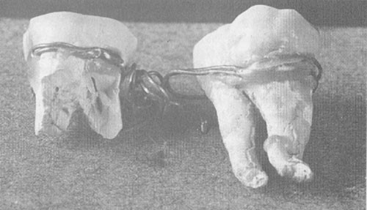
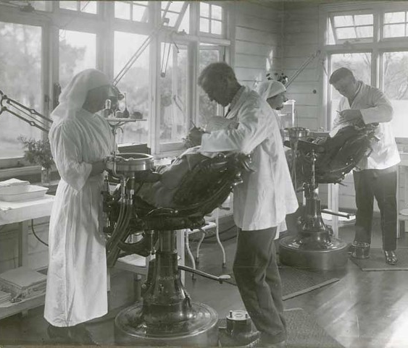
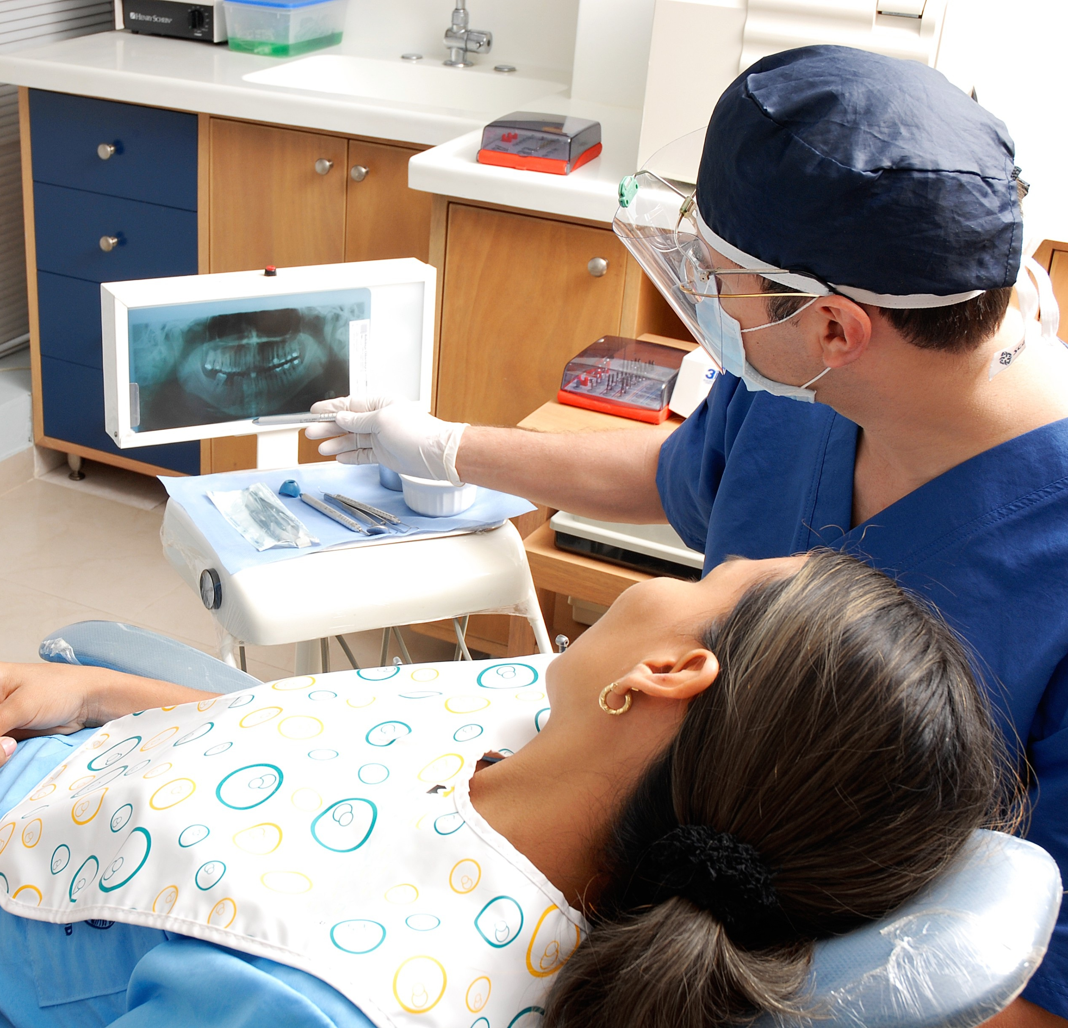
Dental services
The pass - According to, Forshaw,( 2009 ) dentistry has been around from ancient Egypt.
Origin - Meanwhile in Briton, dentistry was established in 1948, when the labour Prime Minister Attlee won the election, he went on to establish the NHS(National Health Service) which included dental services (Clement, 2023).
Before then you would need save up money to get treatment or to be seen for any condition in the nhs (Brain, nd).
Development - During his ruling he makes dentistry free for all, therefore there was no barrier to see a dentist, (Clement, 2023).
Currently - to see a dentist today you need to pay a free, unless you’re on a benefit but the service is there for everyone.
Aiding the communities; although today it may be hard to be seen by a NHS dentist due to waiting time, it is still accessible in the community settings, (Ehsan, 2022).
This Photo by Unknown Author is licensed under CC BY-NC
Notes:
Skeleton body was found with two teeth wired together, to say that someone was trying their hands at dental bridge.
In

Slide 4
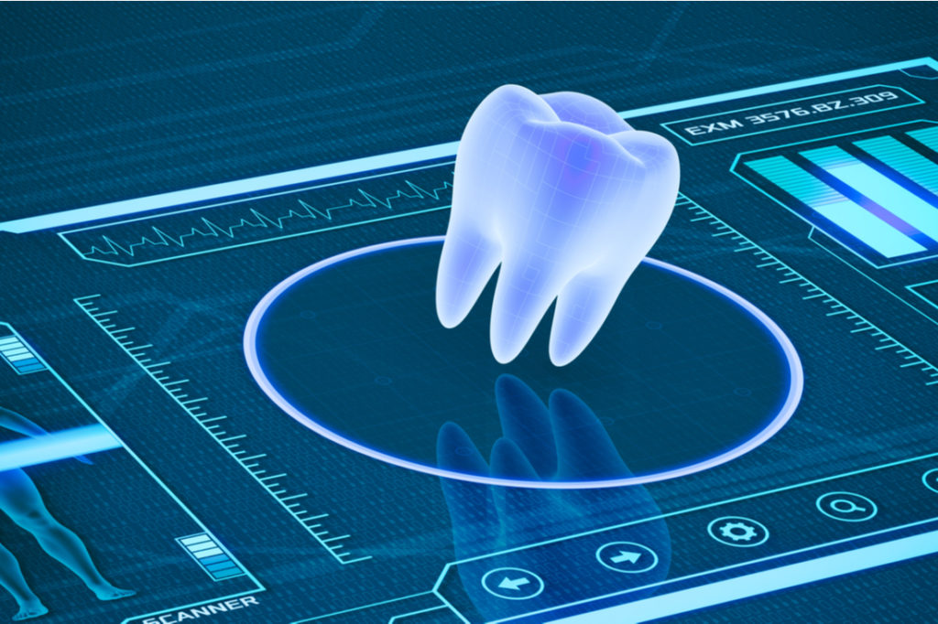
Conclusion
Dentistry is evolving; more money is needed to put into the dental services. Although it may be difficult to see a dentist due to waiting time because of the growing population. Therefore, booking appointment in advance is important. Having a six-monthly check will keep in line with visits. We have come a long way, the dental services is been stretched, as the population grows and more dentist is needed alongside other staff, it is with much needed help that there will need for better pay to maintain and keep the dental services running safely.
This Photo by Unknown Author is licensed under CC BY-NC-ND

Slide 5
References
Brain, J(nd). Article. Historic uk. The birth of the NHS. Available at
The Birth of the NHS - Historic UK (historic-uk.com). Accessed 27th June 2024
Clement, M. (2023). Blog. History of Government. The founding of the NHS:75 years on. Available at: https://history.blog.gov.uk/2023/07/13/the-founding-of-the-nhs-75-years-on/. Accessed 26th June 2024
Ehsan,O (2022). Journal. Online Publication. Oral surgery wait times in NHS secondary dental care in England: a five-year review. Available at https://www.nature.com/articles/s41415-022-4138-5 . Accessed 28th June 2024
Forshaw R.J (2009). British Dental Journal. The practice of dentistry in ancient Egypt. Vol 206, #9, pp479-488.

