Slide 1






Urdd Gobaith Cymru
exploring its impact on the role of the Welsh language in education
PRESENTATION - 2025
Presented by:
Amy Delaney 2217692
(Urdd Cymru, n.d.)

Slide 2
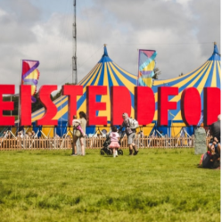


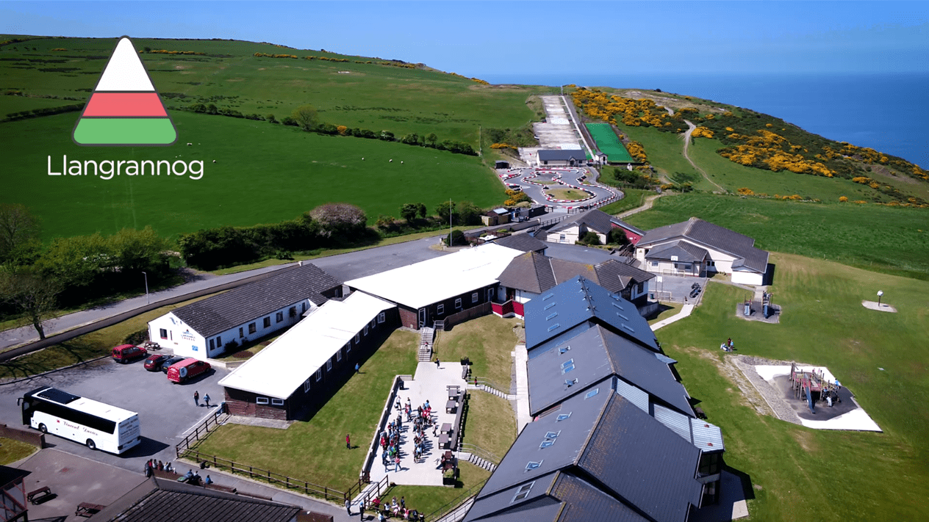
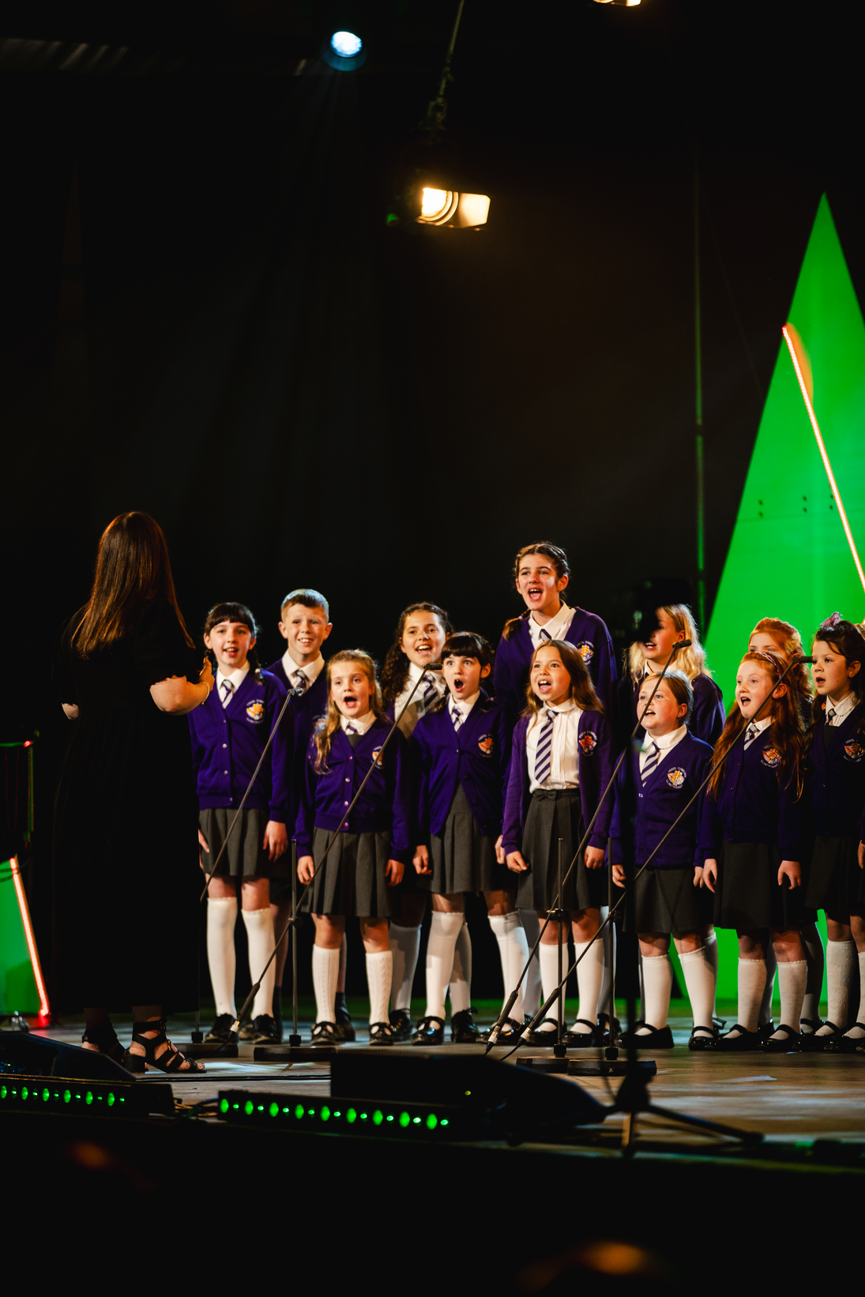
A SENSE OF BELONGING
(West Wales Chronicle, 2021)
(Welsh Government , 2017) (Welsh Government, 2015)

Slide 3
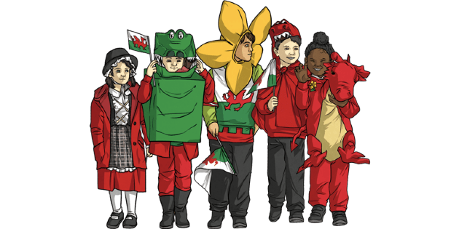
“THESE DAYS, IN MANY VILLAGES, AND IN MOST TOWNS IN WALES, CHILDREN PLAY AND READ IN ENGLISH. THEY FORGET THAT THEY ARE WELSH” (EDWARDS, 1922)
(Urdd, 2025)
(Twinkl, 2025)

Slide 4

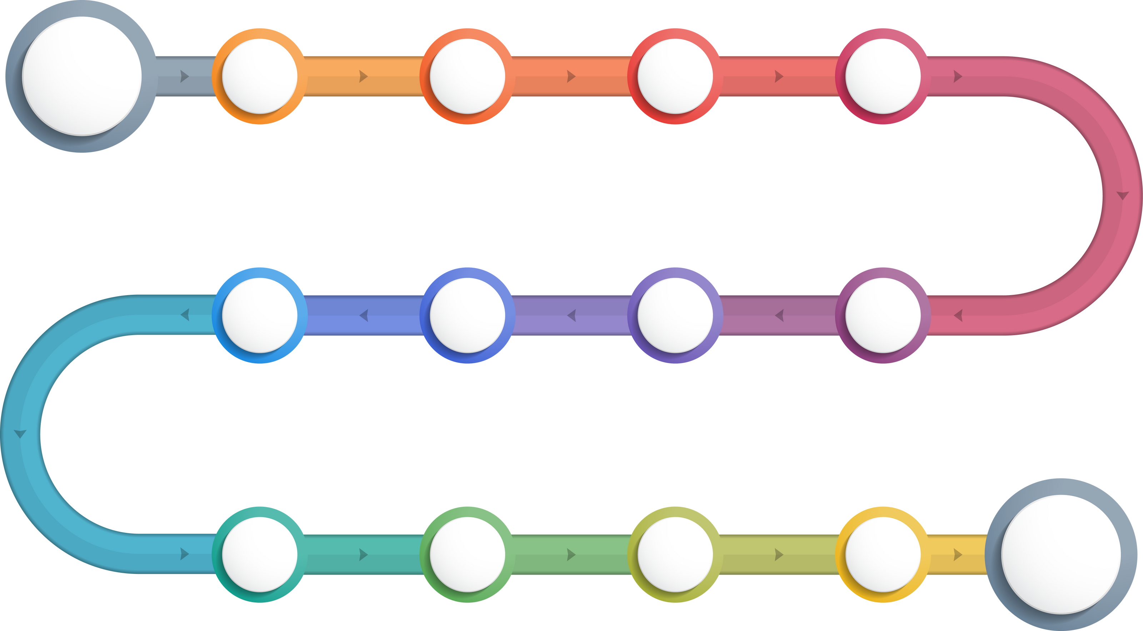







(Urdd, 2025)
1922
1925
1929
1932
1937
Peace & Goodwill
Eisteddfod
Llangranog
Book Campaign
1950
1966
1968
1976
Glan Llyn
Bore da/Mynd
Funding
Mr Urdd
1983
2001
2004
2022
2023
5 day Eisteddfod
Online
Cardiff
Centenary

Slide 5


EISTEDDFOD
Educational Value
Language Development
Cultural Identity
  Welsh & English medium children
  Homework
  Support Curriculum
  Poetry & Singing
  Motivation
  Connection with language
  Music
  Socialising
  Belonging
  Choral Singing
(Urdd Cymru, 2025)
(Davis, 2017).
(Mashayekh and Hashemi, 2011)
(Sams, 2024)
(Johnstone, 2015)

Slide 6
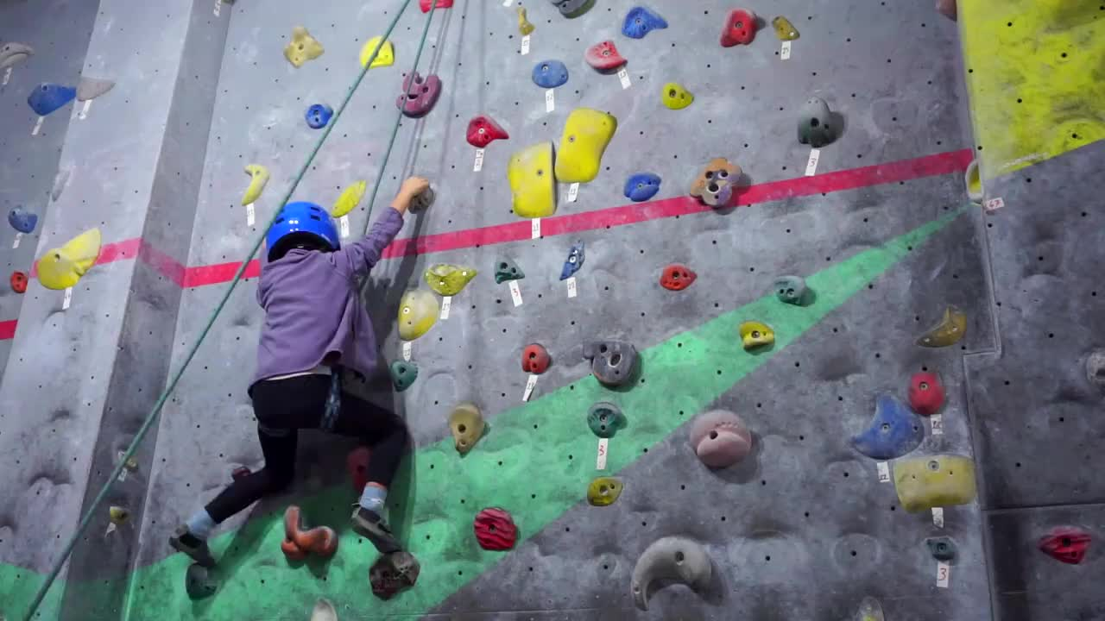
Hwyl at y Gwersyll!
living, learning &
engaging to improve language
proficiency
Welsh Language Immersion
Welsh speaking staff supporting teachers through scaffolding
Support for Welsh Learners
Coming together to create a sense of belonging
Social Benefits
Rafieyan and Rozycki (2018)
(Vygotsky, 1978)
(Nôl i'r Gwersyll, 2024)

Slide 7




Supporting Welsh Schools
Language & Cultural Development
Connection
Curriculum Requirements
(Welsh Government, 2022)
(Donaldson, 2015)

Slide 8
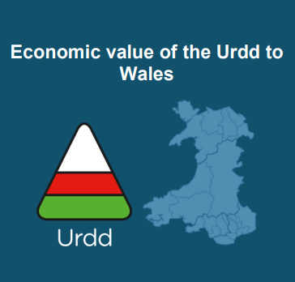


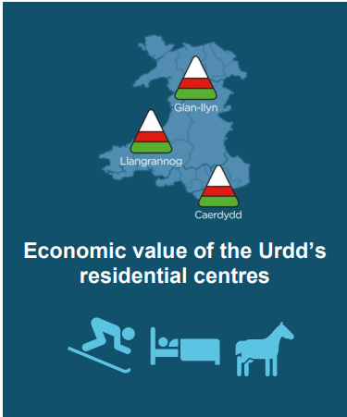


£16m
£6.1m
£44.9m
£7.9m
£4.5m
(Arad Research, 2023)

Slide 9



ADAPTING TO MODERN CHALLENGES
Digital Engagement
Poverty
Global Pandemic
(Urdd Cymru, 2025b)
(Urdd Cymru, 2025c)
(Welsh Government, 2021)

Slide 10
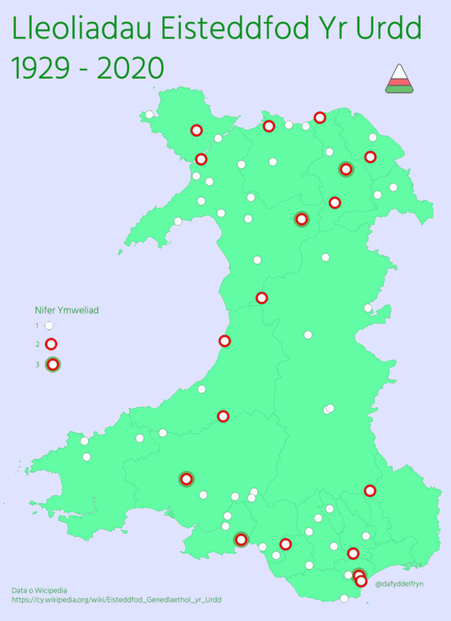
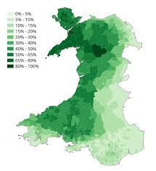


CRITICISMS AND AREAS FOR IMPROVEMENT
Urdd Residential Centres
Number of Welsh Speakers
(Dafydd Elfryn, 2018)
(Office for National statistics, 2021)

Slide 11
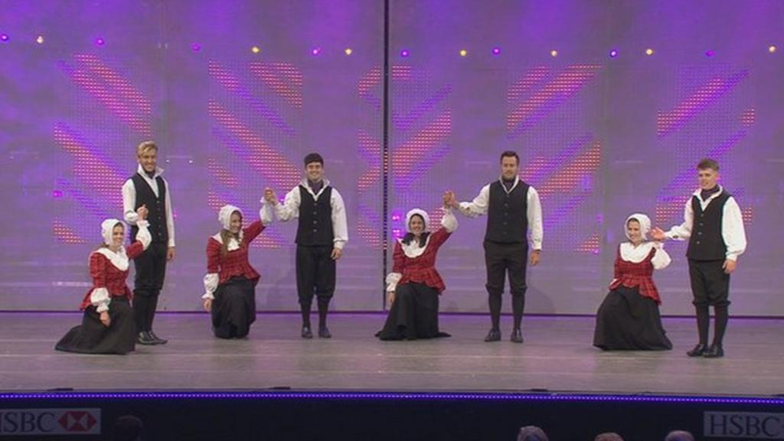
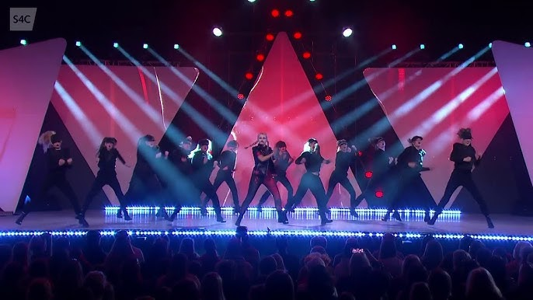
CRITICISMS AND AREAS FOR IMPROVEMENT
(BBC, 2015)
(Eisteddfod yr Urdd - S4C, 2023)
(Onllwyn, 2021)

Slide 12

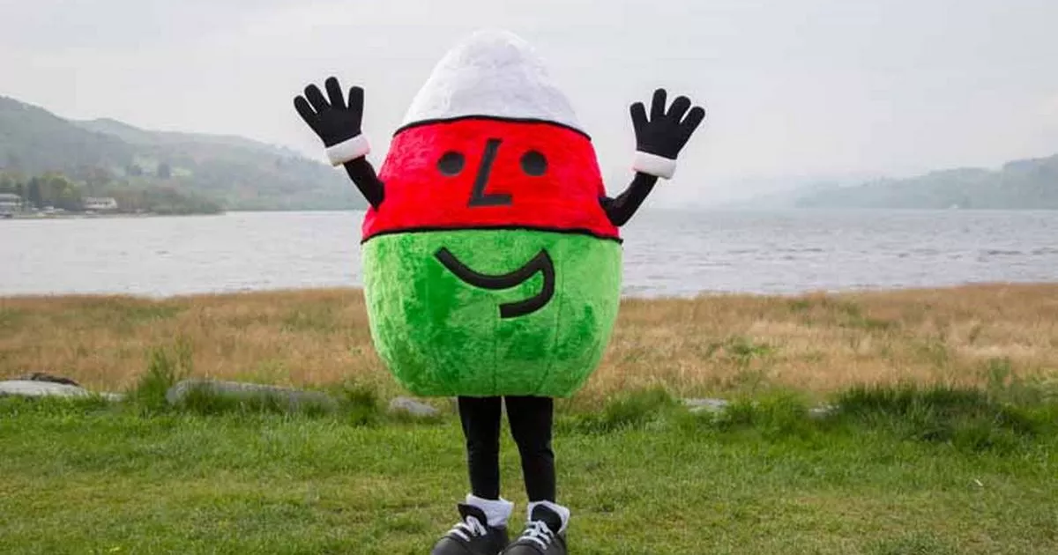
Conclusion
DIOLCH AM WRANDO
(Löffler, 2006)

Slide 13
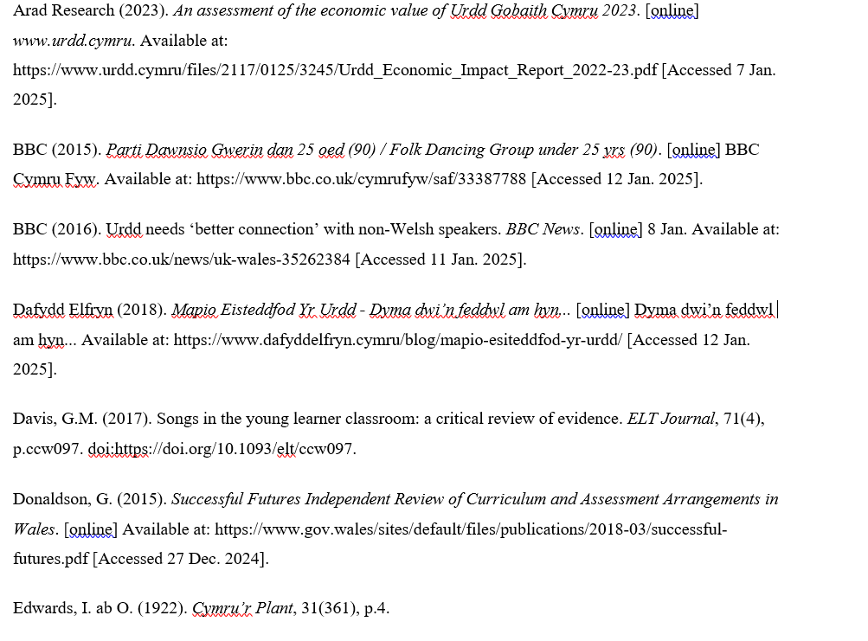
REFERENCES

Slide 14
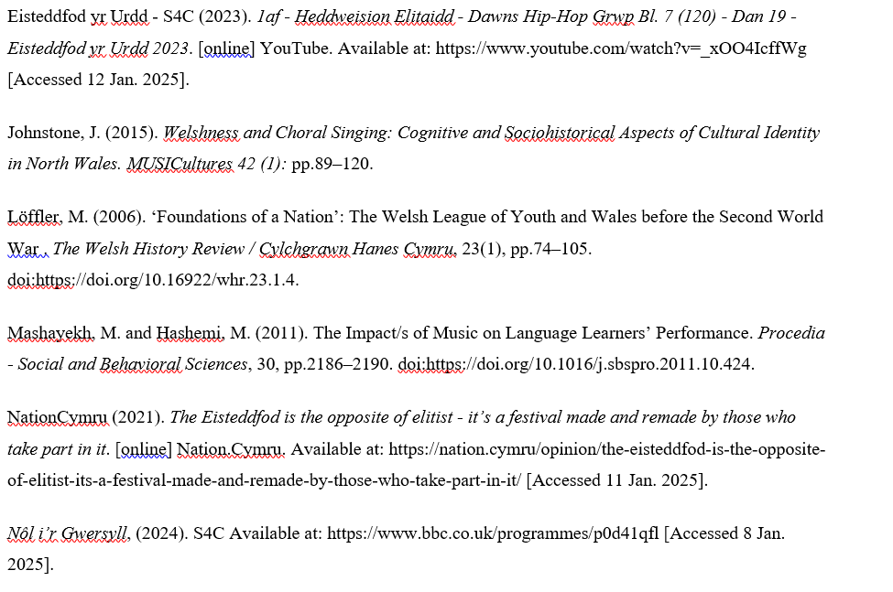
REFERENCES

Slide 15
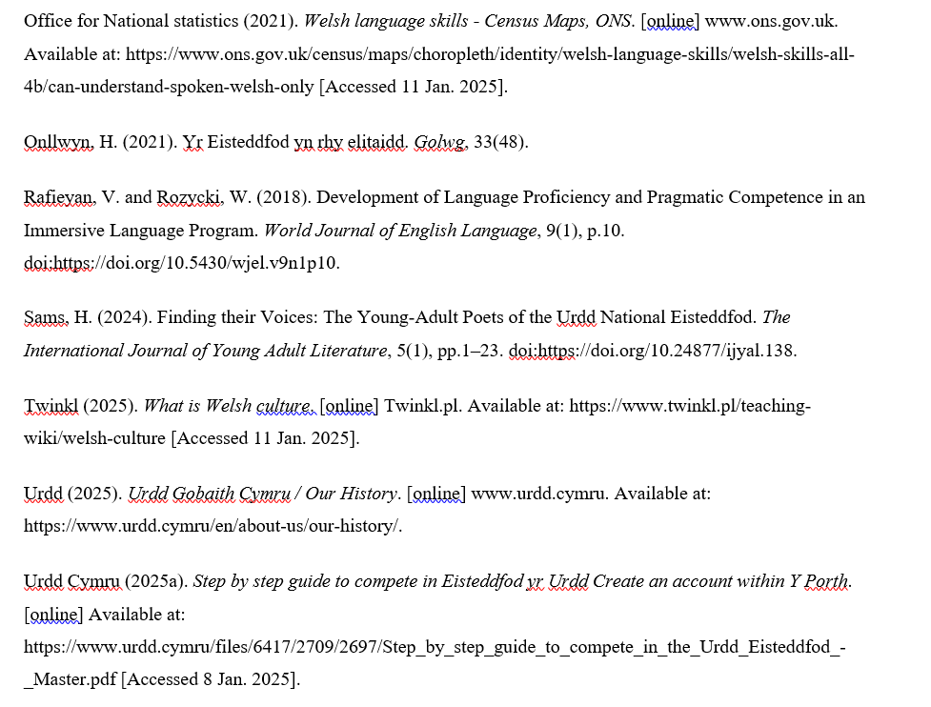
REFERENCES

Slide 16
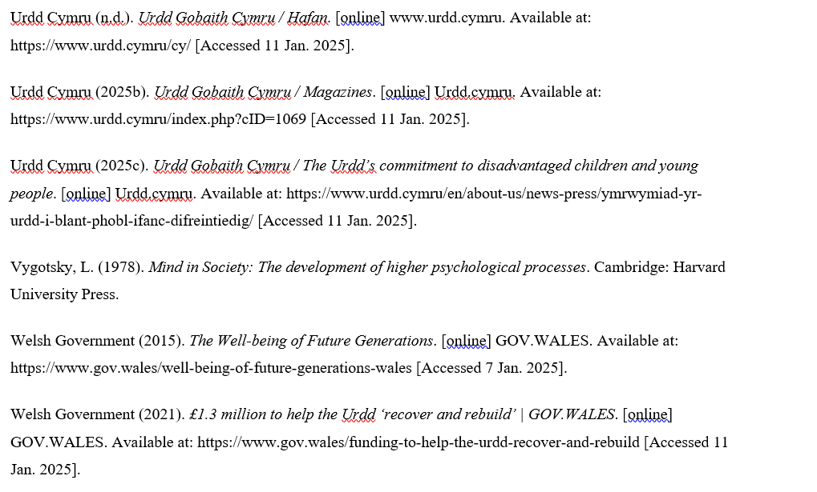
REFERENCES

