Slide 1

How do students use technology to collaborate at UWTSD?

Slide 2
Course: Digital Skills and Research Methods
Module code: BMSW4003
Lecturer: Abdi Rahman
Student: Madalina Pruna 2132441
Student: Lavinia Marina Arva 2128637
Allen, I.E., & Seaman, J. (2011). Going the distance: Online education in the United States. Babson Survey Research Group and Quahong Research Group, LLC.
Brown, J.S. (2000). Growing up digital: How the web changes work, education, and the ways people learn. USDLA Journal. 16 (2), February), 11-20.
Carey, K. (2012, September 7). Into the future with MOOC’S. Chronicle of Higher Education. 59 (2), A136.

Slide 3
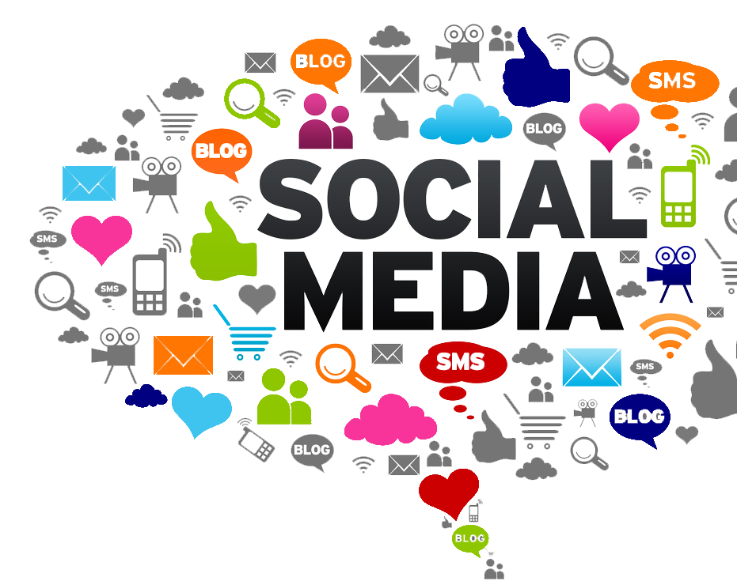
Which digital tool is most used by students at UWTSD to collaborate together?

Slide 4

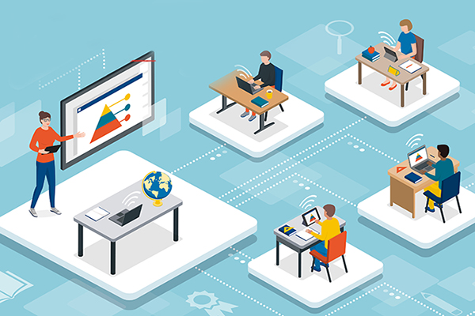
Technology provides students with easy-to-access information, accelerated learning, and fun opportunities to practice what they learn.
The world is changing very rapidly
Information and knowledge come in many forms including DVDs, eBooks, and YouTube videos

Slide 5
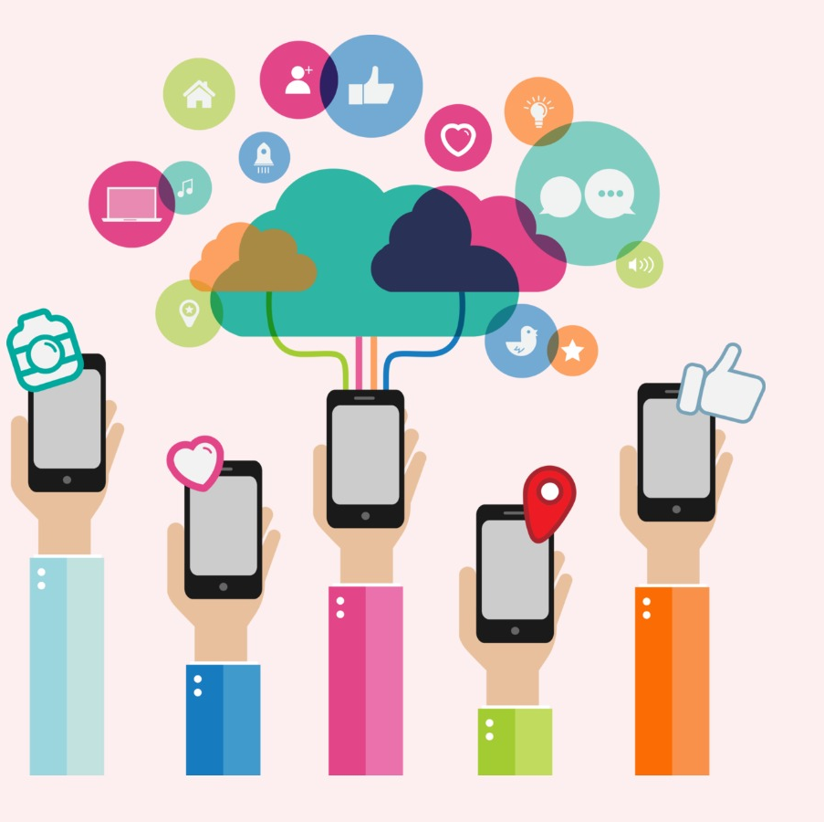
Learning how to communicate and work with others should also be a goal of education (Robinson, 2008)
Communication technologies can include “old” technologies such as email, lectures notes in pdf files, or even an online discussion forum

Slide 6
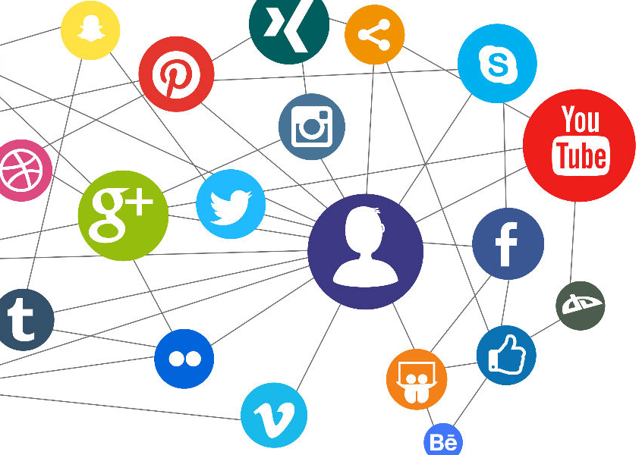
The most popular social media platforms that students use to communicate:
Email
Teams
Whatsapp
Facebook
Instagram
Skype

Slide 7

By and large, social media technologies are concerned with communication between and among human beings.
Why is social media platforms important?
In today's society, the use of social media has become a necessary daily activity. Social media is typically used for social interaction and access to news and information, and decision making. It is a valuable communication tool with others locally and worldwide, as well as to share, create, and spread information.

Slide 8
Conclusion
Social media plays an important role in every student's life. It is often easier and more convenient to access information, provide information and communicate via social media.
Tutors and students can be connected to each other and can make good use of these platforms for the benefit of their learning and teaching.

