Slide 1

Digital Skills and Research Methods
Component 1 Research Methods – Presentation
Module code:BMSW4003
University of Wales Saint David
Professor Abdi Rahmen

Slide 2

Student name: Shamim Abdullah
Student ID: 2110434

Slide 3

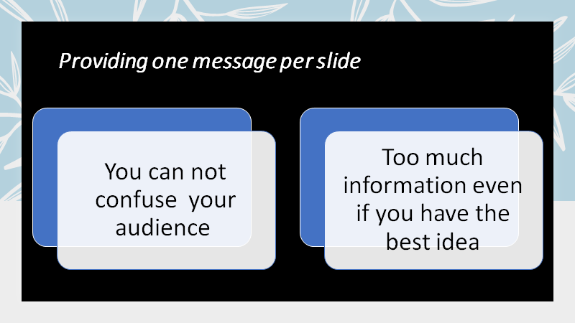

Slide 4


Slide 5


Slide 6

Student name : Salah Mheidean
Student ID : 2109425

Slide 7





size
Digital Skills and Research Methods
Digital Skills and Research Methods
Digital Skills and Research Methods

Slide 8
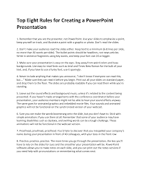
Six
1. Remember that you are the presenter, not PowerPoint
2. Don’t make your audience read the slides either
3. Make sure your presentation is easy on the eyes.
4. Sure you can make the words boomerang onto the slide, but you don’t have to.
5. Proofread, proofread, proofread.
6. Practice, practice, practice.

Slide 9

Student name: Addis Gebregiorgis Gebresilasie
Student ID: 2112297

Slide 10
contrast
While the most com mon application of contrast in PowerPoint in common application of contrast in powerpoint is color.
Contrast can be created by having different object shapes, sizes front sizes alignment.
The principle of contrast is dependent up on the surrounding element being noticeably different from the focal point.
OCT/2012 Powerpointninja.com

Slide 11
While the most common application of contrast in power point is colour
Contrast can be created by having different object shapes front sizes alignment
The principle of contrast is dependent on the surrounding element being noticeably different from the focal point.

Slide 12

Student Name: Cristina Anton
Student ID:2110293

Slide 13
OBJECTS
Objects are anything you can add to PowerPoint:
-A text tag is an object.
-An image is an objects
-Graphs and diagrams are objects
Any element in a slide show is an object
Class, 2019

Slide 14


