Slide 1

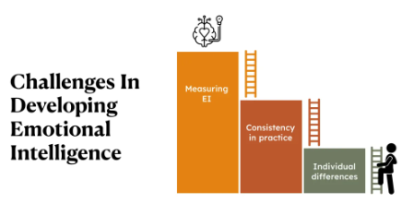
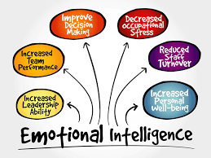
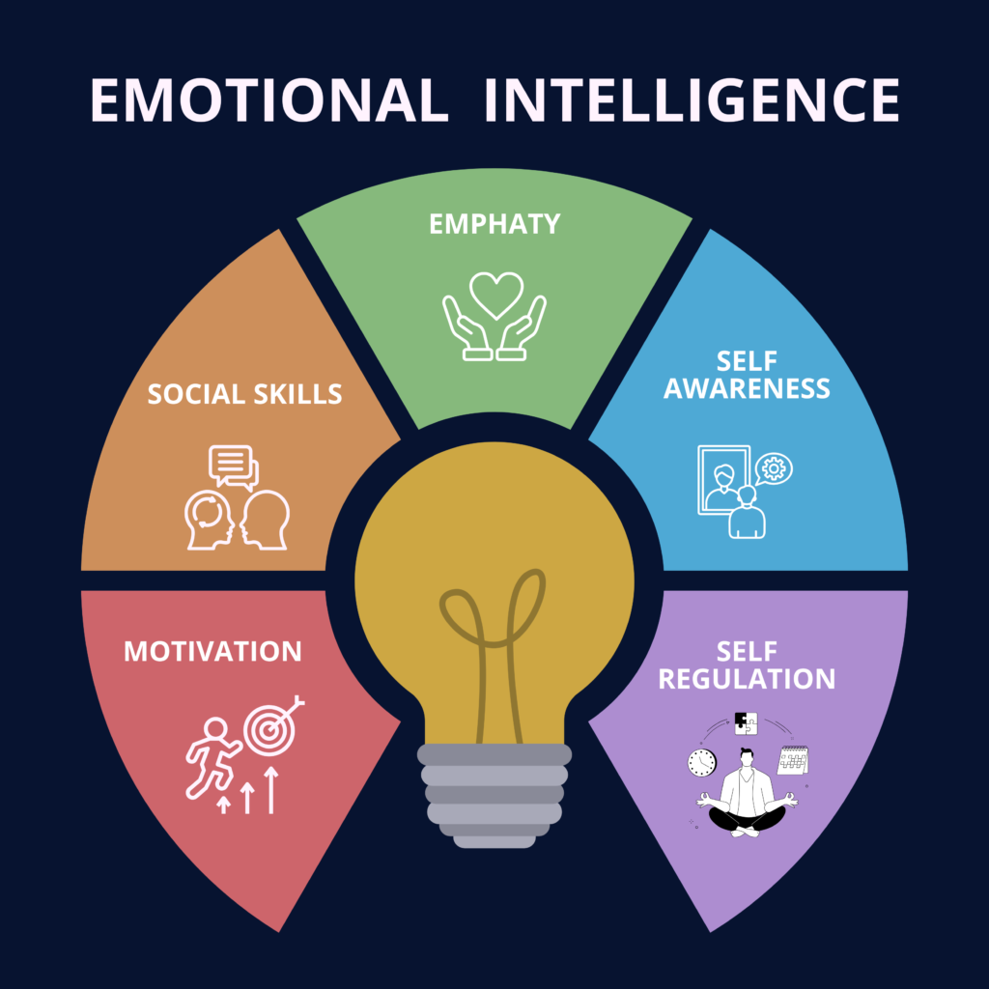
Developing Emotional Intelligence: Understanding and Managing Emotions for Academic Success
Student name: Ali Ansar
Student ID: 2319374
Module code: LCLM5006
Module Leader: Nishi Ramsurrun/Abdallah Naser
Introduction
Developing Emotional Intelligence
Emotional intelligence challenges and success factors
Emotional issues common among students include stress, demotivation, and time management. These issues typically stem from poor self-regulation and poor emotional awareness (Clarke, 2020). Achievement at school depends on management of these emotions using resilience, self-control, and supportive peer social relationships. Feedback, peer work in collaboration, and growth mindset enhance academic self-confidence (Matthews et al., 2022). Through the early resolution of emotional intelligence issues, students can convert emotional obstacles into personal and educational opportunities for development.
Emotional intelligence (EI) involves the ability to recognize, comprehend, and control one's own emotions and react accordingly to other people's feelings. Emotional intelligence is essential in self-awareness, communication, and stress coping in schools (Goleman, 2017). Developing EI helps students control impulsive behavior, build resilience, and maintain motivation throughout learning. This presentation explains how emotional intelligence can be created, how mindfulness aids in managing emotions, and what are the individual behaviors that result in effective learning outcomes (Mayer et al., 2016).
EI growth requires constant self-awareness and feedback. Students can practice emotional control as journaling, mindfulness, and active listening (Cherniss, 2020). Constant self-assessment allows one to determine emotional weaknesses and strengths, providing chances to build self-knowledge. Group assignments also promote flexibility of emotions through teamwork and understanding. Additionally, setting realistic goals in academics improves motivation and confidence (Boyatzis, 2018). With these practices, students become increasingly well-balanced emotionally, which allows them to cope with academic issues more effectively.
Understanding Emotional Intelligence
EI includes four essential dimensions: self-awareness, self-management, social awareness, and relationship management (Salovey & Mayer, 2016). These abilities enable one to read emotional cues and respond intelligently rather than reactively. Self-awareness recognizes emotional triggers of university life, and self-regulation evokes composure in conditions of pressure. With enhanced empathy and communication, students are able to build supportive relationships that contribute to learning success (Petrides, 2018). Therefore, emotional intelligence is the foundation of successful interpersonal communication and personal well-being in higher education.
Conclusion
Emotional intelligence is essential to career and academic success. Regulation and knowledge of emotions make learning more effective as well as workplace success. Through consistent self-monitoring, mind awareness, and emotional regulation, one achieves solid emotional foundations essential for a lifetime of learning (Goleman, 2017). Building these skills ensures adaptability, empathy, and resilience—something that is required for leadership and job performance.
Controlling emotions and practicing mindfulness
References
Mindfulness also allows students to remain emotionally stable by maintaining their attention on the present moment and reducing stress reactions (Siegel, 2019). Mindfulness exercises such as meditation and slow breathing balance one's emotions and prevent excessive reacting in the face of academic pressure. Being a student, mindfulness exercise allows one to possess a calm and clear mind when handling deadlines or team conflicts. It improves focus and endurance, which are essential for quality academic performance (Good et al., 2016). Developing this habit creates mental acuteness and strengthens the emotional control needed to accomplish learning.
Boyatzis, R. E. (2018). The Competent Manager: Emotional Intelligence in Action. Harvard Business Review Press.
Cherniss, C. (2020). Emotional Intelligence: Toward Clarification of a Concept. Industrial and Organizational Psychology, 13(2), 109–123.
Clarke, N. (2020). Emotional intelligence and its relationship with student stress and coping. Journal of Educational Psychology, 112(4), 781–793.
Goleman, D. (2017). Emotional Intelligence: Why It Can Matter More Than IQ. Bantam Books.
Matthews, G., Zeidner, M., & Roberts, R. D. (2022). Emotional Intelligence: Science and Myth. MIT Press.
Siegel, D. J. (2019). Aware: The Science and Practice of Presence. TarcherPerigee.
Mayer, J. D., Salovey, P., & Caruso, D. R. (2016). Emotional Intelligence: New Ability or Eclectic Traits? American Psychologist, 71(6), 484–497.
Good, D. J., Lyddy, C. J., & Glomb, T. M. (2016). Contemplating mindfulness at work. Journal of Management, 42(1), 114–142.
Petrides, K. V. (2018). Personality and Emotional Intelligence: The Trait Perspective. European Journal of Personality, 32(4), 437–458.
Notes:
You can add your presentation notes here. This presentation template for research posters is fully editable so text, graphics and content can be updated to fit your own research needs.
Download more poster presentation templates from FPPT.com

