Slide 1
Personal resourcing and Development
Name: Ema-Roxana Matei
Student ID: 1816275
Lecturer: Jahanzeeb Qurashi

Slide 2
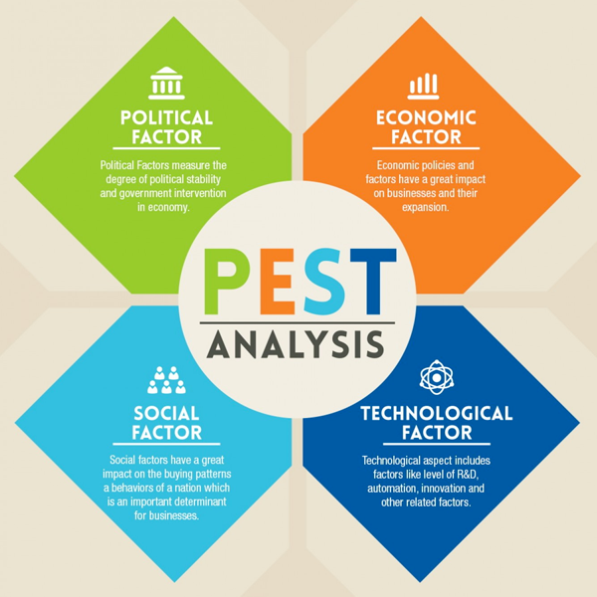
Political Factors
Japan uses the constitutional monarchy system of government headed by an emperor. The monarch system has limited influence on the country’s’ political affairs through the emperor who is regarded the epitome of the national unity within the country.
Japan enjoys a very close relationship with the United States of America (USA). This relationship is Japan’s foreign and security policy.

Slide 3
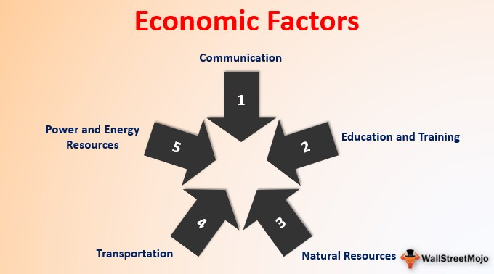
Economic Analysis
Japan’s $4.9 trillion GDP makes it the third world’s largest economy as at December 2019 (6). This economy continues to grow annually at a higher rate.
Japan is also ranked the second largest in the economic scale of Asia. It also has a mixed financial system whereby the government closely works with available industries.
Local companies in Japan are required to pay a corporate tax on income generated both domestically and abroad.

Slide 4
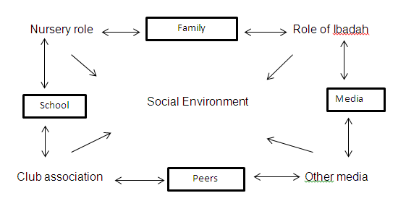
Social Environment Analysis
Japan has a rapid population growth with a current population of 126.6 million people (17). The main two religions in Japan are Shintoism and Buddhism. The most spoken language is Japanese, covering almost 99% of the population.
Japan is faced with several social challenges with a sinking birth rate and the aging population being the two biggest challenges. Sources have forecasted Japan’s population to drop below 100 million by 2048 and 87 million by 2060 (17).

Slide 5
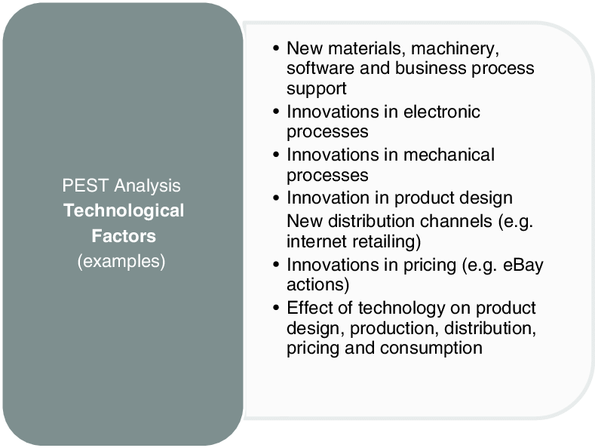
Technological Environment
Japan has the most technological advances. The japans population is known for creativity and learning to use the latest technologies. Japan’s innovation is ahead of most of the advanced countries more so in robotics innovation.
For instance, there is a contactless payment system in Japan that was invented years before any country had a plan of developing it.

Slide 6
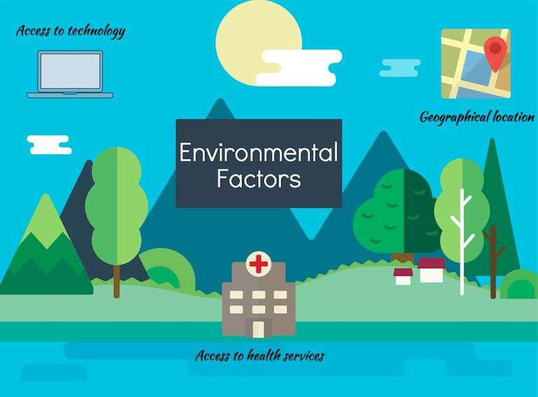
Environmental Factors
Japanese people are friends of the Environment as they are environmentally responsible. However, they face a variety of environmental factors such as Waste management in Tokyo town. Japan is currently under high pressure in a deal to control waste.

Slide 7
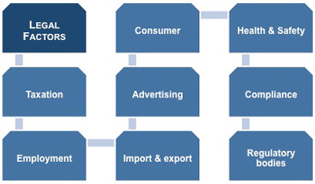
Legal Environment
Legal Environment summarizes the PESTEL analysis. Japan allows for people to work as employees, independent contractors, directors, and dispatched workers. Employees in Japan are guaranteed employment rights and benefits, such as maximum hours of work, holidays, and maternity breaks.

Slide 8

Companies use different sources when recruiting their employees depending on the size of the firm and the kind of employees needed. When making any recruitment and selection in the company, the managing team usually analyses the sources so as to decide which source best fits their required employees. This is because different sources will target different kinds of people. Some of the sources of recruitment and selection processes are employee referrals, social media, job boards, search engines and integrated talent network (16).

Slide 9

Culture, diversity and equality within the organization are some of the most important aspects that any organization should keep a close eye on. Both play a significant role in enhancing the vision and mission of the organization and driving the labor force towards achieving objectives. However, several factors enhance the realization of culture, equality and diversity in organizations.

Slide 10

Companies use various methods to measure and manage performance. One of these many ways is using the Key Performance Indicators (KPIs). KPIs give a measure of how much the company is doing in terms of achieving their goals and objectives. However, the most important function of KPIs is to enable value based discussions to better performance and decision making. Well-designed KPIs help the company determine the kind of decisions to make and the kind of goals an organization intends to achieve

Slide 11
1) Alam, I. The recruitment and selection process at RAK Ceramics (Bangladesh) Limited. 2016.(2) Rohwerder, B. Impact of diversity and inclusion within organisations. Posted May 17, 2017. https://assets.publishing.service.gov.uk/media/5ba51175e5274a54d5c39c19/109_Dsiversity_and_inclusion_within_organisations.pdf (accessed Jun 3, 2020).(3) Al-Kassem, A. H. Recruitment and Selection Practices in Business Process Outsourcing Industry. Archives of Business Research 2017, 5 (3).(4) Amici, M.; Cepiku, D. Performance Management: A Theoretical Framework. Performance Management in International Organizations 2020, 97–114.(5) BBC news. Japan country profile. 2019. https:// www.bbc.com/news/world-asia-pacific-14918801 (accessed 3 June 2020).(6) Country Economy. Japan GDP. 2020. https://countryeconomy.com/gdp/japan (accessed 3 June 2020).(7) Country Economy. Japan Economic Growth Rate. 2020. https://countryeconomy.com/gdp/japan (accessed 3 June 2020).(8) Cascio, W. Managing human resources. McGraw-Hill Education. 2018. (9) Djabi, M.; Shimada, S. Generational Diversity in Organisation: A Meta-Analysis. International Perspectives on Equality, Diversity and Inclusion Management and Diversity 2017, 151–181.(10) Lančarič, D.; Chebeň, J.; Savov, R. Factors Influencing the Implementation of Diversity Management in Business Organisations in a Transition Economy. The Case of Slovakia. Economic Research-Ekonomska Istraživanja 2015, 28 (1), 1162–1184.(11) Muhinyu, N. J.; Gudda, P. Competitive Strategies Adopted by Hotels in Kenya and Their Effects on Financial Performance: A Case of Serena Hotels. The International Journal of Business & Management 2019, 7 (5).(12) Othman, G.; Khalif, A. A.; Alammari, A. Human Resource Management: Tools and Strategies. Management, organizations and society 2017.(13) Pivotal Education. Factors that affect equality and diversity. https://pivotaleducation.com/hidden-trainer-area/training-online-resources/factors-that-affect-equality-and-diversity/ (accessed Jun 3, 2020).(14) Rhodes, H. M.; Martin, A. J. Factors Affecting Workplace Outcomes: Examining the New Zealand Army’s Experiential Leadership Courses. Journal of Outdoor Recreation, Education, and Leadership 2015, 7 (2), 112.(15) Riley, M. Recruitment and Selection. Managing People in the Hospitality Industry 2018, 160–173.(16) Sarma, J. Recruitment And Selection In Assam Carbon Products Limited. Deliberative Research, 2017, 35(1), 27-32.(17) Worldometer. Japan Populaton 2020. 2020. https://www.worldometers.info/world-population/japan-population/ (accessed 3 June 2020).

