Slide 1

Applying Piaget’s Cognitive Development Theory to Support Amira in Early Years Care
Module: LCHS4010 – Psychology in Health and Social Care
Student Name:Noreen Akhtar
Student ID:2321475
Notes:
“Good [morning/afternoon] everyone. Today, I’ll be presenting on how Piaget’s Cognitive Development Theory can be applied to support Amira in early years care. I’ll introduce you to the case of Amira, a three-year-old experiencing anxiety, delayed speech, and challenges in group play. Throughout the session, I’ll demonstrate how Piaget’s ideas provide a framework for understanding her needs, and I’ll also highlight where additional perspectives are essential to create a more holistic support plan.”

Slide 2
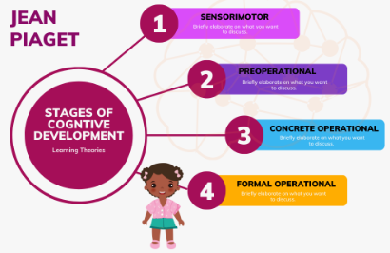
Introduction
This presentation explores how Piaget’s Cognitive Development Theory can be applied to support Amira, a 3-year-old showing anxiety, delayed speech, and difficulties with group play (McLeod, 2025). The presentation will:
Introduce Piaget’s theory and its relevance.
Apply the theory to Amira’s developmental needs.
Suggest strategies informed by Piaget.
Critically evaluate the usefulness and limitations of the theory.
The objective is to demonstrate how psychological theory guides practice in health and social care, while recognising where theory alone is insufficient.
Notes:
“In this presentation, we’ll look at Piaget’s Cognitive Development Theory and apply it to Amira’s developmental profile. Specifically, I’ll explain Piaget’s key ideas, connect them to Amira’s learning and social needs, and share practical strategies we can use in early years practice. Importantly, I’ll also consider the strengths and limitations of Piaget’s model. My goal is to show how theory can guide real-world care, while recognising that psychological theories alone can’t address every aspect of a child’s development.”

Slide 3
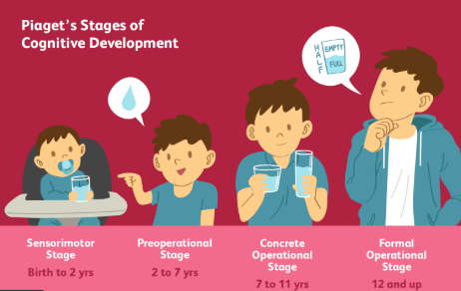
Piaget’s Cognitive Development Theory (Overview)
Jean Piaget, a Swiss psychologist, proposed that children actively construct knowledge through interaction with their surroundings. He described four universal stages of cognitive development: sensorimotor, preoperational, concrete operational, and formal operational (Pakpahan and Saragih, 2022). Amira, at age three, falls within the preoperational stage (2–7 years). Children at this stage develop symbolic thinking but lack logical reasoning. While Piaget’s model remains influential, critics argue that it oversimplifies development and overlooks social and cultural variation (Bukatko, 2018).
Notes:
“Jean Piaget was a Swiss psychologist who believed that children actively construct knowledge through interacting with their environment. He identified four stages of cognitive development: sensorimotor, preoperational, concrete operational, and formal operational. Amira, at three years old, falls within the preoperational stage, where children use symbols and imagination but lack logical reasoning. While Piaget’s model is very influential, it has also been criticised for oversimplifying development and ignoring social and cultural influences. This means we should apply it carefully in practice.”

Slide 4
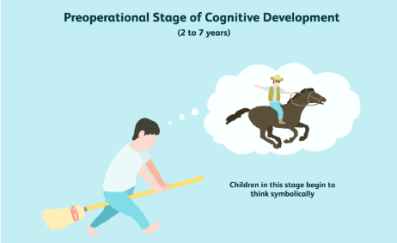
Key Concepts in Preoperational Stage
Piaget identified several features of the preoperational stage:
Symbolic play and language development.
Egocentrism, limiting perspective-taking.
Animism, attributing feelings to objects.
Lack of conservation, failing to recognise quantity consistency.
These concepts explain many early years behaviours. However, later research demonstrates that children can achieve more advanced reasoning with appropriate support, challenging Piaget’s rigid stage-based model (Babakr, Kakamad and Mohamedamin, 2019). This suggests that his framework is best used as guidance rather than a strict developmental timetable.
Notes:
“In the preoperational stage, children engage in symbolic play, begin developing language, and often show egocentrism, meaning they find it hard to see another person’s point of view. They may also display animism, attributing feelings to objects, and struggle with conservation tasks, like realising that liquid remains the same amount even in a different container. These ideas explain many behaviours in early years. However, newer research suggests children can perform more advanced tasks with adult support, showing Piaget’s stages are flexible rather than fixed.”

Slide 5
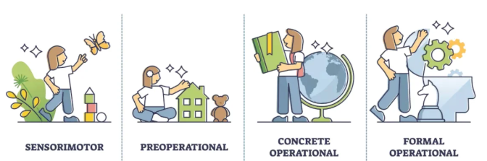
Relevance to Early Years Development
Piaget’s emphasis on play as a vehicle for learning continues to shape early childhood practice. Play fosters imagination, symbolic understanding, and social interaction. His theory highlights the active role of the child in development. However, the model underestimates the importance of adult guidance, later emphasised by theorists such as Vygotsky. In Amira’s case, combining Piaget’s insights with supportive scaffolding is critical to promote both confidence and cognitive growth (Main, 2021).
Notes:
“Piaget’s focus on play remains central in early years practice today. Play isn’t just fun—it supports imagination, symbolic understanding, and social growth. His theory also highlights the active role of children in their own learning. However, Piaget didn’t give enough attention to the role of adults, something Vygotsky later emphasised. In Amira’s case, Piaget’s insights are useful, but she will also benefit from structured guidance and scaffolding from adults to build her confidence and extend her learning.”

Slide 6

Applying Theory to Amira (Cognitive Needs)
Piaget’s model highlights Amira’s limited verbal skills as evidence that her symbolic function is still developing. Her difficulty engaging in group play aligns with Piaget’s concept of egocentrism, where children struggle to adopt others’ perspectives. Anxiety, however, complicates Piaget’s idea of the child as a naturally curious explorer. While the theory helps explain her learning stage, it does not fully account for emotional challenges that restrict her cognitive engagement (Lewis and Carpendale, 2018).
Notes:
“Piaget’s model helps us understand Amira’s cognitive needs. Her delayed speech suggests her symbolic function is still developing. Her difficulties in group play can be linked to egocentrism, where perspective-taking is limited at this age. However, her anxiety complicates things, as Piaget described children as natural explorers, but fear can reduce her willingness to engage. So, while Piaget helps us explain her learning stage, his theory doesn’t fully capture how emotions impact her ability to learn and interact with others.”

Slide 7

Applying Theory to Amira (Social/Emotional Needs)
Amira’s frustration in communication suggests emotional challenges linked to delayed speech. Her anxiety when separated from carers indicates difficulties with confidence and social adaptation. Piaget acknowledged play as important for social and emotional growth, but his theory largely neglects attachment, an area better explained by Bowlby. Supporting Amira requires integrating Piaget’s play-based strategies with emotional support, demonstrating that while Piaget aids understanding of learning needs, it is less effective in addressing social-emotional dimensions (Lefa, 2014).
Notes:
“Amira’s frustration in communication and her separation anxiety point to emotional challenges alongside cognitive ones. Piaget valued play for social growth, but his theory largely overlooks attachment and emotional security. Bowlby’s work, for example, explains separation anxiety better than Piaget’s. For Amira, we need to integrate Piaget’s play-based strategies with emotional support, ensuring she feels safe and confident. This highlights that Piaget is helpful in understanding her learning processes, but it is less effective in addressing her emotional world.”

Slide 8


Practical Strategies for Amira (Based on Piaget)
Practical strategies grounded in Piaget’s theory include:
Symbolic play (role play, storytelling) to enhance imagination and language.
Visual prompts and simplified speech to scaffold communication.
Small group play to gradually reduce anxiety and build social confidence.
Hands-on, repetitive activities to consolidate understanding.
Although derived from Piaget, these strategies require adaptation. Evidence indicates children progress more effectively when guided by adults, supporting a blend of Piaget’s and Vygotsky’s approaches (Mcleod, 2024).
Notes:
“From Piaget’s theory, we can design practical strategies to support Amira. Symbolic play, like role-play or storytelling, helps her imagination and speech. Using visual prompts and simplified language can make communication easier. Small group play can gently build her social confidence, while hands-on and repetitive activities help consolidate her learning. Although rooted in Piaget, these strategies need adaptation. Research shows children learn best with adult guidance, so combining Piaget’s ideas with Vygotsky’s scaffolding gives us a more balanced approach.”

Slide 9

Considering Nature & Nurture
Amira’s development reflects both biological and environmental factors. Nature influences include her genetic developmental pace, temperament, and biological language milestones. Nurture includes the nursery environment, cultural expectations, and the stress of separation from carers (Sravanti, 2017). Piaget’s theory emphasised maturation, leaning toward nature, but Amira’s case demonstrates that nurture strongly shapes progress. Modern perspectives emphasise the interaction between biological readiness and environmental support in development.
Notes:
“Amira’s development is shaped by both nature and nurture. Nature includes her genetic pace of development, temperament, and biological factors affecting speech. Nurture includes her environment, cultural expectations, and experiences of separation. Piaget leaned toward nature, seeing development as unfolding with maturation, but Amira’s case shows the strong role of nurture in shaping progress. Modern psychology recognises that development is an interaction between biology and environment, so Amira’s support should consider both her natural abilities and her social context.”

Slide 10
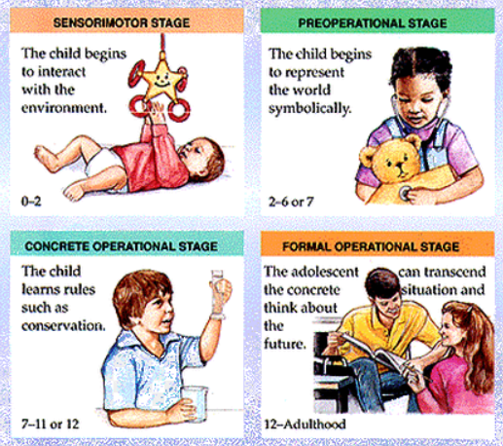
Strengths of Piaget’s Theory
Provides a structured developmental framework still widely used.
Stresses active, play-based learning, aligning with early years curricula.
Highlights children’s role as active learners.
Offers a foundation for observation and assessment of children’s thinking.
Despite criticisms, Piaget’s theory continues to influence pedagogy (Zhang, 2022). Its value lies in shaping practice and stimulating observation, although it requires supplementation with contemporary perspectives.
Notes:
“Despite criticisms, Piaget’s theory has clear strengths. It provides a structured framework for understanding stages of development, which is still widely used today. It highlights active, play-based learning, which aligns with early years curricula. Importantly, it positions children as active learners, not passive receivers of information. Piaget also gave us valuable tools for observing and assessing children’s thinking. His work continues to shape education and care, although we must remember to adapt it with more recent perspectives.”

Slide 11

Limitations of Piaget’s Theory
Piaget’s theory has significant limitations:
Children’s abilities are often underestimated (Cherry, 2023).
Development is not as stage-bound or universal as Piaget proposed.
Limited recognition of cultural, social, and emotional influences.
Potential to mislabel children like Amira as “delayed” when progress varies contextually.
Therefore, Piaget’s theory is most effective when critically applied alongside other models, particularly those emphasising social and emotional development.
Notes:
“Piaget’s theory also has limitations. He often underestimated what children are capable of, and later research shows children can achieve more with support. His idea of universal stages ignores cultural and social differences in development. Emotional and social influences, which we see clearly in Amira’s case, are largely missing from his theory. Finally, relying too rigidly on Piaget may risk mislabelling children as delayed. So, while Piaget is useful, it’s best applied alongside other theories that provide a fuller picture.”

Slide 12
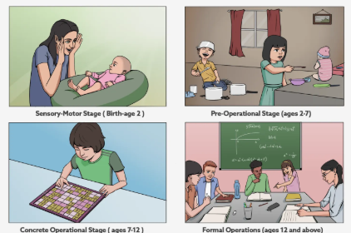
Conclusion
In conclusion, Piaget’s Cognitive Development Theory helps explain Amira’s limited speech, egocentric play, and anxiety within the preoperational stage. His framework informs strategies such as symbolic play, visual supports, and guided group learning. Nonetheless, Piaget’s neglect of emotional and cultural factors means that his theory should not be applied in isolation. Amira’s case demonstrates the importance of combining cognitive insights from Piaget with broader approaches to ensure holistic support.
Notes:
“To conclude, Piaget’s theory helps us understand Amira’s delayed speech, egocentric play, and anxiety within the preoperational stage. His framework guides us toward strategies like symbolic play, visual supports, and guided group learning. However, Piaget’s neglect of emotional and cultural aspects shows why we cannot use his theory in isolation. Amira’s case demonstrates the value of combining Piaget’s insights with other approaches, ensuring we address both her cognitive development and her social-emotional wellbeing for holistic support.”

Slide 13
References (Harvard UWTSD style)
Babakr, Z., Kakamad, K. and Mohamedamin, P. (2019). Piaget’s cognitive developmental theory: Critical review. [online] ResearchGate. Available at: https://www.researchgate.net/publication/335219854_Piaget [Accessed 28 Sep. 2025].
Cherry, K. (2023). Support and criticism of piaget’s stage theory. [online] Verywell Mind. Available at: https://www.verywellmind.com/support-and-criticism-of-piagets-stage-theory-2795460 [Accessed 28 Sep. 2025].
Lefa, B. (2014). The Piaget Theory of Cognitive Development: An educational Implications. [online] ResearchGate. Available at: https://www.researchgate.net/publication/265916960_THE_PIAGET_THEORY_OF_COGNITIVE_DEVELOPMENT_AN_EDUCATIONAL_IMPLICATIONS [Accessed 28 Sep. 2025].
Lewis, C. and Carpendale, J.I.M. (2018). Piaget’s Stages Of Cognitive Development. [online] Child and Family Blog. Available at: https://childandfamilyblog.com/piaget-stages-cognitive-development/ [Accessed 28 Sep. 2025].
Main, P. (2021). Jean piaget’s theory of cognitive development. [online] Structural Learning. Available at: https://www.structural-learning.com/post/jean-piagets-theory-of-cognitive-development-and-active-classrooms [Accessed 28 Sep. 2025].
McLeod, S. (2025). Piaget cognitive stages of development. [online] Simply Psychology. Available at: https://www.simplypsychology.org/piaget.html [Accessed 28 Sep. 2025].
Mcleod, S. (2024). Vygotsky vs. Piaget: A Paradigm Shift. [online] Simply Psychology. Available at: https://www.simplypsychology.org/piaget-vs-vygotsky.html [Accessed 28 Sep. 2025].
Pakpahan, F.H. and Saragih, M. (2022). Theory of cognitive development by Jean Piaget. [online] ResearchGate. Available at: https://www.researchgate.net/publication/362524801_Theory_Of_Cognitive_Development_By_Jean_Piaget [Accessed 28 Sep. 2025].
Sravanti, L. (2017). Nurture the nature. Indian Journal of Psychiatry, [online] 59(3). doi:https://doi.org/10.4103/psychiatry.indianjpsychiatry_341_17.
Zhang, J. (2022). The Influence of Piaget in the Field of Learning Science. Higher Education Studies, [online] 12(3), pp.162–168. doi:https://doi.org/10.5539/hes.v12n3p162.

Slide 14


