Slide 1
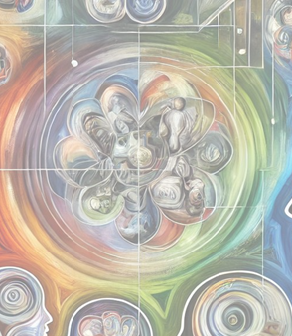
LCHS4010 Psychology in
Health and Social Care
Week 9
Positive Psychology & Cultural Competence
Image generated by CoPilot

Slide 2
Plan for Today
Health Promotion
Positive Psychology
Resilience in the workplace

Slide 3
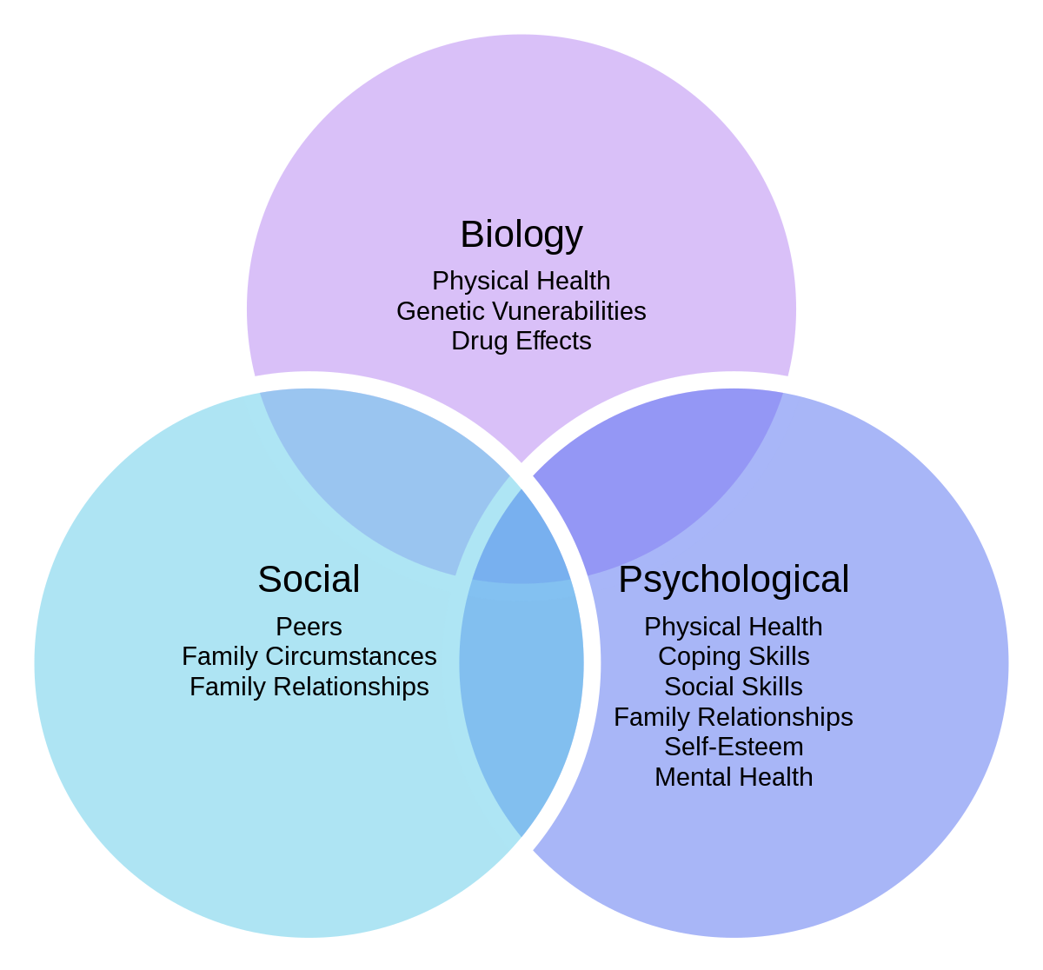
Biopsychosocial model of Health (Engel, 1977)
In addition to physiological/biological factors, people’s perceptions and expectations of health can have profound impacts on their health and wellbeing (Di Blasi et al., 2001; Edwards, 2020)
Therefore, it is also important to support individual’s psychosocial needs
This Photo by Unknown Author is licensed under CC BY-SA

Slide 4
Five approaches to health promotion
(Anderson & Morgan, 2020; Joomun, 2023)
Medical
Patient complying with procedures
Professional’s paternalistic role
Educational
Inform knowledge and understanding of health issues
Assuming knowledge will lead to behaviour
Behavioural change
Change attitude/behaviour to adapt healthy lifestyle
Health as individual’s property
Empowerment
Social change
Partnership with clients/patients/service users: Clients as equal
Gaining self-esteem, confidence and self-efficacy
Legalisations and the environment
Changing society not behaviour

Slide 5

Example
Loneliness
Over 1 million older people in the UK report feeling lonely often(Age Uk, 2024)
Contributing factors are : Retirement, bereavement, reduced mobility, sensory loss, and living alone.
Health risks are:
Increased risk of depression, anxiety, and cognitive decline.
Linked to higher rates of heart disease, stroke, and frailty.
Loneliness is associated with a 26% increased risk of early death (Holt-Lunstad et al., 2015).

Slide 6

Which approach is more effective to help reduce loneliness?
Medical/preventative
Educational
Behavioural change
Empowerment
Social change
Might be good to discuss some previous research/theories we have covered in this module when you explore the different approaches

Slide 7
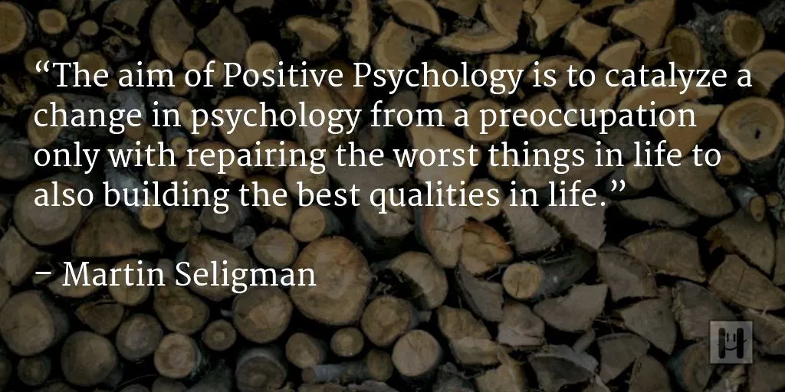
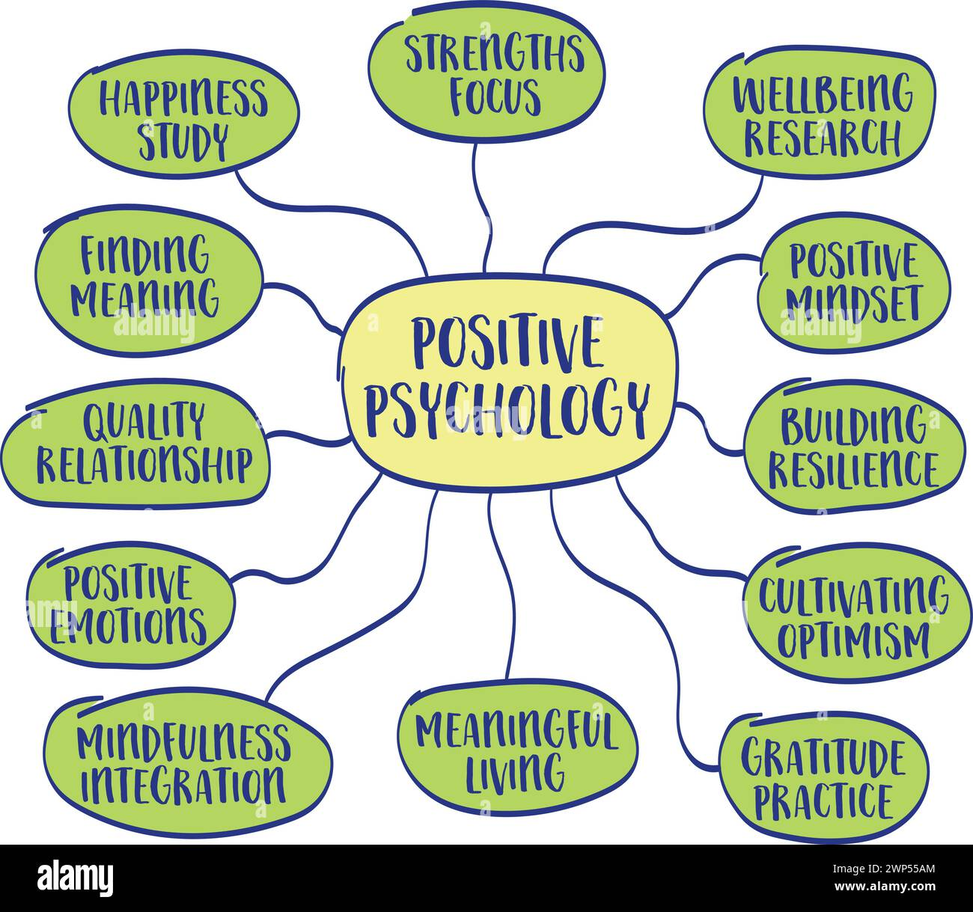
Positive Psychology
Martin Seligman Positive Psychology

Slide 8
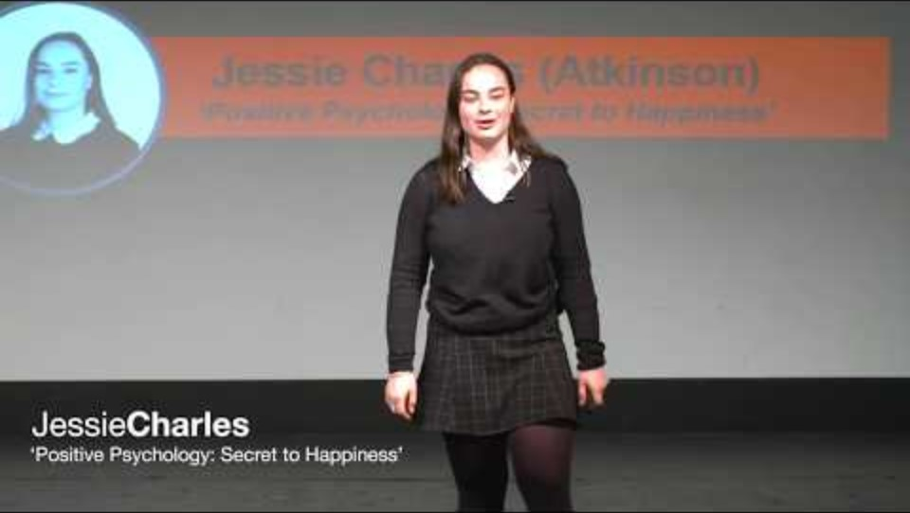
Let a 17-years-old tell you about Positive Psychology

Slide 9
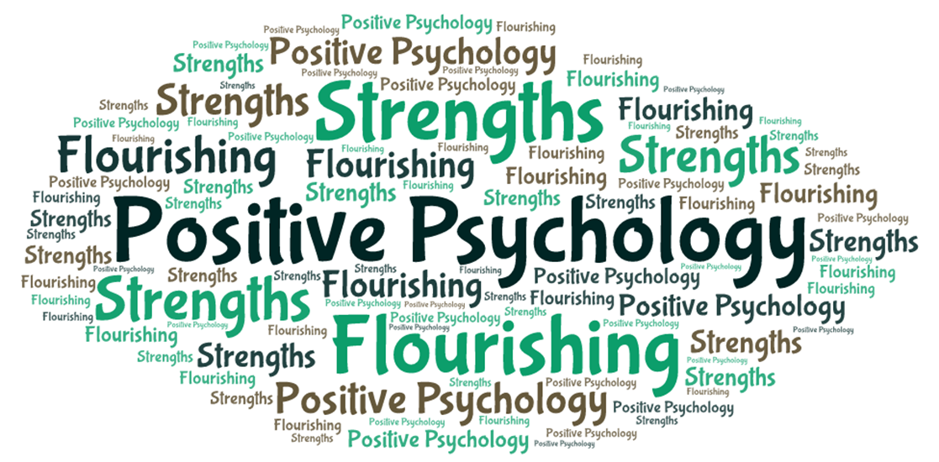
What is Positive Psychology?
The scientific study of what makes life worth living, focusing on strengths, virtues, positive experiences, and factors that contribute to a fulfilling life.
Emerged in the late 1990s as a shift from traditional psychology's focus on mental illness & abnormal functioning.
Peterson defines positive psychology as the “scientific study of what goes right in life" (2006, p. 4).
Key Figures: Martin Seligman, Mihaly Csikszentmihalyi
Seligman, M. E., & Csikszentmihalyi, M. (2000)

Slide 10
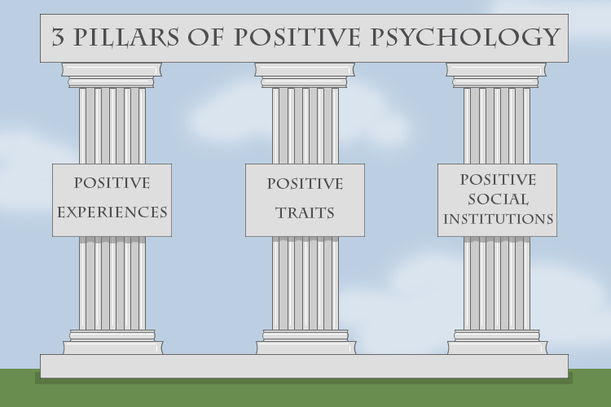
Positive Psychology is more than just happiness (Peterson, 2006)
Experience: Savouring pleasure including happiness, gratification, and fulfilment.
Traits: strengths of character, talents, interests, and values, developing a sense of gratitude
Social institutions: Connecting with others: families, schools, businesses, communities, and societies
https://courses.worldcampus.psu.edu/welcome/psych243/001/content/02_lesson/corefiles/L1_3pillars.png

Slide 11
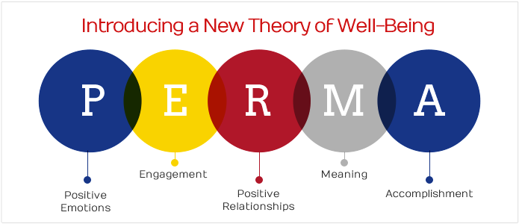
Seligman’s PERMA model A framework from positive psychology that promotes wellbeing through five key elements:
In UK health and social care, it’s used to support older adults, people with disabilities, and those with mental health needs by fostering resilience, purpose, and quality of life.
Notice there is no risk factor or barrier in this model
This Photo by Unknown Author is licensed under CC BY-NC-ND

Slide 12
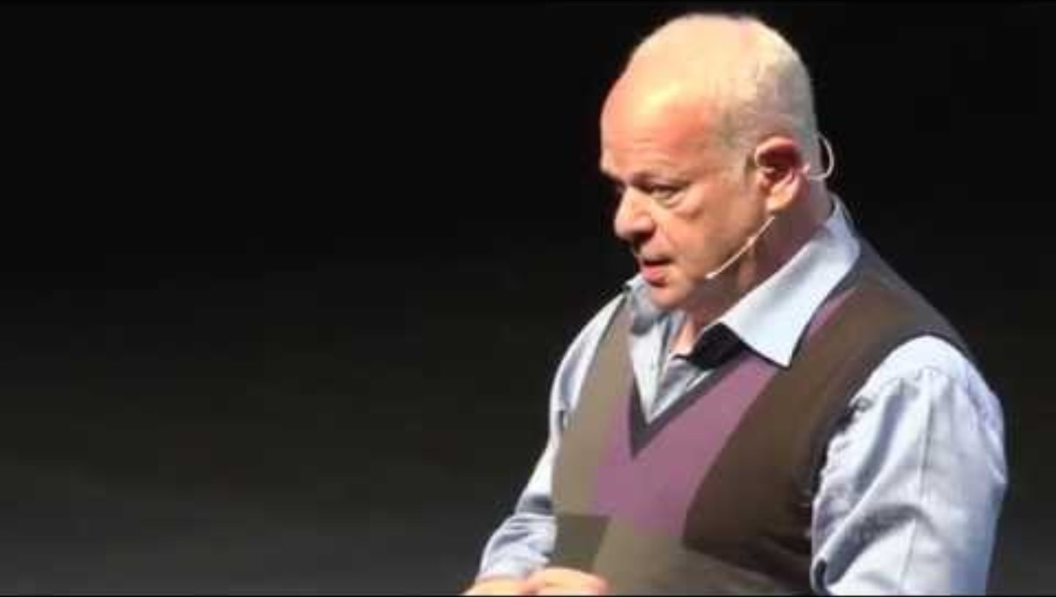

Slide 13
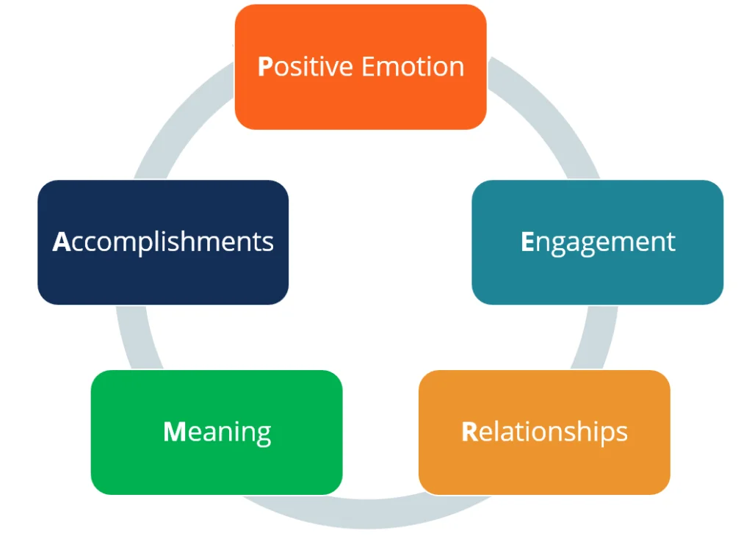
PERMA – applications in Health and Social care
Positive Emotion (P): Encouraging patients and service users to engage in activities that bring satisfaction, hope, and gratitude. For example, group activities like craft or music sessions to foster positive emotions and improve mental health.
Engagement (E): Helping individuals find activities they can become deeply absorbed in, such as hobbies or volunteer work. This can be particularly beneficial for those with mental health challenges, as it promotes a sense of flow and improves mental wellbeing.
Relationships (R): Building strong, supportive relationships is crucial. Health and social care professionals can facilitate support groups or peer programs to help people connect with others who share similar experiences, fostering a sense of belonging and community.

Slide 14
PERMA – applications in H&SC (contd)
Meaning (M): Helping people to find purpose and meaning in their lives. This could involve helping them set personal goals, engage in meaningful work, or participate in community service, increasing their sense of fulfilment and overall well-being.
Accomplishment (A): Encouraging individuals to set and achieve personal goals, no matter how small. Celebrating these achievements can boost self-esteem and motivation. For example, a care plan might include setting milestones for physical rehabilitation or learning new skills.
The PERMA model aims to enhance the quality of life, happiness, and positive outcomes for individuals.

Slide 15

Gratitude & Strengths reflection
Gratitude - Recognising and appreciating the positive aspects of life.
Personal Strengths - Identifying and using one's inherent talents and abilities. Both contribute towards wellbeing.
Gratitude
Write down 3 things you are grateful for. These can be small or big, recent or from the past.
Why are you grateful for these things and how have these positive aspects have impacted your lives.
Strengths
List 3 personal strengths or qualities you possess. These could be traits like kindness, creativity, perseverance, etc.
Write a brief example of how you have used each strength in your daily life or in a challenging situation.
How can focusing on gratitude and strengths can enhance well-being and how you can apply these concepts in your careers in health and social care?

Slide 16

Applying Positive Psychology
There are some overlapping ideas between Positive Psychology and Maslow’s theory with regard to meaning, accomplishment and actualisation.
The social aspects of PERMA have been widely researched by psychologists. However, positive psychology stands out with its marked focus on strengths and positive emotions.
Would this theory be relevant to your report?
See what real world examples of care using the PERMA model for working with older people you can find

Slide 17

Evaluation
What are the Strengths and Limitations of the PERMA model and Positive Psychology?

Slide 18
Resilience in the workplace

Slide 19

Notes:
Note: The video was made during the Covid19 pandemic

Slide 20
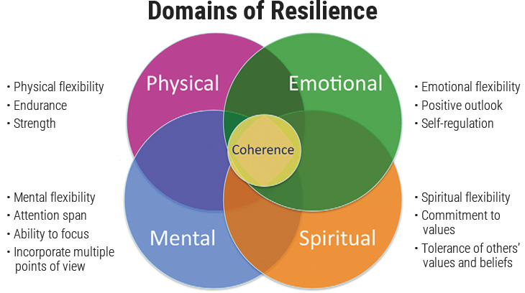
Notes:
a holistic framework for understanding personal resilience by showing how four interconnected domains—Physical, Emotional, Mental, and Spiritual—contribute to overall wellbeing. At the centre, where all domains overlap, is Coherence, representing integrated resilience across all aspects of the self.

Slide 21
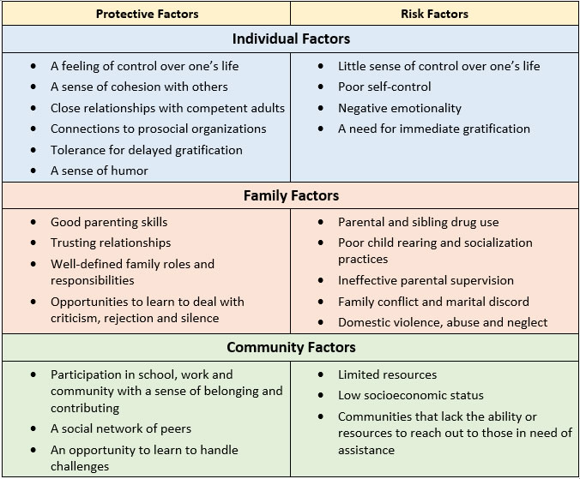
Resilience

Slide 22
Make some notes
A guide to workplace resilience

Slide 23
Key strategies to promote resilience
If you are looking for ways to cultivate your own resilience, start with some of the following strategies:
Build self-esteem by reminding yourself of your strengths and qualities. Try to replace negative thoughts about a problem with positive ones.
Maintain a supportive social network of colleagues. Talk to them about problems and make use of your combined experiences.
Try to be as flexible as possible in the face of change- Sudden changes, in particular, can seem very disruptive. Try wherever possible to see positives in the change.
Develop positive thinking and optimism. A ‘can-do’ attitude helps you to see problems clearly and act appropriately.
Pay attention to your own needs- Healthcare is a demanding profession, and it is vital that you care for yourself, as well as caring for your patients.
Take action to solve problems as soon as they are encountered- The problem probably isn’t going to go away, and the longer you leave it the more stressed you will feel.
Set reasonable goals to deal with problems- Break problem-solving down into small manageable steps. Experiment with, and use, a range of problem-solving strategies.
Above all, remember that many problems that one faces in their daily work are the result of organisational weaknesses or failures. Try not to feel responsible for situations that are beyond your control.

Slide 24
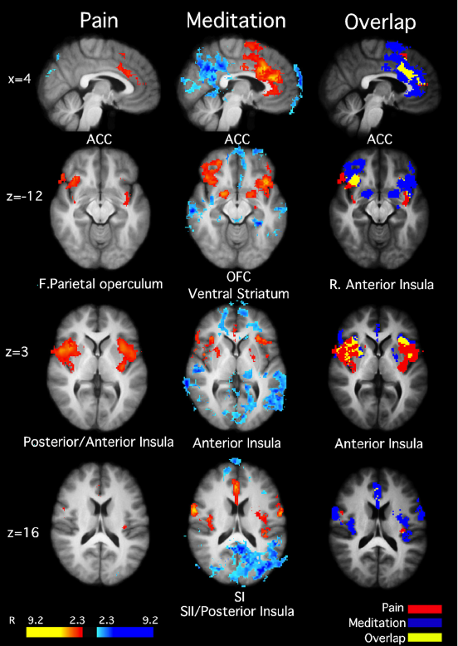
Mindfulness and neuroscience
Used to increase wellbeing or regulate emotions. Mindfulness meditation is one well known technique that NHS provides training on alongside other talking therapies (Mind, n.d.; National Health Services, n.d.).
Mindfulness is a technique that helps us be in the present without judgment.
The benefits of practising mindfulness meditation have been researched and promoted using evidence from Cognitive Neuroscience studies (Hanson, 2017; Tang et al., 2015; Weder, 2022; Wheeler et al., 2017)
  Improving attention, memory and executive control and keeping calm

Slide 25


Slide 26
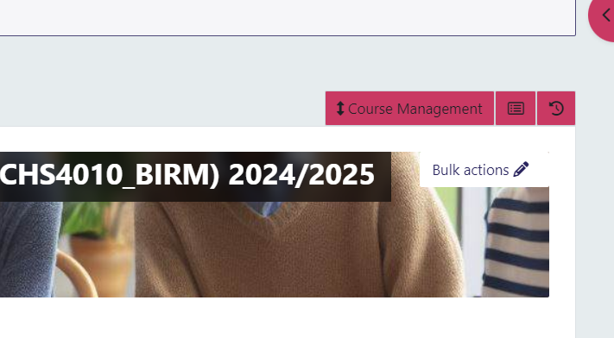
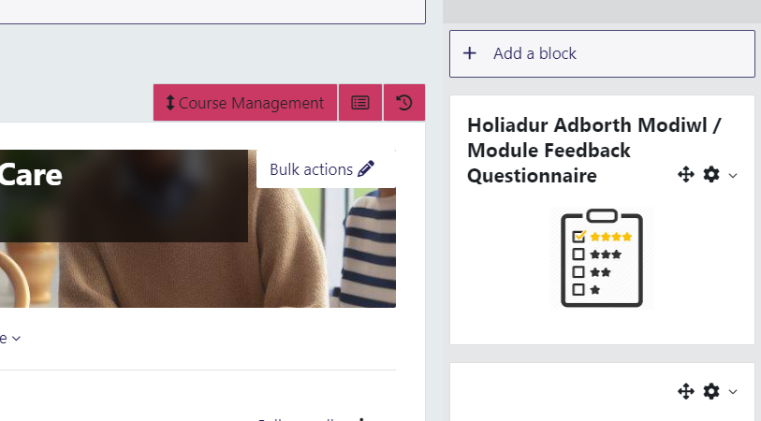
Your feedback about the module
1 click here
2

Slide 27

This Photo by Unknown Author is licensed under CC BY-SA

Slide 28
Selected references
Age UK (2023). Loneliness Research and Impact
Dhingra, Aastha & Khan, Waheeda. (2023). The PERMA Model of Wellbeing: A Comprehensive Framework for Enhancing Reminiscence in the Elderly. 10.4018/978-1-6684-7630-7.ch005.
Hart, R. (2021). Positive psychology: The basics. Routledge.
NHS (2023). Loneliness in Older People
Seligman, M. E., & Csikszentmihalyi, M. (2000). Positive psychology. An introduction. The American psychologist, 55(1), 5–14. https://doi.org/10.1037//0003-066x.55.1.5
Seligman, M. E. (2011). Flourish: A new understanding of happiness and well-being and how to achieve them. Nicholas Brealey.
.
.
Supporting People with PERMA Model of Wellbeing - Leaf Complex Care

