Slide 1

Student Name: Eyob Hunter
Student ID Number: 2438994
Lecturers Name: Annamarie Dufficy
Module Code: LCLM 4004
Module Name: Problem Solving and Decision Making
Component 1: Green Haven Florists

Slide 2
In my presentation I will be:
Providing an overview on Green Haven Florists and the problems they encountered.
Provide an understanding of the 5W2H model and use it on the Green Haven case study.
Provide what PESTEL framework is and demonstrate how we use it.
Provide what Cause and Effect model is.
And finally provide a summary with key findings.
Good Afternoon

Slide 3

Green Haven Florists
Who is Green Haven Florists?
Founded by partners Liam and Priya Patel in 2016
Located in Norwich UK
Independent flower shop
Known for eco friendly packaging and strong community ties
Known for walk in clients to online delivering service catering from buying bouquets to corporate clients and weddings

Slide 4

Identifying the problem internally and externally
Internally
Keeping up with digital marketing trends
Relying on word of mouth
Only posting occasional post's
External
Last 12 month downturn
30% Decrease in store sales
New nearby Competitions moving in
Supply chain disruption and inflation
Rising costs
Prices of materials increasing
Website being out of date and difficult to navigate

Slide 5


What is 5W2H method?
According to Super Engineer(2024) 5W2H is a highly useful technique for describing and identifying the root problems, particularly effective in problem-solving methods.
5W 2H
Who
What
When
Where
Why
How
How much

Slide 6

Identifying The problem using 5W2H model
Who | What | When | Where | Why | How | How much
Who is impacted by the problem? | What Effect is it having? | When was the problem first noticed? | Where did the problem happen? | Why is the problem happening? | How is the problem impacting the Business? | How much did the impact cost
Liam and Priya Patel owners of Green Haven Flower shop | 30% decrease in in store sales | In the past 12 months | Green Haven flower shop | Increasing of online retailers Rising costs and inflation | Decreased in store sale | 30% from previous year

Slide 7
What is PESTEL analysis?
According to Appinio Research(2024) PESTEL analysis is a strategic framework that helps organizations evaluate and understand the external factors that impact their operations and decision-making.
The acronym PESTEL stands for
Political, Economic, Social, Technological, Environmental, and Legal factors.
PESTEL
Political
Economic
Social
Technological
Enviromental
Legal
These represent the various aspects of the external environment that can affect an organization's performance and long-term success.

Slide 8
Company Name: Green Haven
P | E | S | T | E | L
Political | Economical | Social | Technological | Enviromental | Legal
Government not supporting small businesses Import restrictions and delays | 30% decrease in instore sales As Gand review research(2024) state that the global flower delivery service extreme transformation. | Increasing of different competitors across in the area and online Not fulfilling costumers expectations | The shops webpage not up-to-date Difficult to navigate Lack of potential for digital transformation | The price rise of flowers such as orchids and tulips | Rising wage requirements and labour shortages

Slide 9
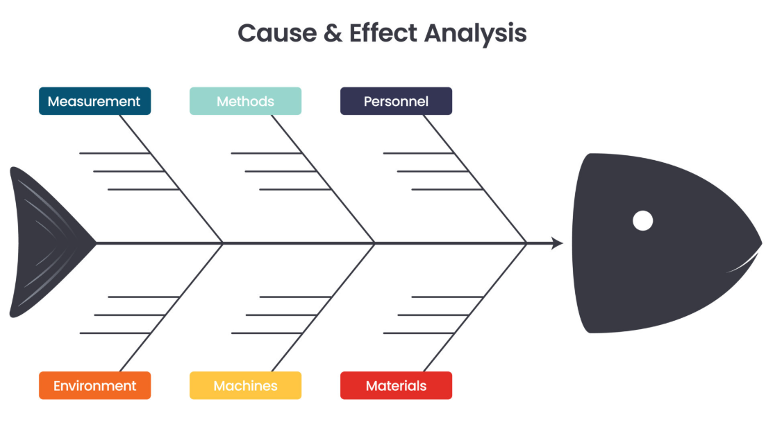
Cause and Effect Analysis
As Cause and Effect Analysis is a visual technique for analysing problems where many possible causes may need to be considered.
The Fishbone diagram is described as “a simple visual technique for analysing problems where many possible causes may need to be considered” (Institute of Leadership & Management, 2013, p. 33).
Problem

Slide 10

Cause and Effect Analysis/Fishbone Diagram
Measurment
Methods
Materials
Rising costs
Limited improvment
Supply chain disruptions
Competition from online
Deacrease of in-store customer
Rising cost of Flowers
Decrease of Sales
Social shift to online shopping
Weak online presence
Limited skills in digital marketing
Down turn in revenue
Economic downturn
Outdated Digital infrastructure
Environment
Machines
People

Slide 11

Key findings
Green Haven flower shop located in Norwich
Global inflation effect on small business
Competitors in Flower industry rising with more advanced in in store and online sales
Lack of understanding in digital marketing skills

Slide 12
Reference Lists
Super Engineer (2024) 5W2H- How to describe a problem in a clear and effective way? Available at: [5W2H - How to describe a problem in a clear and effective way?] (Accessed:13 October 2025)
Appinio (2024) What is a PESTEL Analysis? Available at: [What is a PESTEL Analysis? Definition, Examples | Appinio Blog] ( Accessed: 03 January 2024)
Institute of Leadership & Management (2013) Solving problems and making decisions. London: Routledge. ISBN 9781136356747.
(Section 6.5: Fishbones – a way of analysing problems, pp. 32–33)

Slide 13


Slide 14


