Slide 1
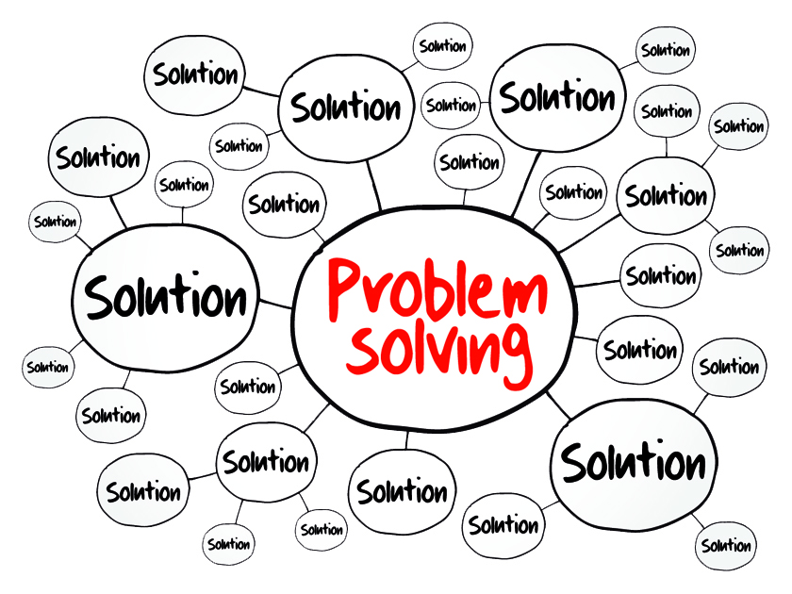
Problem Solving and Decision Making
Student Name: Miller do Espirito Santo Avelino
Student ID: 2025206
Module code: BMSW4004_BIRM
Assignment section: Task 1
Lecturer’s name: Sujeewa Herath
9^{th of November 2021}

Slide 2
Introduction
This work aims to clearly expose the relevant content for solving a problem.
First, let me explain the main of this assignment:
The Nature and Impact of the complex problem on employees
Cause-and-effect analysis of the complex problem
Pestle Analysis
Evaluation of Solutions to work-related stress
Decision Making by PMI
Grid Analysis

Slide 3
The Nature and Impact of the complex problem on employees and organizations
How we can solve this problem?
Little control of the work environment
Lack of participations in decision-marking
Uncontrolled changes in policy
Bad job fit or lack of training
No job satisfaction
Unmotivated
Lack of feedback
Conflict Between other people
Happening?
What we have to do?
Implementing the plan
Is this plan work? What need to happen next?
How Significant?
Bowin and Harvey (2001)

Slide 4
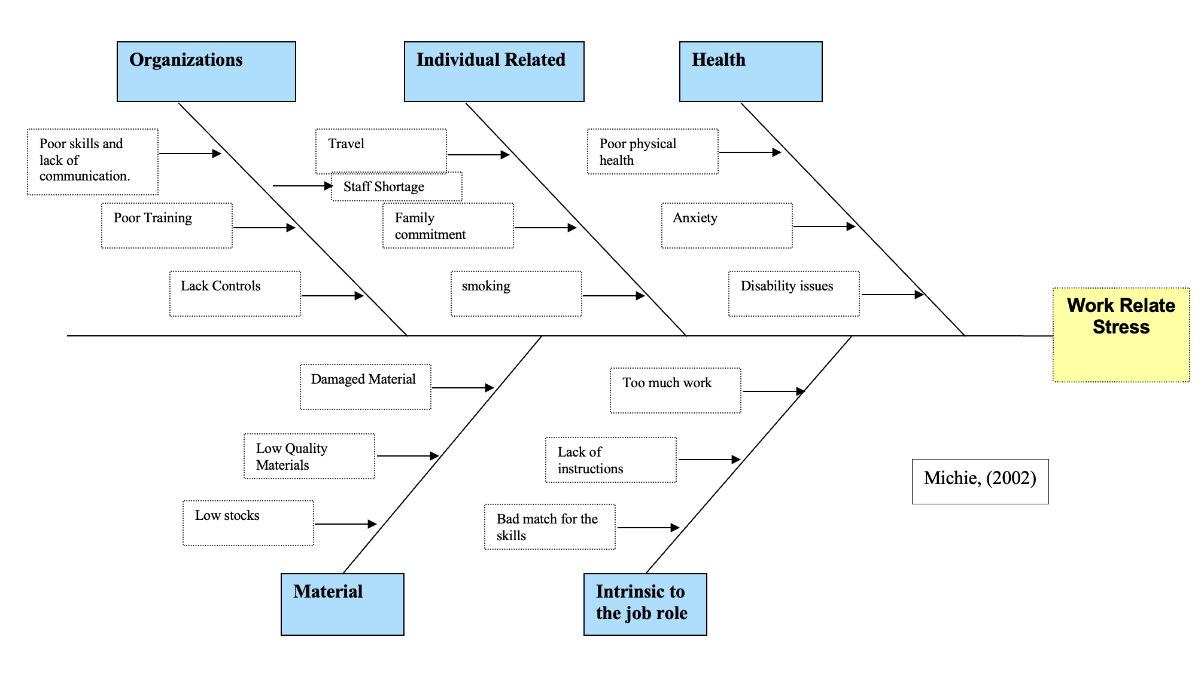
Cause-and-effect analysis of the complex problem

Slide 5
PESTLE ANALYSIS
P | E | S | T | L | E
Brexit Tax Power Law Global Influence | Inflation rates Interest rates Economic growth/decline Exchange rates | Income distribution Lifestyle factors Demographic Influences | Automation Level of innovation Speed Internet (5G) Cybersecurity | Health and safety Employment Laws Discriminations Laws | Environmental Policies Weather Pollution Climate change Recycling
CIPD (2020)

Slide 6
An Evaluation of Solutions to Work-related stress
Solution: To make a better decision, we have chosen the best option. For sample, in my company we work a lot stress. So, we have to take a better decision. 1----5
 | Miller | Sophia | Cristiano | Eleni | Total
Less hours and more productions | 4 | 4 | 1 | 2 | 11
Share works hoards | 2 | 2 | 3 | 3 | 10
More Breaktime | 1 | 3 | 4 | 4 | 12
PPA Time | 2 | 1 | 2 | 1 | 6
The best option is More Breaktime 12

Slide 7
Decision Making by PMI
PMI: Plus, Minus and Interesting.
For sample I planning moving in the jobs
Plus
Moving the jobs +5
Less responsibility +2
Minus
Travel/Distance -3
Adopting to a new Place/colleague could be challenging -4
Interesting
Positive mental Health +5
More money +4
More times +3
Total= 14
More Training -2
Total= -9
New Opportunities+4
More Effective teams +3
New qualifications -4
Better Lifestyle +3
Total: 15-4
= 11
14+11-9
=16: the decision is viable.
N. Alexander and S. John (2005)

Slide 8
Grid Analysis
The solutions to reduce stress at work
0--------10
 | Factors
Alternatives | Money | Time | Traveling | Total
Change The department 3 | 10 - 30 | 6 - 18 | 0 - 0 | 48
Work less hours 2 | 10 - 20 | 8 - 16 | 5 -10 | 46
Change the jobs 1 | 10 - 10 | 10 -10 | 10-10 | 30
The best one is changing the department 48

Slide 9
Conclusion
I would like to conclude that to solve problems there are many phases that help us to make certain decisions to reach the best possible alternatives.
So first of all, we must identify the problems so that it is structured and then we use the best techniques in order to reach a goal.

