Slide 1


Problem solving and decision making
Module Code: BMSW4004
Module Coordinator:
Dr Chijioke D Uba
Internal Verifier:
Yohan Mendis
Name: Keila Costa
Student Number: 2127935
This Photo by Unknown Author is licensed under CC BY-SA-NC

Slide 2
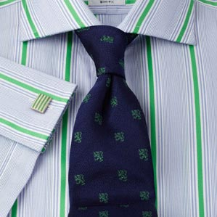
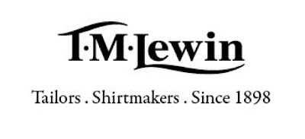

TM Lewin, was founded in 1898 and has been going through financial problems, more precisely due to the pandemic we have experienced in recent years, which led to a sudden drop in profits for the company that sells clothes, since during the crisis of the pandemic, because of a large part of T M Lewin’s customers started work from home. Consequently, even after the pandemic, the company was unable to recover profits as consumers began to spend less since their pockets were directly affected. Therefore, I will analyze the case of this company through PESTEL/PESTLE and Fishbone analysis and finally recommend a solution to the problem that the company faces.
In this case, our problem to solve is the low profit of the company and the decision making will be the process of making the decision that will lead us to solve the problem.
2

Slide 3
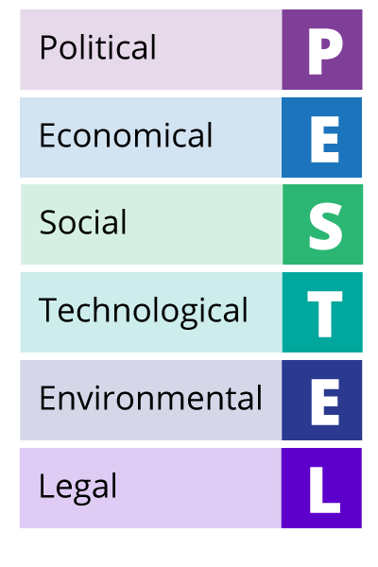

Pestel analysis
PESTEL analysis is an analysis tool that helps us understand which EXTERNAL factors impact the company through six different perspectives: Political, Economic, Sociocultural, Technological, Legal and Environmental. Through this analysis of external factors we will better understand why the sales and consequently the profits in T M Lewin decrease.
3

Slide 4
Pestle/Pestel analyse
ECONOMIC
Raising Imflation
POLITICAL
Lockdown
SOCIAL
Cost of Living
PESTEL Analyse
LEGAL
Restrictions
TECHNOLOGY
ENVIROMENT
5

Slide 5


Fishbone/Ishikawa diagram
Fishbone diagrams or Ishikawa diagrams or cause and effect diagrams help in better understanding a problem as it represents the causes and their effects of a problem.
In this way, by examining all the potential imperfections in the company's systems, we can also identify future problems even before they arise and become large enough to destabilize the company's development.
In this diagram the head represents the problem at hand, the bones attached to the spine are the categories of problems and the smaller bones the difficulties.
5

Slide 6
Fishbone/Ishikawa diagram
Social
Technological
Lockdown- People work from home
Measures of distance between people. Consumers didn't want to be in small spaces with lots of people.
Delay in reacting to the new situation with online sales.
Profit Drop
Sale restrictive/ formal clothes
Inflation/ Covid Pandemic
Supply chain issues
Current Cost of living
Product
Economic Factors
6

Slide 7
Grid analysis
solutions | Cost 5 | Target Audience 2 | Time 4 | Competition 3
Reduce the value of products. | 3 15 | 0 0 | 0 0 | 3 9
Produce more casual clothing. | 3 15 | 2 4 | 0 0 | 2 6
Invest more in online sales marketing. | 3 15 | 2 4 | 0 0 | 0 0
Total
24
25
19
7

Slide 8

References
Crossan, M.M., Fry, J.N. and Killing, J.P., 2004. Strategic analysis and action. Pearson Prentice Hall.
Pan, W., Chen, L. and Zhan, W., 2019. PESTEL analysis of construction productivity enhancement strategies: A case study of three economies. Journal of Management in Engineering, 35(1), p.05018013.
Matovic, I.M., 2020. PESTEL analysis of external environment as a success factor of startup business. ConScienS, p.96.
Nilufer, N., 2020. Critical assessment on business strategy from aviation to retail industry during COVID-19 Pandemic: A Walmart Case. International Journal of Business Ecosystem & Strategy (2687-2293), 2(2), pp.8-14.
Akram, U., Fülöp, M.T., Tiron-Tudor, A., Topor, D.I. and Căpușneanu, S., 2021. Impact of digitalization on customers’ well-being in the pandemic period: challenges and opportunities for the retail industry. International Journal of Environmental Research and Public Health, 18(14), p.7533.
Bose, T.K., 2012. Application of fishbone analysis for evaluating supply chain and business process-a case study on the St James Hospital. International Journal of Managing Value and Supply Chains (IJMVSC), 3(2), pp.17-24.
Vetter, L., Schuepfer, G., Kuster, S.P. and Rossi, M., 2016. A Hospital-wide Outbreak of Serratia marcescens, and Ishikawa's “Fishbone” Analysis to Support Outbreak Control. Quality management in health care, 25(1), p.1.
Shan-Shan Li, Ling-Chu Lee, Using fishbone analysis to improve the quality of proposals for science and technology programs, Research Evaluation, Volume 20, Issue 4, October 2011, Pages 275–282
Pike, S., 2005. The use of repertory grid analysis and importance-performance analysis to identify determinant attributes of universities. Journal of Marketing for Higher Education, 14(2), pp.1-18.

