Slide 1
Certificate of Higher Education - Skills for the Workplace
Health and Social Care
Academic and Employability Skills
(LCHS4001)
Session 2:
Library introduction
Evaluating sources Beginning referencing

Slide 2
Recap quiz!
Notes:
You may not need this slide if the librarian is coming at the beginning of your session – the library intro will serve as a recap. But if needed, you could use the quiz (as a whole class) that will be in the Session Two materials that is hidden from students and is called Session 1 Recap Quiz (or feel free to do your own recap)

Slide 3
In this session we will…..
Meet an academic librarian and get to know the library
Have our first look at the assessment brief
Begin critical thinking and learn about evaluating sources of information
Start referencing and learn how to reference a single-authored book

Slide 4
Library Introduction
from
Academic Liaison Librarian
Notes:
Please prioritise, allow one hour, and welcome the librarians

Slide 5
BREAK

Slide 6
Understanding the assessment brief

Slide 7
Assessments: What is their purpose?
Formative Assessments
  Class activities that help you and your lecturer monitor your learning and help you improve
  You will receive feedback, but not a grade
  Mid-term and end-of-term assessments to see whether you are meeting the learning outcomes for the module
  You will receive a grade as well as feedback which will help you to progress through your course
Summative Assessments
Notes:
Lecturers: The slides on the differences between reports and essays have been removed because they conflict with our requirements for Task 2. We will explain how the process report and essay that are required for Task 2 are different from each other as we move through the term (as we learn about essay writing later and using language, e.g. topic sentences, to structure the writing compared to more subheadings in reports, for example).

Slide 8
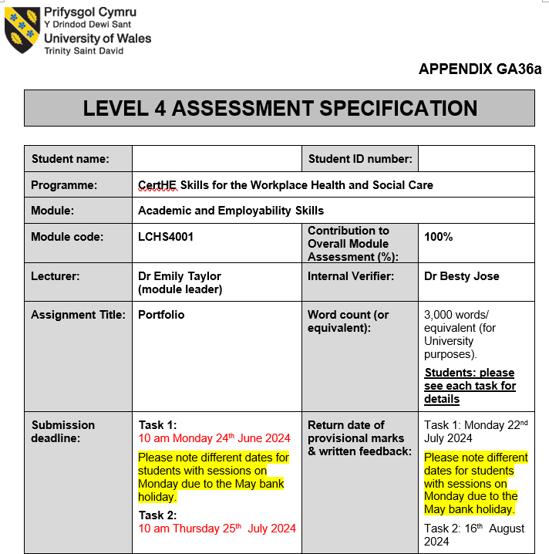
Your assessment brief
Notes:
You may wish to explain the brief fully yourself or show the video (but it’s quite long!)
It’s your choice whether you do this (your explanation) or the next but one slide (students finding info for themselves) first – depending on your group and what you think will work best.

Slide 9
Your assessment brief
Make sure you can:
Find the assessment brief
Find the accompanying video
Notes:
Please show the students where to find both (they are both in the Assessment Brief tile and the video is also in Session 2 and on the homepage)

Slide 10
Activity - Key information from the assessment brief
Read the assessment brief. Find the following information and make a note of it:
How many tasks are there?
What are the tasks called?
What do you need to make for Task 1?
By when do you need to submit Task 1?
What do you need to write for Task 2 (two parts)?
By when do you need to submit Task 2?
Where will you submit Tasks 1 and 2?
Why is it important to do the “formative feedback” activities?
When and where will you do the “formative feedback” activities?
Do you have any questions for your lecturer?

Slide 11
BREAK

Slide 12
Evaluating
sources of information

Slide 13
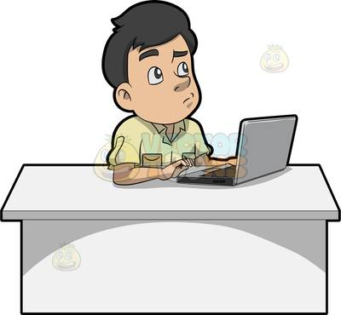
Suitability of a source of information
When you search for information, you are going to find lots of it . . . but is it good information?

Slide 14
What is the CRAAP test?
The CRAAP Test was developed by Blakeslee (2004). It is a list of questions to help you evaluate the sources of information you find.
Currency
Relevance
Authority
Accuracy
Purpose

Slide 15
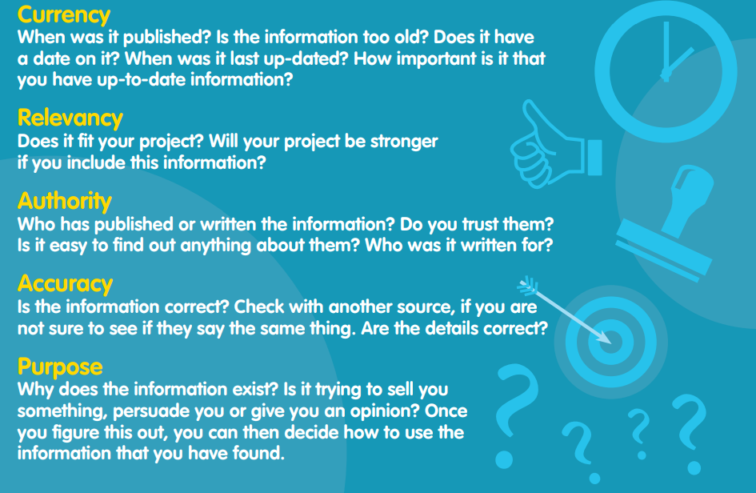
CRAAP
From: CILIP (no date) – please look at the whole document on Moodle

Slide 16

Study task (homework)
Practice using the CRAAP test
Have a go at the
CRAAP Test activity
in this session’s materials.
Your lecturer will briefly explain it.
Notes:
Lecturers – you can set this for homework and review responses next week if you think you are running out of time in today’s session

Slide 17
What is referencing?

Slide 18


What is referencing?
When you produce a piece of academic work, such as for your assessments, you need to search for and use suitable sources of information.
  NB You are not expected to think of clever ideas off the top of your head – this is not good practice!
Referencing is how we acknowledge our ‘sources’ i.e. our sources of information.
There are several reasons for referencing, which include:
Giving credit to the people who gave you the idea
Helping the reader of your work to go and find the source and read more if interested
And as a student…showing the markers of your work that you’ve read widely and developed your knowledge and skills based on suitable sources of information.

Slide 19
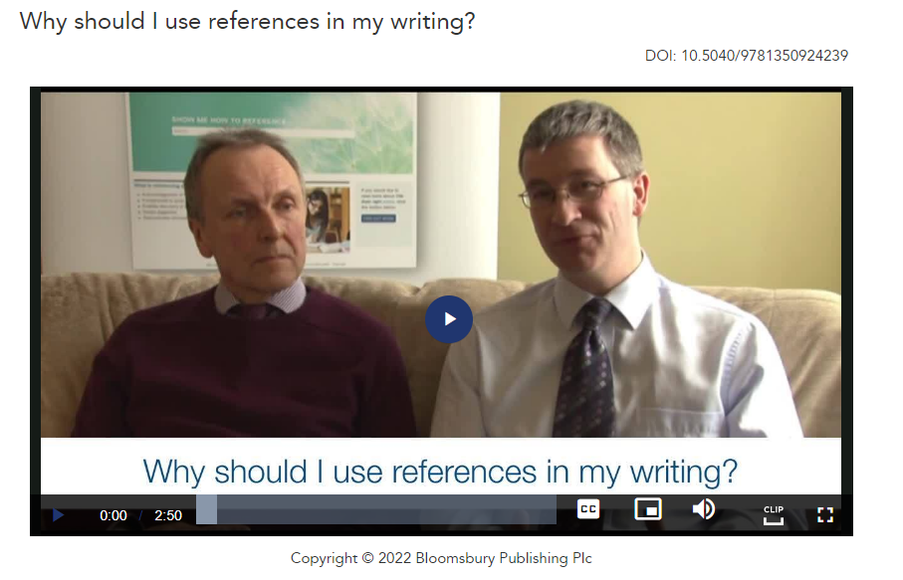
What is referencing?
Notes:
https://www-citethemrightonline-com.ezproxy.uwtsd.ac.uk/video?docid=CTR_6301824067001&tocid=CTR_file_6301824067001

Slide 20
Referencing in your work
In-text citations
Reference list

Slide 21
Always do two things
ONE
The in-text citation is the short form that you put in your writing – in this sentence, the student got this idea about teamwork from reading the book written by Cottrell.
Teamwork depends on a wide range of other skills including listening, speaking up, and giving and receiving feedback (Cottrell, 2019).
TWO
At the end of your work, you need to include the full long reference in a reference list. The full long reference looks like this:
Cottrell, S. (2019) The Study Skills Handbook. 5th edn. London: Red Globe Press.

Slide 22
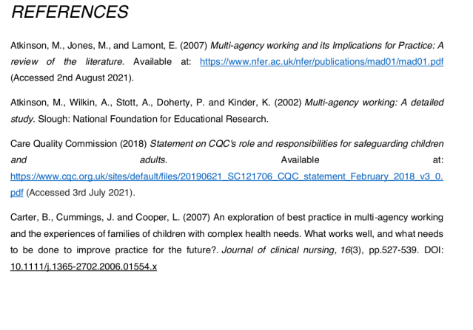
The Reference List
Here is an example for a student report
You need to include a reference list at the end of every assignment which details all of the sources you have used in the body of your text.

Slide 23
BREAK

Slide 24
Referencing a book
with one author

Slide 25
Referencing a book (one author)
Have a go at
Activity 1 on Moodle
(noticing)

Slide 26
Referencing a book (one author)
Surname comma
Initial full stop
Year of publication
in brackets
Title in italics
(end with a full stop)
Glasby, J. (2017) Understanding Health and Social Care. 3rd edn. Bristol: Policy Press.
colon
Publisher
(end with a full stop)
Edition information – write 3rd not third
(end with a full stop)
Place of publication (followed by a colon)

Slide 27
Referencing a book (one author)
Write the in-text citation and full long reference for this book:
Title: The short guide to health and social care
Author: Jon Glasby
Publisher: Policy Press
Year of publication: 2019
Place of publication: Bristol

Slide 28
Best place to get help with referencing (as well as our librarians!)
At UWTSD we use the CiteThemRight website to support our teaching of referencing.
Explore this site to find out more about how to reference different types of sources.
Notes:
https://www-citethemrightonline-com.ezproxy.uwtsd.ac.uk/sourcetype?docid=b-9781350927964&tocid=b-9781350927964-27
The students need to access this via the link on our module Moodle page or via the UWTSD library as this will log them in as a UWTSD student. If students google CiteThemRight they will be prompted to pay.
Please show them the basics e.g. choosing Harvard, choosing a type of source e.g. ebook, looking for the examples and ‘you try’ section etc

Slide 29
Reflective journal entry
Write this week’s entry in your reflective journal. You could consider:
How do I feel about the assessments?
What will be my first steps to prepare for the assessments?
What was the most useful thing I learnt today?
How will I use my self-study time this week (e.g. doing the extra activities for this session on Moodle, thinking about which roles I would like to choose in Task 2 of the assessment)

Slide 30

Summary
What does each letter stand for in the CRAAP test?
What two things do you need to do when referencing?
What information do you need in order to be able to write the full long reference for a book with one author?

Slide 31
References
Blakeslee, S. (2004) ‘The CRAAP Test’ LOEX Quarterly 31 (3) , Article 4.
Available at: https://commons.emich.edu/loexquarterly/vol31/iss3/4 (Accessed: 7 September 2023).
Cottrell, S. (2003) The Study Skills Handbook. 2nd edn. Basingstoke: Palgrave.
CILIP (no date) Evaluating the information that you find using the CRAAP test. Available at: https://infolit.org.uk/wp-content/uploads/ResearchSmarter/Docs/CRAAP.pdf (Accessed: 12 May 2024).

Slide 32

Next session…..
We will look at:
Notetaking and paraphrasing
Giving and receiving feedback
And we will:
Do an activity so you can get formative feedback

