Slide 1
Business Planning
Chris Thomas

Slide 2
Key Dates
Deadlines
  Poster Presentation week commencing 5th Nov
  Website and video 26th Nov
  Report (entrepreneur as hero) 14th Jan

Slide 3
Key Dates
Enterprise Week 13 -17 November:
  Enterprise themes lectures throughout the week
  Entrepreneurial competitions:
    Robert Owen Challenge

Slide 4
Objectives
To clearly understand the differences between:
  Business Idea
  Business Model
  Business Plan

Slide 5
Groups
Have you formed a group yet?
Groups of up to 5 people
Everyone will receive and individual mark
You can work alone but you will have a lot to do!

Slide 6
Lateral thinking
Lateral thinking is the process of using information to bring about creativity and insight restructuring. Lateral thinking can be learned, practiced and used. It is possible to acquire skill in it just as it is possible to acquire skill in mathematics.
https://www.edwdebono.com/lateral-thinking

Slide 7
Lateral thinking
With logic you start out with certain ingredients just as in playing chess you start out with given pieces. But what are those pieces? In most real life situations the pieces are not given, we just assume they are there.
We assume certain perceptions, certain concepts and certain boundaries.
Lateral thinking is concerned not with playing with the existing pieces but with seeking to change those very pieces.
Lateral thinking is concerned with the perception part of thinking. This is where we organise the external world into the pieces we can then 'process'.
A healthy human brain does not want to always be creative, it is designed to figure out how to do things or how to think about things and then 'locks' that automatic response or behaviour into a subconscious process so that your conscious brain can focus on other matters.

Slide 8
Lateral thinking puzzles
Lateral thinking puzzles are strange situations in which you are given a little information and then have to find the explanation. They are solved through a dialogue between the quizmaster who sets the puzzle and the solver or solvers who try to figure out the answer

Slide 9
Lateral thinking puzzles
A man walks into a bar and asks for a drink of water. The bartender gives the man a drink of water, but the man says the water is no good. The bartender thinks for a minute, pulls out a gun and points it at him. The man says, "Thank you," and walks out.
Why?

Slide 10
Acting on an anonymous phone call, the police raid a house to arrest a suspected murderer. They don't know what he looks like but they know his name is John and that he is inside the house. The police bust in on a carpenter, a lorry driver, a mechanic and a fireman all playing poker. Without hesitation or communication of any kind, they immediately arrest the fireman. How do they know they've got their man?

Slide 11
A man lives on the tenth floor of a building. Every day he takes the elevator to go down to the ground floor to go to work or to go shopping. When he returns he takes the elevator to the seventh floor and walks up the stairs to reach his apartment on the tenth floor. He hates walking so why does he do it?

Slide 12
A man walks into a bar and asks the barman for a glass of water. The barman pulls out a gun and points it at the man. The man says ‘Thank you’ and walks out.

Slide 13
Five pieces of coal, a carrot and a scarf are lying on the lawn. Nobody put them on the lawn but there is a perfectly logical reason why they should be there. What is it?

Slide 14
A woman had two sons who were born on the same hour of the same day of the same year. But they were not twins. How could this be so?

Slide 15
Last week’s lecture
No clear definition of entrepreneurship
  Just those who are innovators?
  Those who run a family business?
  They all are willing to ‘venture’ leave their ‘comfort zone’.
  Entrepreneurs will look to start up a business no matter what the state the economy is in or what resources they currently have.

Slide 16
Last week’s lecture
Different reasons (motivations) why people become entrepreneurs
  Necessity
  Social factors: product of their environment
  Economic factors
  Psychological Factors: innate drive that makes them entrepreneurial
Nature v nurture argument

Slide 17
Last week’s tutorial
We looked at business ideas and business models
What’s the difference between the two?
Business model:
  How you plan to make money
  Involve how you will add value i.e. make customers buy your product
    What’s different about your product

Slide 18
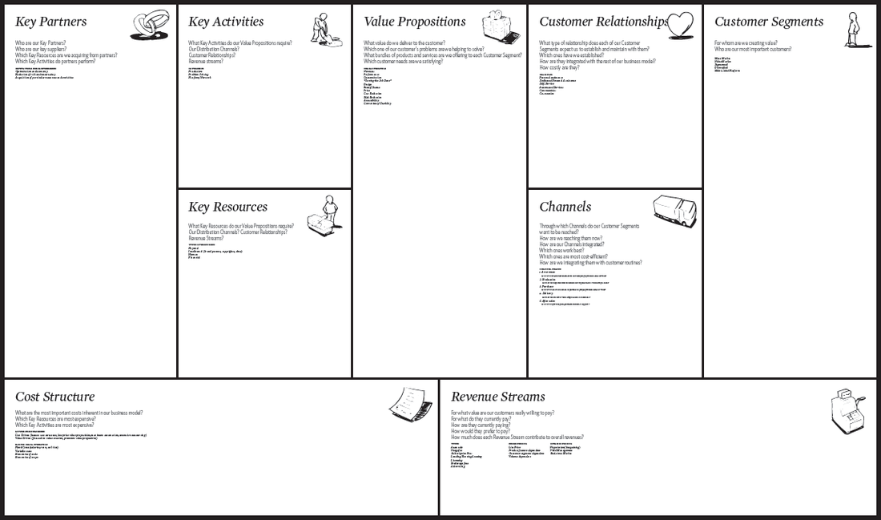

Slide 19

Nespresso Case Study

Slide 20
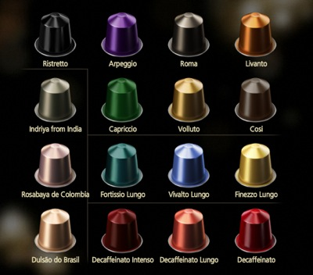

Slide 21
http://www.nespresso.com/uk/en/pages/coffee-landing-page

Slide 22
Nespresso’s business model wasn’t built in a day. Since its first patent in 1976, Nespresso fiddled around with the technology for 10 years, before incorporating the company in 1986. The company decided to service the business-to-business market in the 1990′s, in joint venture with a machine manufacturer that also maintained a sales force. This model failed, and almost bankrupted the company. Around 2000 Nespresso innovated in its business model and worked it out to what it currently is: a model which shows a year-on-year growth rate of around 25% (the fastest growing division at Nestlé), and which noted revenues of over Euro 2.4 billion in 2010.

Slide 23
Nespresso BUSINESS MODEL CANVAS

Slide 24
Business Model Canvas revisited
Business Model Canvas:
Key partners
  Who are your key partners/suppliers/distribution/research and development?
  What are the motivations for the partnerships?
Key activities
  What key activities does your value proposition require?
  What activities are important the most in distribution channels, customer relationships, revenue stream…?
Value Proposition
  What core value do you deliver to the customer?
  Which customer needs are you satisfying?
Customer Relationship
  What relationship that the target customer expects you to establish?
  How can you integrate that into your business in terms of cost and format?
Customer Segment
  Which classes are you creating values for?
  Who is your most important customer?

Slide 25
Last week’s tutorial
Key Resource
  What key resources does your value proposition require?
  What resources are important the most in distribution channels, customer relationships, revenue stream…?
Distribution Channel
  Through which channels that your customers want to be reached?
  Which channels work best? How much do they cost? How can they be integrated into your and your customers’ routines?
Cost Structure
  What are the most cost in your business?
  Which key resources/ activities are most expensive?
Revenue Stream
  For what value are your customers willing to pay?
  What and how do they recently pay? How would they prefer to pay?
  How much does every revenue stream contribute to the overall revenues?

Slide 26
Competitive strategies
3 fundamental strategies to achieve sustainable competitive advantage……

Slide 27
Cost Leadership Strategy
  Lowest cost
Differentiation strategy
  The customer may pay more for a particular characteristic of the product or service
Focus strategy
  Focus of particular segments or niches e.g. car insurance for women

Slide 28
Which strategy is best for your business plan?
Cost leadership?
  Could you work at very low cost cheaper than the competition? Possibly? Lower overheads working from home.
Differentiation strategy
  Mass market, heavy branding think Coke and Nike
Focus strategy
  Small geographical area or students, very personalised service

Slide 29
Evaluating the Business Idea
The Business Model Canvas good but it is general:
Covers basic information on customers
Covers basics in terms of resources
What other information would be good to start a business?

Slide 30
Evaluating the Business Idea
You need to understand your competitors
You need to understand the market place you are about to compete in.
How are you going to attract customers?
  Marketing strategies
Detailed finances needed
Day to day running (operations)

Slide 31
Resources: Capital
Financial
Human – managerial or industry experience plus training.
Social – Networks: friends and commercial contacts.

Slide 32
Money
Employees
Customers
Landlord
Suppliers

Slide 33
What do you need to prove to get those resources in your business?
CREDIBILITY
How do you get it?

Slide 34
BUSINESS PLAN
(detailed)
Business Model
(outline)

Slide 35
Business Plan
Broadly the Business Plan will address:
Viability- customers, competition, marketing strategy and profitability of the business
Resources – people and other resources bur most importantly money that’s needed to finance the start-up and how it will be repaid. Cash flows.
Credibility –track record and experience.

Slide 36
What is the use of a business plan internally?

Slide 37
To Plan…
To focus your efforts, set objectives and company direction.
To enable you to spot potential pitfalls before they happen.
To set realistic targets that allow some flexibility - without steering away from core objectives - for some 'fine tuning' along the way.
To enable you to track your growth.
To structure the financial side of your business.
To raise finance.

Slide 38
Very Useful Links
https://www.gov.uk/starting-up-a-business/start-with-an-idea

Slide 39
Business Plan Video
https://www.youtube.com/watch?v=D8XMS7n8N9Q

Slide 40
How do we translate our ideas into reality?
BUSINESS IDEA
BUSINESS MODEL
BUSINESS PLAN

Slide 41
Need to Evaluate if the Business Plan will work
How?

Slide 42
RESEARCH!
What sort of things do you need to research?

Slide 43
Evaluating the Business Idea
You need to find customers?
You need to understand your competitors
You need to understand the market place you are about to compete in.
How are you going to attract customers?
  Marketing strategies
Ensure you have sufficient resources – MONEY!

Slide 44
Knowing your customers
Too much focus on the product itself and not of the market for the product can lead to failure.
  Who is going to buy?
  Why?
  What needs do they want the product to meet?
  Is the customer reachable?
  Distribution
  Market new/mature?
  Growing /declining market
  How big is the market
  Is the product unique?
  Is the market highly concentrated or fragmented

Slide 45
By doing this you will be able to estimate the sales potential of your market.
Then you can determine the scale and nature of resources you need.
…not always easy if it is a totally new product i.e. iPad where customers could not initially forsee how it would be used.
Or start the business small scale and carefully monitor outcomes.

Slide 46
Knowing your competitors
Too much focus on the product itself and not of the market for the product can lead to failure.
  Who is going to buy?
  Why?
  What needs do they want the product to meet?
  Is the customer reachable?
  Distribution
  Market new/mature?
  Growing /declining market
  How big is the market
  Is the product unique?
  Is the market highly concentrated or fragmented

Slide 47
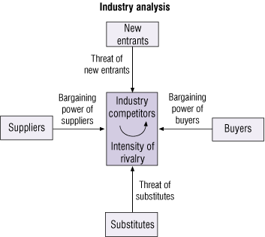
A Model for Structural Analysis:
PORTER’S “FIVE FORCES” MODEL OF COMPETITION
Competition is the result of:
the threat of new entrants
the threat of substitute products
the intensity of rivalry between competing firms
the power of suppliers
the power of buyers
http://www.youtube.com/watch?v=mYF2_FBCvXw

Slide 48
Threat of new entrants/ Barriers to Entry
Economies of Scale: high fixed costs: high volumes of sales needed
Product differentiation/brand loyalty
Capital requirements
Switching costs: financial, time and inconvenience.
Access to distribution channels
Cost advantages: patent rights, know-how, govt subsidies
Access to resources of raw materials on favourable terms

Slide 49
Threat from substitute products
Substitutes offer differing ways of meeting the same customer need. e.g. flying to France is a substitute for catching the Ferry.
When firms are faced with threats from substitute products demand for their products is relatively sensitive to price.

Slide 50
Bargaining power of suppliers
One or two dominant suppliers
Other customers in different industries
Supplier’s products vital to the customers business
Suppliers may produce a differentiated product which buyers need to obtain
Switching costs for buyers may be high

Slide 51
Bargaining power of Customers/buyers
Purchases are substantial % of sales: customers in a strong position
Customer will be in a weaker position if most purchases come from one supplier
Level of switching costs
Strong brand which customers feel they must have.
Customer knowledge
Higher product quality, less price-sensitivity

Slide 52
Rivalry
More intense the rivalry within an industry the more profitability is affected.
Competitive action may take the form of price competition, advertising battles, sales promotion campaigns, new products, improving after sales service etc.

Slide 53
Summary
BUSINESS IDEA
BUSINESS MODEL
BUSINESS PLAN

