Slide 1


BUSINESS PLAN
Babycino – Family-Friendly Cafe
Module name and code: ENTERPRISE AND ENTREPRENEUSHIP (LCL 4006)
Lecturer name: Mohammad rahman
Student name: Mariana Sherenha
Student ID: 2424533

Slide 2
Overview
Introduction to the Business idea
Product and Services
Management Structure
Pestel Analysis
Marketing strategy
Funding Requirements
Conclusion

Slide 3
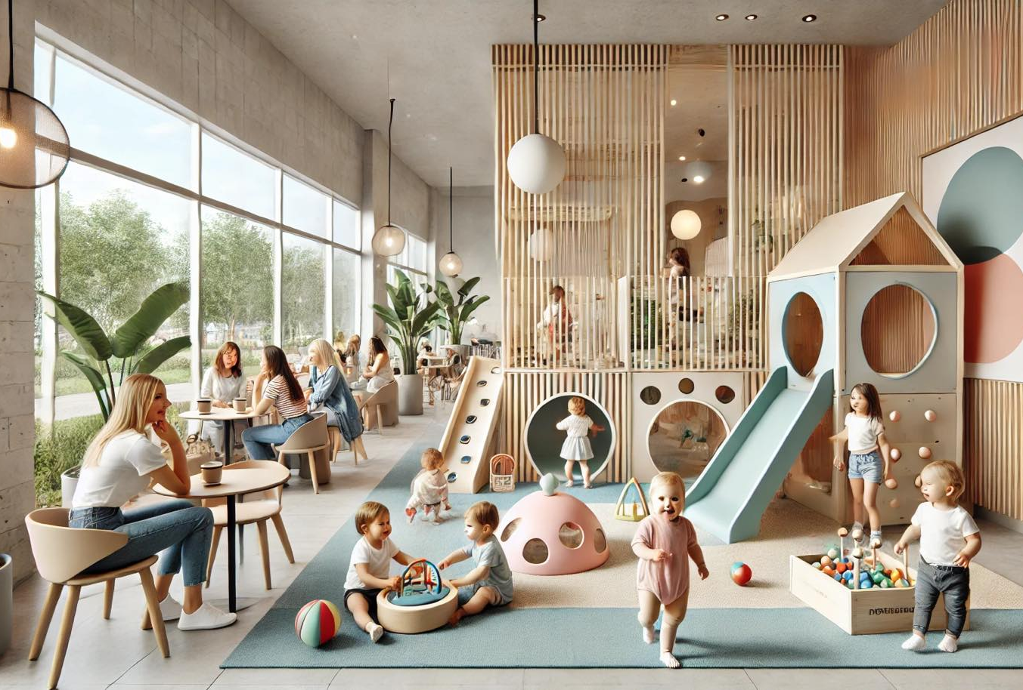
Introduction to the Business idea
Babycino is a family-friendly café designed for parents and young children
The concept combines a cozy coffee shop with a safe, well-equipped indoor play area.
Our aim is to create a comfortable space where parents can relax, work, or socialize while their children play under supervision.

Slide 4

Product and Services
Babycino offers:
High-quality coffee, healthy snacks, and a children menu
A safe and stimulating indoor play zone
Special services: birthday packages, workshops for kids, parent coffee morning

Slide 5
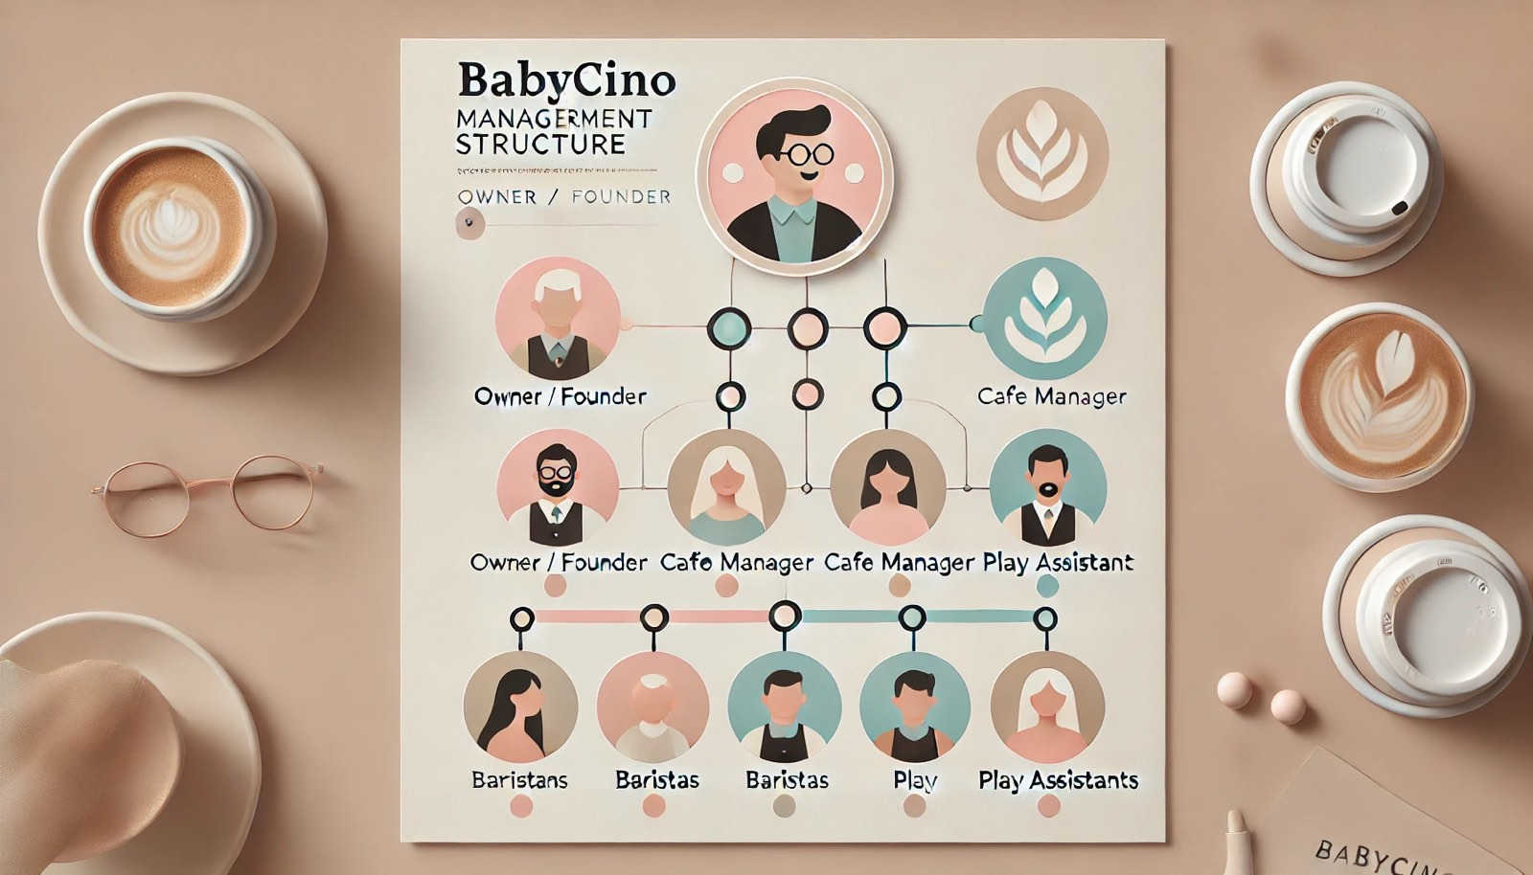
M

Slide 6

Legal Format: private limited company (LTD)

Slide 7
Pestel analysis
Political
Stable UK policies support small businesses and family-friendly services (Department for business and Trade, 2023).
Economic
People in the UK continue to visit cafes even when the economy is not strong. Parents still spend money on places where they can relax and their children can play. This means the demand for family-friendly cafes like Babycino stays stable (IBISWorld, 2023)
Social
Growing demand for safe indoor play spaces and health-conscious cafes for families (Mintel, 2023)

Slide 8
Pestel analysis
Technological
Digital booking, contactless payments, and social media marketing improve customer experience (Deloitte, 2022).
Environmental
Customer expectations for eco-friendly packaging, waste reduction, and sustainable sourcing.
Legal
Compliance with food hygiene, health and safety, and child-safeguarding regulations (UK Government, 2023).

Slide 9

Marketing Strategy
Target audience: parents with children aged 1-8 brand positioning: safe, cosy, modern café that supports family life (Smith, 2022)
Marketing tools:
Social media (Instagram, Facebook, parenting groups)

Slide 10
Customer acquisition Strategy
To reach customers effectively, Babycino will:
Offer family packages and membership options
Run parent-child events
Provide discounts for first-time visitors (ONS, 2023)
Use targeted ads to reach local families
These strategies help build a loyal customer base.

Slide 11
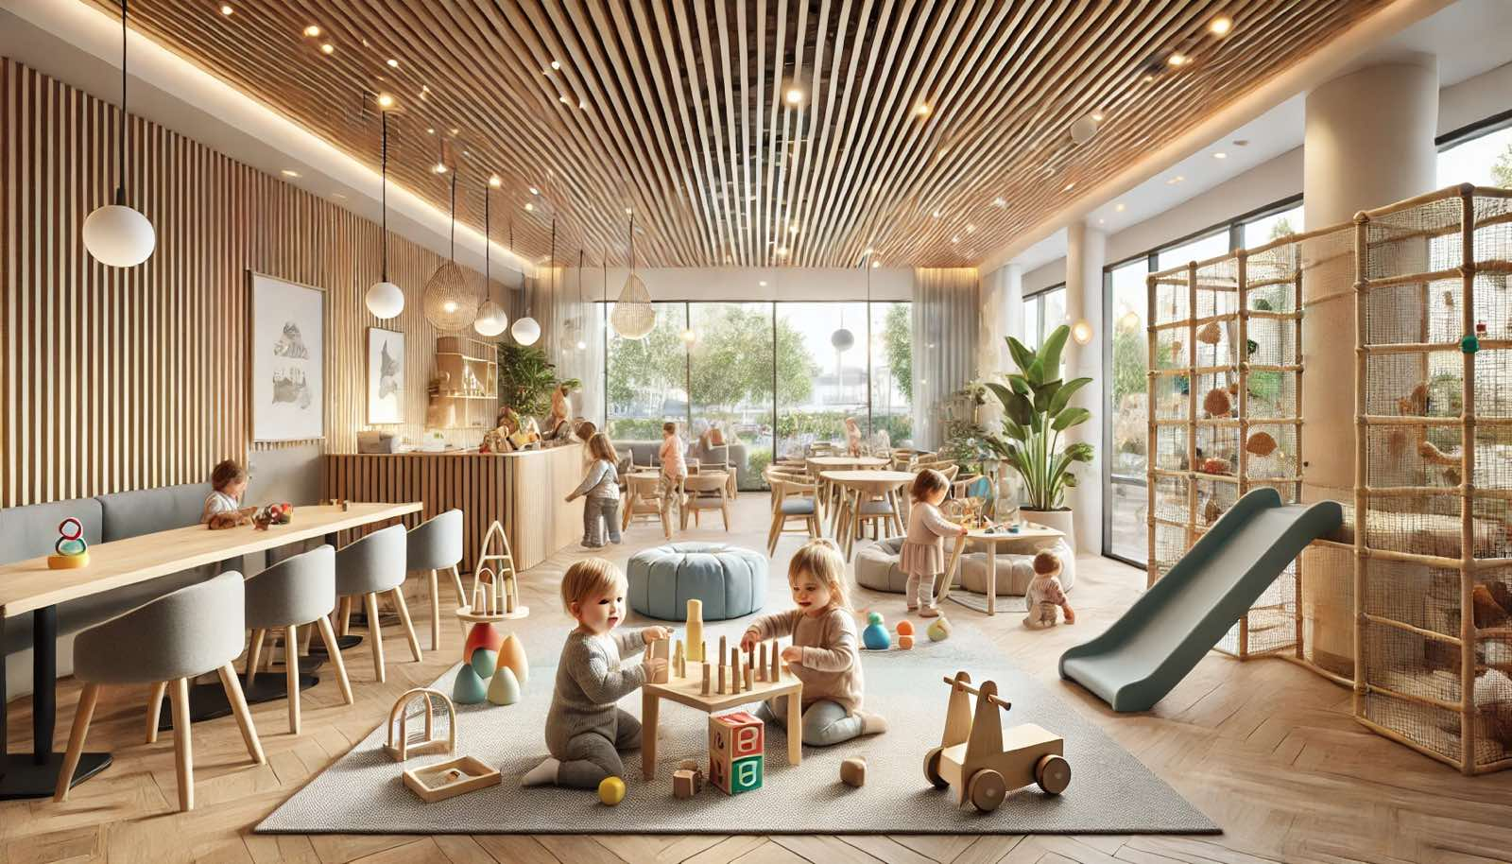
Funding Requirements
Funding Requirements &
Startup Costs
Pie Chart Allocation
• 40% - Equipment & Furniture
• 30% - Renovation
• 20% — Licenses & Stock
• 10% - Marketing
Detailed Cost Breakdown
Category | Cost
Rent (3 months deposit) | £18,000
Renovation & interior design | £10,000
Furniture | £7,000
Children's play area | £5,000
Coffee equipment | £8,000
Kitchen equipment | £4,000
Licensing & insurance | £1,500
Marketing & branding | £2,000
Stock (coffee, food, snacks) | £2,000
Staff recruitment & training | £3,000

Slide 12
Cash Flow forecast
Month | Revenue | Expenses | Net cashflow | Closing balance
Jan | 8,000 | 10,500 | -2,500 | -2,500
Feb | 9,500 | 10,000 | -500 | -3,000
Mar | 11,000 | 10,000 | +1,000 | -2,000
Apr | 12,000 | 10,000 | +2,000 | 0
May | 13,500 | 10,500 | +3,000 | +3,000
Jun | 14,000 | 10,500 | +3,500 | +6,500

Slide 13
Conclusion
Babycino is a good business idea because many parents want a safe, comfortable place where they can relax while their children play. The café offers good coffee, a friendly atmosphere, and a play area for kids, which makes it different from regular cafés.
The start-up costs and funding plan are clear and realistic, and the marketing strategy will help attract local families. If Babycino focuses on good service, safety, and a warm environment, it can become a popular and trusted place in the community.
Overall, Babycino has a strong chance of success and can grow into a well-loved family café.

Slide 14
References
Smith, L. (2022) 'Parents' Preferences in Child-Friendly Cafés', Family Lifestyle Research, 8(1), pp. 10-18.
Office for National Statistics (ONS) (2023) London Rental Market Report. London: Office for National Statistics
Deloitte (2022) Digital Consumer Trends Report. Deloitte Insights.
UK Government (2023) Food Safety and Hygiene Regulations; Health and Safety Executive; Companies House Requirements.
Mintel (2023) Family Lifestyles – UK. Mintel Market Research.
Department for Business & Trade (2023) Small Business Support in the UK. UK Government.
IBISWorld (2023) Cafés & Coffee Shops in the UK – Market Research Report. IBISWorld Industry Reports.

