Slide 1
CRITICAL THEORY, CRITICAL PERSPECTIVES, FRANKFURT SCHOOL
Dr Caroline Jawad
2019

Slide 2
Questions set a
What are the central elements of capitalism? What do some critics find objectionable about capitalism?
Do you support capitalism? If yes, why? If no, why?
What accounts for the unrivalled practical success of market capitalism?
In general, what positive and negative impacts has capitalism had on the world?
What accounts for the unrivalled practical success of market capitalism?

Slide 3
Questions set b
What was Marx’s philosophy?
What compelled did Marx (and Engels) to think that industrial capitalism was bound to collapse?
If Marx were alive today, what would he think about the prosperity enjoyed by the working class in industrial societies?
How does Marxist theory relate to what is happening in our society today?
What is Marx’s alternative to capitalism?

Slide 4
Critical Theory
‘a vein of Marxism’
https://www.youtube.com/watch?v=Ree_q4WweCI

Slide 5
CAPITALISM
AND
SCIENCE
The development of modern western societies has been shaped by two dominating powers: capitalism and science.
A critical basis for analysing capitalism was established by Marx.
His analysis included some reflections on scientific thinking for capitalist development but largely restricted to an appreciation of industrializing the labour process.

Slide 6
problems
Planet earth is being exploited beyond its means! Human beings are in conflict with each other and with themselves.
Societies are in debt, and human beings are continuing the exploitation of earth and other human beings through a new management fad called ‘sustainability’ as they become more narcissistic, materialistic and hedonistic.
This is the result of modern man’s so-called ‘scientific method’ of knowledge creation, characterised by a total focus on sense perception (the sensible) and a total disregard for the metaphysical.
Theory creation in a social environment and the critique against these theories lack the critical element of the metaphysical and a total disregard for human nature.

Slide 7
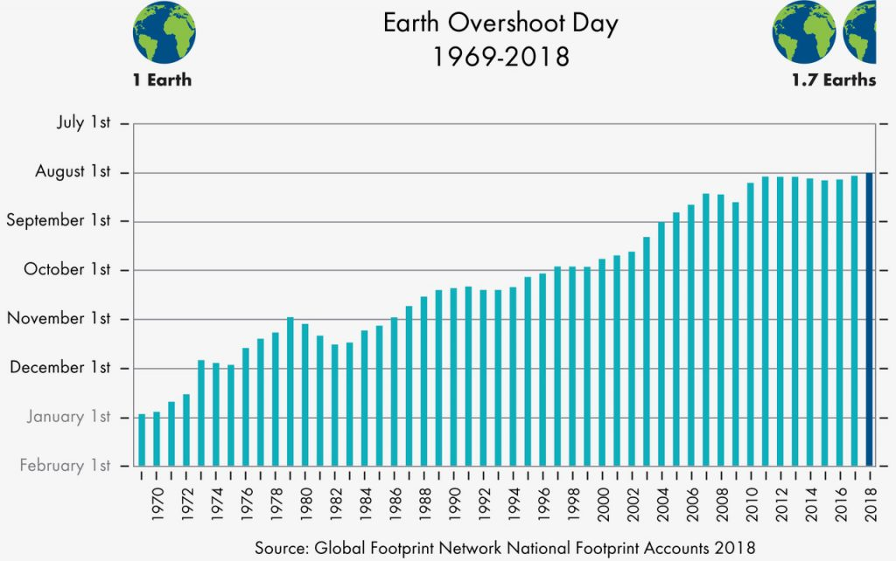

Slide 8
EXPLOITATION HERE
EXPLOITATION THERE
Earth exploitation is reflected in the ‘Earth Overshoot Day’ report (Global Footprint Network 2018) where humanity uses 1.7 times the natural resources produced by planet earth in a year. If humans continue ‘doing business as usual, we shall consume two times the resources produced by planet earth by the year 2030. This means that, every six months, we humans consume one year’s resources produced by planet earth (or a planet every six months). In spite of this, we use a contradicting phrase such as ‘sustainability’ in both the natural and social sciences.

Slide 9
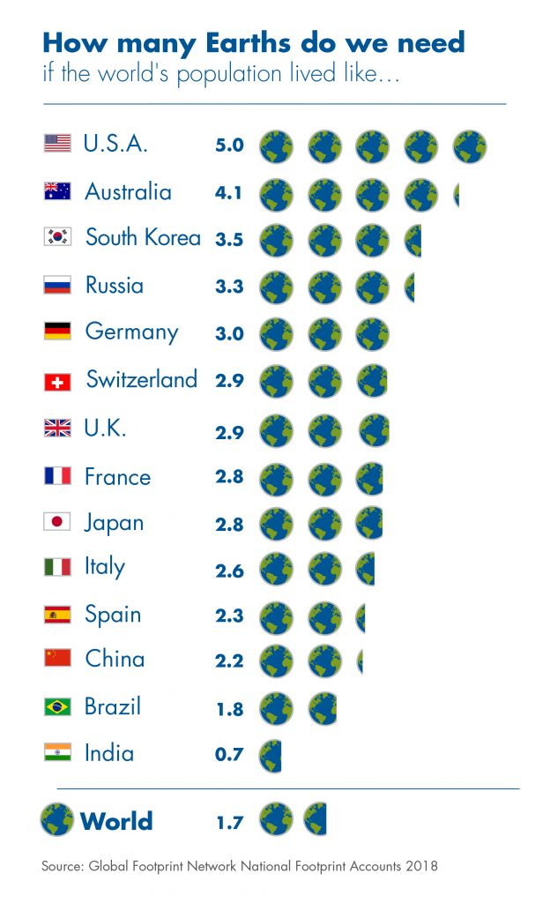

Slide 10
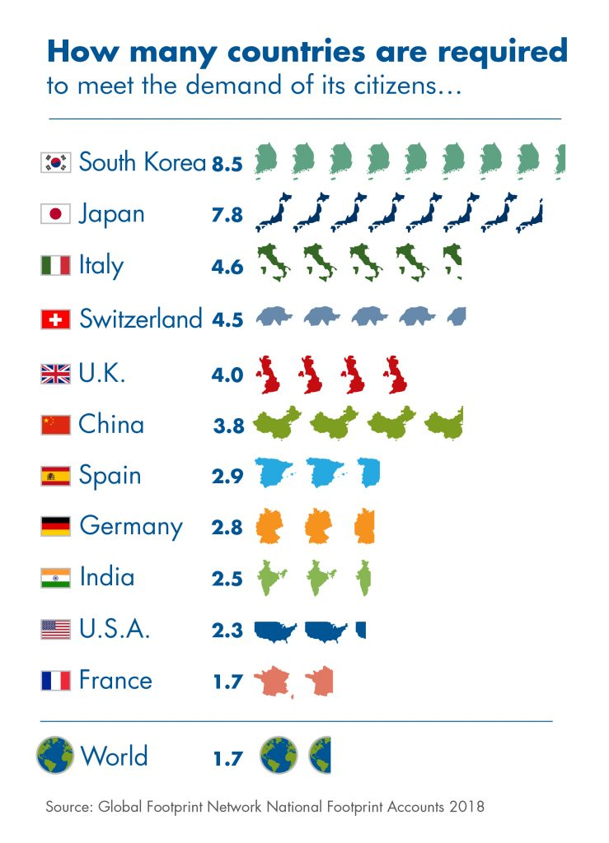

Slide 11
$247 tr
Societies are further overindebted. The so-called value created by organisations is funded by debt as reflected in global debt equals over 300% of global production.
The accompanying question is: ‘How can you owe 300 times more than what you can produce?’
From the two arguments above, it can be concluded that value is not being created but rather being destroyed.
$247,000,000,000,000
https://www.cnbc.com/2018/07/11/global-debt-hits-a-new-record-at-247-trillion.html
https://en.wikipedia.org/wiki/List_of_countries_by_total_wealth

Slide 12
TABLES
https://en.wikipedia.org/wiki/List_of_countries_by_external_debt
https://en.wikipedia.org/wiki/List_of_countries_by_public_debt
https://en.wikipedia.org/wiki/List_of_countries_by_public_debt
https://en.wikipedia.org/wiki/List_of_countries_by_corporate_debt
https://en.wikipedia.org/wiki/United_Kingdom_national_debt

Slide 13
EXPLOITATION
THROUGH CONTROL
The two arguments above lead one to conclude that the collective (society) and the particular (humans) are entering a modern ‘apocalyptic era’ and that this so-called ‘brainy man – Homo sapiens’ is on the brink of extinction (Žižek 2011).
This poses the question: ‘Why did this happen?’
What is even more surprising is that, in the face of all the available evidence to the contrary (and the arguments presented by critical theory), the human species carries on with ‘exploitative business as usual’.
It does not matter in which fashion the essence of capitalism (the legitimatised exploitation of natural and human resources; Žižek 2008:175) is dressed up and softened by inventing new words, concepts and phrases – capitalism remains exploitation through control.

Slide 14
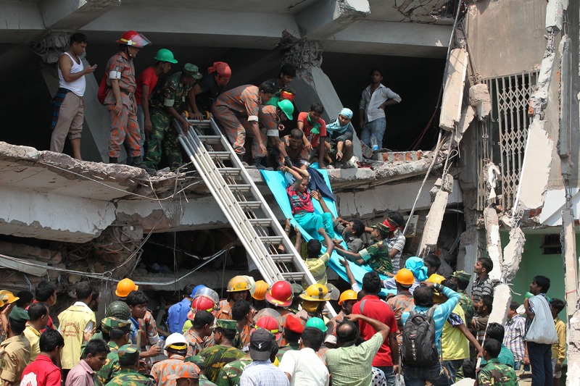

Slide 15
Rana Plaza collapse, Dhaka, Bangladesh 2013
8 storey commercial building collapsed.
Death toll of 1,134, approximately 2,500 injured people.
Deadliest structural failure accident in modern human history and deadliest garment-factory accident in history.
The building contained clothing factories, a bank, apartments, and several shops. The shops and the bank on the lower floors were immediately closed after cracks were discovered in the building.
The building's owners ignored warnings to avoid using the building after cracks had appeared the day before. Garment workers were ordered to return the following day, and the building collapsed during the morning rush-hour.

Slide 16
EXPLOITATION
THROUGH CONTROL
The two arguments above lead one to conclude that the collective (society) and the particular (humans) are entering a modern ‘apocalyptic era’ and that this so-called ‘brainy man – Homo sapiens’ is on the brink of extinction (Žižek 2011).
This poses the question: ‘Why did this happen?’
What is even more surprising is that, in the face of all the available evidence to the contrary (and the arguments presented by critical theory), the human species carries on with ‘exploitative business as usual’.
It does not matter in which fashion the essence of capitalism (the legitimatised exploitation of natural and human resources; Žižek 2008:175) is dressed up and softened by inventing new words, concepts and phrases – capitalism remains exploitation through control.

Slide 17
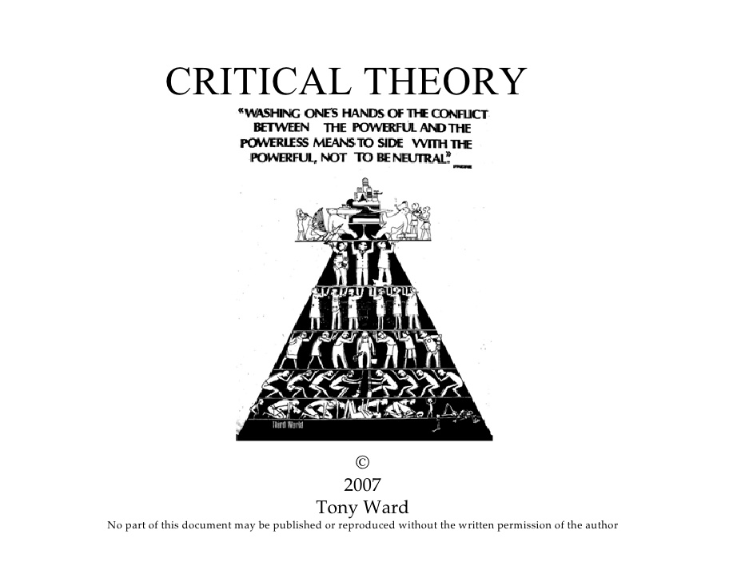

Slide 18
BUT WHAT IS
CRITICAL THEORY - CRITICAL PERSPECTIVES?
Questioning theory, thinking and actions in the prevailing social order (capitalism) or the in body of knowledge that supports this all-devouring social order.
In contemporary capitalism, greed, superficiality and hedonism dominate; and in these circumstances many people find it difficult to develop a sense of well-being or fulfilment.
We are bombarded by images and messages which declare that our lives will be bettered (only) by acquiring more things, finer titles, more impressive careers.

Slide 19
CONTINUED
We then find ourselves caught up in a ‘rat race’ where insecurity, anxiety and suffering are temporarily suspended but unaddressed and so effectively reinforced (Alvesson, 2012b).
Since management is deeply complicit in the organization and development of modern societies, making sense of management, as a key locus of expert control, is critical.
It is critical not only for our self-understanding but, more grandiosely, for the future of modern societies and their sustainability.

Slide 20
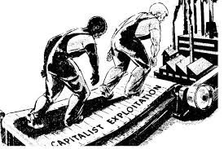
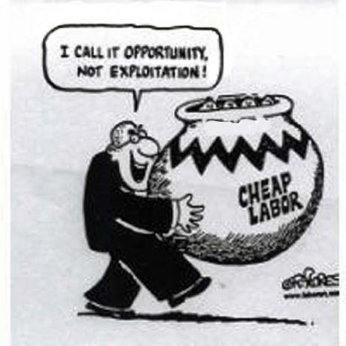
today
CRITICAL THEORY

Slide 21
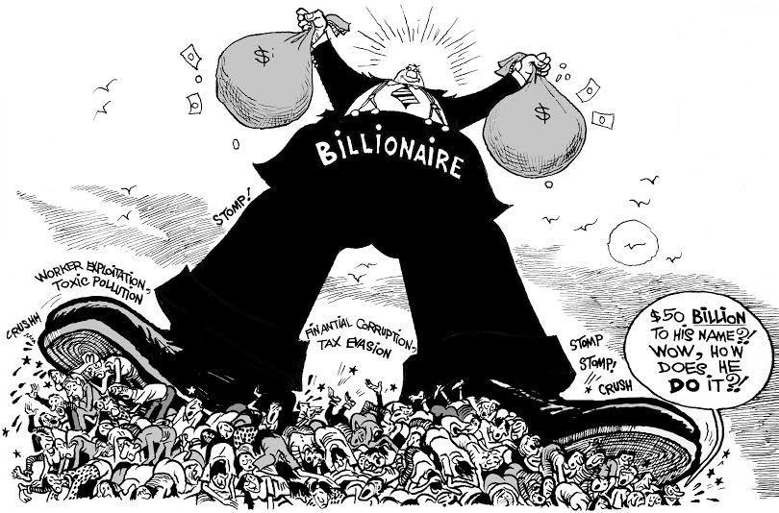

Slide 22
Women
Make up half the world’s population
Perform nearly two-thirds of its work hours
Receive one-tenth of the world’s income
Own less than one-hundredth of the world’s property
UN Report

Slide 23
Critical Theory
Traditional theory is oriented only to understanding or explaining society.
Critical theory, in contrast, is social theory oriented toward critiquing and changing society as a whole.
A critical theory provides the descriptive and normative bases for social inquiry aimed at decreasing domination and increasing freedom in all their forms.

Slide 24
Women
Make up half the world’s population
Perform nearly two-thirds of its work hours
Receive one-tenth of the world’s income
Own less than one-hundredth of the world’s property
Critical Theory is based upon achieving
economic, political and cultural freedom for all people by
interrogating how the rules and structures that govern
society are designed by the powerful to maintain their
privilege and power.

Slide 25
poverty
Capitalism - no essential relationship between wealth and poverty, that within the free-market it is possible to create wealth without a cost to anyone, that the creation of wealth is a personal achievement with no negative consequences.
Against this, socialists note that the creation of wealth requires the creation of a corresponding poverty.
That under capitalism, the creation of poverty is an essential prerequisite for the creation of wealth, that unemployment and low wages are a necessary part of high profits, and are created to maintain investment and production.

Slide 26
Critical Theory: Narrow and Broad
Critical Theory has a narrow and a broad meaning in philosophy and in the history of the social sciences.
In the narrow sense it designates several generations of German philosophers and social theorists in the Western European Marxist tradition known as the Frankfurt School
* Max Horkheimer
* Theodor Adorno
* Herbert Marcuse
* Leo Lowenthal
* Erich Fromm

Slide 27
NARROW
Although this “narrow” conception of critical theory originated with the Frankfurt School, it also prevails among other recent social scientists, such as;
Pierre Bourdieu
Louis Althusser and arguably
Michel Foucault and
Bryan Reynolds
as well as certain feminist theorists and social scientists.

Slide 28
CONTINUED
According to these theorists, a theory is critical to the extent that it seeks human emancipation.
“to liberate human beings from the circumstances that enslave them” (Horkheimer 1982, 244)
Because such theories aim to explain and transform all the circumstances that enslave human beings, many “critical theories” in the broader sense have been developed:
  feminist theory.

Slide 29
THREE CRITERIA
A critical theory is adequate only if it meets three criteria:
It must be explanatory: explain what is wrong with current social reality
It must be practical: identify the actors to change it
It must be normative: provide both clear norms for criticism and achievable practical goals for social transformation
It must satisfy all three of these criteria at the same time.

Slide 30
2018
The wealth of the world’s billionaires increased $900 billion in the last year, which is $2.5 billion a day.
Last year 26 people owned the same as the 3.8 billion people who make up the poorest half of humanity.
Only 4 cents in every dollar of tax revenue comes from taxes on wealth.
In some countries the poorest 10% are paying a higher proportion of their incomes in tax than the richest 10%.

Slide 31
continued
Today 262 million children will not be allowed to go to school.
In Kenya, a Poor girl has a one in 250 chances of continuing her studies beyond secondary school.
Every day 10,000 people die because they lack access to affordable healthcare.
Life expectancy in the richest parts of Sao Paulo, Brazil, is 79 years. In the poorest areas of the city it is 54 years.
MEN own 50% more of the world's wealth than women, and control over 86% of corporations.
The unpaid care work done by women is estimated $10 trillion - 43 times the annual turnover of A
pple.

Slide 32
Continued
Between 2017 and 2018 a new billionaire was created every two days.
The world’s richest man, Jeff Bezos, the owner of Amazon, saw his fortune increase to $112bn. Just 1% of his fortune is equivalent to the whole health budget for Ethiopia, a country of 105 million people.
The poorest 10% of Britons are paying a higher effective tax rate than the richest 10% (49% compared with 34%) once taxes on consumption such as VAT are taken into account.

Slide 33
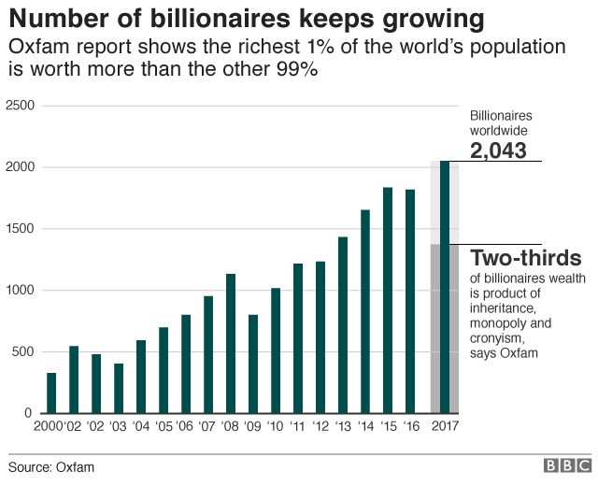

Slide 34
FRANKFURT SCHOOL
Frankfurt School is not a place.
It is a school of thought.
It is a group of similar theories that focus on the same topic.
The scholars that made up the Frankfurt School were all directly, or indirectly associated with the Institute of Social Research.
The nickname of the thinkers, originates in the location of the institute, Frankfurt Germany.
The "Frankfurt School" refers to a group of German-American theorists who developed powerful analyses of the changes in Western capitalist societies that occurred since the classical theory of Marx.

Slide 35
CONTINUED
Prominent theorists believed, and shared Karl Marx’s theory of Historical Materialism (focuses on human societies and their development over time, arguing that they follow a number of observable tendencies).
Each member of the Frankfurt School adjusted Marxism with his additions, or "fix“.
Then, they used the "fixed" Marxist theory as a measure modern society needed to meet.
These ideas came to be known as "Critical Theory”.

Slide 36
What were the Frankfurt school responding to, through the 1930s and 40s?
Failure of Marxian revolution AND
Collapse of liberal democracy as a viable option in many European states
Uncertainties associated with the rise of Russia and Stalinism
Why had the leading nation in Western Europe (Germany), despite the rise of the power of the State (a good thing), technological and material advancement, etc., turned to Fascism rather than experiencing a workers revolution?
The School had two main aims:
  To explain domination and its persistence.
  To influence the future and the transition towards a more rational, free society.

Slide 37
REMEMBER MARXISM?
Developed by Karl Marx in 1880s.
Argues that hierarchical class system is at the root of all social problems and must be ended by a revolution of the workers.
Dominant classes directly control the means of production (labour, factories and land), which is called the base of society.
Ruling classes also control the culture, which is called the superstructure of society. Therefore, the dominant ideology of a society is the ideology of ruling class.
Base: the means of production.
Superstructure: a society’s culture.
Ideology: ideas present in a culture that mislead average people and encourage them to act against their own interests.

Slide 38
NEO-MARXIST APPROACH: FRANKFURT
SCHOOL
The school was concerned with developing a revolutionary, philosophical variant of Western Marxism, opposed to capitalism in the west and Stalinism in the East, which came to be called critical theory.
In 1930s when Hitler came to power, the Institute was forced to leave Germany for New York.
In 1953 it was re-established in Frankfurt.
They saw the media as a cultural industry that maintained power relations and served to lessen the ‘resistance standards’ of cultural aesthetics by popularizing certain types of culture.

Slide 39
CONTRIBUTION
OF THE FRANKFURT SCHOOL
Frankfurt School forced Marxist ideology to broaden its scope.
While Marx said, "This is historical materialism, and this is what it does”
The Frankfurt School said, "This is historical materialism; this is what’s right with it, this is what’s wrong with it, and this is how it works”.
The Frankfurt School also had it’s own effects on philosophy as a whole.
It affected philosophy by preserving the notion of meta-analysis of society through its economic, political, and social systems .
It introduced the notion of social philosophy and made theory part of everyday practice by "mixing" philosophical problems, and empirical problems.

Slide 40
CONTINUED
Frankfurt School work was an articulation of a theory of the stage of state and monopoly capitalism that became dominant during the 1930s.
This was an era of large organisations.
The state and giant corporations manage the economy and individuals submit to state and corporate control.
This period is often described as "Fordism" to designate the system of mass production and the homogenizing regime of capital which wanted to produce mass desires, tastes, and behaviour.

Slide 41
CONTINUED
Fordism was an era of mass production and consumption characterized by uniformity and homogeneity of needs, thought, and behaviour producing a mass society.
Frankfurt School described it as "the end of the individual”.
No longer was individual thought and action the motor of social and cultural progress.
Instead giant organisations and institutions overpowered individuals.

Slide 42
The modern world is shaped by varieties of capitalism in which scientific and technical knowledge has been applied to extract profits from the production and marketing of every conceivable product and service.
The modern world is shaped by varieties of capitalism in which scientific and technical knowledge has been applied to extract profits from the production and marketing of every conceivable product and service.
As a distinctive politico-economic system in which wage labour is hired to make commodities that can be sold for a profit, the reach of capitalism has extended around the globe to incorporate former state socialist societies.
Capitalism has gained legitimacy by absorbing and then promoting pressures to support the public supply, and subsequent privatization (Grimshaw,Vincent and Willmott, 2001), of a basic level of public goods, in the form of housing, health care and education.

Slide 43
NEW MARKETS
With technological progress and wealth creation has come a creeping commercialization and commodification of everyday life.
Most recently, its advance has developed the ‘new’ markets of entertainment, leisure and, increasingly, the premium pricing of ecological correctness (e.g. organic and other green or low carbon produce).

Slide 45
SQUEEZING
SUPPLIER | PROFIT
SKY SPORTS | 2017 £1B ON £13B
BT SPORTS | 2017 £2B ON £24B
PREMIER SPORTS | PRIVATE STATUS
ELEVEN SPORTS | I FAILED
AMAZON | 2017 $10B ON $233B

Slide 46
HOW CONSUMER NEEDS ARE
DEFINED
Marketing techniques play a central role in the formation of these ‘needs’ – for example, by associating products with enviable lifestyles or cultural heroes.
Leading marketing textbooks are largely silent on the issue of how consumer demand is constituted – how anxieties are generated and then exploited or aspirations are fuelled and responded to.
There is scant discussion of the relationship between increased consumption and ecological destruction. In the world of marketing, as in other management specialisms, ‘the environment’ is referred to as if it were something ‘out there’ rather than an integral part of our lives (Naess and Rothenberg, 1991).

Slide 47
AN
OPPORTUNITY !
Growing environmental anxiety among consumers is not addressed directly but, rather, is seized upon as an opportunity for product differentiation and gaining a competitive advantage (e.g. through the so-called greening of products or the building of ‘environmentally friendly’ or ‘sociably responsible’ corporate images).
From a critical perspective the discourses and practices of marketing, for example, are seen to be propagators and seducers of consumer desire as much as they are articulations of, or responses to, human need (Klein, 2000; Morgan, 2003).

Slide 48
DAMAGE
As a counter-image to a dominant view of economic actors being engaged in value creation, one could suggest that many businesses are involved in forms of value destruction:
  cities and landscapes are transformed in environmentally and aesthetically negative ways for commercial purposes
  new images and accompanying aspirations are developed, existing products become out-dated and lose their attractiveness
people are led to believe that what is not novel or fashionable is inferior.

Slide 49
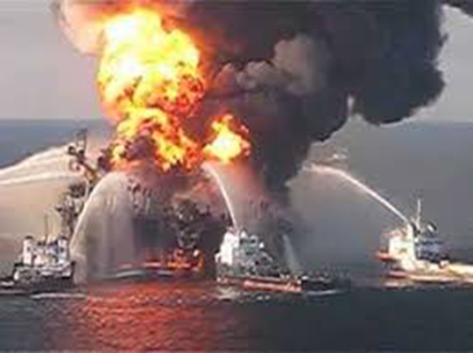
LIES ? hMMM
The strength of attachment to capitalist values (e.g. individualism expressed in the form of maximization of self-interest, as exemplified by the financial sector) and priorities (e.g. private accumulation and mass consumption) means that responsibility for social division (e.g. foreclosures, unemployment) and ecological destruction (e.g. Deepwater Horizon ‘accident’) is more likely to be attributed to industrialization, science, weak regulation, irresponsible companies or some combination of such factors.

Slide 50
OFFICIAL CAUSE OF DEEPWATER HORIZON
The blowout and oil spill on the Deepwater Horizon in the Gulf of Mexico was caused by a flawed well plan that did not include enough cement between the 7-inch production casing and the 9 7/8-inch protection casing. ... Eleven men died instantly and 115 others rushed to the lifeboats or jumped into the Gulf of Mexico.

Slide 53
SHARED
RESPONSIBILITY
By focusing upon such elements, there is a tendency to disregard their shared development within a politico-economic system founded upon domination and exploitation where costs are routinely ‘externalized’ or treated as ‘acceptable business risks’ to be covered by insurance.
Exploitation is systematically built into capitalism.

Slide 54
DOMINATION
The creative capacity of human beings, hired as employees, is harnessed to produce wealth that is appropriated privately by the owners of capital, which takes the form of factories, service firms, intellectual property (e.g. patents), etc.
Domination is an integral feature of capitalism in the form of institutions (e.g. education) and ideologies (e.g. liberalism) that naturalize its features and/or represent them as congruent with ‘human nature’ or most consistent with the preservation of ‘freedom’, ‘equality’, ‘democracy’, and so on. In such ways, divisiveness and destructiveness are downplayed as capitalism is commended as the means of overcoming such problems.

Slide 55
EURO CRISIS
Politicians remain preoccupied with ‘managing’ the survival and growth of their (capitalist) economies and businesses.
Their priorities dramatically demonstrated during the ‘Euro Crisis’ of 2011.
Pproblems (e.g. of Greece and Italy) have been widely diagnosed in terms of national profligacy and ‘sovereign debt’, and the ‘bailing out’ of these nations.
Yet, arguably, it is the banks that have been content to lend to these nations that are, once again, being ‘baled out’ by ordinary taxpayers – of Germany or through the European Central Bank. We, it seems, have become the captives of (financialized) capitalism, unwilling or unable to debate and renew the meaning of modern ideas of freedom, community and democracy.

Slide 56
BILLIONS FOR THE BANKS
The excesses and gross inequalities of capitalist development, nationally and globally, go largely unchallenged, and, at best, state provision addresses only the most shocking, de-legitimating manifestations of destructiveness, deprivation and neglect. Billions have been found almost instantly to bail out the banks but, in the years following the financial crisis, many countries are experiencing great difficulties in sustaining core welfare programmes.
These have been assessed to be too expensive and/or the services have been contracted to the private sector where labour conditions are generally inferior with regards to employment security, trade union representation, pensions, etc., and so costs are lower.

Slide 57
AND SO BACK TO CRITICAL
The critical study of management unsettles conventional wisdoms about its sovereignty as well as its universality and the impartiality of its professed expertise. It is therefore worth stressing that the critical study of management is by no means ‘anti- management’.
It is to challenge received wisdoms about management and to foster less socially oppressive forms of organizing and managing.
The demand here is not for an end to management but for the harnessing and redirection of management to more democratically determined and accountable ends.

Slide 58
WAS MARX WRONG?
https://www.adamsmith.org/blog/thinkpieces/why-marx-was-wrong-about-capitalism

Slide 59
CRITICAL PERSPECTIVES ON MANAGEMENT
‘Best management practice’ is not a matter of identifying the most technically rational means of achieving current ends (e.g. profitable growth).
Rather, ‘best practice’ is evaluated in terms of its contribution to the realization of the progressive objectives of social justice, greater autonomy, responsibility, democracy and ecologically sustainable development.
It looks at forms of oppression within workplaces where there is little or no democratic accountability for how resources are applied; how the divisions of labour are determined; and how tasks are designed, allocated and rewarded.
When framed in this way, the responsibility of management is not equated with preserving or improving structures and processes for a better realization of a given, narrow set of objectives. Instead, this responsibility is conceived as a collective task, guided by processes of critical self-reflection concerned with the identification and realization of alternative values and practices that are humanly (and ecologically) more fulfilling and less degrading.

Slide 60
Demise of the left
It would be difficult to exaggerate the defeat suffered by the Left in the lastdecades of the twentieth century.
The Soviet bloc disappeared.
Socialism has ceased to be a widespread ideal.
Marxism is no longer dominant in the culture of the Left.
Even Labourism largely dissolved. To say that these changes are enormous would be an under-statement...
And as you now know, the principal aspect of the past decades ...can be defined as the virtually uncontested consolidation, and universal diffusion, of neo-liberalism...

Slide 61
continued
The Left no longer constitutes a threat to what J.K. Galbraith (1993) has termed the “culture of contentment”, in which it is accepted that certain features of the capitalist corporation, such as discrimination, deskilling, and downsizing, while regrettable, are unavoidable concomitants of capitalist competition, and the efficiency that the capitalist corporation enjoys.
Capitalism has a current advantage in that with the death of communism and socialism, it has no plausible social system as an active competitor.
It is difficult to have a revolution against capitalism without an alternative ideology.

Slide 62
braverman
Labour and Monopoly Capital - Harry Braverman intended not only to update Marx’s interest in manual workers but also to examine what has happened to white- collar and service workers.
In his view, capitalist control and exploitation, as well as the derivative processes of mechanization and rationalization, are being extended to white collar and service occupations.

Slide 63
MANAGERIAL CONTROL
Braverman recognized economic exploitation, which was Marx’s focus, but concentrated on the issue of control.
He asked the question: How do the capitalists control the laboOr power they employ?
One answer is that they exercise such control through managers.
Braverman concentrated on the more impersonal means employed by managers to control workers.

Slide 64
continued
Braverman believed that the division of labour and specialization in the workplace involves the continual division and subdivision of tasks or operations into minute and highly specialized activities, each of which is then likely to be assigned to a different worker.
This process constitutes the creation of what Braverman calls “detail workers.”

Slide 65
continued
Braverman puts it, the capitalist first breaks down the work process and then “dismembers the worker as well” by requiring the worker to use only a small proportion of his or her skills and abilities.
In Braverman’s terms, the worker “never voluntarily converts himself into a lifelong detail worker.
This is the contribution of the capitalist”. - Why does the capitalist do this?
  First, it increases the control of management.
  Second, it increases productivity.
  Third, specialization allows the capitalist to pay the least for the labor power needed.

Slide 66
CONTINUED
Following the logic of capitalism, employers seek to progressively cheapen the labor of workers, and this results in a virtually undifferentiated mass of what Braverman called “simple labor.”
To Braverman, scientific management is the science of “how best to control alienated labor” .
Scientific management is found in a series of stages aimed at the control of labor gathering many workers in one workshop, dictating the length of the workday, supervising workers directly to ensure diligence, enforcing rules against distractions ( ex; talking), and setting minimum acceptable production levels.

Slide 67
control
Taylor’s early work on the shoveling of coal, which led him to develop rules about the kind of shovel to use, the way to stand, the angle at which the shovel should enter the coal pile, and how much coal to pick up in each motion.
Workers were to be left with as few independent decisions as possible; thus, a separation of the mental and the manual was accomplished.
Instead of controlling the work process, workers come to be controlled by the machine.
It is far easier for management to control machines than to control workers.
Braverman argued that through mechanisms such as the specialization of work, scientific management, and machines, management has been able to extend its control over its manual workers.

