Slide 1
Clare Susan Woolvett
Food & beverage Operations
BMIH4002
Ffion Cumberpatch
Menu Engineering

Slide 2



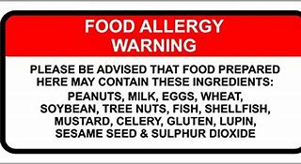
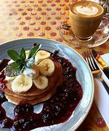
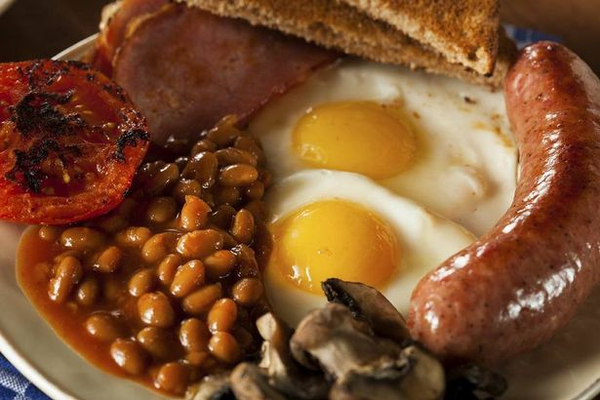
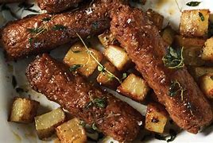

Hotel trinity
0173245678
Hotel Trinity
51 Beach Hut Street
Coastline south
Swansea
South Wales
SA3 5FT
Opening times: Monday-Saturday from 8am-8pm
Accept card/contactless or Cash
Take it away…
Breakfast-
Last serving 12 ‘0’ clock noon
Full-English Breakfast-Two rashes of bacon,1 pork or lamb sausage,2 fried eggs or scrambled egg, mushrooms, Beans or Tomatoes, Hash browns or Toast. Optional: Black pudding. 6.50
Vegetarian Full-English Breakfast- 3 Linda McCartney’s Vegetarian sausages, Beans and Mushrooms, Fried egg or scrambled, Along with some hash browns or toast. 6.00
Bagel – with soft cheese or Jam. 3.00
Pancakes- with 2 Fruit toppings, syrup and whipped cream. 6.50
Any Breakfast dish will come with Tea/Coffee or Orange Juice.
Hot Beverages-
Every Hot Beverage Complimented with Biscoff Lotus Biscuits
Tea/Coffee -
A choice of Twinings English breakfast tea or A simple but satisfying Yorkshire Tea – A variety of Dairy & Non-Dairy milk products to add- Cravendale whole/Semi-skimmed, Koko Coconut milk, Almond and Alpro Soya milk.
Latte
Cappuccino
Mocha
Hot Chocolate – choice to add skirty whip cream with Marshmellows
Small: 1.50 – Reg: 2.50 – Large: 3.00
- (Brecwast- Gweini diwethaf 12 '0' hanner dydd)
Bydd unrhyw ddysgl Frecwast yn dod gyda The/Coffi neu Sudd Oren.
*Please note when collecting orders to collect from the Restaurant collection window-Remember to have your order number* Please Sanitise Hands on arrival and wear a mask * To Ensure everyone is kept safe* Thank you

Slide 3
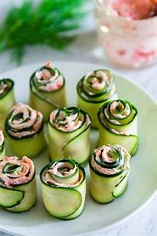
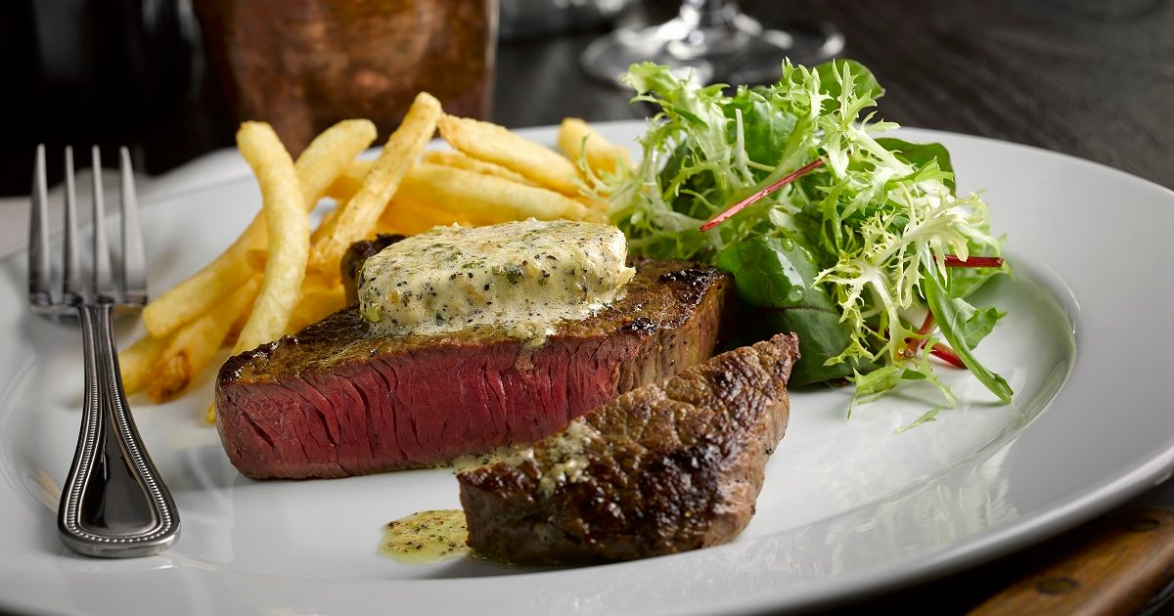
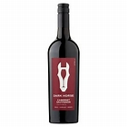
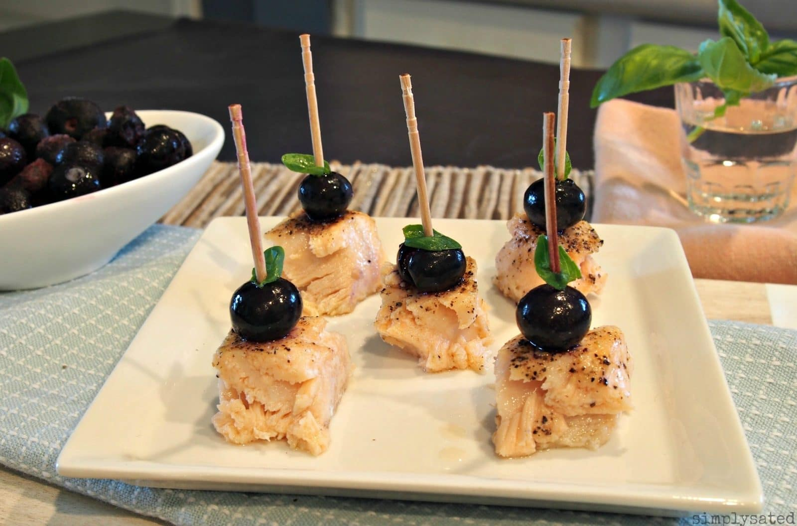
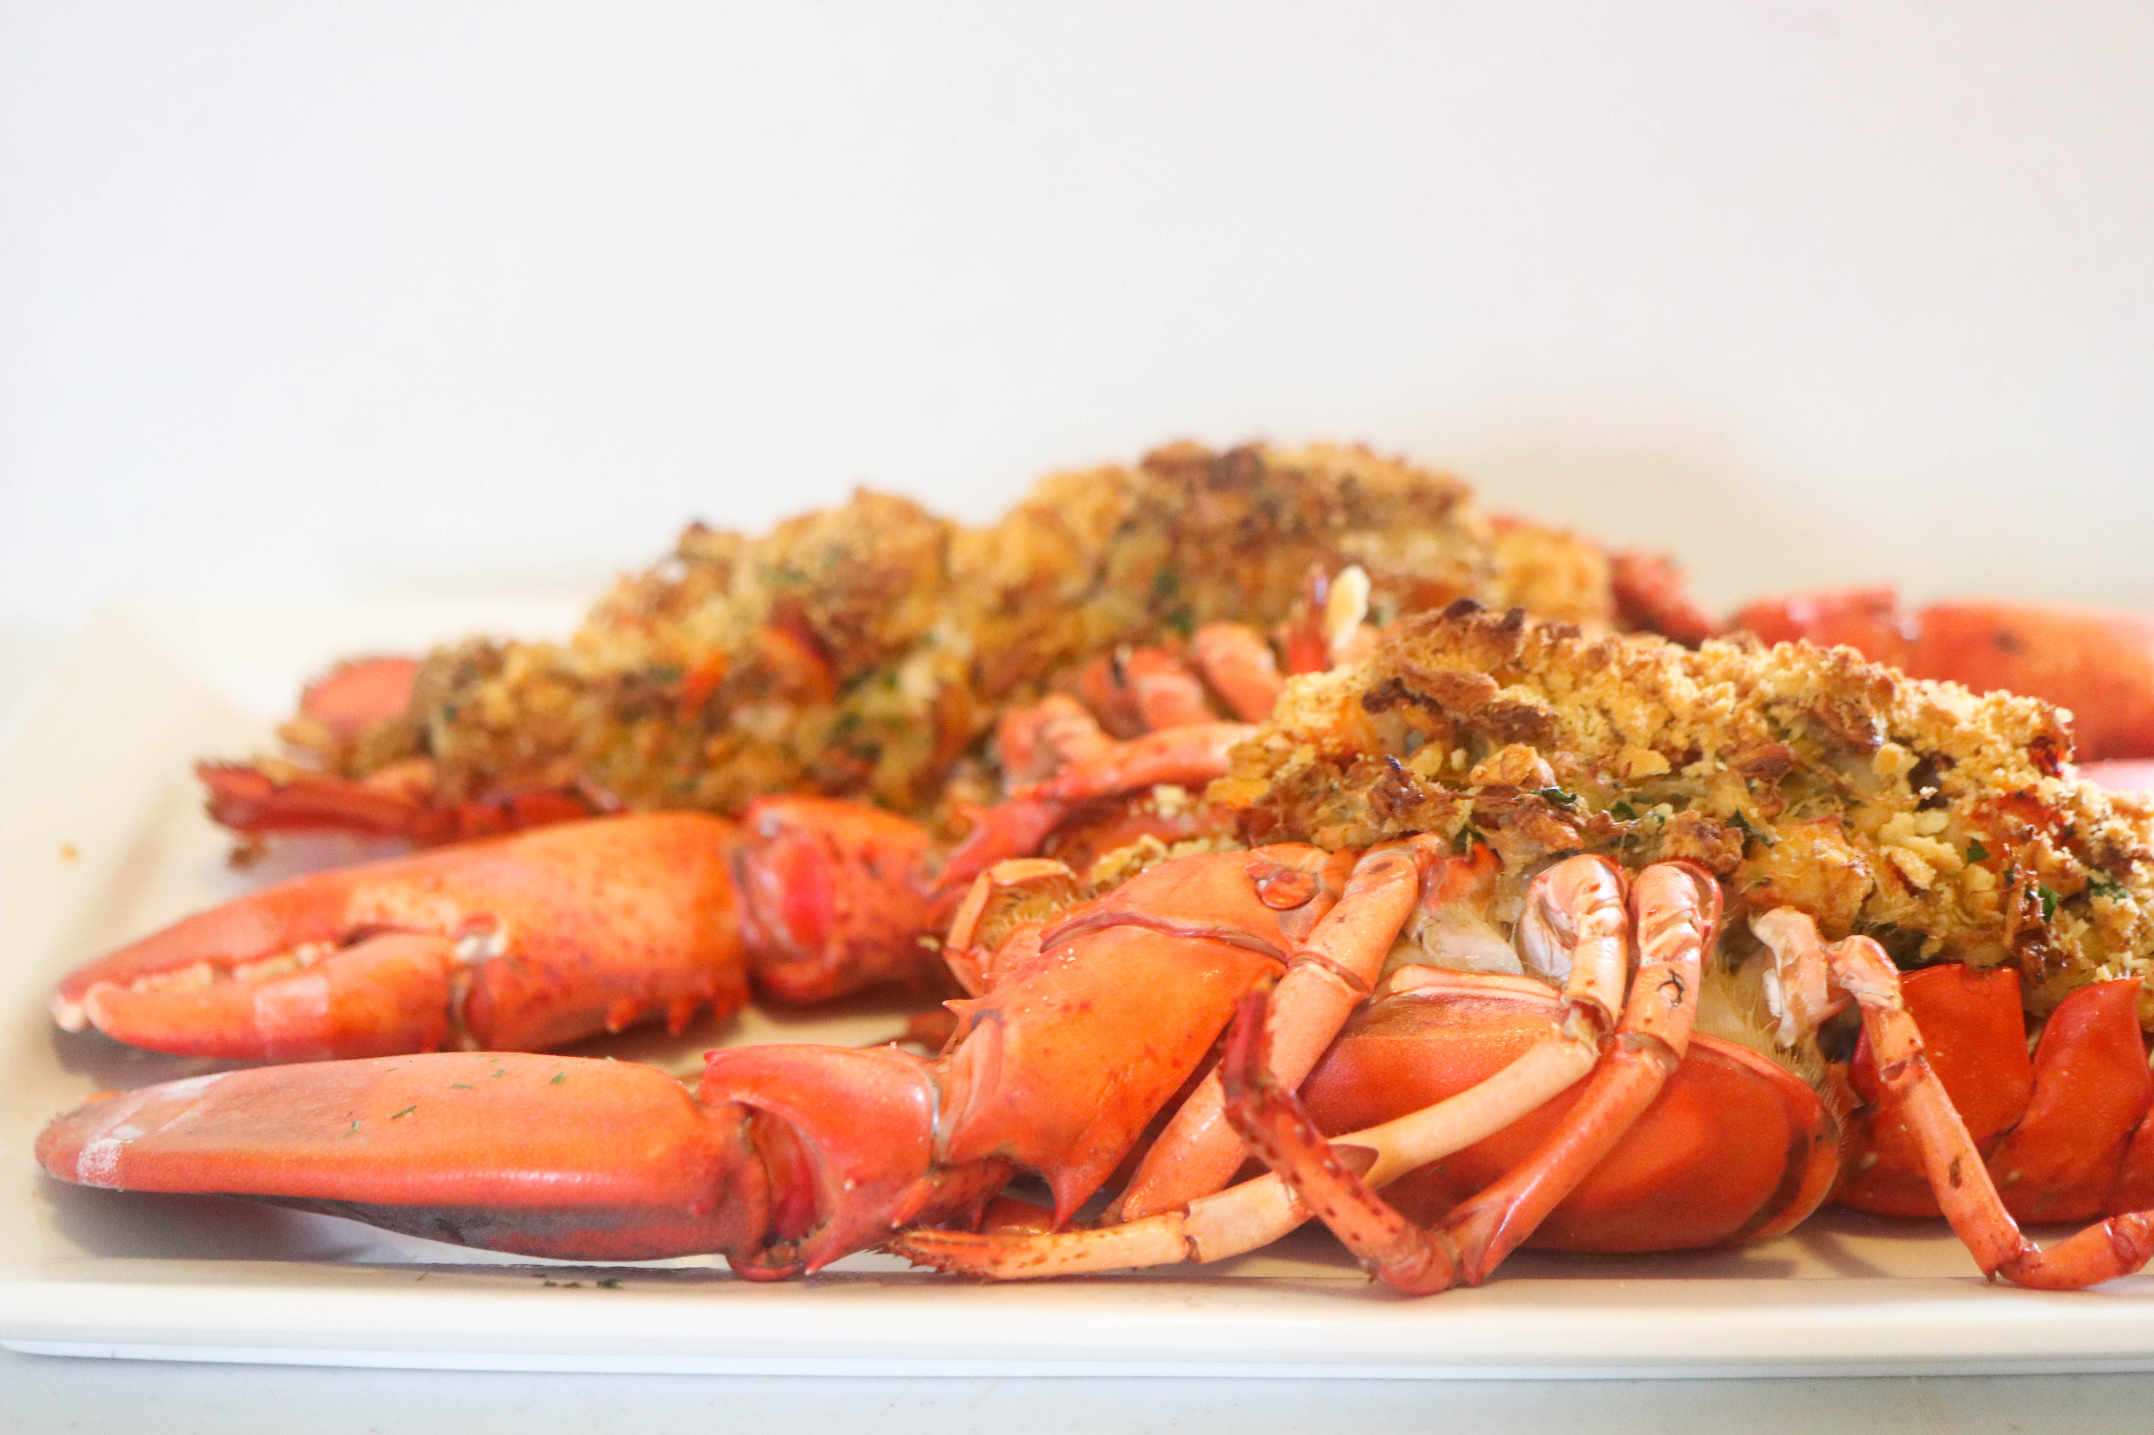
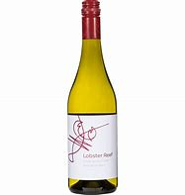
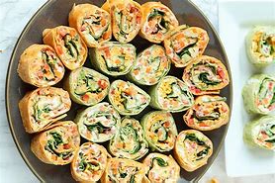
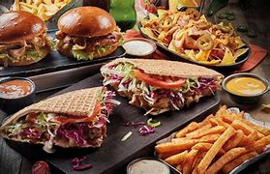
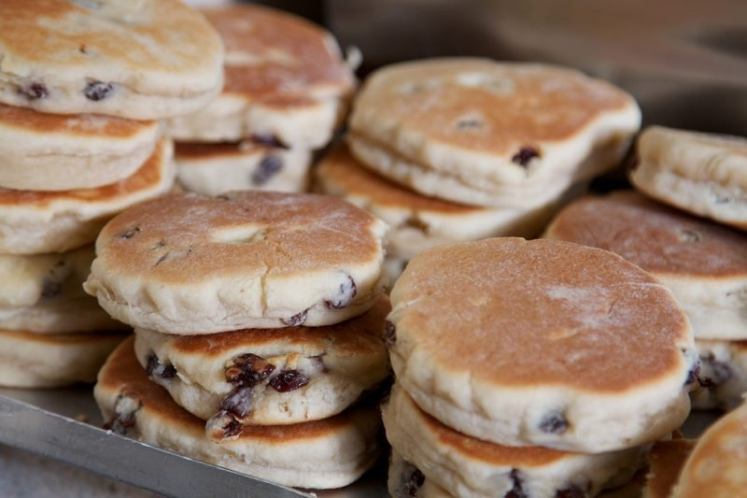
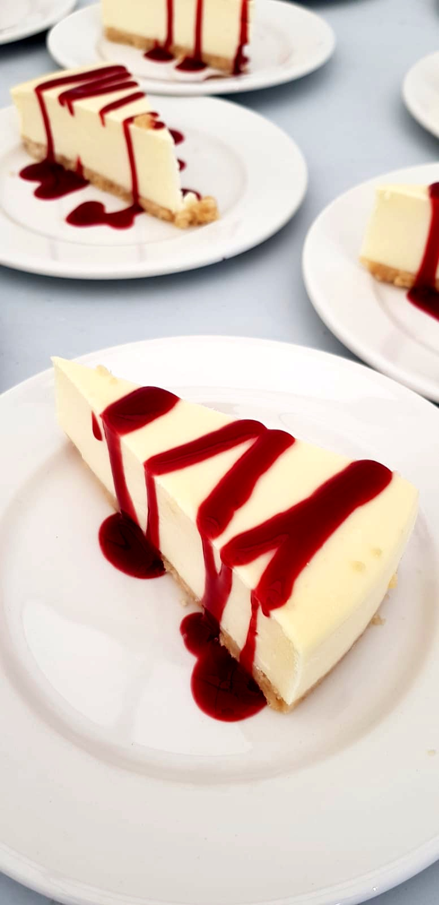
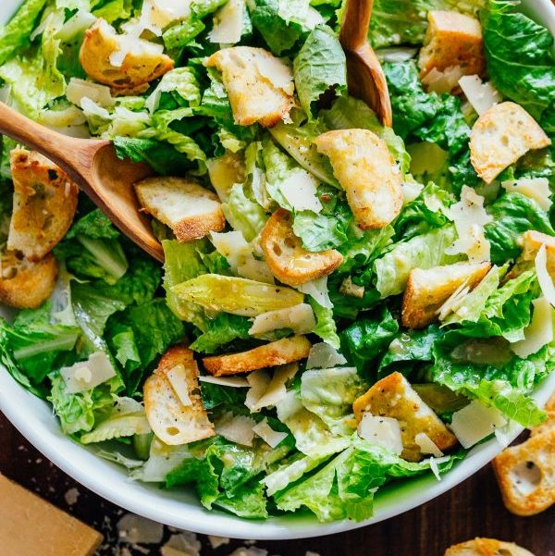
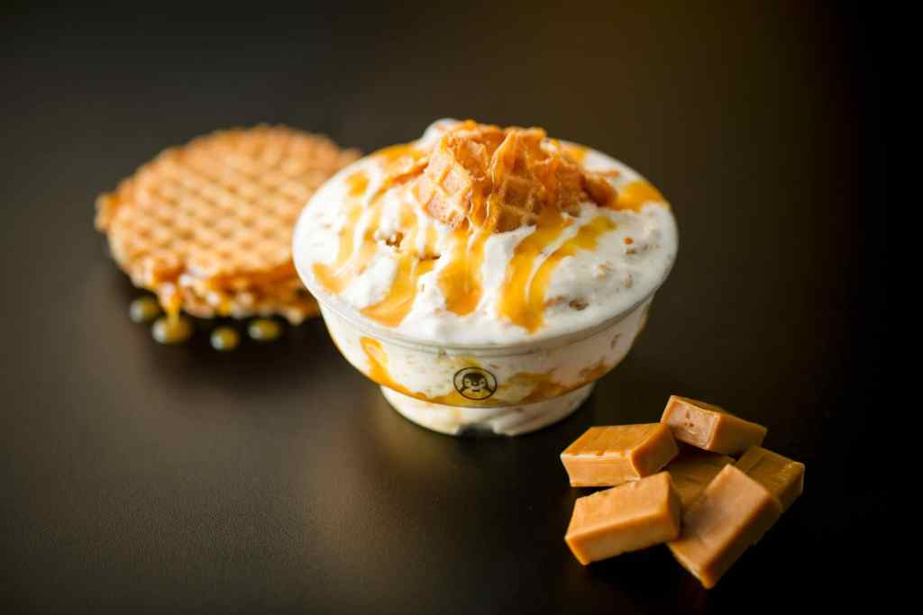
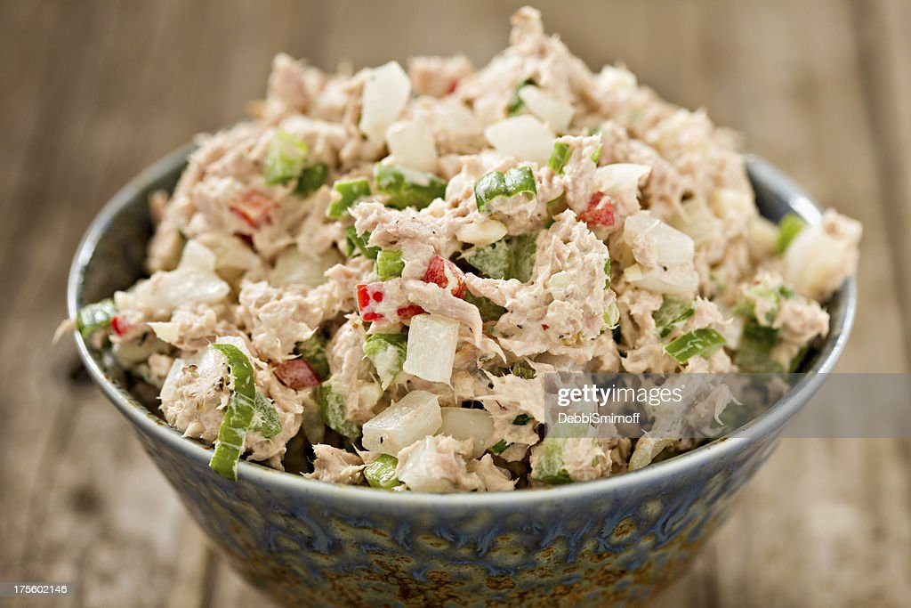
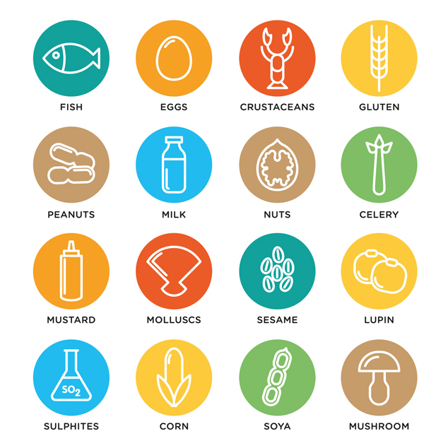
Appetizers
Main Course
Recommended Wine for this dish- Dark Horse Cabernet Sauvignon- Red Wine, California- 13.5% vol – Dark fruit aromas and sweet brown spice. 3.50 discount when bought with dish.
Pepper Steak (well done, medium or rare ) Garnished with garlic butter along with a side salad and a portion of Fries or Garlic honey roast potatoes
10.50
Smoked Salmon Cucumber –
Soft Crream cheese and Smoked Salmon elegantly rolled in a fine cucumber strip.
4.50
Salmon(grilled or baked)
Topped with Basil Blueberry Hats
5.00
Baked stuffed Lobster- Contains, egg, parsley, salt, Pepper, ritz crumbs-Lobster meat-Crab Meat
15.50
Recommended wine with this dish- Lobster Reef Sauvignon Blanc-12.8%-Bright crisp Grapefruit & Citrus fruit with vibrant flavours. 2.50 discount when bought with dish.
Veggie Tortilla Pinwheels
Tortilla wrap filled with salad, finely chopped peppers and tomatoes, with a spread of humous.
4.00
Desserts
German Doner Kebab-Grilled pitta bread filled with Donner meat and salad with a choice of sauce dressing. Along with Sweet potatoe Fries.
10.50
Traditional Welsh Cakes- Incredibly tasty and fruit filled- Made since the 19th century. 2 per portion. 2.50
Salads
Raspberry drizzle cheesecake 2.00
Chicken Caesar Salad- Succulent chicken placed on a bed of salad dressed with Sea salt & Black pepper Croutons and Caesar dressing.
6,50
Alcoholic Drinks
Dark Horse Cabernet Sauvignon- Red wine, California, 13.5% vol. 75 cl Bottle: 13,50 Glass: 4.50
Lobster Reef Sauvignon Blanc, 12.8%, 75 cl bottle:14.50. Glass: 4.00
Bottle of Swansea Jack Beer. £3.00
Caramel fudge Ice cream complimented with a caramel wafer. 3.00
18+ I.D
Tuna Crunch Salad-Freshly made Tuna salad mixed in with Red peppers and Cucumber.
5.50
Soft & Still Drinks
Cola, Lemonade, Orangina, Ginger Beer - (non-alcoholic), Regular : 2.50 - Large: 3.00
Fresh Orange or Pineapple Juice
- 2.00
Jug of Water and Ice – 1.50
*Dishes & Beverages May contain Allergens-Please request information from Staff. * Important *
Ewch i food.gov.uk/ratings i ganfod sgôr hylendid bwyd ein busnes neu gofynnwch inni beth yw ein sgôr hylendid bwyd wrth archebu / Go to food.gov.uk/ratings to find out the food hygiene rating of our business or ask us for our food hygiene rating when you order.

Slide 4
Reference List:
https://www.Jarrold.co.uk/.../Wine/Lobster-reef-sauvignon-blanc-75cl.(Accessed : June,14th, 2022)
https://www.Sainsburys.co.uk/gol-ui/product/dark-horse-cabernet-sauvignon-75cl. (Accessed:June,14th,2022)
https://tomoswatkin.com/collections/Swansea-jack/products/Swansea-jack. (Accessed: June, 14th, 2022)
https://www.cakesfromwales.com/story. (Accessed: June, 10th, 2022)
Dory,.J., (2021), Harbor Fish Market-Recipes- Available at:
https://harborfish.com/baked-stuffed-lobster-2/
(Accessed: June,15th, 2022)
https://Sainsburys.co.uk/gol-ui/lindamccartney-original-sausages
(Accessed: June,2022)
In class study,.F.Cumberpatch,(2022)
Welsh Government (2016) Rules requiring takeaways to promote food hygiene ratings on leaflets, come into force. [online] Gov.wales. Available at: https://gov.wales/rules-requiring-takeaways-promote-food-hygiene-ratings-leaflets-come-force-0
https://bing.com/images/search- Allergen vector Icons set food allergens symbols- available at: Pinterest.com
(Accessed : June,2022)
https://www.Bing.com/images/search/ - https://www.pinterest.com/Trinitysymbol
(Accessed:June,2022)
Microsoft Translater- Welsh to English- https://bing.com/search

