Slide 1

Ethical Considerations
Yr Athrofa
Institute of Education
Conducting Research within Youth and Community Work
This Photo by Unknown Author is licensed under CC BY-SA

Slide 3
Aims & Objectives
Aim:
  To critically explore ethics in research at level 7 and revisit ethics assessment.
Objectives:
  Discuss ethical considerations in research
  Explore, Yr Athrofa and accepted ethical guidelines
  Discuss own ethical issues in relation to your research

Slide 4
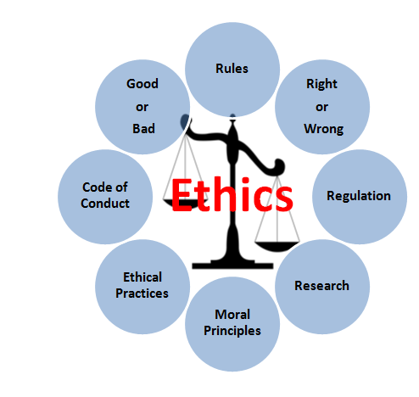
Research Ethics
As a small group, work together to outline what you think are key ethical considerations in research and why….

Slide 5
Research Ethics
“Avoidance of harm, fully informed consent, and the need for privacy and confidentiality …”
(Punch, 2005: 89)

Slide 6
Research Ethics
Research Ethics is normally concerned with:
overall harms and benefits of research,
the rights of participants to information, privacy, anonymity, respect…
the responsibilities of researchers to act with integrity,
The positioning of people / researcher in the research process “whose voice” ?
How do we achieve this?

Slide 7


Slide 8
Ethical Issues in research : Example
Always risks in research, we however need to reduce and minimise the risks….
Review video : Stanford Prison Experiement Here:
Discuss :
Was this study justifiable?
Did the benefits out-way the risks?

Slide 9

Assessment: Your research
Consider your research issue / question you are intending to explore.
Write down 2-3 ethical issues that you feel you may need to consider.

Slide 10
Assessment: Your research
Work in small groups to discuss:
How does the knowledge and experience you have discussed relate to the following:
Research guidelines,
Statutory obligations,
Organisational guidelines,
Professional: codes of practice,
Personal:
Values of honesty frankness and personal integrity,
Responsibilities to those you are working alongside.
Use the internet if you wish to explore:

Slide 11

Yr Athrofa Guidelines – Must be followed.
See power point here
This Photo by Unknown Author is licensed under CC BY-SA

Slide 12

Additional Guidelines for ethical research with children and young people
Please click for information from the Economic and Social Research Council
This Photo by Unknown Author is licensed under CC BY-SA

Slide 13
Research Ethics
We must consider the following when carrying out research in our own practice and when engaging in research for an academic qualification:
Research guidelines
Statutory obligations
Organisational guidelines
Professional : codes of practice
Personal

Slide 14

Research Guidelines
E.g:
    British Educational Research Association (BERA) guidelines (PDF Available on Moodle): https://www.bera.ac.uk/researchers-resources/publications/ethical-guidelines-for-educational-research-2018
Notes:
Discuss that BERA are very useful and as engaged in education are useful to follow .
As the three to loo at one example and report back what is useful / maybe not so useful for them and their areas.

Slide 15
Research Guidelines: BERA
BERA Educational Research Guidelines 2018 (See moodle for Copy: )
Voluntary Informed Consent is central.
Openness and Disclosure
Right to Withdraw
Children, Vulnerable Young People and Vulnerable Adults: See over

Slide 16
Research Guidelines
Community Based Participatory Research (2012) : A Guide to Ethical principles and practices: University of Durham (PDF Available on Moodle).
British Sociological Association : https://www.britsoc.co.uk/ethics

Slide 17
Issues
What do you think are the issues with the following ethical guideline premises:
Voluntary Informed Consent ?
Openness and Disclosure?
Right to Withdraw?
Confidentiality?

Slide 18
Organisational Protocols
You will need to consider your organisation’s protocols and regulations, as well as get permission to carry out the research.
As well as comply with the Universities Ethical Approval (See forms provided and available on Moodle)

Slide 19
Statutory Considerations?
What are the statutory requirements of collecting, storing, dissemination of research data?

Slide 20
GDPR
The EU General Data Protection Regulation (GDPR) and new Data Protection Act come into force on 25 May.
will govern the processing (holding or using) of personal data in the UK.
What counts as ‘personal data’?
is data about living people from which they can be identified. As well as data containing obvious ‘identifiers’ – such as name and date of birth

Slide 21
GDPR
Please click here for a video on GDPR
Having watched the video what are the implications for research practice?

Slide 22
GDPR
The new law demands that data processing is lawful, fair and transparent.
Refer and familiarise your self to UWTSD Data management: https://www.uwtsd.ac.uk/library/research-data-management/
E.g obtaining Research Ethics Committee approval,
only processing personal data that’s necessary (data minimisation)
and anonymising or pseudonymising where possible.
respecting rights and ensuring that personal data is used in line with expectations….

Slide 23
Statutory Considerations: Safeguarding
DBS: Disclosures and Baring Service:
All researchers working with children, and vulnerable adults should be subject to this…
What are the safeguarding issues from a research perspective?

Slide 24
Professional Codes of Ethics: What are ours? Spend ten minutes trying to find out?
How could any Professional Codes of Practice inform your research and possibly choice of research methodology? E.g:
Professional Codes of Practice?
United Nations Convention on the Rights of the Child?

Slide 25

Challenges of conducting research with Children and Young People
Please click here to watch a video on conducting research with children and young people
This Photo by Unknown Author is licensed under CC BY-NC-ND

Slide 26
Ethical Scenario – Youth and Community Work:
‘Safe’ spaces for research conversations:
You arrive at a large secondary school at 8.30am with your schedule for three research conversations. The school facilitator has had difficulties in booking secluded room due to timetable. You are led to a mobile classroom with a dividing screen through the Centre. You quickly realise that it isn’t soundproof and express your concern. As there are no other rooms available, you cancel the first interview.
You wait for the second participant, and are guided to the library which is extremely visible. You express your concerns gain, but the teacher feels that the girls feel this will be acceptable. Think about this and answer the following questions.

Slide 27
Reflections and Responses to ethical dilemma 1
How would you express your concerns to the teacher?
What responsibilities do you have as a youth researcher practitioner in organizing safe spaces for discussions
What are the opportunities/ challenges and ethical issues/risks of going ahead in the two spaces?
How might the researcher’s and participant’s view of a safe space differ?
To what degree should young people be involved in planning or suggesting safe spaces for research qualitative interviews?

Slide 28

Ethics: Personal? Discuss in group
What would you view as essential personal ethics when carrying out research?
This Photo by Unknown Author is licensed under CC BY-NC

Slide 29
Ethics: Personal
Research Activities:
Honesty:
What you write will be regarded as your own work unless stated otherwise e.g. use of references.
Using the thoughts, ideas and works of others without acknowledging their source, even if you paraphrased into your own words, is unethical.
Plagiarism is a serious offence.
Refer to referencing guidelines at all times!!!! (Available on Moodle)

Slide 30
Ethics :Personal
Honesty is essential in the substance of what you write:
Accurate descriptions of how and what, why you have done things.
Accurate descriptions of information you have obtained, techniques used, analysis carried out, the results Methodology and Methods).
E.g. silently rejecting or ignoring evidence which happens to be contrary to one’s beliefs constitutes a breach of integrity.

Slide 31
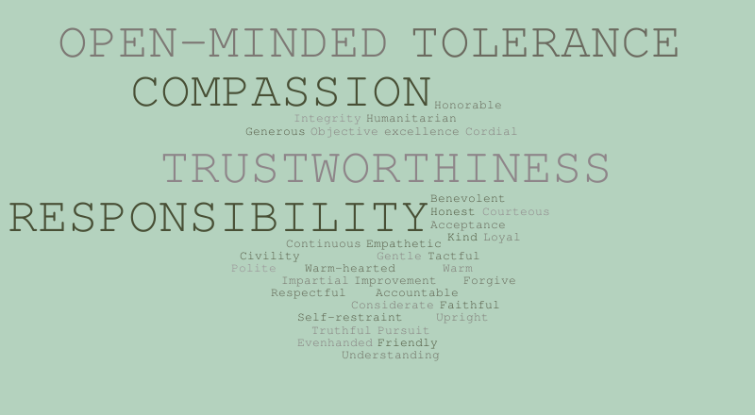

Ethics: Personal
Research Relationships:
May depend upon the guidelines you adopt and the research methodology you adopt:
e.g. BERA or British Psychological Society;
a qualitative or quantitative paradigm
However in all cases the approach has to be un- harmful in anyway, and subject to certain rights
A Considerate and courteous attitude to people will help their readiness to assist you.
You are relying on their good will and co-operation to make the research possible!!!
This Photo by Unknown Author is licensed under CC BY-NC-ND
This Photo by Unknown Author is licensed under CC BY-ND

Slide 32
Ethics: Personal – Think of our Youth Work Values and Principles
Your own perspective will influence the type of research and research ethics you will adopt.
Ask yourself how do I want to be in relation to those I am studying?
Do I want to see them as objects or agents in the research process?
In other words do I want to do research on people or in collaboration with people?

Slide 33
Ethics: Personal / Professional?
Looking after yourself!
What could be the issues / risks to you as a researcher?
How could these be managed?

Slide 34
Ethics at different Stages
Discuss as a group what ethical issues you may need to consider throughout the research process:
Planning
Project proposal
Reading
Collecting primary / empirical data
Data analysis
Writing
Reporting / Dissemination.

Slide 35
Ethics:Key Issue
Research ethics are an integral part of any research project:
You will have to be able to argue that you have taken reasonable, best possible measures to conform to high standards of research ethics, as well as explored the ethical dilemmas experienced:
This will need to be evident in your research ethics approval forms
And also when writing up your thesis.

Slide 36
Reflection on Aims of Session:
Take some time to reflect:
What are the range of issues to consider in relation to ethics?
What are the requirements of you as a student researcher?

Slide 37

This Photo by Unknown Author is licensed under CC BY-SA

Slide 38
References
BERA, (2018). British Educational Research Association Ethical Guidelines (online) Available from https://www.bera.ac.uk/researchers-resources/publications/ethical-guidelines-for-educational-research-2018 (accessed October 2018)
BSA, Ethical Guidelines: https://www.britsoc.co.uk/ethics
Kara, H. (2012) Research and Evaluation for Busy Practitioners. Bristol: Policy Press
Miller, T. (2012 Ethics in qualitative research 2nd ed. London : SAGE

Slide 39
References Cont..
Punch, M. (2005). Politics and Ethics in Qualitative Research and in Denzin, NK & Lincoln, YS. (eds) Handbook of Qualitative Research Thousands Oaks: Sage 88-97
Sercombe, H. (2010.) Youth Work Ethics. London : Sage
Traianou, A. (2012) Ethics in qualitative research : controversies and contexts.S.l. London: Sage
University of Durham (2012). Community Based Participatory Research : A Guide to Ethical principles and practices. Durham: University of Durham
UK Government: Information Commissioners Office 2018. Guide to the General Data Protection Regulation (GDPR). London: Information Commissioners Office
UWTSD Data Management : https://www.uwtsd.ac.uk/library/research-data-management/

