Slide 1
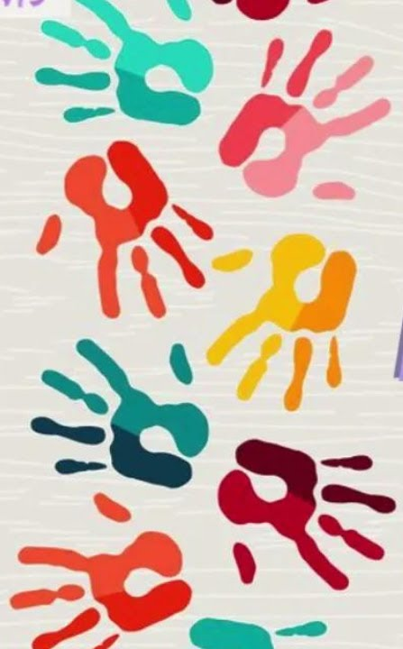
STUDENT: MOHAMMED OUSMAN
ID: 2215608
PRESENTATION: HOLISTIC DEVELOPMENT FOR AMIRA (3 YEAR'S OLD) USING ERIKSON'S PSYCHOSOCIAL THEORY

Slide 2

CONTENT
UNDERSTANDING AND SUPPORTING AMIRA: AN APPLICATION OF ERIKSON'S PSYCHOSOCIAL THEORY
SCENARIO OVERVIEW
ERIKSON'S PSYCHOSOCIAL THEORY
APPLYING THE THEORY TO AMIRA'S SITUATION
PRACTICAL STRATEGIES BASED ON ERIKSON'S THEORY
NATURE AND NURTURE INFLUENCES
CRITICAL EVALUATION OF THE THEORY
CONCLUSION AND SUMMARY
REFERENCE LIST

Slide 3
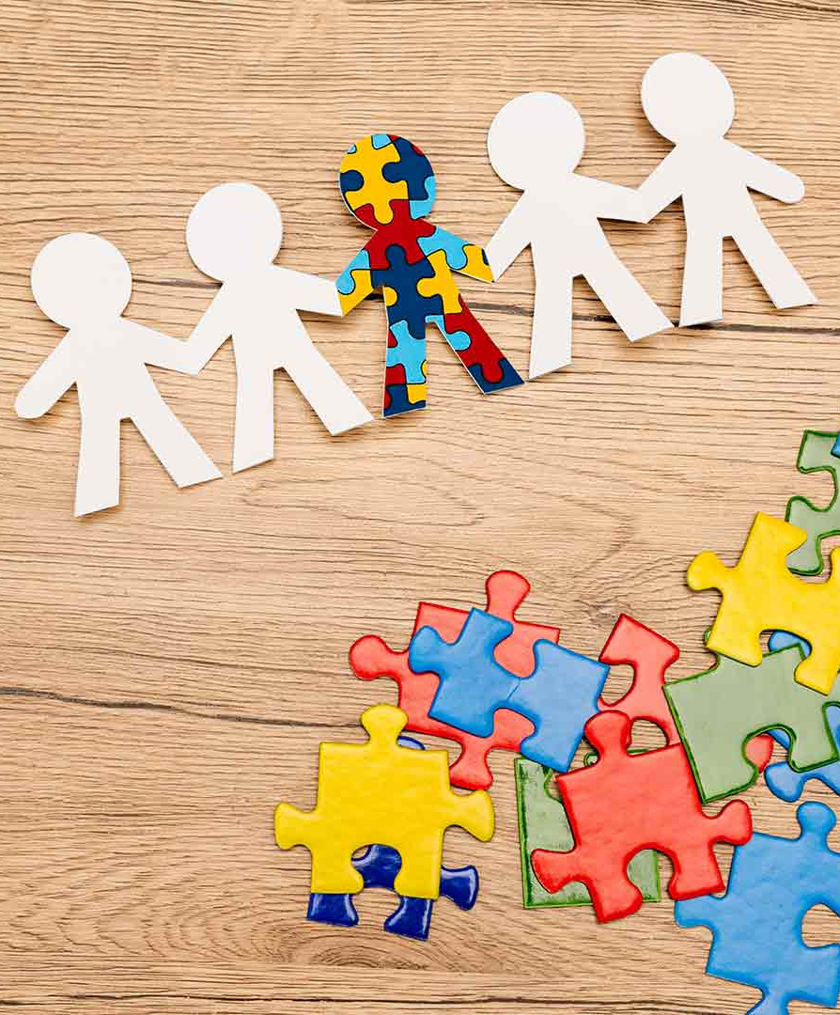
UNDERSTANDING AND SUPPORTING AMIRA: AN APPLICATION OF ERIKSON'S PSYCHOSOCIAL THEORY
A PRACTITIONER'S APPROACH TO FOSTERING EMOTIONAL, SOCIAL AND COGNITIVE WELL-BEING

Slide 4
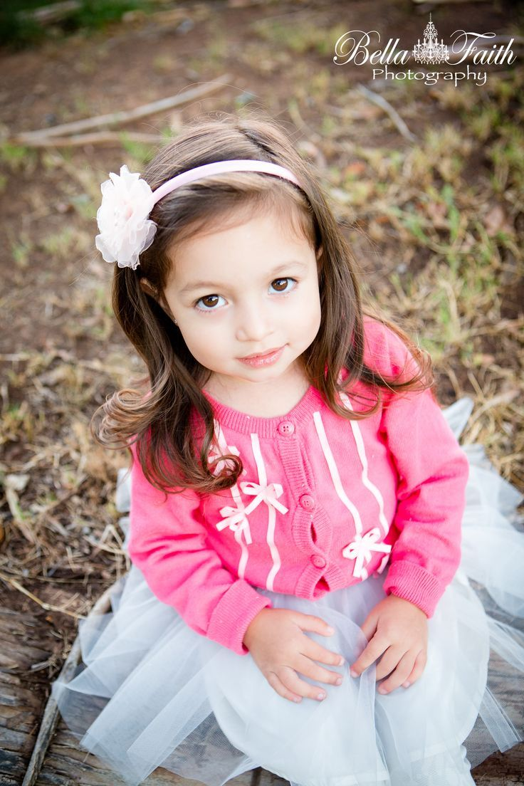
SCENARIO OVERVIEW
Meet Amira: Our Starting Point
· Age: 3 years old.
· Situation: Recently joined the nursery.
· Presented Behaviours:
· Shows signs of anxiety upon separation from her carers.
· Has limited verbal communication.
· Has difficulty engaging in group play.
Our Role: To understand her developmental needs and contribute to a holistic support plan.

Slide 5
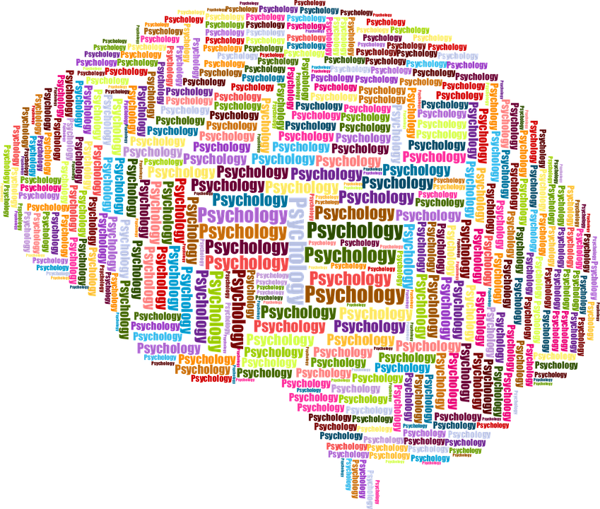
ERIKSON'S PSYCHOSOCIAL THEORY
Erik Erikson's (1950) theory proposes that personality develops in a predetermined order through eight stages of psychosocial development, from infancy to adulthood. Each stage involves a central conflict that serves as a turning point.
Key Concepts for Early Childhood:
· Stage 2: Autonomy vs. Shame & Doubt (Ages 1-3): This is the most relevant stage for Amira. The conflict centres on children developing a greater sense of personal control.
· Positive Resolution (Virtue: Will): If supported, the child gains confidence and a sense of autonomy through making simple choices and gaining self-control.
· Negative Resolution: If criticised or over-controlled, the child experiences feelings of shame and doubt in their own abilities (Erikson, 1950).
Why is this relevant?
Successful navigation of this stage leads to a child who feels secure, capable, and ready to take initiative. Struggles here can directly impact emotional security, social interactions, and the willingness to explore—all key to early years development (McLeod, 2018).

Slide 6
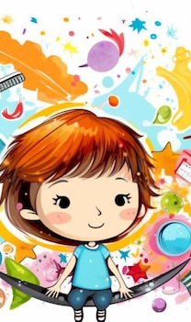
APPLYING ERIKSON'S THEORY TO AMIRA'S SITUATION
Erikson's framework helps us interpret Amira's behaviours not as misbehaviour, but as manifestations of her struggle with the Autonomy vs. Shame and Doubt crisis.
· Separation Anxiety: The nursery transition challenges her nascent autonomy. Leaving her primary carers, her secure base, can trigger a regression, making her doubt her ability to cope alone in a new, unpredictable environment (Shame & Doubt).
· Limited Verbal Communication: Anxiety can inhibit communication. She may feel her words are not effective or that it is not safe to express herself, a sign of doubt in her own capabilities.
· Difficulty with Group Play: Successful group play requires confidence and a sense of self (autonomy). A child struggling with this may feel incompetent, fear rejection, or lack the assertiveness to initiate social contact (Sroufe, Cooper & DeHart, 1996).
Conclusion: Amira's behaviours signal a need to rebuild a sense of safety and autonomous control.

Slide 7

PRACTICAL STRATEGIES BASED ON ERIKSON'S THEORY
To foster Amira's Autonomy and counter Shame & Doubt, we can implement:
1. Empowering Choice-Making:
· Action: Offer limited, simple choices throughout the day. "Would you like the red cup or the blue cup?" "Shall we build with blocks or play with dough?"
· Rationale: This provides a sense of control, reinforcing self-efficacy and "will" (Erikson, 1950).
2. Scaffolding Independence & Mastery:
· Action: Provide achievable tasks (e.g., simple puzzles, posting shapes). Use a "serve-and-return" approach: acknowledge her efforts and offer minimal help to ensure success. Use process praise: "You worked so hard on that!"
· Rationale: Builds competence and directly counters feelings of doubt (National Scientific Council on the Developing Child, 2010).
3. Supporting Social Entry:
· Action: Use a "buddy" system with a calm peer for small-group activities. Model and scaffold social phrases like "Can I play?" or "My turn?"
· Rationale: Reduces the overwhelming pressure of the whole group, allowing her to practice social skills safely.
4. Predictable Routines & Transition Warnings:
· Action: Use visual timetables and consistent, loving goodbye rituals (e.g., a special handshake, a wave at the window).
· Rationale: Predictability helps a child feel in control of their world, mitigating anxiety and fostering a sense of security (Shaffer & Kipp, 2014).

Slide 8
NATURE AND NATURE INFLUENCES
Amira's development is shaped by a complex interplay of biological and environmental factors.
· Nature (Biological Influences):
· Temperament: Amira may have an innate, biologically influenced temperament that is more "slow-to-warm-up" or behaviourally inhibited (Thomas & Chess, 1977). This is her genetic predisposition.
· Neurobiology: High anxiety can be linked to a more reactive amygdala, a brain structure involved in processing fear (National Scientific Council on the Developing Child, 2010).
· Nurture (Environmental Influences):
· Parenting Style: The level of autonomy previously encouraged at home is a key environmental factor.
· Environmental Stressors: The major transition of starting nursery is a significant environmental stressor that has interacted with her temperament to trigger her current anxieties.
· Nursery Environment: Our responses, the physical setup, and peer interactions are all nurturing forces that will shape her outcomes.
Erikson's theory is primarily a nurture-oriented theory, focusing on social and cultural influences, but it operates on the nature-given maturational timetable of the child.

Slide 9

CRITICAL EVALUATION OF THE THEORY
Usefulness in this Context:
· Holistic Framework: It provides a valuable, non-pathologising lens to interpret Amira's behaviours as a normal developmental challenge (McLeod, 2018).
· Practical Guidance: It directly points to interventions focused on fostering independence, choice, and mastery.
· Focus on Social-Emotional Needs: It correctly prioritises emotional well-being as the foundation for other areas of development.
Limitations in this Context:
· Lack of Specificity: The theory doesn't provide specific techniques for non-verbal or highly anxious children. It must be supplemented with other knowledge (e.g., on speech and language development or attachment theory).
· Cultural Bias: The emphasis on "autonomy" and "independence" reflects a Western, individualistic cultural construct. In cultures valuing interdependence, Amira's behaviour might be interpreted differently (Shaffer & Kipp, 2014).
· Over-Simplification: It risks oversimplifying a complex situation. Amira's limited verbal communication may have specific underlying causes (e.g., speech delay, English as an additional language) that require assessment beyond this theoretical lens.

Slide 10

CONCLUSION AND SUMMARY
· Erikson's theory provides a powerful lens to view Amira's challenges as a struggle for Autonomy.
· Our evidence-based support plan should focus on empowering choices, building competence, and creating a predictable, nurturing environment.
· While highly useful for guiding our general approach, we must be aware of its limitations and integrate other professional knowledge and assessments.
· The goal is to help Amira resolve her crisis, developing the "virtue" of Will—the confidence to be an independent, capable, and engaged learner.

Slide 11
REFERENCE LIST
Erikson, E. H. (1950) Childhood and society. New York: Norton.
McLeod, S. A. (2018) Erik Erikson's stages of psychosocial development. Simply Psychology. Available at: https://www.simplypsychology.org/Erik-Erikson.html (Accessed: 20 October 2023).
National Scientific Council on the Developing Child (2010) Persistent fear and anxiety can affect young children’s learning and development. Working Paper No. 9. Available at: https://developingchild.harvard.edu/resources/persistent-fear-and-anxiety-can-affect-young-childrens-learning-and-development/ (Accessed: 20 October 2023).
Shaffer, D. R. and Kipp, K. (2014) Developmental psychology: childhood and adolescence. 9th edn. Belmont, CA: Wadsworth.
Sroufe, L. A., Cooper, R. G. and DeHart, G. B. (1996) Child development: its nature and course. 3rd edn. New York: McGraw-Hill.
Thomas, A. and Chess, S. (1977) Temperament and development. New York: Brunner/Mazel.

