Slide 1
Hello and welcome!!
Individual Academic Poster
Kristisha downer – Thomas
Lecturer: Mumtaz Goolam ​​
​​
Module: Introduction to Physiology ​​
​​
Module code: BMHP5003_BIRM
Notes:
ASK MUMTAZ IF EE GOT EXTENTIONS HOW DOES IT WORK ?
Hello and welcome my name is kristisha downer- Thomas and today I will be presenting a academic presentation poster on the nervous system

Slide 2
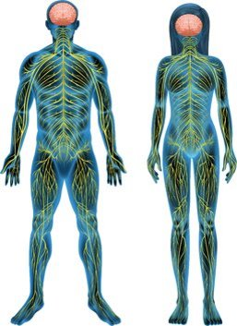
Nervous System
The nervous system is a collection of nerves and cells that transfer and receive information from the brain and spinal cord to other regions of the body. The nervous system detects and responds to changes occurring inside and outside the body. The system is active all the time and controls movement such as blinking and itching your nose. Mandal (2022)
The nervous system together with the endocrine system, coordinates and controls vital aspects of body function and maintains homeostasis which also provide an immediate response. The nervous system consists of the brain, the spinal cord and peripheral nerves. the structure and organisation of the tissues that form these components enables rapid communication between all parts of the body.
(Waugh and Grant, 2014, p. 144)
(The Fame Compass,​
2022) or Deirdre Fay (2022)
https://dfay.com/archives/4670
(Check with libery about what cite it Is for referencing image of nervous system)
Notes:
Mandal, A.DR. (2022) What is the Nervous System? [website] Available at: https://www.news-medical.net/health/What-is-the-Nervous-System.aspx#:~:text=The%20nervous%20system%20is%20a%20complex%20network%20of,the%20Central%20nervous%20system%20and%20Peripheral%20nervous%20system (Accessed: 13th February 2022)
…... (2022) Hacking the nervous system – Polyvagal [image] Available at: https://dfay.com/archives/4670 (Accessed: 14th February 2022)
Waugh, A and Grant, A. (2014) Ross and Wilson Anatomy & Physiology in Health and Illness. 12th edn. (ask mumtaz wer I can find the publication and publisher how do I cite an image from a book? (if I have the same refernce but with different page numbers in do I put both of them in or jus the 1 ?
Start: As human being we all have a nervous system read from slide

Slide 3
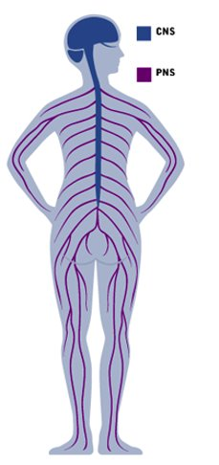
What the nervous system does?
The nervous system controls:
Brain growth and development
Sensations (such as touch or hearing)
Perception (the mental process of interpreting sensory information)
Thought and emotions
Learning and memory
Movement, balance, and coordination
Sleep
Healing and rehabilitation
Stress and the body’s responses to stress
Aging
Breathing and heartbeat
Body temperature
Hunger, thirst, and digestion
Puberty, reproductive health, and fertility
(Society for Neuroscience, 2018)
The brain
CNS -: central nervous system​
​
PNS -: peripheral nervous system
Central nervous system - Wikipedia
spinal cord
Ganglia Anatomy and physiology of the nervous system | Canadian Cancer Society
the nerves
Central nervous system - Wikipedia
Nervous System without Labels - Bing images
This website or
The Adventures of Beaner: The Nervous System and Digestion
To cite for references
Retina labelled retina nervous system diagram - Bing images
sensory neurons nervous system - Students | Britannica Kids | Homework Help
Notes:
Society for Neuroscience (2018) What does the nervous system do? [website] Available at: What does the nervous system do? | NICHD - Eunice Kennedy Shriver National Institute of Child Health and Human Development (nih.gov) (Accessed: 15 February 2022)
Start: What the nervous system does?
The nervous system plays a role in nearly every aspect of our health and well-being. It guides everyday activities such as waking up; automatic activities such as breathing; and complex processes such as thinking, reading, remembering, and feeling emotions. Above I have listed what the nervous system controls, a few from the list are, Brain growth and development, Perception (the mental process of interpreting sensory information), Hunger, thirst, and digestion, feel free to read the rest in your spare time
On the right is another diagram of the nervous system which I have labelled, the central nervous system (CNS) consists of the brain and the spinal cord, and the peripheral nervous system (PNS) consist of all the nerves outside the brain and spinal cord. (Waugh and Grant, 2014, p. 144)
The brain, spinal cord, retina, sensory neurons, ganglia, and nerves are the organs that make up the nervous system. Your nervous system is in charge of how you behave in any event. It creates and transmits electrochemical impulses to all bodily organs via nerves. https://www.bing.com/search?q=what+are+the+organs+to+the+nervous+system+simple+read&qs=n&form=QBRE&msbsrank=1_1__0&sp=-1&pq=what+are+the+organs+to+the+nervous+system+simple+read&sc=1-53&sk=&cvid=83855D675A7C4A628EF1CCC88A2B6207

Slide 4
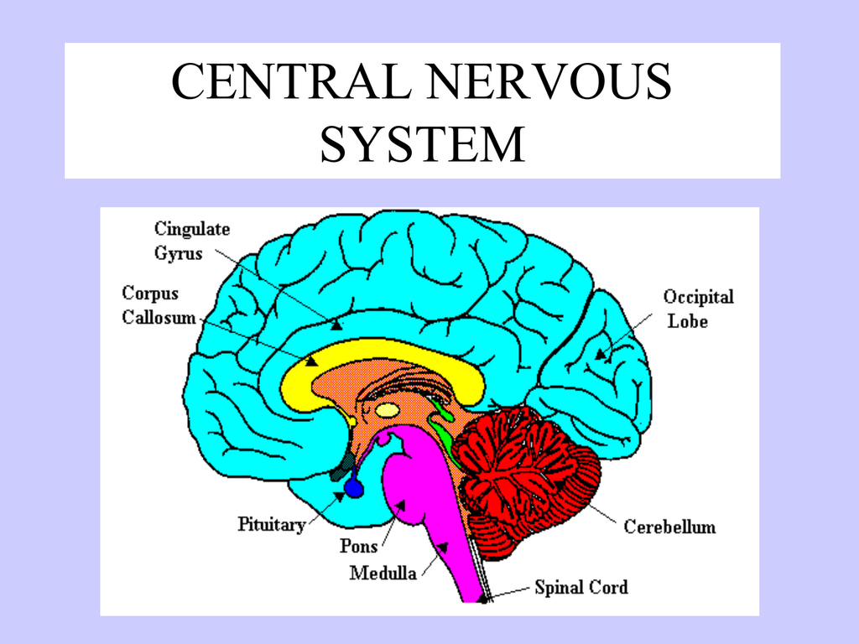
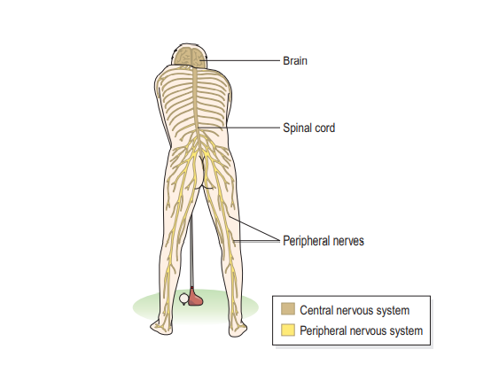
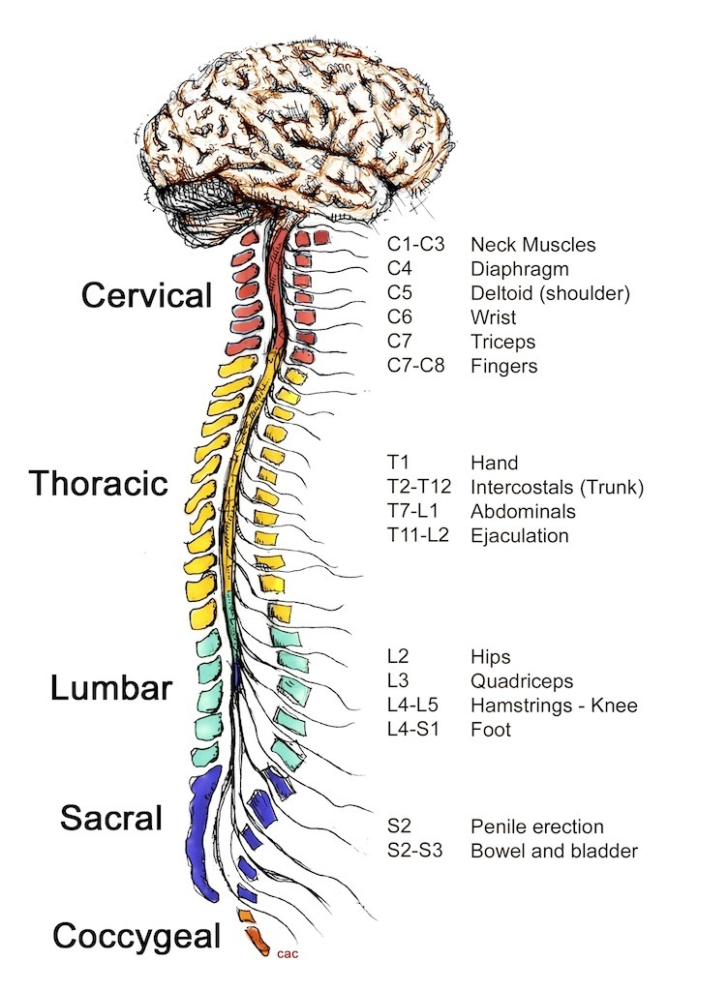
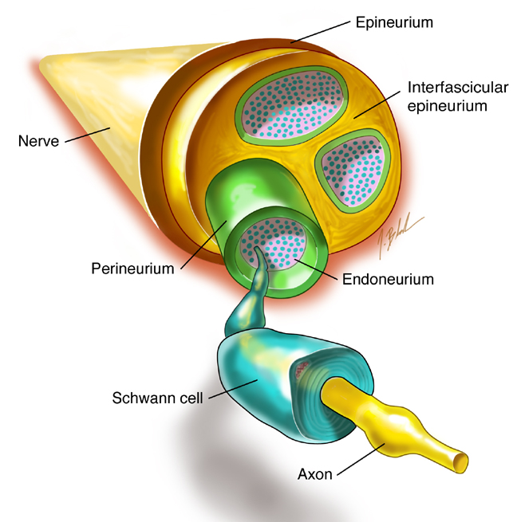
Nervous system main organs
The brain
Spinal cord​
(Waugh and Grant, 2014, p. 10)
Christopher & Dana Reeve Foundation 2022 do I cite as authors or organsisation?
(Studylib, 2022)
The brain is the most complex organ in the human body. It is the controller of all voluntary and involuntary bodily actions and activities, as well as the foundation of awareness. The brain is the most important component of the central nervous system. The brain is so important that it consumes 20% of the total oxygen and calories we eat while only accounting for around 2% of our overall weight. Diener (2022)
During sleep and awake, more than 10 billion interconnected brain cells manage the body's functioning. (Editors of Consumer Guide, 2000)
The central nervous system consist of the spinal cord. The medulla oblongata comprises a lengthy, pipe-like structure. The spinal cord is 40 cm long and 2 cm wide in adults. It connects the brain to the rest of the body. As it transports sensory impulses from all regions of the body to the Central Nervous System via afferent fibers, it is responsible for initial information processing.(BYJU'S, 2022)
peripheral nerves.
Outside of the central nervous system, the peripheral nervous system contains nerves and ganglia. The autonomic system and the somatic nervous system are two divisions of the peripheral nervous system. PNS connects the CNS to the organs, limbs, and skin. The peripheral nervous system permits the brain and spinal cord to send and receive information from various parts of the body, allowing us to respond to stimuli in our surroundings. Cherry (2022)
Armstrong (2012)
Notes:
Waugh, A and Grant, A. (2014) Ross and Wilson Anatomy & Physiology in Health and Illness. 12th edn. (ask mumtaz may need to ask library wer I can find the publication and publisher how do I cite an image from a book? (if I have the same refernce but with different page numbers in do I put both of them in or jus the 1 ? Waugh and grant is the refernce ask library about other reference
Studylib (2022) central nervous system with brain parts and functions [image] Available at: https://studylib.net/doc/10254859/central-nervous-system-with-brain-parts-and-functions (Accessed: 14th February 2022)
Editors of Consumer Guide (2000) The Brain and Nervous System [website] Available at: https://health.howstuffworks.com/human-body/systems/nervous-system/brain-nervous-system-ga.htm (Accessed: 14th February 2022)
Christopher & Dana Reeve Foundation (2022) How the spinal cord works [image] Available at: https://www.christopherreeve.org/living-with-paralysis/health/how-the-spinal-cord-works (Accessed: 14th February 2022) (do I cite as authors or organisation?)
BYJU'S (2022) Spinal Cord [website] Available at: https://byjus.com/biology/spinal-cord/ (Accessed: 14th February 2022)
Armstrong, J. (2012) What is a Nerve Glide? [image] Available at: http://www.kettlebellclub.com/article-What-is-a-Nerve-Glide.htm (Accessed: 14th February 2022)
Kendra Cherry, K. (2022) How the Peripheral Nervous System Works [website] Available at: https://www.verywellmind.com/what-is-the-peripheral-nervous-system-2795465 (Accessed: 14th February 2022)
In the middle we have a diagram of the nervous system and its main organs
The 3 main organs of the nervous system are the brain, spinal cord and the peripheral nerves.

Slide 5
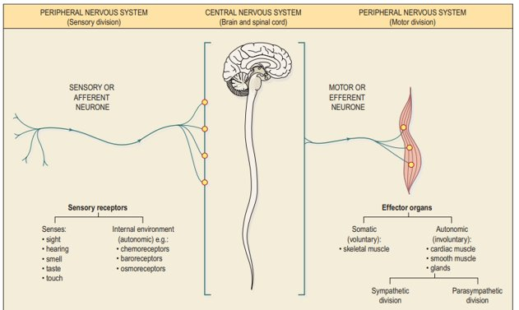
functions of the nervous system are
There are two types of nervous tissue, neurones and neuroglia. Neurones (nerve cells) are the working units of the nervous system that generate and transmit nerve impulses. Neurones are supported by connective tissue, collectively known as neuroglia, which is formed from different types of glial cells. There are vast numbers of both cell types, 1 trillion (1012) glial cells and 10 times fewer (1011) neurones (Waugh and Grant, 2014, p. 145)
controlling, regulating, and communicating
Controlling the interior environment of the body in order to maintain 'homeostasis' The regulation of body temperature is an example of this
Reflexes in the spinal cord are programmed. The stretch reflex is an example of this
Memory and learning
Controlling movement voluntarily.
(QNADMIN, 2021)
Functional components of the nervous system diagram
(Waugh and Grant, 2014, p. 145)
Notes:
QNADMIN (2015) What is the function of the nervous system? [website] Available at: https://questionanswer.io/what-is-the-function-of-the-nervous-system/#what-are-the-main-functions-of-the-nervous-system (Accessed: 14 February 2022)
Waugh, A and Grant, A. (2014) Ross and Wilson Anatomy & Physiology in Health and Illness. 12th edn. (this cite needs finishing off)

Slide 6
Nervous system diseases
Disease that relates to the nervous system that links
Epilepsy
What is epilepsy
Epilepsy is a chronic noncommunicable brain disorder that affects people of all ages. It is distinguished by recurring seizures, which are brief periods of uncontrollable movement involving a portion of the body or the full body and are occasionally accompanied by loss of awareness and control of bowel or bladder function https://www.who.int/news-room/fact-sheets/detail/epilepsy
Symptoms Signs and symptoms of epliepsy
Convulsive seizures which are characterised by involuntary muscular contractions.Epilepsy - Wikipedia
Causes
Epilepsy can have both genetic and acquired causes, with the interaction of these factors in many cases.^{[47]} Established acquired causes include serious brain trauma, stroke, tumours, and brain problems resulting from a previous infection.^{[47]} In about 60% of cases, the cause is unknown.^{[25][30]} Epilepsies caused by genetic, congenital, or developmental conditions are more common among younger people, while brain tumors and strokes are more likely in older people.^{[25]}
Seizures may also occur as a consequence of other health problems;^{[29]} if they occur right around a specific cause, such as a stroke, head injury, toxic ingestion, or metabolic problem, they are known as acute symptomatic seizures and are in the broader classification of seizure-related disorders rather than epilepsy itself.^{[48][49] Epilepsy - Wikipedia}
Alzheimer's disease
Bell’s palsy
Cerebral palsy
Epilepsy
Motor neurone disease (MND)
Multiple sclerosis (MS)
Neurofibromatosis
Parkinson's disease
Sciatica
Shingles
(Health direct, 2019)
Notes:
Make smaller put slide 11 int
Health direct (2019) Nervous system diseases. [website] Available at: Nervous system diseases | healthdirect (Accessed: 18th February 2022) 10
There are multiple nervous system diseases these range from read slide
Epilepsy affects around 50 million individuals worldwide, making it one of the most common neurological diseases on the planet. in low- and middle-income countries 80% of epilepsy patients live, Three-quarters of patients with epilepsy do not receive the necessary care and treatment. .Epilepsy (who.int)

Slide 7
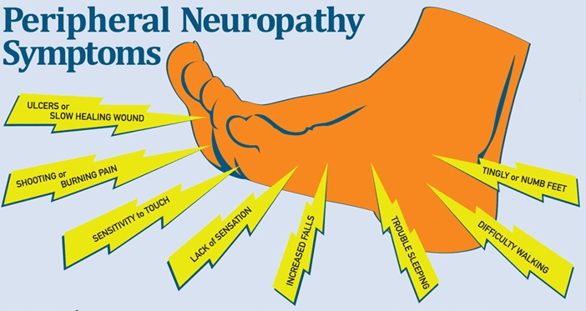
peripheral nerves disease
Peripheral neuropathy
When nerves in the body's extremities, such as the hands, feet, and arms, are injured, peripheral neuropathy develops. Peripheral neuropathy affects nearly one in ten adults aged 55 and up in the United Kingdom. Numbness and tingling in the feet or hands, as well as blistering, stabbing, or shooting pain in the affected areas, loss of balance and coordination, and muscle weakness, particularly in the feet, are all signs of peripheral neuropathy. People with diabetes are at the highest risk of developing peripheral neuropathy. Peripheral neuropathy is caused by a variety of factors. Diabetes-related elevated blood sugar levels can cause nerve damage over time. Diabetic polyneuropathy is the name for this form of nerve injury.
(NHS, 2019)
Peripheral neuropathy - NHS (www.nhs.uk)
FSM relieves peripheral neuropathy (frequencymicrocurrent.com)
Notes:
Take out or describe whats happening to the body or nervous system when this disease attacks

Slide 8
Epilepsy
What is epilepsy? | Epilepsy Action
Notes:
Describe eplipsey agasnist the brain mean
Sign and sympotoms of eplisey if cant all fit put into reommendations

Slide 9
Recommendations for care of the nervous system
epilepsy medicines.
brain surgery
surgery called vagus nerve stimulation
special diet called the ketogenic diet
detailed description of the seizures.
tests to help give them more information about the possible type and cause of the epilepsy.
tests can include blood tests,
an EEG (recording of the brainwaves) and
a brain scan. What is epilepsy? | Epilepsy Action
surgery to remove a small part of the brain that's causing the seizures
a procedure to put a small electrical device inside the body that can help control seizures
Epilepsy - NHS (www.nhs.uk)
Notes:
Sign and sympotoms of eplisey

Slide 10
References
Diener, B.R. (2022) The Brain and Nervous System [website] Available at: https://nobaproject.com/modules/the-brain-and-nervous-system (Accessed: 14th February 2022)
Notes:
under each source, students must describe how the information source informed them and developed their understanding of the chosen body system and associated physiology.
Powerpoint slides should be utilised to create your Poster for the those students enrolled into the virtual classroom. An A2 Poster should be utilised for the classroom Poster presentations.
A minimum of 8 reliable and credible sources should be listed.

