Slide 1

Human capital management Group PPT
Module Code: LCMB7023
Title slide
Human Capital Management
Lecturer’s Name: Dr Gladius Kulothungan
Student Name
Dhruv Trivedi - 2504920
Jigarkumar Prajapati - 2430810
Krishkumar Bhalala - 2505003
Dhrumilkumar Patel - 2510610

Slide 2




Human Capital Management
Human Capital Management Group PPT
Human Capital Management
Dhruv (performance and management)
Jigar ( requirements and selection)
Krish ( training and development)
Dhrumil ( reward and remuneration)

Slide 3




Dhruv (performance and management)

Slide 4
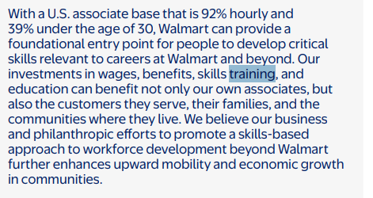

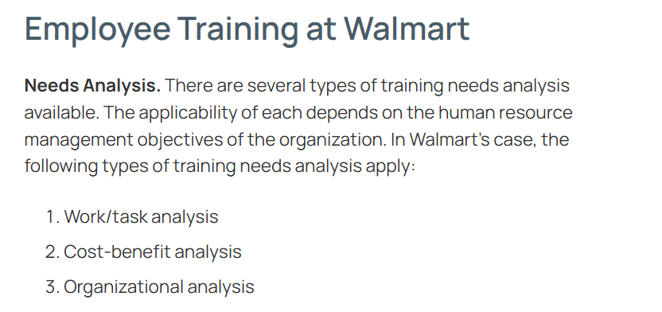


Current HR policies and practices of Walmart pertaining to performance and management
The performance management, if real-time data is considered, centres on three dimensions: customer-service orientation, results/decision-making, and analysis/problem-solving (Thompson, 2025)
The company contemplates combining formal quarterly or annual reviews with ongoing informal feedback from supervisors, peers, and customers to assess associates
High performers in the form of associates and managers are often rewarded financially or through promotions, whereas regular hourly employees may see limited incentives
Notes:
It has to be witnessed that the company considers integrating regular training and the usual on-the-job coaching to enhance performance and the usual consistency. Hence, it is in tandem of the 2025 annual report, as it reiterates the commitment to fair pay and a performance-based culture for associates

Slide 5
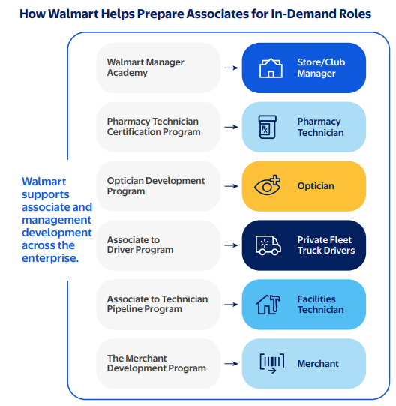


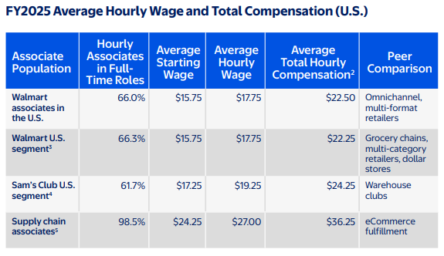

Role of line managers in implementation
The liner managers in Walmart, when it comes to performance and management set and clearly communicate goals and performance expectations aligned with store needs, including customer-service orientation, sales targets, productivity, and quality standards (Thompson, 2025)
They further consider monitoring daily operations, giving regular feedback and coaching, and conducting formal performance reviews or appraisals (Walmart, Inc. FY2025)
They further consider identifying performance issues early (e.g. tardiness, poor customer service) and take corrective or support actions
Notes:
Line managers here often facilitate employee development , which would be through on-the-job training, mentoring, and guiding career-path decisions under HR strategy. Line managers here often act as a major bridge between corporate HR/strategy and frontline workforce, thereby adapting standardized HR policies to the store context and aligning individual performance with business objectives

Slide 6
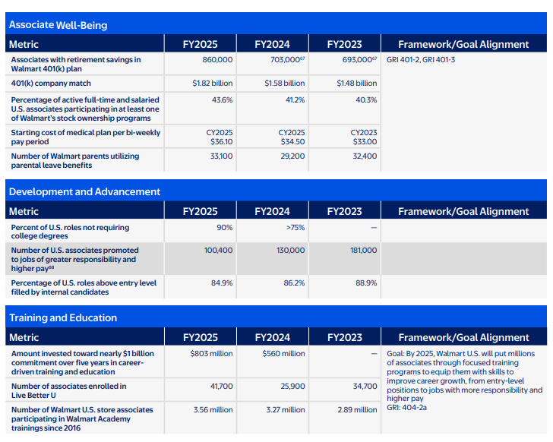
Strategic alignment of HR practices with company goals
In terms of performance management, the hr. practices are are tightly aligned with its “people-led, tech-powered omnichannel” business strategy Walmart Inc. (2025)
Walmart’s workforce strategy often stresses on the usual growth as well as wellbeing, with belonging, and mobility
As of 2025, the company reports further would associates benefit from on-the-job training, cross‑training, upward mobility, flexible scheduling, and competitive compensation As of 2025, the company reports further would associates benefit from on-the-job training, cross‑training, upward mobility, flexible scheduling, and competitive compensation
Robinson (2025) had identified that via programs like Walmart Academy and Live Better U, Walmart invests heavily in upskilling
Notes:
Their workforce strategy emphasizes growth, well‑being, and reports published in 2025, had been supporting both operational efficiency and long-term retention. Moreover, HR goal‑setting and performance evaluation are tied into broader business KPIs. This is dembedding individual performance within company-wide growth and customer‑service objectives

Slide 7
Key HR challenges faced by the company
As of now, the company walmart has been undergoing large-scale workforce restructuring in 2025, including layoffs of roughly 1,500 corporate technology and advertising staff (times of india, 2025)
There had been instances of hundreds of store‑support and training roles such as market‑coordinator and academy coach positions
Hence, such a disruptive transition here in a way creates HR challenges in managing employee uncertainty, retention risk, and internal mobility
Notes:
One here needs to comprehend that rapid adoption of AI and automation further strains HR, as the world calls for a domain where employees must be upskilled quickly, but many roles are being redefined or removed

Slide 8
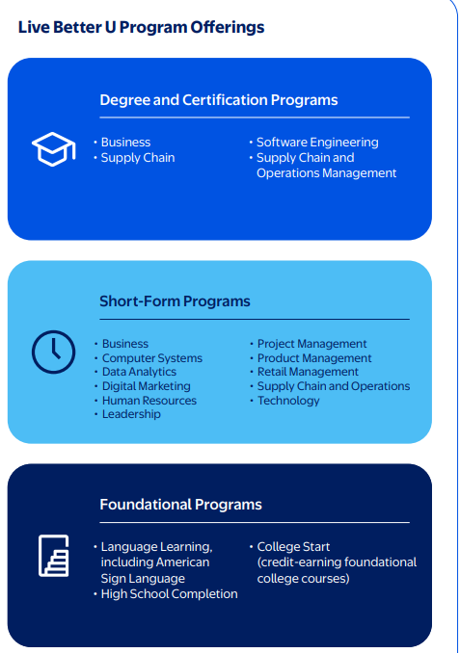
Recommendations
HR Challenge | Recommendation | Expected Outcome
High turnover in frontline roles | Introduce flexible scheduling, wellness programs, and career-path clarity | Improved retention, higher engagement, reduced recruitment costs
Skill gaps for tech and managerial roles | Expand targeted upskilling, internal mobility programs, and mentorship | Faster skill development, reduced external hiring dependency
Employee uncertainty during restructuring | Transparent communication, townhalls, and regular updates | Higher trust, lower anxiety, smoother transitions
Pay and equity pressures | Conduct regular pay benchmarking, equity audits, and merit-based raises | Fair compensation, stronger employer brand
Adoption of AI/automation | Deploy AI with reskilling programs rather than displacement | Maintains morale, future-ready workforce
Performance consistency | Train line managers in feedback, coaching, and standardized evaluations | Higher operational efficiency and goal alignment

Slide 9
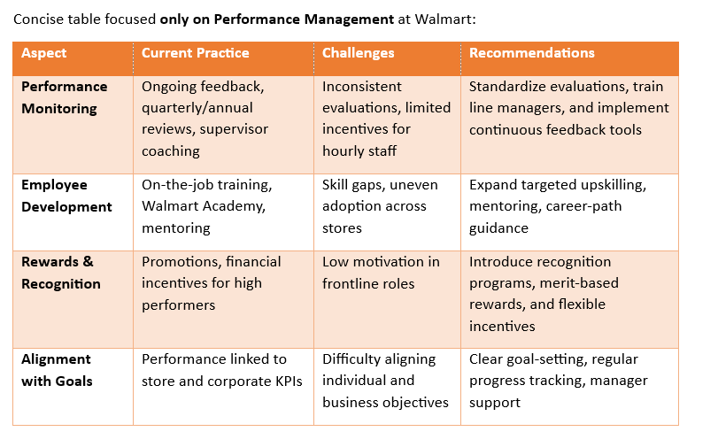
Summary

Slide 10
References
Thompson, A. (2025) Walmart’s HRM: Training, Performance Management. Panmore Institute. Available at: https://panmore.com/walmart-human-resource-management-training-performance-management (Accessed: 26 November 2025)
Walmart, Inc. (2025) FY2025 ESG Report. Fayetteville, AR: Walmart. Accessed 26 November 2025. https://corporate.walmart.com/content/dam/corporate/documents/esgreport/2025/FY2025-Walmart-ESG-Report.pdf
Walmart Inc. (2025) About Walmart. Available at: https://corporate.walmart.com/about (Accessed: 26 November 2025)
Robinson, C. (2025) Why Walmart Invested $1 Billion in Internal Upskilling With Its Academy. Forbes. 29 July. Available at: https://www.forbes.com/sites/cherylrobinson/2025/07/29/why-walmart-invested-1-billion-on-internal-upskilling-with-its-academy/ (Accessed: 26 November 2025)
Times of India, 2025. Walmart layoffs 2025: Technology team faces major jobs cuts amid restructuring. Times of India, 23 May. Available at: https://timesofindia.indiatimes.com/technology/tech-news/walmart-layoffs-2025-technology-team-faces-major-jobs-cuts-amid-restructuring/articleshow/121361312.cms (Accessed: 26 November 2025).

Slide 11

Topic: Requirement and selection (Jigar)

Slide 12
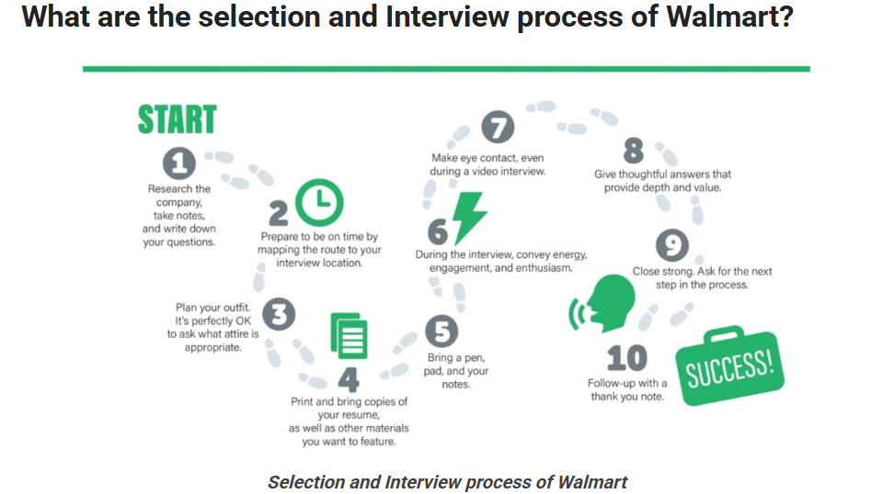
Current HR policies and practices of Walmart pertaining to requirement and selection
In 2025, Walmart’s 2025 selection and recruitment stresses on a combined broad as well as role-specific requirements, for instance, education/skills for tech and availability and customer skills for store roles (JobsPikr, 2025)
Walmart’s Initiative to Reskill 50,000 Cashiers to Meet the Demands of the Future (.JobsPikr, 2025)
SappHire Check (2025) had identified that Walmart Careers considers training new hires, and initially they are compelled to undergo identity/eligibility verification plus state-compliant background checks and, for some roles, drug screening
Employment is conditional on passing these checks, as Walmart’s FY2025 reporting sheds light on hiring targets and outcomes, and a differentiating factor would be the recent example of hiring 29,400 U.S. veterans in FY2025 Consumer Justice Law Firm (2025)
Notes:
: It could be noted that despite having these intents, the company had publicly considered scaling back some 29,400 U.S. veterans hired in FY2025, which are to be discussed in the later slides
Walmart’s selection criteria depend on the job position. Basic criteria include education and training background and results of criminal background checks. For hourly sales positions, the retail company uses knowledge retention (e.g., on product details) and interpersonal skills. Interpersonal skills are essential for these positions because sales personnel communicate directly with customers.

Slide 13
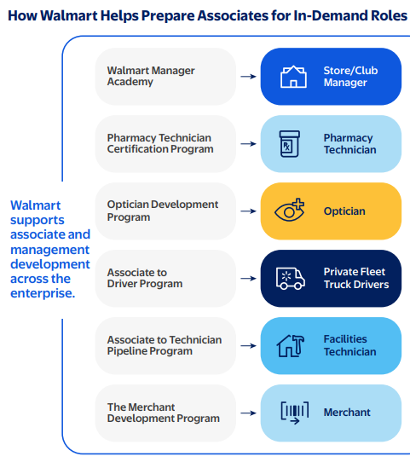



Role of line managers in implementation
The role of line manager in Walmart is well defined, and aids in enhancing as well as implementing recruitment and internal-promotion decisions (HR Executive of the Year, 2025.)
They further consider supporting onboarding and training of employees (often via the company’s internal learning systems), and monitor performance to meet company and store-level targets
Courtesy to this, Walmart’s “people-led, tech-powered” approach under the 2025 leadership HR head, line managers had contemplated to facilitate upskilling and current development of talented websites, through company’s internal HR support system

Slide 14
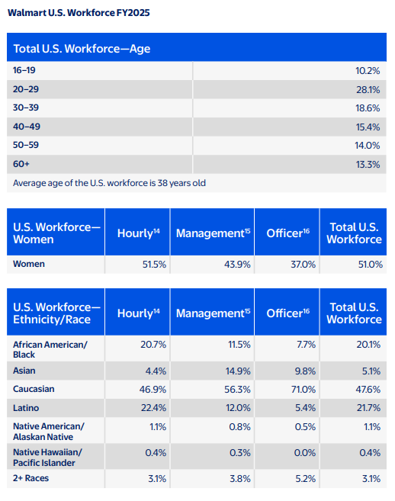
Strategic alignment of HR practices with company goals
Business Goal | HR Practice (Strategically Aligned) | Real-time Data Used | Impact / What It Enables
Increase productivity and adapt quickly | Strategic workforce planning & agile staffing at Walmart | Real-time performance metrics, attendance, and skills utilization data Walmart, Inc. (2025) | Matches people capacity to business demand, reduces over- or under-staffing
Improve retention & reduce turnover costs | Engagement monitoring and timely interventions at Walmart | Pulse-survey responses, turnover risk signals, and absenteeism patterns Walmart, Inc. (2025) | Identifies at-risk employees, allows preemptive retention actions
Build a future-ready workforce for growth/innovation | Learning & development, succession planning at Walmart | Skills-gap data, training uptake, performance-to-skills mappings in real time Walmart, Inc. (2025) | Enables timely training and internal mobility aligned with business growth strategy
Align HR outcomes with business KPIs and strategy | Performance management, talent analytics, and real-time reporting | Real-time dashboards combining HR and business outcome metrics Walmart, Inc. (2025) | Demonstrates HR’s direct contribution to organizational goals, enabling agile strategic decisions
Notes:
These strategies meet the company goals using real time data, as these are the real world examples considered.

Slide 15



Key HR challenges faced by the company
01
02
03
04
The company faces issues, as 1,500 corporate and tech jobs in 2025 were cut, creating uncertainty among employees (Times of India, 2025)
There is a persistent pressure to shift to “skills-first” hiring and upskilling the existing workforce to fill critical roles
There are major Retention difficulties at lower-skilled frontline roles, partly due to job stress
Moreover, high workload and the need for improved working conditions
Notes:
Speaker Notes: It has become a broader challenge for Walmart and due to HR’s adoption of technologies (AI, automation), confronting the issue of alienating or displacing staff has become critical

Slide 16
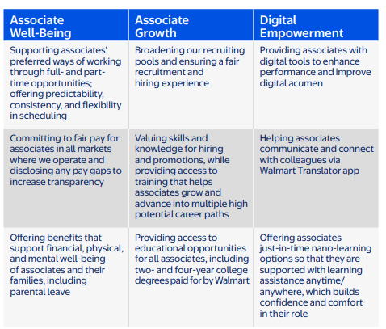



Practical recommendations to address these challenges
In order to address these challenges, Walmart must consider strengthening the usual retention through improved scheduling flexibility, mental-health support, and career-path visibility
Strengthening to enhance communication during restructuring to protect trust is essential
May consider expanding targeted upskilling for tech roles and frontline mobility
Notes:
To confront the challenges, Walmart must consider implementing continuous feedback tools for line managers. Apply transparent pay benchmarking and equity audits. Deploy AI ethically with reskilling, not displacement, as the priority.

Slide 17
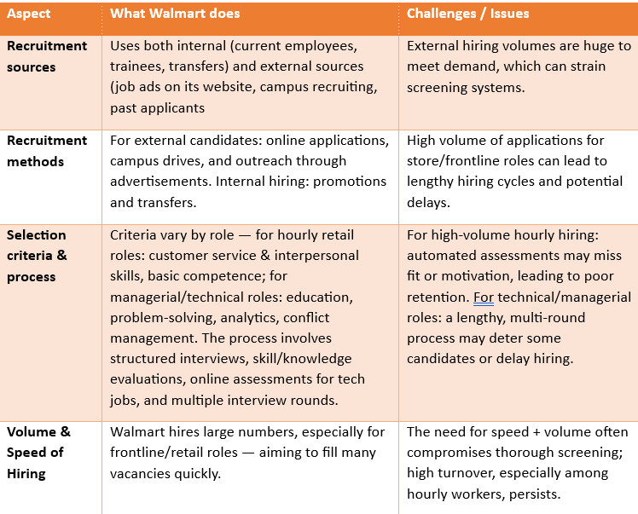
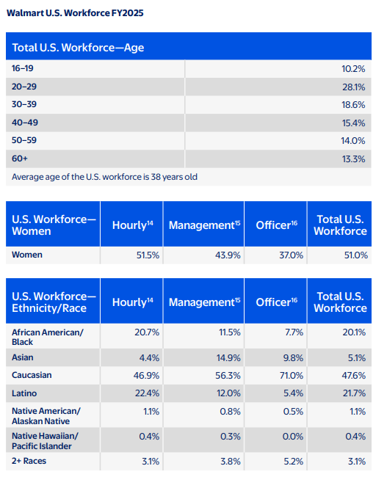
Summary

Slide 18
References
JobsPikr Blog 2025, Walmart Upskills 50,000 Employees for AI & Automation Roles, 2025. . Available at: https://www.jobspikr.com/blog/walmart-reskilling-workforce-2025/ (Accessed: 26 November 2025). jobspikr.com
Consumer Justice Law Firm, 2025. Walmart Background Check Disqualifications: Real vs. Fake. Available at: https://consumerjustice.com/blog/walmart-background-check-fix-errors/ (Accessed: 26 November 2025). consumerjustice.com
HR Executive of the Year 2025. Behind the ‘people-led, tech-powered’ Walmart: Meet our 2025 HR Executive of the Year. HR Executive, 9 September 2025. Available at: https://hrexecutive.com/behind-the-people-led-tech-powered-walmart-meet-our-2025-hr-executive-of-the-year/ (Accessed: 26 November 2025).
Walmart, Inc. (2025) FY2025 ESG Report. Fayetteville, AR: Walmart. Accessed 26 November 2025. https://corporate.walmart.com/content/dam/corporate/documents/esgreport/2025/FY2025-Walmart-ESG-Report.pdf
Times of India, 2025. Walmart layoffs 2025: Technology team faces major jobs cuts amid restructuring. Available at: https://timesofindia.indiatimes.com/technology/tech-news/walmart-layoffs-2025-technology-team-faces-major-jobs-cuts-amid-restructuring/articleshow/121361312.cms (Accessed: 26 November 2025).

Slide 19
Training and development (Krish)

Slide 20

Walmart’s Current HR policies and practices of the selected organisation in terms of training and development
The pursuit of training and development of Walmart is consistent, and Walmart invests heavily in training via Walmart Academy and Live Better U (LBU) Walmart Inc. (2022)
Through its Walmart Academy, revered as the largest private‑sector training system, associates receive on-the-job, digital, and in-person training to build role-specific, leadership, and future‑ready skills Walmart Inc. (2022)
Hence, it is implied that LBU provides free certificates, degrees, and short-form courses for associates, thereby, aiming to upskill or move to in-demand roles like supply chain, tech, or management Walmart Inc. (2025)
Notes:
It has been identified that Walmart has considered expanding training to incorporate AI skill-building through a partnership with OpenAI, thereby preparing employees for digital‑era retail.

Slide 21

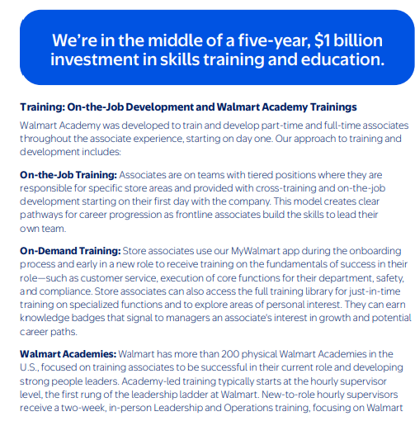
Role of line managers in implementation in terms of training and development
In Walmart, Line managers aid in implementing training and development by coordinating with the internal training arm (Walmart Academy) Walmart, Inc. (2025) Home Office Academy
This is done to schedule on-the-job, virtual, and in‑person learning for associates
Line managers further identify skill‑gaps and enrol associates, which could be including hourly staff, into training or cross-training opportunities to support upward mobility and career progression (Howland, 2017)
They further consider monitoring training effectiveness locally by reviewing performance improvements and adherence to new skills
Notes:
Walmart even it considers restructuring some training‑support roles in 2025, the usual line managers remain central to delivering training at the store level.

Slide 22
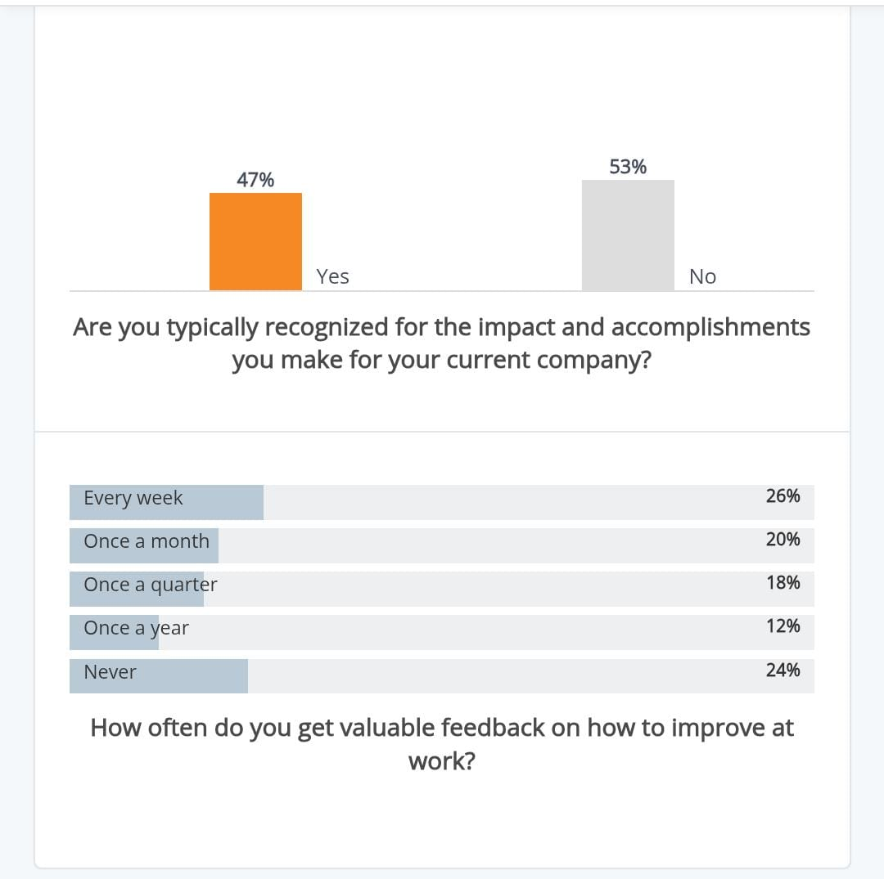


Strategic alignment of HR practices with company goals in terms of training and development
As of now, it has been identified that Walmart aligns training and development with its broader business goals of operational efficiency, digital transformation, and talent retention Walmart, Inc. (2025)
There are programs like Walmart Academy and Live Better U that are designed to upskill employees in areas critical to company strategy, including supply chain, technology, and leadership Walmart Inc. (2025) Live Better U
One here needs to comprehend that such training outcomes are linked to performance metrics and store level and usual KPis
Notes:
Hence, such ensures the growth of an individual’s skills, and it essentially drives the result of the organization. One here could witness that line managers are often considered to control as well as monitor progress, while incentives and career pathways reinforce alignment

Slide 23

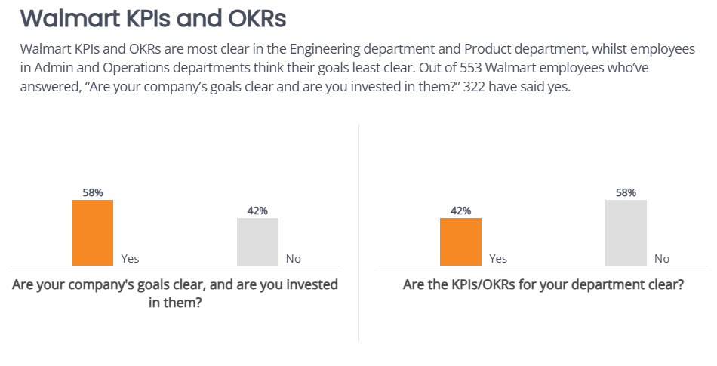

. Key HR challenges faced by the company in terms of training and development
Meanwhile, there is a surge in demand for technical and automation-related skills, exposing a growing skills gap, especially in areas like cybersecurity and IT operations.
From these findings, it is implied that inconsistent implementation of training programs and uneven access, particularly at low-volume or small stores.
Hence, it undermine many associates’ learning opportunities
Notes:
Speaker notes: Hence, it has to be comprehended that the rapidly changing business needs and evolving “skills-first” roles make it hard to keep training curricula up‑to‑date, reducing the relevance of some learning

Slide 24
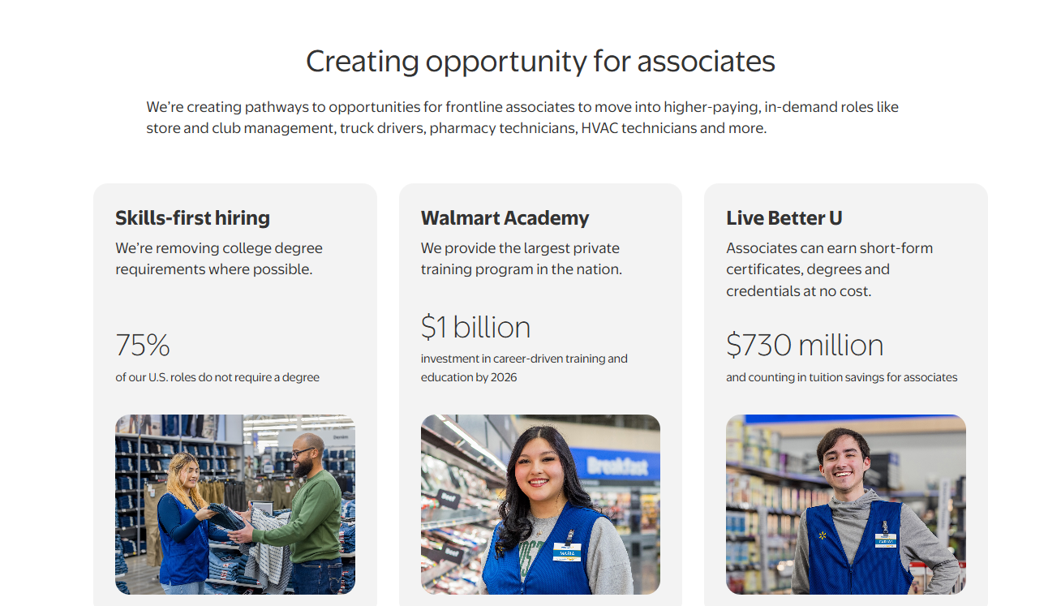
Your practical recommendations to address these challenges in terms of training and development
Hence, it is recommended that Walmart must consider expanding its microlearning and digiral platforms to ensure consistent access across all stores.
Increase line manager involvement in monitoring training uptake
It must consider regularly updating the curricula to match evolving business and tech needs. Reinforce learning with mentoring, hands-on practice, and clear career-path integration
Notes:
Hence, it is recommended for Walmart to include strategies that would track outcomes to measure effectiveness and ROI.

Slide 25
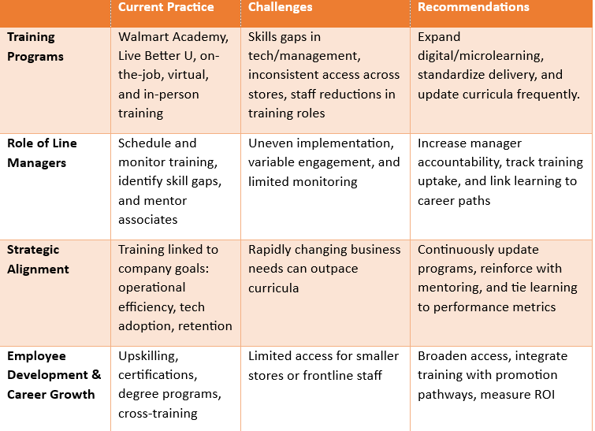
Summary

Slide 26


References
Walmart Inc. (2022) Walmart Launches One Global Walmart Academy To Help 2.3 Million Associates Build and Grow Their Careers. Available at: https://corporate.walmart.com/news/2022/06/02/walmart-launches-one-global-walmart-academy-to-help-2-3-million-associates-build-and-grow-their-careers (Accessed: 26 November 2025).
Walmart Inc. (2025) Live Better U — Working at Walmart. Available at: https://corporate.walmart.com/about/working-at-walmart/live-better-u (Accessed: 26 November 2025).
Walmart, Inc. (2025) Home Office Academy — Learning & Development. Available at: https://public.walmart.com/content/wal-paper/en_in/lod/learning/home-office-academy.html (Accessed: 26 November 2025).
Howland, D. (2017) ‘Walmart celebrates ‘Academy’ graduates in revamped training effort’, Retail Dive, 29 June. Available at: https://www.retaildive.com/news/walmart-celebrates-academy-graduates-in-revamped-training-effort/446164/ (Accessed: 26 November 2025)
Walmart, Inc. (2025) FY2025 ESG Report. Fayetteville, AR: Walmart. Accessed 26 November 2025. https://corporate.walmart.com/content/dam/corporate/documents/esgreport/2025/FY2025-Walmart-ESG-Report.pdf

Slide 27

Reward and Remuneration (Dhrumil)

Slide 28
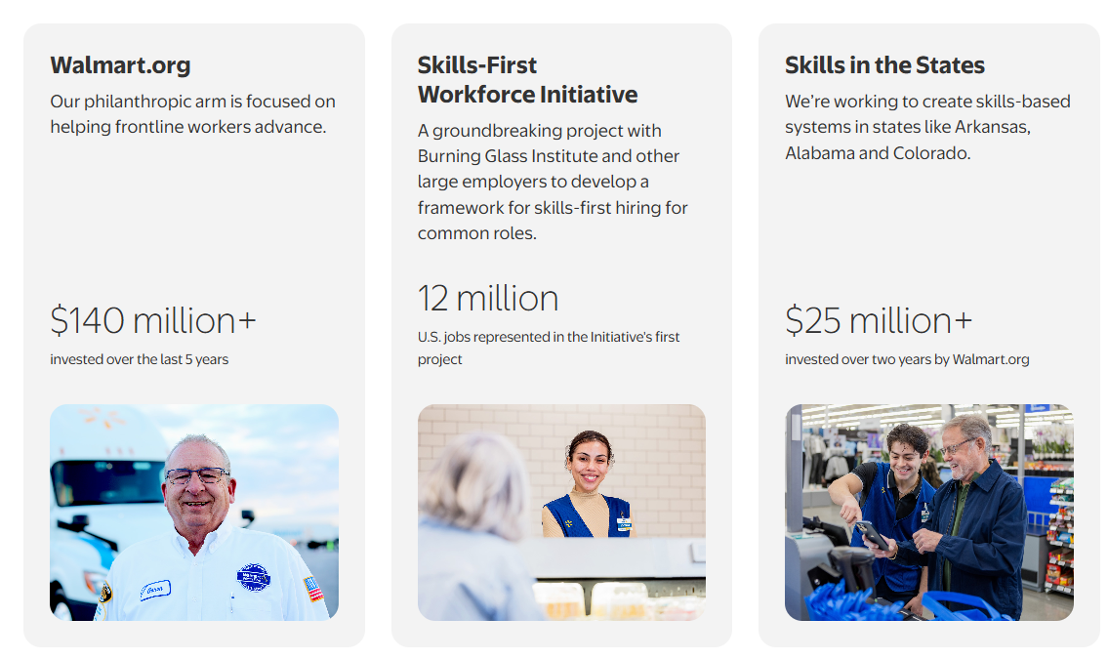
Current HR policies and practices of the selected organisation in the aspect of Walmart reward and remuneration
It has been identified that Walmart significantly boosted compensation in 2025
An instance of such would be the usual market managers, now have total compensation, base pay, stock grants, and bonuses, up to USD 620,000 annually, with base salary rising from $130,000 to $160,000 and stock grants from $75,000 to $100,000 (Yahoo Finance (2025)
Moreover, it has been documented that store‑managers also received raises: average salary increased to ~$128,000 in 2024, plus enhanced bonus potential tied to store performance Yahoo Finance (2025)
Notes:
: It is further witnessed that for hourly associates, Walmart has considered launching a new bonus program aiming to reward longevity and performance

Slide 29
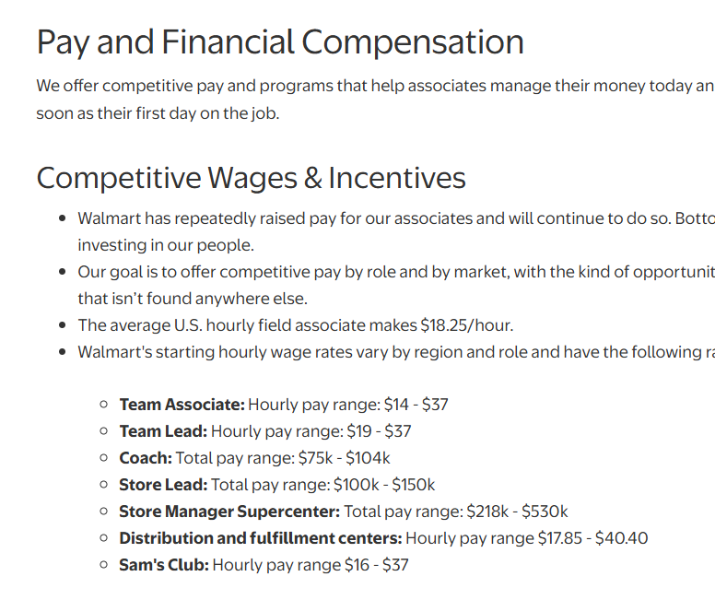
Role of line managers in implementation in aspect of reward and remuneration
e‑reward.co.uk (2025) Rhad stated that line managers in Walmart play a critical role in executing pay and bonus policies
Line managers are often required to assess store performance and individual team productivity, which forms the the basis for bonuses and performance-linked raises for store associates
Line managers are further required to monitor and nominate eligible employees for long-term benefits such as stock grants or promotion-linked pay rises Walmart, Inc. (2025) FY2025 ESG Report.
Notes:
Hence, line managers are obliged to communicate new pay‑policy changes to teams and ensure the timely disbursement of bonuses and raises. One here needs to comprehend that their evaluation and feedback thus directly influence who receives enhanced compensation, tying frontline performance to tangible rewards and reinforcing motivation and retention across stores

Slide 30



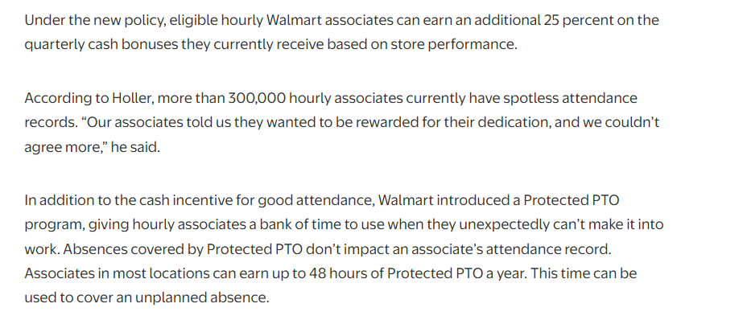

Strategic alignment of HR practices with company goals
It has been witnessed by Mehrotra (2024) that Walmart aligns its reward and compensation structure with overall business objectives by tying pay to performance, profitability, and long‑term retention
In the year 2025, the company has considered raising base pay bonuses and the stock grants for store and market managers.
This has enabled total compensation up to $620,000, which in a way has encouraged ownership mentality and operational excellence (Yahoo Finance (2025)
Notes:
: It is seen that for hourly associates, Walmart offers performance-based bonuses and long-term benefits like 401(k) matching and stock‑purchase plans. Hence, these are directed for results like improved store performance, lower turnover, increased employee loyalty, and sustainable growth.

Slide 31
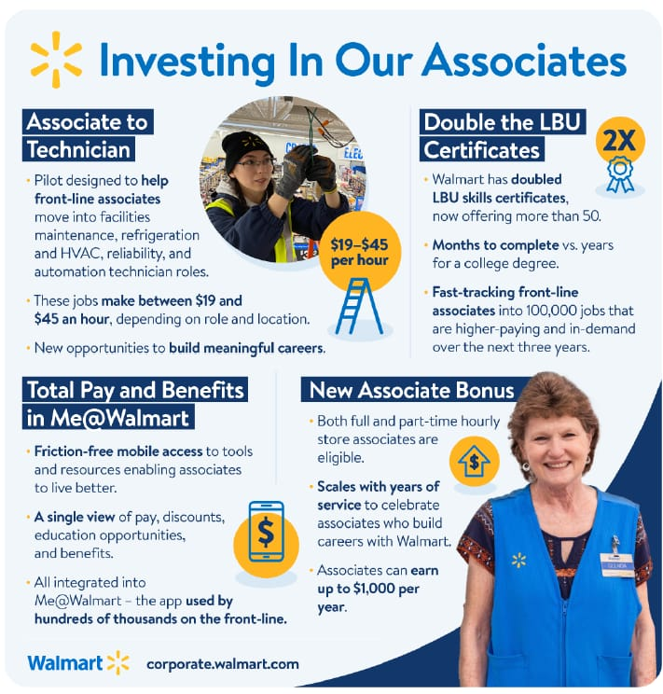
Key HR challenges faced by the company
However, despite these kinds of improvements, the hindrances pertaining to several remuneration-related challenges persist
Rising pay of the managers increases labour costs, pressuring margins is cost-intensive and directly impacts the EBITDA of the company
There are documented instances of disparity between high-paid managers and hourly staff can lead to morale issues and perceptions of unfairness, undermining team cohesion
Notes:
: It is noted that as pay and bonus depend heavily on store performance, external factors (market downturn, inflation, consumer demand) may reduce rewards. This is considered tro be a factor for weakening retention and motivation

Slide 32
Practical recommendations to address these challenges
HR Challenge | Recommendation | Expected Outcome
Rising pay for managers increases labor costs | Implementing cost-effective bonus structures tied to specific KPIs rather than across-the-board raises Walmart, Inc. (2025) FY2025 ESG Report. | Control labor costs while maintaining motivation
Pay disparity between managers and hourly staff | Introducing tiered pay adjustments and enhanced hourly incentives, recognition programs Walmart, Inc. (2025) FY2025 ESG Report. | Improved morale, stronger team cohesion
Inconsistent performance-based pay for hourly workers | Standardizing performance metrics and bonus calculation across stores | Fairness, reduced pay dissatisfaction
External factors affecting store performance and bonuses | Introducing baseline guaranteed incentives plus performance-based components | Reduced volatility in pay, higher retention and motivation
Retention issues linked to perceived inequity | Communicating pay policies transparently, offer non-monetary rewards | Enhanced trust, employee engagement

Slide 33
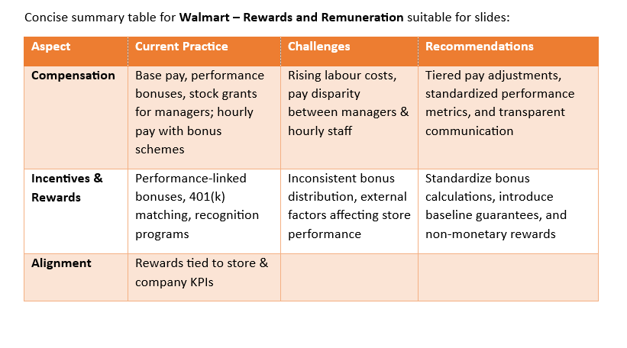
Summary

Slide 34
references
Yahoo Finance (2025) Walmart CEO says paying its star managers upwards of $620,000 yearly empowers them to ‘feel like owners’. Available at: https://finance.yahoo.com/news/walmart-ceo-says-paying-star-155003794.html (Accessed: 26 November 2025).
e‑reward.co.uk (2025) Role of line managers in reward management. Available at: https://www.e-reward.co.uk/news/role-of-line-managers-in-reward-management (Accessed: 26 November 2025). e-reward.co.uk
Mehrotra, A. (2024) ‘Walmart’s Compensation Strategy to Retain Talent’, The Oracle (XLRI), 23 September. Available at: https://theoracle.xlri.ac.in/walmarts-compensation-strategy-to-retain-talent/ (Accessed: 26 November 2025).
Walmart, Inc. (2025) FY2025 ESG Report. Fayetteville, AR: Walmart. Accessed 26 November 2025. https://corporate.walmart.com/content/dam/corporate/documents/esgreport/2025/FY2025-Walmart-ESG-Report.pdf

Slide 35

Group conclusion
It has been stated and well documented in this group ppt that Walmart’s HR policies integrate recruitment, performance management, training, and reward systems to align workforce capability with business goals. Here, it is stated that recruitment often both internal promotion and external hiring. However, performance management had been the core to the discussion, and training ensure associates acquire role-specific and future-ready skills through Walmart Academy and Live Better U.
Moreover, it is identified that reward and remuneration practices tie compensation to individual, store, and corporate performance, promoting retention and motivation. Challenges and hindrances do persist, turnover, skill gaps, pay disparities, and uneven training access had been detrimental. Abiding by this, it could be implied that strategic interventions, standardized evaluations, digital training, tiered pay, and transparent communication

