Slide 1
LAN Technologies
Dr. Carlene Campbell

Slide 2
Topics
Overview of LAN Technologies
Ethernet
Token Ring
FDDI
Why did Ethernet Win?
Wireless LANs

Slide 3
LAN Technologies
Ethernet - logical bus topology (information flow is on a linear bus) and physical star or extended star (wired as a star)
Token Ring - logical ring topology (in other words, information flow is controlled in a ring) and a physical star topology (in other words, it is wired as a star)
FDDI (Fiber Distributed Data Interface) - logical ring topology (information flow is controlled in a ring) and physical dual ring topology (wired as a dual ring)

Slide 4
LAN Speed
Network Type | Data Transfer Rate
Ethernet | 10M – 10G bits/s
FDDI | 100Mbits/s
Token Ring | 4 or 16 Mbits/s
Apple LocaTalk | 0.23 Mbits/s
Wireless | 1-300Mbits/s

Slide 5
IEEE 802 Standards
802.3 – Ethernet
802.5 - Token Ring
802.11 - Wireless LAN

Slide 6
Functions of Ethernet
Ethernet is a broadcast transmission medium
Each device checks the packets for valid MAC addresses
Detecting errors within data packets or on the network
In the CSMA/CD (Carrier Sense Multiple Access With Collision Detection ) access method, networking devices listen-before-transmit
Notes:
Ethernet is a broadcast transmission medium. This means that all devices on a network can see all data that passes along the networking media.
Transmitting and receiving data packets
Decoding data packets and checking them for valid MAC addresses before passing them to the upper layers of the OSI model
Detecting errors within data packets or on the network
In the CSMA/CD (Carrier Sense Multiple Access With Collision Detection ) access method, networking devices with data to transmit over the networking media work in a listen-before-transmit mode.

Slide 7
Different Types of Ethernet
Name | Speed | Standard | Nomenclature
Ethernet | 10 Mbps | IEEE 802.3, 1983 | 10BaseT
Fast Ethernet | 100 Mbps | IEEE 802.3u, 1995 | 100BaseT
Gigabit Ethernet | 1 Gbps | IEEE 802.3z, 1998 | 1000BaseT
Optical Ethernet | 10 Gbps | IEEE 802.3ae, 2002 | ??BaseF

Slide 8

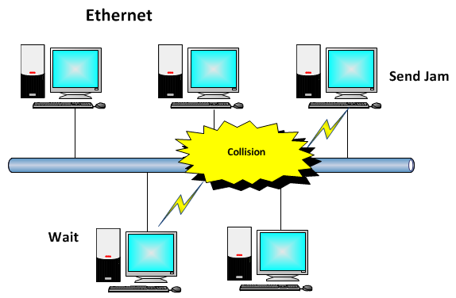
Broadcasting in the Ethernet LAN
Ethernet collision detection

Slide 9
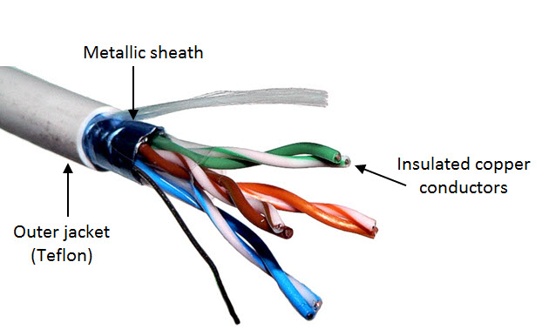
Shielded and Unshielded Twisted Pair
Shielded twisted pair (STP) cable

Slide 10
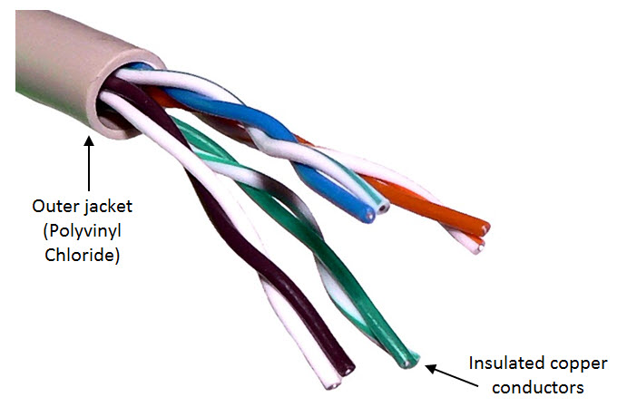
Shielded and Unshielded
Twisted Pair (cont'd)
Unshielded twisted pair (UTP) cable

Slide 11
Twisted-Pair Categories
Cable Grade | Bandwidth | Specific Network(s)
Category 5 | -100 Mbps -Can sustain rates up to 100 MHz | Can be used for both standard Ethernet (10 Mbps) and Fast Ethernet (100 Mbps). A popular implementation
Category 5e | -1 Gbps (1,000 Mbps) -Can sustain rates up to 100 MHz | Can be used for Fast Ethernet and Gigabit Ethernet and other high-speed networks. Has largely replaced Cat 5 in many implementations
Category 6 | -2.5 Gbps -Can sustain rates up to 250 MHz | Supports Gigabit Ethernet. Unlike other categories of twisted pair, Cat 6 is not particularly durable and can cease to function if it is improperly bent
Category 6E | -10 Gbps -Can sustain rates up to 500 MHz | Suitable for 10-Gigabit Ethernet and faster, more powerful networks
Category 7 | -10 Gbps -Can sustain rates up to at least 600 MHz | An emerging standard. Shielded. Contains four individually shielded twisted pairs inside an overall shield, and supports data transmission up to 10 Gbps. Rated at 600 MHz
Twisted-pair cable categories (Cat 5 through Cat 7)

Slide 12
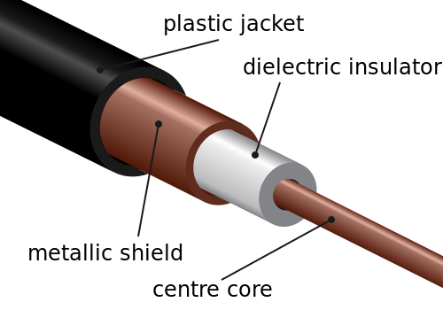
Coaxial Cable
Coaxial cable

Slide 13
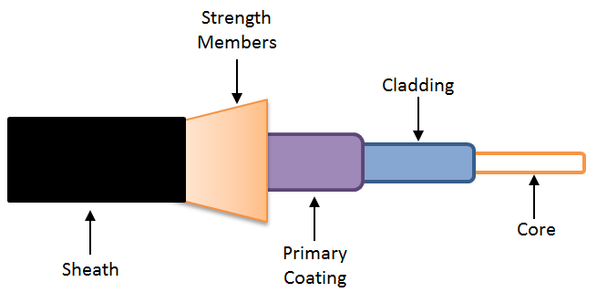
Fiber-Optic Cable
Fiber-optic cable

Slide 14
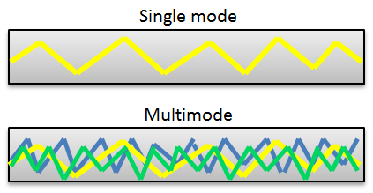
Modes of Optical Fiber
Single and multimode fiber
Single-Mode Fiber | Multimode Fiber
One transmission path | Multiple transmission paths
No smearing | Smearing
More pulses per second | Fewer pulses per second
High transmission speeds | Low transmission speeds
Long-distance transmissions | Short-distance transmissions
Single-mode vs. multimode optical fiber
Notes:
LED
Lower output power
More diffuse beams
For shorter distances
Multimode fibers
Less expensive
Does not require special operating conditions
Laser
Higher output power
Less diffuse beams
For long distances
Single-mode fibers
More expensive
Requires special operating conditions

Slide 15
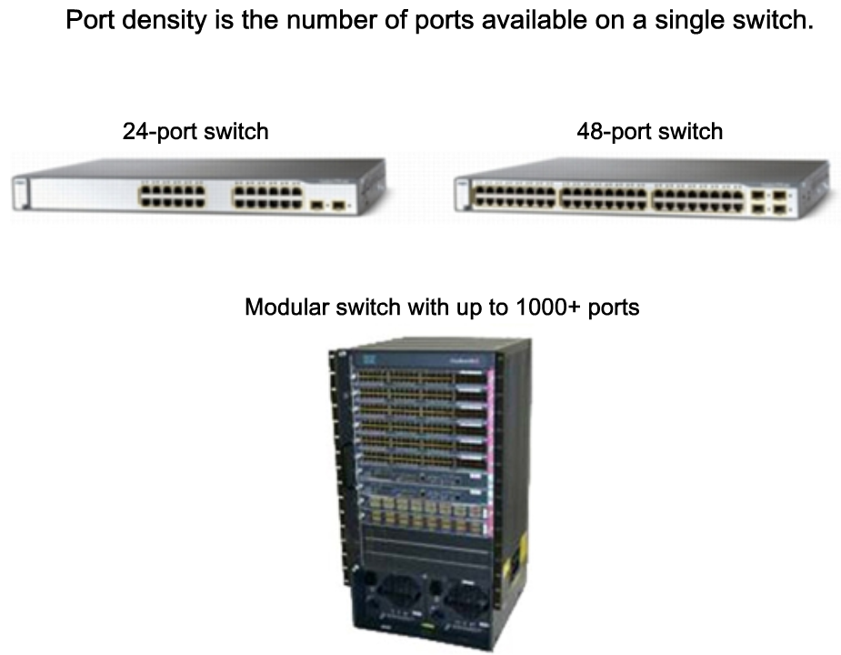
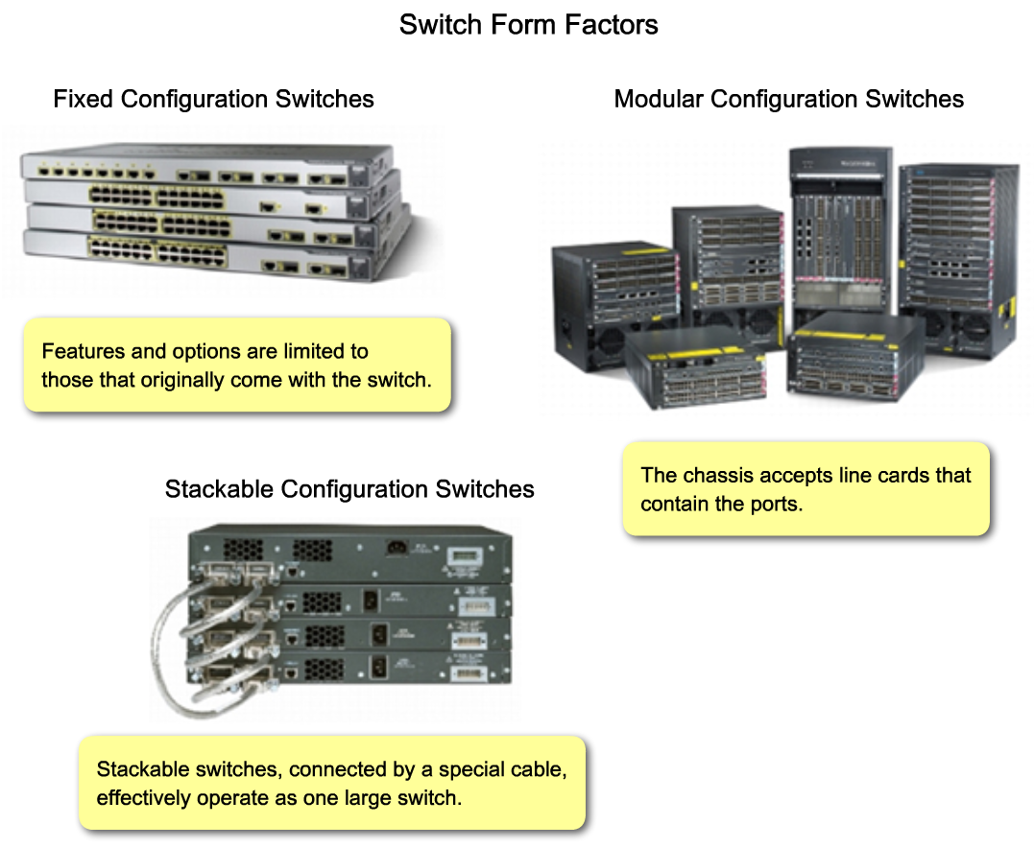
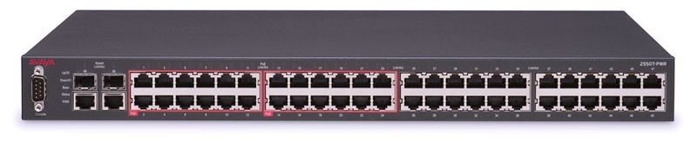
Switches
Ethernet collision detection
Ethernet 50-port switch

Slide 16
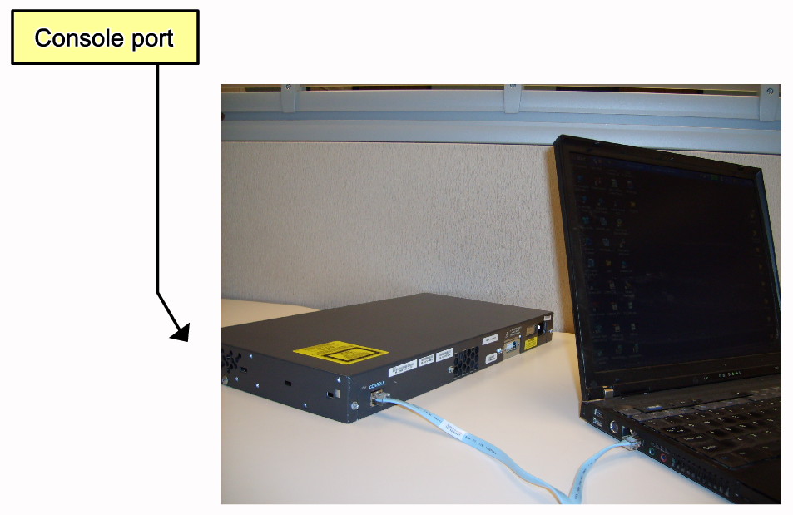
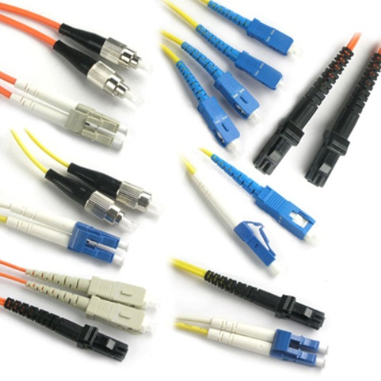
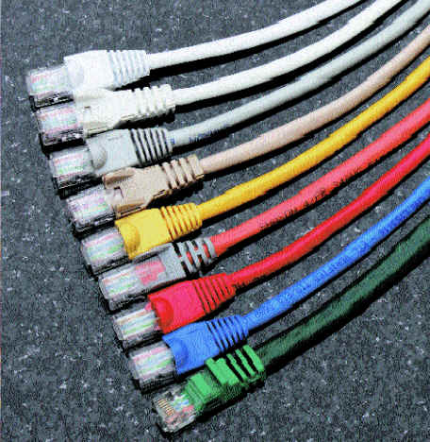
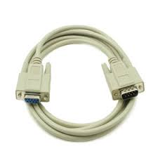
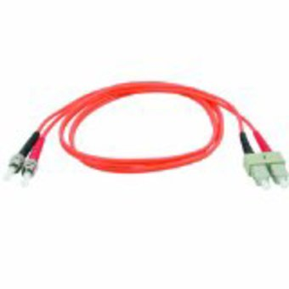
Cables
Fiber-optic patch cables
Twisted pair
Cat 6 cable
RJ45 connector
Fiber-optic cable
St-Sc connector
Serial cable
Notes:
Fibre patch cables
ST-ST
ST-SC
ST-LC
SC-SC
LC-SC
LC-LC

Slide 17
Ethernet Standards
Characteristic | Ethernet | Fast Ethernet
Speed | 10 Mbps | 100 Mbps
IEEE standard | IEEE 802.3 | IEEE 802.3u
Access method | CSMA/CD | CSMA/CD
Topology | Bus/star | Star
Cable support | Co-ax/twisted pair/fiber | Twisted pair/fiber
UTP link distance (maximum) | 100 meters | 100 meters
Ethernet vs. Fast Ethernet

Slide 18
Token Ring
A token is passed to each device
Devices “grab” the token and then transmit their information.
The message is broadcast
The destination “hears” the message and all others ignore the message.
Once the message is delivered, the token is freed for someone else to use.
Notes:
A token is placed on the network and passed to each member of the network
When someone has something to say, they “grab” the token and then transmit their information.
The message is sent to all other members of the network.
The member the message is addressed to “hears” the message and all others ignore the message.
Once the message is delivered, the token is freed for someone else to use.

Slide 19

Token Passed On
Data Forwarding:
Broadcast and Select

Slide 20
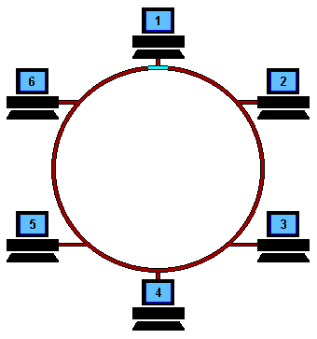
Token Cycling

Slide 21
Token Issues
Good control, but is complex to implement
If token is lost or mutilated, it is replaced
System is deterministic
Notes:
The system has very good control, but is complex in implementation
If token is lost or mutilated, a member of the network must replace the token
Usually automatic after some specified wait time
System is deterministic
That means that if a station has higher priority traffic to send, the system can deal with it.

Slide 22
FDDI
(Fibre Distributed Data Interface)
100Mbps Token Ring pass
Dual ring with fibre optics

Slide 23
Dual Ring
Traffic on two rings flow in opposite directions
During normal transmission, the primary ring is used and the secondary ring remains idle
Dual ring provides superior reliability and robustness

Slide 24
Ethernet Dominance

Slide 25
Why Did Ethernet Win?
Failure modes
  Token rings – network unusable
  Ethernet – node detached
Good performance in common case
Volume → lower cost → higher volume ….
Adaptable
  To higher bandwidths (vs. FDDI)
  To switching (vs. ATM)
Completely distributed, easy to maintain/administer
Easy incremental deployment
Cheap cabling, etc

Slide 26
The Success of Ethernet
The success of Ethernet is due to the following factors:
Simplicity and ease of maintenance
Ability to incorporate new technologies
Reliability
Low cost of installation and upgrade

Slide 27
Wireless LANs

Slide 28
Wireless LAN Standards
IEEE Specification | Theoretical Top Speed | Frequency | Comments
802.11a | 54 Mbps | 5 GHz | -Indoor range of 35 meters; outdoor range of 120 m -Includes error correction -Offers strong encryption and authentication -Not compatible with 802.11b or 802.11g
802.11b | 11 Mbps | 2.4 GHz | -Indoor range of 38 m; outdoor range of 140 m -Subject to interference from microwave ovens, cordless phones and Bluetooth devices, which operate in the same frequency band
802.11g | 54 Mbps | 2.4 GHz | -Indoor range of 38 m; outdoor range of 140 m -Backward compatible with 802.11b (but only at 802.11b speed) -Offers encryption and authentication features similar to 802.11a
802.11n | 300 Mbps | 2.4 GHz and 5 GHz | -Indoor range of 70 m; outdoor range of 250 m -Offers high speed and twice the range of 802.11g -Supports streaming technologies
802.11 wireless LAN flavors

Slide 29
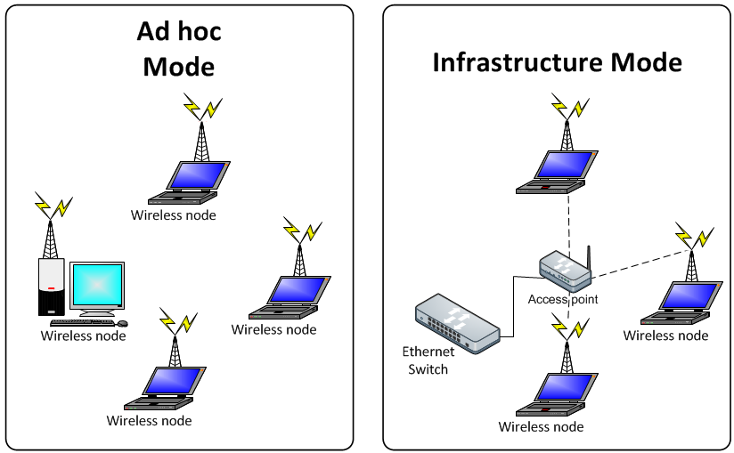
Wireless LANs
Ad hoc networking.
Wireless networking with a access point.

Slide 30
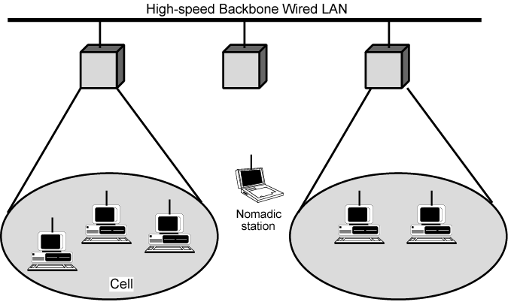
Wireless LAN with a Base Station
By default, Wireless LAN is referring to this types of network,
not ac hoc networks.

Slide 31
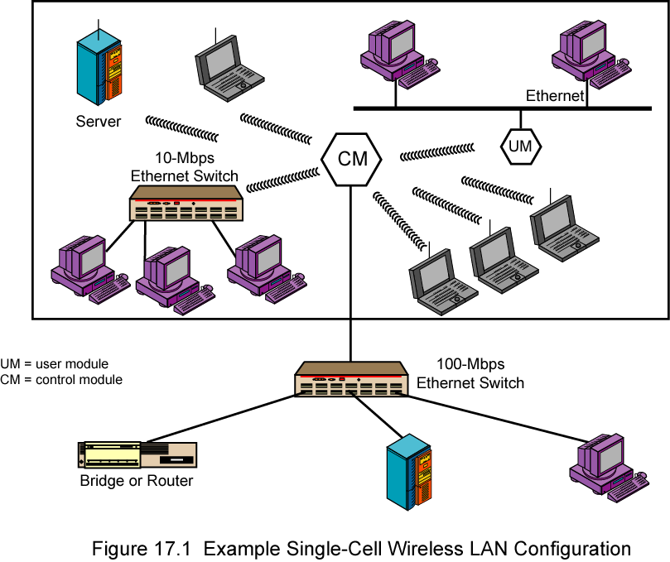
Single-Cell Wireless LAN

Slide 32
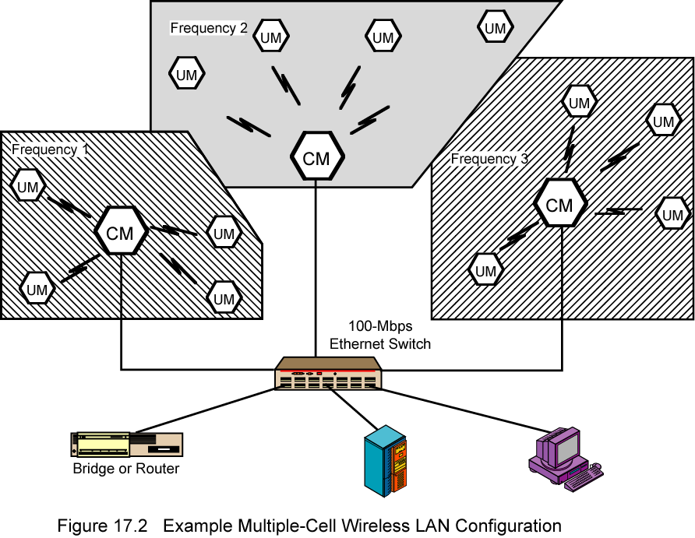
Multi-Cell Wireless LAN

Slide 33
IEEE 802.11 Wireless LAN
802.11b
  2.4-5 GHz unlicensed radio spectrum
  up to 11 Mbps
  direct sequence spread spectrum (DSSS) in physical layer
  widely deployed, using base stations
802.11a
  5-6 GHz range
  up to 54 Mbps
802.11g
  2.4-5 GHz range
  up to 54 Mbps
All use CSMA/CA for multiple access
All have base-station and ad-hoc network versions

Slide 34
802.11 LAN architecture
Wireless hosts communicate with base station.
  base station = access point (AP)
Basic Service Set (BSS) (a.k.a. “cell”) in infrastructure mode contains:
  wireless hosts
  access point
  (ad hoc mode: hosts only)
Internet
hub, switch
or router
AP
BSS 1
AP
BSS 2

Slide 35
802.11:
Mobility within Same Subnet
Host remains in same IP subnet:
IP address can remain same
Switch knows which Access Points are for each host
router
hub or
switch
BBS 1
AP 1
AP 2
H1
BBS 2

Slide 36
Wi-Fi
Wi-Fi is a brand owned by Wi-Fi Alliance.
The Wi-Fi Alliance is a group of companies agreeing to a set of common products
  3Com, Aironet (now Cisco), Harris Semiconductor (now Intersil), Lucent (now LSI Corporation), Symbol Technologies (now Motorola), Nokia.
  Sponsors Apple inc. and Microsoft.
Alliance allows interoperability

Slide 37
Evolution of WLAN Standards
Year | WLAN Standard | Frequency | Modulation | Bit-Rate (Max)
1997 | IEEE 802.11 | 2.4 GHz | Frequency Hopping and Direct Spread Spectrum | 2 Mbps
1998 | ETSI Home RF | 2.4 GHz | Wideband Frequency Hopping | 1.6 Mbps
1999 | IEEE 802.11b | 2.4 GHz | Direct Spread Spectrum | 11 Mbps
1999 | IEEE 802.11a | 5 GHz | OFDM | 54 Mbps
2000 | ETSI Hiper LAN 2 | 5 GHz | OFDM Connection-oriented | 54 Mbps
2003 | IEE 802.11g | 2.4 GHz | OFDM compatible with 802.11a | 54 Mbps

Slide 38
Recap
Overview of LAN Technologies
Ethernet / Token Ring / FDDI
Why Ethernet Won?
Wireless LANs

