Slide 1

A presentation of the critical evaluation of how AFL can be utilized in a learning episode to aid progression across a chosen area of learning
Nina Williams
2300720

Slide 2

Hello, my name is Nina Williams, and my student number is 2300720.

Slide 3


The purpose of this AFL presentation?
Gain deeper knowledge and understanding.
Welsh curriculum.
Impact on children's learning and progression
Why we plan for progression
The reason and purpose for this presentation is to gain deeper knowledge and understanding around AFL and why it has an important role in the Welsh curriculum. Its also to see what impact it has on our children's learning and the difference in their progression. Research suggests its important to know why we plan our lessons and why we pick certain strategies of AFL. By having this knowledge, we can be more confident when planning for pupil progression
(Wolterinck et al., 2022)
(Welsh Government, 2020)
(Department for Education, 2011)

Slide 4
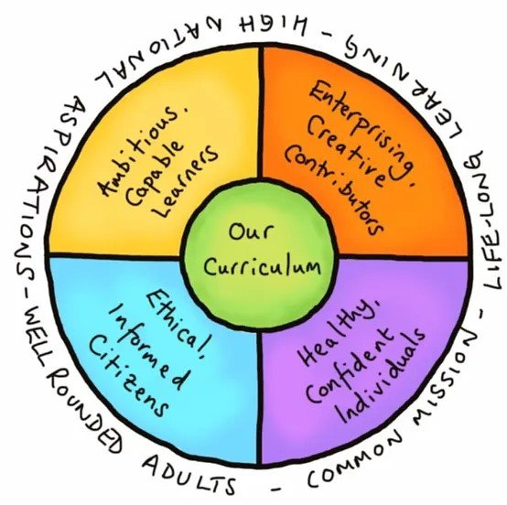
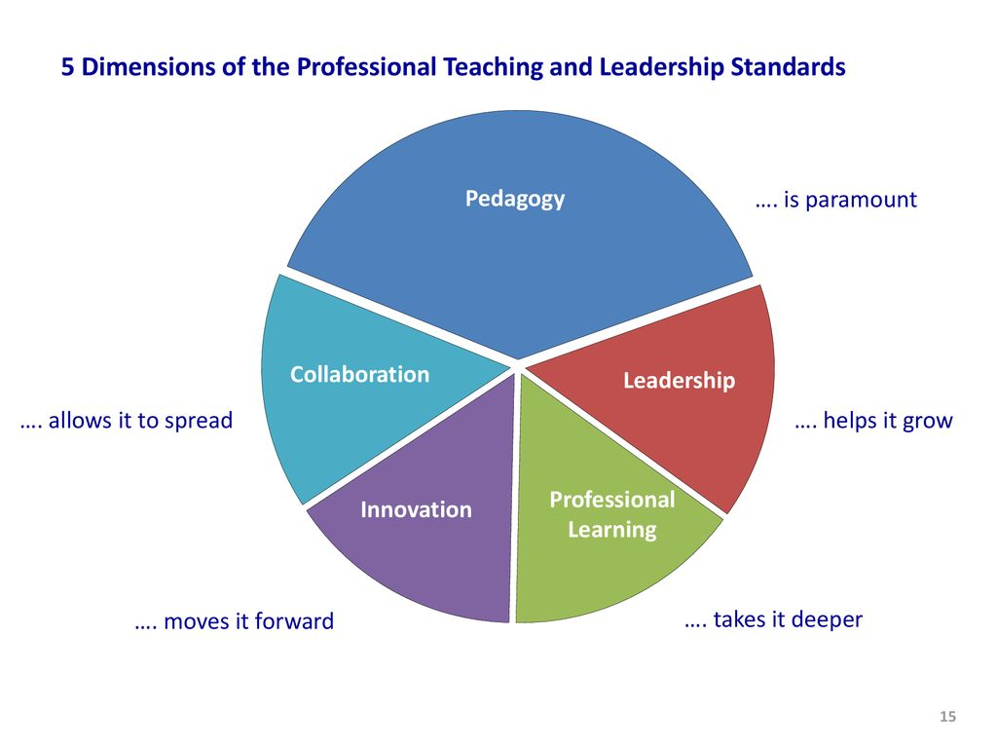
Curriculum for Wales / QTS standards
4 purposes
Principles of progression
QTS standard 6
AFL has links to the CFW and the QTS standards. Principles of progression are closely linked to the 4 purposes which are embedded into teaching and learning and help aid pupil progression. AFL helps teachers identify where children are at in their learning .
There is also a close link with AFL and the QTS standards.
Assessment falls under pedagogy, specifically refining teaching.
The QTS descriptor states “ the range of purpose and practices for assessment is understood and articulated”.
(Welsh Government, 2022)
(Welsh Government, 2019)

Slide 5

My learners
Placement – North Gower Swansea
Small school (140) children
Split year 2/3 class 6–8-year-olds
43 children across the year group
25 students in my lesson
3 ALN
5 MAT
Expressive arts lesson
Cross curricular links to Literacy framework
Specific focus on oracy

Slide 6


What is AFL and where did it come from?
According to the CAIE, “assessment for learning is an approach to teaching and learning that creates feedback which is intended to aid pupil progression”.
Closing the gap.
AFL works in a continuum (where the learner is, where the learner is going, how they will get there).
Dylan William stated, “assessment is indeed the bridge between teaching and learning”.
Raising achievement.
AFL should be the focus in the classroom.
4 key principles of AFL:
clarifying and understanding learning intentions and criteria for success
engineering effective classroom discussions, questions and tasks that elicit evidence of learning
providing feedback that moves learners forward
activating students as instructional resources for each other of their own learning
Cambridge assessment international education, 2011
Mayatt & co,2024
William, 2025

Slide 7
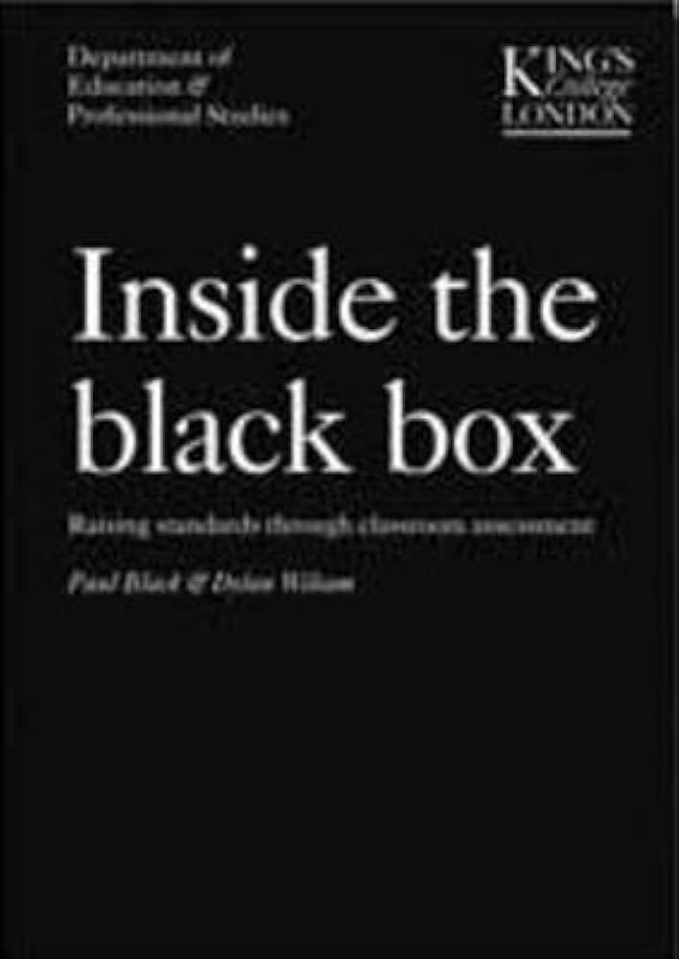

Evidence to support
ESTYN produced a report all about assessment for learning and schools' views on AFL and how their implementing it within their setting.
Most schools considered and developed their approaches to AFL to reflect the Welsh curriculum
Summative/ formative give a better understanding of their learning and identify pupil progression.
recommended teachers have wider understanding of classroom formative assessment.
Paul Black 1998 worked with William to create the black box theory.
Role of formative assessment improved learning outcomes.
Helps children identify where there at how consequently create targets for their progression and increase achievement.
ESTYN, 2022
Jones, 2022
Gregory Ow Md, 2023

Slide 8

Who disagrees?
David Didau 2016 argues that formative assessment is “fundamentally and fatally flawed”.
Theres a difference between learning and performance, and there was no guarantee of learning.
Teachers can't adapt to achievement if children haven't learnt.
Kirshner, Sweller, and Clarke suggested “ if nothing has changed in the long-term memory, nothing has been learnt”.
William came back in defence and highlighted that Didau made an effective critique however he stood by the fact that if teachers reflected on actives and the children's learning then it was an effective form of assessment.
David Didau, 2016
Fletcher-wood, 2017
Didau, 2014

Slide 9

Importance of AFL?
AFL is important to us as teachers
Adapt our strategies
Track children's development and progression
Effectively plan for progression
Provide constructive feedback
Key skill
AFL is beneficial for our learners
Adapt their own learning
Clear goals
Motivation
Knowledge of how to improve
Recognised their achievements
Overall research has shown that AFL is key to the success of all our learners.
Johnson, 2023

Slide 10
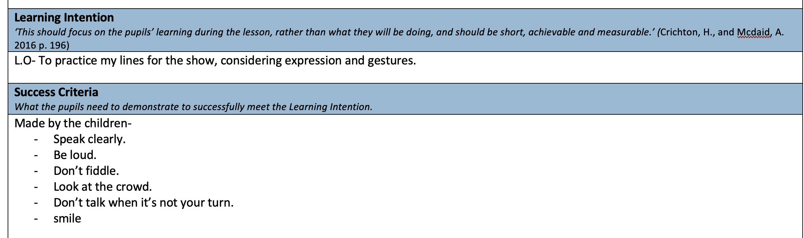
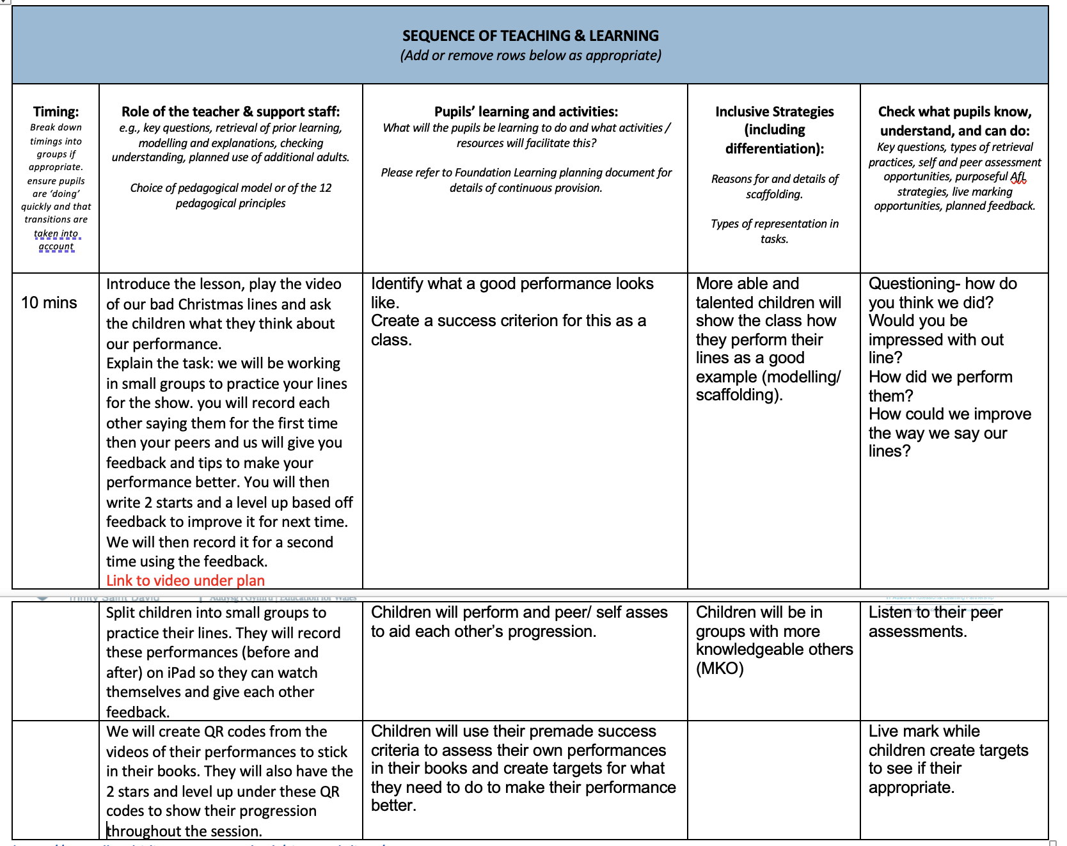

Discussion- lesson plan

Slide 11
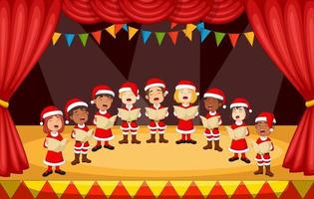

My lesson
Expressive Arts.
scheme of work
rehearsing for the concert
identified children were struggling
plenty of progression to make
whole class
practice their lines with expression and gestures as I felt like this was accessible for all my learners
I expected the lower ability to be able to meet this, and the higher ability were challenged with other skills like tone and speed they spoke their lines.
This fits into curriculum for Wales focusing on specific what matters statements and principles of progression. These were:
WMS2- responding and reflecting, both as an artist and an audience, is a fundamental part of learning in the expressive arts.
PS2- I can consider, with guidance, how my moods, emotions and ideas are communicated both in my own creative work and in the creative work of others.
This lesson also had cross curricular links to the literacy framework looking at the PS2- speaking (clarity and vocabulary): I can speak clearly, varying expression and gestures to communicate my ideas and help listeners.
Welsh government, 2022

Slide 12


Why and what?
Research suggests how important expressive arts is within the classroom
It promotes social and emotional skills and creativity. It also motivates my learners to engage more with the focus of the lesson and therefore achieve progression in the skills I have previously mentioned
children who take part in the arts have higher self-esteem, and it also provides the opportunity for challenge and improvement of skills.
By working on the skills such as confidence and speaking clearly through expressive arts, my learners had a higher chance of progression and development among these skills
A hook
short video
class discussion about this which got them excited and interested
. Hooks are beneficial for a lesson as it gets the learners engaged and ready to learn but it’s also a good memory trigger for the children to remember
Following on from this the children used the video to create their own class success criteria for the upcoming task. They discussed with me how we could improve our performances in the video and made into their own criteria for their performances.
Brown, 2015
Centre For Longitudinal studies, 2019
Kathy, 2022

Slide 13
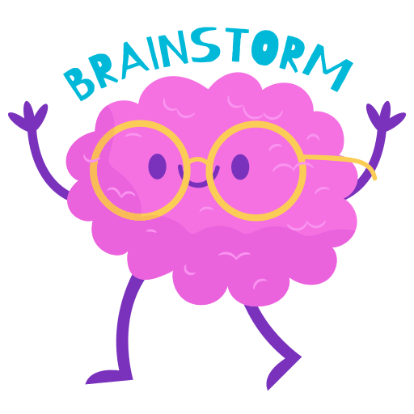
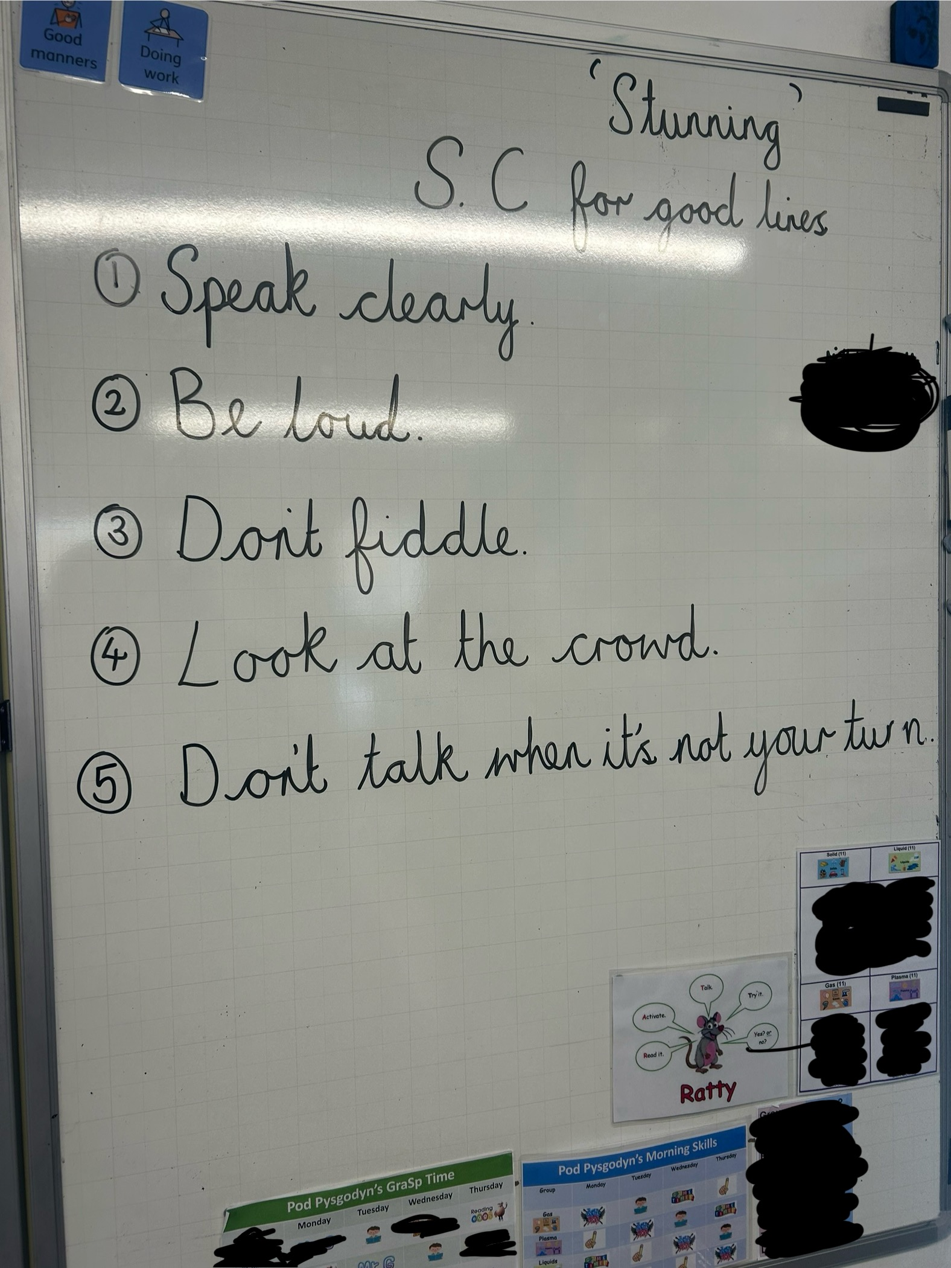
Success criteria
This was the first AFL strategy used in my lesson which falls under clarifying and understanding learning intentions and criteria for success in Dylan Williams’ key principles
Success criteria are derived from a learning intention
Allows children to assess their own learning and progression
I chose to make the success criteria with my students as it allowed them to have a say in what they thought was reasonable and measurable for the task.
Jenifer 2021 suggested that involving students in this process can help with planning in the future as it gives an insight into what skills their confident in already and what may need more improvement.
Many teachers have been influenced to use this approach
It also helps children peer and self-assess each other as having a good understanding of the criteria can help students provide better feedback to peers and their own work.
CSAI, 2024)
Freibrun, 2021
Gonzalez, 2021

Slide 14

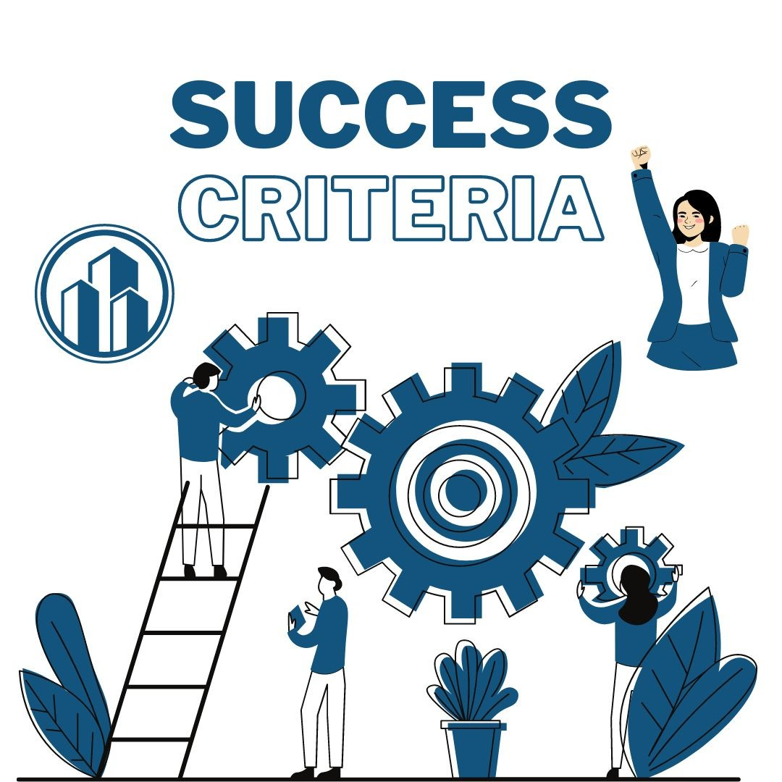
Benefits
There are many benefits to using success criterions as a form of AFL which I considered carefully before choosing this strategy
Hattie found that having a success criteria had an above average effect on student attainment, encouraging them to put much more effort into their work
This is helpful for assessing children as teachers can see the child's full potential and progression.
Another benefit is that learners can check their progress against the criteria to have an active role in their learning and take more responsibility for their progress
Christleton High School back this up and talk about how success criterions are the key to providing feedback for learners to allow for progression.
It helps teachers guide children towards where they need to be in their learning and allows learners to gauge their own progression against the criteria.
Therefore, feedback becomes more specific and can pinpoint areas required for progression
William also quoted “if you don’t know where you’re going, you'll never get there” which homes in on the importance of success criteria for students to progress.
Christleton High, 2024
Zaferis, 2023

Slide 15

Negatives
There are plenty considerations to be cautious about
James suggested that success criteria may limit progression rather than raising attainment
high ability learners may be able to produce work that covers all the points in a success criterion without experiencing any challenge
Therefore, it has limited their progression overall. To avoid this, it may be worth considering specific success criteria for each group of learners.
Wood, 2017 worries about children not having the ability to think for themselves if they always have success criteria. This suggests that even though it’s a good way of assessing progress, children are lacking in autonomy and problem- solving skills
We should be aiming for progression across all areas of learning and the question is whether success criteria are limiting this slightly
I believe it’s something to be cautious about and consider in lessons where the purpose is to develop thinking for oneself.
Durran, 2019
Wood, 2017

Slide 16


Further on in my lesson
children practised performing their lines to each other
These performances were filmed on an iPad so they could watch them back.
they had to peer and self-assess their performance using the success criteria given.
they created 2 stars and a level up ready for their final try of performing.
They then performed them on last time, again filmed on the iPad to show their progression from the first try
They peer assessed this performance too and gave another 2 stars and a level up that they could refer to come their real performance in our Christmas concert
I chose to do this AFL strategy as it showed their progression across the 2 tries

Slide 17
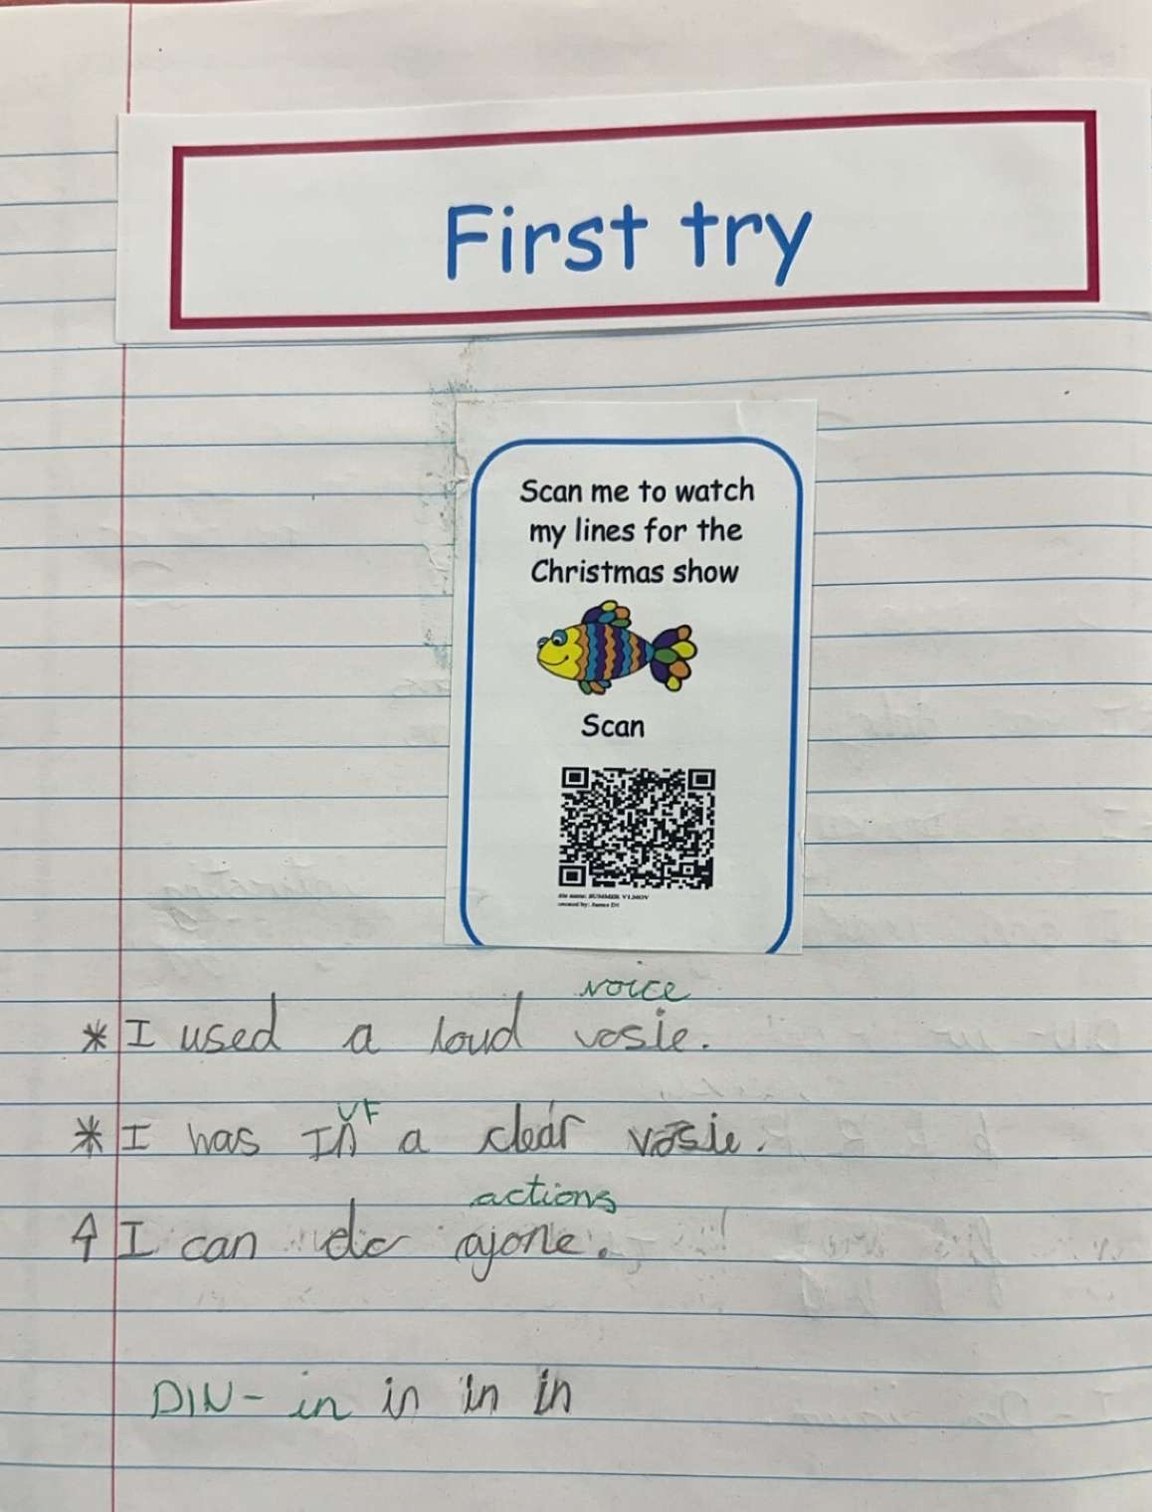
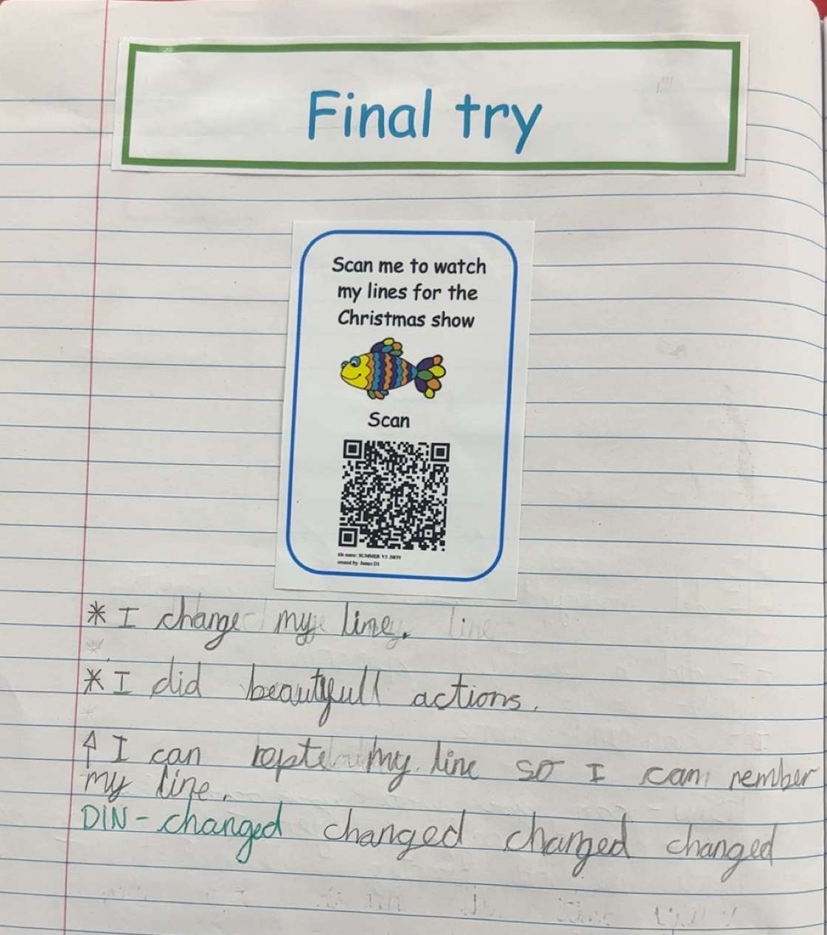
Peer and self assessment

Slide 18
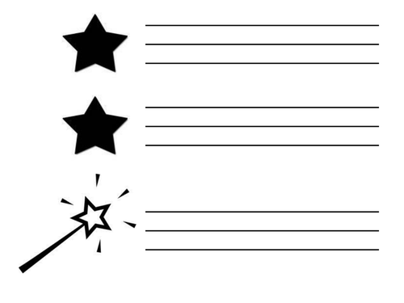

Peer and self assessment
Self-assessment occurs when the learner evaluates their own work to notice their progression, and peer assessment is the same concept just children looking at other learner’s work.
4th principle of AFL which is feedback.
Peer and self-assessment feedback can be given orally or written down and is most effective when it gives suggestion on how to progress and is highly effective with lower ability children
According to Shirly Clarke, self-evaluation empowers children to realise their own learning needs and have control over their future targets and provides teachers with more assessment feedback.
Black and Williams 1998 agrees with this and says, “for formative assessment to be productive pupils should be trained in self-assessment so they can understand the main purpose of their learning and grasp what they need to do to achieve".
teacher need to train pupils in peer assessment, and it needs to be consistent.
From this research, I chose to use peer and self-assessment as its already an AFL strategy use across my placement school, and it helps the children recognise their own learning achievements and how they need to improve in the future. I think it helped my students as they had the knowledge to self and peer evaluate, without this understanding it would have been harder for them to progress in the skills that needed improvement
Lauf and Dole, 2024
Boston 2002
Clarke, 2008

Slide 19


Benefits
Research suggests that if students are involved with their own learning, they are more likely to be engaged in thew learning episode
This helps children learn from pervious mistakes, and target further learning to improve these. It also helps them identify strengths and weaknesses in their work so they can gain an understanding of the quality of work their producing
Research from the educational endowment foundation found that it had a positive impact on students and teachers and was most effective when it was used to consolidate learning. It also helps children internalise the success criteria and use it to reflect on their own learning
Reading university carried out a study on peer and self-assessment as a form of feedback and they suggested it made learning an active process that promoted students to engage with assessment, critical thinking and reflection. It enhanced their ability to give meaningful feedback that could help them, and their peers improve and progress with their knowledge and understanding of the topic
“Activating students as instructional resources for each other and activating students as owners of their own learning” is the last principle in Dylan William’s aspects of AFL, and peer and self-assessment can achieve this and therefore allow success when implementing AFL in the classroom.
geographical association, 2023
reading university, 2024

Slide 20

Negatives
peer assessment can come with some flaws and negative views that need to be considered before using it in your AFL
major disadvantage to using peer assessment is if you have a mixed ability class. Children may find it challenging to assess another child's work if it’s below their level of understanding. Therefore, the assessment and feedback become irrelevant as the child hasn’t understood what their marking
this experience may benefit the lower ability child as it’s an example of Vygotsky's zone of proximal development, however it does not overcome the little amount of useful feedback the MAT child may receive
It’s suggested that it takes too long and takes time away from learning, however some would argue the benefits outweigh this problem.
it is suspected that children may have the opportunity to copy each other’s work during peer assessment and therefore they haven't successfully identified the progress they need to make as an individual
This would defeat the object of using it as an AFL strategy so its defiantly something to be cautious about.
Overall peer and self-assessment needs careful consideration before implementing it as AFL as if it’s not used correctly it could become redundant and unhelpful for the progress of the learners
Double, McGrane and Hopfenbeck, 2019
Power and Tanner, 2023
paulgmoss, 2021

Slide 21
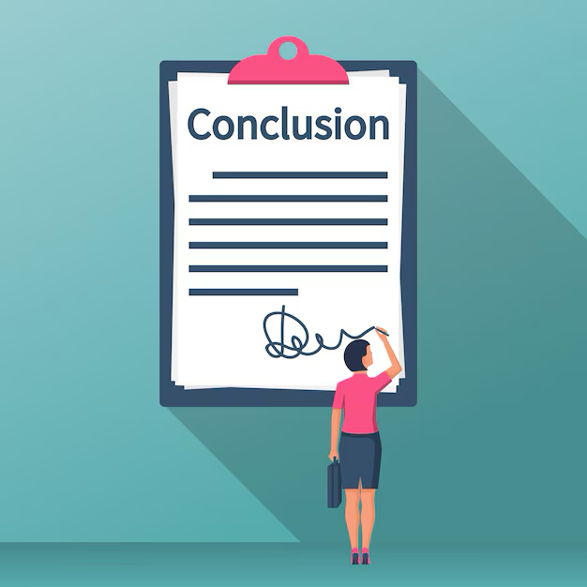

Conclusions
In conclusion, by looking at all the research and discussing the positives and negatives of the specific AFL strategies I used in my lesson, I have learnt and reflected on my choices.
I choice to implement success criteria and peer/self-assessment as I believe they work in collaboration with each other. If children have a clear understanding of what they need to do and how to do it, they can then provide informative feedback to themselves and others.
Throughout my planning and implementing of these AFL strategies I feel like I have got to grips with merging these 2 together to become an effective tool for feedback within my class and it has helped consider future planning for progression with my learners.

Slide 22

Recommendations
Personally, I would like to continue using success criteria as a form of AFL, specifically creating them with my learners as I felt it had a positive impact on their understanding of the task and helped them take responsibility for their own learning.
Furthermore, I think it would be a good idea for this to be implemented more often in schools as from my experience the learners made much more progression because they knew what they needed to do and how to do it. Not only did they have that information, but they created it themselves which made the learning experience personal which in turn allowed them to take responsibility for their own progression.
Moving forward, although I believe peer and self-assessment worked well in my class, I would like to consider ways of avoiding the issue of children receiving irrelevant feedback. As I mentioned earlier, children may not give useful feedback if they can’t understand the work their assessing. I would love to research more into Vygotsky's theory of Zone of Proximal Development and the role of the More Knowledgeable Other to see if it has any relevance to peer assessing and if there are any ideas that could lessen this effect.

Slide 23

Any questions
Overall, I found it helpful and beneficial to my growth as a teacher to investigate AFL as a whole and to look at specific strategies of AFL. It has given me wider knowledge and understanding of why and how we implement it in schools today and the reasons for choosing certain AFL when planning out lessons. In the future I will consider carefully the AFL used in my lesson and how it’s going to promote progression for my learners.

Slide 24
Reference list
Brown, D.N. (2015). Lesson planning: The hook, a good starter. [online] Dr Nicole Brown. Available at: https://www.nicole-brown.co.uk/the-hook/.
Cambridge Assessment International Education (2011). Getting Started with Assessment for Learning. [online] Cambridge-community.org.uk. Available at: https://cambridge-community.org.uk/professional-development/gswafl/index.html.
Centre For Longitudinal studies (2019). CLS | Taking part in the arts could help build children’s self-esteem, new study finds. [online] Taking part in the arts could help build children’s confidence and self esteem. Available at: https://cls.ucl.ac.uk/taking-part-in-the-arts-could-help-build-childrens-self-esteem-new-study-finds/.
Christleton High (2024). Section 2 -Assessment for Learning. [online] Available at: https://www.christletonhigh.co.uk/pdf/teaching-and-learning/section-2-assessment-for-learning.pdf [Accessed 12 Jan. 2025].
Clark, W. and Luckin, R. (2013). ‘#$%! -.+/!/.)!0)1)+02.!1+31! 45+%1!4$!/.)!6(+110##7! -4(7+!6(+08!+$%!9#1)7+03!’:284$!! ! [online] Available at: https://cti.westminster.ac.uk/wp-content/uploads/sites/61/2017/02/2013-iPads-in-the-Classroom-Lit-Review-1-1.pdf.
Clarke, S. (2008). Targeting assessment in the primary classroom strategies for planning, assessment, pupil feedback and target setting. London Hodder Ed.
CSAI (2024). CSAI Resources: Supporting Teachers in Implementing CCRS and Formative Assessment From Building Blocks, Learning Goals, and Success Criteria Learning Goals and Success Criteria. [online] Available at: https://csaa.wested.org/wp-content/uploads/2020/01/Learning_Goals-and_Success_Criteria.pdf.
Department for Education (2011). Teachers’ standards guidance for school leaders, school staff and governing bodies. [online] GOV.UK, p.11. Available at: https://assets.publishing.service.gov.uk/media/61b73d6c8fa8f50384489c9a/Teachers__Standards_Dec_2021.pdf [Accessed 8 Jan. 2025].

Slide 25
Didau, D. (2014a). Dylan Wiliam’s defence of formative assessment. [online] David Didau. Available at: https://learningspy.co.uk/assessment/dylan-wiliams-defence-formative-assessment-2/.
Didau, D. (2014b). Why AfL might be wrong, and what to do about it. [online] David Didau. Available at: https://learningspy.co.uk/myths/afl-might-wrong/.
Double, K.S., McGrane, J.A. and Hopfenbeck, T.N. (2019). The Impact of Peer Assessment on Academic Performance: A Meta-analysis of Control Group Studies. Educational Psychology Review, [online] 32(32), pp.481–509. doi:https://doi.org/10.1007/s10648-019-09510-3.
Durran, J. (2019). Re-thinking ‘success criteria’: a simple device to support pupils’ writing. [online] James Durran. Available at: https://jamesdurran.blog/2019/01/24/re-thinking-success-criteria-a-simple-device-to-support-pupils-writing/.
Estyn (2022). Effective approaches to assessment that improve teaching and learning. [online] Available at: https://www.estyn.gov.wales/system/files/2022-10/Effective%20approaches%20to%20assessment%20that%20improve%20teaching%20and%20learning.pdf [Accessed 8 Jan. 2025].
Fletcher-Wood, H. (2017). Is formative assessment fatally flawed? Confusing learning & performance. [online] Improving Teaching. Available at: https://improvingteaching.co.uk/2017/03/26/formative-assessment-flawed-confusing-learning-performance/.
Freibrun, M. (2021). Using Success Criteria to Spark Motivation in Your Students. [online] Teaching Channel. Available at: https://www.teachingchannel.com/k12-hub/blog/success-criteria/.
geographical association (2023). Formative assessment - Geographical Association. [online] geography.org.uk. Available at: https://geography.org.uk/ite/initial-teacher-education/geography-support-for-trainees-and-ects/learning-to-teach-secondary-geography/assessment-in-geography/formative-assessment/.
geographical association (2023). Peer and self assessment - Geographical Association. [online] geography.org.uk. Available at: https://geography.org.uk/ite/initial-teacher-education/geography-support-for-trainees-and-ects/learning-to-teach-secondary-geography/assessment-in-geography/peer-and-self-assessment/.

Slide 26
Gonzalez, J. (2021). Build it Together: Co-Constructing Success Criteria with Students. [online] Cult of Pedagogy. Available at: https://www.cultofpedagogy.com/co-constructing-success-criteria/.
Gregory Ow, MD (2023). Black Box Theory. [online] Mededmentor.org. Available at: https://mededmentor.org/theory-database/theory-index/black-box-theory/ [Accessed 8 Jan. 2025].
Johnson, E. (2023). What Is Assessment For Learning And Why Is It Still Important For Your Teaching? [online] Third Space Learning. Available at: https://thirdspacelearning.com/blog/what-is-assessment-for-learning/.
Jones, K. (2022). A Summary of Evidence Based Formative Assessment Strategies. [online] Evidence Based Education. Available at: https://evidencebased.education/a-summary-of-evidence-based-formative-assessment-strategies/.
kathy8258 (2022). Expressive Arts in the Classroom. [online] Laurel Life. Available at: https://www.laurellife.com/post/expressive-arts-in-the-classroom [Accessed 9 Jan. 2025].
Lauf, L. and Dole, S. (2024). Assessment for Learning Tasks and the Peer Assessment Process. [online] Available at: https://files.eric.ed.gov/fulltext/ED520928.pdf.
Mayatt & co (n.d.). Thoughts on assessment. [online] Mary Myatt Learning. Available at: https://www.marymyatt.com/blog/thoughts-on-assessment.
paulgmoss (2021). PEER assessment – advantages and caveats. [online] LEARNING DESIGN by Paul G Moss. Available at: https://paulgmoss.com/2021/01/14/peer-assessment-advantages-and-caveats/.
Power, J.R. and Tanner, D. (2023). Peer assessment, self-assessment, and resultant feedback: an examination of feasibility and reliability. European Journal of Engineering Education, 48(4), pp.1–14. doi:https://doi.org/10.1080/03043797.2023.2185769.
reading university (2024). PEER AND SELF-ASSESSMENT. [online] Available at: https://www.reading.ac.uk/cqsd/-/media/project/functions/cqsd/documents/ade/tandl-resources/prp-learning-through-peer-and-self-assessment.pdf.

Slide 27
hwb.gov.wales. Available at: https://hwb.gov.wales/curriculum-for-wales/introduction-to-curriculum-for-wales-guidance/#progression-and-assessment-at-the-heart-of-curriculum-design [Accessed 8 Jan. 2025].
Welsh Government (2022). Curriculum for Wales - Hwb. [online] hwb.gov.wales. Available at: https://hwb.gov.wales/curriculum-for-wales.
Welsh Government (2019). Professional Standards for Teaching and Leadership. [online] Hwb. Welsh Government. Available at: https://hwb.gov.wales/api/storage/19bc948b-8a3f-41e0-944a-7bf2cadf7d18/professional-standards-for-teaching-and-leadership-interactive-pdf-for-pc.pdf.
William, D. (2025). Assessment for learning: why, what, and how? [online] Google.com. Available at: https://www.google.com/url?sa=t&source=web&rct=j&opi=89978449&url=https://www.dylanwiliam.org/Dylan_Wiliams_website/Papers_files/Cambridge%2520AfL%2520keynote.doc&ved=2ahUKEwiS4u_nt-aKAxWZXEEAHaNmD78QFnoECAsQAQ&usg=AOvVaw24wpa1qNdT0j33CCYoZIwe [Accessed 8 Jan. 2025].
Wolterinck, C., Poortman, C., Schildkamp, K. and Visscher, A. (2022). Assessment for Learning: developing the required teacher competencies. European Journal of Teacher Education, 47(4), pp.1–19. doi:https://doi.org/10.1080/02619768.2022.2124912.
Wood, N. (2017). Plastered across many whiteboards in the vast array of schools that I visit are two phrases ‘Learning Intentions’ and ‘Success Criteria’. It seems logical; tell the students what they need to learn, how to demonstrate that learning successfully, and then teach them to do it. [online] Linkedin.com. Available at: https://www.linkedin.com/pulse/does-using-success-criteria-set-our-students-up-narelle-wood?trk=pulse-article_more-articles_related-content-card [Accessed 12 Jan. 2025].
Zaferis, S.-E. (2023). The benefits of outlining learning intentions and success criteria | Atomi. [online] www.getatomi.com. Available at: https://www.getatomi.com/blog/learning-intentions-and-success-criteria.

