Slide 1
(Problem with) water in ome
ACDA6020
‘When YOU LOCK IT IN, YOU LOCK IN THE DEVIL’
E.KAZIMIERSKA@UWTSD.AC.UK

Slide 2

Learning outcomes
review fundamental properties of water and chemistry related to them (structure, mp and bp, acid-base rxns, etc.)
explain the concept of humidity and relative humidity
apply the above/previous knowledge to discuss the unwanted effects to water on OME materials and systems
identify the potential solutions (based on actual situations in BAE)
K4,5,34; S4,7,34; B1-8

Slide 3

Water… what do we know about it?

Slide 4
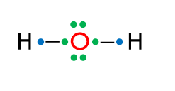
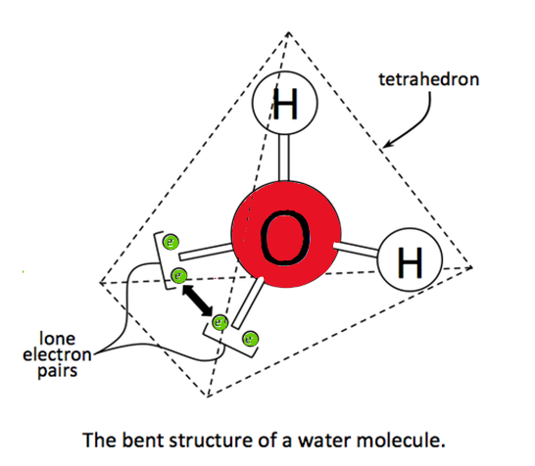
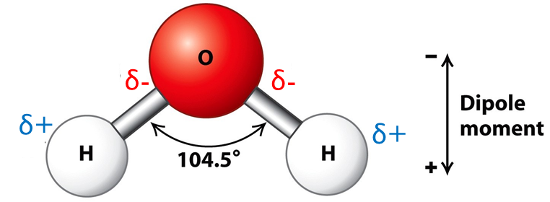
Water – basic info
Formula : H₂0
Electron configuration:
  O: 1s¹ 2s² 2p⁴ => 6 ve,
  H: 1s¹ => 1 ve
Electron geometry vs molecular geometry:
  Lewis structure:
  Is water a linear molecule?
    tetrahedral structure of bonding and lone electron pairs (2 x covalent σ bonds, O−H and 2 x lone pairs)
Polarity
Oxygen, “electron withdrawing” δ-
Hydrogen, “electron donating” δ+
BENT
water is POLAR molecule
Notes:
This terrible hydrogen oxide that was found in 100% of cancer patients ☺
But, molecular geometry also plays a part in molecule polarity. Although the covalent bonds between carbon and oxygen are polar in carbon dioxide (CO₂), the molecule is not polar. This is because carbon dioxide is a linear molecule and the partial positive and negative charges effectively cancel each other out. In other words, its net dipole moment is zero.
Unlike carbon dioxide, water is not a linear molecule. Water has a bent geometry, with 104.5°. The bent shape means the positive and negative charges aren’t evenly distributed and don’t cancel each other out. Water has a net dipole moment.

Slide 5
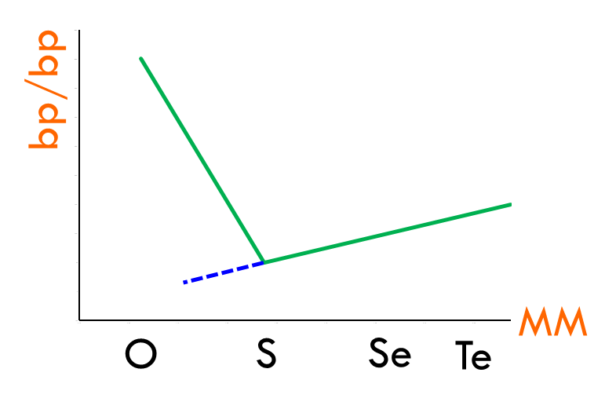

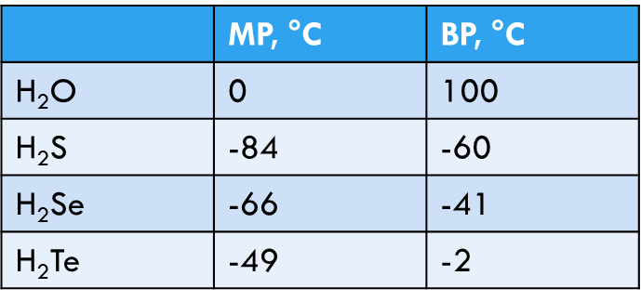
Melting and boiling OF WATER
melting point, mp - the constant temperature at which a solid changes into liquid
boiling point, bp - the constant temperature at which a liquid changes into gas
depend on intermolecular forces
 | mp, °C | bp, °C
H₂O
H₂S | -84 | -60
H₂Se | -66 | -41
H₂Te | -49 | -2
???
increase
polar molecules
IMF: dipole-dipole + London Dispersion
because of HYDROGEN BONDS in water !!!

Slide 6
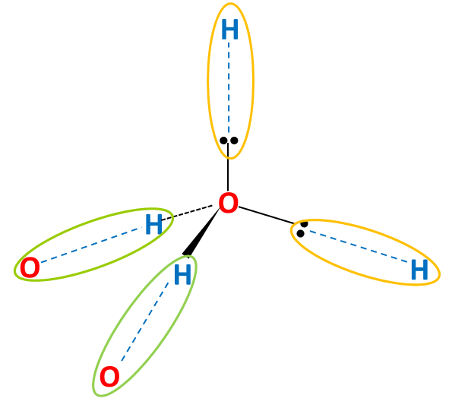
Hydrogen bond
Hydrogen bond is a type of IMF formed between H atom attached to highly electronegative atom (O, N, F) in one molecule and lone pair on the electronegative atom in other molecule.
tetrahedral
How does it form? – O-H bond is polar; the electronegative O pulls the electrons from H creating a large δ+ on H; such H is strongly attracted to the lone pair of electrons on O atom on other H₂O molecule to form a HYDROGEN BOND (~10x stronger than LD forces)
2 donor H bonds
2 acceptor H bonds
Liquid 2-3 H bonds at a given time
https://chem.libretexts.org/Courses/Sacramento_City_College/SCC%3A_Chem_309_-_General_Organic_and_Biochemistry_(Bennett)/Text/07._States_of_Matter_and_the_Gas_Laws/7.2%3A_Solids%2C_Liquids%2C_and_Gases

Slide 7
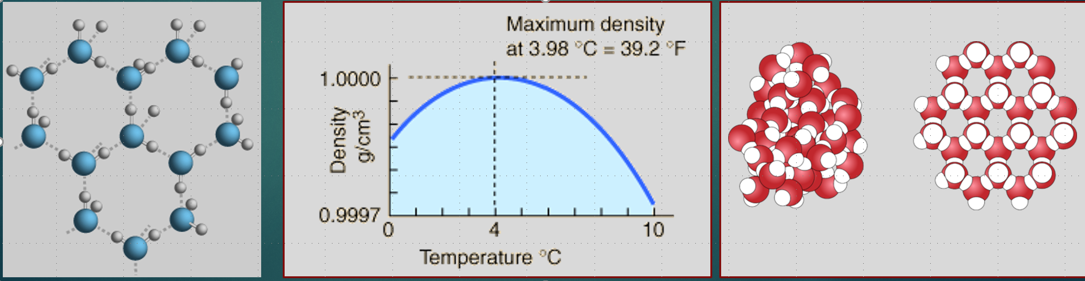
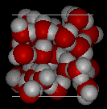
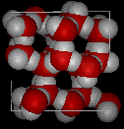

H₂o – unwanted behaviour
density
$$d= \frac{mass}{volume} \sim 1.0 \left(\frac{g}{mL}\right)$$
but changes with temperature
water expands when it freezes
  becomes less dense
  Why?
@4°C
WATER
ICE
there is a change in structure !
Less rigid, Closer together
More dense
Rigid, Further apart
Less dense
Notes:
The density of water which is m/d is roughly 1 gram per milliliter but, this changes with temperature.
Have you ever left a botlle of beer in freezer and forgot it? The chances are that when you reached for it the bottle was cracked. The reason for that is that the volume of your beer increased and didn’t fit the volume of the bottle any more.
If V increases, d decreases. Ice is less dense than liquid water which is why your ice cubes float in your glass.
It was found that H2O reaches the maximum density at 4 degC. 4 degrees is the perfect temperature for the water molecules to lock themselves into a hexagonal shape, due to hydrogen bonding
at 4 degC two opposing effects are in balance. What happenes at this temperature? There is change in structure.
Above 4 degrees the hydrogen bonds will be constantly broken due to high kinetic energy of the molecules, which leads to lower density, while below 4 degrees, water molecules forms larger hydrogen-bonded aggregates which results in lower density

Slide 8

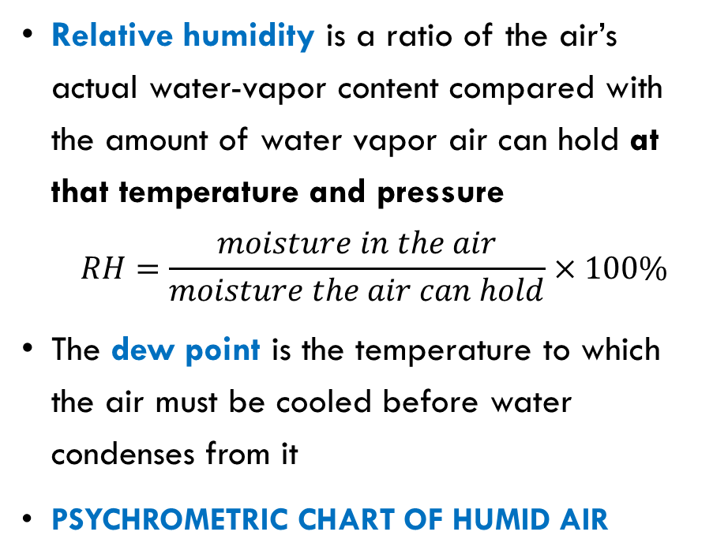
Water in the Atmosphere
Humidity is the concentration of water vapour that is present in air.
75% humidity in summer feels very different than in winter (depends on temperature)
Relative humidity is a ratio of the air’s actual water-vapor content compared with the amount of water vapor air can hold at that temperature and pressure
  $$RH=\frac{moisture in the air}{moisture the air can hold}×100\%$$
The dew point is the temperature to which the air must be cooled before water condenses from it
Psychrometric Chart of Humid Air
Notes:
https://www.youtube.com/watch?v=wB3Yyq4xy_Y, https://www.youtube.com/watch?v=Qsl5yQsinlY

Slide 9

RH and Static Electricity
So why, when working with materials that are so sensitive to moisture we work at high RH? (55 -75%)
The answer is that we are able to discharge the static that builds up on our clothes more easily and gradually into moist air than we are into dry air.
Thermohygrographs are used to record the temperature and humidity in explosive manufacturing facilities so that the environmental conditions munitions are produced under can be traced back and checked should a defect be identified in the field at a later date.
Notes:
During the manufacturing of explosive devices such as munitions, fireworks or flares, uncontrolled static electrical discharge presents a high risk to the combustible materials being processed. By maintaining a humidity of 55%rH static build-up is avoided as the moisture acts as a conductor and dissipates any electrical charge generated by friction.

Slide 10
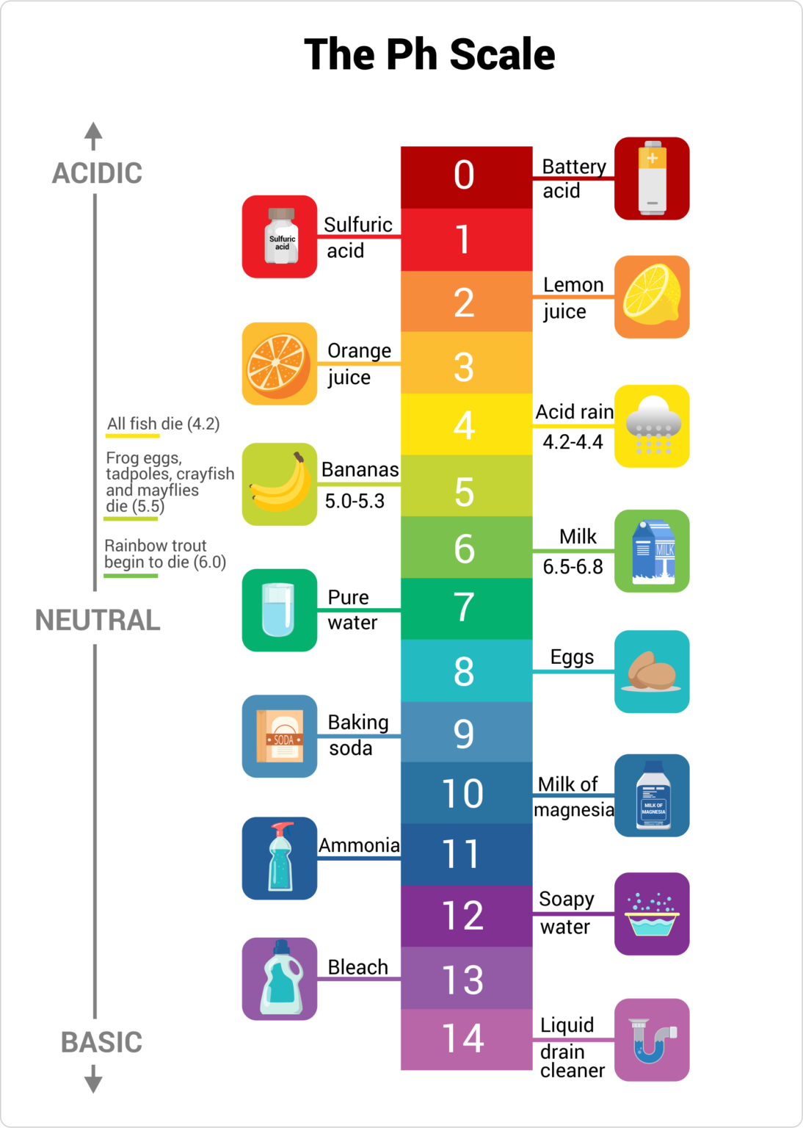
Acids and bases
pH scale
Acids
electrolytes
sour taste
turn litmus red
pH < 7
react with metals to form H₂ gas
corrosive
bases
electrolytes
bitter taste
turn litmus blue
pH > 7
react with acids to form salts and water

Slide 11

Definition of acid and base
an acid is a hydrogen-containing substance that, when in an aqueous solution, is capable of donating a proton (hydrogen ion, H⁺) to another substance, e.g. water
H
+
|
H – Cl + H – O – H H – O – H + Cl ⁻
H₃O⁺ hydronium ion
protonated water
a base is a molecule or ion able to accept a hydrogen ion (proton) from a hydrogen-containing substance (acid)
H
H
+
|
|
H – N – H
+ H – O – H
H – N – H
+ O – H⁻
|
H
hydroxide ion
Notes:
H+ ion called proton can protonate water
H2O → H+ + OH-

Slide 12
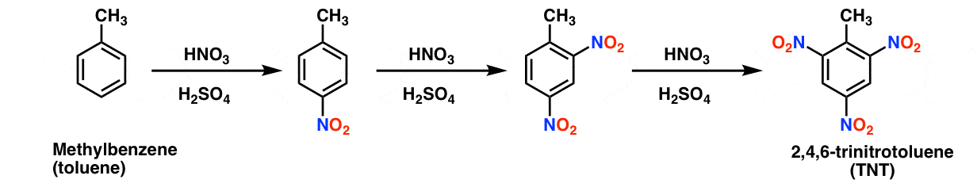
Important acids in ome
Sulphuric Acid: H₂SO₄ + H₂O → H₃O⁺ + HSO⁻₄
  reaction is very exothermic, so remembre ALWAYS pour acid to water when diluting please!
Nitric Acid: HNO₃ + H₂O → H₃O⁺ + NO₃⁻
Nitration: HNO₃ + 2 H₂SO₄ ⇌ NO⁺₂ + H₃O⁺ + 2 HSO₄⁻ nitronium ion
  a mixture of nitric and sulphuric acids introduces a nitro substituent onto various aromatic compounds by electrophilic aromatic substitution.
  synthesis of TNT:

Slide 13
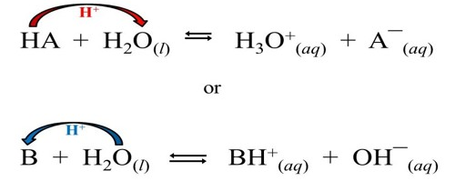
Amphoteric behaviour of water
Amphoteric substance can behave as either ACID or BASE depending on the reaction
Notes:
H2O + H2O → H3O+ + OH-

Slide 14


Periodic Table
left hand side of the periodic table
  water reacts with elements and their oxides to form basic solutions
    KOH, Mg(OH)₂
right hand side of the periodic table
  water reacts with elements and their oxides to form acidic solutions
    HCl, H₂SO₄, HNO₃

Slide 15

Chemistry we don’t want
based on BAE Systems experience with composition containing…
… magnesium, Mg
… phosphorus, P
… polymeric binders, HTPE

Slide 16
Magnesium in military
used since the early years of the 20th century
  in WW I – core element of many munitions, such as incendiary flares and tracer rounds where its flammability and intense light emitting properties were a benefit
  recently - structural components inside military aircraft, vehicles, personal equipment and ballistics
ADVANTAGE: low density (allows weight reduction; creating lighter airframes to enable greater fuel and ordnance payloads, while striking the balance of heavy armour with range and mobility).
DISADVANTAGE: poor corrosion resistance and low strength.
Mg (s) + 2 H₂O (g) → Mg(OH)₂ (aq) + H₂(g)

Slide 17
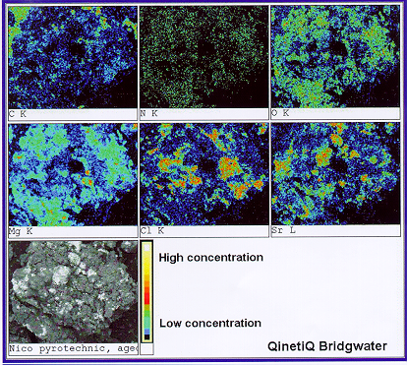
Elemental Mapping
SEM / EDX image and spectra after exposure of Mg to moisture
corroded Mg - black, pitted, non reflective surface under the microscope.
Notes:
Energy-dispersive X-ray spectroscopy (EDS, EDX, EDXS or XEDS), sometimes called energy dispersive X-ray analysis

Slide 18

Students’ activity
In groups discuss the effect of water on tracers, flash cartridges, and flares containing magnesium
Provide potential solutions to overcome the problem(s)

Slide 19
Reaction of Magnesium with Water,
Tracer Story.
Tracer compound contains composition R 284 which is 17% polyvinyl chloride (PVC), 28% magnesium powder (Mg), and 55% strontium nitrate (Sr(NO₃)₂).
Magnesium surface corrodes: Mg (s) + 2 H₂O (g) → Mg(OH)₂ (aq) + H₂(g)
Corrosion products are less dense than Mg metal and cause cracks in pellets
Opportunity for further corrosion: Sr(NO₃)₂ (s) + H₂(g) → Sr(NO₂)₂ (s) + H₂O (l) *
Sources of water
  Poor storage of pellets
  No conditioning of pellets
  Water not removed from
  composition after manufacture
Solutions
  Use more moisture resistant composition
  Improve storage, conditioning and manufacture
*https://doi.org/10.1016/j.tca.2003.07.021

Slide 20
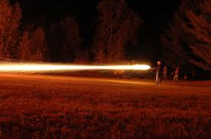
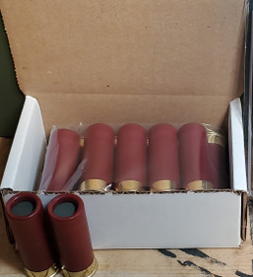
Reaction of Magnesium with Water,
Flash Cartridge Story.
Dragon's breath - a special type of incendiary-effect round for shotguns; consists primarily of magnesium pellets/shards.
Hot day, cool night.
  Evaporation of moisture form cardboard liner → Condensation onto magnesium.
  Surface corrosion effect
Sources of water
  Water trapped in carboard liner after poor storage. (Old shed)
  Carboard contains 6 to 8% water. Do we need another liner material?

Slide 21
Comparison of Fresh and Recovered FLASH CARTRIDGE SR 800
Notes:
Radiometry is the science of measuring light in any portion of the electromagnetic spectrum. In practice, the term is usually limited to the measurement of infrared, visible and ultraviolet light using optical instruments.

Slide 22
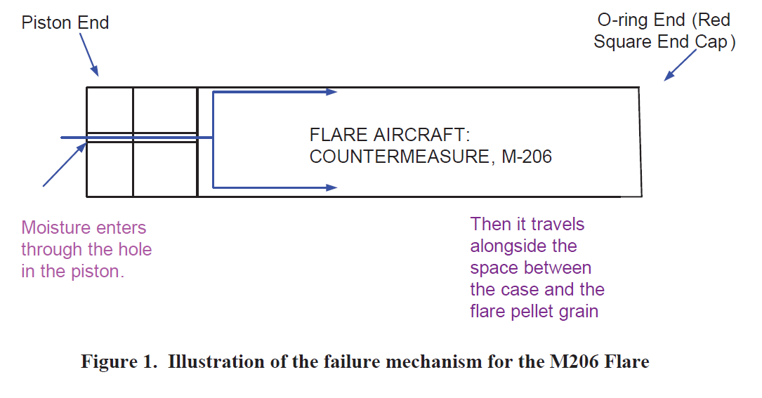
Reaction of Magnesium with Water,
Flare Story.
Self-protection flares are magnesium pellets that, when ignited, burn for 3.5 to 5 seconds at 1100 degC. The burn temperature is hotter than the exhaust of an aircraft, and therefore attracts and decoys heat-seeking weapons targeted on the aircraft.
Mg corrosion product, Mg(OH)₂ is less dense than magnesium, causing swelling of the pellets and formation of cracks and fissures inside
Irratic and unpredictable burn profile *
Sources of moisture:-
  Water in acetone (0.5% for lab reagent)
  Poor sealing of flare payload
Solutions
  Review solvent supply
  Hydrogen “getters” in packaging
  * E.R. Bixon et al.: Estimation of the shelf life of the M206 flareProceedings of the 36th international IPS, Rotterdam.
Notes:
Hydrogen getters are materials that scavenge hydrogen from the gas phase and chemically and irreversibly bind it in the solid state¹. They are used to create and maintain vacuum conditions, as well as to protect hydrogen-sensitive products from contamination

Slide 23
Reaction of Red Phosphorus with Water
RP is an important ingredient for the manufacture of pyrotechnic smokes.
Phosphorus and water react.
  Hence the need for the micro-encapsulation!
A simplistic view of the problem is as follows. 2 P₄ + 12 H₂O → 5 PH₃ + 3 H₃PO₄
  Products: phosphoric acid (H₃PO₄ ) and phosphine (PH₃, a toxic, chemically reactive gas).

Slide 24
Students’ activity
In groups discuss the implication of water ingress into materials containing phosphorus
Provide potential solutions to overcome the problem(s)

Slide 25
Reaction of Red Phosphorus with Water
Source of moisture
  In process, water used as a solvent.
  In solvents, (0.5% in acetone as a lab reagent)
  Atmospheric :- do we need climate control in the process shops?
Solutions
  Use ANALAR reagents
  Improve RP microencapsulation
  Remove metals from formulations
  Use less hygroscopic ingredients
  The gas can pressurise unacceptably a sealed store containing RP compositions, and it reacts with certain metals and plastics causing significant changes in their properties.
  The moisture usually present on red phosphorus can react with other ingredients of a pyrotechnic composition, specifically with metal powders, to generate significant quantities of hydrogen. Acids then formed react with metals (magnesium) in the heater mix releasing hydrogen
https://apps.dtic.mil/sti/pdfs/ADA372367.pdf
Red Phosphorus for Use in Screening Smoke Compositions CRANFIELD
Notes:
RP in incapsulated in organic shell such as an epoxy resin, melamine resin, and phenolic resin but as all pyrotechnic burning on a surface when we cover the surface, more energy is needed to activate this phosphorus.

Slide 26
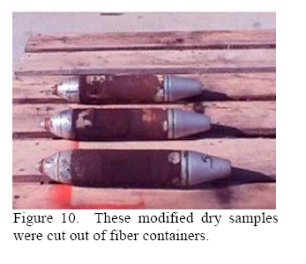
Phosphine Corrodes!

Slide 27
How does the reaction proceed?
What are the implications for Ignition?
PH₃
PH₃

Slide 28
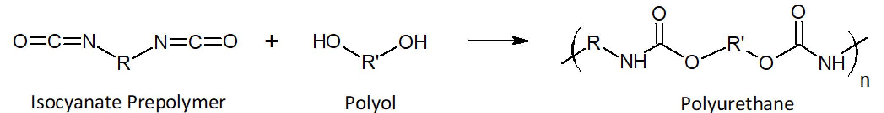
Reaction of binders with Water,
HTPE Story.
this is the basis of the HTPB / HTPE polymerisation reaction.
but .........similar chemicals have been used to produce foams
foamed polyurethanes (from www.essentialchemicalindustry.org )
  “When the two liquids react, a solid polymer is formed. The polymer may be elastic or rigid. However, it may also contain bubbles of gas so that it is cellular - a foam.”
  when producing a foamed polyurethane, there is a gas generated inside the reacting liquid mixture (chemical blowing adds water to the polyol which reacts with some of the polyisocyanate to create carbon dioxide…….and hence bubbles)
  great when you’re making a foam, not when you’re filling a shell.

Slide 29
Students’ activity
In groups discuss the effect of moisture in Binders when filling ammunitions
Provide potential solutions to overcome the problem(s)

Slide 30
Reaction of binders with Water, HTPE Story
Filling ammunition in the presence of moisture led to cavities in the filling cause by the moisture in the atmosphere reacting with the pre-polymer creating bubbles of carbon dioxide.
Result: Ammunition that could cause a premature “event”
Solution:
  Use molecular sieve
    Molecular sieves are synthetic crystalline zeolites in which the atoms are arranged in a definite pattern. Internally, the structure has many cavities inter-connected by smaller pores of a uniform size. These pores are only able to accept and pass to the cavities molecules of the same and smaller size, hence the name molecular sieve.
    Activate molecular sieve correctly (long time heating at high temperature)
    Fill under vacuum to remove “volatiles”
  Install climate control

Slide 31
conclusions
reviewed fundamental properties of water and chemistry related to them (structure, mp and bp, acid-base rxns, etc.)
explained the concept of humidity and relative humidity
applied the above knowledge to discuss the unwanted effect to water on OME materials and systems
identified the potential solutions (based on actual situations in BAE)

