Slide 1


How to Include Autistic People in the Hospitality Industry
Student name: Tatiana Elena Bacalu
ID number: 2224927
“I confirm that I have not used any AI tools in the research and creation of this assignment. I confirm that I have not presented any AI generated materials as my own work. I confirm I have copies of my drafts, notes, and other resources I used, which I may be asked to provide in evidence.”
Notes:
1

Slide 2

Context and Rationale
1:100
People are autistic in the world
(WHO, 2022)
>70%
Employment gap for autistic adults in the UK
(Scott et al, 2022)
The hospitality industry has inclusion problems because of sensory overload, expectations of social interaction and high turnover (Baum, 2019)
Inclusion is needed for social sustainability and ethical hospitality (Costa and Costa, 2022)
Notes:
2

Slide 3


Aim and Research Questions
Aim: To discover how the people in hospitality may be better included in the workplace.
Research Questions
What barriers / issues to the inclusion in hospitality?
What organizational strategies can be successful?
What role can leadership and policy play in sustainable inclusion?
Notes:
3

Slide 4

Insights from Literature
Neurodiversity Framework
Barriers to Inclusion
The framework of neurodiversity redefines autism as difference not deficit (Morris et al., 2025).
The barriers include recruitment bias, sensory intolerance and limited management understanding (Lindsay et al., 2019).
Benefits of Inclusion
Cultural Shift Required
The benefits of inclusion include advantages such as attention to detail, reliability and inventiveness (Austin & Pisano, 2017).
Authentic inclusion is a cultural shift not a token compliance (Butler & Stokes, 2021).
Notes:
4

Slide 5

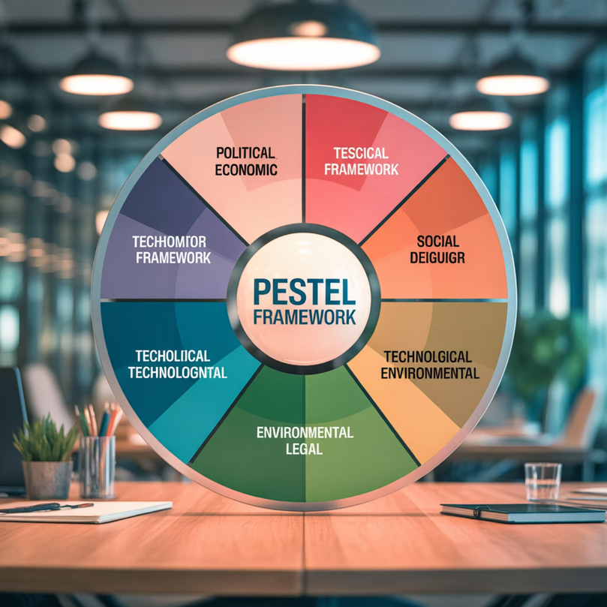
Methodology
01
Research Approach
Qualitative research using peer reviewed literature (2018-2025).
02
Data Sources
Databases used Science Direct, Emerald Insight, Taylor & Francis Online.
03
Analytical Framework
The PESTEL framework was applied to explore macro and organisational factors (Johnson et al., 2020).
04
Ethical Considerations
Ethical rationale: to avoid direct contact with a vulnerable group (Brotherton, 2015).
Notes:
5

Slide 6






Summary of PESTEL
Political
Equality Act 2010; Disability Confident Scheme (Department for Work and Pensions, 2023).
Economic
Retention and productivity outweigh adjustment costs (Foster & Wass, 2013).
Social
Stigma and lack of awareness are still barriers (Lindsay et al., 2019).
Technological
Availability of assistive devices, visual aids, adaptable design (Waisman-Nitzan et al., 2022).
Environmental
Quiet zones and sensory-friendly layouts for wellbeing (Hall, 2020).
Legal
Reasonable adjustments are statutory duties (Singer, 2019).
Notes:
6

Slide 7

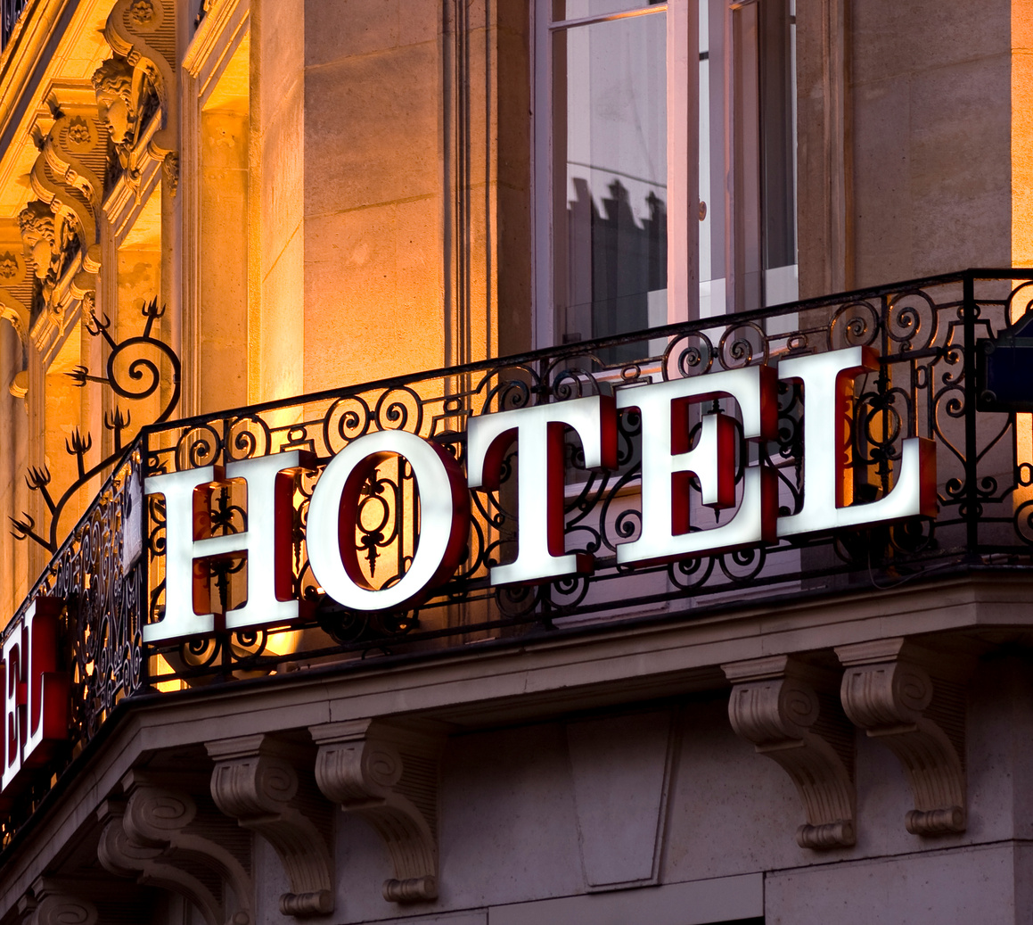




Key Findings
Inclusion Benefits
Current Gaps
Success Stories
Inclusion increases the reliability of service, retention of staff and brand reputation (Griffiths et al., 2020).
Major gaps are present: limited leadership training, poor awareness and structural inflexibility (Baum, 2019).
Case studies (Hilton, Marriott) reveal that success can be achieved through autism specific training (Marriott International, 2023).
Inclusion must move from policy to practice — embedded in the dance of daily operations of the organisation (Costa & Costa, 2022).
Notes:
7

Slide 8




Recommendations
Strategic Integration
Neurodiversity should be embedded in corporate and ESG strategy (Costa & Costa, 2022).
Inclusive Recruitment
Use inclusive recruitment practices: structure interview and skills trials (Griffiths et al., 2020).
Manager Training
Undertake training of managers in autism knowledge and communication modalities (Butler & Stokes, 2021).
Environmental Adaptations
Adapt environments: predictable routines, peaceful areas, visual guidance (Waisman-Nitzan et al., 2022).
Progress Measurement
Measure progress in a structure via KPIs and staff feedback (Morris et al., 2025).
Notes:
8

Slide 9
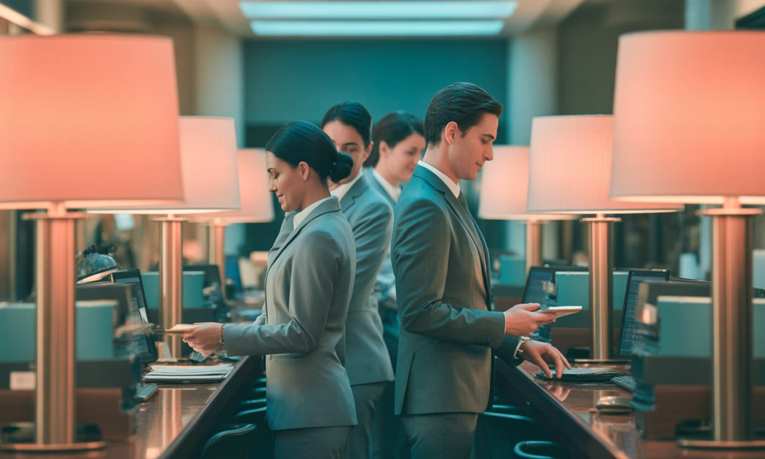
Conclusion
Success depends on commitment by Leadership, training and co-production.
Inclusive hospitality = sustainable hospitality — welcoming diversity in both guests and staff.
Inclusion of autistic individuals is both ethical and strategic.
"True hospitality begins behind the scenes."
Notes:
9

Slide 10

Any Questions?

Slide 11
References
Austin, R.D. and Pisano, G.P. (2017) ‘Neurodiversity as a competitive advantage’, Harvard Business Review, 95(3), pp. 96–103.
Baum, T. (2019) ‘Hospitality employment 2030: a vision for inclusive and sustainable work’, International Journal of Contemporary Hospitality Management, 31(10), pp. 3772–3790.
https://doi.org/10.1108/IJCHM-05-2018-0419
Butler, C. and Stokes, J. (2021) ‘Neurodiversity at work: A systematic review’, Human Resource Management Review, 31(3), 100728.
https://doi.org/10.1016/j.hrmr.2020.100728
Costa, V. and Costa, C. (eds.) (2022) Sustainability and Competitiveness in the Hospitality Industry. Hershey, PA: Business Science Reference.
Department for Work and Pensions (2023) Disability Confident Employer Scheme. UK Government.
Available at: https://www.gov.uk/disability-confident-employer-scheme (Accessed: 12 October 2025).
Foster, D. and Wass, V. (2013) ‘Disability in the labour market: An exploration of employer practices’, Work, Employment and Society, 27(3), pp. 404–420.
https://doi.org/10.1177/0950017012460315
Griffiths, A., Knight, A. and Harwood, R. (2020) ‘Employing people with autism: Barriers and facilitators’, Journal of Management & Organization, 26(3), pp. 491–507.
https://doi.org/10.1017/jmo.2018.66
Hall, C. (2020) ‘Inclusive policy implementation in tourism and hospitality SMEs’, Tourism Management Perspectives, 35, 100678.
https://doi.org/10.1016/j.tmp.2020.100678
Notes:
9

Slide 12
Johnson, G., Scholes, K. and Whittington, R. (2020) Exploring Strategy: Text and Cases (12th edn). Harlow: Pearson Education.
Lindsay, S., Osten, V., Rezai, M. and Bui, S. (2019) ‘Disclosure and workplace accommodations for people with autism: A systematic review’, Disability and Rehabilitation, 41(15), pp. 1919–1934.
https://doi.org/10.1080/09638288.2018.1462414
Marriott International (2023) Neurodiversity Inclusion at Work: Annual Report. Available at: https://www.marriott.com (Accessed: 9 October 2025).
Morris, T., Strickland, K. and Power, S. (2025) ‘Ethical hospitality: Reframing neurodiversity inclusion’, Journal of Sustainable Tourism Studies, 33(1), pp. 45–62.
Scott, M., Milbourn, B., Falkmer, M. and Falkmer, T. (2022) ‘Employment outcomes of autistic adults: A meta-analysis of intervention effectiveness’, Autism, 26(3), pp. 707–721.
https://doi.org/10.1177/13623613211069323
Singer, J. (2019) Neurodiversity: The Birth of an Idea. London: Judy Singer Foundation.
Waisman-Nitzan, M., Gal, E. and Segev, N. (2022) ‘Technology-mediated employment support for adults with autism’, Disability and Rehabilitation: Assistive Technology, 17(6), pp. 600–611.
https://doi.org/10.1080/17483107.2020.1819307
World Health Organization (2022) Autism Spectrum Disorders: Key Facts. Geneva: WHO.
Available at: https://www.who.int/news-room/fact-sheets/detail/autism-spectrum-disorders (Accessed: 10 October 2025).

